Slide 1


Department of Higher Education and Training
OCCUPATIONAL CERTIFICATE - ELECTRICIAN
Tender Briefing

Slide 2
OVERVIEW OF PROGRAMME ACTIVITIES
Development of Digital Learning Assets
Pilot and Deployment
Complete
18 months in total
Cyclical development
Assets developed course by course
May 2019 onwards
Complete
Loading materials on National Open Learning System
11 courses
1-6 topics per course
1 course to be uploaded by April 2019
COMPLETE - PHASE ONE
Notes:
Notes for presenter:
Media Production:

Slide 3
Session talking points
Brief overview of Phase 1:
Curriculum framework
Defining Digital Learning Resources (DLRs)
Storyboarding/ Materials Development
Details of Phase 2:
The Assets Register - how many DLRs will be produced?
Guidelines for DLRs - costing and production
Licensing conditions
Production process
Documents to assist in bid process
Notes:
Presenter Notes:

Slide 4

Curriculum framework
Course 0
World of Electrician
Course 1
Electrical Principles
Course 2
Tools and electrical measuring instruments
Course 3
Electrical components and systems
Course 4
Electrical installations
Course 5
Single phase motors
Course 6
DC Motors
Course 7
Three phase motors
Course 8
Transformers
Course 10
Electronics
Course 9
Programmable logic controllers
Bidders can access the detailed programme development overview online at
http://ol4nocelectrician.weebly.com/resources.html
Notes:
Presenter Notes:
In Phase 1 of this project, a curriculum framework was developed for the Occupational Certificate: Electrician.
There are 11 courses, each containing between 1-6 topics.
Each topic has between 1-6 units of learning or storyboards as they will be referred to for the rest of this presentation.

Slide 5
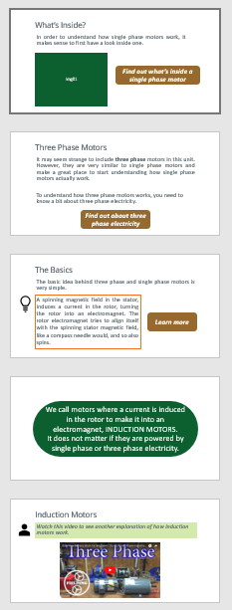
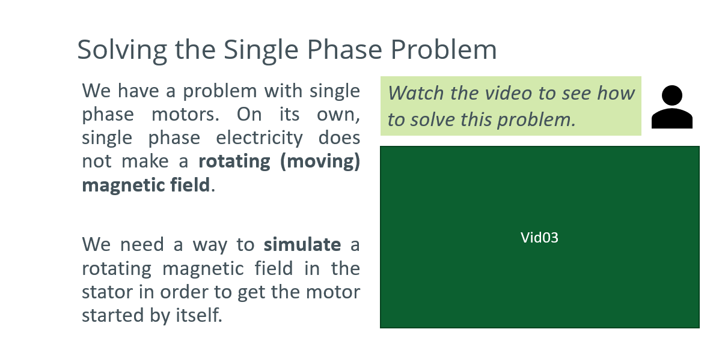
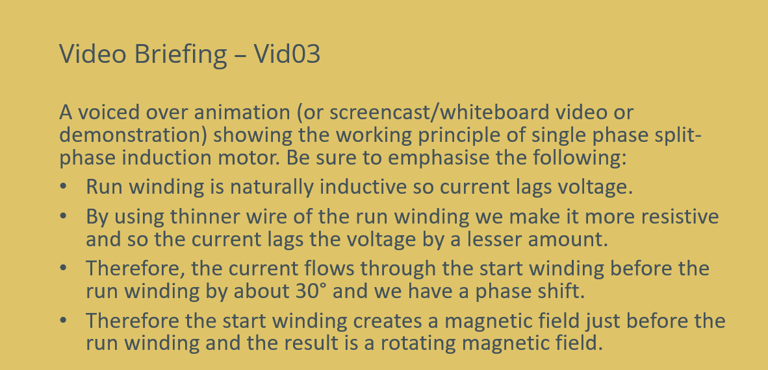
Storyboards
Bidders can access detailed storyboards at http://ol4nocelectrician.weebly.com/resources.html
Some storyboards are still be being finalised. These are being made available for illustrative purposes only.
Notes:
Presenter Notes:
For each unit of study a storyboard was developed.
Storyboards contain all the suggested flow of learning (Image 1)
The information to be covered and supportive materials such as multimedia. (Image 2)
Detailed information about the multimedia item that needs to be produced (Image 3). These are called Digital Learning Resources or DLRs
DEMONSTRATION
At this point you can show 1 exemplar storyboards in more detail if needed.

Slide 6
Definition of Digital Learning Resources
The Successful Bidder is expected to produce the DLRs indicated in the storyboards.
DLRs include the following:
Live action and animated videos (including demonstration and documentary style)
Interactive multimedia content
Simulations
Audio files
Infographic diagrams
Photographs
PDFs
Word documents
Drawn diagrams
Notes:
Presenter Notes:
The types and number of DLR’s vary depending on the needs of each storyboard.

Slide 7
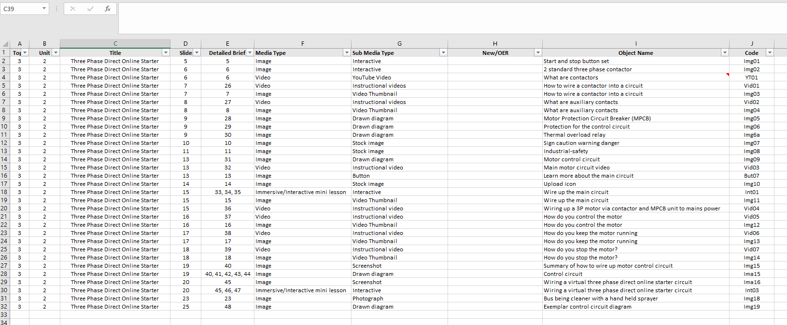
The Asset Register
There is a detailed Asset Register that indicates the number and type of DLRs for each storyboard. You can use this to help with your budgeting for this tender.
The Asset Register can be accessed online at http://ol4nocelectrician.weebly.com/resources.html
Notes:
DEMONSTRATION
Open the Asset Register and take participants through the various categories and how they work. It would be useful to talk the same exemplar storyboard mentioned earlier in the presentation (Slide 7).

Slide 8
How should DLRs be produced?
Bidders are encouraged to seek to harness existing content as much as possible to make bids more competitive.
It is envisioned that the successful bidder will form relationships with training institutes/service providers within the electrical field in order to take photographs and shoot video footage on site.
To reduce costs, it is suggested that scheduled shoots aim to capture multiple photographs/ video footage within a single period as possible as this will significantly reduce production costs.
Notes:
Presenter Notes:
Attach images as an example.

Slide 9
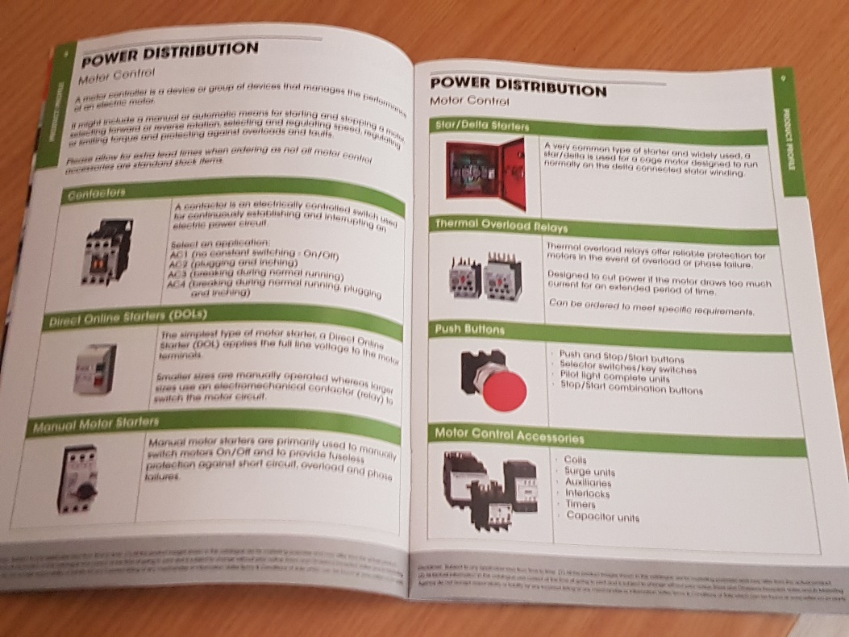
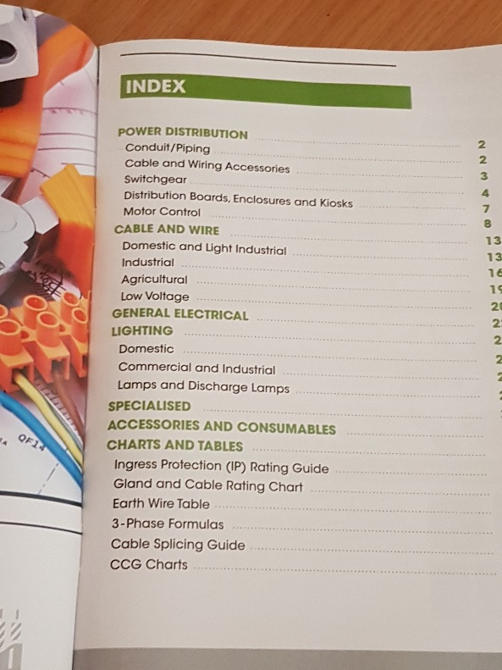
How should DLRs be produced?
It is envisioned that the successful bidder will form relationships with suppliers of electrical materials (parts, cables etc.) to share catalogues of images and descriptions (securing necessary permissions to use these).
Notes:
Presenter Notes:
Attach images as an example.

Slide 10
How should DLRs be produced?
Photographs- Mostly practical in nature, to be taken on the premises of a training institute/service provider.
Videos- Mostly screencast/ information demonstration types of videos. Experienced electricians/facilitators talking through a topic and demonstrating where applicable.
Simulations- Motor starter wiring simulator (Course 7). A virtual simulator that lets students connect motors (three and single phase) to a range of different motor starters to explore the understand the working of both the main and control circuits.
This will require customised programming to build. For an example of a similar type of simulation please see: PhET Interactive Simulations
https://phet.colorado.edu/en/simulation/capacitor-lab-basics

Slide 11
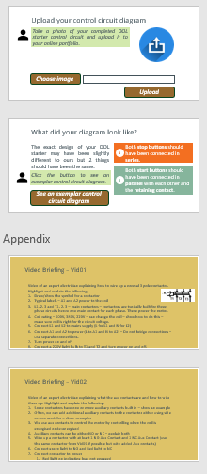
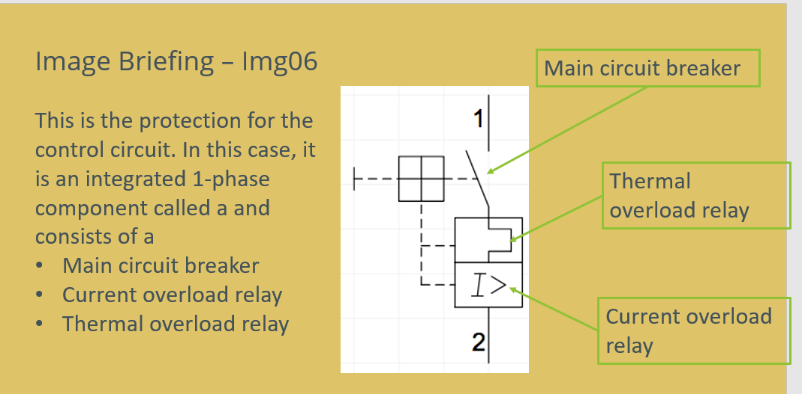
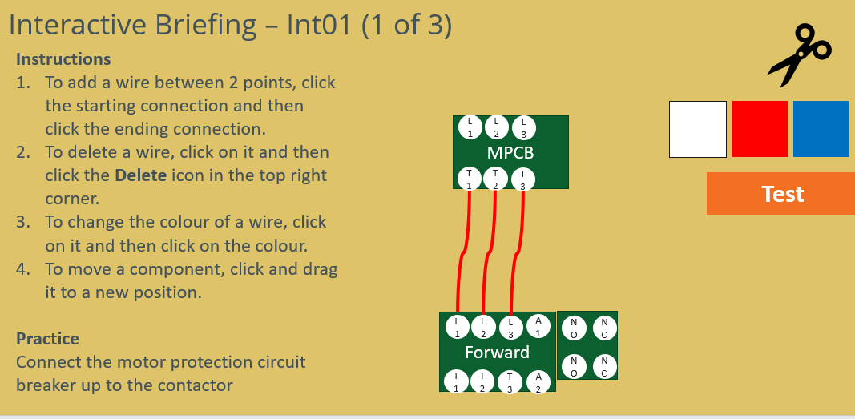
Production briefs
The successful bidder will receive detailed instructions for each DLR to be produced.
Notes:
DEMONSTRATION
Open the Asset Register and take participants through the various categories and how they work. It would be useful to talk the same exemplar storyboard mentioned earlier in the presentation (Slide 7).

Slide 12
General guidelines for DLRs
DLRs must be contextually relevant (limited bandwidth, offline user storage)
No stereotyping
Voice-overs must have South African accents
For use on mobile devices and computers
DHET will provide/develop standardised templates to be used
Bidders can access the style guide online at http://ol4nocelectrician.weebly.com/resources.html
Notes:
Sto

Slide 13
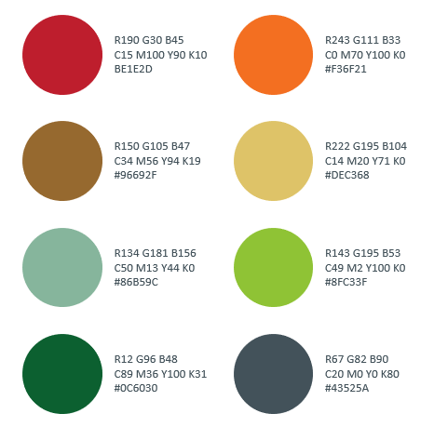
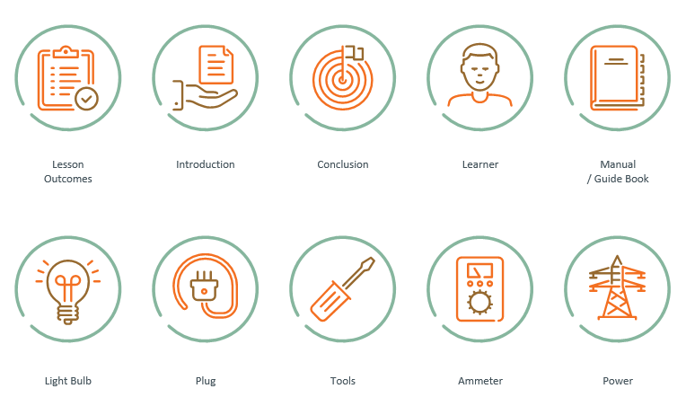

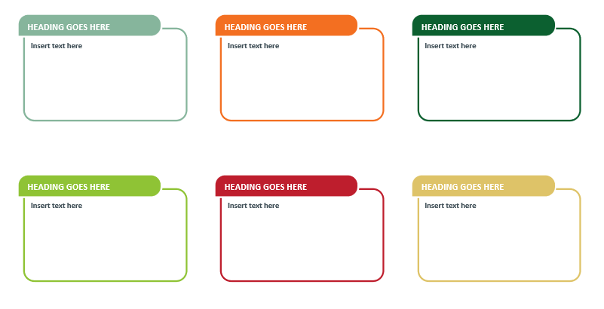
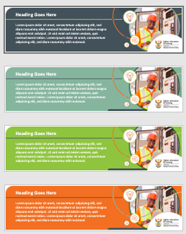
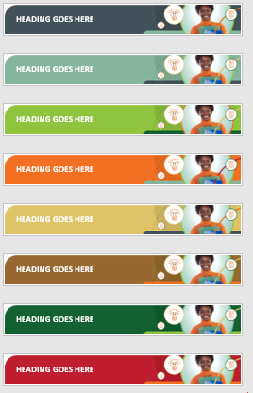


Style guide
Colour scheme
Icons
Cover slide template
Banners and information boxes
Notes:
Presenter Notes:
You will be provided the following graphic design elements to ensure consistency of look and feel. You can use these as starting point.

Slide 14
Licensing conditions
All copyright and intellectual property rights in respect of materials developed by the service provider during this project will vest in the Department of Higher Education and Training, which will have the right to allow any individual, company, agency or organisation to use or modify the materials for any purpose approved by this Department, including selling the materials or releasing them under an appropriate open licence.
Notes:
DEMONSTRATION
Open the Asset Register and take participants through the various categories and how they work. It would be useful to talk the same exemplar storyboard mentioned earlier in the presentation (Slide 7).

Slide 15
What are Open Educational Resources?
All materials, including the DLRs produced for the Occupational Certificate: Electrician, will be Open Educational Resources.
Brief summary of OER:
Any type of educational materials that are in the public domain or shared under an open licence.
Depending on the licence, anyone can legally and freely copy, use, adapt and re-share them.
OERs range from textbooks to curricula, syllabi, lecture notes, assignments, tests, projects, audio, video and animation.
Notes:
DEMONSTRATION
Open the Asset Register and take participants through the various categories and how they work. It would be useful to talk the same exemplar storyboard mentioned earlier in the presentation (Slide 7).

Slide 16
Use of OER to produce DLRs
In addition to releasing the DLRs as OER, DHET would like to use this project to illustrate the cost saving methods of using OER in developing DLRs.
The Bidder is to take existing OER into account when costing for this tender. This will make your bid more competitive.
Notes:
DEMONSTRATION
Open the Asset Register and take participants through the various categories and how they work. It would be useful to talk the same exemplar storyboard mentioned earlier in the presentation (Slide 7).

Slide 17
How many DLR’s are to be produced?
This programme will require a maximum 5400 DLRs of which approximately 2000 will be new assets to be produced. The remainder can be sourced from Open Educational Resources (OER).
Notes:
Presenter Notes:

Slide 18
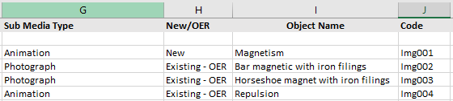
Use of OER by Production Company
DHET has developed a list of possible OER that can be used as DLRs. This is a suggested list only. Successful bidder must make final decisions on whether they can be used or not and should look further for additional resources.
In addition, the Asset Register indicates where there is a suggestion of an existing OER for which the Successful Bidder can search.
Bidders can access the Asset Register and Open Learning and Teaching Resources document at http://ol4nocelectrician.weebly.com/resources.html
Notes:
DEMONSTRATION
Open the Asset Register and take participants through the various categories and how they work. It would be useful to talk the same exemplar storyboard mentioned earlier in the presentation (Slide 7).

Slide 19




The production process
The Successful Bidder will be working closely with the DHET and its appointed Project Management Company (PMC) who will manage this process on behalf of DHET.
The production process will be cyclical,
so the same process will be followed
for each of the 11 courses.
Department of Higher Education and Training
Successful Bidder
Project Management Company

Slide 20
PMC provides SB with production briefs for each DLR in course.
SB to produce first drafts of DLRs for the course.
SB sends PMC first drafts via file sharing system.
PMC reviews materials for: adherence to brief, accuracy, quality, consistency.
PMC provides feedback in writing to SB indicating changes to be made.
Briefing meeting between DHET, PMC and SB. Relevant docs to be handed over.
SB makes requested changes and produces final versions of DLRs.
PMC and DHET review DLRs and if satisfied provide sign off in writing.
SB to provide PMC and DHET with final assets as well as editable files for each asset.
SB shares samples of DLR to show that production briefs have been followed.
Only for 1st course
Only for 1st course
1
2
3
4
5
6
7
8
Key:
DHET - Department of Higher Education and Training
PMC - Project Management Company
SB – Successful Bidder
DLR - Digital Learning Resources
9
10
Notes:
Presenter Notes:
Talk through the various steps in the process.
Click to show numbers for each box

Slide 21
Documents to assist in tender process
The following documents will assist you in compiling your tender and can be accessed online at:
http://ol4nocelectrician.weebly.com
Detailed Programme Overview
Teaching and Learning Resources and Assessment Tasks
Learning Pathways
Materials Development Specifications
Digital Asset Register
Storyboards
Style guide
Open Learning and Teaching Resources
Notes:
Presenter Notes:
Talk through the various steps in the process.

Slide 22
Any questions?
Notes:
Presenter Notes:
Talk through the various steps in the process.

