Slide 1
Electronics
Topic 6: Diodes

Slide 2
Assumed prior learning
05_01_00
05_01_02
05_02_01
05_03_01
05_04_01
Notes:
Note for navigation on site:
This information needs to be taken into account and needs to stated on the LMS, perhaps as part of the introduction?

Slide 3
Outcomes
By the end of this unit the learner will be able to:
Explain the effect on a circuit of placing Zener diodes in parallel.
Explain the effect on a circuit of placing Zener diodes in series.
Draw a circuit diagram showing how different output voltages can be achieved from a common supply using different Zener diodes.
Describe how Zener diodes can be used to clamp and AC voltage.
Draw an accurate waveform indicating peak input voltage and clamped AC Zener voltage.

Slide 4
Unit 6.6: Voltage Clamping

Slide 5
Introduction
In the previous unit, we learnt about how Zener diodes can be used to regulate the voltage to a load and keep it constant in spite of changes in the DC supply voltage.
In this unit, we will extend this concept to voltage clamping and keeping an AC voltage between specific limits.
Notes:
Img01 = Img08 from 10_06_02

Slide 6
Voltage regulation recap
Before we continue, lets quickly recap voltage regulation
When reverse biased, Zener diodes will drop a constant voltage – the Zener breakdown voltage.
1
Zener diodes require a minimum current in order to drop their breakdown voltage.
2
Zener diodes have a power rating that determines the maximum amount of current they can handle.
3
Notes:
I-V curve = on click, open Img08 from 10_06_02 (including hotspots) in a popup

Slide 7
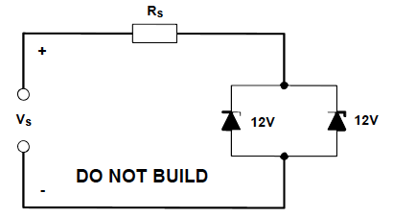
Zener diodes in parallel
Consider this circuit with 2 these Zener diodes connected in parallel. What do you think will happen as we increase the supply voltage from 1V to 15V?
Take a few moments to think about this and write your prediction on a piece of paper.
Notes:
Img02 = redraw without DO NOT BUILD

Slide 8
Zener diodes in parallel experiment
Ready to test out your predictions? Here is a virtual circuit we can use.
Download and work through the worksheet. Then watch the video to make sure you completed everything correctly.
Vid01
Download the worksheet
Notes:
Download the worksheet = on click, open Doc01. See appendix for brief
Img03 = EveryCircuit logo
Vid01 = on click, play Vid01 full screen. See appendix for brief

Slide 9
Parallel Zeners
When Zeners are connected in parallel, the output voltage will be that of the lower voltage Zener and it will do all the work.
But what happens when Zener didoes are connected in series?
Take a few moments to think about this and write your prediction on a piece of paper.
Notes:
Img02

Slide 10
Zener didoes in series experiment
We know that we can use Zener diodes to drop a specific and constant voltage in a circuit. But what happens when we have more than 1 Zener is series? Let’s find out.
Download and work through the worksheet. Then watch the video to make sure you completed everything correctly.
Vid02
Download the worksheet
Notes:
Download the worksheet = on click, open Doc02. See appendix for brief
Img03 = EveryCircuit logo
Vid02 = on click, play Vid02 full screen. See appendix for brief

Slide 11
Series Zeners
When Zeners are connected in parallel, the total voltage drop is the sum of their individual voltage drops.
Drag the diodes you would need to create a total voltage drop of 16.7V into the box.
3V
5V
8V
10V
12V
Check
Notes:
Img04 = https://www.electronicshub.org/wp-content/uploads/2015/01/6.-Zener-Diode-connected-in-Series.jpg - redraw but with the following Zener voltages – 3V, 5V, 8V, 12V – and the corresponding cumulative voltage drops.
Drag and drop question:
Correct answer: 3V, 5V, 8V and silicon diode

Slide 12
Draw a Zener diode I-V curve
Using 3V, 5V and 10V Zener diodes, draw three circuits showing how you can obtain an 8V, 15V and 18V voltage output from a 20V DC supply.
Take a photo of your circuit diagrams and upload it to your portfolio.
Choose image
Upload
Notes:
Choose image = Launch file selection window
Upload = Upload file

Slide 13
Zener didoes with AC voltage
Most of the time, we have been dealing with Zener diodes regulating DC voltage. How do Zener diodes behave in AC circuits where the voltage is always changing.
Vid03
Watch this video to see what happens when we use Zener diodes in an AC circuit.
Notes:
Vid03 = on click, play Vid03 full screen. See appendix for brief

Slide 14
Voltage clamping
Zener diodes can be used to clip or limit either one or both halves of an AC voltage. This is called voltage clamping. We usually label the clamped voltage as V_{K}.
Notes:
Img05 = http://hyperphysics.phy-astr.gsu.edu/hbase/Electronic/ietron/zenlim.gif - redraw but change Vz to Vk and use arrows to indicate the height of Vk above the dotted line.

Slide 15
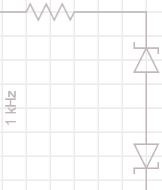
A clamped voltage graph
Click the button to download a blank axis and then draw the input and output AC voltage waveforms that would result from the circuit in the diagram. Your graph should accurately show the input peak V_{P} as well as the clamped voltage V_{K}.
25V AC RMS
Download a blank axis
Notes:
Img06 – redraw
Download a blank axis = open Img07 in a new window. Img07 = https://www.desmos.com/calculator/mluuw6tt2q formatted for A4

Slide 16
Upload your clamped voltage graph
This is what your graph should have looked like.
Img08
Click on the image to see a larger version. Correct your graph if necessary then upload a picture of it to your portfolio.
Choose image
Upload
Notes:
Img08 = on click, open Img08 full screen. See appendix for brief
Choose image = Launch file selection window
Upload = Upload file

Slide 17
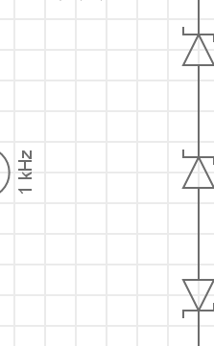
A clamped voltage graph
Click the button to download a blank axis and then draw the input and output AC voltage waveforms that would result from the circuit in the diagram. Your graph should accurately show the input peak V_{P} as well as the clamped voltage V_{K}.
20V AC RMS
Download a blank axis
Notes:
Img09 – redraw
Download a blank axis = open Img07 in a new window. Img07 = https://www.desmos.com/calculator/mluuw6tt2q formatted for A4

Slide 18
Upload your clamped voltage graph
This is what your graph should have looked like.
Img10
Click on the image to see a larger version. Correct your graph if necessary then upload a picture of it to your portfolio.
Choose image
Upload
Notes:
Img10 = on click, open Img10 full screen. See appendix for brief
Choose image = Launch file selection window
Upload = Upload file

Slide 19
Test Yourself
We have come to the end of this unit. Answer the following questions to make sure you understand the basics of series and parallel Zener diodes and AC voltage clamping.

Slide 20
Question 1
What would the reading on the voltmeter be?
1
2
3
4
Notes:
Multiple choice question
Correct answer is
Feedback:

Slide 21
Question 2
What would the reading on the voltmeter be?
1
2
3
4
Notes:
Multiple choice question
Correct answer is
Feedback:

Slide 22
Question 3
What would the reading on the voltmeter be?
1
2
3
4
Notes:
Multiple choice question
Correct answer is
Feedback:

Slide 23
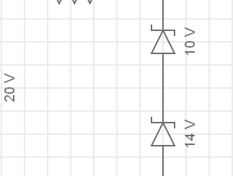
Question 4
What would the reading on the voltmeter be?
1
2
3
4
Notes:
Multiple choice question
Correct answer is
Feedback:

Slide 24
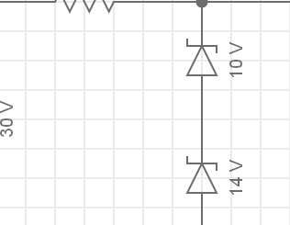
Question 5
What would the reading on the voltmeter be?
1
2
3
4
Notes:
Multiple choice question
Correct answer is
Feedback:

Slide 25
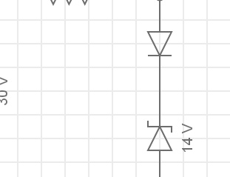
Question 6
What would the reading on the voltmeter be?
1
2
3
4
Notes:
Multiple choice question
Correct answer is
Feedback:

Slide 26
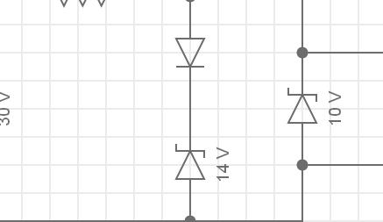
Question 7
What would the reading on the voltmeter be?
1
2
3
4
Notes:
Multiple choice question
Correct answer is
Feedback:

Slide 27
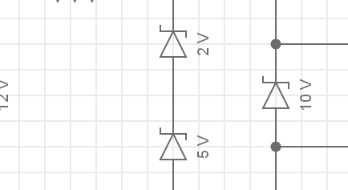
Question 8
What would the reading on the voltmeter be?
1
2
3
4
Notes:
Multiple choice question
Correct answer is
Feedback:

Slide 28
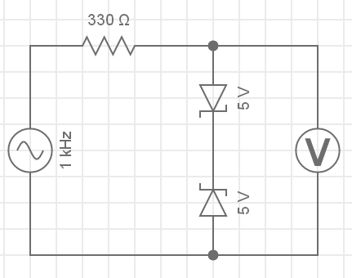
Question 9
What would the maximum and minimum readings on the voltmeter be?
1
2
3
4
10V
Notes:
Multiple choice question
Correct answer is
Feedback:

Slide 29
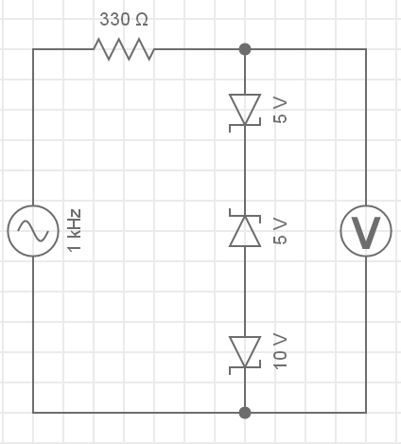
Question 10
What would the maximum and minimum readings on the voltmeter be?
1
2
3
4
10V
Notes:
Multiple choice question
Correct answer is
Feedback:

Slide 30
Document Briefing – Doc01
Create an annotated PDF worksheet with the following steps.
Make sure you have downloaded the EveryCircuit App from your app store.
If you are working on a computer, visit http://everycircuit.com/app/.
Open the EveryCircuit app and signup. After your trial, you will still have access to EveryCircuit and other people’s circuits. You will just not be able to create your own circuits.
Go to the community space and search for the circuit called “NOC_Parallel Zener diodes”
Open the circuit.
You will see that we have a 1VDC supply connected to a 100Ω resistor and a 5V and 10V Zener diode, which are connected in parallel with each other.
Is there current flowing in the circuit? Why or why not?
What would we need to make the supply voltage in order for current to flow in the circuit?
Change the supply voltage to 5V. Does current flow in the circuit. Why or why not?
Change the supply voltage to 7V? Through which diode does current flow? Why is this the case?
What do you think will happen if we change the supply voltage to 10V? Will current flow through the 10V Zener?
Change the supply voltage to 10V. Does current flow through the 10V Zener. Why or why not?
Change the supply voltage to 15V. Does current flow through the 10V Zener. Why or why not?

Slide 31
Video Briefing – Vid01
A screencast video presented by an expert electrician working through Doc01.
Explain why no current flows through the circuit when the supply is 1V.
Explain why current will start to flow if the supply voltage was 5V and show this by changing the supply voltage
Explain why, at 10V, no current flows through the 10V Zener – voltage drop across 5V Zener is 5V, therefore, 10V Zener “sees” a voltage of 5V which is below its breakdown voltage.
All that happens as we increase the supply voltage is that the current through the 5V increases. If we keep doing this, the current will keep increasing until the 5V Zener is destroyed.
No matter what we make the supply voltage, the 10V Zener will always see a voltage of 5V so will not conduct. Only if the 5V Zener is removed or destroyed will the 10V see any other voltage.

Slide 32
Document Briefing – Doc02 (1 of 2)
Create an annotated PDF worksheet with the following steps.
Make sure you have downloaded the EveryCircuit App from your app store.
If you are working on a computer, visit http://everycircuit.com/app/.
Open the EveryCircuit app and signup. After your trial, you will still have access to EveryCircuit and other people’s circuits. You will just not be able to create your own circuits.
Go to the community space and search for the circuit called “NOC_Series Zener diodes”
Open the circuit.
You will see that we have a 1VDC supply connected in series to a 470Ω resistor and a 5V and 10V Zener.
Is there current flowing in the circuit? Why or why not?
What would we need to make the supply voltage in order for current to flow in the circuit?
Change the supply voltage to 5V. Does current flow in the circuit. Why or why not?
Change the supply voltage to 10V? Does current flow in the circuit. Why or why not?
At what supply voltage do we expect current to start flowing in the circuit?
Change the supply current to 15V. Does current flow?
What is the voltage drop across the 5V Zener?
What is the voltage drop across the 10V Zener

Slide 33
Document Briefing – Doc02 (2 of 2)
What is the combined voltage drop across both Zener diodes?
Change the supply voltage to 20V. What is the combined voltage drop across both Zener diodes?
How could we get a total voltage drop of 16.4V?
Go to the community space and search for the circuit called “NOC_Series Zener diodes 2”
In this circuit, we have added to ordinary diodes in parallel with our Zener diodes. Each of these drops about 0.7V in the forward biased orientation, bringing the total to 16.5V.

Slide 34
Video Briefing – Vid02
A screencast video presented by an expert electrician working through Doc02.
Explain why no current flows through the circuit when the supply is 1V.
Explain why current only really starts to flow when the supply voltage is 15V – the 5V Zener is going to drop some voltage but less than 5V so it will not conduct. Also the 10V will also drop some voltage but less than 10V so it will also not conduct. Both diodes need to conduct before current will flow in the circuit. At 15V, each Zener can drop its breakdown voltage – both will conduct and so current will flow in the circuit.
Explain why the total voltage drop is 15V at supply voltage – 15V and more – emphasis that we can use multiple Zeners in series to achieve a very specific voltage drop.
Explain that by adding normal silicon diodes in series we can achieve even more fine grained voltage control – in this case 16.4 – 16.5V.

Slide 35
Video Briefing – Vid03 (1 of 3)
A screencast video presented by an expert electrician using http://everycircuit.com/circuit/5073185791016960 to explain the action of Zener diodes in AC circuits.
Explain what is happening in the circuit with VAC = 5V
When voltage is positive, Zener is forward biased and drops the standard 0.7V. In the forward biased direction the Zener allows current to flow
When voltage is negative, Zener is reverse biased but the voltage is not enough to cause the diode to breakdown and conduct. No current flows but the Zener drops the entire supply voltage.
Change VAC to 12V and explain what is happening in the circuit (for best results, pause sim, change VAC, restart sim, play again).
At this voltage, when the Zener is forward biased (positive supply voltage), it still drops its forward voltage (up to 0.8V now) and allows current to flow.
When reverse biased, the supply voltage exceeds the Zener breakdown voltage and the diode limits the voltage to this voltage. The negative part of the supply cycle is clipped. As the breakdown voltage gets exceeded for part of the negative cycle, the Zener conducts for a part of the negative cycle.

Slide 36
Video Briefing – Vid03 (2 of 3)
Change VAC to 20V. Explain what happens in the circuit (for best results, pause sim, change VAC, restart sim, play again).
Nothing has changed (except more voltage = more current) when the diode is forward biased (positive half of the cycle).
When reverse biased, the diode continues to clip the negative half cycle to its Zener breakdown voltage of 10V but as the supply voltage is higher, more current flows when breakdown voltage is exceeded.
But how could we clip both halves of the AC cycle? We could add another Zener so that it is reverse biased during the positive half cycle.
Add a second 10V Zener in the opposite orientation to the first
Change the voltmeter connections to read voltage across both diodes
Add the supply voltage and Zener voltmeter voltage to the graph (remove current from graph for now)
(for best results, pause sim, change VAC, restart sim, play again)
Explain what is happening in the circuit now.

Slide 37
Video Briefing – Vid03 (3 of 3)
Now both halves of the AC cycle get clipped at the Zener breakdown voltage of 10V. This is called clamping as it prevents the AC voltage from ever getting above the specified voltage of the Zener didoes.
The actual clamped voltage is +/- 10.8V because in both halves of the AC cycle, one of the diodes is forward biased and drops 0.8V.
Add in the current (through the resistor) to the graph and explain what is happening (for best results, pause sim, change VAC, restart sim, play again).
Only when each Zener’s breakdown voltage is exceeded does current flow in the circuit. When the supply voltage is between -10V and 10V, no current flows.
Now change one of the Zeners to 5V to show non-symmetrical clamping and remove current form graph (for best results, pause sim, change VAC, restart sim, play again).
We can see that when the 5V Zener is reverse biased, the AC voltage is clipped to 5V not 10V.
We can also use multiple Zener didoes in series to produce different clamped voltages. Change the diode above back to 10V and add another 5V Zener diode to the circuit (for best results, pause sim, change VAC, restart sim, play again).
Start the simulation and show how the one half cycle is clipped at about 10V and the other at about 15V (10V + 5V).
Show again how the forward biased diode(s) in both half cycles contribute to the clamping level
Half cycle with 2 reverse and 1 forward biased diodes = 5V + 10V + 0.7V
Other half cycle with 1 reversed and 2 forward biased diodes = 10V + 0.7V + 0.7V = 11.5V

Slide 38
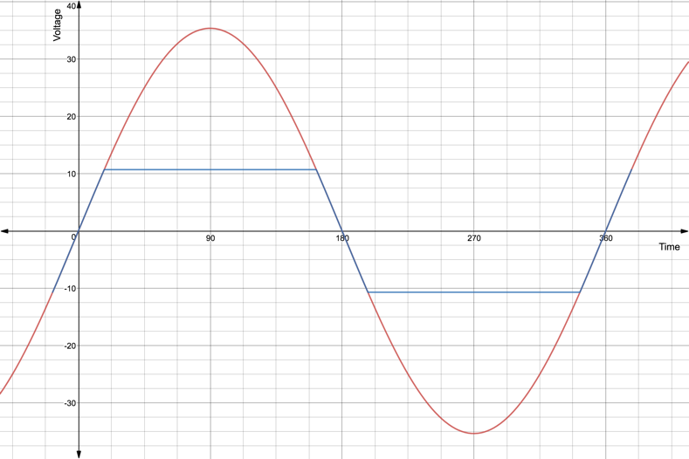
Image Briefing – Img08
Original source at https://www.desmos.com/calculator/9soa7ar2br
$$V_{P}=\frac{RMS}{0.707}=\frac{25V}{0.707}=35.36V$$
$$V_{K}=10V+0.7V=10.7V$$
$$V_{K}=−10.7V$$
$$V_{P}=−35.36V$$

Slide 39
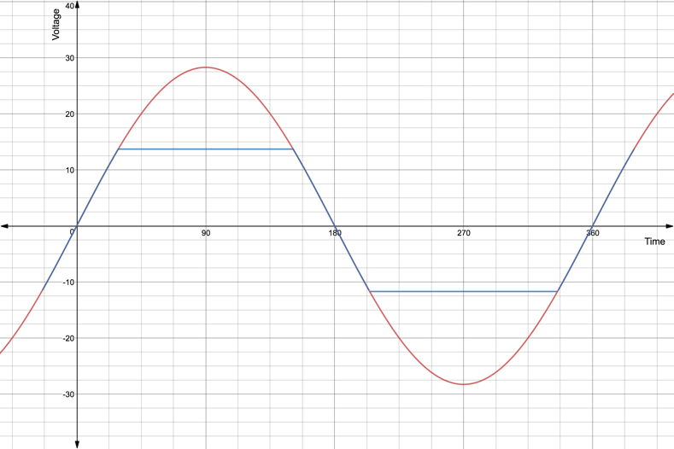
Image Briefing – Img08
Original source at https://www.desmos.com/calculator/uuguajamug
$$V_{P}=\frac{RMS}{0.707}=\frac{20V}{0.707}=28.328V$$
$$V_{K}=10V+3V+0.7V=13.7V$$
$$V_{K}=−10V−0.7V−0.7V=11.4V$$
$$V_{P}=−28.28V$$

