Slide 1
Electronics
Topic 6: Diodes

Slide 2
Assumed prior learning
05_01_00
05_01_02
05_02_01
05_03_01
05_04_01
Notes:
Note for navigation on site:
This information needs to be taken into account and needs to stated on the LMS, perhaps as part of the introduction?

Slide 3
Outcomes
By the end of this unit the learner will be able to:
Identify and explain Zener breakdown voltages
Draw and interpret a typical Zener diode I-V curve
Explain the purpose of a series resistor in voltage regulation circuits
Calculate the resistance of the series resistor required for a voltage regulation circuit

Slide 4
Unit 6.5: Voltage Regulation

Slide 5
Introduction
We learnt about Zener diodes in unit 2 of this topic when we were introduced the different types of diodes. We said then that Zener diodes are very useful for voltage regulation.
In this unit we will explore what voltage regulation is in more detail.
Notes:
Img01 = Img08 from 10_06_02

Slide 6
Zener recap
Before we continue, lets quickly recap Zener diodes.
Zener diodes are designed to be reverse biased
1
When the voltage exceeds the Zener voltage, the diode conducts. In the reverse direction
2
The voltage remains constant at the rated value, irrespective of the reverse current
3
Click the button to see an interactive I-V Zener diode curve.
I-V curve
Notes:
I-V curve = on click, open Img08 from 10_06_02 (including hotspots) in a popup

Slide 7
Important
Zener diodes are primarily used to regulate voltage, in other words, to keep the voltage steady.

Slide 8
Zener diode experiment
Using this schematic as a guide, build the circuit to explore what Zener diodes do.
Rollover or touch each symbol in the schematic to find out more. Watch the video if you need help.
Watch how to build the circuit
Notes:
Reproduce schematic image as an image with hotspots over each component.
Component01 = on click present a tooltip with “This symbol represents a voltage source like a battery Use a 9V battery.”
Component02 = on click present a tooltip with “This symbol represents a resistor. Use a 470Ω resistor.
Component03 = on click present a tooltip with “This symbol represents a Zener diode. Use a 5V, 1W Zener diode. It is the component that looks like this (https://cdn.sparkfun.com//assets/parts/4/7/0/4/10301-01.jpg)
Component04 = You will need to connect your multimeter in series to measure the current through the circuit.
Component05 = You will need to connect your multimeter in parallel across the diode to measure the voltage across the diode.
Watch how to build the circuit = on click, play Vid01 (see brief) full screen
Hide tooltip on clicking away from component or another component.

Slide 9
Review How To Use a Multimeter
We now need to take some readings from our circuit and do some calculations.
Img02
Refer to the multimeter guide saved on your device or click the image to see it again.
Notes:
Img02 = image of the same multimeter guide screenshot as used in 10_02_03 slide 10 linking to the same document.

Slide 10
Step 1
Measure the current flowing through the circuit.
Img03
Enter the current
mA
Check
Notes:
Img03 = image of the words “Step 1”
Check = on click, check the current entered. It should be between 7.5mA and 9mA
Feedback:
If in range – That look’s about right. Your current should be about 8.6mA. Make a note of the current on a piece of paper.
If not in range – That does not look correct. Your current reading should be about 8.6mA. Check it again. Make sure that the circuit has been connected correctly and that your battery supplies a voltage of about 9V. If it is less than 8.5V, replace it.

Slide 11
Step 2
Measure the voltage across the Zener diode.
Img04
Enter the voltage
V
Check
Notes:
Img04 = image of the words “Step 2”
Check = on click, check the voltage entered. It should be between 4.8V and 5.2V.
Feedback:
If in range – That look’s about right. The voltage should be the Zener’s rated 5V breakdown voltage.
If not in range - Your voltage reading should be about 5V because you are using a 5V Zener diode. Check it again.

Slide 12
Step 3
Now, replace the 5V Zener diode with a 10V, 1W diode. It is part number 1N4742A.
Measure the current through the circuit and voltage across the diode.
Img05
Enter the current
mA
Enter the voltage
V
Check
Notes:
Img05 = image of the words “Step 3”
Check = on click, check the values entered
Current: 0mA
Feedback:
If in range – That is right. The Zener voltage of the diode is greater than the battery’s voltage so it will not conduct any current.
If not in range – That is not correct. You should have found that no current is flowing because the Zener breakdown voltage has not been exceed. Make sure that the diode is in the reverse bias direction i.e. the cathode connected to the positive terminal of the battery.
Voltage: 8V – 9V
Feedback:
If in range – Well done. The Zener will drop the whole circuit voltage. As there is no current flowing, no voltage will being dropped by the resistor.
If not in range – Something went wrong. You should find that the voltage across the Zener is the full 9V of the battery. As there is no current flowing, no voltage will being dropped by the resistor.

Slide 13
Step 4
Now add a second 9V battery to your circuit. Make sure to connect the positive terminal of one to the negative terminal of the other. What is the circuit voltage now?
Measure the current through the circuit and voltage across the diode.
Img06-
Enter the current
mA
Enter the voltage
V
Check
Notes:
Img06 = image of the words “Step 4”
Check = on click, check the values entered
Current: 14mA – 20mA
Feedback:
If in range – That looks about right. The current should be about 17mA. The circuit voltage is now about 18V (2 x 9V batteries). Therefore, the Zener voltage has been exceeded and current will flow.
If not in range – That is not correct. You should have found that about 17mA is flowing. Current is flowing because the Zener voltage has now been exceeded (2 x 9V = 18V). Make sure that the diode is in the reverse bias direction i.e. the cathode connected to the positive terminal of the battery and recheck your readings.
Voltage: 9.5V – 10.5V
Feedback:
If in range – Well done. The Zener will drop its rated 10V.
If not in range – Something went wrong. You should find that the voltage across the Zener is 10V because you are using a 10V Zener diode. Make sure that everything is connected correctly and measure again.

Slide 14
Experiment results
We have just seen that, unless the circuit input voltage exceeds the Zener breakdown voltage of a Zener diode, it does not allow current to flow. But as soon as the Zener breakdown voltage is exceeded, the Zener allows current to flow and drops its Zener breakdown voltage.
Vid02
Watch the video to see each step in the experiment.
Notes:
Vid02 = on click, play Vid02 full screen. See appendix for brief.

Slide 15
Zener voltage
Lets explore Zener diodes and voltage regulation in more detail by using a virtual circuit.
Download and work through the worksheet. Then watch the video to make sure you completed everything correctly.
Vid03
Download the worksheet
Notes:
Download the worksheet = on click, open Doc01. See appendix for brief
Img07 = EveryCircuit logo
Vid03 = on click, play Vid03 full screen. See appendix for brief

Slide 16
Draw a Zener diode I-V curve
Click on the button to see the completed tables of values from the virtual circuits.
Plot your own I-V curve for this 5V Zener diode, then take a photo of it and upload it to you portfolio.
You can download an empty axis if you would like.
Reverse biased
Forward biased
Axis
Choose image
Upload
Notes:
Reverse biased = on click, display slide 17 as a popup
Forward biased = on click, display slide 18 as a popup
Axis = on click, download Img08. See appendix for brief
Choose image = Launch file selection window
Upload = Upload file

Slide 17
Reverse biased results
V_{S} | 1V | 2V | 3V | 4V | 5V | 6V | 7V | 8V | 9V | 10V
V_{Z} (V) | -1 | -2 | -3 | -4 | -4.92 | -4.99 | -5.02 | -5.04 | -5.05 | -5.07
I_{T} (mA) | 0 | 0 | 0 | 0 | -0.09 | -10.1 | -19.8 | -29.6 | -39.5 | -49.3

Slide 18
Forward biased results
V_{S} | 0.2V | 0.4V | 0.6V | 0.8V | 1V | 2V | 4V | 6V | 8V | 10V
V_{Z} (V) | 0.2 | 0.4 | 0.599 | 0.715 | 0.745 | 0.795 | 0.84 | 0.872 | 0.9 | 0.926
I_{T} (mA) | 0 | 0 | 0 | 0.85 | 2.55 | 12 | 31.6 | 51.3 | 71 | 90.7

Slide 19
Voltage regulation
We have confirmed that, unless the circuit input voltage exceeds the Zener voltage of a Zener diode, it does not allow current to flow. But as soon as the Zener voltage is exceeded, the Zener allows current to flow and drops its rated Zener voltage.
YT01
Watch the video to see how to create a voltage regulator with a Zener diode.
Notes:
YT01 = on click, play YT01 full screen. YT01 = https://www.youtube.com/watch?v=E4IIiIhIYAg

Slide 20
Zener voltage
We know that we can use Zener diodes to drop a specific and constant voltage in a circuit. But what happens if the load current in a circuit changes? Let’s explore this with a virtual circuit.
Download and work through the worksheet. Then watch the video to make sure you completed everything correctly.
Vid04
Download the worksheet
Notes:
Download the worksheet = on click, open Doc02. See appendix for brief
Img07 = EveryCircuit logo
Vid04 = on click, play Vid04 full screen. See appendix for brief

Slide 21
Draw a Zener diode I-V curve
Take pictures of your graphs of Zener Voltage vs Load Resistance and Zener current vas Load Resistance and upload these to your portfolio.
Click the buttons to see the results again or download blank axes.
Results
V_{Z} Axis
I_{Z} Axis
Choose image
Upload
Notes:
Results = on click, display slide 22 as a popup
VZ Axis = on click, download Img09. See appendix for brief
IZ Axis = on click, download Img10. See appendix for brief
Choose image = Launch file selection window
Upload = Upload file

Slide 22
Load current results
RL (Ω) | 10K | 4K7 | 2K2 | 470 | 330 | 220 | 150
V_{Z} (V) | 9.98 | 9.98 | 8.96 | 8.17 | 7.2 | 6V | 4.86V
I_{Z} (mA) | 8.18 | 8.08 | 4.73 | 0 | 0 | 0 | 0
I_{L} (mA) | 0.1 | 2.12 | 4.53 | 17.4 | 21.8 | 27.3 | 32.4

Slide 23
Zener voltage and current
In order for a Zener diode to drop its full breakdown voltage, it needs a certain minimum current (I_{Z}min) to flow through it. If I_{Z} is below I_{Z}min, the Zener will NOT drop its full breakdown voltage. Most Zeners have a stated I_{Z}min of between 5mA to 10mA.
The I_{z}min is usually indicated on the Zener diode I-V curve.
Img11
Notes:
Img11 = Img08 from 10_06_02 (without hotspots)

Slide 24
Protecting Zener diodes
You may be wondering why we always add a resistor when experimenting with Zener diodes. This is to limit the current through the Zener diode to a safe value and to drop excess circuit voltage. We need to check the power ratings of Zener diodes to make sure that they will not get destroyed in our circuit by excessive current.
Remember: P = I x V
Watch the video to learn more about power ratings.
Zener Power ratings
Notes:
Zener Power Ratings = on click, play YT02 full screen. YT02 = https://www.youtube.com/watch?v=N9UDobarNhU

Slide 25
Zener power ratings
All Zener diodes have a power rating. The most common are 0.5W and 1W. We can use the power rating to work out the maximum current rating (I_{Z}max) of a diode as well as its safe operating range.
Vid05
Watch the video to see how this is done.
Notes:
Vid05 = on click, play Vid05 full screen. See appendix for brief

Slide 26
For Zener diodes with a power rating of less than 1W assume
I_{Z}min = 5mA
For Zener diodes with a power rating of 1W or more, assume
I_{Z}min = 10mA

Slide 27
What resistor should we use (example 1)?
If you know the I_{SOR} of a Zener diode and the supply voltage of the circuit, you can work out what resistor you will need to protect your Zener diode.
The midpoint of the SOR of a 5V, ½W Zener diode is 15mA. The Zener will be used in a circuit with a 12VDC supply. What resistor must be used to protect the Zener diode?
See if you can work out the answer first and then watch the video to see if you are correct.
Worked Solution
Notes:
Worked Solution = on click, play Vid06 full screen. See appendix for brief

Slide 28
What resistor should we use (example 2)?
Here is another example to try on your own first.
A 10V, 1W Zener diode will be used in a circuit with a 25VDC supply. What resistor must be used to protect it?
See if you can work out the answer first and then watch the video to see if you are correct.
Worked Solution
Notes:
Worked Solution = on click, play Vid07 full screen. See appendix for brief

Slide 29
What resistor should we use (example 3)?
Here is another example to try on your own first.
A 12V, 1W Zener diode will be used in a bridge rectification circuit with a 12VAC supply. What resistor must be used to protect it?
See if you can work out the answer first and then watch the video to see if you are correct.
Worked Solution
Notes:
Worked Solution = on click, play Vid08 full screen. See appendix for brief

Slide 30
Test Yourself
We have come to the end of this unit. Answer the following questions to make sure you understand the basics of rectification and rectifiers.

Slide 31
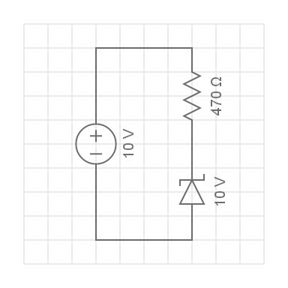
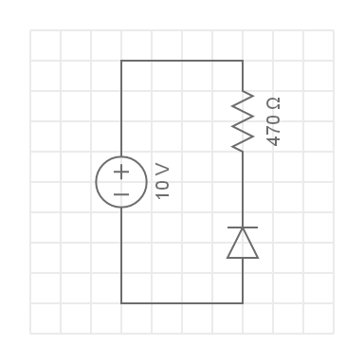
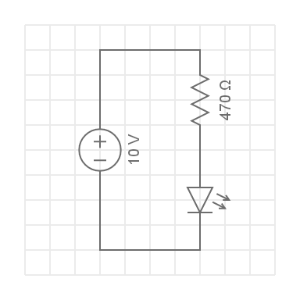
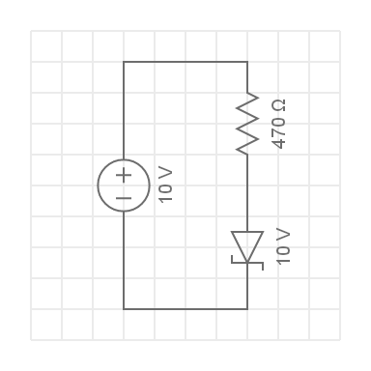
Question 1
In which circuit, will the Zener diode act as a voltage regulator?
a)
b)
c)
d)
Notes:
Multiple choice question
Correct answer is a
Feedback:
a – Well done. The Zener diode is reverse biased and so will act as a voltage regulator.
b – That is not correct. The diode is reverse biased but it is not a Zener diode.
C – That is not correct. This is an LED.
D – That is not correct. This Zener diode is forward biased. It will act as a normal diode.

Slide 32
Question 2
Which of the following statements is true for a reverse biased 12V Zener diode?
If the supply voltage is 11V, the voltage dropped by the Zener will be 12V.
The voltage dropped by the Zener diode will decrease as the supply voltage increases.
If the supply voltage is 14V, the voltage dropped by the Zener diode will be 12V.
None of the above statements are true.
Notes:
Multiple choice question
Correct answer is c
Feedback:
A – This is not true. The Zener breakdown voltage has not bee exceeded so the Zener will not drop its rated Zener breakdown voltage.
B – This is not true. As the supply voltage increases, the voltage dropped across the Zener diode will increase.
C – This is true. The Zener breakdown voltage has been exceeded, therefore, the Zener will drop its rated Zener breakdown voltage.
D – This is not true

Slide 33
Question 3
True of False: If the supply voltage exceeds the Zener breakdown voltage, the Zener will drop its rated Zener breakdown voltage irrespective of the load connected in parallel to it?
True
False
Notes:
Multiple choice question
Correct answer is b
Feedback:
Correct – Well done. The load resistance affects the amount of current that flows through the Zener diode. If I_{Z} falls below I_{Z}min, the Zener will stop dropping its full rated Zener breakdown voltage.
Incorrect – That is not correct. The load resistance affects the amount of current that flows through the Zener diode. If I_{Z} falls below I_{Z}min, the Zener will stop dropping its full rated Zener breakdown voltage.

Slide 34
Question 4
What is the I_{Z}max rated value for a 20V, 11W Zener diode?
55A
550A
550mA
55mA
Notes:
Multiple choice question
Correct answer is c
Feedback:
Correct – Well done. To calculate I_{Z}max we divide the power rating by the Zener breakdown voltage. Therefore, I_{Z}max = 11W/20V = 0.55A = 550mA.
Incorrect – That is not correct. To calculate I_{Z}max we divide the power rating by the Zener breakdown voltage. Therefore, I_{Z}max = 11W/20V = 0.55A = 550mA.

Slide 35
Question 5
What is the I_{Z} Permissible values for a 22V, 12W Zener diode?
109.09mA
436.36mA
545.45mA
4.36A
Notes:
Multiple choice question
Correct answer is b
Feedback:
Correct – Well done. To calculate I_{Z} Permissible we need to multiply I_{z}max by 0.8 (80%). I_{z}max = 12W/22V = 0.5454A = 545.45mA. Therefore I_{Z} Permissible = 545.45mA x 0.8 = 436.36mA.
Incorrect – That is not correct. To calculate I_{Z} Permissible we need to multiply I_{z}max by 0.8 (80%). I_{z}max = 12W/22V = 0.5454A = 545.45mA. Therefore I_{Z} Permissible = 545.45mA x 0.8 = 436.36mA.

Slide 36
Question 6
What is the minimum current that must be passed through a 22V, 12W Zener diode for it to drop a constant voltage?
545.45mA
100mA
10mA
5mA
Notes:
Multiple choice question
Correct answer is c
Feedback:
Correct – Well done. Because the diode has a power rating of 1W or more, we assume I_{Z}min = 10mA.
Incorrect – That is not correct. Because the diode has a power rating of 1W or more, we assume I_{Z}min = 10mA.

Slide 37
Question 7
Which is the best choice of resistor to be connected in series with a 6V, ½W Zener diode if the supply current is 12VDC?
150Ω
330Ω
470Ω
2K2Ω
Notes:
Multiple choice question
Correct answer is a
Feedback:
A – Well done. This is correct. As a 0.5W Zener, we assume Izmin is 5mA. Izmax = 0.5W/12V = 83.33mA. Iz Permissible = 80% x 83.33mA = 66.67mA. Therefore, Isor = (66.67 + 5)/2 = 35.83mA. V across the resistor will be Vs – Vz = 12V – 6V = 6V. R = 6V/0.03583A = 167Ω. So the 150Ω resistor is best.
B , C, D– That is not correct. As a 0.5W Zener, we assume Izmin is 5mA. Izmax = 0.5W/12V = 83.33mA. Iz Permissible = 80% x 83.33mA = 66.67mA. Therefore, Isor = (66.67 + 5)/2 = 35.83mA. V across the resistor will be Vs – Vz = 12V – 6V = 6V. R = 6V/0.03583A = 167Ω. So the 150Ω resistor is best.

Slide 38
Question 8
Which is the best choice of resistor to be connected in series with a 10V, 1.5W Zener diode if the diode is connected to a bridge rectifier with an input voltage of 23.4VAC?
150Ω
330Ω
470Ω
2K2Ω
Notes:
Multiple choice question
Correct answer is b
Feedback:
A, C, D – That is not correct. As a 1.5W Zener, we assume Izmin is 10mA. Izmax = 1.5W/10V = 150mA. Iz Permissible = 80% x 150mA = 120mA. Therefore, Isor = (120 + 10)/2 = 65mA. Vp = 23.4/0.707 = 33.10V. But the Zener is after the bridge rectifier which will drop about 1.2V. So the Vp that the Zener will “see” is 31.9V. The voltage drop over the resistor = Vp – Vz = 31.9V – 10V = 21.9V. Resistance = 21.9V/0.065A = 336.92Ω. Therefore the 330Ω resistor will be best.
B – Well done. That is correct. As a 1.5W Zener, we assume Izmin is 10mA. Izmax = 1.5W/10V = 150mA. Iz Permissible = 80% x 150mA = 120mA. Therefore, Isor = (120 + 10)/2 = 65mA. Vp = 23.4/0.707 = 33.10V. But the Zener is after the bridge rectifier which will drop about 1.2V. So the Vp that the Zener will “see” is 31.9V. The voltage drop over the resistor = Vp – Vz = 31.9V – 10V = 21.9V. Resistance = 21.9V/0.065A = 336.92Ω. Therefore the 330Ω resistor will be best.

Slide 39
Video Briefing – Vid01
Create a video presented by an expert presenter showing step-by-step how to build the circuit on a breadboard. The presenter needs to explain the following:
Add resistor and Zener to board esp. reverse biasing zener
Connect end to end with a jumper
Connect to power rail
Connect power rail to battery

Slide 40
Video Briefing – Vid02
Create a video presented by an expert presenter showing step-by-step how to take the measurements and do the calculations of the Zener diode experiment. The presenter needs to explain the following:
Measure the current and voltage with 9V battery and 5V Zener
Explain why current flows and why the voltage across the diode is 5V
Measure the current and voltage with 9V battery and 10V Zener
Explain why current does not flow and voltage across diode is 9V
Measure voltage and current with 2 x 9V batteries and 10V Zener
Explain why current flows and why voltage across diode is 10V

Slide 41
Document Briefing – Doc01 (1 of 2)
Create an annotated PDF worksheet with the following steps.
Make sure you have downloaded the EveryCircuit App from your app store.
If you are working on a computer, visit http://everycircuit.com/app/.
Open the EveryCircuit app and signup. After your trial, you will still have access to EveryCircuit and other people’s circuits. You will just not be able to create your own circuits.
Go to the community space and search for the circuit called “NOC_Zener diodes reverse biased”
Open the circuit.
You will see that we have a 1VDC supply connected to a 100Ω resistor and a 5V Zener diode.
At the moment, no current is flowing. Why is this the case?
Complete the first column of the table (V_{S} = 1V) with the values of the total circuit current (I_{T}) and the voltage across the Zener diode V_{Z}. Remember that your VZ values will be negative
Reverse Biased
V_{S} | 1V | 2V | 3V | 4V | 5V | 6V | 7V | 8V | 9V | 10V
V_{Z} (V)
I_{T} (mA)

Slide 42
Document Briefing – Doc01 (2 of 2)
Now increase the supply voltage to 2V and complete the 2nd column of the table.
Complete the rest of the table, changing the supply voltage as necessary each time.
What do you notice about the IT at V_{S} = 5V?
What do you notice about I_{T} and V_{Z} from VS = 6V to V_{S} = 10V?
Go to the community space and search for the circuit called “NOC_Zener diodes forward biased”. This is the same circuit, except that the diode is not in the forward biased direction.
Complete this table.
Forward Biased
V_{S} | 0.2V | 0.4V | 0.6V | 0.8V | 1V | 2V | 4V | 6V | 8V | 10V
V_{Z} (V)
I_{T} (mA)

Slide 43
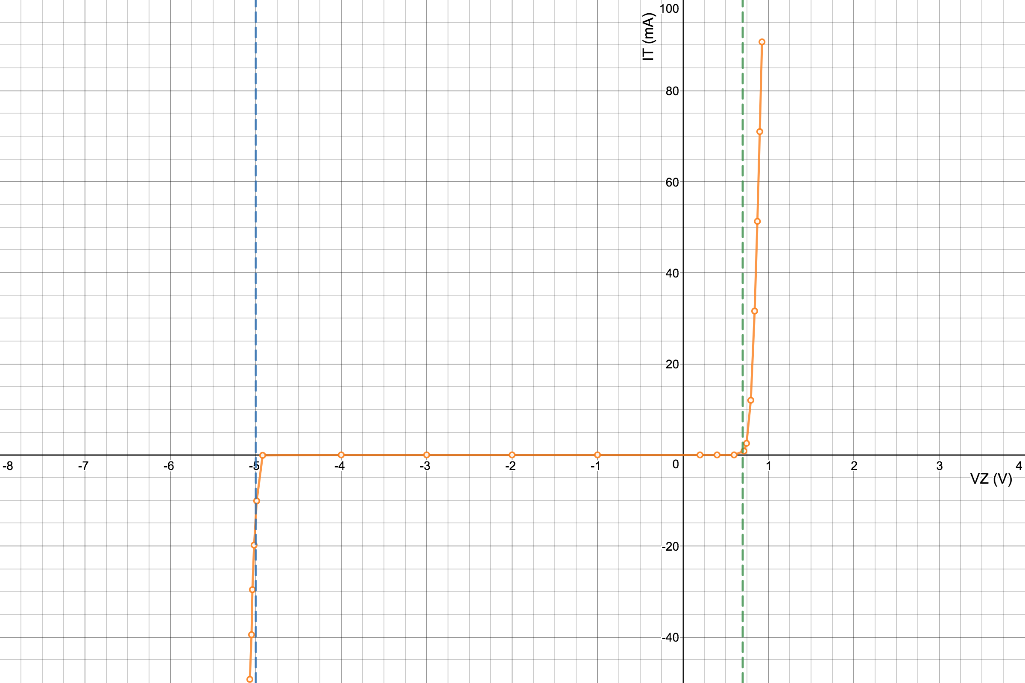
Video Briefing – Vid03
A screencast video presented by an expert electrician working through Doc01.
Explain why no current is flowing initially
Complete both tables of values.
Explain what the values in the tables tell us about the operation of Zener diodes.
Use the graph of the results available at https://www.desmos.com/calculator/vfcsxxxy6f to help show that in the forward bias direction the diode behaves like a normal silicon diode with a forward voltage of about 0.7V but that it also has a Zener voltage (reverse voltage) of -5V. Using the shape of the graph, show how the voltage drop at the Zener breakdown voltage is slightly more constant – the line is more vertical – than at the forward voltage.

Slide 44
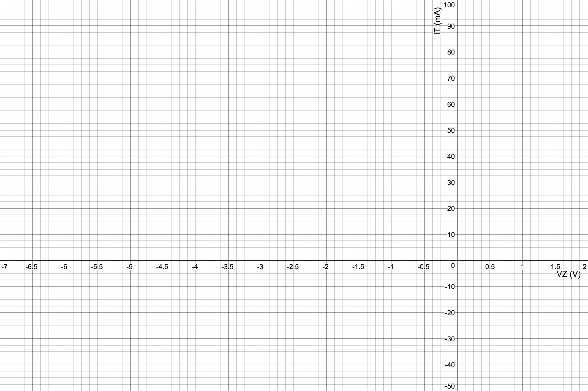
Image Briefing – Img08
Download from - https://www.desmos.com/calculator/hu5sgkzqek. Format for A4.
Notes:
Redraw

Slide 45
Document Briefing – Doc02 (1 of 2)
Create an annotated PDF worksheet with the following steps.
Make sure you have downloaded the EveryCircuit App from your app store.
If you are working on a computer, visit http://everycircuit.com/app/.
Open the EveryCircuit app and signup. After your trial, you will still have access to EveryCircuit and other people’s circuits. You will just not be able to create your own circuits.
Go to the community space and search for the circuit called “NOC_Zener and load current”
Open the circuit.
You will see that we have a 12VDC supply connected to a 220Ω resistor in series with a 10V Zener diode.
Connected across the Zener is a load resistor which has a resistance (R_{L})of 10KΩ.
Complete the table by changing the resistance of the load resistor each time. For each value of the load resistor, measure the voltage across the load and Zener diode (V_{Z}), the current through the Zener diode (I_{Z}) and the current through the load resistor (I_{L}). To measure I_{Z} and I_{L}, click on the Zener diode and the load resistor and the click on the ”eye” icon.
R_{L} (Ω) | 10K | 4K7 | 2K2 | 470 | 330 | 220 | 150
V_{Z} (V)
I_{Z} (mA)
I_{L} (mA)

Slide 46
Document Briefing – Doc02 (2 of 2)
What do you notice about the relationship between V_{Z} and R_{L}?
What do you notice about the relationship between I_{Z} and R_{L}?
What do you notice about the relationship between I_{L} and R_{L}?
Sketch a graph of I_{Z} vs R_{L}. How does the load resistance affect I_{Z}?
Now, sketch a graph of V_{Z} vs R_{L}. How does the load resistance affect V_{Z}?
How does the current through the Zener diode affect its ability to drop a constant voltage?
What is the minimum current required through the Zener diode for it to drop its rated Zener breakdown voltage?

Slide 47
Video Briefing – Vid03
A screencast video presented by an expert electrician working through Doc02.
Show how to take the readings and complete the table.
Describe and explain the relationship between V_{Z} and R_{L}?
Describe and explain the relationship between I_{L} and R_{L}?
Describe and explain the relationship between I_{Z} and I_{Z}?
Sketch a graph of I_{Z} vs R_{L} and explain how the load resistance affects I_{Z}?
Sketch a graph of V_{Z} vs R_{L} and explain how the load resistance affects V_{Z}?
Explain that a Zener voltage cannot hold its defined breakdown voltage unless a specific amount of current is flowing through it. As the load resistance decreases, more current flows through the load and less through the Zener diode, until the Zener is unable to hold is Zener breakdown voltage.
I_{Z} has to be a certain minimum for V_{Z} to be constant. In this case the minimum I_{Z} for this is about 8mA. We call this I_{z}min.

Slide 48
Image Briefing – Img09
Download from - https://www.desmos.com/calculator/y5zqboma7b. Format for A4.
Notes:
Redraw

Slide 49
Image Briefing – Img10
Download from - https://www.desmos.com/calculator/egjbfhxtib. Format for A4.
Notes:
Redraw

Slide 50
Video Briefing – Vid05 (1 of 2)
A screencast video presented by an expert electrician showing the following:
How to calculate I_{Z}max from P_{Z} for a 1W Zener.
$$I_{z}max=\frac{Power in watts}{V_{z}}=\frac{1}{10}=0.1A=100mA$$
But we normally like to remain within 80% of this theoretical maximum
Therefore the practical I_{Z}max = 80% x 100mA = 80mA
We also usually assume that Zeners with a P_{Z} < 1W have I_{Z}min = 5mA and where P_{Z} > 1W, I_{Z}min = 10mA
With this we can work out the mid-point of the functional or safe operating (SOR) range for a 1W Zener
$$MidI_{SOR}=\frac{I_{Z }Permissible+I_{z}min}{2}=\frac{80mA+10mA}{2}=45mA$$

Slide 51
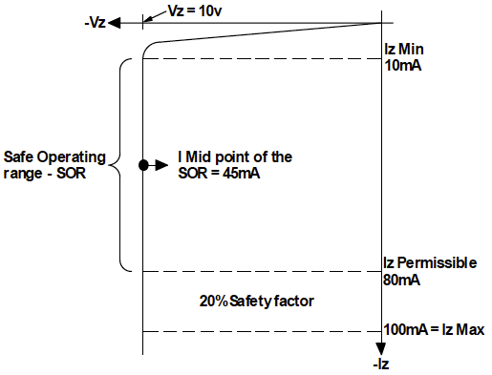
Video Briefing – Vid05 (2 of 2)
Show these values on this graph (Img12)

Slide 52
Video Briefing – Vid06
A screencast video presented by an expert electrician showing how to solve the problem.
We know that the Zener will drop 5V so the voltage drop across the resistor will be
V_{R} = V_{S} – V_{Z} = 12V – 5V = 7V
We also know that we need about 15mA to flow through the Zener and the resistor. Therefore,
R = V/I = 7V/0.015A = 466.67Ω.
Se we will need to use a 470Ω resistor to protect the diode.
Check your answer

Slide 53
Video Briefing – Vid07
A screencast video presented by an expert electrician showing how to solve the problem.
We can calculate the Izmax: 1W/10V = 0.1A = 100mA.
But Iz Permissible = 80% x 100mA = 80mA
As a 1W Zener, we assume that Izmin = 10mA. Therefore, the SOR is 10mA – 80MA. Therefore the midpoint is (10 + 80)/2 = 45mA. We want 45mA flowing through the Zener.
The Vs = 25V so V_{R} = V_{S} – V_{Z} = 25V – 10V = 15V
R = V/I = 15V/0.045A = 333Ω. So we should use a 330Ω resistor.

Slide 54
Video Briefing – Vid08
A screencast video presented by an expert electrician showing how to solve the problem.
Things are a bit more complicated because of the AC supply and the bridge rectifier. Firstly the supply is a 12VAC. Therefore the RMS value of the supply is 12V. So the peak voltage (Vp) = 12V/0.707 = 16.97. We need to work with Vp to make sure that the Zener is not damaged by any peak current.
But the 2 diodes in the bridge rectifier will drop about 1.2V. Therefore the Vp the Zener will see is 16.97V – 1.2V = 15.77V.
The voltage drop over the resistor will be VR = Vp – Vz = 15.77V – 12V = 3.77V.
A 1W Zener will have a Izmax = 100mA and a Izmin = 10mA. But Iz Permissible = 80% of Izmax = 80mA. Therefore mid point of I_{SOR} = 45mA. So the current needs to be limited to 45mA.
R = V/I = 3.77V/0.045mA = 83.85Ω. Therefore, we would need to use a 80Ω resistor.

