Slide 1
Electronics
Topic 6: Diodes

Slide 2
Assumed prior learning
05_01_00
05_01_02
05_02_01
05_03_01
05_04_01
Notes:
Note for navigation on site:
This information needs to be taken into account and needs to stated on the LMS, perhaps as part of the introduction?

Slide 3
Outcomes
By the end of this unit the learner will be able to:
Explain what capacitive smoothing is
Draw a bridge rectifier circuit with a smoothing capacitor
Explain how the capacitance and load affect the size of the DC ripple

Slide 4
Unit 6.4: Capacitive Smoothing

Slide 5
Introduction
We saw in the previous unit how we can change AC (current that keeps changing direction) in DC (current that always flows in the same direction). This is called rectification.
We can rectify either half the original AC wave or the full original AC wave.
Notes:
Img01 = Img08 from 10_06_03

Slide 6
Remember
The typical AC and rectified DC wave forms are the same shape for voltage and current. In other words, this graph could show either the voltage across a load or the current through the load. The scales would be different but the shape would be the same.
Notes:
Img02 = part of Img01

Slide 7
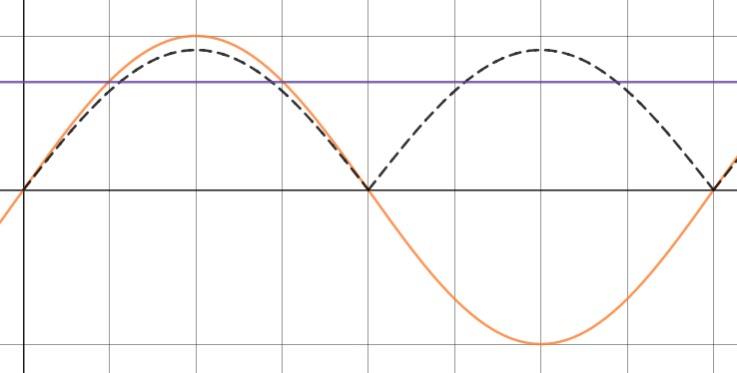
Pulsating DC
We also saw that, even for full wave rectification, the DC voltage (and current) was pulsating – it kept rising and fallen between zero and its peak value. This constantly changing DC is not steady enough for most purposes. We need to find a way to smooth the rectified wave out into DC which is steadier and smoother (like the purple line).
Any ideas as to what component we could use to make the pulsating DC smoother?
Notes:
Img03 = https://www.desmos.com/calculator/djjo0gr2tq - marked for reuse – add the following labels
Orange – AC
Dotted black – full wave rectified DC (pulsating)
Purple – steady DC

Slide 8
Capacitive smoothing
In order to smooth the bumps out of our pulsating DC output, we can use a capacitor. Can a look at how this works in the virtual circuit.
Download and work through the worksheet. Then watch the video to make sure you completed everything correctly.
Vid01
Download the worksheet
Notes:
Download the worksheet = on click, open Doc01. See appendix for brief
Img04 = EveryCircuit logo
Vid01 = on click, play Vid01 full screen. See appendix for brief

Slide 9
Take a picture
Draw a picture of a bridge rectifier with a smoothing capacitor connected in parallel across a load.
Take a photo of your drawing and upload it to your portfolio.
Choose image
Upload
Notes:
Choose image = Launch file selection window
Upload = Upload file

Slide 10
Average voltage
Because the smoothed capacitor voltage does not fall all the way to zero between peaks, its average voltage is higher than the voltage directly from the rectifier.
Average Capacitor Voltage
Average Rectified Voltage
Notes:
Img05 = https://qph.fs.quoracdn.net/main-qimg-2e55af769c5750d552fc37570eb7f07b - redraw but use existing elements from Img04

Slide 11
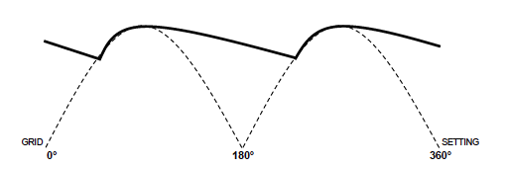
Small and big ripples
We also saw that if we increased the capacitance of the capacitor, we could reduce the size of the ripple even further.
Bigger Ripple
Lower capacitance
Smaller Ripple
Higher capacitance
Notes:
Img06 = Screenshots - redraw

Slide 12
Take a picture
Draw a picture of an unsmoothed waveform. Now, on the same axis, draw a picture of a smoothed waveform that would be produced by a smoothing capacitor.
Take a photo of your drawing and upload it to you portfolio.
Choose image
Upload
Notes:
Choose image = Launch file selection window
Upload = Upload file

Slide 13
Test Yourself
We have come to the end of this unit. Answer the following questions to make sure you understand the basics of rectification and rectifiers.

Slide 14
Question 1
What happens to the mean DC output voltage when a smoothing capacitor is connected across the load?
It increases
It decreases
It stays the same
Cannot predict
Notes:
Multiple choice question
Correct answer is a
Feedback:
Correct – Well done. Because the voltage does not drop all the way to zero after reaching every peak, the average voltage increases.
Incorrect – That is not correct. Because the voltage does not drop all the way to zero after reaching every peak, the average voltage increases.

Slide 15
Question 2
What happens to the size of the ripple in the DC output voltage if we decrease the capacitance of the smoothing capacitor?
It increases
It decrease
It stays the same
Cannot predict
Notes:
Multiple choice question
Correct answer is a
Feedback:
Correct – Well done. If we decrease the capacitance of the capacitor, the size of the ripple increases. The capacitor discharges more quickly between peaks.
Incorrect – That is not correct. If we decrease the capacitance of the capacitor, the size of the ripple increases. The capacitor discharges more quickly between peaks.

Slide 16
Question 3
Select the correct words from the dropdown lists to make the statement true.
In selecting a smoothing capacitor, its rated DC voltage must be higher/lower than the applied DC mean/peak voltage.
Notes:
Dropdown question
Correct answer is higher | peak
Feedback:
Correct – Well done.
Incorrect – That is not correct. A smoothing capacitor must always have a rated DC voltage higher than the DC peak. If not, it will be damaged by excessive voltage.

Slide 17
Question 4
Which output is the result of a smoothing capacitor with a greater capacitance?
a)
b)
Notes:
Multiple choice question
Correct answer is b
Feedback:

Slide 18
Document Briefing – Doc01 (1 of 3)
Create an annotated PDF worksheet with the following steps.
Make sure you have downloaded the EveryCircuit App from your app store.
If you are working on a computer, visit http://everycircuit.com/app/.
Open the EveryCircuit app and signup. After your trial, you will still have access to EveryCircuit and other people’s circuits. You will just not be able to create your own circuits.
Go to the community space and search for the circuit called “NOC_Capacitive smoothing”.
Open the circuit.
In this circuit, a bridge rectifier is connected to a 12VAC supply through a transformer. The transformer does not change the voltage because the turns ratio is 1:1.
A 1kΩ load resistor is connected to the bridge rectifier and there is a 1 μF capacitor connected in parallel across the resistor. At the moment the capacitor is disconnected and we can see the familiar full wave rectified voltage appear across the load.
What is the minimum and maximum voltage across the load? Does the difference in supply voltage and load voltage match the diode forward voltage drop we expect?
What is the minimum and maximum current through the load? Click on the resistor and then on the eye icon to add this measure to the graph. How does the shape of this graph compare to the voltage across the load?

Slide 19
Document Briefing – Doc01 (2 of 3)
Close the switch to connect the capacitor. What happens to the voltage (and current) across the load now? Why do you think this happens? What is the minimum and maximum voltage across(and current through) the load now?
How could we make the DC voltage across (and current through) the load even smoother?
Click on the capacitor and then click on the spanner icon. Make its capacitance smaller (say 500 nF). What happens? Why do you think this happens? What is the minimum and maximum voltage across the load now? What is the minimum and maximum current through the load now?
Make the capacitance bigger (say 2μF). What happens? Why do you think this happen? What is the minimum and maximum voltage across the load now? What is the minimum and maximum current through the load now?
What happens if you make the capacitance of the capacitor 100μF? What is the minimum and maximum voltage across the load now? What is the minimum and maximum current through the load now?
Why do you think the output V_{DC} and I_{DC} get smoother as we increase the capacitance of the capacitor?

Slide 20
Document Briefing – Doc01 (3 of 3)
What do you think will happen if we increase the load i.e. increase the resistance of the load resistor?
Set the capacitance back to 1μF and make a note of what the maximum and minimum voltage across and current through the load are again.
Now change the resistance of the resistor to 10kΩ. What happens to the voltage across the resistor? What is its minimum and maximum value now? What is the minimum and maximum current through the load now?
Change the resistance of the resistor to 100Ω. What happens to the voltage across the resistor? What is its minimum and maximum value now? What is the minimum and maximum current through the load now?
Why do you think the output V_{DC} and I_{DC} get smoother as we increase the resistance of the resistor?

Slide 21
Video Briefing – Vid01 (1 of 2)
A screencast video presented by an expert electrician working through Doc01.
Highlight the standard pulsating rectified wave from the bridge rectifier and that the expected forward voltage drop can be seen. Also show how the current wave form is the same shape and how the current rises and falls.
Show how the load voltage (and current) smooths out when we add the capacitor – we have a min and max that are closer together.
Explain how the capacitor smooths out the bumps (use the graph on page 2 to help explain)
As the voltage output from the rectifier rises, the capacitor gets charged up to the same peak voltage. THE RATED DC VOLTAGE OF THE CAP MUST ALWAYS BE GREATER THAN THE DC PEAK OTHERWISE THE CAP WILL BE DAMAGED BY EXCESSIVE VOLTAGE.
As the voltage starts to fall, the capacitor starts to discharge. Its rate of discharge (time constant) is T = RC. The discharging capacitor “replaces” the voltage lost as a result of the rectifier voltage dropping.
As the rectifier voltage increases again, it starts to recharge the capacitor once the rectifier voltage becomes equal to the capacitor voltage.
Show what happens when we decrease and increase the capacitance of the capacitor. Explain why a higher capacitance results in a smoother V_{DC} and I_{DC} (i.e. min and max that are closer together).
Time constant in RC circuit is T = R x C. If we increase C, we increase T so the capacitor discharges more slowly therefore the output is smoother.
Show what happens when we decrease and increase the load (resistance of the resistor). Explain why a greater load results in a smoother V_{DC} and I_{DC} (i.e. min and max that are closer together).
Time constant in RC circuit is T = R x C. If we increase R, we increase T so the capacitor discharges more slowly therefore the output is smoother.

Slide 22
Video Briefing – Vid01 (2 of 2)
The output voltage does not fall all the way to zero because of the capacitor discharging. There ripples are much smaller.
The output voltage falls to zero between peaks. There is a large amount of ripple.
Average Voltage
Average Voltage
Notes:
Img04 = https://makingcircuits.com/wp-content/uploads/2015/11/ripple-2.png – redraw

