Slide 1
Electronics
Topic 6: Diodes

Slide 2
Assumed prior learning
05_01_00
05_01_02
05_02_01
05_03_01
05_04_01
Notes:
Note for navigation on site:
This information needs to be taken into account and needs to stated on the LMS, perhaps as part of the introduction?

Slide 3
Outcomes
By the end of this unit the learner will be able to:
Name the 5 most common types of didoes
Explain the main characteristics and uses of the 5 most common types of diodes

Slide 4
Unit 6.2: Types of Diodes

Slide 5
Introduction
While all diodes do basically the same thing (allow current to flow in one direction), there are a huge number of different types.
These different types all have slightly different properties and are extremely useful in all sorts of ways.
Notes:
Img01 =https://upload.wikimedia.org/wikipedia/commons/e/ea/Componentes.JPG – marked for reuse

Slide 6
1. The signal diode
The diode we used in the previous unit (the 1N4148) is an example of a signal diode. Signal diodes are the basic, common and cheap members of the family.
Click on the buttons to learn about their general characteristics or see the diode’s datasheet.
Forward Current
Peak Inverse Voltage
Total Power Dissipation
1N4148 Datasheet
Notes:
Img02 = image of a 1N4148 signal diode e.g. http://4.bp.blogspot.com/-zRVOD7F7ius/VOq23JMktFI/AAAAAAAAIdw/Nqv-TnaM9PI/s1600/Signal%2BDiode.gif – add in signal diode symbol.
Maximum Current = on click, present slide 7 in a popup
Peak Inverse Voltage = on click, present slide 8 as a popup
Total Power Dissipation = on click, present slide 9 as a popup
1N4148 Datasheet = on click, open http://www.farnell.com/datasheets/954873.pdf (download a copy and serve locally)

Slide 7
Forward current (I_{F})
This is also called continuous forward current and is the maximum current the diode can continuously handle.
When a diode conducts, power is dissipated (lost) as heat. Too much current, produces too much heat and damages the diode.
The 1N4148 has a I_{F} of 200mA but others can go up to 450mA.
Overall, this is still quite low, so signal diodes are good for low current circuits.
I_{F}

Slide 8
Peak inverse voltage (PIV)
Peak inverse voltage or peak repetitive reverse voltage (V_{RRM}), is the maximum reverse biased voltage the diode can handle before it is damaged. This is also called breakdown voltage (V_{BR}).
The 1N4148, for example, has a V_{RRM} of 100V.
Again, this value is relatively low making signal diodes best for low voltage circuits.
V_{RRM}

Slide 9
Total power dissipation (P_{tot})
This rating is the maximum possible power dissipation of the diode when it is forward biased and conducting current.
A diode is not a perfect conductor. There is always some internal resistance. When current flows, some power is lost in the form of heat.
The 1N4148, for example, has a P_{tot} of 500mW. This is not very high, indicating again, that the diode is best suited for low current, low voltage circuits.
P_{tot}

Slide 10
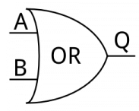
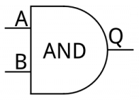
Uses of signal diodes
What are logic gates?
As we saw, signal diodes may be cheap and common but they cannot handle large currents and large reverse bias voltages. This makes them best for low power circuits. One useful application of signal diodes is as logic gates. Here are the 2 most basic ones.
Click on button and the logic gate symbols to learn more.
Notes:
Img03 = https://cdn.sparkfun.com/assets/learn_tutorials/2/1/5/digital-logic.png
What are logic gates? = on click present slide 11 as a popup
OR = on click, present slide 12 as a popup
AND = on click, present slide 13 as a popup

Slide 11
What are logic gates
Logic gates are basically very simple calculators. Give them some inputs and they give a certain output.
Computers use millions of logic gates to do what they do.
Most of the logic gates in the earliest computers were actually made of simple diodes very similar to signal diodes, called vacuum tubes.
Notes:
Img04 = https://upload.wikimedia.org/wikipedia/commons/3/3b/Two_women_operating_ENIAC.gif – marked for reuse

Slide 12
The OR gate
The OR gate gives an output of on if one of its inputs is on. In other words, Q is on if either A OR B is on.
We sometimes refer to on as being 1 and off as being 0.
So Q is 1 if either A OR B is 1.
Click the button to open a demonstration of an OR gate. Open and close each of the switches to make the light come on.
See how an OR gate works
Notes:
See how an OR gate works = on click, open http://everycircuit.com/circuit/4594919468695552

Slide 13
The AND gate
The AND gate produces 1 only if both the inputs are 1. In other words, Q is 1 if both A AND B are 1.
Click the button to open a demonstration of an OR gate. Open and close each of the switches to make the light come on.
See how an AND gate works
Notes:
See how an AND gate works = on click, open http://everycircuit.com/circuit/6366749841948672

Slide 14
2. The power diode
Power diodes are physically bigger than signal diodes and are designed to work with much higher currents and reverse bias voltages.
This makes them perfect for rectification – converting AC supply into DC. They are also called rectification diodes.
Click on the button to learn a bit more about rectification.
What is rectification?
Notes:
Img04 = image of a power or rectifier diode e.g. https://protostack.com.au/wp-content/uploads/SC-DI-1N4004.jpg – add in diode symbol

Slide 15
Rectification
Rectification will be covered in more detail later in this topic.
Basically, rectification is the conversion of alternating current (current flows in both directions) into direct current (current only flows in one direction).
Notes:
Img05 = https://ibphysicsnotes.files.wordpress.com/2016/01/24-full-wave-rectifier-r1-1024x364.gif?w=1200

Slide 16
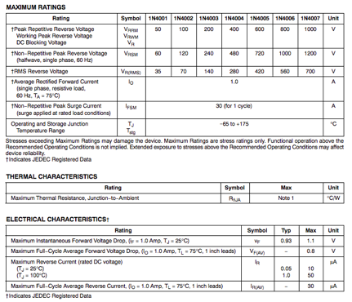
The 1N4007 power diode
A very common power diode is the 1N4007. It can handle a maximum reverse biased voltage of 1 000v and can continuously conduct currents up to 1A.
Click the image to open its datasheet.
Notes:
Img06 = screenshot of http://www.farnell.com/datasheets/1689669.pdf. On click open http://www.farnell.com/datasheets/1689669.pdf

Slide 17
3. The zener diode
When forward biased, Zener diodes behave like other diodes. When reverse biased, normal diodes literally break at their reverse breakdown voltage. But zeners are different. Once their breakdown voltage is exceeded, they keep working. But what’s the point?
Zener diodes
Click the button to find out.
Notes:
Img07 = image of a Zener diode e.g. https://www.elfa.se/Web/WebShopImages/landscape_large/7-/01/RND_1N4148_30092887-01.jpg – add symbol
Zener diodes =on click play YT01 full screen. YT01 = https://www.youtube.com/watch?v=XhQqtdTlRus

Slide 18
The zener diode curve
The I-V curve for Zener diodes is similar to other diodes.
We will learn more about how Zener diodes are used for voltage regulation in unit 5 of this topic.
Click on each part of the diode curve to read more.
Notes:
Img08 =https://www.electronics-tutorials.ws/diode/diode11.gif – need to redraw
Create the following hotspots on the image. On clicking of each hotspot, present the following in tooltips.
Hotspot1 = Zener diodes are so special that they get their own special diode symbol. Zener diodes are always used in reverse bias orientation in a circuit.
Hotspot2 = The Zener voltage or V_{Z} is the reverse voltage at which the diode will conduct current with a practically fixed voltage drop. The line here is almost vertical. The V_{Z} can be very accurately controlled using doping to achieve values of, for example, 4.3V or 7.5V. Zener diodes are manufactured with V_{Z} values of 3V to 200V.
Hotspot3 = I_{Z(max)} is the maximum current that the Zener diode can reliably handle. So long as the current is between I_{Z(min)} and I_{Z(max)} the Zener diode will drop a constant defined voltage, the Zener voltage, irrespective of how much current is flowing.
Hotspot4 = Zener diodes still have the normal forward voltage of other diodes – about 0.7V for silicon and 0.3V for germanium.

Slide 19
4. The schottky diode
Schottky diodes are very similar to standard silicon diodes except for one important thing – they have much lower forward voltage drops (V_{f}). Remember this is the forward voltage that needs to be applied to get the diode to start conducting.
Their V_{f} is typically between 0.15V and 0.45V. This makes Schottky diodes much more efficient.
Schottky diodes
Click the button to find out more.
Notes:
Img09 = image of a Schottky diode e.g. https://www.globalpc.co.nz/prodimages/Z0040.jpg – add in symbol
Schottky diodes = on click, play YT02 full screen. YT02 = https://www.youtube.com/watch?v=bXEyCf1P0UU

Slide 20
5. The light emitting diode (LED)
Probably the most famous diode of all is is the LED and they are everywhere!
LEDs are very similar to other PN junction diodes except that the silicon is doped with slightly different materials so that when an electrons fills a whole, it looses energy that we can see.
LEDs
Click the button to watch a great overview of how LEDs work.
Notes:
Img10 = image of an LED e.g. https://www.globalpc.co.nz/prodimages/Z0040.jpg – add in symbol
LEDs = on click, play YT03 full screen. YT03 = https://www.youtube.com/watch?v=uyse_I-zo4Q

Slide 21
LED colours
LEDs are available in a wide range of colours. The most common are red, amber, yellow and green.
The colour of an LED is determined by the exact materials used to dope the silicon.
Click on the image to get a closer look at what materials are used to make different coloured LEDs.
Notes:
Img11 = https://cdn.sparkfun.com/assets/5/b/5/b/a/51f95fcd757b7f6f3dcb351f.jpg. On click open https://cdn.sparkfun.com/assets/5/b/5/b/a/51f95fcd757b7f6f3dcb351f.jpg

Slide 22
LED V_{F}
Because each colour of LED is made using different doping materials, each colour has a different V_{F}. The V_{F} of the standard red LED is about 1.2V.
Low power LEDs can handle maximum currents of between 10mA and 30mA. Resistors are used to limit the current so the LED is not destroyed.
Notes:
Img12 = https://www.electronics-tutorials.ws/diode/diode12.gif

Slide 23
Test Yourself
We have come to the end of this unit. Answer the following questions to make sure you understand the different types of diodes.

Slide 24
Question 1
In which direction will this diode allow conventional current to flow?
From left to right
From right to left
Notes:
Multiple choice question
Correct answer is a
Feedback:

Slide 25
Question 2
To which side of the supply must the cathode be connected when a diode is forward biased?
Positive
Negative
Notes:
Multiple choice question
Correct answer is b
Feedback:

Slide 26
Question 3
Which symbol is the symbol for a diode?
Notes:
Multiple choice question
Correct answer is c
Feedback:

Slide 27
Question 4
What is V_{BR}?
The reverse bias voltage beyond which a diode is destroyed.
The forward bias voltage after which a diode starts conducting.
The reverse bias voltage after which a diode starts conducting.
The maximum current a diode can conduct.
Notes:
Multiple choice question
Correct answer is a
Feedback:

Slide 28
Question 4
What is V_{F}?
The reverse bias voltage beyond which a diode is destroyed.
The forward bias voltage after which a diode starts conducting.
The reverse bias voltage after which a diode starts conducting.
The maximum current a diode can conduct.
Notes:
Multiple choice question
Correct answer is b
Feedback:

Slide 29
Question 5
What is the typical V_{F} of germanium diodes?
0.2V
0.3V
0.5V
0.7V
Notes:
Multiple choice question
Correct answer is b
Feedback:

Slide 30
Question 6
The maximum reverse-bias voltage a diode can withstand before breaking down is called…
Max.I
Forward Voltage
Cathode
Peak Inverse Voltage
Notes:
Multiple choice question
Correct answer is d
Feedback:

Slide 31
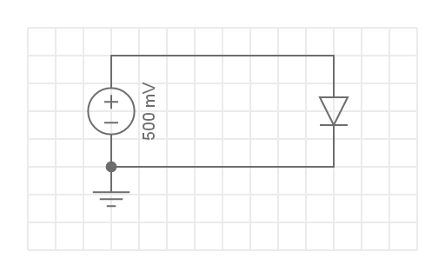
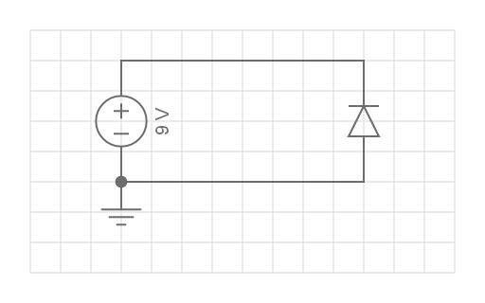
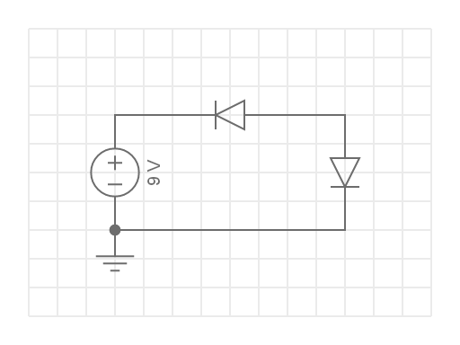
Question 7
In which circuit will current flow? In all cases the diodes are silicon diodes.
c)
a)
b)
d)
Notes:
Multiple choice question
Correct answer is b
Feedback:

Slide 32
Question 8
What element is typically used to dope silicon to make N-type semi-conductor material?
Phosphorous
Iron
Boron
Beryllium
Notes:
Multiple choice question
Correct answer is c
Feedback:

Slide 33
Question 9
True or False: P-type semi-conductor material is positively charged.
True
False
Notes:
Multiple choice question
Correct answer is b
Feedback:

Slide 34
Question 9
Will a PN junction connected like this conduct electricity?
True
False
P
N
-
+
Depletion Layer
Notes:
Multiple choice question
Correct answer is b
Feedback:

