Slide 1
Electronics
Topic 6: Diodes

Slide 2
Assumed prior learning
05_01_00
05_01_02
05_02_01
05_03_01
05_04_01
Notes:
Note for navigation on site:
This information needs to be taken into account and needs to stated on the LMS, perhaps as part of the introduction?

Slide 3
Outcomes
By the end of this unit the learner will be able to:
State what a diode does in a circuit
Distinguish between the anode and cathode of a diode
Draw the circuit symbol of a diode
State in which direction a diode is biased when it conducts
Explain the features of the diode curve
Explain the basics of a PN junction

Slide 4
Unit 6.1: An Introduction to Diodes

Slide 5
Introduction
You have probably heard of “semiconductors” before. In this topic, we are going to learn about the simplest kind of semiconductor – the diode.
One of the most well known diodes is the LED – the Light Emitting Diode. But diodes are so much more than this.
Notes:
Img01 = https://c1.staticflickr.com/1/163/437341293_be6c2f3190_b.jpg – marked for reuse

Slide 6
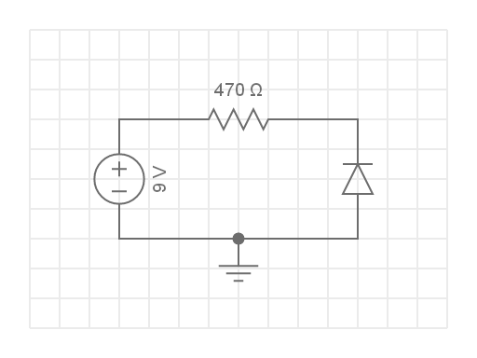
Build the Circuit
As usual, the best way to find what a component does, is to play with it. Here is the simple circuit you need to build.
Build this circuit. Rollover or touch each symbol in the schematic to find out more. Watch the video if you need help.
Watch how to build the circuit
Notes:
Reproduce schematic image as an image with hotspots over each component.
Component01 = on click present a tooltip with “This symbol represents a voltage source like a battery. Use a 9V battery.”
Component02 = on click present a tooltip with “This symbol represents a 470Ω resistor.”
Component03 = on click present a tooltip with “This symbol represents a diode. You need to find the component in your kit that looks like this [image of 1N4007 diode e.g. https://components101.com/sites/default/files/styles/image_1100x580/public/components/1N4148-Diode.jpg?itok=BPMBHiFQ]. It will have 1N4148 written on it. To start with connect the end of the diode with the grey strip to the negative terminal of the battery.”
Hide tooltip on clicking away from component or another component.
Watch how to build the circuit = on click, play vid01 (see brief) full screen

Slide 7
Review How To Use a Multimeter
We now need to take some readings from our circuit and do some calculations.
Img02
Refer to the multimeter guide saved on your device or click the image to see it again.
Notes:
Img02 = image of the same multimeter guide screenshot as used in 10_02_03 slide 10 linking to the same document.

Slide 8
Step 1
Set your multimeter to read mA and take a reading of the current flowing through the circuit. What is the current?
Img03
Current:
mA
Check
Notes:
Img03 = image of the words “Step 1”
Fill in the blank question – correct answer is anything between 16mA and 19mA
Check = on click, check the answer
Feedback:
Correct = Well done. You should find that the current through the circuit is about 17mA. 9V/470Ω = 19mA so it seems that the diode is also contributing a little bit of resistance to the circuit.
Incorrect = That is not right. You should find that the current through the circuit is about 17mA. If your reading is below this, check that all the connections are good, that you have the correct resistor in the circuit and that your battery is supplying about 9V.

Slide 9
Step 2
Now remove the diode from the circuit and put it back in the reverse direction i.e. with the side with the grey strip connected to the positive terminal of the battery. What is the current now.
Img04
Current:
mA
Check
Notes:
Img04 = image of the words “Step 2”
Fill in the blank question – correct answer is 0mA
Check = on click, check the answer
Feedback:
Correct = Well done. You should find that there is no current flowing through the circuit. The only thing we have changed is the direction of the diode so it seems that the diode is somehow blocking the current.
Incorrect = That is not right. You should find that there is no current flowing through the circuit. Make sure you have connected the side of the diode with the grey strip to the positive terminal of the battery.

Slide 10
Step 3
Flip the diode around again and make sure that current again flows through the circuit. Keep flipping the diode back and forth until you can reliably start and stop the current.
What do you think the diode is doing in this circuit?
Img05
Notes:
Img05 = image of the words “Step 3”
MQC – correct answer is a)
Check = on click, check the answer
Feedback:
Correct = Well done. You should have seen that the bulb lit up very briefly but then went out again.
Incorrect = This is not what you should have seen. You should have seen the bulb light up and then go out again.

Slide 11
One way electronic streets
Diodes only let current flow through them in one direction. They are one way electronic valves.
Watch the video to see a diode in action.
Diode in action
Notes:
Img06 = https://upload.wikimedia.org/wikipedia/commons/0/08/One_way_sing.jpg – marked for reuse
Diode in action = on click, play YT01 = https://www.youtube.com/watch?v=6lep5e3KMdY full screen.

Slide 12
Which way is which?
Because diodes only allow current to flow one way through them, we say that they are polarized. They have a definite positive and negative side as shown here.
The cathode is indicated by a strip, a dot or a short leg and is connected to the negative side of the supply if you want current to flow.
A
K
Notes:
Img07 = Composite image made up of
https://upload.wikimedia.org/wikipedia/commons/8/83/Diode_pinout_en_fr.svg – marked for reuse
https://upload.wikimedia.org/wikipedia/commons/thumb/5/52/%2B-_of_LED_2.svg/2000px-%2B-_of_LED_2.svg.png – marked for reuse
Add in “A” for anode and “K” for cathode

Slide 13
The diode symbol
The arrow in the diode symbol points in the direction in which the diode will let conventional current flow i.e. positive to negative.
A
K
Notes:
Img08 = https://upload.wikimedia.org/wikipedia/commons/8/83/Diode_pinout_en_fr.svg – marked for reuse
Add the “A” and “K”

Slide 14
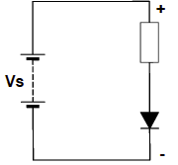
Forward and Reverse Biased
When a diode is connected in a circuit so that the anode is connected to the positive supply and current is flowing, we say that the diode is forward biased.
When it is connected the other way around so that current does not flow it is reverse biased.
Forward bias
Current flows
Click the button to switch between pictures of forward and reverse biased circuits.
See reverse bias
Notes:
Img09 = reproduce this circuit diagram
See reverse bias = on click display img10 and display a new button – See forward bias
Img10 – same as img09 but diode orientation is reversed and label reads “Reverse bias No current flows”

Slide 15
Build the Circuit
It is time to go back to our initial circuit so that we can discover some important characteristics of diodes. Here it is again.
Build this circuit. Rollover or touch each symbol in the schematic to find out more. Watch the video if you need help.
Watch how to build the circuit
Notes:
Reproduce schematic image as an image with hotspots over each component.
Component01 = on click present a tooltip with “This symbol represents a voltage source like a battery. Use a 9V battery.”
Component02 = on click present a tooltip with “This symbol represents a 470Ω resistor.”
Component03 = on click present a tooltip with “This symbol represents a diode. You need to find the component in your kit that looks like this [image of 1N4007 diode e.g. https://components101.com/sites/default/files/styles/image_1100x580/public/components/1N4148-Diode.jpg?itok=BPMBHiFQ]. It will have 1N4148 written on it. Make sure to connect the diode in the forward bias direction.”
Hide tooltip on clicking away from component or another component.
Watch how to build the circuit = on click, play vid01 (see brief) full screen

Slide 16
Step 1
Set your multimeter to read mV and take a reading of the voltage over the diode. What is the voltage?
Now set your multimeter to read mA and take a reading of the current through the circuit.
Img11
Voltage:
mV
Current:
mA
Check
Notes:
Img11 = image of the words “Step 1”
Fill in the blank question – correct answer is anything between 700mV and 900mV and 16mA to 18mA
Check = on click, check the answer
Feedback:
Correct = Well done. You found that the voltage across the diode is about 800mV. This means that about 8V is being dropped across the 470Ω resistor. You also found that the current through the circuit is about 17mA. Start a table of circuit current and voltage drop over diode and enter these values.
Incorrect = That is not right. You should find that the voltage across the diode is about 800mV. This means that about 8V is being dropped across the 470Ω resistor. You also find that the current through the circuit is about 17mA. Start a table of circuit current and voltage drop over diode and enter these values. If you got very different readings, check that all the connections are good, that you have the correct resistor in the circuit and that your battery is supplying about 9V and try take the readings again.

Slide 17
Set up a table
The first thing you need to do is set up a table to record your results. Create a table like this one.
Resistor in circuit | Current in circuit | Voltage drop over diode
470Ω
250Ω
1kΩ

Slide 18
Step 2
Now replace the 470Ω resistor with a 250Ω resistor. Do you expect the current in the circuit to be lower or higher? What about the voltage over the diode?
Take these measurements.
Img12
Voltage:
mV
Current:
mA
Check
Notes:
Img12 = image of the words “Step 2”
Fill in the blank question – correct answer is anything between 700mV and 930mV and 31mA to 33mA
Check = on click, check the answer
Feedback:
Correct = Well done. You found that the voltage across the diode is still about 800mV, maybe a little higher. This means that about 8V is still being dropped across the resistor even though it is almost half the value of the previous 470Ω one. You also found that the current was quite a bit higher, about 32mA. As there is less resistance in the circuit this makes sense. Make a note of the voltage drop over the diode and the current in the circuit.
Incorrect = That is not right. You should find that the voltage across the diode is about still about 800mV, maybe a little higher. This means that about 8V is still being dropped across the resistor even though it is almost half the value of the previous 470Ω one. You should also find that the current is quite a bit higher, about 32mA. As there is less resistance in the circuit this makes sense. If you got very different readings, check that all the connections are good, that you have the correct resistor in the circuit and that your battery is supplying about 9V and try take the readings again.

Slide 19
Step 3
Now replace the 250Ω resistor with a 1kΩ resistor. Do you expect the current in the circuit to be lower or higher? What about the voltage over the diode?
Take these measurements.
Img13
Voltage:
mV
Current:
mA
Check
Notes:
Img13 = image of the words “Step 3”
Fill in the blank question – correct answer is anything between 680mV and 900mV and 7mA – 9mA
Check = on click, check the answer
Feedback:
Correct = Well done. You found that the voltage across the diode is still about 800mV, maybe a little lower. This means that about 8V is still being dropped across the resistor even though it is 4 times the value of the previous 250Ω one. You also found that the current was quite a bit lower, about 8mA. As there is more resistance in the circuit this makes sense. Make a note of the voltage drop over the diode and the current in the circuit.
Incorrect = That is not right. You should find that the voltage across the diode is about still about 800mV, maybe a little lower. This means that about 8V is still being dropped across the resistor even though it is 4 times the value of the previous 250Ω one. You should also find that the current is quite a bit higher, about 32mA. As there is less resistance in the circuit this makes sense. If you got very different readings, check that all the connections are good, that you have the correct resistor in the circuit and that your battery is supplying about 9V and try take the readings again.

Slide 20
Take a picture
Take a picture of your table of circuit current and diode voltage drop values and upload it to you portfolio.
Choose image
Upload
Notes:
Button 01 – Launch file selection window
Button 02 – Upload file

Slide 21
Forward voltage drop
In the previous investigation, we saw that the voltage drop across the diode stayed pretty constant even when we added resistors of very different values to the circuit and got very different amounts of current flowing. Why is this the case. Why is the voltage across the diode so stable?
Vid02
Watch the video to learn more about what is going on.
Notes:
Vid02 = on click, play vid02 full screen. See appendix for brief

Slide 22
The diode curve
Max Current
The diode curve gives us all the key characteristics of a diode.
Click on each part of the diode curve to read more.
Notes:
Img14 = https://cdn.sparkfun.com/assets/4/4/a/5/b/5175b518ce395f2d49000000.png – need to redraw and add in Max Current and dotted line
Create the following hotspots on the image. On clicking of each hotspot, present the following in tolltips.
Hotspot1 = This is the diode’s breakdown voltage or V_{BR}. If this voltage is exceed, the diode will not be able to prevent current flowing and, most of the time, will be destroyed.
Hotspot2 = This area indicates when the diode is reverse biased and prevent current from flowing. The graph indicates these as negative voltages or when the diode’s cathode is connected to the positive supply.
Hotspot3 = This area indicates when the diode is forward biased. However, the diode only starts conducting at about its Forward Voltage.
Hotspot4 = This is the diodes forward voltage or V_{F}. Once the voltage across the diode reaches this level, it starts conducting. Thereafter, this forward voltage drop across the diode stays relatively constant.
Hotspot5 = Max Current or Max.i is the maximum amount of current the diode can safely conduct before it becomes damaged.

Slide 23
What are semi-conductors?
In order to understand how diodes work, we need to get to grips with semi-conductors and PN junctions.
Don’t worry. Its not as hard as it sounds. Plus afterwards, you will really be able to impress your friends!
YT02
Watch this video to learn the basics of semi-conductors and PN junctions.
Notes:
YT02 = on click, play https://www.youtube.com/watch?v=0RlMcuO2bOM full screen.

Slide 24
PN junctions
This video gives a really nice summary of everything we have learnt in this unit.
YT03
Notes:
Img15 = See appendix for brief

Slide 25
Quick summary
This video gives a really nice summary of everything we have learnt in this unit.
YT03
Notes:
YT03 = on click, play https://v637g.app.goo.gl/D4GcCcZ9UmKi3pVf6 full screen.

Slide 26
Test Yourself
We have come to the end of this unit. Answer the following questions to make sure you understand the basics of diodes.

Slide 27
Question 1
In which direction will this diode allow conventional current to flow?
From left to right
From right to left
Notes:
Multiple choice question
Correct answer is a
Feedback:

Slide 28
Question 2
To which side of the supply must the cathode be connected when a diode is forward biased?
Positive
Negative
Notes:
Multiple choice question
Correct answer is b
Feedback:

Slide 29
Question 3
Which symbol is the symbol for a diode?
Notes:
Multiple choice question
Correct answer is c
Feedback:

Slide 30
Question 4
What is V_{BR}?
The reverse bias voltage beyond which a diode is destroyed.
The forward bias voltage after which a diode starts conducting.
The reverse bias voltage after which a diode starts conducting.
The maximum current a diode can conduct.
Notes:
Multiple choice question
Correct answer is a
Feedback:

Slide 31
Question 4
What is V_{F}?
The reverse bias voltage beyond which a diode is destroyed.
The forward bias voltage after which a diode starts conducting.
The reverse bias voltage after which a diode starts conducting.
The maximum current a diode can conduct.
Notes:
Multiple choice question
Correct answer is b
Feedback:

Slide 32
Question 5
What is the typical V_{F} of germanium diodes?
0.2V
0.3V
0.5V
0.7V
Notes:
Multiple choice question
Correct answer is b
Feedback:

Slide 33
Question 6
The maximum reverse-bias voltage a diode can withstand before breaking down is called…
Max.I
Forward Voltage
Cathode
Peak Inverse Voltage
Notes:
Multiple choice question
Correct answer is d
Feedback:

Slide 34
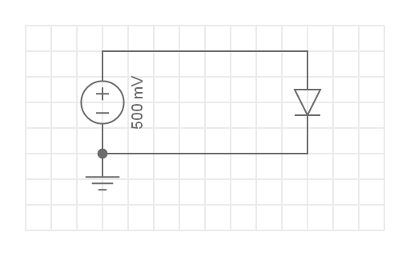
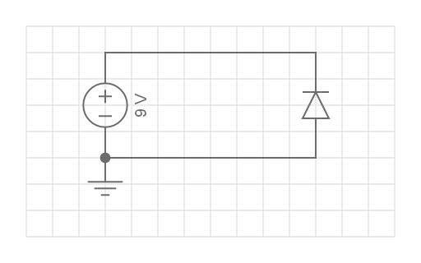
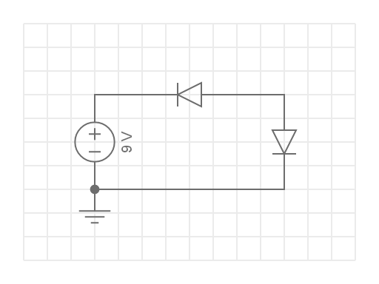
Question 7
In which circuit will current flow? In all cases the diodes are silicon diodes.
c)
a)
b)
d)
Notes:
Multiple choice question
Correct answer is b
Feedback:

Slide 35
Question 8
What element is typically used to dope silicon to make N-type semi-conductor material?
Phosphorous
Iron
Boron
Beryllium
Notes:
Multiple choice question
Correct answer is c
Feedback:

Slide 36
Question 9
True or False: P-type semi-conductor material is positively charged.
True
False
Notes:
Multiple choice question
Correct answer is b
Feedback:

Slide 37
Question 9
Will a PN junction connected like this conduct electricity?
True
False
P
N
-
+
Depletion Layer
Notes:
Multiple choice question
Correct answer is b
Feedback:

Slide 38
Video Briefing – Vid01
Create a video presented by an expert presenter showing step-by-step how to build the circuit on a breadboard. The presenter needs to explain the following:
How to connect the diode “correctly” so that current flows. Do not mention that this is the correct orientation. Let learners discover this.

Slide 39
Video Briefing – Vid02 (1 of 2)
Create a video presented by an expert presenter showing and explaining the relatively stable voltage drop across the diode in the circuit investigation starting on slide 13.
Replicate each step in the investigation to show that the voltage dropped across the diode stays relatively constant.
Explain that, according to our knowledge of voltage dividers, this should not be the case. If we assume that the diode has a fixed resistance, then its voltage drop should change far more when we swop out the other resistor.
Explain the Forward Voltage Drop of a diode in terms of the “knee” graph (at https://cdn.sparkfun.com/assets/4/4/a/5/b/5175b518ce395f2d49000000.png and to the right - see Img14).
Explain that silicon based diodes only start conducting when the voltage drop across them gets to about 0.6V and by 0.7V they are conducting fully and that this “forward voltage drop” stays relatively constant irrespective of the amount of current that flows through the diode. It does increase but only gradually. Use http://everycircuit.com/circuit/6721496327389184 to help demonstrate this.
Mention that Germanium based diodes have a forward voltage of about 0.3V.

Slide 40
Video Briefing – Vid02 (2 of 2)
Also explain the Breakdown Voltage using the ”knee” graph. The diode will prevent current flowing if the voltage across it is between the Breakdown voltage and Forward Voltage
Breakdown voltage is also called the Peak Inverse Voltage or PIV
Explain, that for most diodes, exceeding the breakdown voltage will destroy the diode.
Lastly, explain that diode also have a maximum current that they can conduct called Maximum Current or Max.I

Slide 41
Image Briefing – Img15 (1 of 5)
Create a set of 4 images that learners can click through. Create the images in the same style
P
N
Extra holes
Extra electrons

Slide 42
Image Briefing – Img15 (2 of 5)
Image 1 caption: A PN junction is created at the border between a P and N type semiconductor. The P type has extra holes for electrons. The N type has extra electrons. Both the P and N type materials are neutral overall.
P
N
Extra holes
Extra electrons

Slide 43
Image Briefing – Img15 (3 of 5)
Image 2 caption: Electrons from the N type material jump over to the P type material and fill some of the holes. This makes the region in the N type material near the border slightly positively charged (its lacks electrons) and the region in the P type material near the border slightly negatively charged (it has too many electrons). Together, these areas are the depletion layer.
-
+
P
N
Depletion Layer

Slide 44
Image Briefing – Img15 (4 of 5)
Image 3 caption: If we apply a voltage in the reverse bias direction, the depletion layer gets bigger. Extra electrons added to the P type material fill more holes and make more of the P type negatively charged which repels any additional electrons. The reverse happens in in the N type material. No current can flow.
-
+
P
N
-
+
Depletion Layer

Slide 45
Image Briefing – Img15 (5 of 5)
Image 4 caption: If we apply a voltage in the forward bias direction, the depletion layer gets smaller and disappears. Extra electrons added to the N type material, jump over to the P type material to fill holes and extra holes added to the P type materials jump over to the N type material for electrons to fill. Current flows.
P
N
+
-

