Slide 1
Electronics
Topic 4: Capacitors

Slide 2
Assumed prior learning
05_01_00
05_01_02
05_02_01
05_03_01
05_04_01
Notes:
Note for navigation on site:
This information needs to be taken into account and needs to stated on the LMS, perhaps as part of the introduction?

Slide 3
Outcomes
By the end of this unit the learner will be able to:
Explain the terms Impedance and Capacitive Reactance in AC circuits and use their symbols correctly.
Describe how Capacitive Reactance changes with capacitance and frequency.
Calculate the total capacitance of capacitors in series and parallel.

Slide 4
Unit 4.3: Capacitors in AC circuits

Slide 5
Introduction
In the previous unit, we had a look at the characteristics of a capacitor in a DC circuit. But what happens when we put a capacitor into an AC circuit where the voltage and current are constantly changing?
Before, we start answering this question, we should make sure we understand what alternating current is.
Notes:
Img01 = image of AC symbol e.g. https://cdn.pixabay.com/photo/2012/04/13/12/18/ac-supply-32158_960_720.png

Slide 6
Alternating Current
Alternating current alternates. Instead of current always flowing in the same direction, AC changes direction back and forth all the time like the water in the animation.
Click the button to watch a short explanation of the difference between DC and AC.
Difference between DC and AC
Notes:
Img02 = create an animated gif like on https://learn.sparkfun.com/tutorials/alternating-current-ac-vs-direct-current-dc/alternating-current-ac
Difference between DC and AC = on click, play YT01 full screen. YT01 = https://www.youtube.com/watch?v=vN9aR2wKv0U

Slide 7
The AC sine wave
We saw in that last video that we use the shorthand of AC to describe current AND voltage that alternates.
We also saw that we most often show AC as a nice smooth wave – the sine wave.
Click the button to learn more about AC and this sine wave.
Alternating Current
Notes:
Img03 = https://awo.aws.org/wp-content/uploads/2015/08/Alternating-Cureent-Sine-Wave-Electrons-1.png – recreate but make wires shown current direction bigger and clearer.
Alternating Current = on click, play YT02 full screen. YT02 = https://www.youtube.com/watch?v=q-DKc4KHPqU

Slide 8
“Average” AC
Because voltage and current in AC are always changing, we cannot just use the peaks as an indication of power of the supply. We need something else.
Vid01
Watch the video to see how we can calculate a useful “average” voltage or current of an AC supply.
Notes:
Vid01 = on click, play Vid01 full screen. See appendix for brief.

Slide 9
RMS examples
$$RMS=Peak ×0.707$$
A 6V AC supply will have a peak voltage of 6V/0.707 = 8.49V.
A 230V mains supply has a peak voltage of 230V/0.707 = 325V.
AC with a peak current of 12A will have an RMS current of 12A x 0.707 = 8.48A.
$$Peak= \frac{RMS}{0.707}$$
When dealing with AC, Always assume that values given are RMS UNLESS otherwise indicated.

Slide 10
Quick quiz question 1
If an AC peak voltage is 380V, what is the RMS voltage?
269V
537V
380V
266V
Notes:
MCQ:
Correct answer is a)
Feedback:
A – Well done. That is right. RMS = peak x 0.707 = 380V x 0.707 = 269V.
B – That is not right. It looks like you divided rather than multiplied by 0.707. RMS = peak x 0.707 = 380V x 0.707 = 269V.
C – That is not right. Peak voltage in AC is greater than RMS voltage. RMS = peak x 0.707 = 380V x 0.707 = 269V.
D – That is not right. It looks like you multiplied peak by 0.7 instead of by 0.707. RMS = peak x 0.707 = 380V x 0.707 = 269V.

Slide 11
Quick quiz question 2
If an AC RMS current is given as 6.25A, what is the peak current?
3.13A
4.42A
6.25A
8.84A
Notes:
MCQ:
Correct answer is d)
Feedback:
A – That is not right. Remember that RMS = peak x 0.707. Therefore, peak = RMS/0.707 = 6.25A/0.707 = 8.84A.
B – That is not right. Remember that RMS = peak x 0.707. Therefore, peak = RMS/0.707 = 6.25A/0.707 = 8.84A.
C – That is not right. Remember that RMS = peak x 0.707. Therefore, peak = RMS/0.707 = 6.25A/0.707 = 8.84A.
D – Well done. RMS = peak x 0.707. Therefore, peak = RMS/0.707 = 6.25A/0.707 = 8.84A.

Slide 12
Quick quiz question 3
If an AC current is given as 12A, what is the RMS current?
16.97A
8.48A
12A
No way to tell
Notes:
MCQ:
Correct answer is c)
Feedback:
A – That is not right. Remember that when AC current is given, we mean the RMS current. So 12A is the RMS current.
B - That is not right. Remember that when AC current is given, we mean the RMS current. So 12A is the RMS current.
C – Well done. When AC current is given, we mean the RMS current. So 12A is the RMS current.
D - That is not right. Remember that when AC current is given, we mean the RMS current. So 12A is the RMS current.

Slide 13
AC power
Take a few minutes to get more familiar with AC by playing with our AC simulator.
Vid02
Download and work through the worksheet. Then watch the video to make sure you completed everything correctly.
Download the worksheet
Notes:
Download the worksheet = open Doc01 (see appendix)
Img04 = EveryCircuit logo
Vid02 = On click, play video full screen. See appendix for brief.

Slide 14
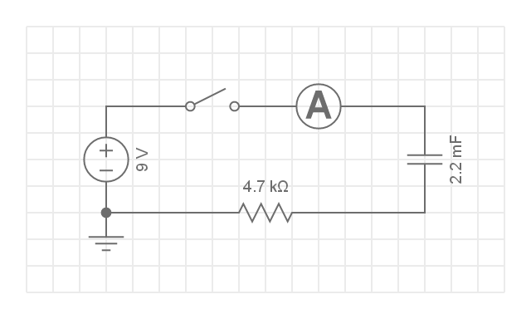
Build the Circuit
To continue our exploration of capacitor characteristics, recreate this circuit from the previous unit.
Build this circuit. Rollover or touch each symbol in the schematic to find out more. Watch the video if you need help.
Watch how to build the circuit and set up your multimeter
Notes:
Reproduce schematic image as an image with hotspots over each component. PLEASE NOTE THAT THIS DIAGRAM NEEDS TO BE REDONE AS THE CAPACITOR SYMBOL IS INCORRECT. IT SHOULD BE THE ELECTROLYTIC (POLORISED) CAP SYMBOL.
Component01 = on click present a tooltip with “This symbol represents a voltage source like a battery. Use a 9V battery.”
Component02 = on click present a tooltip with “This symbol represents a single pole, single throw switch. The switch in your kit will work like a normal light switch. Press it once and the circuit will close. Press it again and the circuit will open.”
Component03 = on click present a tooltip with “This symbol represents an ammeter. You need to connect your multimeter in series and set it to measure current (mA).”
Component04 = on click present a tooltip with “This symbol represents a polarised electrolytic capacitor. Look for the component that looks like this [image of a 2200μF 16V electrolytic capacitor from the kit]. It is has a capacitance of 2200μF or 2.2mF. Because it is polarised make sure to connect the negative terminal (cathode) to the negative terminal of the battery.”
Component05 = on click present a tooltip with “You need a 4.7KΩ resistor for this circuit.”
Hide tooltip on clicking away from component or another component.
Button01 = play vid03 (see brief) full screen

Slide 15
Step 1
Open the stopwatch app on your mobile phone. Close the switch and time how long it takes for the current through the circuit to reach about 0.7mA or 700μA
Img05
Time to reach 0.7mA
s
Check
Notes:
Img05 = image of the words “Step 1”
Button01 = on click, check the time entered. Should be between 8s and 12s
Feedback:
If in range – That look’s about right. It should have taken about 10s for the current through the circuit to drop to 0.7mA. Did you notice that it dropped from about 2mA to begin with and continued dropping.
If not in range – It should have taken about 10s for the current to drop to about 0.7mA. If it took longer than than, check that the voltage of your battery is about 9V. If it is lower than 8V, you should change it. Did you notice that it dropped from about 2mA to begin with and continued dropping.

Slide 16
Current falls
Even if your time in step 1 was not about 10s, you should have noticed that the current in the circuit kept falling. Why do you think this happened?
As the capacitor charged up…
The voltage of the battery decreased.
It became harder for the negative plate of the capacitor to accept more electrons as so fewer electrons could flow until no more electrons were able to flow.
The capacitor voltage decreased.
Notes:
Multiple choice question
Correct answer is b)

Slide 17
Discharge your capacitor
To discharge your capacitor, simply connect an LED in series with a 470Ω resistor to the capacitor. Just make sure that you connect the LED’s anode to the side of the capacitor that was connected to the positive terminal of the battery. Once the LED no longer shines for about 2-3 seconds, the capacitor is discharged
Img06
Notes:
Img06 = image of an LED connected to a 470Ω resistor just by twisting the leads together and these connected to a capacitor with a label indicating LED cathode connected to cathode of the capacitor.

Slide 18
Step 2
Redo the experiment as before, but this time see what happens to the current after about 60s.
Img07
Current after 60s
mA
Check
Notes:
Img07 = image of the words “Step 2”
Button01 = on click, check the current entered. Should be less than 0.002.
Feedback:
If correct – That’s right. After about 60s there is very little, if any, current flowing through the circuit. This is because the capacitor is fully charged. The battery does not have enough force to get any more electrons onto the negative plate or to attract any electrons away from the positive plate. The capacitor becomes like a break in the circuit.
If not in correct – That is not correct. After about 60s you should see very little, it any current. This is because the capacitor is fully charged. The battery does not have enough force to get any more electrons onto the negative plate or to attract any electrons away from the positive plate. The capacitor becomes like a break in the circuit.

Slide 19
Step 3
Calculate the time constant for this capacitor. Remember T = RC.
Img08
R x C =
Check
Notes:
Img08 = image of the words “Step 3”
Button01 = on click, check the value entered. Should be 10.34
Feedback:
If correct – That’s right. If we multiply 4700Ω by 0.0022F we get an answer of 10.34. This is more or less the time it took for the current to fall to about 0.7mA.
If not in correct – That is not correct. You should have got 10.34 as the answer. 4.7KΩ = 4700Ω and 2200μF = 0.0022F. So R x C = 4700Ω x 0.0022F = 10.34. This is more or less the time it took for the current to fall to about 0.7mA.

Slide 20
Step 4
Based on the voltage and the resistance of the resistor, what is the maximum current that can flow in the circuit? What is 37% of this value?
Img09
Max current
mA
37% of max current
mA
Check
Notes:
Img09 = image of the words “Step 3”
Button01 = on click, check the value entered. Max Current: 1.9mA; 37% of max current: 0.7mA
Feedback:
Max Current:
If correct – That’s right. Using Ohm’s Law we get the following. I = V/R = 9V/4700Ω = 0.0019A = 1.9mA.
If not correct – That is not correct. If you use Ohm’s Law you get the following. I = V/R = 9V/4700Ω = 0.0019A = 1.9mA.
37%:
If correct – That’s right. 37% of 1.9mA = 1.9mA x 0.37 = 0.7mA.
If not correct – That is incorrect. 37% of 1.9mA = 1.9mA x 0.37 = 0.7mA.

Slide 21
The time constant for current
You should be able to see where all this is going. The time constant tells us when a capacitor has charged to 63% of the applied voltage. It also tells us when the current will be down to 37% of its maximum value.
Watch the video to find out more.
Vid04
Notes:
Vid03 = on click, play Vid03 full screen. See appendix for brief.

Slide 22
What we know so far
Vid05
So far, we have seen that in a DC circuit, when a capacitor is fully charged, no current flows through the circuit. It is like the capacitor has infinite resistance.
But what happens in an AC circuit when the voltage is always changing as is the direction of the current?
Watch the video to see how capacitors behave in AC circuits.
Notes:
Vid04 = on click, play Vid04 full screen. See appendix for brief.

Slide 23
Capacitors in AC circuits
You probably don’t have access to an AC power supply, so we need to keep investigating with virtual circuits.
Download and work through the worksheet. Then watch the video to make sure you completed everything correctly.
Vid06
Download the worksheet
Notes:
Button01 = open Doc02 (see brief)
Img04 = EveryCircuit logo
Vid05 = on click, play Vid05 full screen. See appendix for brief

Slide 24
Capacitive Reactance
Click each number to see what we have learnt.
We call the resistance offered by capacitors in AC circuits Capacitive Reactance (Xc).
1
Capacitive Reactance (Xc) decreases as the frequency of the AC power increases.
2
Capacitive Reactance (Xc) decreases as the capacitance of the capacitor increases.
3
The total resistance to current in an AC circuit is called Impedance (Z). Z = R + X
4
Notes:
Do not display full points – only numbers. On click reveal the full point.

Slide 25
A Virtual Circuit
Let’s use a simulation to see the potential real life effects of capacitive reactance.
Download and work through the worksheet. Then watch the video to make sure you completed everything correctly.
Vid07
Download the worksheet
Notes:
Button01 = open Doc03 (see brief)
Img04 = EveryCircuit logo
Vid06 = on click, play Vid05 full screen. See appendix for brief

Slide 26
Capacitators in Series and Parallel
We now know that capacitors offer resistance to the flow of current in an AC circuit in much the same way as resistors do. We call this kind of resistance capacitive reactance.
Do capacitors in series and parallel behave the same as resistors in series and parallel? Let’s find out.
Img14
Notes:
Img14 = of the capacitive reactance symbol Xc

Slide 27
Capacitors in Series and Parallel
We are going to explore capacitors in series and parallel with a virtual circuit.
Download and work through the worksheet. Then watch the video to make sure you completed everything correctly.
Vid08
Download the worksheet
Notes:
Button01 = open Doc04 (see brief)
Img04 = EveryCircuit logo
Vid07 = on click, play Vid07 full screen. See appendix for brief

Slide 28
Capacitators behave opposite to resistors
We have just discovered that when capacitors are in series, their total capacitance decreases and that when capacitors are in parallel, there total capacitance increases.
They behave in the opposite way to resistors.
Img16
Notes:
Img16 = of the capacitive reactance symbol Xc

Slide 29
Capacitators in Parallel
It turns out that capacitors in parallel work the same way as resistors in series.
Capacitors in PARALLEL
Resistors in SERIES
Img17
Img18
Notes:
Img17 = C₁ + C₂ + C₃ + … = C_{T}
Img18 = R₁ + R₂ + R₃ + … = R_{T}

Slide 30
Capacitators in Series
It turns out that capacitors in series work the same way as resistors in parallel.
Capacitors in SERIES
Resistors in PARALLEL
Img19
Img20
Notes:
Img19 = $\frac{1}{C_{1}}+\frac{1}{C_{2}}+\frac{1}{C_{3}}+…=\frac{1}{C_{T}}$
Img20 = $\frac{1}{R_{1}}+\frac{1}{R_{2}}+\frac{1}{R_{3}}+…=\frac{1}{R_{T}}$

Slide 31
Test Yourself
We have come to the end of this unit. Answer the following questions to make sure you understand how capacitors behave in AC circuit.

Slide 32
Question 1
Capacitors in series, parallel
Notes:
Img16 = Image of a 4.7μF capacitor .e.g. https://encrypted-tbn0.gstatic.com/images?q=tbn:ANd9GcQIdPM7MHxHP_zBklENl9VRlMRXDW-LubKKcSiqW_YMag7kuO-NKw.
Multiple Choice Question
Correct answer is d
Feedback
a) – That is not correct. The capacitor has a capacitance of 4.7μF and a working voltage of 250V. Therefore the maximum amount of charge this capacitor can theoretically hold is given by Q = CV = 4.7μF x 250V = 1,175μC = 1.175mC.
b) – That is not correct. The charge that a capacitor can store is given by Q = CV where C is its capacitance and V is the voltage that is applied to it. The greater the capacitance or the voltage, the more charge will be stored. In this case, the maximum amount of charge this capacitor can theoretically hold is given by Q = CV = 4.7μF x 250V = 1,175μC = 1.175mC.
c) – That is not correct. It looks like you made a mistake with the units. We know that Q = CV. In this case CV = 4.7μC x 250V = 1,175μC. Because the capacitance was in μF, the charge will be in μC and 1,175μC is the same as 1.175mC because 1,000μC = 1mC.
d) – Well done. You got it. Q = CV = 4.7μF x 250V = 1,175μC = 1.175mC.

Slide 33
Video Briefing – Vid01 (1 of 3)
Create a screencast vide presented by an expert electrician explaining RMS voltage/current in AC systems. Base explanation on https://www.allaboutcircuits.com/textbook/alternating-current/chpt-1/measurements-ac-magnitude/. Use similar images to those on page 3.
AC is always changing value. What value do we give it? Can we use peak values even though, most of the time the AC is less than the peak value? DC is easy because voltage and current are always the same.
We could try the average but, for any sine wave this is zero (A).
We could make all the negative values positive(B) first and get an average this way.
But this average is not the same as the supply’s ability to do work or its power. It is slightly less. Remember that P = V²/R or I²R. There are squares involved.
Having a measure that allows us to compare the power delivered by different AC supplies and between AC and DC supplies would be useful (C).
If 50W were dissipated in a DC circuit with 10V, 5A and 2Ω, then it would be useful to be able to say that an AC circuit with 5A and 2Ω and also dissipating 50W was also 10V.

Slide 34
Video Briefing – Vid01 (2 of 3)
This 10V AC is called the Root Mean Square or RMS value. You don’t need to know the maths behind this. You just need to know that RMS = Peak of the AC x 0.707.
RMS of an AC voltage or current is the equivalent DC voltage or current that would deliver the same amount of power. RMS is sometimes called DC equivalent.
The conversion factor of 0.707 ONLY applies to AC sources that are sinusoidal. Other waves forms have different conversion factors.
For sine waves the average voltage or current = Peak of the AC x 0.637.
Because RMS allows us to make better comparisons it is almost always used instead of Average.
When dealing with AC always assume that the values given are RMS values UNLESS you are told otherwise.

Slide 35
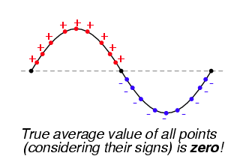
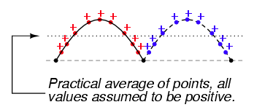
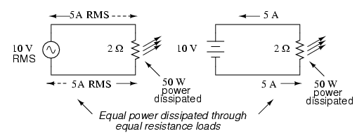
Video Briefing – Vid01 (3 of 3)

Slide 36
Document Briefing – Doc01
Create an annotated PDF worksheet with the following steps.
Make sure you have downloaded the EveryCircuit App from your app store.
If you are working on a computer, visit http://everycircuit.com/app/.
Open the EveryCircuit app and signup. After your trial, you will still have access to EveryCircuit and other people’s circuits. You will just not be able to create your own circuits.
Go to the community space and search for the circuit called “NOC_AC”.
Open the circuit.
The circuit is being powered by a 220V AC power supply running at 50Hz. This is the same as your plug points at home. The animation speed is set to 20ms/s which means that each cycle takes 1 second to complete. The wave next to the power supply, shows the voltage. The graph above the circuit shows the current and the dots on the circuit show the movement of the electrons.
What is the maximum current through the circuit? What is the Root Mean Square or RMS current through the circuit? What is the RMS voltage of the circuit?
At what voltage is the light bulb the brightest? Is this what you expect? Why?
Why don’t we see bulbs flash normally?
If you decrease the voltage of the supply to 110V will the electrons move back and forth half as slowly? Why or why not?
Change the supply voltage to 110V. Did the electrons move back and forth half as slowly? What happened to the light bulb? Why did this happen?
If you change the frequency to 60Hz will the light bulb flash more quickly. Why or Why not?
Change the frequency to 60Hz. Did the light bulb flash more quickly

Slide 37
Video Briefing – Vid02
Create a video presented by an expert presenter working through Doc01 and answering the questions with the aid of http://everycircuit.com/circuit/4691379468107776. Show that
That current is a max when voltage is a max. Show by adding voltage to the graph.
The light bulb is brightest when current is a max.
Changing the voltage has no effect on frequency but does affect current (Ohm’s Law)
Changing frequency has no effect on voltage or current
Show how to calculate RMS from peak: RMS = peak x 0.707.

Slide 38
Video Briefing – Vid03
Create a video presented by an expert presenter showing step-by-step how to build the circuit on a breadboard. The presenter needs to explain the following:
Add the capacitor, resistor, ammeter and the switch in series to the breadboard – make sure of the capacitor polarity
Connect them to the power rail
Set up the multimeter to measure the current in the appropriate range
Connect power rail to battery

Slide 39
Video Briefing – Vid04
Create a video presented by an expert presenter explaining the following with the aid of a similar graphic. Also use the virtual circuit at http://everycircuit.com/circuit/5290262825009152 to help explain.
T = RC tells when a capacitor will get to 63% of the voltage applied to it.
T = RC also tells us when the current in the circuit will get to 37% of its maximum value.
The same is true (theoretically at least) for 5T.
We could see that as the capacitor charged, the current flowing through the circuit decreased. It decreases in exactly the same way as the voltage across the capacitor increases – quickly at first and then slower and slower.
What makes current in a circuit decrease for the same voltage? A higher resistance. In our circuit, the resistance of the 4K7 resistor was fixed so the only other thing that could have added resistance to the current in the circuit was the capacitor. As it charged up, it had the effect of adding more and more resistance to the circuit until it was fully charged, and allowed no more current to flow. At this point, it is like the capacitor has infinite resistance.
To be clear, no electrons ever flow between the plates, but they do flow onto and off off the plates and this looks like current flowing through the capacitor.
Also, this capacitor resistance is not exactly the same resistance as that from a resistor but it is also measured in ohms.
When the current in our circuit got to 0.7mA we had a total resistance in the circuit of 9V/0.0007A = 12.85KΩ. 4.7KΩ came form the resistor so the other 8.15KΩ must have come from the capacitor at this point.

Slide 40
Video Briefing – Vid05
Create a video presented by an expert presenter showing, in principle, how a capacitor behaves in an AC circuit using https://www.youtube.com/watch?v=NInt1Ss3vQ4 as a guide.
In DC, current only ever flows in one direction. We know that as a capacitor charges up, current flow decreases until the capacitor is at the same potential as the power source and no more current flows. Capacitor acts as a break – something with infinite resistance.
In AC, the voltage and current increase and decrease and change direction (show the sine wave and explain positive as voltage and current in one direction and negative as V and I in opposite direction).
Let’s call the cap plates 1 and 2.
We turn the power on and the capacitor starts charging until voltage is a max. Electrons flow through the wires – onto plate 1 and off plate 2.
As voltage reaches a max and starts to drop, the PD across the cap is greater than the power supply, so it starts discharging and electrons flow through the wires off plate 1 and onto plate 2.
As voltage passes through 0, the power source starts to push electrons through the wire but this time in the opposite direction – onto plate 2 and pulls them off plate 1.
Power source does this until its voltage reaches a maximum and then the electrons start flowing off plate 2 and onto plate 1.
Even through no electrons pass between the plates, electrons are still flowing in the wires so current is still flowing.

Slide 41
Document Briefing – Doc02
Create an annotated PDF worksheet with the following steps.
Make sure you have downloaded the EveryCircuit App from your app store.
If you are working on a computer, visit http://everycircuit.com/app/.
Open the EveryCircuit app and signup. After your trial, you will still have access to EveryCircuit and other people’s circuits. You will just not be able to create your own circuits.
Go to the community space and search for the circuit called “NOC_Capacitor in AC Circuits 1”
Open the circuit.
At the moment, we have a 20V AC power source that is running at 1Hz. This means that the voltage completes one complete cycle once every second. The simulation is running in real time, so you can see that the wave next to the power source reaches the same point once every second.
We also have a 10μF capacitor in the circuit. There are no other resistors in the circuit so the only thing that could provide resistance to the flow of current is the capacitor
We can also see that, because the switch is open, there is no current flowing.
Now, if we close the circuit we see a few things
We see that the capacitor charges, discharges, recharges in the reverse direction, discharges and recharges in the original direction. This is what we expect.
We can also see that because the capacitor keeps charging and discharging, electrons keep flowing through the wires i.e. a current keeps flowing. The maximum size of this current is 1.26mA.
Using Ohm’s Law, calculate the resistance in the circuit. Note that this will be a close but approximate amount because of various other factors that we are not interested in.
Now click on the power source and increase the frequency to 2Hz. We can see that the wave now completes 2 cycles every second.
What happens to the current? Therefore, what do you think has happened to the “resistance” of the capacitor?
Increase the frequency of the power supply to 5Hz. What happens to the current. Therefore what can we say about the “resistance” of the capacitor?
In general, what can we say happens to the “resistance” of the capacitor as the frequency of the AC power increases?
Set the power supply back to 1Hz and change the capacitance of the capacitor from 10μF to 20μF. What happens to the current? Therefore, what can we say about the “resistance” of the capacitor.
Change the capacitance to 30μF. What happens to the current? Therefore, what can we say about the “resistance” of the capacitor.
In general, what can we say happens to the “resistance” of the capacitor as its capacitance increases?

Slide 42
Video Briefing – Vid06
Create a screen capture video presented by an expert presenter showing showing how to do all the calculations in doc01 using the simulation.
At the end explain that while the capacitor does offer resistance to current, it does so a bit differently from ordinary resistors in that its resistance is because of the AC current. So we give its “resistance” another name. We call it Reactance (X). We call the reactance of capacitors, capacitive reactance and the symbol Xc (X for reactance and c for capacitor). But we still measure reactance in Ω.
Because we now have 2 types of resistance (normal resistor resistance and reactance) in an AC circuit, if we have both of these in a circuit, we need another new word for their total. We call this Impedance and give it the symbol Z.
Therefore, in a circuit with only normal resistors Impedance (Z) = Resistance (R)
In a circuit with only reactance Impedance (Z) = Reactance (X)
And in a circuit with both Impedance (Z) = Resistance (R) + Reactance (X)

Slide 43
Document Briefing – Doc03
Create an annotated PDF worksheet with the following steps.
Make sure you have downloaded the EveryCircuit App from your app store.
If you are working on a computer, visit http://everycircuit.com/app/.
Open the EveryCircuit app and signup. After your trial, you will still have access to EveryCircuit and other people’s circuits. You will just not be able to create your own circuits.
Go to the community space and search for the circuit called “NOC_Capacitor in AC Circuits 2”
Open the circuit.
You can see that we have 2 x 12V lamps, one of which is connected in series with a 10μF capacitor. Everything is connected to a 12V AC supply running at 50Hz (the same frequency of the AC electricity that comes out of our plugs.
Flip the switch. Which lamp shines brighter – the one connected to the capacitor or the other one?
What do you think will happen if we increased the capacitance of the capacitor? Would the lamp in series with it shine brighter or not. Why do you think so?
Increase the capacitance to 20μF. Were your predictions right?

Slide 44
Video Briefing – Vid07
Create a screen capture video presented by an expert presenter showing showing how to do all the calculations in doc01 using the simulation.
Explain that the lamp in series shines less brightly initially because it is in series with something that is providing “resistance” to the flow of current = less current = less light.
As we increase the capacitance, we decrease the capacitive reactance and so less “resistance” = more current = more light.

Slide 45
Document Briefing – Doc04 (1 of 2)
Create an annotated PDF worksheet with the following steps.
Make sure you have downloaded the EveryCircuit App from your app store.
If you are working on a computer, visit http://everycircuit.com/app/.
Open the EveryCircuit app and signup. After your trial, you will still have access to EveryCircuit and other people’s circuits. You will just not be able to create your own circuits.
Go to the community space and search for the circuit called “NOC_Capacitors in Series and Parallel”
Open the circuit.
There are 2 circuits. In the top circuit there are two 10μF capacitors in series and in series with one of the light bulbs (L2), although one of the capacitors is currently shorted out of the circuit by S2 being closed. In the bottom circuit there are two 10μF capacitors in parallel. Both circuits have a 20V AC power source that is running at 50Hz. [Embed images of the 2 circuits with the switches and lamps labelled – see next slide.]
We are first going to explore how capacitors in series behave (the top circuit). Close S1. Which lamp, L1 or L2 shines brighter? Why is this?
If we were to add the second capacitor in series to the circuit by opening S2, what do you think would happen to the brightness of L2? Why do you think this would be the case? Remember from the previous unit that as capacitance increases, reactance decreases.
Now open S2 to add the second capacitor to the circuit in series with the first. Does L2 shine more or less brightly than before? Is this what you expected? What do you think has happened to the total reactance in this part of the circuit?
Let’s look at the second circuit with the capacitors in parallel. Close S3. Which lamp, L3 or L4 glows more brightly. Why is this?
If we were to add the second capacitor in parallel to the circuit by closing S4, what do you think would happen to the brightness of L4? Why do you think this would be the case? Remember from the previous unit that as capacitance increases, reactance decreases.
Now close S4 to add the second capacitor to the circuit in parallel with the first. Does L4 shine more or less brightly than before? Is this what you expected? What do you think has happened to the total reactance in this part of the circuit?

Slide 46
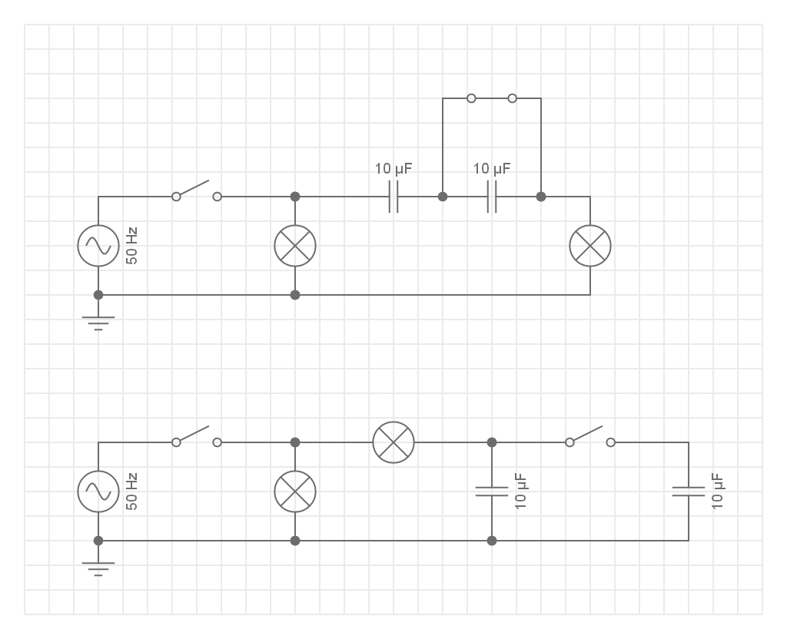
Document Briefing – Doc04 (2 of 2)

Slide 47
Video Briefing – Vid08
Create a video presented by an expert presenter explaining how capacitors in series and parallel behave based on http://everycircuit.com/circuit/5031175566655488. Work through doc01 and its questions.
Opened S1. L1 shone more brightly than L2 as expected because L2 was connected in series with a capacitor which offered resistance to the flow of current to L2.
If we open S2 to add the second capacitor in series we would expect L2 to shine more brightly. More capacitance means less reactance so more current to flow through L2.
But when we opened S2, L2 shone LESS brightly. Less current was allowed to flow = more reactance = less capacitance. So when we added a second capacitor is SERIES we got less capacitance like resistors in PARALLEL.
Opened S3. L3 shone more brightly than L4 as expected because L4 was connected in series with a capacitor which offered resistance to the flow of current to L2.
If we close S4 to to add the second capacitor in parallel we would expect L4 to shine less brightly. Less capacitance means more reactance so less current to flow through L4.
But when we closed S4, L4 shone MORE brightly. More current was allowed to flow = less reactance = more capacitance. So when we added a second capacitor is PARALLEL we got more capacitance like resistors in SERIES.

