Slide 1
Electronics
Topic 4: Capacitors

Slide 2
Assumed prior learning
05_01_00
05_01_02
05_02_01
05_03_01
05_04_01
Notes:
Note for navigation on site:
This information needs to be taken into account and needs to stated on the LMS, perhaps as part of the introduction?

Slide 3
Outcomes
By the end of this unit the learner will be able to:
Describe and explain what capacitors are and how they work
Describe the main types of capacitors and how they are made
Decode a capacitor using a colour code chart
Explain what capacitance is and what affects it
Give the abbreviations and values, in farads of
Microfarads
Picofarads
Nanofarads

Slide 4
Unit 4.1: Capacitor Basics

Slide 5
Introduction
In the previous topic we learnt about resistors which are passive components meaning that they do not generate any energy and need no power to do their job.
In this topic, we will look at another very common passive component – the capacitor.
Click the button to learn a bit more about passive components.
Learn more about passive components
Notes:
Button01 = link to https://www.electronics-tutorials.ws/blog/passive-devices.html
Img01 = https://images.pexels.com/photos/269520/pexels-photo-269520.jpeg?cs=srgb&dl=analog-build-capacitor-269520.jpg&fm=jpg

Slide 6
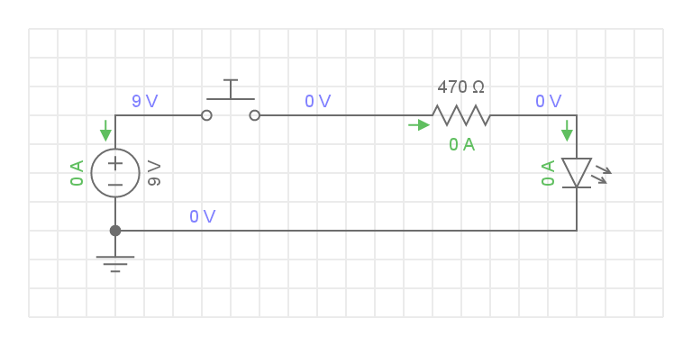
Build the Circuit
The best way to learn what capacitors are and what they do is to see them in action in a real circuit.
Build this circuit. Rollover or touch each symbol in the schematic to find out more. Watch the video if you need help.
Watch how to build the circuit
Notes:
Reproduce schematic image as an image with hotspots over each component.
Component01 = on click present a tooltip with “This symbol represents a voltage source like a battery. Use a 9V battery.”
Component02 = on click present a tooltip with “This symbol represents a push button. This is different to a normal switch because you have to keep pressing the button to keep the circuit closed?
Component03 = on click present tooltip with “This symbol represents a normal 470Ω resistor. Use your resistor colour chart to find the right resistor.”
Component04 = on click present a tooltip with “This symbol represents an LED. Use a Red LED?
Hide tooltip on clicking away from component or another component.
Button01 = play vid01 (see brief) full screen

Slide 7
What Happens?
Push the pushbutton to close the circuit. What happens? Is this what you expect? Release the pushbutton. What happens? Is this what you expect?
On pushing and releasing the pushbutton the LED…
Immediately turned on and then off.
a
Stayed on.
c
b
Slowly turned on and then off.
Stayed off.
d
Notes:
Multiple Choice question
Option a is correct
Feedback:
a) – That’s right. As you close the circuit, current is allowed to flow, turning the LED on. As soon as you break the circuit, no current can flow and the LED turns off immediately.
b), c) or d). That is not correct. You should have seen the LED turn on as soon as you pushed the pushbutton because at this moment current is allowed to flow through the circuit. As soon you released the pushbutton, the current would have stopped flowing, turning the LED off immediately.

Slide 8
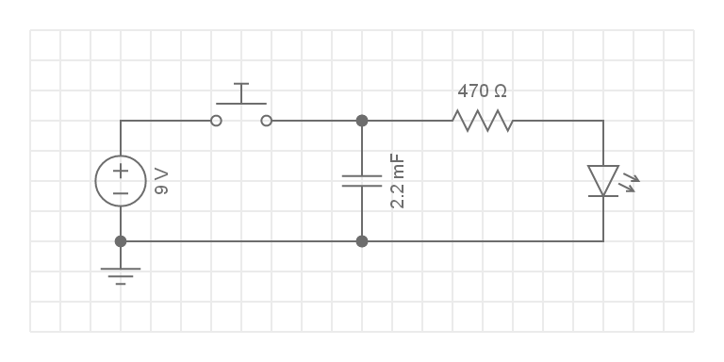
Build the Circuit
Now add a capacitor to the circuit and see what effect this has.
Build this circuit. Rollover or touch each symbol in the schematic to find out more. Watch the video if you need help.
Watch how to build the circuit
Notes:
Reproduce schematic image as an image with hotspots over each component.
Component01 = on click present a tooltip with “This symbol represents a voltage source like a battery. Use a 9V battery.”
Component02 = on click present a tooltip with “This symbol represents a push button. This is different to a normal switch because you have to keep pressing the button to keep the circuit closed?
Component03 = on click present tooltip with “This symbol represents a normal 470Ω resistor. Use your resistor colour chart to find the right resistor.”
Component04 = on click present a tooltip with “This symbol represents an LED. Use a Red LED?
Component05 = on click present a tooltip with “This symbol represents a capacitor. It will become clear in a moment why this symbol was chosen. Look for the component that looks like this [image of 2200μF capacitor - https://www.mouser.co.za/images/avx/lrg/TWA_series_DSL.jpg - 2200μF tantalum capacitor]. We will learn later on what 2200μF actually means.”
Hide tooltip on clicking away from component or another component.
Button01 = play vid02 (see brief) full screen

Slide 9
What Happens Now?
Push the pushbutton to close the circuit. What happens? Is this what you expect? Release the pushbutton. What happens? Is this what you expect?
On pushing and releasing the pushbutton the LED…
Immediately turned on and then off.
a
Stayed on.
c
b
Turned on, stayed on and then slowly turned off.
Stayed off.
d
Notes:
Multiple Choice question
Option b is correct
Feedback:
b) – That’s right. As you close the circuit, current is allowed to flow, turning the LED on. As soon as you break the circuit, though, the LED stayed on for a little while before slowly turning off.
a), c) or d). That is not correct. You should have seen the LED turn on as soon as you pushed the pushbutton because at this moment current is allowed to flow through the circuit. As soon you released the pushbutton, the current would have stopped flowing, but the LED should have stayed on for a little bit before slowly turning LED off.

Slide 10
Take a picture
Take a picture of your capacitor circuit and upload it.
Choose image
Upload
Notes:
Button 01 – Launch file selection window
Button 02 – Upload file

Slide 11
What Do Capacitors Do?
You should have seen that when we added a capacitor to our circuit, the LED stayed on for a bit even after we released the pushbutton and broke the circuit. After this time, it then slowly turned off. But why is this?
Img02
Watch the video to learn more about what the capacitor in the circuit is doing.
Notes:
Img02 = screenshot of vid03 (see brief). On click play video full screen.

Slide 12
Capacitors Store Charge
What we have just seen is how capacitors can store electrical charge. In this way they are like batteries. But they can release this charge much faster than batteries do which makes them very useful in all sorts of ways, as we will see.
Watch this video for an excellent summary of how capacitors are made and how they work.
Img03
Notes:
Img03 = screenshot of vid04 (see brief). On click play video full screen.

Slide 13
The Capacitor Symbol
The symbol for a capacitor should make sense now. It shows the metal plates with the dielectric gap.
Notes:
Img04 = https://cdn.sparkfun.com/assets/a/f/3/b/2/51969be3ce395f662c000000.png
Img05 = https://upload.wikimedia.org/wikipedia/commons/thumb/8/89/Capacitor_Symbol.svg/2000px-Capacitor_Symbol.svg.png

Slide 14
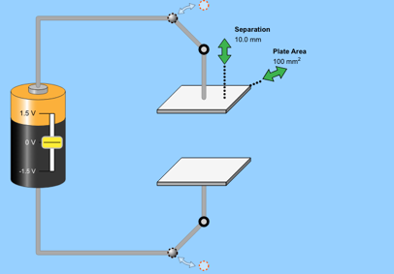
How Much Charge?
There are three things that influence how much electric charge a capacitor can store. These are:
The type of dielectric used
1
The surface area of the plates
2
The distance between the plates
3
Click the image to play around with a capacitor simulation to see the effect of these factors.
Notes:
Img06 = screenshot from https://phet.colorado.edu/sims/html/capacitor-lab-basics/latest/capacitor-lab-basics_en.html. On click of image open https://phet.colorado.edu/sims/html/capacitor-lab-basics/latest/capacitor-lab-basics_en.html

Slide 15
Capacitance
We measure the capacity of capacitors to store charge as capacitance. Capacitance (C) is measured in Farads (F) but 1F is actually a huge amount of charge so we normally work with mF (millifarad), μF (microfarad) and nF (nanofarad) capacitors.
Img06
Click the image to view a Farad conversion table. Download the document to your device or print it out for later reference.

Slide 16
Convert Capacitances
Take a moment to get some practice converting between these different units by entering the corresponding values in each case.
4,700μF =
45mF =
5,600pF =
70nF =
mF
μF
Submit
μF
pF
Notes:
Correct answers as follows:
4,700μF = 4.7mF
45mF = 4,500μF
5,600pF = 5.6μF
70nF = 70,000pF
On submit highlight which answers are incorrect and show correct answers.

Slide 17
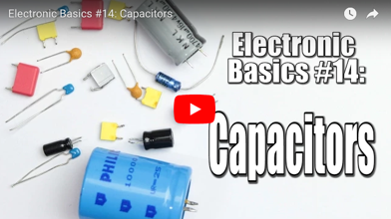
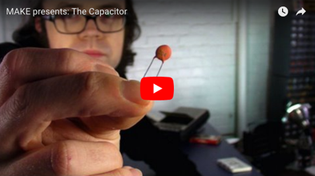
Make your own capacitor
Making your own capacitor is actually pretty easy.
Watch these two videos to see two different ways to make your own capacitor.
Notes:
Youtube video: URL = https://www.youtube.com/watch?v=otQGdPLyF3w
Play video full screen
https://www.youtube.com/watch?v=ZYH9dGl4gUE

Slide 18
Types of capacitors
Like resistors, there are basically 2 types of capacitors that you might use in electronics.
Click on the pictures to find out more about each type of capacitor.
Img07
Img08
Fixed Value Capacitors
Variable Capacitors
Notes:
Img07 = image with an numerous different types of fixed capacitors (e.g. https://study.com/cimages/multimages/16/electrolytic_capacitors.jpg)
Img07 = on click present a popup of slide 19.
Img08 = image with an example of both a variable capacitor (e.g. https://www.amplifiedparts.com/sites/default/files/uc_products/c-v100p_0.png)
Img08 = on click present a popup of slide 21.

Slide 19
Fixed Capacitors
Fixed capacitors have…fixed capacitance. They are, by far the most common type of capacitors you will use in electronics. There are many types but here are the main ones.
Img09
Paper capacitors have 2 metal strips separated by a waxy paper dielectric and can have a capacitance between 1nF and 1μF.
Img10
Here the dielectric is a thin sheet of mica (a kind of silicon mineral). They offer high precision and reliability but are usually small – less than 1μF
Paper Capacitor
Mica capacitor
Click the button to see more.
See more
Notes:
Img09 = image of a typical paper capacitor
Img10 = image of a typical mica capacitor
Button01 = open slide 18

Slide 20
Fixed Capacitors
All these fixed capacitors have the same standard capacitor symbol.
Not too popular, these capacitors have film deposits of ceramic on their plates and can have capacitances of 10pF - 100μF.
Img11
Ceramic Capacitor
Usually
Img12
The dielectric is a kind of plastic. These are very stable and can be found from 1μF – 47mF.
Sometimes
Polycarbonate capacitor
Notes:
Img11 = image of a typical ceramic capacitor
Img12 = image of a typical polycarbonate capacitor

Slide 21
Variable Capacitors
As the name suggests, you can change the capacitance of these capacitors. They have a slightly different symbol.
Img13
A variable capacitor has one or more fixed metal plates know as the stator. A second set of movable metal plates, called the rotor, can be rotated so that they interleave the stator plates. The dielectric is air.
Variable capacitors are often used in radios.
Variable Capacitor
Notes:
Img13 = image of a typical variable capacitor

Slide 22
Electrolytic Capacitors
There is one more type of capacitor, called the electrolytic capacitor. These capacitors are polorised. They have to be connected is a certain way indicated by their symbol. They also typically have much higher capacitances than other types.
Watch the video to learn more about electrolytic capacitors.
Notes:
Youtube video: URL = https://www.youtube.com/watch?v=uoa3OB74SmM
Play video full screen

Slide 23
Working Voltage
We know that a capacitor will charge to the same voltage as the power source. But do capacitors have a limit? Yes they do! This is the Working Voltage. Connect a 3V capacitor into a 12V circuit and…boom!
Watch the video to see some cool CAP explosions.
Notes:
Youtube video: URL = https://www.youtube.com/watch?v=77ARIvt9RrE
Play video full screen

Slide 24
Reading Electrolytic Capacitors
Electrolytic capacitors are amongst the easiest to read because things are printed nicely on the outside.
This capacitor has a capacitance of 4700μF or 4.7mF and a working voltage of 25V. You can also clearly see which is the negative lead.
Notes:
Img13a = https://www.electronics-tutorials.ws/capacitor/cap_3.html
Need to recreate

Slide 25
Reading Capacitors
Enter the capacitance and working voltage of each of the following electrolytic capacitors.
Capacitance
μF
Capacitance
μF
Working Voltage
V
Working Voltage
V
Submit
Notes:
Img14 = https://cdn.instructables.com/F0J/AVW9/IQU11L3S/F0JAVW9IQU11L3S.LARGE.jpg
Img15 = https://media.rs-online.com/t_large/F0572215-01.jpg
Answers as follows:
Img14
10 μF and 35V
Img15
1,000μF and 63V

Slide 26
Ceramic Capacitor Codes
Sometimes the values of capacitance are printed on capacitors using a simple code similar to resistors
Click on the image to learn more about the capacitor colour chart and how to use it.
Notes:
Img16 = https://www.elprocus.com/wp-content/uploads/2015/06/Capacitor-Color-Code.jpg
On click open https://www.elprocus.com/capacitor-color-code/

Slide 27
Test Yourself
We have come to the end of this unit. Answer the following questions to make sure you understand the basics of capacitors.

Slide 28
Question 1
Decode the following capacitor (the colours start at the top).
Green, Blue, Yellow, Red, Red
560,000pF at ±20% tolerance and 250V
560μF at ±2% tolerance and 250V
560pF at ±2% tolerance and 250V
560,000μF at ±2% tolerance and 250V
Notes:
Multiple choice question
Correct answer is b
Feedback:

Slide 29
Question 1
What colour code would be needed to describe this capacitor.
0.018μF ±2% tolerance and 630V
Brown, grey, orange, red, blue
Brown, brown, orange, red, blue
Brown, grey, red, red, blue
Brown, grey, orange, red, yellow
Notes:
Multiple choice question
Correct answer is a
Feedback:

Slide 30
Video Briefing – Vid01
Create a video presented by an expert presenter showing step-by-step how to build the simple series circuit on a breadboard. The presenter needs to explain the following:
Add LED, resistor and pushbutton to board
Connect end to end in series
Make sure LED is connected in right polarity
Connect power rail to battery

Slide 31
Video Briefing – Vid02
Create a video presented by an expert presenter showing step-by-step how to build the simple series circuit on a breadboard. The presenter needs to explain the following:
Add LED, resistor and pushbutton to board
Connect end to end in series
Add the capacitor in parallel with the resistor and LED, explaining how to do this
Make sure LED is connected in right polarity
Connect power rail to battery

Slide 32
Video Briefing – Vid03
Create a video presented by an expert presenter showing the operation of the circuit without and with the capacitor. Presenter to explain that the capacitor
Stores charge – while the pushbutton is pressed, charge stored in the capacitor
When the pushbutton is released, this charge is released from the capacitor but the capacitor gradually gets empty which is why the LED slowly turns off
Like a water tank releasing water – at the start there is good pressure but this pressure (voltage) in our circuit gets less and less.

Slide 33
Video Briefing – Vid04
Create an animated video showing the construction and working of a capacitor using the following script and https://www.youtube.com/watch?v=L6cgSxpGmDo and visual source
Capacitors are made of 2 parallel metal plates separated by an insulator called a dielectric. Each plate is connected to a terminal. When connected to a voltage source (like a DC power supply), electrons flow, as normal to the positive terminal to the battery and away from the negative terminal. In this way, electrons accumulate on the plate connected to the negative battery terminal creating an overall negatively charged plate and an absence of electrons on the other plate makes that plate positively charged.
But like all tragic love stories, the negative and positive charges on the plates cannot get to each other and unite because of the pesky dielectric between the plates. So, with no where to go, these charges just hang around as static charges on the plates. They can still feel each other’s attraction across the dielectric because of the electric field but cannot reach each other. So they just stay there.
At some point, the plates become so negatively and positively charged that no further negative or positive charges can be added. The battery does not have enough force to add more electrons to the negative plate or attract electrons away from the positive plate. We know that this force is called voltage. At this point the capacitor is “fully charged”. At this point the potential across the capacitor’s plates is the same at the potential of the power supply. If the power supply is 9V, the capacitor will also be 9V when fully charged. The potential across the plates of a capacitor can never be more than the voltage of the battery that charged it.
When we stop applying the original voltage source and provide an alternative path can the electrons flow, the electrons will flow through the circuit to equalize the charges on both plates. Thus the capacitor discharges.

Slide 34
Document Briefing – Doc01
Produce a PDF document of the following table
1 F | One farad |  | 1 F | One farad
1 mF | One millifarad | 10⁻³ F | 0.001 F | One thousands of a farad
1 μF | One microfarad | 10⁻⁶ F | 0.000001 F | One millionth of a farad
1 nF | One nanofarad | 10⁻⁹ F | 0.000000001 | One billionth of a farad
1 pF | One picofarad | 10-¹² F | 0.000000000001 | One trillionth of a farad

