Slide 1
Electronics
Topic 3: Resistors

Slide 2
Assumed prior learning
05_01_00
05_01_02
05_02_01
05_03_01
05_04_01
Notes:
Note for navigation on site:
This information needs to be taken into account and needs to stated on the LMS, perhaps as part of the introduction?

Slide 3
Outcomes
By the end of this unit the learner will be able to:

Slide 4
Unit 3.6: Series and Parallel Circuits

Slide 5
Introduction
So far, we have learn 4 very important things about circuits.
Click each box to see what these are.
Resistors in series
Kirchoff’s Voltage Law
1
3
Resistors in parallel
Kirchoff’s Current Law
2
4
Notes:
On click of each button present a pop-up with the indicated text:
1 – Resistors in series: When resistors are in series in a circuit, we add up their values to find the total resistance. Note that this applies to any components in a ciruit that supply resistance.
2 – Resistors in parallel: When resistors are in parallel in a circuit, we use the following formula to work out the total resistance
$$\frac{1}{R_{T}}=\frac{1}{R1}+\frac{1}{R2}+…+\frac{1}{Rn}$$
Note that this applies to any components in a ciruit that supply resistance.
3 – Kirchoff’s Voltage Law: Resistors in series divide up the voltage in proportion to their resistances. Note that this applies to any components in a ciruit that supply resistance.
4 – Kirchoff’s Current Law: Resistors in parallel divide up the current in proportion to their resistances. Note that this applies to any components in a ciruit that supply resistance.

Slide 6
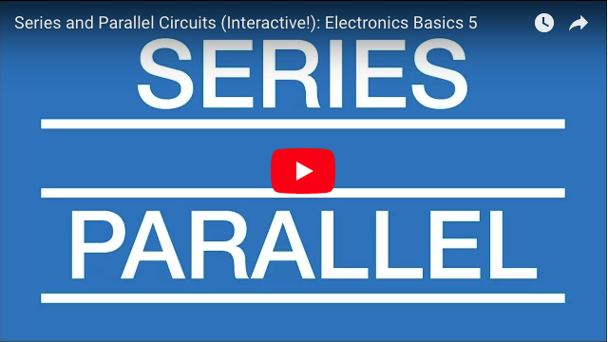
Series vs Parallel
Watch this video for an excellent summary of the differences between series and parallel circuits.
Notes:
Youtube video: URL = https://www.youtube.com/watch?v=MMD32gyHVQw
Play video full screen

Slide 7
A Virtual Circuit
Take a moment to play around with this virtual circuit that helps illustrate some of the differences between series and parallel circuits.
Img01
Download and work through the worksheet. Then watch the video to make sure you completed everything correctly.
Download the worksheet
Notes:
Button01 = open Doc01 (see brief)
Img02 = EveryCircuit logo
Img01 = Screenshot of vid01 (see brief). Play video full screen.

Slide 8
Circuit Analysis
The reason we learn about Ohm’s Law, Kirchoff’s Voltage Law and Kirchoff’s Current Law is so that we can analyse what is happening at every part of a circuit. This is a process called circuit analysis.
Img02
Watch the video to see what circuit analysis is all about and how to do it.
Notes:
Img02 = screenshot of vid02 (see brief). On click play video full screen.

Slide 9
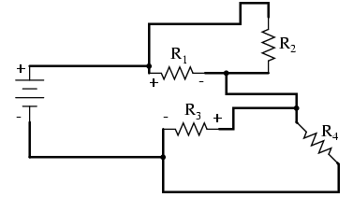
Redrawing Circuits
Sometimes it is necessary to redraw circuits in order to get a handle on which components are in series and which are in parallel.
Redraw each of the this circuit on a piece of paper to make it easier to see which resistors are in series and which are in parallel.
Notes:
Img03 = https://sub.allaboutcircuits.com/images/00132.png. Need to redraw.

Slide 10
How to Redraw Circuits
How did you go with redrawing that last circuit? Being able to redraw complicated or confusing circuits makes the circuit easier to analyse.
Img04
Watch the video to see how to redraw the previous circuit.
Notes:
Img04 = screenshot of vid03 (see brief). On click play video full screen.

Slide 11
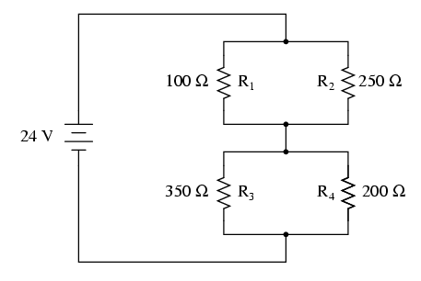
Analyse the Circuit – Step 1
Here is a circuit to analyse. When we analyse a circuit, we want to find the voltage across and the current through each of the components.
Start by making a copy of this table on a sheet of paper.
R1 | R2 | R3 | R4 | R1//R2 | R3//R4 | Total
 |  |  |  |  |  | 24 | Voltage (V)
 |  |  |  |  |  |  | Current (A)
100 | 250 | 350 | 200 |  |  |  | Resistance (Ω)
Notes:
Img05 = https://sub.allaboutcircuits.com/images/00123.png. Need to redraw.

Slide 12
Analyse the Circuit – Step 2
Calculate the equivalent resistance of R1 and R2 to 2 decimal places.
Enter the resistance of R1//R2
Ω
Check
R1 | R2 | R3 | R4 | R1//R2 | R3//R4 | Total
 |  |  |  |  |  | 24 | Voltage (V)
 |  |  |  |  |  |  | Current (A)
100 | 250 | 350 | 200 |  |  |  | Resistance (Ω)
Notes:
Img05 = https://sub.allaboutcircuits.com/images/00123.png. Need to redraw.
Button01 = on click, check the resistance entered. It should be 71.43Ω
Feedback:
Correct = Well done. You got this!
Incorrect = That is not correct. Remember, R1 and R2 are in parallel. Therefore the total or equivalent resistance is given by 1/R_{T} = 1/100Ω + 1/250Ω. Therefore R_{T} or R1//R2 = 71.43Ω (to 2 decimal places).

Slide 13
Analyse the Circuit – Step 3
Calculate the equivalent resistance of R3 and R4 to 2 decimal places.
Enter the resistance of R1//R2
Ω
Check
R1 | R2 | R3 | R4 | R1//R2 | R3//R4 | Total
 |  |  |  |  |  | 24 | Voltage (V)
 |  |  |  |  |  |  | Current (A)
100 | 250 | 350 | 200 | 71.43 |  |  | Resistance (Ω)
Notes:
Img05 = https://sub.allaboutcircuits.com/images/00123.png. Need to redraw.
Button01 = on click, check the resistance entered. It should be 127.27Ω
Feedback:
Correct = Well done. You got this!
Incorrect = That is not correct. Remember, R3 and R4 are in parallel. Therefore the total or equivalent resistance is given by 1/R_{T} = 1/350Ω + 1/200Ω. Therefore R_{T} or R1//R2 = 127.27Ω (to 2 decimal places).

Slide 14
Analyse the Circuit – Step 4
Now calculate the total resistance in the circuit (to 2 decimal places).
Enter the total circuit resistance
Ω
Check
R1 | R2 | R3 | R4 | R1//R2 | R3//R4 | Total
 |  |  |  |  |  | 24 | Voltage (V)
 |  |  |  |  |  |  | Current (A)
100 | 250 | 350 | 200 | 71.43 | 127.27 |  | Resistance (Ω)
Notes:
Img05 = https://sub.allaboutcircuits.com/images/00123.png. Need to redraw.
Button01 = on click, check the resistance entered. It should be 198.70Ω
Feedback:
Correct = Well done. You got this!
Incorrect = That is not correct. We have calculated the equivalent resistance of R1 and R2 (R1//R2) and R3 and R4 (R3//R4). But these 2 equivalent resistances are in series with each other. In other words R1//R2 is in series with R3//R4. Therefore, we need to add these equivalent resiatances together to get the total resistance in the circuit. So R_{T} = 71.43Ω + 127.27Ω = 198.70Ω.

Slide 15
Analyse the Circuit – Step 5
Now calculate the total current in the circuit using Ohm’s Law (to 2 decimal places.
Enter the total circuit current
mA
Check
R1 | R2 | R3 | R4 | R1//R2 | R3//R4 | Total
 |  |  |  |  |  | 24 | Voltage (V)
 |  |  |  |  |  |  | Current (A)
100 | 250 | 350 | 200 | 71.43 | 127.27 | 198.70 | Resistance (Ω)
Notes:
Img05 = https://sub.allaboutcircuits.com/images/00123.png. Need to redraw.
Button01 = on click, check the current entered. It should be 120.78mA
Feedback:
Correct = Well done. You got this!
Incorrect = That is not correct. According to Ohm’s Law I = V/R. Therefore, I_{T} = V_{T}/R_{T} = 24V/198.70Ω = 120.78mA

Slide 16
Analyse the Circuit – Step 6
What is the current through the equivalent resistances R1//R2 and R3//R4?
Current through R1//R2 and R3//R4
mA
Check
R1 | R2 | R3 | R4 | R1//R2 | R3//R4 | Total
 |  |  |  |  |  | 24 | Voltage (V)
 |  |  |  |  |  | 120.78m | Current (A)
100 | 250 | 350 | 200 | 71.43 | 127.27 | 198.70 | Resistance (Ω)
Notes:
Img05 = https://sub.allaboutcircuits.com/images/00123.png. Need to redraw.
Button01 = on click, check the current entered. It should be 120.78mA
Feedback:
Correct = Well done! The current through each equivalent resistance is the same as the total current of 128.78mA. Resistances is series divide voltage NOT current.
Incorrect = That is not correct. Because these equivalent resistances (R1//R2 and R3//R4) are in series, we know that the same current flows through both of them which is the same as the total current - 120.78mA. Resistances in series divide voltage NOT current.

Slide 17
Analyse the Circuit – Step 7
Calculate the voltage across R1 and R2 (to 2 decimal places).
Voltage across R1 and R2
V
Check
R1 | R2 | R3 | R4 | R1//R2 | R3//R4 | Total
 |  |  |  |  |  | 24 | Voltage (V)
 |  |  |  | 120.78m | 120.78m | 120.78m | Current (A)
100 | 250 | 350 | 200 | 71.43 | 127.27 | 198.70 | Resistance (Ω)
Notes:
Img05 = https://sub.allaboutcircuits.com/images/00123.png. Need to redraw.
Button01 = on click, check the voltage entered. It should be 8.63V
Feedback:
Correct = Well done! We know that resistances in series divide voltage (Kirchoff’s Voltage Law). Therefore R1//R2 and R3//R4 divide the voltage in the same proportion as their resiatance.
Incorrect = That is not correct. We know that resistances in series divide voltage (Kirchoff’s Voltage Law). Therefore R1//R2 and R3//R4 divide the voltage in the same proportion as their resiatance. To find the voltage across R1//R2, we can use Ohm’s Law. V_{R1//R2} = I_{R1//R2} x R1//R2 = 120.78mA x 71.43Ω = 8.63V.

Slide 18
Analyse the Circuit – Step 8
Calculate the voltage across R3 and R4 (to 2 decimal places).
Voltage across R3 and R4
V
Check
R1 | R2 | R3 | R4 | R1//R2 | R3//R4 | Total
 |  |  |  | 8.63 |  | 24 | Voltage (V)
 |  |  |  | 120.78m | 120.78m | 120.78m | Current (A)
100 | 250 | 350 | 200 | 71.43 | 127.27 | 198.70 | Resistance (Ω)
Notes:
Img05 = https://sub.allaboutcircuits.com/images/00123.png. Need to redraw.
Button01 = on click, check the voltage entered. It should be 8.63V
Feedback:
Correct = Well done! We know that resistances in series divide voltage (Kirchoff’s Voltage Law). Therefore R1//R2 and R3//R4 divide the voltage in the same proportion as their resiatance.
Incorrect = That is not correct. We know that resistances in series divide voltage (Kirchoff’s Voltage Law). Therefore R1//R2 and R3//R4 divide the voltage in the same proportion as their resiatance. To find the voltage across R3//R4, we can use Ohm’s Law. V_{R3//R4} = I_{R3//R4} x R3//R4 = 120.78mA x 127.27Ω = 15.37V.

Slide 19
Analyse the Circuit – Step 9
We know we are right because the voltages across R1//R2 and R3//R4 are equal to the total voltage.
What is the voltage across R1 and R2?
Voltage across R1 and R2
V
Check
R1 | R2 | R3 | R4 | R1//R2 | R3//R4 | Total
 |  |  |  | 8.63 | 15.37 | 24 | Voltage (V)
 |  |  |  | 120.78m | 120.78m | 120.78m | Current (A)
100 | 250 | 350 | 200 | 71.43 | 127.27 | 198.70 | Resistance (Ω)
Notes:
Img05 = https://sub.allaboutcircuits.com/images/00123.png. Need to redraw.
Button01 = on click, check the voltage entered. It should be 8.63V
Feedback:
Correct = Well done! Because R1 is in parallel with R2, we know that the same voltage is across both of them and that this is the same as the voltage across their equivalent resistance.
Incorrect = That is not correct. Because R1 is in parallel with R2, we know that the same voltage is across both of them and that this is the same as the voltage across their equivalent resistance. Remember resistors in parallel divide current NOT voltage.

Slide 20
Analyse the Circuit – Step 10
What is the voltage across R3 and R4?
Voltage across R3 and R4
V
Check
R1 | R2 | R3 | R4 | R1//R2 | R3//R4 | Total
8.63 | 8.63 |  |  | 8.63 | 15.37 | 24 | Voltage (V)
 |  |  |  | 120.78m | 120.78m | 120.78m | Current (A)
100 | 250 | 350 | 200 | 71.43 | 127.27 | 198.70 | Resistance (Ω)
Notes:
Img05 = https://sub.allaboutcircuits.com/images/00123.png. Need to redraw.
Button01 = on click, check the voltage entered. It should be 8.63V
Feedback:
Correct = Well done! Because R3 is in parallel with R4, we know that the same voltage is across both of them and that this is the same as the voltage across their equivalent resistance.
Incorrect = That is not correct. Because R3 is in parallel with R4, we know that the same voltage is across both of them and that this is the same as the voltage across their equivalent resistance. Remember resistors in parallel divide current NOT voltage.

Slide 21
Analyse the Circuit – Step 11
Calculate the current through R1 to 2 decimal places.
Current through R1
mA
Check
R1 | R2 | R3 | R4 | R1//R2 | R3//R4 | Total
8.63 | 8.63 | 15.37 | 15.37 | 8.63 | 15.37 | 24 | Voltage (V)
 |  |  |  | 120.78m | 120.78m | 120.78m | Current (A)
100 | 250 | 350 | 200 | 71.43 | 127.27 | 198.70 | Resistance (Ω)
Notes:
Img05 = https://sub.allaboutcircuits.com/images/00123.png. Need to redraw.
Button01 = on click, check the current entered. It should be 86.30mA
Feedback:
Correct = Well done! We know the voltage across R1 and its resistance value so we can find the current through R1 by using Ohm’s Law. I_{R1} = V_{R1}/R1 = 8.63V/100Ω = 86.30mA.
Incorrect = That is not correct. We know the voltage across R1 and the resistance value of R1. Therefore, to calculate the current through R1, we use Ohm’s Law. I_{R1} = V_{R1}/R1 = 8.63V/100Ω = 86.30mA.

Slide 22
Analyse the Circuit – Step 12
Calculate the current through R2 to 2 decimal places.
Current through R2
mA
Check
R1 | R2 | R3 | R4 | R1//R2 | R3//R4 | Total
8.63 | 8.63 | 15.37 | 15.37 | 8.63 | 15.37 | 24 | Voltage (V)
86.30m |  |  |  | 120.78m | 120.78m | 120.78m | Current (A)
100 | 250 | 350 | 200 | 71.43 | 127.27 | 198.70 | Resistance (Ω)
Notes:
Img05 = https://sub.allaboutcircuits.com/images/00123.png. Need to redraw.
Button01 = on click, check the current entered. It should be 34.52mA
Feedback:
Correct = Well done! We know the voltage across R2 and its resistance value so we can find the current through R2 by using Ohm’s Law. I_{R2} = V_{R2}/R2 = 8.63V/250Ω = 34.52mA.
Incorrect = That is not correct. We know the voltage across R2 and the resistance value of R2. Therefore, to calculate the current through R2, we use Ohm’s Law. I_{R2} = V_{R2}/R2 = 8.63V/250Ω = 34.52mA.

Slide 23
Analyse the Circuit – Step 13
Calculate the current through R3 and R4 to 2 decimal places.
Current through R3 and R4
I_{R3}
mA
Check
I_{R4}
mA
R1 | R2 | R3 | R4 | R1//R2 | R3//R4 | Total
8.63 | 8.63 | 15.37 | 15.37 | 8.63 | 15.37 | 24 | Voltage (V)
86.30m | 34.52m |  |  | 120.78m | 120.78m | 120.78m | Current (A)
100 | 250 | 350 | 200 | 71.43 | 127.27 | 198.70 | Resistance (Ω)
Notes:
Img05 = https://sub.allaboutcircuits.com/images/00123.png. Need to redraw.
Button01 = on click, check the current entered. It should be I_{R3} = 43.91mA and I_{R4} = 76.85mA
Feedback:
Correct = Well done! We know the voltage across R3 and R4 and the resistance values of R3 and R4 so we can find the current through each of them by using Ohm’s Law.
Incorrect = That is not correct. We know the voltage across R3 and R4 and the resistance values of R3 and R4 so we can find the current through each of them by using Ohm’s Law. I_{R3} = V_{R3}/R3 = 15.37V/350Ω = 43.91mA. I_{R4} = V_{R4}/R4 = 15.37V/200Ω = 76.85mA.

Slide 24
Analyse the Circuit – Step 14
We have completed analysing this circuit. In this case, the circuit only had resistors but the same process works no matter what components are in the circuit.
Watch the video to see all the calculations done.
Watch the video of all the calculations
R1 | R2 | R3 | R4 | R1//R2 | R3//R4 | Total
8.63 | 8.63 | 15.37 | 15.37 | 8.63 | 15.37 | 24 | Voltage (V)
86.30m | 34.52m | 43.91m | 76.85m | 120.78m | 120.78m | 120.78m | Current (A)
100 | 250 | 350 | 200 | 71.43 | 127.27 | 198.70 | Resistance (Ω)
Notes:
Button01 = play vid04 (see brief) full screen

Slide 25
Build the Circuit
Why not build the circuit yourself and take all the relevant readings to check our calculations?
Watch the video if you need help building the circuit and taking the readings.
Watch how to build the circuit
Notes:
Img05 = https://sub.allaboutcircuits.com/images/00123.png. Need to redraw.
Button01 = play vid05 (see brief) fullscreen

Slide 26
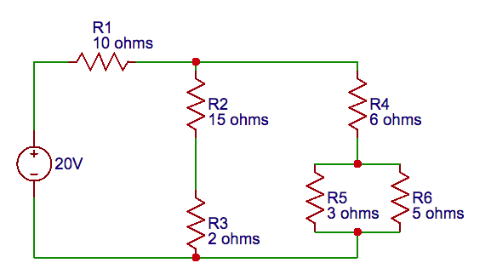
Analyse the Circuit
Here is another circuit analysis problem for you to try.
Analyse the circuit by completing the table below.
Note
R1 | R2 | R3 | R4 | R5 | R6 | R2--R3 | R5//R6 | R4--(R5//R6) | (R4--(R5//R6))//(R2--R3) | Total
 |  |  |  |  |  |  |  |  |  |  | Voltage (V)
 |  |  |  |  |  |  |  |  |  |  | Current (A)
10 | 15 | 2 | 6 | 3 | 5 |  |  |  |  |  | Resistance (Ω)
Notes:
Img06 = Need to redraw.
Button01 = On click display popup with “R2--R3 means the equivalent resistance of R2 and R3 which are in series. R5//R6 means the equivalent resiatance of R5 and R6 which are in parallel. R4--(R5//R6) means the equivalent resistance where the equivalent of R5 and R6 (parallel) is in series with R4.”

Slide 27
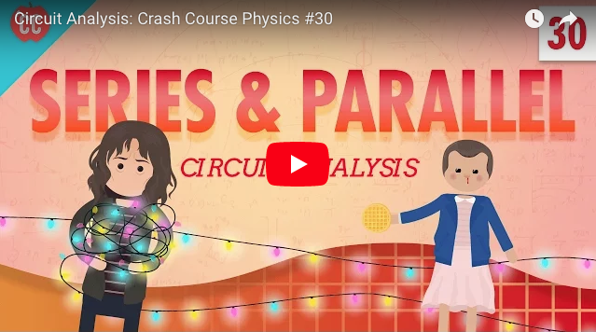
Series vs Parallel
Watch this video for a full worked solution to the previous circuit analysis problem.
R1 | R2 | R3 | R4 | R5 | R6 | R2--R3 | R5//R6 | R4--(R5//R6) | (R4--(R5//R6))//(R2--R3) | Total
13.000 | 6.18 | 0.824 | 5.334 | 1.667 | 1.667 | 7.000 | 1.667 | 7 | 7 | 20 | Voltage (V)
1.3 | 0.412 | 0.412 | 0.889 | 0.556 | 0.333 | 0.412 | 0.889 | 0.889 | 1.3 | 1.3 | Current (A)
10 | 15 | 2 | 6 | 3 | 5 | 17 | 1.875 | 7.875 | 5.382 | 15.382 | Resistance (Ω)
Notes:
Youtube video: URL = https://www.youtube.com/watch?v=-w-VTw0tQlE
Play video full screen

Slide 28
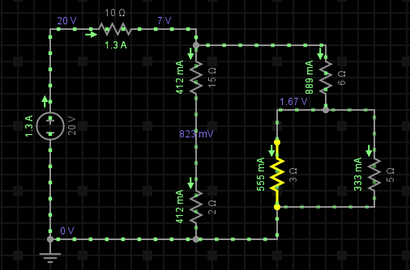
A Virtual Circuit
Take a moment to have a look at a virtual simulation of the circuit we have just analysed to make sure that you agree with all our answers.
Click the button below to open the virtual circuit.
Open the virtual circuit
Notes:
Button01 = open the virtual circuit at http://everycircuit.com/circuit/5471889744199680
Img08 = EveryCircuit logo
Img07 = Screenshot of the virtual circuit at http://everycircuit.com/circuit/5471889744199680

Slide 29
Test Yourself
We have come to the end of this unit. Answer the following questions to make sure you understand how to analyse a circuit.

Slide 30
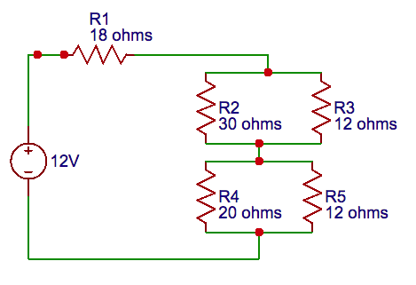
Question 1
Analyse the circuit and complete the following table.
R1 | R2 | R3 | R4 | R5
6.34 | 3.02 | 3.02 | 2.64 | 2.64 | Voltage (V)
352 | 101 | 252 | 132 | 220 | Current (mA)
18 | 30 | 12 | 20 | 12 | Resistance (Ω)
Notes:
Complete the table question
Answers in italics in the table
On submission highlight which answers are correct and incorrect and provide the full worked solution – Doc02 (see Brief)

Slide 31
Document Briefing – Doc01
Create an annotated PDF worksheet with the following steps.
Make sure you have downloaded the EveryCircuit App from your app store.
If you are working on a computer, visit http://everycircuit.com/app/.
Open the EveryCircuit app and signup. After your trial, you will still have access to EveryCircuit and other people’s circuits. You will just not be able to create your own circuits.
Go to the community space and search for the circuit called “NOC_Series and Parallel Circuits”
Open the circuit.
There are 2 circuits represented – a series circuit and a parallel circuit. You should be able to tell which one is which. Each circuit has 3 identical LEDs in it. The LEDs need a voltage of 3V across them to shine. We will learn why in a later topic.
Calculate the resistance that each LED supplies to the series and parallel circuits. Remember the LEDs are identical in each circuit. Does each LED in the series circuit provide as much resistance as each LED in the parallel circuit?
What happens if you lower series circuit voltage to 3V?
Why does the series circuit need a higher voltage for the LEDs to light than the parallel circuit?
If the LEDs need a minimum current of 5.6mA to light up, what is the minimum voltage needed in the series circuit?
If we had to run the parallel circuit with a 9V power supply, what would we need to add to the circuit to make sure that the LEDs still had 3V across them?

Slide 32
Video Briefing – Vid01
Create a screencast video presented by an expert presenter working through Doc01, making the circuit changes and answering the questions.
Make sure to highlight the voltage drops in the series circuit and why they are all the same - 3V at a time.
Make sure to show that all three parallel LEDs have the same voltage across them.
For point 11 make sure the learners understand
Why the resistor must be in placed in series (voltage dividers)
Why the resistor must be 100Ω

Slide 33
Video Briefing – Vid02
Create a video presented by an expert presenter working through the circuit at http://everycircuit.com/circuit/5111611651260416. Presenter to
Redraw the circuit and explain which resistors are in series and which are in parallel – highlighting that the 2 resistors in parallel could be replaced by an equivalent resistor in series with the other 2.
Calculate the total circuit resistance
Confirm by calculation the total circuit current
Confirm the voltage across each resistor – by calculation and using a voltmeter
Confirm the current through each resistor – by calculation
Draw an equivalent circuit with a single resistor.
Build the simulated version of this equivalent circuit to confirm that the total voltage and current is the same

Slide 34
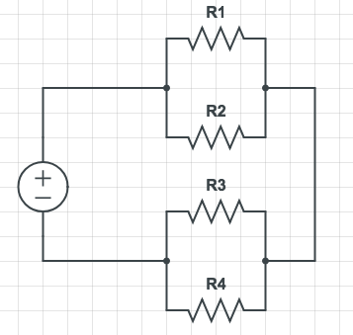
Video Briefing – Vid03
Create a video presented by an expert presenter were they redraw the circuit to make it easier to see what is in series and what is in parallel.
See https://www.allaboutcircuits.com/textbook/direct-current/chpt-7/re-drawing-complex-schematics/ for an excellent method and explanation.

Slide 35
Video Briefing – Vid04
Create a video presented by an expert presenter were they go through the full circuit analysis using the same process as found at https://www.allaboutcircuits.com/textbook/direct-current/chpt-7/analysis-technique/

Slide 36
Video Briefing – Vid04
Create a video presented by an expert presenter were they build the circuit on a breadboard and take all the necessary readings to complete the following table. Also show the virtual circuit at http://everycircuit.com/circuit/5240367925690368
R1 | R2 | R3 | R4 | Total
8.63 | 8.63 | 15.37 | 15.37 | 24 | Voltage (V)
86.3m | 34.52m | 43.91m | 76.85m | 120.78m | Current (A)
100 | 250 | 350 | 200 | 198.70 | Resistance (Ω)

Slide 37
Document Briefing – Doc02
TBC – see http://everycircuit.com/circuit/5471889744199680

