Slide 1
Electronics
Topic 3: Resistors

Slide 2
Assumed prior learning
05_01_00
05_01_02
05_02_01
05_03_01
05_04_01
Notes:
Note for navigation on site:
This information needs to be taken into account and needs to stated on the LMS, perhaps as part of the introduction?

Slide 3
Outcomes
By the end of this unit the learner will be able to:

Slide 4
Unit 3.4: Variable Voltage Dividers

Slide 5
Introduction
Do you remember the volume dial on old radios and TVs? Turn it one way and the volume increases. Turn it the other and the volume decreases?
This is the basic principle behind variable resistors – resistors whose resistance we can change.
Img01
Notes:
Img01 = image of an old fashioned radio with a clear volume dial

Slide 6
A Reminder
Img02
The resistance of a variable potentiometers can be easily and continually adjusted with a dial.
We touched on variable resistors in unit 2 of this topic. Remember, variable resistors are also called potentiometers. Some can be easily adjusted with a knob while others are set to a pre-set value and then left.
Variable Potentiometer
Img03
A pre-set potentiometer (also called a trim pot) is set to a specific value for a specific application and left there.
Trim Pot
Notes:
Img02 = image of a typical potentiometer
Img03 = image of a typical trim pot

Slide 7
LEDs
You have probably heard of an LED before. They are little lights and are found everywhere - in TVs, your phone, fridges and traffic lights.
We will take a closer at LEDs in another topic. For now, we just need to use one in a circuit.
Img04
Find the LED in your kit that looks like the component in the image.
Notes:
Img04 = picture of the 5mm RED LED in the kit

Slide 8
Build the Circuit
Using this schematic as a guide, build the following circuit. Make sure that the long wire of your LED is connected to the positive terminal of your battery.
Rollover or touch each symbol in the schematic to find out more. Watch the video if you need help.
Watch how to build the circuit
Notes:
Reproduce schematic image as an image with hotspots over each component.
Component01 = on click present a tooltip with “This symbol represents a voltage source like a battery. Use a 9V battery as indicated.”
Component02 = on click present a tooltip with “This symbol represents an LED. LED stands for light emitting diode. The symbol is that of a diode (which we will learn more about in another topic) with arrows indicating that it emits light. Use a red 5mm LED.”
Hide tooltip on clicking away from component or another component.
Button01 = play vid01 (see brief) fullscreen

Slide 9
RIP LED!
What happened to your LED? Did it light up?
You probably saw it light up briefly and then go out. Your LED is dead! But let’s investigate why.
Img05
Watch the video to find out why.
Notes:
Img05 = screenshot of vid02 (see brief). On click play video full screen

Slide 10
Limit the Current
So we need to limit the current in our circuit to no more than 20mA.
Assume the resistance of the LED and wires to be zero. Measure the voltage of the battery and then calculate the resistance we need to add to the circuit to limit the current to 20mA.
Enter the required circuit resistance
Ω
Check
Notes:
Button01 = on click, check the resistance entered. It should be between 430Ω and 470Ω
Feedback:
If in range – That look’s about right. Well done. You need to add about 450Ω of resistance to the circuit to limit the current to 20mA
If not in range – It looks like you have made a mistake. Check your calculations again. You should find that you need about 450Ω of resistance to limit the current to 20mA.

Slide 11
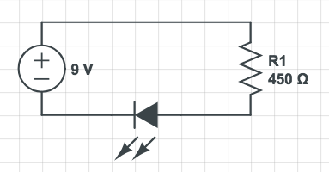
Build the Circuit
Using this schematic as a guide, build the following circuit. You will need to throw the blow LED away and use a new one. Make sure you use a red LED.
Rollover or touch each symbol in the schematic to find out more. Watch the video if you need help.
Watch how to build the circuit
Notes:
Reproduce schematic image as an image with hotspots over each component.
Component01 = on click present a tooltip with “This symbol represents a voltage source like a battery. Use a 9V battery as indicated.”
Component02 = on click present a tooltip with “This symbol represents a resistor. We have named it R1 and its value in this circuit must be 450Ω.”
Component03 = on click present a tooltip with “This symbol represents an LED. LED stands for light emitting diode. The symbol is that of a diode (which we will learn more about in another topic) with arrows indicating that it emits light. Use a red 5mm LED.”
Hide tooltip on clicking away from component or another component.
Button01 = play vid03 (see brief) fullscreen

Slide 12
Take a picture
Take a picture of your completed circuit and upload it to your online portfolio.
Choose image
Upload
Notes:
Button 01 – Launch file selection window
Button 02 – Upload file

Slide 13
Review How To Use a Multimeter
We can see that our LED glows. We now need to make a few changes to our circuit, take some readings from our circuit and do some calculations.
Img06
Refer to the multimeter guide saved on your device or click the image to see it again.
Notes:
Img06 = image of the same multimeter guide screenshot as used in 10_02_03 slide 10 linking to the same document.

Slide 14
Step 1
Measure the current flowing through the circuit.
Img07
Enter the current in the circuit
mA
Check
Notes:
Img07 = image of the words “Step 1”
Button01 = on click, check the current entered. It should be between 14.6mA and 16.6mA.
Feedback:
If in range – That look’s about right. The current flowing through the circuit is about 15.6mA. This is not quite the 20mA we wanted but the wires and LED do have a bit of resistance. It is better to be on the safe side and have slightly too much total resistance rather than risking another dead LED!
If not in range – That does not look correct. Check your measurement again. Remember, in a series circuit, you can measure the current anywhere in the circuit. You should find that the current is about 15.5mA. This is not quite the 20mA we wanted but the wires and LED do have a bit of resistance. It is better to be on the safe side and have slightly too much total resistance rather than risking another dead LED!

Slide 15
Step 2
Add another 450Ω resistor in series to the circuit. What happens to the LED? Measure the current flowing through the circuit now.
Img08
Enter the current in the circuit
mA
Check
Notes:
Img08 = image of the words “Step 2”
Button01 = on click, check the current entered. It should be between 6.9mA and 8.9mA.
Feedback:
If in range – That look’s about right. We have increased the resistance in the circuit so there is less current flowing through the circuit. We doubled the resistance, so the current has halved to about 7.8mA. This is why the LED shines less brightly.
If not in range – That does not look correct. Check your measurement again. Remember, in a series circuit, you can measure the current anywhere in the circuit. You should find that the current has halved to about 7.8mA because we have doubled the resistance. This is why the LED shines less brightly.

Slide 16
Step 3
Replace one of the 450Ω resistors with a 2KΩ resistor. What happens to the LED? Measure the current flowing through the circuit now.
Img09
Enter the current in the circuit
mA
Check
Notes:
Img08 = image of the words “Step 3”
Button01 = on click, check the current entered. It should be between 1.9mA and 3.9mA
Feedback:
If in range – That look’s about right. We have increased the resistance in the circuit to a total of 2,450Ω or 2.45KΩ. This means that there is only about 2.9mA flowing through the circuit, which is too little to make the LED glow at all.
If not in range – That does not look correct. Check your measurement again. Remember, in a series circuit, you can measure the current anywhere in the circuit. You should find that the current is about 2.9mA, too little to light the LED at all.

Slide 17
Step 4
If a 2.9mA current is flowing through the circuit, calculate what the voltage across the LED should be.
Img10
Enter the expected voltage across the LED
V
Check
Notes:
Img10 = image of the words “Step 4”
Button01 = on click, check the voltage entered. It should be 1,895V
Feedback:
If correct– That’s right. Well done. We expect the voltage across the LED to be 1.895V.
If not correct – That is not correct. We have a total circuit voltage of 9V. If 2.9mA is flowing through the circuit, the voltage drop across the LED will be 9V – the voltage drop across the resistors. As the resistors are in series, we can add their values together and treat them as a single resistor of 2450Ω. So V_{R} = 2.9mA x 2450Ω = 7.105V. Therefore V_{LED} = V_{T} – V_{R} = 9V – 7.105V = 1.895V

Slide 18
Step 5
Measure the actual voltage across the LED.
Img11
Enter the actual voltage across the LED
V
Check
Notes:
Img11 = image of the words “Step 5”
Button01 = on click, check the voltage entered. It should be between 1,3V – 2.4V
Feedback:
If correct– That’s right. Well done. We expected the voltage across the LED to be about 1.9V.
If not correct – That is not correct. Check your measurement again. Remember, we expect the voltage across the LED to be about 1.9V.

Slide 19
Controlling an LED
We seem to have found a way to control the brightness of an LED. We can do this by changing the amount of resistance there is in the circuit. The more resistance we add the less brightly the LED shines, until is goes out completely.
Watch the video to see how all the calculations were done and why we get the results we do.
Img12
Notes:
Img12 = screenshot of vid04 (see brief). On click of image play vid03 full screen.

Slide 20
Variable Resistance
Instead of swopping resistors in and out of a circuit, we can use a potentiometer (a “pot”) to control the brightness of an LED much more easily by changing the resistance of the pot. In this case, we are using a pot as a simple variable resistor or rheostat.
Watch the video to see what’s inside a pot and how it works as a variable resistor.
Notes:
Youtube video: URL = https://www.youtube.com/watch?v=1G11DbaUlec
Play video full screen

Slide 21
Measure the Resistance of Your Pot
Connect the left hand pin of your pot to the positive terminal of your multimeter and the centre pin to the negative terminal. Measure the minimum and maximum resistance of your potentiometer. You will need to set your multimeter to read KΩ.
Img12
Notes:
Img12 – schematic drawing of a pot – see https://qph.fs.quoracdn.net/main-qimg-e41a6d46e6033c64b92226aa3f382820 as a reference

Slide 22
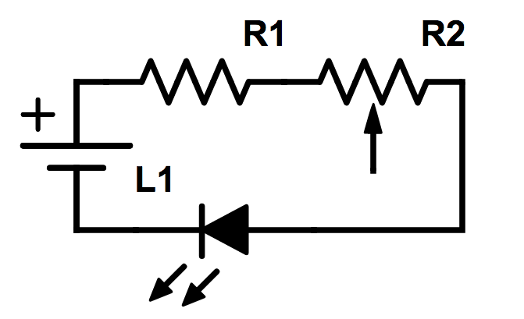
Build the Circuit
Let’s use our potentiometer as a variable resistor to control the brightness of an LED. Build the circuit represented in the schematic. Why do we still need R1?
Rollover or touch each symbol in the schematic to find out more. Watch the video if you need help.
Watch how to build the circuit
Notes:
Reproduce schematic image as an image with hotspots over each component.
Component01 = on click present a tooltip with “This symbol represents a voltage source like a battery. Use a 9V battery as indicated.”
Component02 = on click present a tooltip with “This symbol represents a resistor. We have named it R1 and its value in this circuit must be 450Ω. We need R1 in the circuit to protect the LED when the resistance of the pot is made very low.”
Component03 = on click present a tooltip with “This symbol represents an LED. LED stands for light emitting diode. The symbol is that of a diode (which we will learn more about in another topic) with arrows indicating that it emits light. You need to use a red 5mm LED for this circuit”
Component04 = on click present a tooltip with “This is the symbol for a variable resistor. The arrow represents the slider inside the pot that wipes over the resistive material.”
Hide tooltip on clicking away from component or another component.
Button01 = play vid05 (see brief) fullscreen

Slide 23
Take a picture
Take a picture of your completed circuit and upload it.
Choose image
Upload
Notes:
Button 01 – Launch file selection window
Button 02 – Upload file

Slide 24
Step 1
Let’s take some readings from our circuit.
Img13
Turn the pot all the way to the one side so that the LED is brightest. Measure the current in the circuit.
Enter the current in the circuit
mA
Check
Notes:
Img13 = image of the words “Step 1”
Button01 = on click, check the current entered. It should be between 14.6mA and 16.6mA.
Feedback:
If in range – That look’s about right. The current flowing through the circuit is about 15.6mA like in our previous circuit.
If not in range – That does not look correct. Check your measurement again. Remember, in a series circuit, you can measure the current anywhere in the circuit. You should find that the current is about 15.6mA.

Slide 25
Step 2
Now turn the pot in the other direction until the LED just stops shining. Measure the current flowing in the circuit now.
Img14
Enter the current in the circuit
mA
Check
Notes:
Img14 = image of the words “Step 2”
Button01 = on click, check the current entered. It should be between 3.9mA – 5.9mA
Feedback:
If in range – That look’s about right. We have increased the resistance in the circuit so there is less current flowing through the circuit. The current in the circuit at the point where the LED just stops shining is about 4.9mA.
If not in range – That does not look correct. Check your measurement again. Remember, in a series circuit, you can measure the current anywhere in the circuit. You should find that the current in the circuit at the point where the LED just stops shining is about 4.9mA.

Slide 26
Step 3
If the voltage across the LED must be about 2V for it to shine, calculate the resistance of the pot at the point when the LED just stops shining.
Img15
Enter the expected resistance of the pot
Ω
Check
Notes:
Img15 = image of the words “Step 3”
Button01 = on click, check the resistance entered. It should be 978Ω.
Feedback:
If in range – That look’s about right. The resistance of the pot at the point when the LED stops shining should be about 978Ω.
If not in range – That does not look correct. Check your calculatons again. If the voltage across the LED is about 2V, that means that the voltage across the resistors is 7V (we have a total of 9V across the circuit). We measured the current in the circuit as 4.9mA. R = V/I so R_{T} = 7V/4.9mA = 1,428Ω. But some of this resistance comes from the 450Ω resistor so the resistance of the pot must be 1,428Ω - 450Ω = 978Ω.

Slide 27
Step 4
Measure the resistance of the pot at this point when the LED just stops shining.
Img16
Enter the actual resistance of the pot
Ω
Check
Notes:
Img16 = image of the words “Step 4”
Button01 = on click, check the resistance entered. It should be 800Ω - 1.1kΩ
Feedback:
If correct– That looks about right. We expected the resistance of the pot to be about 980Ω.
If not correct – That does not look right. Check your measurements again. Remember, we calculated that the resistance of the pot at the point when the LED just turns off should be about 980Ω.

Slide 28
Controlling an LED
Using a pot as a variable resistor is a much easier way for us to control the brightness of our LED.
Watch the video to see how all the previous measurements and calculations were done and why we get the results we do.
Img17
Notes:
Img17 = screenshot of vid06 (see brief). On click of image play vid03 full screen.

Slide 29
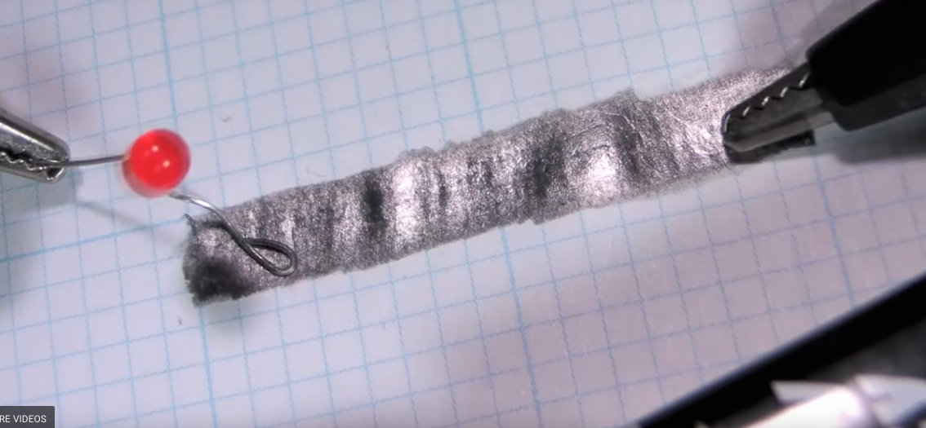
Make Your Own Variable Resistor
Making your own variable resistor is easy and fun. Why not try it out.
Watch this video to see how to make your own variable resistor.
Notes:
Youtube video: URL = https://goo.gl/d9Xe7E
Play video full screen

Slide 30
Pots as Voltage Dividers
So far in this unit, we have only used pots as simple variable resistors or rheostats. But pots are actually designed as variable voltage dividers. This is why they have three pins.
Img18
Watch the video to see how pots can be connected to act as variable voltage dividers in a circuit.
Notes:
Img18 = screenshot of vid07 (see brief). Play full screen

Slide 31
Play with EveryCircuit
It is time to play with another EveryCircuit simulation, this time exploring how pots work as variable voltage dividers. We will come back to these sorts of parallel circuits in the next unit.
Img19
Download and work through the worksheet. Then watch the video to make sure you completed everything correctly.
Download the worksheet
Notes:
Button01 = open Doc01 (see brief)
Img19 = Screenshot of vid08 (see brief). Play video full screen.
Img20 = EveryCircuit logo

Slide 32
Other Kinds of Variable Resistors
In this unit we have focused on the normal potentiometer but there are other kinds of variable resistors out there.
Click on each image to find out more.
Img20
Img21
Img22
Img23
Rheostat
Varistor
Digital Pot
Trim Pot
Notes:
Img20 = image of a rheostat – see http://www.resistorguide.com/pictures/rheostat_rotary.png for a reference
Img21 = image of a varistor – see https://5.imimg.com/data5/DK/LY/MY-7231459/mov-500x500.jpg for a reference
Img22 = image of a digital pot – see https://www.omega.com/Auto/images/OMDC-DP4_m.jpg for a reference
Img23 = image of a trim pot – see https://www.westfloridacomponents.com/mm5/graphics/H01/3386R-1-201.jpg for a reference
Img20 = on click display a popup with “The rheostat is very similar to a pot but only has 2 pins and so can only be used as a variable resistor not a a variable voltage divider like a pot. Rheostats are typically used in circuits with higher currents and voltages than what we have in electronic circuits. Like a pot, the resistance is controlled mechanically, by turning a knob. Visit http://www.resistorguide.com/rheostat/ for more information”
Img21 = on click display a popup with “The varistor also has a variable resistance but its resistance is controlled by voltage. They are used mainly to provide circuit protection against excessive voltage increases. Visit http://www.resistorguide.com/varistor/ for more information”
Img22 = on click display popup with “The digital pot does the same job as a normal pot but its resistance is controlled by electronic signals. Visit http://www.resistorguide.com/digital-potentiometer/ for more information”
Img23 = on click display popup with “Trimpots are the baby brothers of pot. They are used to make very fine adjustments and calibrations to the resistance in circuits. Visit http://www.resistorguide.com/trimpot/ for more information”

Slide 33
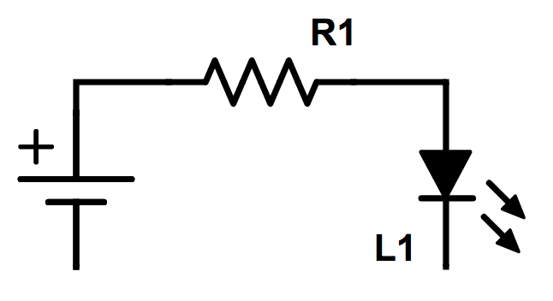
Build Your Own Simple Ohmmeter
We can use the fact that a change in the total resistance of a circuit changes the brightness of an LED to use to make our own ohmmeter.
Rollover or touch each symbol in the schematic to find out more. Watch the video if you need help.
Learn how the tester works
Watch how to build the circuit
Notes:
Reproduce schematic image as an image with hotspots over each component.
Component01 = on click present a tooltip with “This symbol represents a voltage source like a battery. Use a 9V battery as indicated.”
Component02 = on click present a tooltip with “This symbol represents a resistor. We have named it R1 and its value in this circuit must be 390Ω. We need R1 in the circuit to protect the LED when the resistance of what we are testing is very low.”
Component03 = on click present a tooltip with “This symbol represents an LED. You need to use a red 5mm LED”
Hide tooltip on clicking away from component or another component.
Button01 = play vid09 (see brief) fullscreen
Button02 = open doc02 (see brief)

Slide 34
Take a picture
Take a picture of your completed ohmmeter and upload it.
Choose image
Upload
Notes:
Button 01 – Launch file selection window
Button 02 – Upload file

Slide 35
Test Yourself
We have come to the end of this unit. Answer the following questions to make sure you understand potentiometers.

Slide 36
Question 1
Three
Notes:
Multiple choice question
Option b is correct
Feedback:
A = That is not correct. The total power P = VI = 9V x 0.03A = 0,27 watts. So while this resistor would work, its rating is quite far above what is needed. Therefore, it would be a waste of money using this resistor.
B = Well done. That is right. The total power P = VI = 9V x 0.03A = 0,27 watts. A resistor rated at 0,5 watts would do well in this circuit.
C = That is not correct. The total power P = VI = 9V x 0.03A = 0,27 watts. A 0,25 watt resistor would likely be damaged.
D = That is not correct. The total power P = VI = 9V x 0.03A = 0,27 watts. So while this resistor would work, its rating is quite far above what is needed. Therefore, it would be a waste of money using this resistor.

Slide 37
Video Briefing – Vid01
Create a video presented by an expert presenter showing step-by-step how to build the simple series circuit on a breadboard. The presenter needs to explain the following:
Add the LED to the board
Connect the LED to the battery emphasizing polarity
Oops! LED blows!

Slide 38
Video Briefing – Vid02
Create a video presented by an expert presenter showing the simple series circuit on a breadboard. The presenter needs to explain the following:
Explain why the LED blew
LED only rated for a current of about 20mA
The resistance of the LED is too low to limit the current to only 20mA
“If only we had a component that can limit the current flowing in a circuit. Oh wait! We do!” A resistor

Slide 39
Video Briefing – Vid03
Create a video presented by an expert presenter showing step-by-step how to build the simple series circuit on a breadboard. The presenter needs to explain the following:
Connect the LED and the resistor in series
Emphasise that we need to use the same kind of red LED as before
Emphasise that the long wire must connect to the positive terminal
Connect the circuit to the battery
See the LED glow

Slide 40
Video Briefing – Vid04
Create a video presented by an expert presenter showing step-by-step how to build the simple series circuit, change the resistors, take the readings and do the calculations. The presenter needs to explain the following:
Measure the current in the circuit
Add a 450 ohm resistor in series
Measure the current now
Swop a 450 ohm for a 2K ohm resistor
Measure the current now
Calculate the voltage across the LED
Measure the voltage across the LED
Note that below a certain voltage (the forward voltage) an LED will not work at all, irrespective of the current. Above this special voltage, then the more current, the brighter the LED until the LED becomes damaged by too much current.
Note that we will learn more about these LED characteristics in the topic on Diodes.

Slide 41
Video Briefing – Vid05
Create a video presented by an expert presenter showing step-by-step how to build the simple series circuit. The presenter needs to explain the following:
Measure the resistance of the pot
Build the circuit by connecting the components in series
Explain why we need R1
Connect the circuit to the battery
Change the brightness of the LED

Slide 42
Video Briefing – Vid06
Create a video presented by an expert presenter showing step-by-step how to take the measurements and do the calculations. The presenter needs to explain the following:
Measure the current when the LED is brightest
Explain that the pot is contributing very little to the total resistance
Explain why the 450 ohm resistor is still in the circuit – to protect the LED
Slowly turn the pot and see the affect on the LED
Explain that as we turn the pot, we increase the total resistance, decrease the total current and make the LED less bright
Measure the current at the point when the LED turns off
Explain that at this point, the LED turns off more because there is not enough voltage across it. Remind learners that resistors in series divide voltage so the greater the resistance of the pot plus 450 ohm resistor compared to the LED, the greater the portion of the 9V will be dropped across these resistors.
Calculate the expected pot resistance if we assume the LED forward voltage is 2V.
Measure the actual pot resistance.

Slide 43
Video Briefing – Vid07
Create a video presented by an expert presenter showing step-by-step how to connect a pot as a variable voltage divider.
Build a simple circuit with 2 multimeters connected across each half of the pot (i.e. pins 1 and 2 and 3 and 2)
Explain how the pot is connected with all three pins – the middle pin is always the wiper.
Connect 2 multimeters to measure the divided voltages
Turn the pot all the way to one side an see the readings
Slowly turn the pot and see how the voltages change – at each point confirm that the sum of the voltages is still the circuit total

Slide 44
Document Briefing – Doc01
Create an annotated PDF worksheet with the following steps.
Make sure you have downloaded the EveryCircuit App from your app store.
If you are working on a computer, visit http://everycircuit.com/app/.
Open the EveryCircuit app and signup. After your trial, you will still have access to EveryCircuit and other people’s circuits. You will just not be able to create your own circuits.
Go to the community space and search for the circuit called “NOC_POT Voltage Divider”
Open the circuit.
You will see that the voltage is 20V and that there is a 10mA current flowing through the circuit. Calculate the total resistance required to be in the circuit.
There is one 1KΩ resistor in series with a total 1KΩ pot. Does this match with the total resistance you calculated was required to be in the circuit?
Are the resistors dividing up the total voltage in the same proportion as their resistances?
At the moment the pot wiper is halfway between pins 1 and 3 so each half has a resistance of 500Ω. How could we make the reading on one of the voltmeters connected to the pot 10V?
Where would you need to move the wiper so that the voltage on one of the voltmeters read 2.5V? What would the voltage on the other voltmeter read? Check this by changing the position of the pot wiper. Click on the pot and then click on the spanner icon. By default the Wiper position setting is selected.
Why is the total voltage on both voltmeters connected to the pot always 10V? What could we do to make this total voltage 15V?
If the pot wiper was at 80% and the voltage was reduced to 15V, what readings would be on all three voltmeters?
Check this by making the changes to the circuit.

Slide 45
Video Briefing – Vid08
Create a video presented by an expert presenter showing step-by-step how to create the circuit and how to use it to test the following:
Variable resistor
Diode
Resistor
LED

Slide 46
Document Briefing – Doc02
Create an annotated document as follows:
We can put this notion of variable resistance changing how brightly an LED glows to good use by creating our very own component and continuity tester. This can be used to test if a circuit is complete and closed (i.e. can current flow) as well as whether individual components still work.
The basic principle is as follows:
LED bright means the resistance is low, less than about 1kΩ
LED dim means the resistance is medium, a few kΩ
LED off means the resistance is high, more than about 10kΩ or there is no continuity.
It would be best for you to not use your breadboard to create your tester so that you can keep it and use it whenever you need to in the future.
For a complete reference of all the components that can be tested with your component and continuity tester see https://electronicsclub.info/p_simpletester.htm.

