Slide 1
Electronics
Topic 3: Resistors

Slide 2
Assumed prior learning
05_01_00
05_01_02
05_02_01
05_03_01
05_04_01
Notes:
Note for navigation on site:
This information needs to be taken into account and needs to stated on the LMS, perhaps as part of the introduction?

Slide 3
Outcomes
By the end of this unit the learner will be able to:

Slide 4
Unit 3.3: Voltage Dividers

Slide 5
Introduction
We can place multiple resistors into a circuit in series to ensure that we have the correct amount of total resistance.
But there is another, sometimes more important reason for using resistors in series which we will discover in this unit.
Img01
Notes:
Img01 = image of a carbon resistor, a wire wound resistor and a potentiometer.

Slide 6
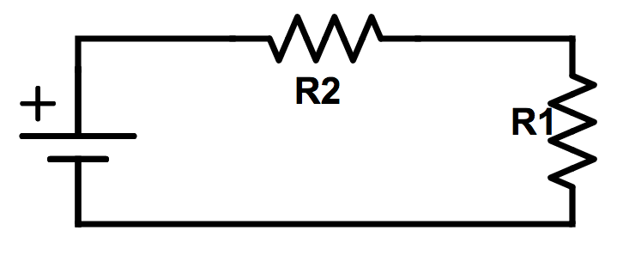
Build the Circuit
Using this schematic as a guide, build the following circuit. Make sure that the resistors are connected end to end so that there is only one one path for the electrons to follow
Rollover or touch each symbol in the schematic to find out more. Watch the video if you need help.
Watch how to build the circuit
Notes:
Reproduce schematic image as an image with hotspots over each component.
Component01 = on click present a tooltip with “This symbol represents a voltage source like a battery. Use a 9V battery.”
Component02 = on click present a tooltip with “This symbol represents a resistor. In this case we have called the resistor R1.” Place your 1KΩ resistor here?
Component03 = on click present a tooltip with “This symbol represents a resistor. In this case we have called the resistor R2.” Place your 500Ω resistor here?
Hide tooltip on clicking away from component or another component.
Button01 = play vid01 (see brief) full screen

Slide 7
Take a picture
Take a picture of your completed circuit and upload it.
Choose image
Upload
Notes:
Button 01 – Launch file selection window
Button 02 – Upload file

Slide 8
Review How To Use a Multimeter
We now need to take some readings from our circuit and do some calculations.
Img02
Refer to the multimeter guide saved on your device or click the image to see it again.
Notes:
Img02 = image of the same multimeter guide screenshot as used in 10_02_03 slide 10 linking to the same document.

Slide 9
Step 1
Measure the voltage of the battery by taking a reading with your multimeter across the terminals.
Img03
Enter the voltage of the battery
V
Check
Notes:
Img03 = image of the words “Step 1”
Button01 = on click, check the voltage entered. It should be between 8V and 9.5V.
Feedback:
If in range – That look’s about right. Remember to make a note of the voltage on your paper.
If not in range - Your battery’s voltage should be about 9V. If it is less than 8V, you should try and get a new battery. If you cannot right now, use the voltage reading you got. Remember to write it down on your paper.

Slide 10
Step 2
Measure the voltage across resistor R1 (the 1kΩ resistor (using your multimeter.
Img04
Enter the voltage across R1
V
Check
Notes:
Img04 = image of the words “Step 2”
Button01 = on click, check the resistance entered. It should be between 5.5V and 6.5V
Feedback:
If in range – That look’s about right. Well done. You measured the voltage across resistor R1 (1KΩ) as being about 6V. Remember to write this value down on a piece of paper.
If not in range - The voltage across R1 (the 1KΩ resistor) should be about 6V. Check your reading again.

Slide 11
Step 3
Measure the voltage across resistor R2 (the 500Ω resistor) using your multimeter.
Img05
Enter the voltage across R2
V
Check
Notes:
Img05 = image of the words “Step 3”
Button01 = on click, check the current entered. It should be between 2.5V and 3.5V
Feedback:
If in range – That look’s about right. Well done. You measured the voltage across resistor R2 (500Ω) as being about 3V. Remember to write this value down on a piece of paper.
If not in range - The voltage across R1 (the 500Ω resistor) should be about 3V. Check your reading again.

Slide 12
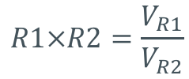
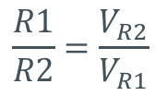
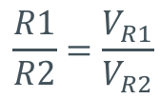
Step 4
What do you notice about the voltages across R1 and R2? Which of the following describes the relationship between the voltage across R1 and R2?
Img06
$$\frac{R1}{R2}=\frac{V_{R1}}{V_{R2}}$$
$$R1×R2=\frac{V_{R1}}{V_{R2}}$$
a
c
$$\frac{R1}{R2}=\frac{V_{R2}}{V_{R1}}$$
d
$$R1×V_{R1}=R2×V_{R2}$$
b
Notes:
Img06 = image of the words “Step 4”
Multiple Choice question
Option a is correct
Feedback:
a) – That’s right. The voltage across each resistor is in the same proportion as the value of each resistor. Resistor R1 has twice as much resistance as R2 and it has twice as much voltage across it.
b), c) or d). That is not correct. The value of R1 is 1KΩ and the value of R2 is 500Ω. R1, therefore, has twice the resistance as R2. You should also have found that the voltage across R1 is about 6V and the voltage across R2 is about 3V. So the voltage across R1 is twice as big as the voltage across R2. Therefore we can say that the voltage across each resistor is in the same proportion as the value of the resistors. In this case R1:R2 = 2:1 = V_{R1}:V_{R2}.

Slide 13
Step 5
Before we move on, take one more set of readings.
Img07
Measure the current before R2, between R2 and R1 and after R1. Is there any difference? What does this tell you about the current in the circuit?
The current is the same throughout the circuit.
The current is different in different parts of the circuit.
a
b
Notes:
Img07 = image of the words “Step 4”
Multiple Choice question
Option a is correct
Feedback:
a) – That’s right. The current flowing through each part of the circuit is exactly the same (about 6mA). This makes sense as there is only 1 path for the electrons to take.
b) - That is not correct. You should have found that the current is the same flowing through all parts of the circuit (about 6mA). This is because there is only one path through the circuit that electrons can travel.

Slide 14
Resistors in Series Divide the Voltage
You should have discovered that the two resistors in series divided up the total circuit voltage (9V) in the same proportion as their resistances. In other words the voltage across R1 was 6V and the voltage across R2 was 3V. The total voltage did not change. The current was the same at all parts of the circuit.
Watch the video to see how all the calculations were done and why we get the results we do.
Img08
Notes:
Img08 = screenshot of vid02 (see brief). On click of image play vid03 full screen.

Slide 15
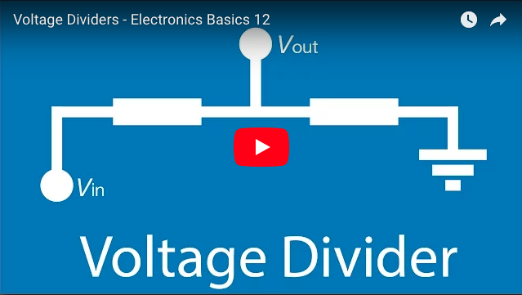
Kirchoff’s Voltage Law
We now know that resistors in series act to divide up the total voltage and that the voltage across each resistor adds up to the total circuit voltage (or the voltage of the power source like a battery). Resistors in series are voltage dividers.
This is called Kirchoff’s Voltage Law.
Watch the video to learn more about how resistors in series act as voltage dividers.
Notes:
Youtube video: URL = https://www.youtube.com/watch?v=fmSC0NoaG_I
Play video full screen

Slide 16
Remember
Resistors in series divide up the total voltage in the same proportion as their resistances.
Resistors in series are voltage dividers.

Slide 17
A Virtual Circuit
Take a moment to play around with another virtual circuit that helps illustrate voltage dividers and Kirchoff’s Voltage Law.
Img09
Download and work through the worksheet. Then watch the video to make sure you completed everything correctly.
Download the worksheet
Notes:
Button01 = open Doc01 (see brief)
Img10 = EveryCircuit logo
Img09 = Screenshot of vid03 (see brief). Play video full screen.

Slide 18
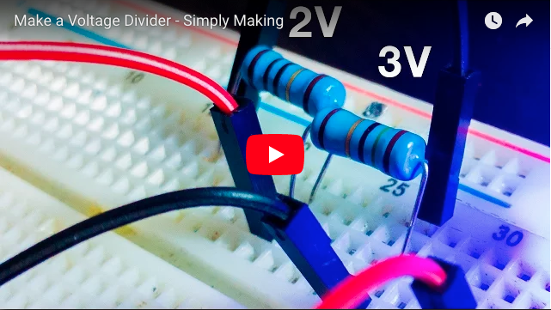
Build Your Own Voltage Divider
Using series resistors as voltage dividers can be very useful when you have a component in your circuit that only needs some of the total circuit voltage.
Design and construct your own voltage divider circuit with a 9V battery such that you have a voltage drop across one resistor of about 3V. Watch the video if you need some help.
Notes:
Youtube video: URL = https://www.youtube.com/watch?v=L321aqTvrLQ
Play video full screen

Slide 19
Build Another Voltage Divider
As we saw earlier, we can make a voltage divider using more than 2 resistors.
Construct your own voltage divider circuit with a 9V battery and a 100Ω, 120Ω, 150Ω and 180Ω resistor. Measure the voltage across each resistor. Does your circuit obey Kirchoff’s Voltage Law? Watch the video if you need help.
Img11
Notes:
Img11 = screenshot of vid04 (see brief). Play video full screen.

Slide 20
Take a picture
Take a picture of your completed circuit and upload it.
Choose image
Upload
Notes:
Button 01 – Launch file selection window
Button 02 – Upload file

Slide 21
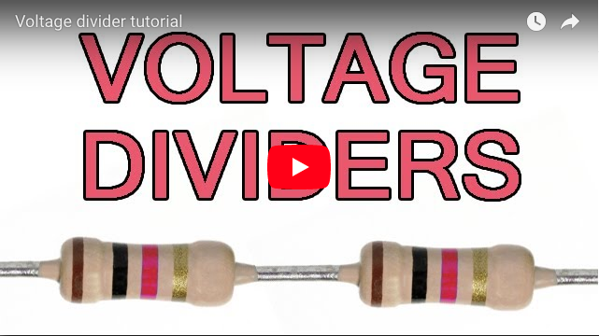
An Important Note
We know that resistors in series will divide the total voltage in proportion to their resistances but this is not the only thing one needs to consider when making a voltage divider.
Watch the video to find out why
Notes:
Youtube video: URL = https://www.youtube.com/watch?v=XxLKfAZrhbM
Play video full screen

Slide 22
Test Yourself
We have come to the end of this unit. Answer the following questions to make sure you understand resistors in series acting as voltage dividers.
You can use the virtual circuit you have just been using to check some of your answers if you like.

Slide 23
Question 1
Three resistor of values 10Ω, 20Ω and 30Ω are connected in series across a 12 volt battery. Calculate the total circuit resistance.
200Ω, 1 watt
200Ω, ½ watt
200Ω, ¼ watt
200Ω, 2 watt
Notes:
Multiple choice question
Option b is correct
Feedback:
A = That is not correct. The total power P = VI = 9V x 0.03A = 0,27 watts. So while this resistor would work, its rating is quite far above what is needed. Therefore, it would be a waste of money using this resistor.
B = Well done. That is right. The total power P = VI = 9V x 0.03A = 0,27 watts. A resistor rated at 0,5 watts would do well in this circuit.
C = That is not correct. The total power P = VI = 9V x 0.03A = 0,27 watts. A 0,25 watt resistor would likely be damaged.
D = That is not correct. The total power P = VI = 9V x 0.03A = 0,27 watts. So while this resistor would work, its rating is quite far above what is needed. Therefore, it would be a waste of money using this resistor.

Slide 24
Question 2
Three resistor of values 10Ω, 20Ω and 30Ω are connected in series across a 12 volt battery. Calculate the total circuit current.
200Ω, 1 watt
200Ω, ½ watt
200Ω, ¼ watt
200Ω, 2 watt
Notes:
Multiple choice question
Option b is correct
Feedback:
A = That is not correct. The total power P = VI = 9V x 0.03A = 0,27 watts. So while this resistor would work, its rating is quite far above what is needed. Therefore, it would be a waste of money using this resistor.
B = Well done. That is right. The total power P = VI = 9V x 0.03A = 0,27 watts. A resistor rated at 0,5 watts would do well in this circuit.
C = That is not correct. The total power P = VI = 9V x 0.03A = 0,27 watts. A 0,25 watt resistor would likely be damaged.
D = That is not correct. The total power P = VI = 9V x 0.03A = 0,27 watts. So while this resistor would work, its rating is quite far above what is needed. Therefore, it would be a waste of money using this resistor.

Slide 25
Question 3
Three resistor of values 10Ω, 20Ω and 30Ω are connected in series across a 12 volt battery. Calculate: the current through each resistor.
200Ω, 1 watt
200Ω, ½ watt
200Ω, ¼ watt
200Ω, 2 watt
Notes:
Multiple choice question
Option b is correct
Feedback:
A = That is not correct. The total power P = VI = 9V x 0.03A = 0,27 watts. So while this resistor would work, its rating is quite far above what is needed. Therefore, it would be a waste of money using this resistor.
B = Well done. That is right. The total power P = VI = 9V x 0.03A = 0,27 watts. A resistor rated at 0,5 watts would do well in this circuit.
C = That is not correct. The total power P = VI = 9V x 0.03A = 0,27 watts. A 0,25 watt resistor would likely be damaged.
D = That is not correct. The total power P = VI = 9V x 0.03A = 0,27 watts. So while this resistor would work, its rating is quite far above what is needed. Therefore, it would be a waste of money using this resistor.

Slide 26
Question 4
Three resistor of values 10Ω, 20Ω and 30Ω are connected in series across a 12 volt battery. Calculate the voltage drop across each resistor.
200Ω, 1 watt
200Ω, ½ watt
200Ω, ¼ watt
200Ω, 2 watt
Notes:
Multiple choice question
Option b is correct
Feedback:
A = That is not correct. The total power P = VI = 9V x 0.03A = 0,27 watts. So while this resistor would work, its rating is quite far above what is needed. Therefore, it would be a waste of money using this resistor.
B = Well done. That is right. The total power P = VI = 9V x 0.03A = 0,27 watts. A resistor rated at 0,5 watts would do well in this circuit.
C = That is not correct. The total power P = VI = 9V x 0.03A = 0,27 watts. A 0,25 watt resistor would likely be damaged.
D = That is not correct. The total power P = VI = 9V x 0.03A = 0,27 watts. So while this resistor would work, its rating is quite far above what is needed. Therefore, it would be a waste of money using this resistor.

Slide 27
Question 5
Four resistors of value 120Ω, 250Ω and 360Ω and 470Ω are connected in series across a 24V supply. Calculate the voltage drop across the 470Ω resistor.
200Ω, 1 watt
200Ω, ½ watt
200Ω, ¼ watt
200Ω, 2 watt
Notes:
Multiple choice question
Option b is correct
Feedback:
A = That is not correct. The total power P = VI = 9V x 0.03A = 0,27 watts. So while this resistor would work, its rating is quite far above what is needed. Therefore, it would be a waste of money using this resistor.
B = Well done. That is right. The total power P = VI = 9V x 0.03A = 0,27 watts. A resistor rated at 0,5 watts would do well in this circuit.
C = That is not correct. The total power P = VI = 9V x 0.03A = 0,27 watts. A 0,25 watt resistor would likely be damaged.
D = That is not correct. The total power P = VI = 9V x 0.03A = 0,27 watts. So while this resistor would work, its rating is quite far above what is needed. Therefore, it would be a waste of money using this resistor.

Slide 28
Video Briefing – Vid01
Create a video presented by an expert presenter showing step-by-step how to build the simple series circuit on a breadboard. The presenter needs to explain the following:
Add resistors to board
Connect end to end with a jumper
Connect each resistor to power rail
Connect power rail to battery
Emphasise what we mean by series – only one path – no branching

Slide 29
Video Briefing – Vid02
Create a video presented by an expert presenter showing step-by-step how to take the measurements and do the calculations. The presenter needs to explain the following:
Measure the across the battery – total circuit voltage
Measure the voltage across R1
Measure the voltage across R2
See the V_{R1} + V_{R2} = VT.
See that V_{R1} : V_{R2} = R1 : R2
Measure current before R2, between R2 and R1 and after R1 and show that the current in the whole circuit is the same because there is only one path for the electrons to flow.
Conclude with the fact that the resistors divided up the voltage in the same proportion as their resistances.

Slide 30
Document Briefing – Doc01
Create an annotated PDF worksheet with the following steps.
Make sure you have downloaded the EveryCircuit App from your app store.
If you are working on a computer, visit http://everycircuit.com/app/.
Open the EveryCircuit app and signup. After your trial, you will still have access to EveryCircuit and other people’s circuits. You will just not be able to create your own circuits.
Go to the community space and search for the circuit called “NOC_Kirchoff Voltage Law”
Open the circuit.
You will see that the voltage is 12V and that there is a 8.89mA current flowing through the circuit.
There are two resistors in series – a 450Ω and a 900Ω resistor.
Are the resistors dividing up the total voltage in the same proportion as their resistances?
How would you divide the voltage evenly between both resistors (i.e. get the voltage across each resistor to be 6V) while still keeping the current flowing through the circuit the same (8.89mA)? Remember that resistors in series add together for the total circuit resistance. Remember also that V=IR.
How would you make the voltage across one resistor 4 times that across the other resistor while still keeping the current through the circuit at 8.89mA.
What 2 resistors would you need if you wanted a current through the circuit of 12mA and the voltage across one resistor to be 3 times that across the other?
What 3 resistors would you need if you wanted to divide the 12V into three parts (2V, 4V, 6V) with a total current through the circuit of 10mA.

Slide 31
Video Briefing – Vid03
Create a screencast video presented by an expert presenter. The presenter needs to work through the Doc01 worksheet and cover and explain the following steps.
Opening the app and opening the circuit – (hhttp://everycircuit.com/circuit/6011278182318080) for mobile and desktop
Doing the calculations
Making the resistor changes

Slide 32
Video Briefing – Vid04
Create a video presented by an expert presenter showing step-by-step how to build the voltage divider circuit circuit on a breadboard with 100, 120, 150 and 180 ohm resistors. The presenter needs to explain the following:
Add resistors to board
Connect end to end with a jumper
Connect each resistor to power rail
Connect power rail to battery
Measure voltage drops across each resistor
Confirm all voltage drops = total voltage by also measuring voltage across battery terminals
Confirm voltage drops across each resistor in proportion to each’s resistance

