Slide 1
Electronics
Topic 3: Resistors

Slide 2
Assumed prior learning
05_01_00
05_01_02
05_02_01
05_03_01
05_04_01
Notes:
Note for navigation on site:
This information needs to be taken into account and needs to stated on the LMS, perhaps as part of the introduction?

Slide 3
Outcomes
By the end of this unit the learner will be able to:

Slide 4
Unit 3.2: Resistors in Series

Slide 5
Introduction
In this unit we are going to look at resistors in series. If you have done Course 1: Electrical Principles, you will already be familiar with series circuits.
We will also learn about the different kinds of resistors that are available and how we can use them.
Img01
Notes:
Img01 = image of a carbon resistor, a wire wound resistor and a potentiometer.

Slide 6
EveryCircuit
EveryCircuit is a free tool that let’s you create and experiment with different electronic circuits on your computer or mobile device. We are going to use it often during this course so you need to download it to your device now.
Click the button to download the free EveryCircuit app to your mobile device sign up for the free trial.
Download EveryCircuit
After the trial period, you will still be able to access circuits. You just will not be able to make your own.
Notes:
Button01 = open http://everycircuit.com/
Img02 = EveryCircuit logo

Slide 7
Play with EveryCircuit
Take some time to get familiar with EveryCircuit. To help you, we have prepared a short worksheet and an introductory video.
Img03
Download and work through the worksheet. Then watch the video to make sure you completed everything correctly.
Download the worksheet
Notes:
Button01 = open Doc01 (see brief)
Img03 = Screenshot of vid01 (see brief). Plat video full screen.
Img03a = EveryCircuit logo

Slide 8
Resistor Types
There are basically 2 types of resistors that you might use in electronics.
Img04
Img05
Click on the pictures to find out more about each type of resistor.
Fixed Value Resistors
Variable Resistors
Notes:
Img04 = image with an example of both a carbon (e.g. https://media.rs-online.com/t_large/R0132494-01.jpg) and wire wound resistor (e.g. https://media.rs-online.com/t_large/F4852631-01.jpg)
Img04 = on click present a popup of slide 9.
Img05 = image with an example of both a variable potentiometer (e.g. https://images-na.ssl-images-amazon.com/images/I/61hQscs1Y8L._SY355_.jpg) and a trim pot (e.g. https://www.westfloridacomponents.com/mm5/graphics/M07/P163.jpg)
Img05 = on click present a popup of slide 10.

Slide 9
Fixed Resistors
Fixed resistors have…fixed resistance. They are, by far the most common type of resistors you will use in electronics. They come in two main types.
Img05
Carbon resistors are made by depositing a film of carbon on a ceramic rod. The more carbon the higher the resistance.
Img06
A thin resistive wire is wound around a ceramic core. The longer and thinner the wire, the higher the resistance.
Carbon Resistor
Wire-Wound Resistor
Click the button to learn more.
Learn more
Notes:
Img05 = image of a typical carbon resistor
Img06 = image of a typical wire-wound resistor
Button01 = open https://www.electronics-tutorials.ws/resistor/res_1.html in a new window

Slide 10
Variable Resistors
Variable resistors have…variable resistance. They are also know as potentiometers and not as common as fixed resistors. They come in two main types.
Img07
The resistance of a variable potentiometers can be easily and continually adjusted with a dial.
Img08
A pre-set potentiometer (also called a trim pot) is set to a specific value for a specific application and left there.
Variable Potentiometer
Trim Pot
We will come back to variable resistors later in this topic.
Notes:
Img07 = image of a typical potentiometer
Img08 = image of a typical trim pot

Slide 11
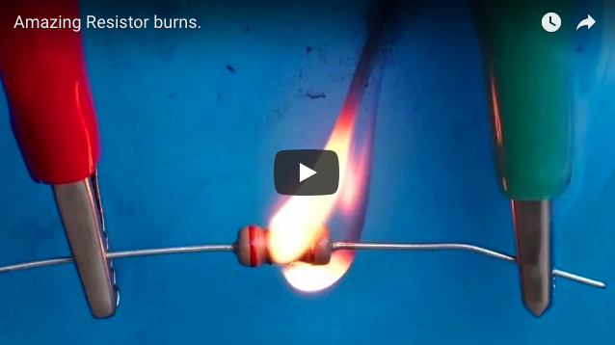
Smokin’
When the voltage across a resistor forces current through it, the resistor gets hot. We need to make sure that the resistor is not damaged by too much heat. So resistors also have a power rating to indicate their limit.
Watch the video to see what happens if we exceed a resistor’s power rating and it gets too hot.
Notes:
Youtube video: URL = tps://www.youtube.com/watch?v=SjlnW5g9np4
Play video full screen

Slide 12
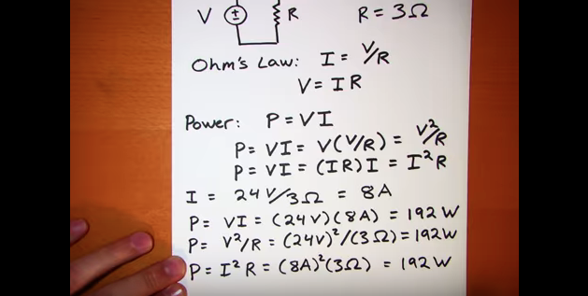
Resistor Power Ratings
Resistor power ratings are given in Watts and tell us how much voltage and current the resistor can handle. Two 100Ω resistors will have the same resistance but one rated at 1W will be able to handle more voltage and current than one rated at ½W.
Watch the video to find out more about power ratings.
Notes:
Youtube video: URL = https://v637g.app.goo.gl/h1XZuaenvHHmrtUo6
Play video full screen

Slide 13
Bigger = Higher Power
Carbon resistors come in many different power ratings. The bigger the resistor, the higher the power rating.
Wire-wound resistors generally have higher power ratings (as high as 50W) than carbon resistors.
Notes:
Img09 = https://www.electronicshub.org/wp-content/uploads/2015/09/resistor-wattage.jpg or make a similar comparative image.

Slide 14
Remember
A 200Ω, ½ watt and a 200Ω, 5 watt resistor will have exactly the same influence on a circuit. It is just that a 5 watt resistor can withstand more voltage and current than a ½ watt resistor.

Slide 15
Resistors in Series
It is not possible for resistor makers to make a resistor of every possible resistance. So sometimes it is necessary to add more than 1 resistor to a circuit to get to the desired total resistance.
We are going to build a circuit with a total resistance of 740Ω using a 470Ω and a 270Ω resistor.
Use a resistor guide to find the correct resistors in your kit.

Slide 16
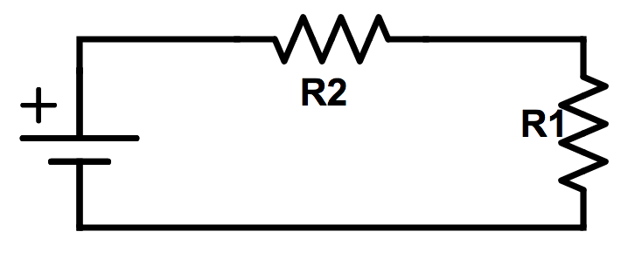
Build the Circuit
Using this schematic as a guide, build the circuit. Make sure that the resistors are connected end to end so that there is only one path for the electrons to follow.
Rollover or touch each symbol in the schematic to find out more. Watch the video if you need help.
Watch how to build the circuit
Notes:
Reproduce schematic image as an image with hotspots over each component.
Component01 = on click present a tooltip with “This symbol represents a voltage source like a battery Use a 9V battery.”
Component02 = on click present a tooltip with “This symbol represents a resistor. In this case we have called the resistor R1.” Do you think it matters if we place the 470Ω or 270Ω resistor here?
Component03 = on click present a tooltip with “This symbol represents a resistor. In this case we have called the resistor R2.” Do you think it matters if we place the 470Ω or 270Ω resistor here?
Button01 = play vid02 (see brief) full screen
Hide tooltip on clicking away from component or another component.

Slide 17
Take a picture
Take a picture of your completed circuit and upload it.
Choose image
Upload
Notes:
Button 01 – Launch file selection window
Button 02 – Upload file

Slide 18
Review How To Use a Multimeter
We now need to take some readings from our circuit and do some calculations.
Img10
Refer to the multimeter guide saved on your device or click the image to see it again.
Notes:
Img10 = image of the same multimeter guide screenshot as used in 10_02_03 slide 10 linking to the same document.

Slide 19
Step 1
Measure the voltage of the battery by taking a reading with your multimeter across the terminals.
Img11
Enter the voltage
V
Check
Notes:
Img11 = image of the words “Step 1”
Button01 = on click, check the voltage entered. It should be between 8V and 9.5V.
Feedback:
If in range – That look’s about right. Remember to make a note of the voltage on your paper.
If not in range - Your battery’s voltage should be about 9V. If it is less than 8V, you should try and get a new battery. If you cannot right now, use the voltage reading you got. Remember to write it down on your paper and use it in any calculations.

Slide 20
Step 2
Measure the current flowing through the circuit by connecting your multimeter in series between the positive terminal of the battery and the first resistor.
Img12
Enter the current
mA
Check
Notes:
Img12 = image of the words “Step 2”
Button01 = on click, check the current entered. It should be between 10mA – 14mA.
Feedback:
If in range – That look’s about right. Remember to make a note of the current on your paper.
If not in range - Your current reading should be about 12mA. Check it again. If your voltage was less than 8V, your current could be less than 10mA. If so, use this reading but remember to make a note of it on your paper.

Slide 21
Step 3
Use Ohm’s Law to calculate the resistance in the circuit. Remember Ohm’s Law can be written as V = I x R. Enter the resistance in the space below. Remember to convert your mA current reading into A by dividing it by 1,000 first.
Img13
Enter the resistance
Ω
Check
Notes:
Img13 = image of the words “Step 3” as well as the VIR triangle
Button01 = on click, check the resistance entered. It should be between 710Ω – 770Ω
Feedback:
If in range – That look’s about right. Well done. You have found out that the resistance in the circuit is about 740Ω
If not in range - Your resistance calculation answer should be about 740Ω. Check your calculations again.

Slide 22
Step 4
Disconnect the circuit and measure the resistance of each resistor directly with your multimeter. Does the total match the resistance you calculated for the circuit?
Img14
Yes
No
Notes:
Img14 = image of the words “Step 4”
Yes/No option:
Feedback:
Yes – That’s right. Measuring the resistance of the resistors directly should give us more or less the same answer as before. Before, we were calculating the resistance of the whole circuit but the wires, being very good conductors, should have contributed very little to this total. The wires do have a little bit of resistance which is why the resistance in the whole circuit is a little bit more than the resistance of the resistors.
No – It look’s like something has gone wrong. Check your resistance measurement again.

Slide 23
Resistors in Series Add Together
You should have discovered that the total value of both resistors (which you got by measuring their resistance directly with your multimeter) was more or less the same as the total circuit resistance you calculated – about 740Ω.
Watch the video to see how all the calculations were done and why we get the results we do.
Img13
Notes:
Img15 = screenshot of vid03 (see brief). On click of image play vid03 full screen.

Slide 24
The total resistance in our circuit is about 740Ω. Therefore, when resistors are placed in series all we need to do to work out their combined resistance is to add their values together.
Notes:
Youtube video: URL = tps://www.youtube.com/watch?v=SjlnW5g9np4
Play video full screen

Slide 25
A Virtual Circuit
It is time to try this out with a virtual circuit in the EveryCircuit app.
Download and work through the worksheet. Then watch the video to make sure you completed everything correctly.
Img15
Download the worksheet
Notes:
Button01 = open Doc02 (see brief)
Img14 = EveryCircuit logo
Img15 = Screenshot of vid04 (see brief). Play video full screen.

Slide 26
Test Yourself
We have come to the end of this unit. Answer the following questions to make sure you understand resistors in series.
You can use the virtual circuit you have just been using to check some of your answers if you like.

Slide 27
Question 1
Which resistor should you use in a circuit where the voltage is 9V and the current drawn is 30mA?
200Ω, 1 watt
200Ω, ½ watt
200Ω, ¼ watt
200Ω, 2 watt
Notes:
Multiple choice question
Option b is correct
Feedback:
A = That is not correct. The total power P = VI = 9V x 0.03A = 0,27 watts. So while this resistor would work, its rating is quite far above what is needed. Therefore, it would be a waste of money using this resistor.
B = Well done. That is right. The total power P = VI = 9V x 0.03A = 0,27 watts. A resistor rated at 0,5 watts would do well in this circuit.
C = That is not correct. The total power P = VI = 9V x 0.03A = 0,27 watts. A 0,25 watt resistor would likely be damaged.
D = That is not correct. The total power P = VI = 9V x 0.03A = 0,27 watts. So while this resistor would work, its rating is quite far above what is needed. Therefore, it would be a waste of money using this resistor.

Slide 28
Question 2
True or False: A 470Ω, 1 watt resistor would be damaged in a circuit powered by a 24V supply.
True
False
Notes:
T/F question
True is correct
Feedback:
True = Well done. The power in this circuit is P = VI or V²R = 24V x 470Ω = 1,22 watts. Therefore a 1 watt resistor would be damaged.
False = That is not correct. The power in this circuit is P = VI or V²R = 24V x 470Ω = 1,22 watts. Therefore a 1 watt resistor would be damaged.

Slide 29
Question 3
Two resistors (540Ω and 3K4Ω) are in series. The circuit is connected to a 6V supply. What current would flow through the circuit?
15mA
15A
15μA
1.5mA
Notes:
Multiple choice question
Correct option is D
Feedback:
A = That is not correct. Remember that a 3K4Ω resistor is a 3,400Ω resistor. So the total resistance in the circuit is 540Ω + 3,400Ω = 3,940Ω. According to Ohm’s Law I = V/R = 6V/3940Ω = 0.0015A = 1.5mA
B = That is not correct. Remember that a 3K4Ω resistor is a 3,400Ω resistor. So the total resistance in the circuit is 540Ω + 3,400Ω = 3,940Ω. According to Ohm’s Law I = V/R = 6V/3940Ω = 0.0015A = 1.5mA
C = That is not correct. Remember that a 3K4Ω resistor is a 3,400Ω resistor. So the total resistance in the circuit is 540Ω + 3,400Ω = 3,940Ω. According to Ohm’s Law I = V/R = 6V/3940Ω = 0.0015A = 1.5mA
D = Well done. That is correct.

Slide 30
Question 4
In which circuit would 15mA be flowing?
Notes:
Multiple choice question

Slide 31
Question 5
Which kind of resistors are better suited for circuits with high current.
Carbon resistors
Wire-wound resistors
Notes:
Multiple choice question

Slide 32
Question 6
Drag the resistors onto the schematic such that the total current flowing in the circuit will be 5.04mA.
Notes:
Drag and drop question.
All the following resistors need to be dragged onto the schematic – 1, 3, 4. Do not display numbers.
Img16 = image of a 220Ω resistor
Img17 = image of a 430Ω resistor
Img18 = image of a 400Ω resistor
Img19 = image of a 570Ω resistor
Img20 = image of a 330Ω resistor
6V, total R = 1190Ω

Slide 33
Document Briefing – Doc01
Create an annotated PDF worksheet with the following steps.
Make sure you have downloaded the EveryCircuit App from your app store.
If you are working on a computer, visit http://everycircuit.com/app/.
Open the EveryCircuit app and signup. After your trial, you will still have access to EveryCircuit and other people’s circuits. You will just not be able to create your own circuits.
Go to the community space and search for the circuit called “NOC_Ohms Law”
Open the circuit.
You will see that the voltage is 9V and that there is a 20mA current flowing through the circuit.
The value of the resistor of 450Ω. Does this circuit agree with Ohm’s Law?
What current would flow through the circuit if the voltage was 4V? Do the calculation.
Now click on/touch the battery then click on/touch the little spanner icon that appears under the circuit. Change the voltage to 4V.
With the same resistor in place, what is the current now? Does this agree with your calculation above?
With a voltage of 5V, calculate the resistance you need to create a current of 65mA?
Change the voltage in the circuit to 5V and the resistance of the resistor to your calculated value. Do you get a current of 65mA?

Slide 34
Video Briefing – Vid01
Create a screencast video presented by an expert presenter. The presenter needs to work through the Doc01 worksheet and cover and explain the following steps.
Opening the app and opening the circuit – (http://everycircuit.com/circuit/6217393797070848) for mobile and desktop
Doing the calculations
Making the voltage and resistor changes

Slide 35
Video Briefing – Vid02
Create a video presented by an expert presenter showing step-by-step how to build the simple series circuit on a breadboard. The presenter needs to explain the following:
Add resistors to board
Connect end to end with a jumper
Connect each resistor to power rail
Connect power rail to battery
Emphasise what we mean by series – only one path – no branching

Slide 36
Video Briefing – Vid03
Create a video presented by an expert presenter showing step-by-step how to take the measurements and do the calculations. The presenter needs to explain the following:
Measure the voltage
Measure the current
Calculate resistance
Show Ohm’s Law triangle
Show calculation for resistance
Do calculation
Emphasise units
Directly measure the resistance in series
Emphasis only measuring in disconnected circuit
Compare measured and calculated measures of resistance
Emphasis total R is R1 + R2

Slide 37
Document Briefing – Doc02
Create an annotated PDF worksheet with the following steps.
Make sure you have downloaded the EveryCircuit App from your app store.
If you are working on a computer, visit http://everycircuit.com/app/.
Open the EveryCircuit app and signup. After your trial, you will still have access to EveryCircuit and other people’s circuits. You will just not be able to create your own circuits.
Go to the community space and search for the circuit called “NOC_Ohms Law 2”
Open the circuit.
You will see that the voltage is 9V and that there is a 6mA current flowing through the circuit.
There are two resistors in series – a 500Ω and a 1K Ω resistor.
What is the total resistance of the resistors.
What is the total circuit resistance as calculated by Ohm’s Law
Is sum of the resistors the same as the total circuit resistance.
Calculate the total resistance you would need to draw a 15mA current form this 9V battery.
Change one or both of the resistor values to draw this current.

Slide 38
Video Briefing – Vid04
Create a screencast video presented by an expert presenter. The presenter needs to work through the Doc02 worksheet and cover and explain the following steps.
Opening the app and opening the circuit – (http://everycircuit.com/circuit/5866742265151488) for mobile and desktop
Doing the calculations
Making the resistor changes

