Slide 1
Electronics
Topic 2: Circuit Basics

Slide 2
Assumed prior learning
05_01_00
05_01_02
05_02_01
05_03_01
05_04_01
Notes:
Note for navigation on site:
This information needs to be taken into account and needs to stated on the LMS, perhaps as part of the introduction?

Slide 3
Outcomes
By the end of this unit the learner will be able to:

Slide 4
Unit 2.3: Tools

Slide 5
Introduction
In the rest of this course, you are going to build and test a number of different electronic circuits.
To do this you will need to use your kit of electronics components, your creativity and, of course, a different tools. In this unit, we will look at some of the tools you will need, what they do and how to use them correctly.
Img01
Notes:
Img01 = Image of an array of different electronics tools including, multimeter, cutters, pliers and soldering iron

Slide 6
Hand Tools
There are basically two different groups of tools:
Hand Tools
1
2
Measuring Tools
Watch the next video to get a run down of the different hand tools that are available.
Notes:
Youtube video: URL = https://www.youtube.com/watch?v=Kv7Y8nAOoFE
Play video full screen

Slide 7
What’s in your Kit
The kit you bought for this course contains a few hand tools.
Click on each image to learn more about each tool.
Img02a
Img02b
Img02c
Img02d
Img02e
Notes:
Need to decide what will go into the kit first
On click of each picture, present a popup with additional information.

Slide 8
Measuring Tools
Besides the tools you need to physically build your circuits, you are also going to need to measure what is happening inside them to check that they are working as designed and expected. There is one truly indispensable measuring tool and that is the basic multimeter.
Img02
Notes:
Img02 = picture of a standard multimeter

Slide 9
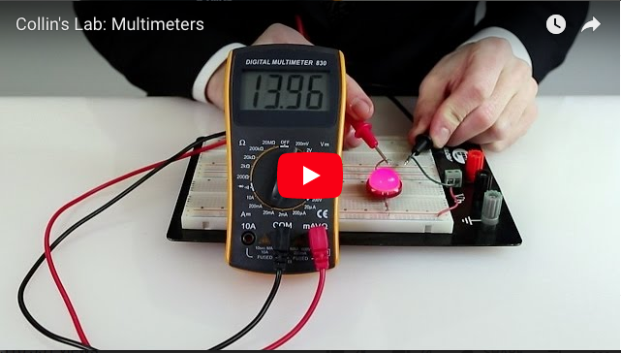
Multimeters
Multimeters, like the name suggests, can measuring multiple things, including voltage, resistance, current and continuity (whether the circuit is complete or not).
Watch this video to see the different kinds of test you can do with a multimeter.
Notes:
Youtube video: URL = https://www.youtube.com/watch?v=rPGoMbVSUu8
Play video full screen

Slide 10
A Handy Testing Guide
Click on the image to download a handy guide for how to do the basic tests with your multimeter. Save the guide to your device for later reference.
Img03
Notes:
Img03 = screenshot of the full guide (see Img03 brief)

Slide 11
A Handy Testing Guide
For a really good summary of the multimeter and how to use it, be sure to visit the How to Use a Multimeter page at Sparkfun. (https://learn.sparkfun.com/tutorials/how-to-use-a-multimeter)

Slide 12
Let’s Test
Get some practice using your multimeter by doing the following tests. Remember to refer to your testing guide.
Click on each test to see what you need to do.
Continuity Test
Voltage Test
1
3
Resistance Test
Current Test
2
4
Notes:
On click of each test present popups with the following information:
See brief
See brief
See brief
See brief

Slide 13
The Breadboard
Breadboards are really useful for creating temporary electronic circuits to test their properties and behaviours.
Breadboards are great because there is no soldering necessary (more on soldering later) which means that it is very easy to change your circuit or swop different components in or out as often as you like.
Img04
Notes:
Img04 = image of a typical breadboard

Slide 14
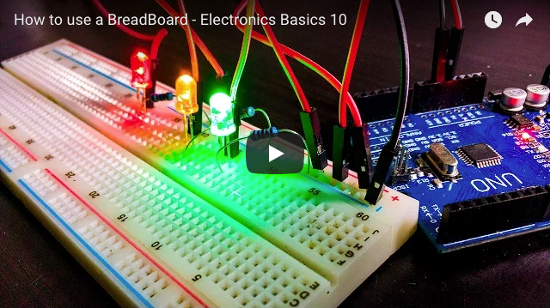
Breadboard????
Breadboards are called breadboards because before breadboards were available, people used actual breadboards to make and test their circuits. Confused?
Watch the video to sort out any confusion
Notes:
Youtube video: URL = https://www.youtube.com/watch?v=fq6U5Y14oM4
Play video full screen

Slide 15
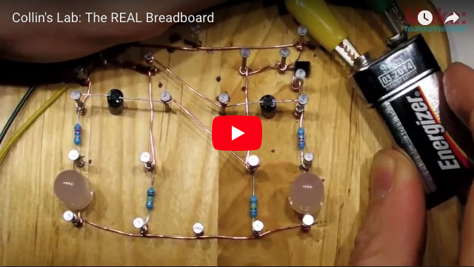
The Real Breadboard
Watch this great video which shows you some of the benefits of using an actual breadboard. Just for fun, of course.
Notes:
Youtube video: URL = https://www.youtube.com/watch?v=HrG98HJ3Z6w
Play video full screen

Slide 16
Jumper Wires
It is time for you to get busy again.
Throughout the rest of this course, you are going to need jumper wires – short wires to connect the different components in your breadboard circuits.
Read the guide on how to create jumper wires, then watch the video for how to make the perfect jumper wires.
Read the guide
Watch the video
Notes:
Button01 = on click open http://www.dummies.com/programming/electronics/how-to-make-jumper-wires/) in a new window
Button02 = on click open Youtube video: URL = https://www.youtube.com/watch?v=ver-Av8vr1Q. Play video full screen

Slide 17
Make Your Own Coin Battery
Make the following jumper wires and then upload a picture of your completed wires.
5 x 5cm
5 x 7cm
5 x 10cm
5 x 15cm
Img05
Storage Tip
Choose image
Upload
Notes:
Img05 = image of the same set of jumpers neatly arranged by length
Button 01 – Launch file selection window
Button 02 – Upload file
Button03 = On click open a popup with the following text - You will find it very useful if you keep all your jumper wires organised by length and/or colour so that you can find the jumper you need when you need it.

Slide 18
Test Yourself
Answer the following questions to make sure you understand what you need to know about batteries.

Slide 19
Question 1
Batteries are a good source of power for electronics circuits because
They provide high quality AC power.
They provide power at high voltages.
They provide DC power.
They can be thrown away when they are flat.
Notes:
Multiple choice question
Correct option is c)
Feedback:
That is not right. Batteries provide DC power. It is usually only mains electricity that is supplied as AC.
That is not right. Batteries tend to provide power at low voltages. It is usually mains electricity sent over many kilometres that is supplied at high voltage.
Well done. You got it! Batteries are a good source of DC power.
That is not correct. Batteries should never be thrown away in ordinary rubbish. They should always be recycled or disposed of in special bins available at many shops.

Slide 20
Question 2
Q
Notes:
Multiple choice question
Correct option is c)
Feedback:
That is not right. Batteries provide DC power. It is usually only mains electricity that is supplied as AC.
That is not right. Batteries tend to provide power at low voltages. It is usually mains electricity sent over many kilometres that is supplied at high voltage.
Well done. You got it! Batteries are a good source of DC power.
That is not correct. Batteries should never be thrown away in ordinary rubbish. They should always be recycled or disposed of in special bins available at many shops.

Slide 21
Question 3
Q
Notes:
Multiple choice question
Correct option is c)
Feedback:
That is not right. Batteries provide DC power. It is usually only mains electricity that is supplied as AC.
That is not right. Batteries tend to provide power at low voltages. It is usually mains electricity sent over many kilometres that is supplied at high voltage.
Well done. You got it! Batteries are a good source of DC power.
That is not correct. Batteries should never be thrown away in ordinary rubbish. They should always be recycled or disposed of in special bins available at many shops.

Slide 22
Image Briefing – Img03
Create a downloadable visual guide describing each of the following tests. Represent each point graphically and with words.
Testing for Continuity:
Only test WITHOUT voltage source (unpowered circuit))
Set the multimeter to the continuity setting (show typical dial marking)
Connect the probes to the xxx sockets of the multimeter.
Place probes at the start and end of circuit in any orientation
Measuring Resistance:
Only test WITHOUT voltage source (unpowered circuit)
Set the multimeter to the resistance setting (show typical dial marking)
Connect the probes to the yyy sockets of the multimeter
Place probes at both ends of the component in either orientation
Measuring Voltage:
Test WITH a voltage source connected (powered circuit)
Set the multimeter to the voltage setting (show typical dial marking)
Connect the probes to the zzz sockets of the multimeter
Place probes at start and end points of the section of circuit across which voltage is being measured, positive terminal connected to positive side of circuit (otherwise a negative voltage will be displayed).
Measuring Current:
Test WITH a voltage source connected (powered circuit)
Set the multimeter to the current setting (usually mA for electronics circuits) (show typical dial marking)
Connect the probes to the aaa sockets pf the multimeter
Break the circuit where you want to measure the current and connect the multimeter with the red lead connected to positive side of the circuit.

