Slide 1
Electronics
Topic 2: Circuit Basics

Slide 2
Assumed prior learning
05_01_00
05_01_02
05_02_01
05_03_01
05_04_01
Notes:
Note for navigation on site:
This information needs to be taken into account and needs to stated on the LMS, perhaps as part of the introduction?

Slide 3
Outcomes
By the end of this unit the learner will be able to:

Slide 4
Unit 2.1: Wires and Switches

Slide 5
Introduction
Now that we have the voltage source (battery or power supply) for our circuit sorted, we need to actually make a circuit. This is the job of wires which let us connect the components in our circuit to the voltage source and switches, which let us turn the circuit on and off.
Img01
Notes:
Img01 = picture of a simple circuit consisting of a 9V battery in a battery holder, wires, a switch and a light bulb.

Slide 6
Good Conductors
We want as much of the energy in our circuit to be used by the components (resistors, LEDs, diodes, transistors etc.) as possible. Therefore, the wires and connectors should be good conductors and resist the flow of electrons as little as possible. Many wires are made out of copper because it is such a good conductor.
There are basically 2 types of wires commonly used:
Learn more about different wires

Slide 7
Good Conductors
Drag each of the phrases below describing solid core and stranded wires to the correct picture.
Insulation around metal conductor
Flexible
Many thin wire bundled together
Insulation around metal conductor
Not very flexible
Solid Core
Stranded
Single piece of wire
Notes:
Drag and drop. Correct placement is as follows. Assess on each drop.
Solid core:
Insulation around metal conductor
Not very flexible
Single piece of wire
Stranded:
Insulation around metal conductor
Flexible
Many thin wires bundled together
See comments for image sources. Need to replace with similar CC or new images.

Slide 8
More Wires
Solid core and stranded are the main types of wires used in electronics. But there are a few other types available.
Img04
Click the button below to see a more complete list of all the different types of wires.
Learn more about the different wires
Notes:
Img04 = image of different kinds of wires
Button01 = on click open https://electronicsclub.info/connectors.htm#cable in a new window.

Slide 9
Gauges
Both solid core and stranded wire comes in different thicknesses or gauges.
Generally, the thicker the wire, the more current it can safely carry. Remember current is a measure of the amount of charge (really the number of electrons) flowing past a point in the circuit per second. So the thicker the wire is, the more electrons can flow through it per second.

Slide 10
Gauges
Notes:
https://learn.sparkfun.com/tutorials/working-with-wire#introduction

Slide 11
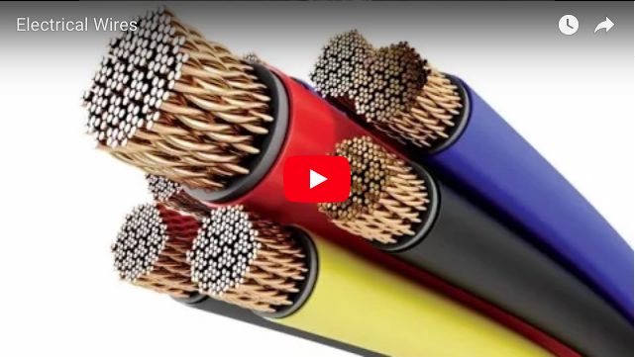
All about Wires
Watch the video to learn more about the different types, of wires, their composition, manufacture, thicknesses and applications.
Notes:
Youtube video: URL = https://www.youtube.com/watch?v=_AApboO3aj0
Play video full screen

Slide 12
Switches
What does a light switch in your house have in common with the buttons on your phone? They are all switches!
Img05
Img06
Notes:
Img05 = image of a light switch
Img06 = image of a feature phone key pad and the on/off button of a smart phone

Slide 13
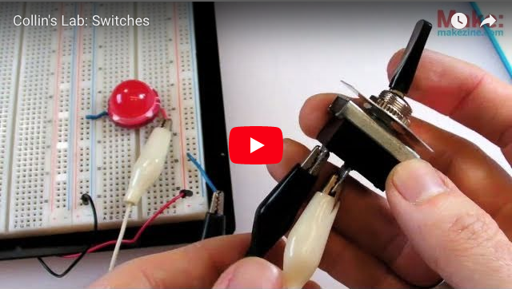
Wonder Switches
A switch is a switch is a switch…right? Wrong! While the basic function of a switch is pretty simple – to open or close a circuit – there is a whole lot more to these little guys than you might imagine.
Watch the video to learn more about the wonderful world of switches.
Notes:
Youtube video: URL = https://www.youtube.com/watch?v=S2AHimvbovI
Play video full screen

Slide 14
Draw It
Make your own drawing of a switch on a piece of paper. Then take a picture of it and upload it.
Choose image
Upload

Slide 15
Test Yourself
Answer the following questions to make sure you understand what you need to know about wires and switches.

Slide 16
Question 1
Q
Notes:
Multiple choice question
Correct option is c)
Feedback:
That is not right. Batteries provide DC power. It is usually only mains electricity that is supplied as AC.
That is not right. Batteries tend to provide power at low voltages. It is usually mains electricity sent over many kilometres that is supplied at high voltage.
Well done. You got it! Batteries are a good source of DC power.
That is not correct. Batteries should never be thrown away in ordinary rubbish. They should always be recycled or disposed of in special bins available at many shops.

Slide 17
Question 2
Q
Notes:
Multiple choice question
Correct option is c)
Feedback:
That is not right. Batteries provide DC power. It is usually only mains electricity that is supplied as AC.
That is not right. Batteries tend to provide power at low voltages. It is usually mains electricity sent over many kilometres that is supplied at high voltage.
Well done. You got it! Batteries are a good source of DC power.
That is not correct. Batteries should never be thrown away in ordinary rubbish. They should always be recycled or disposed of in special bins available at many shops.

Slide 18
Question 3
Q
Notes:
Multiple choice question
Correct option is c)
Feedback:
That is not right. Batteries provide DC power. It is usually only mains electricity that is supplied as AC.
That is not right. Batteries tend to provide power at low voltages. It is usually mains electricity sent over many kilometres that is supplied at high voltage.
Well done. You got it! Batteries are a good source of DC power.
That is not correct. Batteries should never be thrown away in ordinary rubbish. They should always be recycled or disposed of in special bins available at many shops.

Slide 19
Video Briefing – Vid01

