Slide 1
Electronics
Topic 2: Circuit Basics

Slide 2
Assumed prior learning
05_01_00
05_01_02
05_02_01
05_03_01
05_04_01
Notes:
Note for navigation on site:
This information needs to be taken into account and needs to stated on the LMS, perhaps as part of the introduction?

Slide 3
Outcomes
By the end of this unit the learner will be able to:

Slide 4
Unit 2.1: Batteries

Slide 5
Introduction
For any electric circuit to work, there needs to be a supply of voltage - that force that makes current (actually the electrons) flow through the circuit. Unless there is a voltage, the electrons don’t flow and nothing useful happens.
In electronics, one of the most common sources of voltage are batteries. These are portable sources of voltage and use chemical reactions to create the flow of electrons.
Img01
Notes:
Img01 = picture of a 9V battery

Slide 6
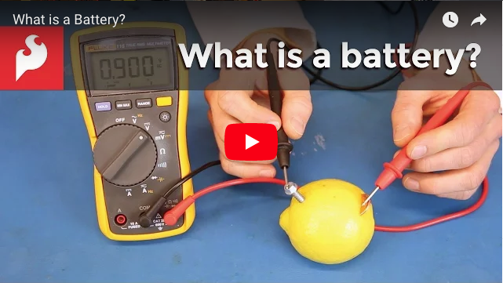
What is a Battery?
There are many of different kinds of batteries. They come in different shapes and sizes and use different chemical reactions to make electrons flow. Some are rechargeable and others not. But they all work in much the same way.
Watch this video to learn more about what batteries are and how they work.
Notes:
Youtube video: URL = https://www.youtube.com/watch?v=-EB7NVA7rI4
Play video full screen

Slide 7
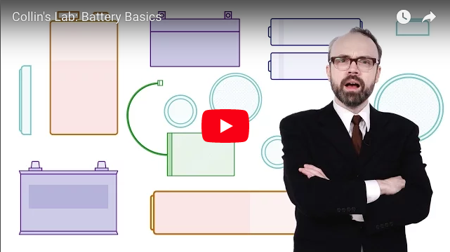
Different Types of Batteries
Even though all batteries work in a similar way, they have their advantages and disadvantages and so are useful for powering different kinds of electronic circuits for different purposes.
Watch this video to learn more about the different types of batteries available.
Notes:
Youtube video: URL = https://www.youtube.com/watch?v=8ftkn7nZSDo
Play video full screen

Slide 8
Other Sources of Voltage
Batteries are not the only sources of voltage available to us. We can also use power supplies that plug into the wall. These kinds of power supplies have two main jobs.
Change AC electricity to DC electricity
Img02
1
Step down the voltage
2
Touch/click on each point above to learn more.
Notes:
Img02 = image of lightening bolt
On click of each point present popups with the following information:
All electronics circuits need direct current (DC) not the alternating current (AC) that comes out of the wall. So these power supplies change the AC to DC, a process called rectification. We will see exactly how this is done later in the course.
Most electronics circuits can only handle a couple of volts not the 230V that comes out of the wall. So these power supplies step the voltage down from 230V to something far lower. Again we will see how this is done later in the course.

Slide 9
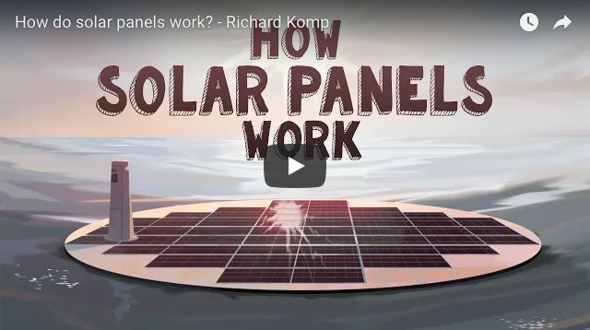
Solar Power
Another type of voltage source or power supply available to us is solar power!
Solar panels are simple devices. They are really just layers of two types of silicon. We will learn far more about how they work later on in this course when we get to diodes.
Watch the video to get an excellent overview of solar panels.
Notes:
Youtube video: URL = https://www.youtube.com/watch?v=xKxrkht7CpY
Play video full screen

Slide 10
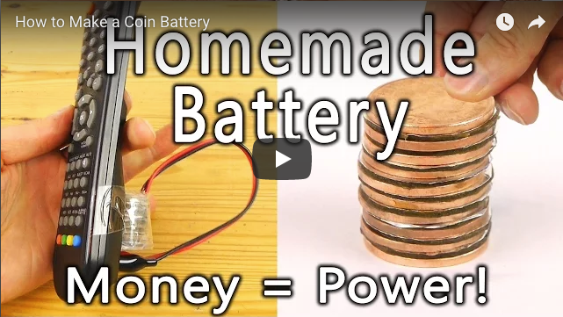
Money Is Power
We saw in a previous video how to make your own battery from a lemon, a coin and a nail.
Watch the video for step by step instructions on how to make your own coin battery.
Notes:
Youtube video: URL = https://www.youtube.com/watch?v=vIHfUJu3aKo
Play video full screen

Slide 11
Make Your Own Coin Battery
Img03
Using the previous video as a guide, construct your own coin battery using about 9 or 10 copper coins. Two cents pieces will be great for this. When you are done take a picture or video of the working battery
Choose image
Upload
Notes:
Img03 = https://cdn.pixabay.com/photo/2016/01/03/00/43/upload-1118929_960_720.png
Button 01 – Launch file selection window
Button 02 – Upload file

Slide 12
What if…?
Answer these questions then click them to see the answer.
What do you think would happen if you made a coin battery using 20 coins?
1
What do you think would happen if you made your coin battery out of smaller coins?
2
What do you think would happen if you used R1 coins to make your battery instead?
3
How would you recharge your coin battery?
4
Notes:
On click of each question, display a popup with the following answers.
Voltage would be higher
Smaller surface area = less voltage
Not copper – not as conductive – less current
Soak the paper in more solution

Slide 13
Battery Safety
Before we move onto the next unit, there are a few things you should know about battery safety.
Click on each image to learn more
Img04
Img05
Img06
Notes:
Img04 = icon of a battery being thrown into a bin with a big line through it
Img05 = icon of battery terminals connected directly with a big line through it
Img06 = icon of battery being thrown into a fire with a big line through it
On click of each picture replace picture with the following text.
Img04: Don’t throw batteries into the bin. They are full of harmful chemicals. Find special battery bins at shops like Pick ‘n Pay.
Img05: Don’t connect the terminals of a battery directly together. Without a load, too much current will be drawn and the battery could burn.
Img06: Don’t throw batteries into fire. They can explode.

Slide 14
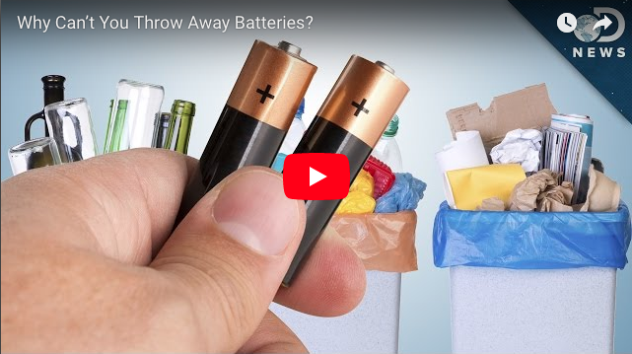
Don’t Throw Batteries Away
Watch this video to learn more about why you should not thrown batteries in the bin.
Notes:
Youtube video: URL = https://www.youtube.com/watch?v=sdAme_Nw7qM
Play video full screen

Slide 15
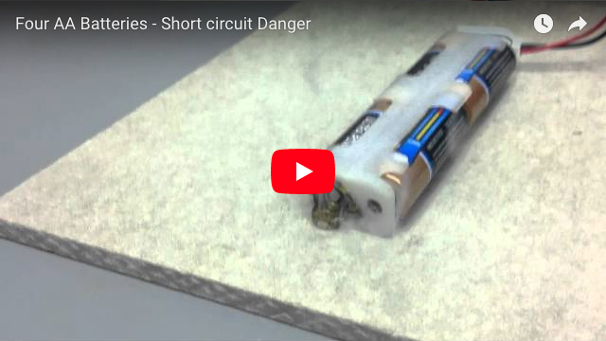
Short Circuit Danger
Watch this video to learn more about why short circuiting a battery is not a good idea.
Notes:
Youtube video: URL = https://www.youtube.com/watch?v=4fj5BLo27yw
Play video full screen

Slide 16
Test Yourself
Answer the following questions to make sure you understand what you need to know about batteries.

Slide 17
Question 1
Batteries are a good source of power for electronics circuits because
They provide high quality AC power.
They provide power at high voltages.
They provide DC power.
They can be thrown away when they are flat.
Notes:
Multiple choice question
Correct option is c)
Feedback:
That is not right. Batteries provide DC power. It is usually only mains electricity that is supplied as AC.
That is not right. Batteries tend to provide power at low voltages. It is usually mains electricity sent over many kilometres that is supplied at high voltage.
Well done. You got it! Batteries are a good source of DC power.
That is not correct. Batteries should never be thrown away in ordinary rubbish. They should always be recycled or disposed of in special bins available at many shops.

Slide 18
Question 2
Your friend wants to connect the 2 terminals of a 9V battery together with just a piece of copper wire. Drag the following statements into the correct sequence to explain to him why this is not a good idea.
The copper wire has very little resistance.
Therefore, there will be very little resistance in the circuit.
A very large current will be allowed to flow in the circuit.
The copper wire will become extremely hot
The battery will run down very quickly and may be damaged
Notes:
Sequence drag and drop question
The statements are presented above in the correct order but must be presented to the learner in random order.

Slide 19
Question 3
Q

Slide 20
Question 4
Q

Slide 21
Video Briefing – Vid01

