Slide 1
Transformers
Topic 1: Transformers

Slide 2
Assumed prior learning
05_01_00
05_01_02
05_02_01
Notes:
Note for navigation on site:
This information needs to be taken into account and needs to stated on the LMS, perhaps as part of the introduction?

Slide 3
Outcomes
By the end of this unit you will be able to:
Explain and describe the differences between open core, closed core, shell type and auto-transformers;
Do power, current, voltage and turn calculations with double wound and aut0-transformers;
Explain transformer losses how transformer cooling systems work;
Explain why transformers are rated in kVA; and
Discuss the use of instrument transformers.

Slide 4
Unit 1.3: Types of transformers

Slide 5
Introduction
Transformers all do the same job. They step voltage either up or down. But there are a few different types. In this unit, we will learn about these different types and how they are constructed.
Notes:
Img01 = a picture of different types of transformers e.g. http://distroy.ru/uploads/posts/2017-08/1501878737_vidy-transformatorov.jpg

Slide 6
An iron core
In unit 1, we were reminded that one of the ways to increase the strength of the magnetic field produced by a solenoid (a coil) is to wrap the wire around a ferromagnetic core, like an iron rod.
Ferromagnetic metals, like iron, are strongly attracted to magnets. Therefore, an iron rod inside a coil will concentrate the magnetic field inside it. All transformers use some kind of ferromagnetic core - usually iron because it is cheap.
Click the button to learn more about ferromagnetic materials
Ferromagnetic materials
Notes:
Ferromagnetic materials = On click, play YT01 full screen. YT01 = https://www.youtube.com/watch?v=6wEWbX_FruY

Slide 7
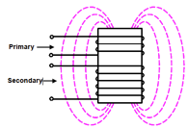
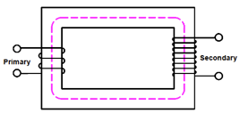
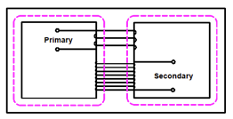
Types of iron core
There are basically three different types of transformer design, depending on how their iron core is made.
Click on each image to find out more about each type.
Open core
Closed core
Shell or divided core
Notes:
On click of each image, display contents of indicated slides as a popup. Each image is a thumbnail of the images detailed on these slides.
Open core = slide 8
Closed core = slide 9
Shell or divided core = slide 10

Slide 8
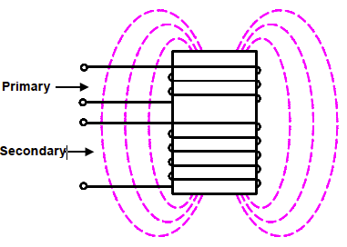
Open core
These are the least expensive as there is the least amount of iron.
Some of the magnetic field has to travel through the air, which is not very efficient so the strength of the field is weakened.
Open cores are used when small size is important.
Notes:
Img02 = reproduce this image but use different colours for the primary and secondary coils. Also, add in filed lines travelling inside the core.

Slide 9
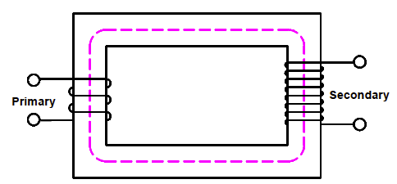
Closed core
Closed cores allow almost all the magnetic field to travel through the iron core which makes them much more efficient than open cores and good for high voltage applications like substations.
Notes:
Img03 = reproduce this image but use different colours for the primary and secondary coils

Slide 10
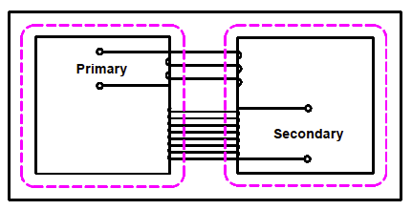
Shell or divided core
In this case, the iron core of the open design is extended so that almost all the magnetic field can travel through the core. In addition, there are two paths for the magnetic field, making the divided core even more efficient than the closed core.
Notes:
Img04 = reproduce this image but use different colours for the primary and secondary coils

Slide 11
The auto-transformer
You may have noticed that all three transformer designs we have just looked at have 2 separate windings – one for the primary and one for the secondary coil. Makes sense.
But, auto-transformers have only a single winding used for both the primary and secondary coils.
Vid01
Watch the video to learn more about autotransformers.
Notes:
Vid01 = On click, play Vid01 full screen. See appendix for Vid01 brief.

Slide 12
What is a Variac?
A really cool application of auto-transformers is the ability to change the voltage (and hence the current) in the secondary coil “on the fly”. These machines are called Variacs.
YT01
Watch the video to learn more about Variacs.
Notes:
YT01 = On click, play YT01 full screen. YT01 = https://www.youtube.com/watch?v=M8cJrJyR87o

Slide 13
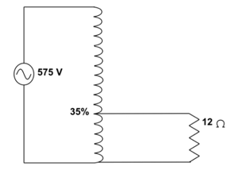
Calculations with a step-down auto-transformer
Try answer the questions, then watch the video solution.
35% of the primary voltage of 575V is used to power a 12Ω load.
What is the secondary voltage?
What is the secondary current?
What is the transformer’s power?
What is the primary current?
How much current flows in the shared part of the winding?
Solution
Notes:
Solution = On click, play YT02 full screen. YT02 = https://www.youtube.com/watch?v=XgVxbjmdJ7s
Img08 = redraw and on click display full screen

Slide 14
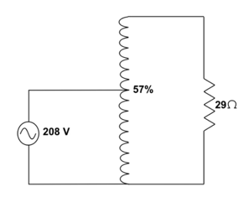
Calculations with step-up auto-transformer
Try answer these questions, then watch the video solution.
A primary voltage of 208V is stepped-up by 57% to power a load of 29Ω.
What is the secondary voltage?
What is the secondary current?
What is the transformer’s power?
What is the primary current?
How much current flows in the shared part of the winding?
Solution
Notes:
Solution = On click, play YT03 full screen. YT03 = https://www.youtube.com/watch?v=un0o4aMThwk
Img09 = redraw and on click display full screen

Slide 15
Try these!
Try the next few questions using the transformer and power equations on your own.
Notes:
Img10 = https://cdn.pixabay.com/photo/2016/12/22/04/39/question-mark-1924516_960_720.png – marked for reuse (same as Img05 in 08_01_02)

Slide 16
Question 1
A single phase transformer has a supply of 2200V. At full load the primary current is 100A and the secondary current is 500A. There are 300 turns on the primary coil. Calculate the:
Secondary voltage
Secondary turns
Voltage ratio
Primary : Secondary turns ratio
Power of the transformer
Solution
Notes:
Question is actually 5 separate numeric questions – submit answer for each question one-by-one. After each submission indicate whether answer is correct or not and give correct answer if not correct. After 5th answer submitted make the Solution available.
Answers:
a)
Solution = on click open Doc01. See appendix for brief.

Slide 17
Question 2
A single phase transformer has a supply of 3500V. The turns ratio primary:secondary is 10:1. The secondary current at full load is 2A and the secondary coil has 280 turns. Calculate the:
Secondary voltage
Primary current
Primary turns
Solution
Notes:
Question is actually 3 separate numeric questions – submit answer for each question one-by-one. After each submission indicate whether answer is correct or not and give correct answer if not correct. After 3rd answer submitted make the Solution available.
Solution = on click open Doc02. See appendix for brief.

Slide 18
Question 3
A single phase transformer has a supply of 380V and a primary:secondary turns ratio of 14:3. The secondary circuit drives a load of 9Ω. Calculate the:
Secondary voltage
Secondary current current
Primary turns if there are 60 secondary turns
The transformer power
Solution
Notes:
Question is actually 4 separate numeric questions – submit answer for each question one-by-one. After each submission indicate whether answer is correct or not and give correct answer if not correct. After 4th answer submitted make the Solution available.
Solution = on click open Doc03. See appendix for brief.

Slide 19
Question 4
Calculate the secondary voltage on a 220V transformer through which passes a 3A current when the secondary current is 10A.
Solution
Notes:
1 numeric question
Solution = on click open Doc04. See appendix for brief.

Slide 20
Question 5
A step-down auto-transformer steps down a primary voltage of 480V by 43% to drive a secondary load of 23Ω. What is the primary current and how much current flows through the shared part of the winding?
Solution
Notes:
Question is actually 2 separate numeric questions – submit answer for each question one-by-one. After each submission indicate whether answer is correct or not and give correct answer if not correct. After 2nd answer submitted make the Solution available.
Solution = on click open Doc05. See appendix for brief.

Slide 21
Question 6
The secondary side of a step-up transformer is 50V/0.6A and the turn ratio is 1:11.9, with 419 turns on the secondary. Calculate the:
Supply voltage
Supply current
Power
Primary turns
Solution
Notes:
Question is actually 4 separate numeric questions – submit answer for each question one-by-one. After each submission indicate whether answer is correct or not and give correct answer if not correct. After 4th answer submitted make the Solution available.
Solution = on click open Doc06. See appendix for brief.

Slide 22
How are transformers rated?
In all the previous calculations, we assumed that the power drawn by the secondary circuit (W) was the same as the power delivered by the primary circuit (W). Transformers are designed with a maximum number of volts and amps at which they can operate.
But transformers are not rated in Watts. They are rated in Volt-Amperes (VA) or kilovolt-Amperes (kVA). A transformer able to deliver 75A at 500V will have a rating of 500V x 75A = = 37,500VA or 37.5kVA.

Slide 23
Why are transformers not rated in Watts?
Not all the power used in an electric circuit is always ”useful” power. Some of it is “wasted power”.
Vid02
Watch the video to find out more about this wasted power and how it affects the total power in a circuit.
Notes:
Vid02 = On click, play Vid02 full screen. See appendix for Vid02 brief.

Slide 24
kVA ratings
Because transformers need to supply apparent power and not just active power, they are rated for apparent power i.e. VA. Most transformers are rated in the thousands of Volt-Amperes so you will mostly see kVA ratings.
Active Power
(kW)
V x I x cosθ
Reactive Power
(kVAR)
V x I x sinθ
Apparent Power
(kVA)
V x I
+
=

Slide 25
Power factor calculations
A single phase transformer has a supply voltage of 480V and a primary current of 20A at full load. The secondary current is 7A. There are 600 turns on the primary coil. Calculate the:
Turns ratio
Number of secondary turns
Secondary voltage
Power if the power factor is 0.8
Try answer these questions, then watch the video solution.
Solution
Notes:
Solution = on click open Doc07. See appendix for brief.

Slide 26
Try these!
Try the next few questions using the transformer and power equations on your own.
Notes:
Img10 = https://cdn.pixabay.com/photo/2016/12/22/04/39/question-mark-1924516_960_720.png – marked for reuse (same as Img05 in 08_01_02)

Slide 27
Question 7
A single phase transformer powers a factory with a total active power requirement of 2.3kW and a power factor of 0.866. What is the minimum rating this transformer should have?
Solution
Notes:
Solution = on click open Doc07. See appendix for brief.

Slide 28
Question 8
At full load, a single phase transformer has a secondary current of 21A and a primary : secondary turn ratio of 30 : 1.
If the supply voltage is 10kV, what is the transformer’s rating?
It the power factor of the load is 0.896, what is the load’s active power requirement?
Solution
Notes:
Solution = on click open Doc08. See appendix for brief.

Slide 29
Question 9
A 12kVA transformer is ordered to provide power to a load that has an active power requirement of 26.6A at 380V. The supply voltage is
It is discovered that the load’s power factor is 0.823. Will this transformer be suitable?
If your answer to part a) is “no” what must the load’s power factor be reduced to for this transformer to safely operate?
If the supply voltage is 11kV, what will the primary current be at this new power factor?
Solution
Notes:
Solution = on click open Doc09. See appendix for brief.

Slide 30
Question 10
Calculate the power factor if the active power in a circuit is 45.6kW and the reactive power is 18.87kVAR.
Solution
Notes:
Solution = on click open Doc10. See appendix for brief.

Slide 31
Do transformers loose energy?
We said in the previous unit that transformers are such efficient machines that we usually ignore power losses in calculations. Most transformers are 95% to 99% efficient, meaning that up to 99% of the primary power gets transferred to the secondary coil. But no transformer is perfect and there are always some losses.
Click the buttons to learn about the 2 main types of losses.
Copper losses
Core losses – Eddy currents
Core losses – Hysteresis
Notes:
On click of each button, display contents of indicated slides as a popup.
Copper losses = slide 23
Core losses – Eddy currents = slide 24
Core losses – Hysteresis = slide 25

Slide 32
Copper losses
Copper is a really good conductor but it is not perfect. As current flows through the coils, it heats up and this heat is lost energy or power. We know that $P=V×I$ and that $V=I×R$. Therefore we can calculate this power loss by using $P=\left(I×R\right)×I=I^{2}R$.
A good way to minimise copper losses is to use thicker cable. Thicker cables have less resistance (but they do cost more). Copper losses are highest under full load.
Notes:
Img11 = https://www.publicdomainpictures.net/pictures/110000/velka/copper-wound.jpg – marked for reuse

Slide 33
Core losses – Eddy currents
The magnetic field that induces a current in the coils, also induces small currents in the iron core called eddy currents. These heat up the core and, again, result in a loss of power.
Eddy currents can be reduced by increasing the resistance of the iron core to eddy currents. This is done by making it out of many insulated thin strips of metal instead of 1 sold chunk. These strips are called laminations.
Learn more about eddy currents
Notes:
Img12 - https://upload.wikimedia.org/wikipedia/commons/thumb/6/67/Laminated_core_eddy_currents.svg/2000px-Laminated_core_eddy_currents.svg.png – marked for reuse
Learn more about eddy currents = On click, play YT05 full screen. YT05 = https://www.youtube.com/watch?v=zJ23gmS3KHY

Slide 34
Core losses - Hysteresis
Every time the AC supply reverses direction, the magnetic field reverses polarity. This reversal uses energy. This energy loss is called hysteresis.
You can think of hysteresis as the energy you need to use to change direction quickly.
Some materials, such as silicone steel, change polarity easily, so that when such materials are used as core material, hysteresis loss is reduced to a minimum.
Notes:
Img13 = https://upload.wikimedia.org/wikipedia/commons/thumb/a/ab/Korean_Traffic_sign_%28U-Turn%29.svg/2000px-Korean_Traffic_sign_%28U-Turn%29.svg.png – marked for reuse

Slide 35
Transformer losses summary
Watch the video for a great summary of the types of transformer losses that can occur.
YT06
Notes:
TY06 = https://www.youtube.com/watch?v=QDE1kNZe-pk. On click, play full screen

Slide 36
How do we cool transformers?
Air cooled
Copper loses account for most of the energy lost by transformers and this is lost as heat.
We need to remove this heat otherwise the transformer might be damaged.
Smaller transformers use air cooling while larger ones use oil.
Click on the images to learn more.
Oil cooled
Notes:
On click of each image, display contents of indicated slides as a popup. Air cooled image is a thumbnail of the image on slide 28.
Img14 (oil cooled) = image of an oil cooled transformer e.g. https://www.vde-kassel.de/resource/blob/1667190/0cbfeba08ad6b2a32f4ea7280b922fe0/400-110-30-kv-transformator-1030105-data.jpg or a similar oil cooled transformer – cylindrical tank should be clearly visible
Air cooled = slide 28
Oil cooled = slide 29

Slide 37
Air cooled
Some transformers rely on natural heat exchange by using fins to increase the surface area over which heat can be lost. This is often called an air natural or AN system.
Larger air cooled transformers use fans to force air to circulate through the windings and core and so improve the rate of cooling. Such a system is called an air forced or AF system.
Notes:
Img15 (AN) - https://cdn.pixabay.com/photo/2017/10/05/18/31/electricity-2820425_960_720.jpg – marked for reuse
Img16 (AF) – picture of an AF cooled transformer e.g. https://electrical-engineering-portal.com/wp-content/uploads/transformer-fans-1.jpg

Slide 38
Oil cooled
Most transformers are inside a steel case filled with mineral oil that helps remove heat from the coils and core. This oil is either forced through the tank or allowed to circulate naturally.
Often you will see a cylindrical tank on top to keep the oil level right.
YT07
Watch the video for a good overview of all the different types of oil cooled transformers available.
Notes:
TY07 = https://www.youtube.com/watch?v=TSlliIYPWsM. On click, play full screen

Slide 39
What would happen?
We can generally safely measure voltages up to 450V and currents up to 10A directly.
Think what would happen if you connected a voltmeter directly to a 6,6kV line.
Think what would happen if you tried to measure a current of 300A.
Notes:
Img17 = https://upload.wikimedia.org/wikipedia/commons/e/e6/OneTeslaTS_DRSSTC_Tesla_Coil.jpg – marked for reuse
Img18 = https://i.ytimg.com/vi/RF5gzjvuNvk/maxresdefault.jpg (YT screenshot – should be OK to use)

Slide 40
Instrument Transformers
We can use the principle of transformers to step-down very high voltages and currents to safer levels. This makes measuring safer and means that we can use normal measuring instruments.
Click on each box to learn more
Current transformers step up the voltage to reduce the current
Voltage/Potential transformers step down the voltage
Notes:
On click of each button, display contents of indicated slides as a popup.
Current Transformers = slide 34
Voltage/Potential Transformers = slide 35
Learn more about eddy currents = On click, play YT07 full screen. YT08 = https://v637g.app.goo.gl/52LMT4ooVjuxkL3H6

Slide 41
Current Transformers
Current transformers step up the voltage to reduce the current. Often, they are a ring, where the primary coil is the actual high current wire.
Most often CTs are rated at 5A e.g. 300A = 5A. This means if you get a reading of 2.5A on your ammeter, then there is a primary current of 150A.
Notes:
Img19 = https://www.electronics-tutorials.ws/transformer/trans53.gif - reproduce

Slide 42
Voltage Transformers
Voltage of potential transformers step down the voltage. These are basically standard step-down transformers.
Most often VTs (or PTs) are rated at 110VA e.g. 20kV = 110V. This means if you get a reading of 55V on your voltmeter, then there is a primary voltage of 10kV.
Notes:
Img20 = https://upload.wikimedia.org/wikipedia/commons/5/5b/Instrument_Transformer.jpg – marked for reuse

Slide 43
Conclusion
So far in this course we have only dealt with transformers connected to single phase AC. In the next unit, we will take a look at three phase transformers and how these are connected.
Notes:
Img21 = https://upload.wikimedia.org/wikipedia/commons/thumb/4/48/Dreiphasen_Transformator.svg/870px-Dreiphasen_Transformator.svg.png – marked for reuse

Slide 44
Video Briefing – Vid01 (1 of 3)
Create a screencast video of an expert electrician explaining auto-transformers, how they work and their applications and disadvantages. Use https://www.youtube.com/watch?v=RblT05CLPw8 as a guide, and using Img05 – Img07
Notes:
Img05 = redraw

Slide 45
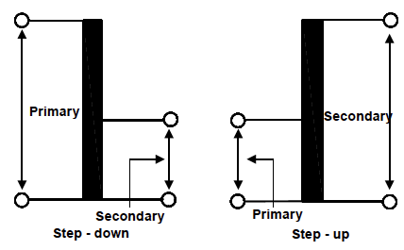
Video Briefing – Vid01 (2 of 3)
The “auto” does not mean automatic. It means single or one – one coil.
A part or all of the coil is used for the primary winding depending on whether it is a step-down or step-up transformer.
In step-up, the magnetic field produced by this piece of the coil cuts all the windings in the coil. Voltage across each turn is the same so voltage over whole coil is greater i.e. step-up.
The situation is reversed for step-down
Notes:
Img05 = redraw

Slide 46
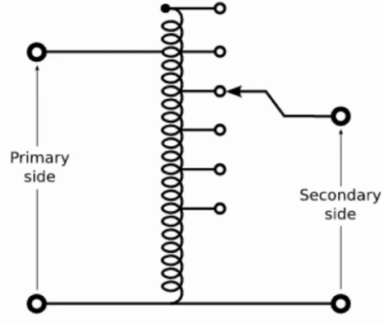
Video Briefing – Vid01 (3 of 3)
Auto-transformers usually have multiple tap points – points at which, especially the secondary voltage is tapped. Change the location of the tap point, change the number of turns, change the voltage.
The portion of the coil that is shared carries both currents. So part of the secondary current comes directly form the primary current and part comes from electromagnetic induction.
Auto-transformers need less wire so are cheaper than two coil transformers
But they don’t isolate primary and secondary currents so have limited application, mainly to lower voltages.
Notes:
Img06 = redraw
Img07 = picture of a variac e.g. https://www.circuitspecialists.com/content/255472/tdgc2-2-0.jpg

Slide 47
Video Briefing – Vid02 (1 of 4)
Create a simple animation with the following voiceover.
Aeroplanes transport people and stuff from A to B. (visual = a plane moving in an arc between A and B)
To do so, they burn fuel. (visual = zoom in on an engine with a small flame and smoke out the back)
But some of the fuel is also used to move the aeroplane itself. (visual = zoom out to the plane itself)
Not all the fuel is burned doing the “useful” work of transporting people and stuff. (visual = zoom through a window to see some passengers)
Some is unavoidably also used doing the “non-useful” work of moving the plane. (visual = zoom out to the plane again)

Slide 48
Video Briefing – Vid02 (2 of 4)
The same is true in some electric circuits. (visual = change seen to a simple electric circuit with a battery and a bulb).
In a circuit which only contains a light bulb, for example, all the work is “usefully” used to create light (and heat). (visual = zoom in on the bulb)
But a circuit with an electric motor is different. (visual = change scene to a washing machine)
Electric motors have coils of wire used to create magnetic fields. (visual = zoom inside the washing machine to see the electric motor with a cut away exposing the stator coils with magnetic field lines e.g. https://i.imgur.com/quEY7up.png)
It is these magnetic fields that make the motor spin. To make these magnetic fields, however, some of the energy needs to be used. (visual = battery energy meter symbol like https://thumbs.dreamstime.com/z/battery-question-to-idea-battery-meter-charge-levels-questions-to-brigth-idea-full-load-111879945.jpg labelled energy next to the motor reducing in height. By 1 bar to show that some energy is being used up)
This is like the fuel aeroplanes have to use to move themselves in order to also move the people and stuff. (visual = a similar battery energy meter next to a plane colour-coded to show 1 bar going to move the plane and 4 bars going to move people and stuff.

Slide 49
Video Briefing – Vid02 (3 of 4)
Visual = New scene with an electric shock symbol (e.g. https://previews.123rf.com/images/eriksvoboda/eriksvoboda1505/eriksvoboda150500006/39575278-attention-electric-shock-signs-symbol-vector-illustration-for-your-design-and-presentation-.jpg) and directly beneath it a plane symbol (e.g. https://encrypted-tbn0.gstatic.com/images?q=tbn:ANd9GcTktJcfn0bpbw4UDwJojyEi-_Iq1TFPka0ZaYTbd8kHH6Gb9Zif). Both on the left hand side.
We call the energy used to do the “useful” work in a circuit Active Power. It is measured in Watts (W) and we give it the symbol P for power (visual = block labelled P = Active Power (W) in line with and to the right of electric shock symbol and directly underneath this a label saying “Fuel to move passengers and stuff” i.e. in line with and to the right of the plane symbol)
We call the energy used to do necessary but “un-useful” work like generating magnetic fields Reactive Power and measure this as Volt-Ampere Reactive (VAR). We give it the symbol Q. (visual = a block to the right of Active Power labelled Q = Reactive Power (VAR) and directly beneath it a label saying “Fuel to move the plane itself”).
If we add these two together… (visual = a + sign inserted between both blocks and between both labels)
…we get the total or Apparent Power needed by the circuit. We measure this as Volt-Amperes (VA) and give it the symbol S. (visual = an “=“ sign and then a block labelled S = Apparent Power (VA) as well as an “=“sign and a label saying “total fuel needed”)

Slide 50
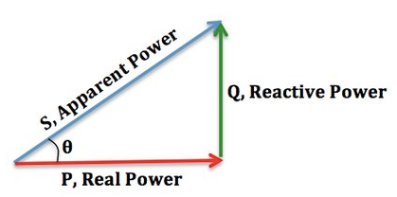
Video Briefing – Vid02 (4 of 4)
Just like lighter planes that need less fuel to move are better than heavier planes that need lots of fuel to move…(visual = new scene with a skinny plane next to a fat plane)
…so circuits with less Reactive Power are more efficient. More of the energy is spent doing useful work.
We call the ratio between Active Power and Apparent Power… (visual = $\frac{P}{S}$)
…the Power Factor of the circuit (visual = $\frac{P}{S}=Power Factor$)
We can rearrange this to get Active Power equal to Apparent Power multiplied by the Power Factor. (Visual = “P = S x Power Factor”)
The Power Factor can also be found by calculating the cosine of the angle theta in the power triangle. (Visual =

Slide 51
Video Briefing – Vid02
You can see that the smaller we make theta, the less reactive power there is and the closer the values of Apparent Power and Active Power get to one another (visual = animate triangle to reduce the size of the angle and the length of the green line so that blue eventually lies on red)
The smaller we make theta, the closer the value of cosine theta (the power factor) gets to 1 (visual = do the same animation as above but add “cosθ = “next to it and as theta gets smaller show that the value of cosθ gets closer and closer to 1)
Whenever you calculate power as voltage times current… (visual = power triangle and underneath it “P = V x I”)
...you are assuming a power factor of 1 – in other words no reactive power in the circuit (visual = make a “x 1” pop up to the right of “P = V x I”.
Almost always though, there is some reactive power so the power factor is less than 1. Therefore, Active Power (or just Power for short) is Voltage times Current times the Power Factor… (visual = power triangle and underneath it “P = V x I x Power Factor”)
Or Power is Voltage times Current times the cosine of theta. (visual = replace the ”x Power Factor” in the previous with ”cosθ”)
Reactive Power can also be calculated from this triangle if need be. Reactive Power is equal to Voltage x Current x the sine of theta (visual = replace the “cosθ” with “sinθ”)

