Slide 1
Three Phase Motors
Topic 5: Connecting and Starting Three Phase Pole Changing Motors

Slide 2
Assumed prior learning
05_01_00
05_01_02
05_02_01
Notes:
Note for navigation on site:
This information needs to be taken into account and needs to stated on the LMS, perhaps as part of the introduction?

Slide 3
Outcomes
By the end of this unit you will be able to:
Wire the main circuit of a pole changing motor starter with contactors;
Wire the control circuit of a pole changing motor starter with contacts; and
Explain the benefits of using contactors instead of a selector switch.

Slide 4
Unit 5.2: Pole Changing Motor Selector Switch Starter

Slide 5
Introduction
In the previous unit, we learnt how to use a selector switch to manually change the speed of a pole changing motor.
Using a manual selector switch has the disadvantage of needing a human to switch the motor between running speeds.
Using contactors allows us to make these changes automatically based on some input if we want to.
Using your knowledge of pole changing motors and the selector switch, how many contactors do you think will be needed?

Slide 6
Remember contactors?
We dealt extensively with three phase contactors in topic 3 of this course “Connecting and starting three phase induction motors”. But you may need a refresher.
What are contactors?
How are contactors wired?
Click on the buttons to review the different aspects of contactors
What are auxiliary contacts?
Notes:
Img01 = Img02 from 07_03_02
What are contactors = On click, play YT01 full screen. YT01 = https://www.youtube.com/watch?v=5Iujs94re_U
How are contactors wired = On click, play Vid01 from 07_03_02 full screen
What are auxiliary contacts = On click, play Vid02 from 07_03_02 full screen

Slide 7
Safety first
When you work with motors you must put your safety and the safety of others first. You must complete the necessary Hazard Identification and Control (HIAC) Form.
Need help with HIACs? Click the button to go to Topic X in The World of an Electrician
Get help with HIAC Forms
Notes:
Img01 = https://cdn.pixabay.com/photo/2014/04/02/10/38/sign-304093_960_720.png
Button 01 = direct learner to Topic X in Course 0

Slide 8
Before We Begin
Before you do any work on a motor, you must make sure that you have isolated and locked out the supply to the motor.
Make sure you know how to do this by referring to Topic X in The World of An Electrician.
Learn about Isolating and Lock-Out Procedures
Notes:
Img02 =
Button 01 = direct learner to Topic X in Course 0

Slide 9
The main circuit
We need three contactors for the basic pole changing motor starter – one for the low speed and two for the high speed.
Int01
Click on the image to see how these contactors are wired and how they work.
Notes:
Int01 = screenshot of Int01. On click, open Int01 full screen See appendix for Int01 brief.

Slide 10
Wire up the main circuit
Int02
Did you notice that the main circuit is identical for both delta and star connected motors? Now practice wiring a pole-changing starter with contactors.
Click on the image to access the motor wiring simulator. Click on the button if you would like to watch a video of the motor being wired.
Notes:
Int02 = On click of Int02 screenshot, open Int02 full screen. See the Appendix for Int02 brief.

Slide 11
The main circuit
Draw your own main circuit for the pole changing motor starter that uses three contactors. Then take a picture of your circuit and upload it to your online portfolio.
Choose image
Upload
Notes:
Img04 = https://cdn.pixabay.com/photo/2016/01/03/00/43/upload-1118929_960_720.png
Button01 – Launch file selection window
Button02 – Upload file

Slide 12
The control circuit
The control circuit is a little more complicated than the main circuit. Let’s take a look at it piece by piece.
Step 1: Basic slow circuit
1
Step 2: Basic fast circuit
2
Click on the buttons to see the control circuit explained step by step.
Step 3: Bridging circuit
3
Step 4: Interlocks
4
Notes:
Button 1 = On click, play step 1 of Vid01 full screen. See appendix for Vid01 brief.
Button 2 = On click, play step 2 of Vid01 full screen. See appendix for Vid01 brief.
Button 3 = On click, play step 3 of Vid01 full screen. See appendix for Vid01 brief.
Button 4 = On click, play step 4 of Vid01 full screen. See appendix for Vid01 brief.

Slide 13
The control circuit
Draw your own control circuit for the pole changing motor starter that uses three contactors. Then take a picture of your circuit and upload it to your online portfolio.
Choose image
Upload
Notes:
Img04 = https://cdn.pixabay.com/photo/2016/01/03/00/43/upload-1118929_960_720.png
Button01 – Launch file selection window
Button02 – Upload file

Slide 14
Wire up the control circuit
Int03
Practice wiring the control circuit for the pole-changing starter with contactors.
Click on the image to access the motor wiring simulator. Click on the button if you would like to watch a video of the motor being wired.
Notes:
Int03 = On click of Int03 screenshot, open Int03 full screen. See the Appendix for Int03 brief.

Slide 15
Conclusion
You have completed this unit on the pole changing motor starter. In this unit, you learnt how to:
Wire the main circuit of a pole changing motor starter with contactors;
Wire the control circuit of a pole changing motor starter with contacts; and
Explain the benefits of using contactors instead of a selector switch.
Notes:
Int03 = On click of Int03 screenshot, open Int03 full screen. See the Appendix for Int03 brief.

Slide 16
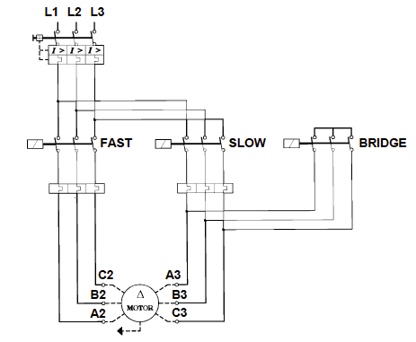
Interactive Briefing – Int01 (1 of 6)
Click on the motor to change from delta to star connection.
Create a simple slideshow indicating how the three main contactors of the pole changing motor starter work.
Redraw the image and add the indicated buttons and instructions.
Clicking on the motor toggles between this slide (slide 1) and slide 4
Clicking on Slow goes to slide 2
Clicking on Fast goes to slide 3
Slow
Fast
Reset
Notice the motor symbol
Slide 1 (Delta off)

Slide 17
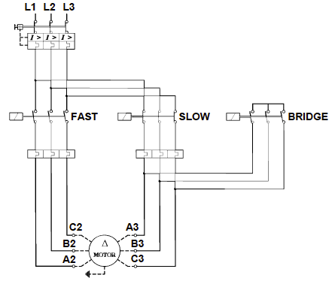
Interactive Briefing – Int01 (2 of 6)
Click on the motor to change from delta to star connection.
Redraw the image and add the indicated buttons and instructions as well as the highlights which show where current is flowing.
Clicking on the motor toggles between this slide (slide 2) and slide 4
Clicking on Reset goes to slide 1
Clicking on Fast goes to slide 3
Energised
Slow
Fast
Reset
Slide 2 (Delta slow)

Slide 18
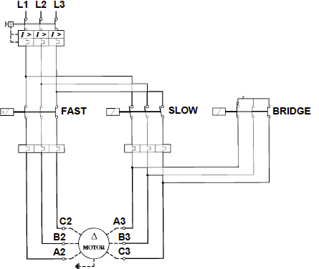
Interactive Briefing – Int01 (3 of 6)
Click on the motor to change from delta to star connection.
Redraw the image and add the indicated buttons and instructions as well as the highlights which show where current is flowing.
Clicking on the motor toggles between this slide (slide 3) and slide 4
Clicking on Reset goes to slide 1
Clicking on Slow goes to slide 2
Energised
Energised
Slow
Fast
Reset
Slide 3 (Delta Fast)

Slide 19
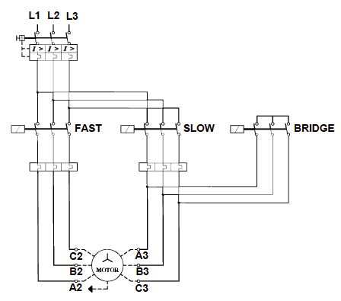
Interactive Briefing – Int01 (4 of 6)
Click on the motor to change from delta to star connection.
Redraw the image and add the indicated buttons and instructions.
Clicking on the motor toggles between this slide (slide 4) and slide 1
Clicking on Slow goes to slide 5
Clicking on Fast goes to slide 6
Slow
Fast
Reset
Notice the motor symbol
Slide 4 (Star Off)

Slide 20
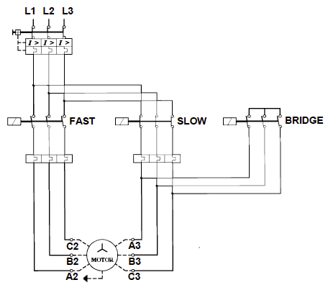
Interactive Briefing – Int01 (5 of 6)
Click on the motor to change from delta to star connection.
Redraw the image and add the indicated buttons and instructions as well as the highlights which show where current is flowing.
Clicking on the motor toggles between this slide (slide 5) and slide 1
Clicking on Fast goes to slide 6
Clicking on Reset goes to slide 4
Energised
Slow
Fast
Reset
Slide 5 (Star slow)

Slide 21
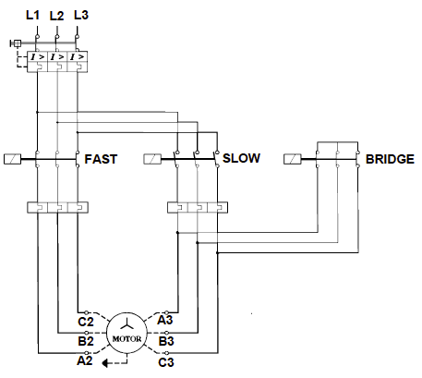
Interactive Briefing – Int01 (6 of 6)
Click on the motor to change from delta to star connection.
Redraw the image and add the indicated buttons and instructions as well as the highlights which show where current is flowing.
Clicking on the motor toggles between this slide (slide 6) and slide 1
Clicking on Reset goes to slide 4
Clicking on Slow goes to slide 5
Energised
Energised
Slow
Fast
Reset
Slide 6 (Star Fast)

Slide 22
Interactive Briefing – Int02 (1 of 3)
Instructions
To add a wire between 2 points, click the starting connection and then click the ending connection.
To delete a wire, click on it and then click the Delete icon in the top right corner.
To change the colour of a wire, click on it and then click on the colour.
To move a component, click and drag it to a new position.
Practice
Connect the motor protection circuit breaker up to the contactor
L1
L2
MPCB
L3
T1
T2
T3
Test
Forward
L1
L2
L3
A1
NO
NC
NO
NC
T1
T2
T3
A2
Notes:
White circles on components are wire connection points
Make wires curve around components
When connected components are moved, have wires stay connected
On click of first connection, highlight connection point and start to draw wire and have end of wire follow finger/mouse until next connection. Use 2 second time delay on second connection before making the connection. When second connection is selected, highlight it also.

Slide 23
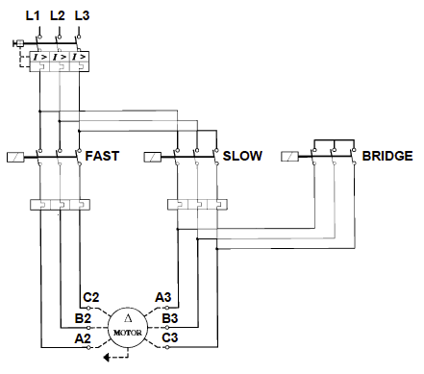
Interactive Briefing – Int04 (2 of 3)
Wire the 3P pole changing motor according to the circuit diagram.
R
W
B
L1
L2
L1
L2
Overload Relay
L3
Contactor S
Overload Relay
L1
L2
L3
A1
NO
NC
L3
Test
T1
T2
T3
NO
NC
T1
T2
T1
T2
T3
A2
T3
Instructions
L1
L2
Contactor B
MPCB
L3
L1
L2
L3
A1
NO
NC
Print
NO
NC
T1
T2
T3
T1
T2
T3
A2
B3
A3
3M
C3
Circuit Diagram
Contactor F
L1
L2
L3
A1
NO
NC
E
NO
NC
A2
T1
T2
T3
A2
C2
B2
Notes:
Fix position of power
Fix position of motor and terminals
Present other components unconnected and unpositioned.
Button01 = on click test circuit connections. Highlight all connections that are incorrect. See next slide for all correct connections
Button02 = display the instructions on previous slide in a pop-up window.
Button03 = print a jpg or pdf version of the final circuit for the learner to download and save.
Button04 = open the main circuit diagram (see Img03). Redraw Img03

Slide 24
Interactive Briefing – Int04 (2 of 3)
Wire the 3P pole changing motor according to the circuit diagram.
R
W
B
L1
L2
L3
MPCB
T1
T2
T3
Test
Contactor B
Contactor S
L1
L2
L3
A1
NO
NC
Contactor F
L1
L2
L3
A1
NO
NC
L1
L2
L3
A1
NO
NC
Instructions
NO
NC
NO
NC
NO
NC
T1
T2
T3
T1
T2
T3
A2
T1
T2
T3
A2
A2
Print
L1
L2
Overload Relay
L3
L1
L2
B3
Overload Relay
L3
A3
3M
C3
Circuit Diagram
T1
T2
T3
T1
T2
T3
E
A2
C2
B2
Notes:
Fix position of power
Fix position of motor and terminals
Present other components unconnected and unpositioned.
Button01 = on click test circuit connections. Highlight all connections that are incorrect. See next slide for all correct connections
Button02 = display the instructions on previous slide in a pop-up window.
Button03 = print a jpg or pdf version of the final circuit for the learner to download and save.
Button04 = open the main circuit diagram (see Img03). Redraw Img03

Slide 25
Video Briefing – Vid01 (1 of 4)
L2/3
L1
Create a screencast video of an expert electrician explaining the pole changing starter control circuit using a diagram like this one.
Step 1: Cover basic circuit protection, overload relay aux, ES button, SO button, SS button, -S contactor and –S retaining contact
-OL (Overload relay)
ES (emergency stop)
SO (slow stop)
SS (slow start)
-S
-S (slow)

Slide 26
Video Briefing – Vid01 (2 of 4)
L2/3
L1
Step 2: Add in FO (fast stop button), FS (fast start button), -F (fast contactor) and retaining –F contact
-OL
ES
SO
FO
SS
-S
FS
-F
-S
-F

Slide 27
Video Briefing – Vid01 (3 of 4)
L2/3
L1
Step 3: Add in –B (bridging contactor) and the –B retaining contact over the FS button so that the motor will not run in high speed unless both –F and –B are energised.
-OL
ES
SO
FO
-F
SS
-S
FS
-B
-S
-F
-B

Slide 28
Video Briefing – Vid01 (4 of 4)
L2/3
L1
Step 4: Add in the following interlocks:
-F and –B (NC) on the slow circuit so that slow circuit cannot run if either –F or –B are energised
-S (NC) on the fast circuit so that it cannot run if –S is energised
-OL
ES
SO
FO
-F
SS
-S
FS
-B
-F
-S
-B
-S
-F
-B

Slide 29
Interactive Briefing – Int04 (1 of 3)
Instructions
To add a wire between 2 points, click the starting connection and then click the ending connection.
To delete a wire, click on it and then click the Delete icon in the top right corner.
To change the colour of a wire, click on it and then click on the colour.
To move a component, click and drag it to a new position.
Practice
Connect the motor protection breaker circuit breaker up to the contactor
L1
L2
MPCB
L3
T1
T2
T3
Test
Forward
L1
L2
L3
A1
NO
NC
NO
NC
T1
T2
T3
A2
Notes:
White circles on components are wire connection points
Make wires curve around components
When connected components are moved, have wires stay connected
On click of first connection, highlight connection point and start to draw wire and have end of wire follow finger/mouse until next connection. Use 2 second time delay on second connection before making the connection. When second connection is selected, highlight it also.

Slide 30
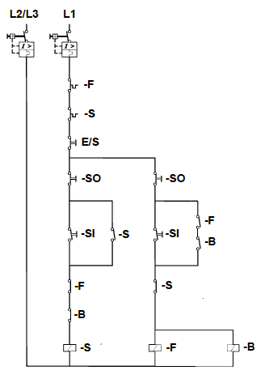
Interactive Briefing – Int04 (2 of 3)
Wire the control circuit for a pole-changing motor according to the circuit diagram.
R
W
B
L1
Breaker2
L1
Breaker1
ES
Fast Start
Slow Start
Fast Stop
Slow Stop
T1
T1
Test
Instructions
L1
L2
Overload Relay
L3
NO
NC
Print
NO
NC
T1
T2
T3
ContactorB
Circuit Diagram
ContactorS
ContactorF
L1
L2
L3
A1
NO
NC
L1
L2
L3
A1
NO
NC
L1
L2
L3
A1
NO
NC
NO
NC
NO
NC
NO
NC
T1
T2
T3
A2
T1
T2
T3
A2
T1
T2
T3
A2
Notes:
Fix position of power
Fix position of motor and terminals
Present other components unconnected and unpositioned.
Button01 = on click test circuit connections. Highlight all connections that are incorrect. See next slide for all correct connections
Button02 = display the instructions on previous slide in a pop-up window.
Button03 = print a jpg or pdf version of the final circuit for the learner to download and save.
Button04 = open the main circuit diagram (see Img04). Redraw Img04

Slide 31
Interactive Briefing – Int04 (2 of 3)
Wire the control circuit for a pole-changing motor according to the circuit diagram.
R
W
B
L1
Breaker2
L1
L1
L2
Breaker1
Overload Relay
L3
NO
NC
ES
NO
NC
T1
T1
T1
T2
T3
Test
Fast Stop
Fast Start
Slow Stop
Slow Start
Instructions
Print
ContactorB
L1
L2
L3
A1
NO
NC
ContactorF
Circuit Diagram
ContactorS
L1
L2
L3
A1
NO
NC
L1
L2
L3
A1
NO
NC
NO
NC
T1
T2
T3
A2
NO
NC
NO
NC
T1
T2
T3
A2
T1
T2
T3
A2
Notes:
Fix position of power
Fix position of motor and terminals
Present other components unconnected and unpositioned.
Button01 = on click test circuit connections. Highlight all connections that are incorrect. See next slide for all correct connections
Button02 = display the instructions on previous slide in a pop-up window.
Button03 = print a jpg or pdf version of the final circuit for the learner to download and save.
Button04 = open the main circuit diagram (see Img04). Redraw Img04

