Slide 1
Three Phase Motors
Topic 5: Connecting and Starting Three Phase Pole Changing Motors

Slide 2
Assumed prior learning
05_01_00
05_01_02
05_02_01
Notes:
Note for navigation on site:
This information needs to be taken into account and needs to stated on the LMS, perhaps as part of the introduction?

Slide 3
Outcomes
By the end of this unit you will be able to:
Phase out star and delta connected pole changing motors;
Test a pole changing motor selector switch;
Wire the main circuit of a pole changing motor selector switch starter; and
Wire the control circuit of a pole changing motor selector switch starter.

Slide 4
Unit 5.2: Pole Changing Motor Selector Switch Starter

Slide 5
Introduction
In the previous unit, we learnt about the theory of pole changing motors and how they can be connected in either delta or star formation to create motors with a constant power output (constant kilowatt) or constant torque as they are switched from low to high speed.
Constant-kilowatt | Constant Torque
Connected in delta | Connected in star
Torque decreases as speed increases so total power output stays the same. | Torque stays the same so power output increases as the speed increases.
Notes:
On click on table, present it full screen

Slide 6
The selector switch
In this unit, we are going to see how to connect a pole changing motor to a selector switch so that we can control its speed and switch it from low speed to high speed.
Selector switches are manual switches that you turn. They can have 2, 3 or more different switch positions.
YT01
Watch the video to find out more.
Notes:
YT01 = On click, play YT01 full screen. YT01 = https://v637g.app.goo.gl/SZhBbqbEpoyqdPo56

Slide 7
Pole changing motor selector switches
Pole changing motors need special selector switches with 9 connections. Spend a few minutes playing with the interactive selector switch connected to the delta and star two-speed motors.
Int01
Click on the image to access the interactive selector switch.
Notes:
Int01 = On click of Int01 screenshot, open Int01 full screen. See the Appendix for Int01 brief.

Slide 8
You should have noticed that the selector switch is connected in exactly the same way to both the delta and star types of two-speed pole changing motors.
Notes:
Img02 = https://cdn.pixabay.com/photo/2016/09/30/12/29/important-1705212_960_720.png – marked for reuse

Slide 9
Safety first
When you work with motors you must put your safety and the safety of others first. You must complete the necessary Hazard Identification and Control (HIAC) Form.
Need help with HIACs? Click the button to go to Topic X in The World of an Electrician
Get help with HIAC Forms
Notes:
Img03 = https://cdn.pixabay.com/photo/2014/04/02/10/38/sign-304093_960_720.png
Button 01 = direct learner to Topic X in Course 0

Slide 10
Before We Begin
Before you do any work on a motor, you must make sure that you have isolated and locked out the supply to the motor.
Make sure you know how to do this by referring to Topic X in The World of An Electrician.
Learn about Isolating and Lock-Out Procedures
Notes:
Img04 =
Button 01 = direct learner to Topic X in Course 0

Slide 11
Testing a selector switch?
Sometimes, the selector switch you are using will not be nicely marked so you will need to figure out which studs are which. To do this test you will need a continuity tester. A multimeter set to the continuity setting will also work well.
Vid01
Watch a video to see how to do this test.
Notes:
Vid01 = On click, play Vid01 full screen. See appendix for Vid01 brief.

Slide 12
Phasing out pole changing motors
Sometimes you will need to phase out a pole changing motor. The process is slightly different depending on whether it is a star or delta connected motor.
Phasing out a delta connected pole changing motor
Click on the buttons to see how these procedures are done for both kinds of pole changing motors.
Phasing out a star connected pole changing motor.
Notes:
Delta connected = On click, play Vid02 full screen, See appendix for Vid02 brief.
Star connected = On click, play Vid03 full screen, See appendix for Vid03 brief.

Slide 13
Same direction for both speeds
Is the 2’s or 3’s swop required for both low and high speed?

Slide 14
The main circuit
Refer back to the earlier interactive selector switch to remind yourself how a pole changing motor is connected to it. Now draw your own main circuit for pole changing motor selector switch starter. Then take a picture of your circuit and upload it to your online portfolio.
Interactive selector switch
Choose image
Upload
Notes:
Img05 = https://cdn.pixabay.com/photo/2016/01/03/00/43/upload-1118929_960_720.png
Button01 – Launch file selection window
Button02 – Upload file
Button03 – Open Int01 full screen

Slide 15
Wire up the main circuit
Int02
Using your main circuit diagram as a guide, wire up the main circuit.
Click on the image to access the motor wiring simulator. Click on the button below if you would like to watch a video of the motor being wired.
Watch the motor being wired
Notes:
Int02 = On click of Int02 screenshot, open Int02 full screen. See the Appendix for Int02 brief.
Watch the motor being wired = On click, play Vid04 full screen. See appendix for Vid04 brief.

Slide 16
Wire it up
Practice wiring the pole changing motor selector switch starter control circuit using the motor wiring simulator.
Int03
Click on the image to access the motor wiring simulator.
Notes:
Int03 = On click of Int03 screenshot, open Int03 full screen. See the Appendix for Int03 brief.

Slide 17
Conclusion
You have completed this unit on the pole changing motor selector switch starter. In this unit, you learnt how to:
Phase out star and delta connected pole changing motors;
Test a pole changing motor selector switch;
Wire the main circuit of a pole changing motor selector switch starter; and
Wire the control circuit of a pole changing motor selector switch starter.
Notes:
Int03 = On click of Int03 screenshot, open Int03 full screen. See the Appendix for Int03 brief.

Slide 18
Interactive Briefing – Int01 (1 of 3)
An interactive tool to allow learners to switch from one connection to another to see the effects.
The image on the right is the basic switch and truth table. Xs have been placed in the cells to show which connections are made in each position but these must only be shown in the simulation when the learner switches to that position. To switch, learners should be able to click on each side of the knob. A menu (dropdown or list- depending on space) must be shown with the following options
Constant-kilowatt
Constant-torque
See the next slides for the connection types learners can explore.
0
1
2
1 | 0 | 2
X
 |  | X
X
 |  | X
X
 |  | X
 |  | X
 |  | X
 |  | X
L1
A3
A2
L2
B3
B2
L3
C3
C2

Slide 19
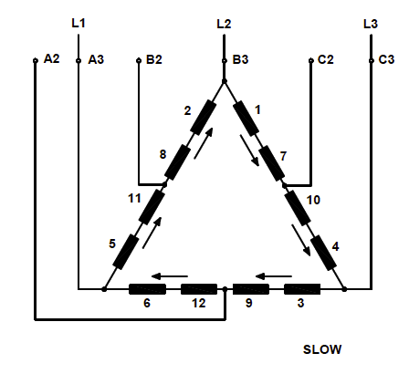
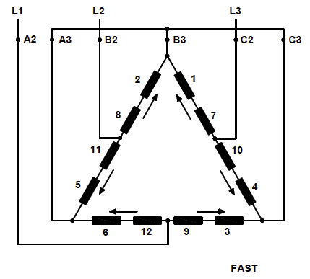
Interactive Briefing – Int01 (2 of 3)
Constant-kilowatt connection type.
Present the switch along with the 2 connection images. Change the labels and highlight the lines as per the diagrams below as the learner toggles the switch from 1 (slow) to 2 (fast)
0
1
2
1 | 0 | 2
X
 |  | X
X
 |  | X
X
 |  | X
 |  | X
 |  | X
 |  | X
L1
A3
A2
L2
B3
B2
L3
C3
C2

Slide 20
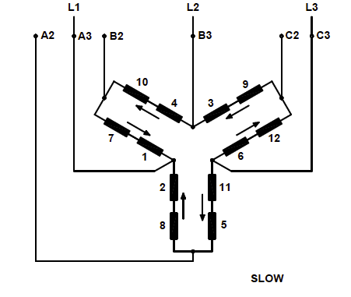
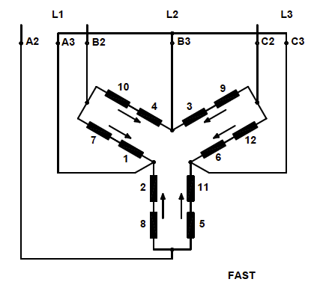
Interactive Briefing – Int01 (3 of 3)
Constant-torque connection type.
Present the switch along with the 2 connection images. Change the labels and highlight the lines as per the diagrams below as the learner toggles the switch from 1 (slow) to 2 (fast)
0
1
2
1 | 0 | 2
X
 |  | X
X
 |  | X
X
 |  | X
 |  | X
 |  | X
 |  | X
L1
A3
A2
L2
B3
B2
L3
C3
C2

Slide 21
Video Briefing – Vid01 (1 of 4)
Create a demonstration video of an expert electrician showing how to practically do a selector switch test for a pole changing motor following these steps:
Make a drawing like the image.
2
3
4
5
6
7
8
9

Slide 22
Video Briefing – Vid01 (2 of 4)
Switch the selector to the “fast” position.
Test for continuity between all 9 studs until you find 3 studs that are all connected.
Mark these as A3, B3 and C3 as these must bridge together in the fast position.
A3
B3
C3

Slide 23
Video Briefing – Vid01 (3 of 4)
Switch the selector to the “slow” position.
Test each of studs A3, B3 and C3 to find out where they bridge.
Mark these as L1, L2 and L3, as A3, B3 and C3 must be connected to the lines in slow position.
L1
L2
L3
A3
B3
C3

Slide 24
Video Briefing – Vid01 (4 of 4)
Switch the selector back to the “fast” position.
Test from studs L1, L2 and L3 to find out where they bridge.
Mark these as A2, B2 and C2 because these must be connected to the lines in the fast position.
L1
L2
L3
A3
B3
C3
A2
B2
C2

Slide 25
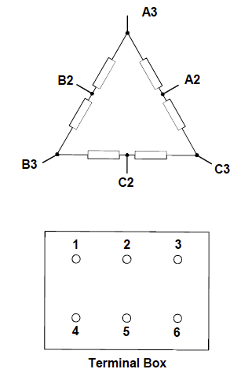
Video Briefing – Vid02 (1 of 3)
Create a demonstration video of an expert electrician showing how to practically phase out a delta connected pole changing motor, using the following steps:
You are going to need a multimeter or ohmmeter. Check that it is working properly.
Draw a diagram of the windings and the terminal block like these and label the studs 1 – 6.

Slide 26
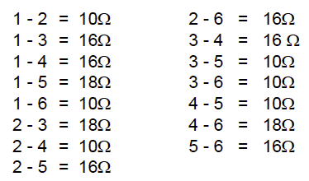
Video Briefing – Vid02 (2 of 3)
Make a table of all the possible stud pairs and test the resistance between each pair of studs. Record all your results.
You should find that you get three different values – 6 x low; 6 – medium and 3 – high. Getting these types of readings confirms that you are dealing with a delta connected pole changing motor.
If you look at your winding diagram, you can see that the lowest resistances will be obtained between stud pairs like A2 – C3 and the largest readings between stud pairs like C3 – B2

Slide 27
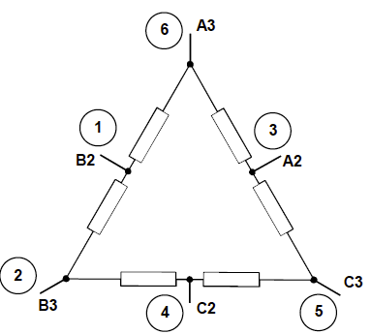
Video Briefing – Vid02 (3 of 3)
It helps if a terminal board stud is marked as the start (3) or the end (2) of a winding i.e that stud 3 is marked as a 2. Then stud 3 can be A2, B2 or C2. Let’s make it A2.
The largest reading from stud 3 will be to B3. So we mark B3 as stud 2.
The smallest readings from stud 2 (B3) will be to B2 and C2. These are 1 – 2 and 2 – 4. So let’s make B2 stud 1 and C2 stud 4.
The biggest reading with stud 4 will be to A3 which is reading 4 – 6. So let’s make A3 stud 6. That means that C3 must be stud 5.

Slide 28
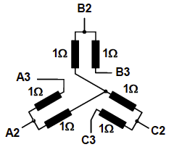
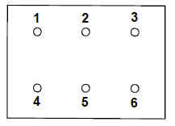
Video Briefing – Vid03 (1 of 3)
Create a demonstration video of an expert electrician showing how to practically phase out a star connected pole changing motor, using the following steps:
You are going to need a multimeter or ohmmeter. Check that it is working properly.
Draw a diagram of the windings and the terminal block like these and label the studs 1 – 6 (but without the assumed 1Ω resistance values).

Slide 29
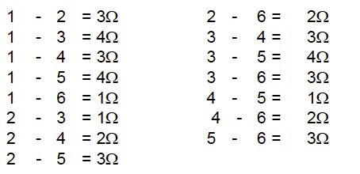
Video Briefing – Vid03 (2 of 3)
Make a table of all the possible stud pairs and test the resistance between each pair of studs. Record all your results.
You should find that you get four different values – 3 x low; 3 – medium, 6 – medium high and 3 – high. Getting these types of readings confirms that you are dealing with a star connected pole changing motor.
If you look at your winding diagram, you can see that the lowest resistances will be obtained between stud pairs like A2 – A3 and the largest readings between stud pairs like A3 – B3, B3 – C3 and C3 – A3.

Slide 30
Video Briefing – Vid03 (3 of 3)
These highest readings exist between studs 1 – 3, 1 – 5 and 3 – 5. So we can mark 1 as A3, 3 as B3 and 5 as C3.
A2 – A3 will be one of the lowest resistances. If A3 is stud 1 than A2 is stud 6 as 1 – 6 gave a low value.
By the same logic, we can make B2 stud 2 and C2 stud 4

Slide 31
Interactive Briefing – Int02 (1 of 3)
Instructions
To add a wire between 2 points, click the starting connection and then click the ending connection.
To delete a wire, click on it and then click the Delete icon in the top right corner.
To change the colour of a wire, click on it and then click on the colour.
To move a component, click and drag it to a new position.
Practice
Connect the motor protection circuit breaker up to the contactor
L1
L2
MPCB
L3
T1
T2
T3
Test
Forward
L1
L2
L3
A1
NO
NC
NO
NC
T1
T2
T3
A2
Notes:
White circles on components are wire connection points
Make wires curve around components
When connected components are moved, have wires stay connected
On click of first connection, highlight connection point and start to draw wire and have end of wire follow finger/mouse until next connection. Use 2 second time delay on second connection before making the connection. When second connection is selected, highlight it also.

Slide 32
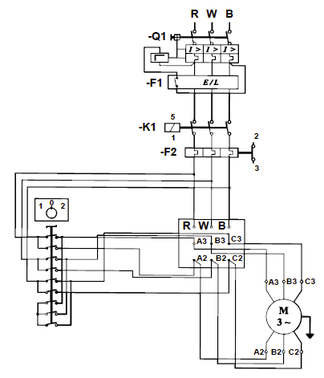
Interactive Briefing – Int04 (2 of 3)
Wire the 3P pole changing motor according to the circuit diagram.
R
W
B
L1
L2
Overload Relay
L3
L1
L2
Test
Selector switch
L3
T1
T2
T3
T1
T2
T3
T4
T5
T6
Instructions
L1
L2
MPCB
L3
Print
T1
T2
T3
B3
A3
3M
C3
Circuit Diagram
Contactor
L1
L2
L3
A1
NO
NC
E
NO
NC
A2
T1
T2
T3
A2
C2
B2
Notes:
Fix position of power
Fix position of motor and terminals
Present other components unconnected and unpositioned.
Button01 = on click test circuit connections. Highlight all connections that are incorrect. See next slide for all correct connections
Button02 = display the instructions on previous slide in a pop-up window.
Button03 = print a jpg or pdf version of the final circuit for the learner to download and save.
Button04 = open the main circuit diagram (see Img06). Redraw Img06

Slide 33
Interactive Briefing – Int04 (2 of 3)
Wire the 3P pole changing motor according to the circuit diagram.
R
W
B
L1
L2
MPCB
L3
T1
T2
T3
Test
Contactor
L1
L2
L3
A1
NO
NC
L1
L2
Instructions
Selector switch
NO
NC
L3
T1
T2
T3
A2
B3
Print
T1
T2
T3
T4
T5
T6
A3
3M
C3
L1
L2
Overload Relay
L3
E
Circuit Diagram
T1
T2
T3
A2
C2
B2
Notes:
Fix position of power
Fix position of motor and terminals
Present other components unconnected and unpositioned.
Button01 = on click test circuit connections. Highlight all connections that are incorrect. See next slide for all correct connections
Button02 = display the instructions on previous slide in a pop-up window.
Button03 = print a jpg or pdf version of the final circuit for the learner to download and save.
Button04 = open the main circuit diagram (see Img06). Redraw Img06

Slide 34
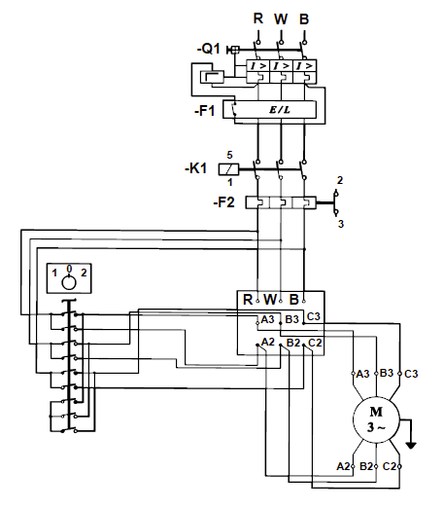
Video Briefing – Vid04
Video of an expert electrician explaining each part of the main motor circuit, what all the symbols mean and how to wire it.
Explain
The need for motor circuit protection including MPCB and overload relay
Which connections need to be connected to which.
Note that the Overloads are ”in line” and therefore need to protect the motor at low and high speed. But because the motor will draw more current at high speed, it needs to be set to the higher of the 2 ampere values on the nameplate (show these values on the motor nameplate)
Notes:
Use the redrawn Img09 in the video.

Slide 35
Interactive Briefing – Int03 (1 of 3)
Instructions
To add a wire between 2 points, click the starting connection and then click the ending connection.
To delete a wire, click on it and then click the Delete icon in the top right corner.
To change the colour of a wire, click on it and then click on the colour.
To move a component, click and drag it to a new position.
Practice
Connect the motor protection circuit breaker up to the contactor
L1
L2
MPCB
L3
T1
T2
T3
Test
Forward
L1
L2
L3
A1
NO
NC
NO
NC
T1
T2
T3
A2
Notes:
White circles on components are wire connection points
Make wires curve around components
When connected components are moved, have wires stay connected
On click of first connection, highlight connection point and start to draw wire and have end of wire follow finger/mouse until next connection. Use 2 second time delay on second connection before making the connection. When second connection is selected, highlight it also.

Slide 36
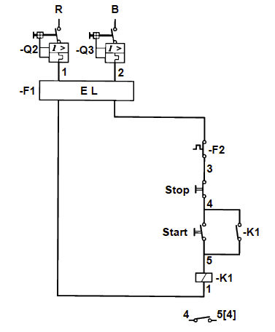
Interactive Briefing – Int04 (2 of 3)
Wire the 3P pole changing motor according to the circuit diagram.
R
W
B
Test
L1
L1
Breaker2
Breaker1
Start
Stop
Instructions
T1
T1
L1
L2
Overload Relay
L3
NO
NC
Print
NO
NC
T1
T2
T3
ContactorF
Circuit Diagram
L1
L2
L3
A1
NO
NC
NO
NC
T1
T2
T3
A2
Notes:
Fix position of power
Fix position of motor and terminals
Present other components unconnected and unpositioned.
Button01 = on click test circuit connections. Highlight all connections that are incorrect. See next slide for all correct connections
Button02 = display the instructions on previous slide in a pop-up window.
Button03 = print a jpg or pdf version of the final circuit for the learner to download and save.
Button04 = open the main circuit diagram (see Img07). Redraw Img07

Slide 37
Interactive Briefing – Int04 (2 of 3)
Wire the 3P pole changing motor according to the circuit diagram.
R
W
B
L1
Breaker1
Stop
L1
Breaker2
T1
Test
T1
Instructions
ContactorF
L1
L2
L3
A1
NO
NC
L1
L2
Overload Relay
L3
NO
NC
Print
NO
NC
NO
NC
T1
T2
T3
A2
T1
T2
T3
Circuit Diagram
Start
Notes:
Fix position of power
Fix position of motor and terminals
Present other components unconnected and unpositioned.
Button01 = on click test circuit connections. Highlight all connections that are incorrect. See next slide for all correct connections
Button02 = display the instructions on previous slide in a pop-up window.
Button03 = print a jpg or pdf version of the final circuit for the learner to download and save.
Button04 = open the main circuit diagram (see Img07). Redraw Img07

