Slide 1
Three Phase Motors
Topic 5: Connecting and Starting Three Phase Pole Changing Motors

Slide 2
Assumed prior learning
05_01_00
05_01_02
05_02_01
Notes:
Note for navigation on site:
This information needs to be taken into account and needs to stated on the LMS, perhaps as part of the introduction?

Slide 3
Outcomes
By the end of this unit the learner will:

Slide 4
Unit 5.1: Pole Changing Motors

Slide 5
Topic Introduction
Sometimes we need to change the speed of a motor. We saw in Topic 1 of this course that the speed of a three phase induction motor depends on the frequency of the AC supply – the higher the frequency, the faster the motor spins.
But changing the frequency of AC power is difficult and expensive, so we need another way to change the speed of induction motors.
Img01
Notes:
Img01 = image of a pole changing or a three phase two-speed induction motor motor

Slide 6
Introduction
Think about a municipal water pump. In the mornings and evenings, it would be useful if it could pump water at a higher speed when demand is high and at a lower speed when demand is lower. Or what about a crane. It would be useful for these motors to also be able to run at different speeds – slower for heavy loads and faster for lighter ones.
Notes:
Img02 = https://cdn.pixabay.com/photo/2015/03/18/02/17/crane-678609_960_720.jpg

Slide 7
When are multiple speeds useful?
There are many times when it is very useful to have a motor that can run at more than 1 defined speed. Can you think of other instances?
Click on each box to learn about other real multi-speed motor applications.
1
2
3
Notes:
On click of each box replace the number with the following text:
1 = ventilation fans with a high and low speed for different requirements
2 = lifts with a higher “rush hour” speed
3 = a conveyor belt with a higher speed for heavy loading

Slide 8
How fast does it go?
The standard squirrel cage induction motor is basically a single speed motor. We learnt in Topic 1: How Three Phase Motors Work that the speed of the stator rotating magnetic field is given by this equation.
$$N_{S}=\frac{120×f}{p}$$
Click on each symbol in the equation to remind yourself what it means.
Notes:
Button01 = on click display the following in a popup - “N is the synchronous speed of the motor in Revolutions per Minute (RPM). This tells us how quickly the stator magnetic field spins.”
Button02 = on click display the following in a popup - “f is the supply voltage frequency in hertz (Hz).”
Button03 = on click display the following in a popup – “p is the number of pairs of poles in the stator.”

Slide 9
Slip
We also learnt in Topic 1: How Three Phase Motors Work, that all motors have a specific amount of slip, the difference between the synchronous speed and the rotor speed. We calculate slip (as a percentage) with this equation.
Click on each symbol in the equation to remind yourself what it means.
$S=\frac{N_{S}−N_{R}}{N_{S}}×100$
Notes:
Button01 = on click display the following in a popup - “S is slip, calculated as a percentage.”
Button02 = on click display the following in a popup - “N_{S} is synchronous speed, in rpm.”
Button03 = on click display the following in a popup – “N_{R} is the rotor speed, in rpm.”

Slide 10
How can we change a motor’s speed?
It follows logically that if we change a motor’s synchronous speed (the speed of rotation of the stator magnetic field), we will also change the rotor speed.
$$N_{S}=\frac{120×f}{p}$$
Look at the equation again and think how we could change a motor’s synchronous speed?
Notes:
Button01 = on click display the following in a popup - “N_{S} is the synchronous speed of the motor in Revolutions per Minute (RPM). This tells us how quickly the stator magnetic field spins.”
Button02 = on click display the following in a popup - “f is the supply voltage frequency in hertz (Hz).”
Button03 = on click display the following in a popup – “p is the number of pairs of poles in the stator.”

Slide 11
Changing speed
We can change the speed of an induction motor by changing the frequency of the supply, but this is difficult and expensive.
The other way is to change the number of poles the motor has.
$$N_{S}=\frac{120×f}{p}$$
What happens to the speed of a motor if we double the number of poles?
Notes:
Button01 = on click display the following in a popup - “N is the synchronous speed of the motor in Revolutions per Minute (RPM). This tells us how quickly the stator magnetic field spins.”
Button02 = on click display the following in a popup - “f is the supply voltage frequency in hertz (Hz).”
Button03 = on click display the following in a popup – “p is the number of pairs of poles in the stator.”

Slide 12
What about voltage?
If we look at the equation, we can see that the synchronous speed of a motor is not affected by the supply voltage.
The voltage does affect the motor’s power and torque, however. Torque is proportional to V². If we double the voltage, we increase the torque 4 times.
$$N_{S}=\frac{120×f}{p}$$

Slide 13
The pole-changing motor
So the easiest and cheapest way of changing a motor’s speed is to change its number of poles. Pole-changing motors allow you to do just that.
These motors are designed to run with one or two sets of poles, the second set of poles being activated when low speed operation is required. Thus, slow speed is always half of high speed.
Vid05
Notes:
Play vid05 full screen. See appendix for brief.

Slide 14
A quick example
A dual speed motor that can be connected to run with 2 poles or 4 poles is connected to a 50Hz supply. If the slip is 4%, what 2 rotor speeds can this motor produce?
Vid01
Try answer this question on your own first and then watch the video to see the solution.
Notes:
Vid01 = on click, play Vid01 fullscreen (see appendix)

Slide 15
Dual-winding motors
Some motors allow 2 speeds by having 2 separate windings. These are called dual-winding motors. If such a motor, able to be connected for 6- or 8-pole operation, is connected to a 60Hz supply, what synchronous speeds can it be made to run at?
1,000rpm and 500rpm respectively
1,200rpm and 900rpm respectively
600rpm and 1,200rpm respectively
600rpm and 300rpm respectively
Notes:
MCQ = correct answer is b)
Feedback:
A = That is not correct. A 4-pole motor connected to a 60Hz supply will have a synchronous speed of 60 x 120 / 6 = 1,200rpm. Doing the same calculation for a8 pole motor, gives synchronous speeds of 900rpm.
B = Well done. That is correct.
C = That is not correct. A 4-pole motor connected to a 60Hz supply will have a synchronous speed of 60 x 120 / 6 = 1,200rpm. Doing the same calculation for a8 pole motor, gives synchronous speeds of 900rpm.
The fewer poles a motor has, the fast it runs.
D = That is not correct. It looks like you might have used the wrong equation. You need to multiply the frequency by 120 if you divide by the number of poles per phase. If you divide by the number of pole pairs THEN you multiply the frequency by 60.

Slide 16
A note on hybrid motors
Single winding pole changing motors are more commonly used than two winding dual rotor motors because they are simpler to control.
A hybrid motor combines both types and is therefore able to produce 4 different speeds. These are quite rare because of their cost.
Img04
Notes:
Img04 = picture of a hybrid motor

Slide 17
Star or delta?
Just like single speed induction motors, the coils of 2-speed motors can be connected in either star or delta configuration. Connecting the motor in one or the other changes how the motor performs. The windings of the coils are also positioned differently in the stator, as we will see.
Click the buttons to remind yourself about star and delta connections.
Star Connections
Delta Connections
1
2
Notes:
Button01 = on click open slide 18 as a popup
Button02 = on click open slide 19 as a popup

Slide 18
Star connections
Star connections have the ends of the coils connected together at a single point. In star connection:
Line current = phase current
$$I_{L}=I_{P}$$
Line voltage = phase voltage x √3
$$V_{L}=V_{P}×\sqrt{3}$$
Y
Notes:
Img05 = image of star connection – colour coded like this one and also orientated like the symbol “Y” and including the symbol

Slide 19
Delta connections
Delta connections have the end of one coil connected to the beginning of another coil.
Line voltage = phase voltage
$$V_{L}=V_{P}$$
Line current = phase current x √3
$$I_{L}=I_{P}×\sqrt{3}$$
Δ
Notes:
Img06 = image of delta connection – colour coded like this one and including the symbol

Slide 20
Remember that motor manufacturers connect and arrange the coils in star or delta formation internally. These cannot be changed. What electricians change are the power connections to the coils to make the motor run in low or high speed.
Notes:
On click, play Vid02 full screen. See brief

Slide 21
Constant-kilowatt
If a two-speed motor is internally connected and arranged in delta configuration, the torque changes inversely with the speed so the power output stays constant.
Vid02
Watch the video to find out why these motors produce a constant kilowatt power output.
Notes:
On click, play Vid02 full screen. See brief

Slide 22
Constant-torque
If a two-speed motor is internally connected and arranged in star configuration, the torque stays the same in both low and high speed. Therefore, the power output increases at the higher speed.
Vid03
Watch the video to find out why.
Notes:
On click, play Vid03 full screen. See brief

Slide 23
Variable-torque and variable-kilowatt
It is possible to construct a two-speed motor so that both the torque and the power output change with speed and increase with the motor connected in high speed mode.
Vid04
Watch the video to find out more.
Notes:
On click, play Vid03 full screen. See brief

Slide 24
Some applications
Each of the different kinds of two-speed motors have specific applications in industry depending on their specific characteristics.
Click on each button to find out what these are.
Constant-Kilowatt
Constant-torque
Variable-torque, variable-kilowatt
1
2
3
Notes:
Button01 = on click open slide 24 as a popup
Button02 = on click open slide 25 as a popup
Button03 = on click open slide 26 as a popup

Slide 25
Constant-kilowatt
These are connected in delta configuration and are used to drive woodwork, lathes and milling machines.
Img07
Notes:
Img07 = image of a constant-kilowatt lathe motor

Slide 26
Constant-torque
These are connected in star configuration and are used to drive stokers, conveyors and air compressors.
Img08
Notes:
Img08 = image of a constant-torque motor

Slide 27
Variable-torque, variable kilowatts
These are connected in star series and star parallel configuration and are used to drive fans, blowers and centrifugal pumps.
Img09
Notes:
Img09 = image of a variable torque, variable kilowatt motor

Slide 28
Advantages and disadvantages
Dahlander motors have advantages compared to other speed control systems like variable frequency drives, as there is less power loss. This is because most of the power is used to drive the motor and no electrical pulse switching is done. The system is much simpler and easier to use compared to other speed control methods available. However, the Dahlander motor has the disadvantage of fast mechanical wear and tear due to changing speeds in such a drastic ratio; this type of connection also produces high harmonic distortion during the shifting of poles as the angular distance between the power generated increases as the poles are decreased in the motor.[9]
Img09
Notes:
https://www.revolvy.com/page/Dahlander-pole-changing-motor

Slide 29
Dual-winding vs Pole-changing
Dual-winding method of speed control is less efficient and more costly.
Img09

Slide 30
References
http://www.elkmotor.com.tr/EN/two-speed-dahlender-winding-types.pdf
http://www1.labvolt.com/publications/datasheets/current2/dsa8223.pdf
https://hackaday.io/project/655-arduino-based-dahlander-switch/details
https://www.quora.com/What-is-the-electrical-circuit-diagram-for-pole-changing-speed-control-method

Slide 31
Video Briefing – Vid01
Screencast video of an expert electrician doing the calculations to work out he 2 possible rotor speeds.
2 pole motor:
Ns = 50Hz x 120/2 = 3000rpm
S = (Ns – Nr)/Ns x 100 and S = 4%
Therefore: Nr = Ns – SxNs/100 = 3000 – 4%x3000/100 = 3000 – 120 = 2880rpm
4pole motor:
Ns = 50Hz x 120/4 = 1500rpm
S = (Ns – Nr)/Ns x 100 and S = 4%
Therefore: Nr = Ns – SxNs/100 = 1500 – 4%x1500/100 = 1500 – 60 = 1440rpm

Slide 32
Video Briefing – Vid02 (1 of 3)
L1
L2
L3
A2
A3
B2
B3
C2
C3
Screencast video of an expert electrician explaining how the constant-kilowatt motor works and how it is connected for slow and fast speed.
Use the diagram to explain how the motor is connected in slow speed mode.
Here the phase windings are arranged in a delta formation.
The low speed actually has two halves of each phase winding connected in parallel (draw out the coils connected in parallel and show how each parallel part is connected in star) and actually connected to power in a star configuration.
In this configuration, there are 6 poles (show and number the poles).
In this configuration, full voltage is applied to each half winding (show this in the top diagram) i.e. maximum current = maximum strength of magnetic field = maximum torque.
L2
L1
L3

Slide 33
Video Briefing – Vid02 (2 of 3)
L1
L2
L3
A2
A3
B2
B3
C2
C3
Use the diagram to explain how the motor is connected in high speed mode.
For the high speed connection, the full winding is connected to power in a delta configuration.
In this configuration there are effectively 3 poles.
Each coil receives the full line voltage (V_{L} = V_{P} in delta) but this is halved across each half of the coils, reducing the torque by half. But as the speed is double, the overall power remains the same.
L2
L3
L1

Slide 34
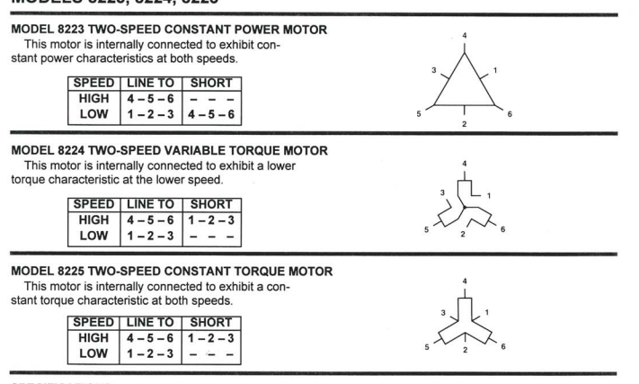
But this…

Slide 35
Video Briefing – Vid02 (3 of 3)
The power output of a motor is proportional to the torque and the speed. If the torque increases at the same rate as the speed decreases (i.e. half the speed gives double the torque), then the power output stays the same.
This is why connecting two-speed motors in delta produces a contact-kilowatt motor.

Slide 36
Video Briefing – Vid03 (1 of 3)
The situation is the opposite for constant-torque two-speed motors. Here the torque stays the same while the speed changes. Therefore if only the speed changes, the power output must also change. Let’s take a closer look at why the torque stays the same.

Slide 37
Video Briefing – Vid03 (2 of 3)
L1
L2
L3
A2
A3
B2
B3
C2
C3
Use the diagrams to explain how the motor is connected in low speed mode.
Here the phase windings are arranged in a star formation.
But in this case, the phase windings are electrically connected in delta. But because their physical arrangement is different to the constant-kilowatt motor, 6 poles are effectively produced (show this with arrows and explain by referring to an instant on the 3-P sine curve in terms of voltage and the direction of current flow through the coils – the arrows in diagram 1 assume L3 at max, L2 negative and L1 most negative).
Each half of each phase winding gets the full line voltage (delta connection) divided by 2 i.e. $\frac{V_{L}}{2}$
L2
L1
L3

Slide 38
Video Briefing – Vid03 (3 of 3)
L1
L2
L3
A2
A3
B2
B3
C2
C3
Use the diagram to explain how the motor is connected in high speed mode.
Again, the phase windings are physically arranged in star formation.
The 2 halves of each coil are connected in parallel and each coil electrically connected in star. But because their physical arrangement is different to the constant-kilowatt motor, 3 poles are effectively produced (show this with arrows as in diagram 1).
Each half of each phase winding gets the full voltage (parallel connection) but this is only $\sqrt{3}$ of the line voltage i.e. $\frac{V_{L}}{1.73}$. This is basically the same voltage as in the low speed connection hence the motor is constant-torque.
L2
L3
L1

Slide 39
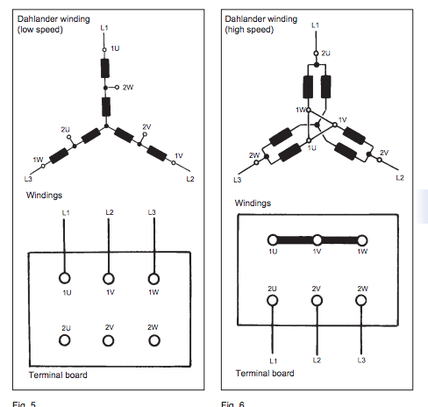
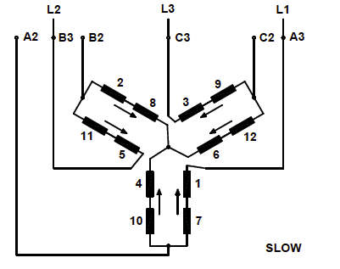
Video Briefing – Vid04 (1 of 3)
Use the diagram to explain how the motor is connected in star series for low speed mode (explain what the arrows indicate and why they are in these directions – supply connected to A3, B3 and C3). Connecting it like this produces double the number of poles, hence half the speed.
In this configuration, … (needs SME input)

Slide 40
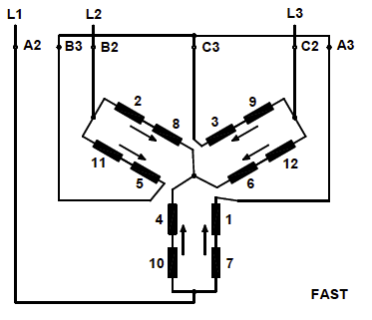
Video Briefing – Vid04 (2 of 3)
Use the diagram to explain how the motor is connected in star parallel for high speed mode (explain what the arrows indicate and why they are in these directions – supply connected to A2, B2 and C2 and A3, B3, C3 shorted). Connecting it like this produces half the number of poles, hence double the speed.
In this configuration, … (needs SME input)
Note that the current in this motor increase more between low and high speeds than with the constant-torque motor – explain why this is the case (needs SME input).

Slide 41
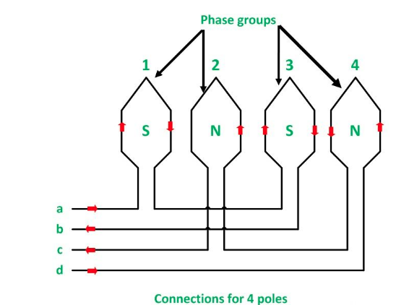
Video Briefing – Vid05
Screencast video of expert electrician explaining the basic idea of how pole-changing motors work. Base the explanation on the content of https://circuitglobe.com/pole-changing-method.html (section = Method of consequent poles)
Note that the 8 poles image in the section contains mistakes.

