Slide 1
Three Phase Motors
Topic 3: Connecting and Starting Three Phase Induction Motors

Slide 2
Assumed prior learning
05_01_00
05_01_02
05_02_01
Notes:
Note for navigation on site:
This information needs to be taken into account and needs to stated on the LMS, perhaps as part of the introduction?

Slide 3
Outcomes
By the end of this unit the learner will:

Slide 4
Unit 3.7: Automatic Start-Delta Starter

Slide 5
Introduction
In the previous unit we learn about the star-delta starter and why this is so important.
We also saw how to start a motor with manual and semi-automatic starter systems.
In this unit, we will explore the fully automatic star-delta starter.
Notes:
Img01 = image of a real auto star-delta starter panel e.g. https://4.imimg.com/data4/CE/KA/MY-5442088/motor-starter-control-panel-500x500.jpg

Slide 6
Introduction
Sometimes you may come across single automatic star-delta starter components. However, in order to understand how the starter works, we need to open up the box and take a look inside.
Notes:
Img02 = image of any large motor e.g. https://img.tolexokit.com/media/catalog/product/a/u/automatic-star-delta-starter_3.jpg?resize=1&q=95&w=365&h=365&zc=2

Slide 7
A quick summary
Here is a quick summary of what we learnt in the previous unit. Click each point to see the next one.
Motors can draw lots of current when they start up.
1
We can limit the amount of current drawn if we start the motor in star formation.
2
Star formation is not great for running because of the reduced torque available.
3
So once the motor is running we switch it to delta formation.
4
Notes:
Only show point 1. On click reveal the next point

Slide 8
Manual and semi-automatic starters
We also saw in the last unit that we use 3 contactors in the control circuit and that we can switch between the star and delta contactors manually with a leaver or switch, or semi-automatically with a push button.
Main Contactor
1
Click on the buttons to remind yourself what each contactor does.
Star Contactor
2
Delta Contactor
3
Notes:
Button01 = on click display the following in a popup – “The main contactor is used to connect the motor to the main three phase supply – L1 – A1, L2 – B1 and L3 – C1.”
Button02 = on click display the following in a popup – “The star contactor is used to connect the motor in star formation. A2, B2, C2 are connected to one side of the contactor and then these three contacts are connected together on the other side of the contactor.”
Button03 = on click display the following in a popup – “The delta contactor is used to connect the motor in delta formation. A2, B2 and C2 are connected to one side of the contactor and then C2 is connected to B1 on the main contactor as is B2 connected to A1 and A2 connected to C1”

Slide 9
Safety first
When you work with motors you must put your safety and the safety of others first. You must complete the necessary Hazard Identification and Control (HIAC) Form.
Need help with HIACs? Click the button to go to Topic X in The World of an Electrician
Get help with HIAC Forms
Notes:
Img03 = https://cdn.pixabay.com/photo/2014/04/02/10/38/sign-304093_960_720.png
Button 01 = direct learner to Topic X in Course 0

Slide 10
Before We Begin
Before you do any work on a motor, you must make sure that you have isolated and locked out the supply to the motor.
Make sure you know how to do this by referring to Topic X in The World of An Electrician.
Learn about Isolating and Lock-Out Procedures
Notes:
Img04 = https://cdn.pixabay.com/photo/2016/07/01/22/38/industrial-safety-1492062_960_720.png
Button 01 = direct learner to Topic X in Course 0

Slide 11
Review the main circuit
Take a moment to remind yourself how the main circuit is wired.
Img05
Click on the image to see how the main circuit is wired. If you need a more detailed reminder, watch the video to see how to wire up the main circuit for the start-delta starter.
See how the main circuit is wired
Notes:
Img05 = see brief
Button01 = play Vid01 (same as 07_03_06 Vid02). Play video full screen

Slide 12
The control circuit?
In order to have the motor switch from star to delta configuration automatically, we need to use a timer to make this switch between contactors happen.
Remember we used timers to create automatic sequence starters?
Try and design the automatic star-delta starter control circuit. There are a few possible configurations.
Notes:
Img06 = image of an ordinary motor control timer e.g. http://voxintech.com/wp-content/uploads/2017/03/13UDT0-1.jpg

Slide 13
How do you wire an automatic star-delta starter?
Did you manage to design the automatic starter? See how your design compares to this one.
Img07
Watch the video showing how to wire an automatic star-delta starter and how it works.
Notes:
Img07 = screenshot of Vid02 (see brief). Play video full screen.

Slide 14
Another configuration
Here is another configuration of the same starter.
Img08
Click on the image to see the circuit full screen and then click on the button to watch a video explaining how it works.
See how the circuit works
Notes:
Img08 = see brief
Button01 = Vid03 (see brief). Play video full screen

Slide 15
Additional interlocks
Here is another configuration of the same starter, this time with additional interlocks between the star and delta contacts.
Img09
Click on the image to see the circuit full screen.
Notes:
Img09 = see brief

Slide 16
Remember current in delta connections?
Remember in the last unit we said that in delta connection Line Current (I_{L}) was equal to $\sqrt{3}×$ the Phase Current (I_{P})?
In a star-delta starter, the current in line is going to be greater than the current in phase.
$$I_{L}=\sqrt{3}×I_{P}$$
Notes:
Img09 = see brief

Slide 17
Overload relays in line?
Earlier, when we reviewed the main circuit, you might have noticed that the overload relay was placed BEFORE the split or junction with the delta contactor. This means that the relay is IN LINE and must be set to the motor’s normal full load current.
Img10
Notes:
Img09 = see brief

Slide 18
Overload relays in phase
However, if we place the overload relay AFTER the delta contactor split or junction, the relay will be IN PHASE and must be set to $\frac{1}{\sqrt{3}}×$the motor’s normal full load current.
Img11
Notes:
Img09 = see brief

Slide 19
Where should we place the overload relay?
Most of the time, we place the overload relays IN PHASE in automatic star-delta starters.
It also matters what kind of overload relay we use.
Oil Magnetic Overloads
1
Thermal Overloads
2
Click on the buttons to learn how to set each kind of overload relay.
Notes:
Img09 = see brief

Slide 20
Oil magnetic overloads
When using oil magnetic overloads, set the overload to maximum motor current + 25% of maximum motor current.
If the maximum motor current is 7.8A, set the overload to
$7.8A+7.8A×0.25=9.75A$ for IN PHASE
$\frac{7.8A+7.8A×0.25}{\sqrt{3}}=5.6A$ for IN PHASE
Notes:
Img09 = see brief

Slide 21
Thermal overloads
When using thermal overloads, just set the overload to maximum motor current.
If the maximum motor current is 7.8A, set the overload to
$7.8$ for IN PHASE
$\frac{7.8A}{\sqrt{3}}=4.5A$ for IN PHASE
Notes:
Img09 = see brief

Slide 22
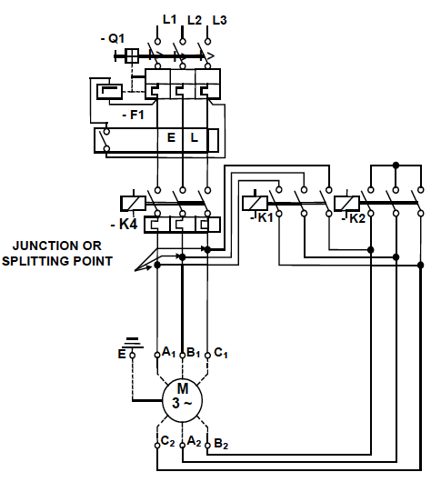
Image Briefing – Img05

Slide 23
Video Briefing – Vid02
Demonstration video presented by an expert electrician showing the automatic star-delta starter, how it works, how to wire it and how to draw the control circuit diagram.
Demonstrate how the starter works – press start – after set time star/delta contacts switch.
Show the control circuit diagram and explain, step-by-step how the starter works (see 2 of 2)
Motor stopped
Start button pressed and released
Star coil energizes
S1 opens to prevent delta coil energizing
S2 closes
Main coil energizes
M1 and M2 close to retain Main coil
Timer activated
Motor is running in star
Timer runs down
T1 opens and de-energises Star coil
T2 closes
S2 opens
S1 closes and Delta coil energises
D1 opens to prevent Star coil energising
Motor running in delta
Use https://www.youtube.com/watch?v=WajJpWV8yz8 to aid with the explanation
Show how the control circuit is wired in reality.

Slide 24
Video Briefing – Vid01 (2 of 2)
L1
L2/3/N
-Stop
-M(1)
-Start
-T(1)
-T(2)
-M(2)
-S(2)
-D(1)
-S(1)
-T
-S
-D
-M

Slide 25
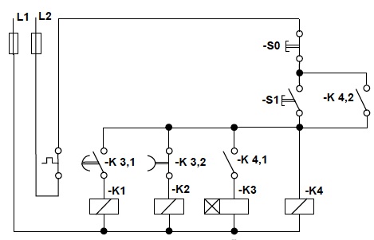
Image Briefing – Img08
Redraw the image but add the following key:
-K4 = Main coil
-K3 = Timer coil
-K2 = Star coil
-K1 = Delta coil

Slide 26
Video Briefing – Vid03
Screencast video of an expert electrician working through how the control circuit works and explaining how the star and delta contacts are electronically interlocked by the timer contacts.
Also explain and show how we can add additional interlocks to this circuit by adding in the NC contacts from K(2) and K(1).

Slide 27
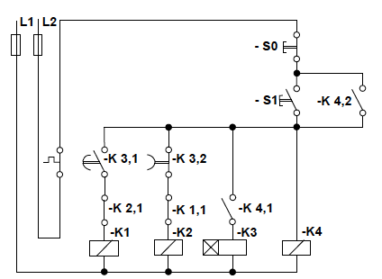
Image Briefing – Img09
Screencast video of an expert electrician working through how the control circuit works and explaining how the star and delta contacts are electronically interlocked by the timer contacts.
Also explain and show how we can add additional interlocks to this circuit by adding in the NC contacts from K(2) and K(1).
Additional electronic
interlocks

Slide 28
Image Briefing – Img10
Overload relay BEFORE the delta contactor split.

Slide 29
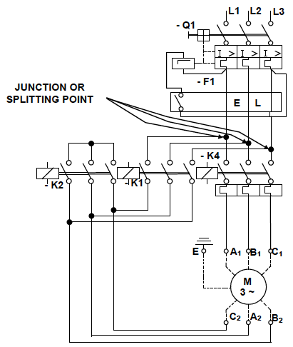
Image Briefing – Img11
Overload relay AFTER the delta contactor split.

