Slide 1
Three Phase Motors
Topic 3: Connecting and Starting Three Phase Induction Motors

Slide 2
Assumed prior learning
05_01_00
05_01_02
05_02_01
Notes:
Note for navigation on site:
This information needs to be taken into account and needs to stated on the LMS, perhaps as part of the introduction?

Slide 3
Outcomes
By the end of this unit the learner will:

Slide 4
Unit 3.6: Manual and Semi-Automatics Start-Delta Starters

Slide 5
Introduction
So far in this topic, we have created starters that work really well for smaller motors (4 horse power or less). But when big motors start up, they draw huge amounts of current; so much that they can affect other devices in the factory.
In this unit we will see how to solve this problem by reducing the amount of current large motors draw when starting.
Notes:
Img01 = image of any large motor e.g. http://www.actom.co.za/wp-content/uploads/2016/10/Large-Motors-Duvha-Matla-Kriel-Oct-09-Small.jpg

Slide 6
Why do big motors draw so much current?
Lets go back to the basics of induction motors to see why all this is a problem in the first place.
View the video to learn why induction motors draw more current when they start up.
Img02
Notes:
Img02 = screenshot of Vid01 (see brief). Play video full screen

Slide 7
What is the solution?
The solution lies in how we connect the coils of the motor together. We know one side of the coils must be connected to the three phase power (L1, L2 and L3). But there are 2 basic ways we can connect the other ends of the coils.
Star Connections
Click the buttons to see an overview of the possible motor winding connections.
1
Delta Connections
2
Notes:
Button01 = on click open slide 8 as a popup
Button02 = on click open slide 9 as a popup

Slide 8
Star connections
Star connections have the ends of the loads in all three phases connected together at a single point. Most often, a neutral line is also connected to this point in case the loads on each phase are not balanced. You will also see these connections called “Wye” or “Y” connections.
Y
Notes:
Img03 = image of star connection – colour coded like this one and including the symbol “Y”

Slide 9
Delta connections
Delta connections have the end of the load in one phase connected to the beginning of the load in the next phase. There is no neutral line.
They are called delta because they look like the Greek symbol for “d”.
Δ
Notes:
Img04 = image of delta connection – colour coded like this one and including the symbol

Slide 10
So what?
Vid05
You may be wondering what all this has to do with solving our initial problem. There is one more piece of the puzzle. Star and delta connections have some important effects on the voltage and current across and through the motor coils.
Watch the video to learn more.
Notes:
Play vid05 full screen. See brief.

Slide 11
A quick summary
We have just seen that connecting loads, like the coils in a three phase motor, in star and delta configuration has important affects on the voltage across and current through these loads. Here is a short summary of what we have learnt.
Current in star connections
Current in delta connections
1
3
Click on each box to find out more.
Voltage in star connections
Voltage in delta connections
2
4
Notes:
Button01 = open slide 12 as a popup
Button02 = open slide 13 as a popup
Button03 = open slide 14 as a popup
Button04 = open slide 15 as a popup

Slide 12
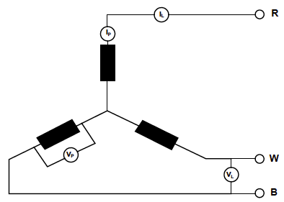
Current in a star connections
Line current
In a star connection, the current flowing through a line (the line current or I_{L}) is equal to the current flowing through the connected coil (the phase current or I_{P}).
This makes sense because there is only one path for the current to flow.
Phase current
I_{L} = I_{P}
Notes:
Img07 = image like this one but make the I_{L} and I_{P} symbols bigger and remove the V_{P} and V_{L} symbols.

Slide 13
Voltage in a star connections
In a star connection, the voltage drop between any two lines (the line voltage or V_{L}) is equal to √3 (1.732) times the voltage across the connected coil (the phase voltage or V_{P}).
Line voltage
Phase voltage
V_{L} = √3 x V_{P}
Notes:
Img08 = image like this one but make the V_{L} and V_{P} symbols bigger and remove the I_{P} and I_{L} symbols.

Slide 14
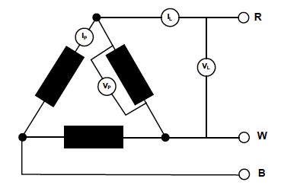
Current in a delta connections
Line current
Phase current
In a delta connection, the current flowing through a line (the line current or I_{L}) is equal to √3 (1.732) times the current flowing through the connected coil (the phase current or I_{P}).
I_{L} = √3 x I_{P}
Notes:
Img09 = image like this one but make the I_{L} and I_{P} symbols bigger and remove the V_{P} and V_{L} symbols.

Slide 15
Voltage in a star connections
Line voltage
In a delta connection, the voltage drop between any two lines (the line voltage or V_{L}) is equal to the voltage drop across the connected coil (the phase voltage or V_{P}).
Phase voltage
V_{L} = V_{P}
Notes:
Img10 = image like this one but make the V_{L} and V_{P} symbols bigger and remove the I_{P} and I_{L} symbols.

Slide 16
A quick summary
Star
Delta
$$I_{P}=\frac{I_{L}}{\sqrt{3}}$$
Current
$$I_{L}=\sqrt{3}×I_{P}$$
$$I_{L}=I_{P}$$
$$V_{P}=\frac{V_{L}}{\sqrt{3}}$$
Voltage
$$V_{L}=\sqrt{3}×V_{P}$$
$$V_{L}=V_{P}$$

Slide 17
And the solution is…
Click each heading to see the solution to our original problem.
In delta
In star
V_{P} = V_{L}
Maximum voltage available
Motor can produce maximum torque
Good for running
V_{P} = V_{L}/√3
Reduced voltage available
Motor cannot produce maximum torque
But motor draws much less current because of Ohm’s Law $V=\frac{I}{R}$
If the voltage is less, the current must be less as R stays the same
Good for starting
Notes:
For each list on clicking heading reveal point 1 with a note to click again to reveal next point until all points revealed.

Slide 18
How do you wire Star and Delta connections in motors?
Click on each connection type to see what the connection looks like in a three phase motor terminal block.
Img05
Img06
Notes:
Img05 = see brief
Img06 = see brief

Slide 19
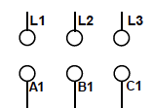
Question 1
Drag the available bridge pieces onto the terminal to connect this motor up in star formation.
Submit
Notes:
Drag and drop question:
See img10a for correct answer
Feedback:
Correct – Well done. You got it.
Incorrect – That is not correct. You need to connect L1 to A1, L2 to B1 and L3 to C1 for power. Then you need to connect A2 to B2 and B2 to C2 to make the star point. [Also show image of correct placement)
Button01= On click check answers and provide feedback

Slide 20
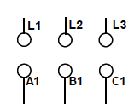
Question 2
Drag the available bridge pieces onto the terminal to connect this motor up in delta formation.
Submit
Notes:
Drag and drop question:
See img10b for correct answer
Feedback:
Correct – Well done. You got it.
Incorrect – That is not correct. You need to connect L1 to A1, L2 to B1 and L3 to C1 for power. Then you need to connect A2 to B2 and B2 to C2 to make the star point. [Also show image of correct placement)
Button01= On click check answers and provide feedback

Slide 21
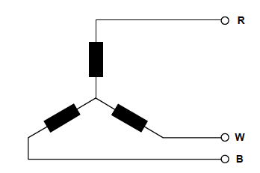
Question 3
Click on the circle that represents where you would take a reading of V_{L} in the diagram.
1
2
A
3
Notes:
Image hotspot question
Circle with A is correct answer.
Feedback:
Correct – Well done.
Incorrect
If choose 1: This is not correct. That is where you would measure line current (I_{L}).
If choose 2: This is not correct. That is where you would measure phase voltage (V_{P}).
If choose 3: This is not correct. That is where you would measure phase current (I_{P}).

Slide 22
Question 4
Click on the circle that represents where you would take a reading of I_{P} in the diagram.
1
2
3
A
Notes:
Image hotspot question
Circle with A is correct answer.
Feedback:
Correct – Well done.
Incorrect
If choose 1: This is not correct. That is where you would measure line current (I_{L}).
If choose 2: This is not correct. That is where you would measure phase voltage (V_{P}).
If choose 3: This is not correct. That is where you would measure line voltage (V_{L}).

Slide 23
Question 5
A 380 volt supply is connected to a three phase, 380 volt induction motor. What voltage would be measured across each phase if the motor was connected in:
Star
V
Delta
V
Submit
Notes:
Cloze question:
Star – between 219 and 220 V
Delta – 380V
Feedback:
Star:
Correct – Well done. You got it. In star the V_{P} = V_{L}/√3 = 380V/1.732 = 219.4V.
Incorrect – That is not correct. Remember, in star the V_{P} = V_{L}/√3 = 380V/1.732 = 219.4V.
Delta:
Correct – Well done. You got it. In delta the V_{P} = V_{L} = 380V.
Incorrect – That is not correct. Remember, in delta the V_{P} = V_{L} = 380V.
Button01= On click check answers and provide feedback

Slide 24
Question 6
Complete the table, correct to 0 decimal places.
Connection | I_{L} | I_{P} | V_{L} | V_{P}
Star | 25 | 25 | 779 | 450
Delta | 69 | 40 | 600 | 600
Delta | 20 | 12 | 210 | 210
Star | 18 | 18 | 320 | 185
Submit
Notes:
Cloze question:
Answers in table in orange
Feedback:
Present the table with correct answers in GREEN and incorrect answers in RED with the correct answers in GREEN in brackets.
Also display a link to the summary on slide 16.
Button01= On click check answers and provide feedback

Slide 25
Safety first
When you work with motors you must put your safety and the safety of others first. You must complete the necessary Hazard Identification and Control (HIAC) Form.
Need help with HIACs? Click the button to go to Topic X in The World of an Electrician
Get help with HIAC Forms
Notes:
Img11 = https://cdn.pixabay.com/photo/2014/04/02/10/38/sign-304093_960_720.png
Button 01 = direct learner to Topic X in Course 0

Slide 26
Before We Begin
Before you do any work on a motor, you must make sure that you have isolated and locked out the supply to the motor.
Make sure you know how to do this by referring to Topic X in The World of An Electrician.
Learn about Isolating and Lock-Out Procedures
Notes:
Img12 =
Button 01 = direct learner to Topic X in Course 0

Slide 27
The Star-Delta Starter
Obviously, manually swopping the connections in the motor terminal from star to delta after the motor starts would be a silly (and dangerous) idea.
This is why we use 2 contactors – on wired in star and the other in delta – and switch between them.
Notes:
Img15 = image of the a simplified star-delta starter main circuit like this one (https://i.pinimg.com/originals/10/81/75/108175882c7cdc67c4a2fc76779b3f24.png).

Slide 28
Review the basic DOL starter
Before we go further, lets review the basic main and control circuits for the Direct Online starter.
Click on the images to remind yourself what the DOL main and control circuits look like.
Img13
Img14
Notes:
Img13 = Img09 from 07_03_01
Img14 = Img15 (5 of 5) from 07_03_01

Slide 29
How do you wire the main circuit?
The key parts of the main circuit are the 2 contactors wired in star and delta.
Watch the video to see how to wire up the main circuit for the start-delta starter.
Img15
Notes:
Img15 = screenshot of Vid02 (see brief)

Slide 30
The main circuit diagram?
Before, we move on, have another look at the main circuit diagram for the star-delta starter.
Click on the image to see the main circuit full screen.
Img15a
Notes:
Img15a = see brief

Slide 31
Wire it up
Practice wiring the main star-delta starter circuit using the motor wiring simulator
Img16
Click on the image to access the motor wiring simulator.
Notes:
Img16 = screenshot of Int01 (see brief)

Slide 32
Upload your control circuit diagram
Draw your own version of the main star-delta starter circuit. Take a photo of your completed circuit and upload it to your online portfolio.
Choose image
Upload
Notes:
Img17 = https://cdn.pixabay.com/photo/2016/01/03/00/43/upload-1118929_960_720.png
Button 01 – Launch file selection window
Button 02 – Upload file

Slide 33
The control circuit?
As we saw from the main circuit, we need to find a way to switch between the start (star) and run (delta) contactors after a few seconds of the motor starting.
There are a few way we can do this.
Manually with a lever system
1
Semi-automatically with a push button system
2
Automatically with a timer system
3
Click each box to find out more.
Notes:
Button01 = on click display the following as a popup – “This is an old method that is not used much nowadays. It involves a special mechanical contraption with a lever that one physically pushes from the start to run position.”
Button02 = on click display the following as a popup – “This is a more modern method that is sometimes still used. It involves a single start button which when pressed and held in activates the start (star) contactor and when released, switched the motor over to the run (delta) contactor.”
Button03 = on click display the following as a popup – “In this method, a timer is used to automatically switch over from the start (star) to the run (delta) contactor after a pre-determined time. Often, all the contactors and control components are integrated into a single physical device. This is how most start-delta starters today work.”

Slide 34
How do you wire a manual star-delta starter?
Even though manual starters are seldom used anymore, they still give has a great sense of how the basic control system works.
Img18
Watch the video showing how to wire a manual star-delta starter and how it works.
Notes:
Img18 = screenshot of Vid03 (see brief). Play video full screen.

Slide 35
The manual star-delta starter
Manual star-delta starters are purely mechanical devices. Even though they are old they are still pretty ingenious.
Click on the button to play with a manual starter simulation.
Open the manual star-delta starter simulation
Notes:
Img18a = photo of the inside of a manual star-delta starter (e.g. https://i.ytimg.com/vi/dqSw4rifhGE/maxresdefault.jpg)
Button01 = on click present Int02 (see brief) full screen.

Slide 36
Upload your control circuit diagram
Draw your own version of the manual star-delta starter control circuit. Take a photo of your completed circuit and upload it to your online portfolio.
Choose image
Upload
Notes:
Img19 = https://cdn.pixabay.com/photo/2016/01/03/00/43/upload-1118929_960_720.png
Button 01 – Launch file selection window
Button 02 – Upload file

Slide 37
The semi-automatic star-delta starter
In the semi-automatic starter there is a start and stop button. You hold the start button in for start and then let it go to switch to run.
Img20
Watch the video to see a semi-automatic star-delta starter in action and how it is connected.
Notes:
Img20 = screenshot of Vid04 (see brief). Play video full screen.

Slide 38
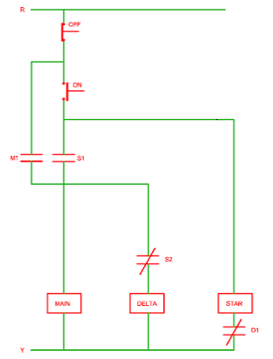
The semi-automatic star-delta starter
The semi-automatic star-delta starter is a very clever control circuit.
Click on the image to a larger version of the semi-automatic star-delta starter control circuit.
Notes:
Img21 = diagram of semi-automatic star-delta starter (see brief).

Slide 39
Wire it up
Practice wiring the semi-automatic star-delta starter control circuit using the motor wiring simulator
Img22
Click on the image to access the motor wiring simulator.
Notes:
Img22 = screenshot of Int03 (see brief)

Slide 40
Upload your control circuit diagram
Draw your own version of the semi-automatic star-delta starter control circuit. Take a photo of your completed circuit and upload it to your online portfolio.
Choose image
Upload
Notes:
Img23 = https://cdn.pixabay.com/photo/2016/01/03/00/43/upload-1118929_960_720.png
Button 01 – Launch file selection window
Button 02 – Upload file

Slide 41
Video Briefing – Vid01
Animated video explaining why induction motor draw more current and cause a voltage drop on the line when starting. Explain the following:
Current in the coils of the stator creates a rotating magnetic field.
This rotating magnetic field cuts the bars of the rotor and induces a current in these bars (electromagnetic induction)
This induced current creates a magnetic field in the rotator which tries to align with the stator rotating magnetic field causing the rotor to spin.
Remember that the greater the rate of change of the magnetic field cutting a conductor, the greater the current induced
At start-up, the rate of change of the stator field cutting the rotor bars is very high because the difference in the speed of the stator rotating field and the rotor is very big. Therefore the current induced in the rotor bars is very high.
But, the current in the stator coils and rotor bars is linked by transformer action, so there must be a high current flowing in the stator coils as well.
The bigger the motor, the bigger these current flows are and the bigger the problem we have.
Notes:
See https://v637g.app.goo.gl/v7kAfwvL3RNkXPMU6 as a reference. If necessary, this video clip could be provided to learners instead.

Slide 42
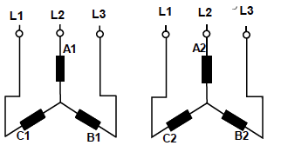
Image Briefing – Img05 (1 of 4)
On click of the image rotate through the following images:
This is the schematic representation of the Star connection.
Notes:
Colour code windings like image03 and img04

Slide 43
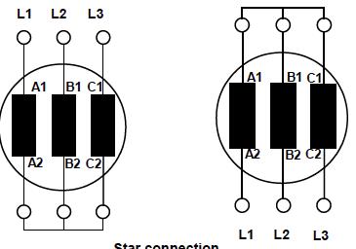
Image Briefing – Img05 (2 of 4)
We can connect either the A1, B1, C1 or A2, B2, C2 ends of the windings together. The other ends of the wings are connected to the three phase power
Notes:
Colour code windings like image03 and img04

Slide 44
Image Briefing – Img05 (3 of 4)
This is what the Star connection looks like in the motor terminal box. We use jumpers to connect the ends of the windings together. Note that the windings are also often called U, V and W as in this picture
Notes:
Photo of a star connection in motor terminal box.

Slide 45
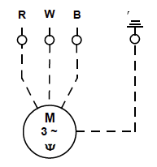
Image Briefing – Img05 (4 of 4)
You may see Star connected motors represented with this symbol.
Motor
Three phase AC
Star connection

Slide 46
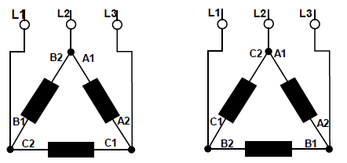
Image Briefing – Img06 (1 of 4)
On click of the image rotate through the following images:
This is the schematic representation of the Delta connection.
Notes:
Colour code windings like image03 and img04

Slide 47
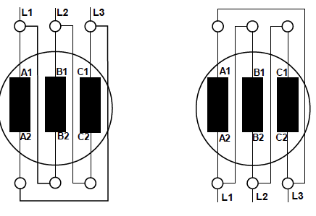
Image Briefing – Img06 (2 of 4)
We can connect either the A1 to B2, B1 to C2 and C1 to A2 or C1 to B2, B1 to A2 and A1 to C2. We can also connect power to A1, B1 and C1 or A2, B2 and C2.
Notes:
Colour code windings like image03 and img04

Slide 48
Image Briefing – Img06 (3 of 4)
This is what the Delta connection looks like in the motor terminal box. We use jumpers to connect the ends of the windings together. Note that the windings are also often called U, V and W as in this picture.
Notes:
Photo of a delta connection in motor terminal box.

Slide 49
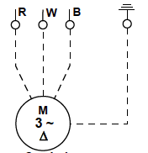
Image Briefing – Img06 (4 of 4)
You may see Delta connected motors represented with this symbol.
Motor
Three phase AC
Delta connection
Notes:
Photo of a star connection in motor terminal box.

Slide 50
Video Briefing – Vid02 (1 of 2)
Demonstration video presented by an expert electrician showing and explaining the wiring of the main star-delta circuit (wire according to the diagram on 2 of 2).
Wire up the motor control circuit breaker and the Overload relay – explain that we are placing the OL on the line side of the main/delta junction, and what this means (we have to set the overload to the full motor current rating)
Wire in the main contactor between protection and motor and connect motor - U1 – L1, V1 – L2, W1 – L3
Wire up the delta contactor and connect it to the motor and to L1, L2, L3 so that W2 – U1 – L1, U2 – V1 – L1, V2 – W1 – L3
Wire up the star contactor and connect it to the motor or to the leads running to the delta contactor U2 – U2, V2 – V2, W2 – W2
At each step above draw in that part of the circuit until the whole main circuit diagram is complete.

Slide 51
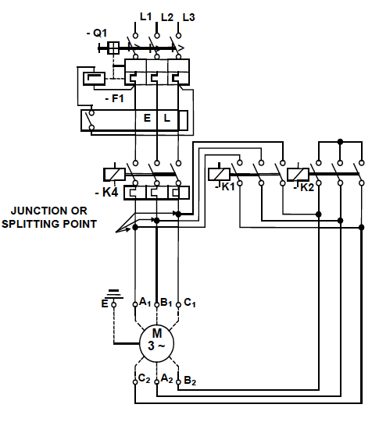
Video Briefing – Vid02 (2 of 2)

Slide 52
Image Briefing – Img15a (1 of 2)
Reproduce this image with 2 buttons that highlight the star and delta parts when clicked.
Star this slide
Delta next slide
Star
Delta

Slide 53
Image Briefing – Img15a (2 of 2)
Star
Delta

Slide 54
Interactive Briefing – Int01 (1 of 4)
Instructions
To add a wire between 2 points, click the starting connection and then click the ending connection.
To delete a wire, click on it and then click the Delete icon in the top right corner.
To change the colour of a wire, click on it and then click on the colour.
To move a component, click and drag it to a new position.
Practice
Connect the motor protection breaker circuit breaker up to the contactor
L1
L2
MPCB
L3
T1
T2
T3
Test
Forward
L1
L2
L3
A1
NO
NC
NO
NC
T1
T2
T3
A2
Notes:
White circles on components are wire connection points
Make wires curve around components
When connected components are moved, have wires stay connected
On click of first connection, highlight connection point and start to draw wire and have end of wire follow finger/mouse until next connection. Use 2 second time delay on second connection before making the connection. When second connection is selected, highlight it also.

Slide 55
Interactive Briefing – Int01 (2 of 4)
Wire up the 3P Star-Delta main circuit.
R
W
B
L1
L2
Overload Relay
L3
NO
NC
Test
NO
NC
T1
T2
T3
ContactorD
Instructions
L1
L2
L3
A1
NO
NC
L1
L2
MPCB
L3
NO
NC
V1
T1
T2
T3
A2
U1
Print
3M
W1
T1
T2
T3
E
ContactorS
See diagram
ContactorM
L1
L2
L3
A1
NO
NC
L1
L2
L3
A1
NO
NC
U2
V2
W2
NO
NC
NO
NC
T1
T2
T3
A2
T1
T2
T3
A2
Notes:
Fix position of power
Fix position of motor and terminals
Present other components unconnected and unpositioned.
Button01 = on click test circuit connections. Highlight all connections that are incorrect. See next slide for all correct connections
Button02 = display the instructions on previous slide in a pop-up window.
Button03 = print a jpg or pdf version of the final circuit for the learner to download and save.
Button04 = display the control circuit diagram as (3 of 4 – same as Img15)

Slide 56
Interactive Briefing – Int01 (3 of 4)

Slide 57
Interactive Briefing – Int01 (4 of 4)
Wire up the 3P Star-Delta main circuit.
R
W
B
L1
L2
MPCB
L1
L2
L3
Overload Relay
L3
NO
NC
NO
NC
T1
T2
T3
T1
T2
T3
Test
ContactorM
L1
L2
L3
A1
NO
NC
ContactorS
Instructions
L1
L2
L3
A1
NO
NC
ContactorD
L1
L2
L3
A1
NO
NC
NO
NC
NO
NC
T1
T2
T3
A2
T1
T2
Print
NO
NC
T3
A2
T1
T2
T3
A2
V1
U1
3M
See diagram
W1
E
U2
V2
W2
Notes:
Fix position of power
Fix position of motor and terminals
Present other components unconnected and unpositioned.
Button01 = on click test circuit connections. Highlight all connections that are incorrect. See next slide for all correct connections
Button02 = display the instructions on previous slide in a pop-up window.
Button03 = print a jpg or pdf version of the final circuit for the learner to download and save.
Button04 = display the control circuit diagram as (3 of 4 – same as Img15)

Slide 58
Video Briefing – Vid03
Demonstration video presented by an expert electrician showing and explaining the wiring of the manual star-delta starter.
Show how the starter works – push the leaver and see how the contacts move
Demonstrate how to wire the starter
Work through the control circuit explaining how it shifts from one contactor to the other.

Slide 59
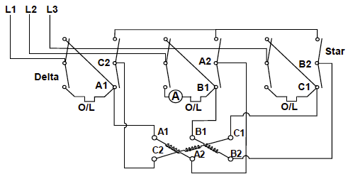
Interactive Briefing – Int02 (1 of 3)
Create an interactive manual star-delta starter.
START
RUN
Notes:
Switch has 3 positions – off, start, run. Image currently in “off” position
Start engages Star circuit (Blue contacts closed – only for briefing – don’t mark as blue) – highlight conducting conductors and the fact that the following connections are made: A1 – A2, B1 – B2, C1 – C2 and A2 - B2 – C2 (see 2 of 3)
Run engages Delta circuit (RED contacts closed – only for briefing – don’t mark as blue) – highlight conducting conductors and the fact that the following connections are made: A1 – C2, B1 – A2, C1 – B2 (see 3 of 3)

Slide 60
Interactive Briefing – Int02 (2 of 3)

Slide 61
Interactive Briefing – Int02 (3 of 3)

Slide 62
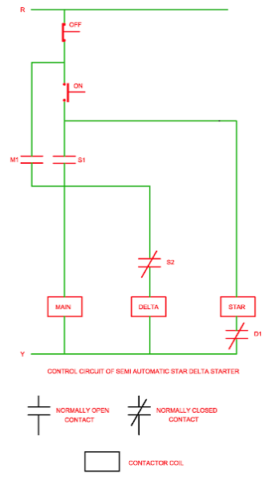
Video Briefing – Vid04
Demonstration video presented by an expert electrician showing and explaining the control circuit and wiring of the semi-automatic star-delta starter.
Show how the starter works – push the start button in for star and then release for delta
Show the control circuit diagram and explain, step-by-step how the starter works
Motor stopped
Start button pressed and held
Star coil energizes
S1 closes
Main coil energizes
M1 closes
S2 opens
Motor is running in star
Start button released
Star coil de-energizes
S1 opens but Main coil retained by M1
S2 closes
Delta coil energizes
D1 opens to prevent Star coil form energizing (interlock)
Motor running in delta
Stop button pressed
Mail and Delta coils de-energize
M1 opens
D1 closes
Show how the control circuit is wired in reality.

Slide 63
Image Briefing – Img21
Recreate the diagram in the same way as all other diagrams in this topic have been drawn i.e. use all the same symbols.

Slide 64
Interactive Briefing – Int03 (1 of 3)
Instructions
To add a wire between 2 points, click the starting connection and then click the ending connection.
To delete a wire, click on it and then click the Delete icon in the top right corner.
To change the colour of a wire, click on it and then click on the colour.
To move a component, click and drag it to a new position.
Practice
Connect the motor protection breaker circuit breaker up to the contactor
L1
L2
MPCB
L3
T1
T2
T3
Test
Forward
L1
L2
L3
A1
NO
NC
NO
NC
T1
T2
T3
A2
Notes:
White circles on components are wire connection points
Make wires curve around components
When connected components are moved, have wires stay connected
On click of first connection, highlight connection point and start to draw wire and have end of wire follow finger/mouse until next connection. Use 2 second time delay on second connection before making the connection. When second connection is selected, highlight it also.

Slide 65
Interactive Briefing – Int03 (2 of 3)
Wire up the semi-automatic SD starter as per the diagram
R
W
B
L1
L1
Breaker2
L1
L2
Breaker1
Start
Stop
Overload Relay
L3
NO
NC
Test
NO
NC
T1
T1
T1
T2
T3
Instructions
ContactorD
L1
L2
L3
A1
NO
NC
NO
NC
Print
T1
T2
T3
A2
ContactorS
See diagram
ContactorM
L1
L2
L3
A1
NO
NC
L1
L2
L3
A1
NO
NC
NO
NC
NO
NC
T1
T2
T3
A2
T1
T2
T3
A2
Notes:
Fix position of power
Fix position of motor and terminals
Present other components unconnected and unpositioned.
Button01 = on click test circuit connections. Highlight all connections that are incorrect. See next slide for all correct connections
Button02 = display the instructions on previous slide in a pop-up window.
Button03 = print a jpg or pdf version of the final circuit for the learner to download and save.
Button04 = display the control circuit diagram (img21)

Slide 66
Interactive Briefing – Int03 (2 of 3)
Wire up the semi-automatic SD starter as per the diagram
R
W
B
L1
Breaker1
L1
L1
L2
Stop
Breaker2
Overload Relay
L3
NO
NC
NO
NC
T1
T1
T2
T3
T1
Test
Start
ContactorM
Instructions
L1
L2
L3
A1
NO
NC
ContactorS
L1
L2
L3
A1
NO
NC
NO
NC
T1
T2
T3
A2
NO
NC
Print
T1
T2
T3
A2
See diagram
ContactorD
L1
L2
L3
A1
NO
NC
NO
NC
T1
T2
T3
A2

Slide 67
Video Briefing – Vid05 (1 of 5)
Screencast video with a professional electrician r explaining how star and delta connections affect phase current and voltage.
Start with a quick recap of three phase electricity.
Single phase needs 2 wires – three phase needs 3 or 4 - therefore much more efficient – explain as in https://www.youtube.com/watch?v=quABfe4Ev3s up to 2:28

Slide 68
Video Briefing – Vid05 (2 of 5)
Line current
Explain the difference between the line current and the phase current in the star connection.
Explain why line current = phase current – show that there is only 1 path for the current to flow from the line to the phase.
Therefore if there are 20A flowing through the line, 20A will be flowing through the phase and the load.
Explain why the star point is not a short circuit – if loads are balanced, current at this point is zero (explain this by looking at the three phase sine waves and visually inferring the total current at any instant. In this image the max current is 1A but it could be any amount in a balanced system – where the same amount of current is being drawn by each load.
Phase current
I_{L} = I_{P}

Slide 69
Video Briefing – Vid05 (3 of 5)
Explain the difference between the line and phase voltage in the star connection.
Explain why line voltage is phase voltage x sqrt3 – in a 220V system, we know that the voltage drop across any one phase is 220V. But the voltage drop between 2 different phases (i.e. line voltage) is greater (refer to the three phase sine waves e.g. between phase 1 and 2 and any instant). Without going into all the Maths, it turns out that this difference is always sqrt3 more than the phase voltage of any phase.
So line voltage = phase voltage x sqrt3
If phase voltage is 220V, line voltage will be 220 x sqrt3 = about 380V.
If line voltage is 380V, phase voltage = 380V/sqrt3 = about 220V. This is why the single phase power in your house is 220V.
Line voltage
Phase voltage
V_{L} = √3 x V_{P}

Slide 70
Video Briefing – Vid05 (4 of 5)
Line current
Phase current
Now let’s look at delta connections. The bottom line is the relationships between phase and line currents and voltages are the reverse of star connections.
Explain the difference between the line current and the phase current in the delta connection.
Explain why line current = phase current x sqrt3 – show that there are now 2 paths for the current to flow so it splits. Again without going into the maths, it turns out that the line current = phase current x sqrt3.
If the phase current is 20A, this means the line current at any instant will be 20 x sqrt3 = about 34A.
I_{L} = √3 x I_{P}

Slide 71
Video Briefing – Vid05 (5 of 5)
Line voltage
Explain the difference between the line and phase voltage in the delta connection.
We can clearly see that the voltage drop across any of the loads will be the same as the voltage drop between the 2 corresponding lines because they form a parallel circuit and the voltage drop across parallel circuits are always the same.
Phase voltage
V_{L} = V_{P}

