Slide 1
Single Phase Motors
Topic 4: Connecting and Starting Single Phase Motors

Slide 2
Assumed prior learning
05_01_00
05_01_02
05_02_01
05_03_01
05_04_01
Notes:
Note for navigation on site:
This information needs to be taken into account and needs to stated on the LMS, perhaps as part of the introduction?

Slide 3
Outcomes
By the end of this unit the learner will be able to:
Draw schematic and line diagrams for the wiring of a single phase motor to a reverse rotary switch.

Slide 4
Unit 4.1: Connect a Single Phase Motor to a Reversing Contactors

Slide 5
Introduction
In the previous unit, we connected a single phase capacitor-start motor to a rotary reversing switch. This allowed us to easily reverse the direction of the motor.
In this unit we are going to achieve the same result but using reversing contactors.

Slide 6
Safety first
When you work with motors you must put your safety and the safety of others first. You must complete the necessary Hazard Identification and Control (HIAC) Form.
Need help with HIACs? Click the button to go to Topic X in The World of an Electrician
Get help with HIAC Forms
Notes:
Img01 = https://cdn.pixabay.com/photo/2014/04/02/10/38/sign-304093_960_720.png
Button 01 = direct learner to Topic X in Course 0

Slide 7
Potential Hazards
Here are some of the potential hazards you should look out for:
Vehicles, traffic or mobile equipment
Working at heights above 2m
Hazardous Materials or Waste
Lifting and material handling
Electricity, machinery, stored energy or machine isolation
Work with Oxy-fuel gas mixtures
Notes:
Present boxes with just a representative icon in each circle. On click/touch, reveal the full statement.
Display small animations to indicate that boxes can be clicked/touched

Slide 8
Stop and Check?
Because there are some potential hazards associated with this job, you need to check that all the necessary safety controls related to these hazards are in place.
If you are not sure what these safety controls are, you should stop this unit and refer back to Topic X in The World of an Electrician before continuing.
Learn about Safety Controls
Notes:
Img02 = https://upload.wikimedia.org/wikipedia/commons/9/9d/Stop_sign_light_red.svg
Button 01 = direct learner to Topic X in Course 0

Slide 9
Before We Begin
Before you do any electrical tests, you must make sure that you have isolated and locked out the supply to the motor.
Make sure you know how to do this by referring to Topic X in The World of An Electrician.
Learn about Isolating and Lock-Out Procedures
Notes:
Img03 = https://cdn.pixabay.com/photo/2016/07/01/22/38/industrial-safety-1492062_960_720.png
Button 01 = direct learner to Topic X in Course 0

Slide 10
The downsides of rotary switches.
Reversing a motor using a rotary switch if fine but it has its drawbacks.
Img04
You have to walk to the motor to manually turn the switch.
1
The motor cannot change direction on its own based on input from a limit switch or other control device.
2
Would you want a garage door controlled by a rotary switch?
Notes:
Present boxes with just the number. On click/touch, reveal the full statement as a slide right animation
Img04 = image of automatic garage door as in 05_04_02.

Slide 11
Automatic control at a distance
Instead of using a rotary switch, we can use a pair of contactors to make our single phase motor run in forward and reverse directions. This will let us control the motor from a distance and automatically if we need to.
Forward
Reverse
Notes:
Img4a = image of 2 standard three phase contactor e.g. https://images-na.ssl-images-amazon.com/images/I/61cnQwdnjLL._SY450_.jpg one labelled forward the other reverse

Slide 12
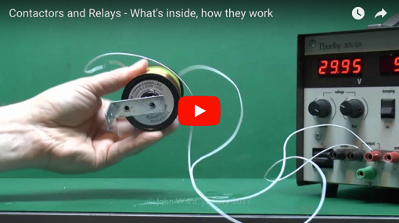
A Refresher on Contactors
Contactors are basically electromagnetically operated switches. They were covered fully in Course 3 but if you need a quick refresher, this video does a great job.
Watch this video to find out a bit more about contactors.
Notes:
Youtube video: URL = https://www.youtube.com/watch?v=5Iujs94re_U. Play video full screen

Slide 13
How do you wire contactors?
Now that we understand how contactors work in theory, let’s see how to get them to work in practice
Img04c
Watch this video to find out how to wire a contactor into a circuit.
Notes:
Img4c = screenshot of Vid01 (see brief). Play video full screen

Slide 14
What are auxiliary contacts?
Besides the main contacts in a contactor, we can also fit extra contacts to the contactor. These are called auxiliary contacts and are used to control the motor.
Img04d
Watch this video to find out more about auxiliary contacts an how to use them to control circuits.
Notes:
Img4d = screenshot of Vid02 (see brief). Play video full screen

Slide 15
Even if we wire up single phase motors, we normally use three phase contactors. In this case, it is a good idea to replace the 380V coils with 220V coils suitable for single phase power.
Notes:
Img09 = screenshot of Int03 (see brief). On click present Int03 full screen.

Slide 16
How do you reverse a single phase motor?
Do you remember how to reverse the direction of a single phase motor? Which of the following options are correct? There may be more than one correct answer.
Reverse the start winding
Reverse the run winding
Reverse both windings
Reverse neither winding
Notes:
Multiple correct
Options a) and b) are correct.
Provide following feedback:
a) AND b) – Well done. Yes, you can reverse either the start or run windings to reverse a single phase motor
only – That is right but it is not the whole picture. Reversing the start winding will reverse the direction of a single phase motor BUT, reversing the run winding will also have the same effect.
only – That is right but it is not the whole picture. Reversing the run winding will reverse the direction of a single phase motor BUT, reversing the start winding will also have the same effect.
That is not correct. If you reverse both sets of windings, the direction of the motor will not change. Reversing one winding will change the direction of the motor but then reversing the other as well will set the change the direction back to what it was.
That is not correct. You have to reverse one of the windings (either the start OR run) to reverse the direction of the motor.

Slide 17
The running winding
In this unit, we will reverse the motor direction by reversing the run winding.
Remember, you could also reverse the start winding to achieve the same effect.
Notes:
Button01 = on click display the following popup – The run often has no other components like centrifugal switches or capacitors. Some capacitors are designed

Slide 18
Basic Schematics
Here are schematics for a motor in the forward and reverse direction. Draw your own versions of these diagrams now.
The arrows indicate the direction of conventional current through the run winding.
Notes:
Img05 and img06 - Redraw both diagrams.

Slide 19
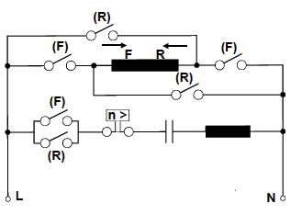
The Complete Schematic
This schematic shows both the forward a reverse circuits together.
Click the Forward and Reverse buttons to see how the circuit works.
Draw your own copy of this diagram.
Note the direction of current through the start winding is always the same.
Forward
Reverse
Notes:
Img07 = screenshot of Int01 (see brief). On click present Int01 full screen.

Slide 20
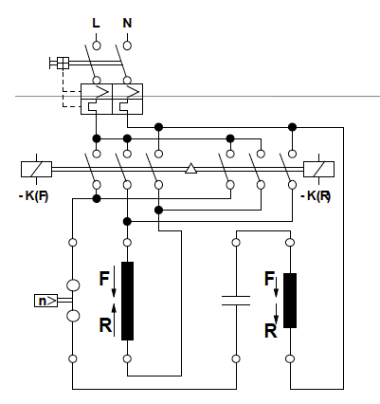
The Line Diagram
When dealing with circuits involving contactors, we often draw line diagrams. This diagram shows two 3-pole contactors.
Click the image to view the main line diagram in more detail.
Notes:
Img08 = screenshot of Int02 (see brief). On click present Int02 full screen.

Slide 21
The Line Diagram
Now click the image to view an interactive line diagram to see how current flows through the circuit.
Remember that in line diagrams a solid black dot indicates a connection between wires. Wires that cross WITHOUT a black dot are NOT CONNECTED.
Notes:
Img09 = screenshot of Int03 (see brief). On click present Int03 full screen.

Slide 22
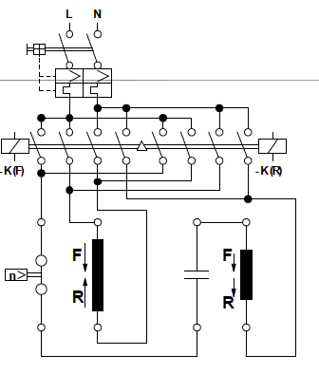
Four pole contactors
The same job can be done by a 4-pole contactor. The only difference in this case is that the 4th contact is used for the neutral conductor of the starting circuit.
Now click the image to view an interactive line diagram to see how current flows through the circuit.
Notes:
Img09a = edit Img09 to include an additional contact in each of the contactors and the connection of the neutral wire from the start winding to this fourth contact.

Slide 23
Upload your completed circuit
Draw your own copies of the motor circuit with the 3-pole and 4-pole contactors or the same sheet of paper. Then take a photo and upload it to your portfolio. Make sure you label them so that it is easy to tell which is the 3-pole and which is the 4-pole circuit.
Choose image
Upload
Notes:
Img09b = https://cdn.pixabay.com/photo/2016/01/03/00/43/upload-1118929_960_720.png
Button 01 – Launch file selection window
Button 02 – Upload file

Slide 24
Main vs control circuits
So far we have connected our motor to the mains supply. We now need to work on starting and controlling it by opening and closing the contactors. Things normally get very complicated if we try and draw the main power circuit and the contactor control circuit together. So we draw them separately.
Click on the buttons to learn more about these circuits.
Main Motor Circuits
Motor Control Circuits
Notes:
Button01 = On click present the following in a popup – “The main motor circuit is the one that actually delivers the electricity to the motor. The main circuit almost always includes a contactor because of the large currents usually involved (especially at start up) and because of how quickly contactors can open and close. The main circuit usually also includes other motor protection components like circuit breakers and relays to protect the motor.”
Button02 = On click present the following in a popup – “The motor control circuit is separate from the main circuit. It is a low current circuit (usually mA rather than A) and it is designed to control when the motor starts and stops by controlling when the contactor coil energises and de-energisers. The control circuit draws power from the same source as the main circuit and usually also includes protection components like breakers, fuses or relays.

Slide 25
Let’s get wiring
Ready to wire up our circuit according to the line diagram?
Img10
Watch the video to see how this is done.
Notes:
Img10 = screenshot of Vid03 (see brief). Play video full screen.

Slide 26
Retaining contacts
We saw that we need to add something to “retain” or keep the contactor’s coil energised even when we let go of the start button.
Img11
Watch the video to see how to wire in a retaining contact.
Notes:
Img11 = screenshot of Vid04 (see brief). Play video full screen.

Slide 27
Interlocks
But what if the motor is running in reverse and we accidentally press the forward start button?
Img12
Watch the video to see how we can prevent these sorts of accidents from damaging the motor.
Notes:
Img12 = screenshot of Vid05 (see brief). Play video full screen.

Slide 28
A quick summary
We have done through quite a bit. Let’s pause for a summary of our final control circuit.
Img13
Click on the image to view a full screen summary of how we wired up our motor control circuit.
Notes:
Img13 = screenshot of the first part of Img13 (see brief). On click open Img13 full screen.

Slide 29
The main and control circuits
Most of the time, things get too complicated if we try and represent everything together, so we usually split up our circuit diagrams into the main circuit and the control circuit.
Img14
Img15
Notes:
Img14 = same image as Img09
Img15 = final image from the Img13 sequence

Slide 30
Try it yourself
Have a go wiring a virtual forward reverse starter control circuit for a single phase motor. You need to connect up the main and control circuits.
Img16
Click on the image to access the virtual motor wiring tool. When you are done, print the circuit so you can upload a copy.
Notes:
Img16 = screenshot of Int04 (see brief)

Slide 31
Upload your completed circuit
Print out your completed motor circuit and upload a copy to your portfolio.
Choose image
Upload
Notes:
Img17 = https://cdn.pixabay.com/photo/2016/01/03/00/43/upload-1118929_960_720.png
Button 01 – Launch file selection window
Button 02 – Upload file

Slide 32
Video Briefing – Vid01
Video of an expert electrician explaining how to wire up a normal 3 pole contactor. Highlight and explain the following:
Draw/show the symbol for a contactor
Typical labels – A1 and A2 power to the coil
L1, 2, 3 and T1, 2, 3 – main contactors – contactors are typically built for three phase circuits hence one main contact for each phase. These power the motor.
Coil rating – 400V, 380V, 220V – can change the coil – show how to do this – make sure coil is right for the circuit voltage.
Connect L1 and L2 to mains supply (L for L1 and N for L2)
Connect A1 and A2 to power (L to A1 and N to A2) – Do not bridge connections – use separate connections.
Turn power on and off
Connect a 220V light bulb to T1 and T2 and turn power on and off.
Almost all main contacts are of the Normally Open type – they are normally open and only close when the coil is energised.
Notes:
See https://www.youtube.com/watch?v=gOcImlyCRQk as an example. This video is the same as Vid01 in 07_03_02.

Slide 33
Video Briefing – Vid02
Video of an expert electrician explaining what the aux contacts are and how to wire them up. Highlight and explain the following:
Some contactors have one or more auxiliary contacts built in – show an example
Often, we can add additional auxiliary contacts to the contactor either using side or face modules – show examples.
We use aux contacts to control the motor by controlling when the coil is energised or de-energised
Auxiliary contacts can be either NO or NC – explain both
Wire up a contactor with at least 1 NO Aux Contact and 1 NC Aux Contact (use the same contactor from Vid01 if possible but with added Aux contacts)
Connect green light to NO and Red light to NC
Connect contactor to power
Red light on indicating load not engaged
Energise coil and see green light go on and red light go off
Explain this as a result of NO closing and NC opening.
Notes:
See https://www.youtube.com/watch?v=E30g5C-qdmQ as a reference. VThis video is the same as Vid02 in 07_03_02.

Slide 34
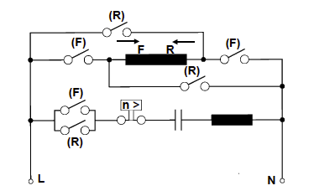
Interactive Briefing – Int01
Create an interactive based on this diagram.
On pressing Forward button, open all R switches (if closed) and close all F switches and show current flowing through the circuit using arrows in the same colour as the button.
On pressing Reverse button, open all F switches (if closed) and close all R switches and show current flowing through the circuit using arrows in the same colour as the button.
In all cases current flows FROM L TO N
Forward
Reverse

Slide 35
Interactive Briefing – Int02 (1 of 6)
Click on the highlighted portions to learn more about the line diagram.
Notes:
1 = see slide 21
2 = see slide 22
3 = see slide 23
4 = see slide 24
5 = see slide 25

Slide 36
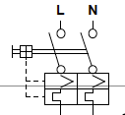
Interactive Briefing – Int02 (2 of 6)
Main circuit breaker
This is the main motor protection. In this case, it is an integrated component called a Motor Protection Circuit Breaker (MPCB) and consists of a
Main circuit breaker
Current overload relay
Thermal overload relay
Current overload relay
Thermal overload relay
Notes:
2P Motor control protection breaker symbol e.g. https://symbols.radicasoftware.com/category/Circuit-Breakers.html.

Slide 37
Interactive Briefing – Int02 (3 of 6)
This contactor has 3 primary contacts. These contacts are all normally open. We call them normally open contacts or NO for short.
This is the forward contactor. We know this because it has been labelled as –K(F). Contactors are often referred to in line diagrams as –K.
This symbol is the coil of the contactor

Slide 38
Interactive Briefing – Int02 (4 of 6)
This contactor has 3 primary contacts. These contacts are all normally open. We call them normally open contacts or NO for short.
This is the reverse contactor. We know this because it has been labelled as –K(R). Contactors are often referred to in line diagrams as –K.
This symbol is the coil of the contactor

Slide 39
Interactive Briefing – Int02 (5 of 6)
An open dot represents a join in the circuit like where the wires are connected to the contactor primary contacts.
Lines that cross with a dot are connected.
Lines that cross without a dot are NOT CONNECTED.

Slide 40
Interactive Briefing – Int02 (6 of 6)
This symbol indicates that there are 2 separate contactors involved in the circuit – one either side of the triangle.
This is the circuit overload protection

Slide 41
Interactive Briefing – Int03
Create an interactive based on this diagram.
On pressing Forward button, open the three –K(R) contacts if closed and close the three –K(F) contacts and show the current flowing through the circuit using arrows of the same colour as the Forward button. Also highlight the -K(F) and label it as energised
On pressing Reverse button, open the three –K(F) contacts if closed and close the three –K(R) contacts and show the current flowing through the circuit using arrows of the same colour as the Reverse button. Also highlight the -K(R) and label it as energised
In all cases current flows FROM L back to N
Forward
Reverse

Slide 42
Video Briefing – Vid03
Video of an expert electrician explaining how to wire up the single phase forward/reverse starter using contactors. Highlight and explain the following:
Connect a start button to provide power to -K(F) and –K(R) respectively and connect these to power.
Connect contactor –K(F) in forward configuration to the motor
Connect contactor –K(R) in reverse configuration to the motor
Press the F start button – note the problem – motor only stays on while button pressed
Press R start button and note the same problem
Explain that we need to find a way to keep the motor running even after we release the start button.
Explain the concept of a retaining contact – if we have a NO contactor connected to in parallel with the start button then
Press start button and coil energises
NO contact closes and current flows through it to the coil
Release start button but because connected in parallel, current continue to flow through this retaining contact to keep coil energised.
Make sure this is all drawn carefully.

Slide 43
Video Briefing – Vid04
Video of an expert electrician explaining how to wire up the single phase forward/reverse starter using contactors and retaining contacts. Highlight and explain the following:
Explain the concept of a retaining contact again – if we have a NO aux contact connected in parallel with the start button then
Press start button and coil energises
NO contact closes and current flows through it to the coil
Release start button but because connected in parallel, current continue to flow through this retaining contact to keep coil energised.
Make sure this is all drawn carefully. Explain the positive feedback loop
Wire up a retaining contact for the forward direction. Push start and see that the motor keeps running
But now we need to way to stop the motor. Is pressing the reverse start button a good idea at this point? Explain step by step what would happen if we did.
Engage the reverse circuit BUT nothing has disconnected the forward circuit – that coil is still energised and the main contacts are all still closed.
If possible actually demonstrate what happens to a motor if the forward and reverse circuits are active at the same time.
We need a forward stop button. Where should we place it if we want to de-energise the forward coil? In series with the start button – before or after.
Wire a stop button in series with the forward start button.
Start forward motor and stop forward motor
Start reverse motor and note we still need to add a retaining contact
Add reverse retaining contact and stop button
Demonstrate how the circuit works
All through the video keep updating the control circuit diagram

Slide 44
Video Briefing – Vid05
Video of an expert electrician explaining how to wire up the single phase forward/reverse starter using contactors and interlocking contacts. Highlight and explain the following:
We know that using a NO contact we can retain the energised state of a coil. When the coil is energised, the NO closes.
What if we wired a NC contact from one contactor into the other contactor? When contactor F was energised the NC would open and prevent the R coil being energised until the F coil was de-energised and the NC closed again.
Wire the F interlock into the R circuit.
Start F and see that start R has no effect
Wire the R interlock into the F circuit
Start R and see that start F has no effect
Finally add a catch all emergency stop button

Slide 45
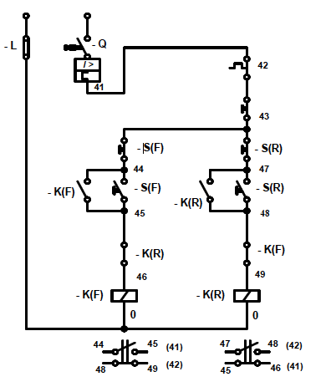
Image Briefing – Img13 (1 of 6)
N
Step 1:
This is the basic circuit we started with. The motor stopped when we let go of the start button.
-Start(F)
-Start(R)
-K(F)
-K(R)
Next
Notes:
Create a series of 6 images that build up the full control circuit step by step.
Vitally important to standardise on all circuit symbols (TBA). On click of Next display the next image in the series.
Master diagram on far right.
NB that circuit components are NOT moved between images.

Slide 46
Image Briefing – Img13 (2 of 6)
N
Step 2:
We then added 2 NO auxiliary contacts in parallel with the start buttons as retaining contacts. These kept the coil energised and the motor running even when we let go of the start button. But we still had no way of easily stopping the motor.
-K(F)
-Start(F)
-K(R)
-Start(R)
-K(F)
-K(R)
Next
Back
Notes:
Highlight the 2 retaining contacts
On click of Back display the previous image in the series

Slide 47
Image Briefing – Img13 (3 of 6)
N
Step 3:
To fix this, we added in stop buttons in series with the start buttons. These buttons were NC buttons.
But we still had one problem. What if we accidentally pushed the forward start button while the motor was running in reverse?
-Stop(F)
-Stop(R)
-K(F)
-Start(F)
-K(R)
-Start(R)
-K(F)
-K(R)
Next
Back
Notes:
Highlight the 2 stop push buttons

Slide 48
Image Briefing – Img13 (4 of 6)
N
Step 4:
To solve this problem and prevent accidental damage to the motor, we wired NC auxiliary contacts as interlocks between the contactors.
Notice how we label these NC auxiliary contacts (linked back to their controlling coil).
-Stop(F)
-Stop(R)
-K(F)
-Start(F)
-K(R)
-Start(R)
-K(R)
-K(F)
-K(F)
-K(R)
Next
Back
Notes:
Highlight the 2 interlock contacts

Slide 49
Image Briefing – Img13 (5 of 6)
N
Step 5:
Finally we added a button to rule them all – an emergency stop button.
-Emergency Stop
-Stop(F)
-Stop(R)
-K(F)
-Start(F)
-K(R)
-Start(R)
-K(R)
-K(F)
-K(F)
-K(R)
Next
Back
Notes:
Highlight the emergency stop button

Slide 50
Image Briefing – Img13 (6 of 6)
N
Often, to make things easier to read, we number the various parts of the circuit. You can really choose whatever numbers you like if you are the author of the diagram.
10
-Emergency Stop
11
-Stop(F)
-Stop(R)
12
16
13
17
-K(F)
-Start(F)
-K(R)
-Start(R)
14
18
-K(R)
-K(F)
15
19
-K(F)
-K(R)
Back

Slide 51
Interactive Briefing – Int04 (1 of 2)
L
N
Instructions
To add a wire between 2 points, click the starting connection and then click the ending connection.
To delete a wire, click on it and then click the Delete icon in the top right corner.
To change the colour of a wire, click on it and then click on the colour.
To move a component, click and drag it to a new position.
Practice
Connect the stop button, start button and coil in series.
Stop
Test
F
Forward
L1
L2
L3
A1
NO
NC
NO
NC
T1
T2
T3
A2
Notes:
White circles on components are wire connection points
Make wires curve around components
When connected components are moved, have wires stay connected
On click of first connection, highlight connection point and start to draw wire and have end of wire follow finger/mouse until next connection. Use 2 second time delay on second connection before making the connection. When second connection is selected, highlight it also.

Slide 52
Interactive Briefing – Int04 (2 of 2)
Wire up the main and control circuit for a single phase forward reverse motor starter.
L
N
Stop
F
Stop
F
Test
L1
L2
MPCB
L3
Stop
Instructions
T1
T2
T3
Print
Forward
Reverse
L1
L2
L3
A1
NO
NC
L1
L2
L3
A1
NO
NC
RW
SW
NO
NC
NO
NC
T1
T2
T3
A2
T1
T2
T3
A2
Notes:
Fix position of LIVE and NEUTRAL connections
Fix position of motor terminals
Present other components unconnected and unpositioned.
Button01 = on click test circuit connections. Highlight all connections that are incorrect. See next slide for all correct connections
Button02 = display the instructions on previous slide in a pop-up window.
Button03 = print a jpg or pdf version of the final circuit for the learner to download and save.

