Slide 1
Single Phase Motors
Topic 4: Connecting and Starting Single Phase Motors

Slide 2
Assumed prior learning
05_01_00
05_01_02
05_02_01
05_03_01
05_04_01
Notes:
Note for navigation on site:
This information needs to be taken into account and needs to stated on the LMS, perhaps as part of the introduction?

Slide 3
Outcomes
By the end of this unit the learner will be able to:
Draw schematic and line diagrams for the wiring of a single phase motor to a reverse rotary switch.

Slide 4
Unit 4.1: Connect a Single Phase Motor to a Rotary Reversing Switch

Slide 5
Introduction
In the previous unit, we connected a single phase capacitor-start motor directly to a power source.
In this unit we are going to use a rotary reversing switch to control and change the direction of a capacitor-start motor.
In the next unit, we will use reversing contactors to do the same thing.

Slide 6
Safety first
When you work with motors you must put your safety and the safety of others first. You must complete the necessary Hazard Identification and Control (HIAC) Form.
Need help with HIACs? Click the button to go to Topic X in The World of an Electrician
Get help with HIAC Forms
Notes:
Img01 = https://cdn.pixabay.com/photo/2014/04/02/10/38/sign-304093_960_720.png
Button 01 = direct learner to Topic X in Course 0

Slide 7
Potential Hazards
Here are some of the potential hazards you should look out for:
Vehicles, traffic or mobile equipment
Working at heights above 2m
Hazardous Materials or Waste
Lifting and material handling
Electricity, machinery, stored energy or machine isolation
Work with Oxy-fuel gas mixtures
Notes:
Present boxes with just a representative icon in each circle. On click/touch, reveal the full statement.
Display small animations to indicate that boxes can be clicked/touched

Slide 8
Stop and Check?
Because there are some potential hazards associated with this job, you need to check that all the necessary safety controls related to these hazards are in place.
If you are not sure what these safety controls are, you should stop this unit and refer back to Topic X in The World of an Electrician before continuing.
Learn about Safety Controls
Notes:
Img02 = https://upload.wikimedia.org/wikipedia/commons/9/9d/Stop_sign_light_red.svg
Button 01 = direct learner to Topic X in Course 0

Slide 9
Before We Begin
Before you do any electrical tests, you must make sure that you have isolated and locked out the supply to the motor.
Make sure you know how to do this by referring to Topic X in The World of An Electrician.
Learn about Isolating and Lock-Out Procedures
Notes:
Img03 = https://cdn.pixabay.com/photo/2016/07/01/22/38/industrial-safety-1492062_960_720.png
Button 01 = direct learner to Topic X in Course 0

Slide 10
Changing Direction
Often in the real world, we need to change the direction of a motor. One simple example is a motorised garage door.
Img04
Can you think of any other examples?
Having to change the bridge pieces in the terminal box to do this would be a real pain. There is an easier way!!
Notes:
Img04 = photograph of a motorized garage door showing the motor

Slide 11
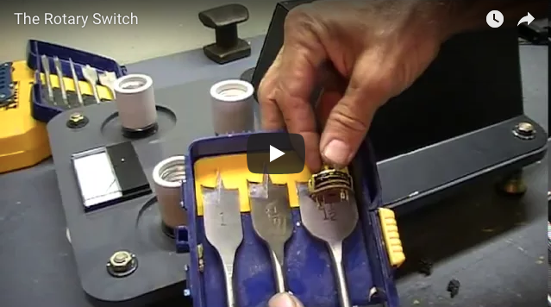
The Rotary Switch
Rotary switches are manual switches that you turn. They can have 2, 3 or more different switch positions.
Watch this video to find out a bit more about rotary switches
Img04a
Notes:
Img04a = photograph of an old appliance (radio or TV) with the channel knobs highlighted.
Youtube video: URL = https://www.youtube.com/watch?v=muQdJLsfosE

Slide 12
Reversing a Single Phase Motor
Do you remember how to reverse the direction of a single phase motor? Which of the following options are correct? There may be more than one correct answer.
Reverse the start winding
Reverse the run winding
Reverse both windings
Reverse neither winding
Notes:
Multiple correct
Options a) and b) are correct.
Provide following feedback:
a) AND b) – Well done. Yes, you can reverse either the start or run windings to reverse a single phase motor
only – That is right but it is not the whole picture. Reversing the start winding will reverse the direction of a single phase motor BUT, reversing the run winding will also have the same effect.
only – That is right but it is not the whole picture. Reversing the run winding will reverse the direction of a single phase motor BUT, reversing the start winding will also have the same effect.
That is not correct. If you reverse both sets of windings, the direction of the motor will not change. Reversing one winding will change the direction of the motor but then reversing the other as well will set the change the direction back to what it was.
That is not correct. You have to reverse one of the windings (either the start OR run) to reverse the direction of the motor.

Slide 13
Need Some Help?
If you need some help understanding how to reverse the direction of a single phase induction motor, go back to the unit on How Single Phase Motors Work.
How Single Phase Motors Work
Notes:
Button 01 = Link to 05_02_01

Slide 14
The Running Winding
In this unit, we will reverse the motor direction by reversing the running winding.
Remember, you could also reverse the start winding to achieve the same effect.
Notes:
Redraw both diagrams and include

Slide 15
The Basic Schematics
Here are schematics for a motor in the forward and reverse directions. Draw your own version of these diagrams now.
The arrows indicate the direction of conventional current through the run winding.
Notes:
Img05 and img06 - Redraw both diagrams.

Slide 16
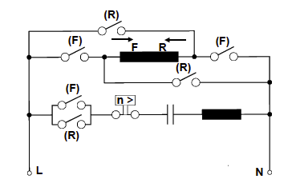
The Complete Schematic
This schematic shows that the rotary switch contacts as well.
Click the Forward and Reverse buttons to see how the circuit works.
Practice drawing your own copy of this diagram.
Note the direction of current through the start winding is always the same.
Forward
Reverse
Notes:
Int01 (see brief)

Slide 17
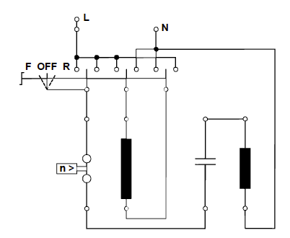
The Line Diagram
We can also represent the motor wiring as a line diagram.
Remember that in line diagrams a solid black dot indicates a connection between wires. Wires that cross WITHOUT a black dot are NOT CONNECTED.
Notes:
Img07 = reproduce image

Slide 18
Turn the Switch
Img08
Here is an interactive wire diagram to play with.
Click on the image to open the interactive diagram.
Toggle the switch to see how current flows through the circuit.
Make your own copy of these diagrams in F, OFF and R positions.
Notes:
Ing08 = screenshot of Int02 (see brief). On click open Int02 full screen.

Slide 19
The Wiring
Schematic and line diagrams are great, but they are not the same as seeing the real thing.
Watch the video to see the full process of wiring a single phase motor to a rotary reverse switch.
Vid01
Notes:
Play vid01 full screen.

Slide 20
Upload Your Motor Schematic Diagram
Now take a picture of your completed schematic diagrams and upload it.
Make sure that your schematic diagrams clearly show the forward and reverse wiring as well as the rotary switch contacts.
Choose image
Upload
Notes:
Img17 = https://cdn.pixabay.com/photo/2016/01/03/00/43/upload-1118929_960_720.png
Button 01 – Launch file selection window
Button 02 – Upload file

Slide 21
Upload Your Line Diagrams
Now take a picture of your completed line diagram and upload it.
Make sure that your line diagrams clearly shows the rotary switch contacts in the F, OFF and R positions and that all conductor connections are clearly indicated.
Choose image
Upload
Notes:
Img17 = https://cdn.pixabay.com/photo/2016/01/03/00/43/upload-1118929_960_720.png
Button 01 – Launch file selection window
Button 02 – Upload file

Slide 22
Interactive Briefing – Int01
Create an interactive based on this diagram.
On pressing Forward button, open all R switches (if closed) and close all F switches and show current flowing through the circuit using arrows in the same colour as the button.
On pressing Reverse button, open all F switches (if closed) and close all R switches and show current flowing through the circuit using arrows in the same colour as the button.
In all cases current flows FROM L TO N
Forward
Reverse

Slide 23
Interactive Briefing – Int01 (1 of 2)
L
N
Create an interaction based on this line diagram. The diagram is in 2 parts (see groups).
Learners must be able to drag the red switch left and right into the F, OFF and R positions.
Each each position show the direction of current flow through the circuit using arrows.
In all cases current flows FROM L to N.
Black dots indicate wire connections. Wires crossing without black dot DO NOT CONNECT.
Use a visual indication (like a handle and arrows) to make it clear that learners must move switch left and right.
F
OFF
R
RW
n >
SW

Slide 24
Interactive Briefing – Int01 (2 of 2)
L
N
L
N
F
OFF
R
F
OFF
R
RW
RW
n >
n >
SW
SW
Forward position
Reverse position

Slide 25
Video Briefing – Vid01 (1 of 2)
Video of an electrician demonstrating the the full process of wiring a single phase motor to a rotary reverse switch:
Ensure hazards and safety procedures noted.
Lock-out motor
Open the terminal box
Look for a wiring diagram
Draw the terminal block diagram
Use continuity tests to confirm C/S, RW and SW
Add these results to the terminal block diagram
Draw a schematic diagram of the motor with SW, RW, C/S and Cap and note position of terminals on schematic (see next slide)
From this diagram determine supply position – usually supply is connected to RW terminals. As AC orientation does not matter.
Confirm bridging needed for forward direction

Slide 26
Video Briefing – Vid01 (2 of 2)
Explain connections of rotary switch – use continuity tests to find connected terminals.
Draw line diagram as in Int02 and number switch terminals.
Wire up switch to motor and switch to supply using correct size conductors
Correctly earth the motor
Power-off Test with bell-tester
Power-on Test – show motor running in forward and reverse directions.

