Slide 1
Single Phase Motors
Topic 2: The Different Types and Uses of Single Phase Motors

Slide 2
Assumed prior learning
Notes:
Note for navigation on site:
This information needs to be taken into account and needs to stated on the LMS, perhaps as part of the introduction?

Slide 3
Outcomes
Text
Notes:
Note for design:
This list of text should be broken up to make it more interesting. Text should be presented in a menu type of format.
Note for interactivity:
Information should be presented in a clickable menu so that learner can click on each outcome instead of it being one long list.

Slide 4
Unit 2.1: Capacitor Motors

Slide 5
Introduction
In Topic 1, we learnt how single phase induction motors work. We saw that we need some trickery to simulate a rotating magnetic field and that one way to do this is to add a capacitor to the starting windings.
In this topic, we will take a closer look at the motors that use capacitors to simulate a rotating magnetic field.

Slide 6
Single Phase Capacitor-Based Induction Motors
There are three basic kinds of single phase motors that use a capacitor to create a rotating magnetic field.
Capacitor-start
Capacitor-start and run
Click on each button to find out more.
Capacitor-start Capacitor-run
All three are still induction motors because the stator magnetic field induces a current in the rotor.
Quiz
Notes:
Button 1 = Goto Slide 7
Button 2 = Goto Slide 9
Button 3 = Goto Slide 14
Suppress navigation
As user returns to this menu, indicate which motors they have viewed. When all motors have been viewed, display the Quick Quiz button instead.
Button 04 = Goto slide 20

Slide 7
Capacitor-Start Motors
We covered the capacitor-start motor in the previous topic when looking at how single phase induction motors work.
If you need a reminder of how this motor works, have a look at the video.
Video
Notes:
Video = Vid03 (from 05_01_02). Play full screen

Slide 8
Uses of Capacitor-Start Motors
Capacitor-start motors are very common. Because of the high phase angle between the starting and running windings during start, these motors have a high starting torque. They can be started with a heavy load.
Img01
Img02
Img03
Conveyor Belt
Pump
Compressor
Back to
motor menu
Notes:
Img01 = conveyor belt
Img02 = pump
Img03 = compressor
For all three images, add view full screen option.
Button 1 = Goto Slide 6

Slide 9
Capacitor-Start and Run Motors
These motors are almost identical to capacitor-start motors except for 2 things:
Img04
They have a smaller capacitor in series with the starting windings that always stays connected.
1
Therefore, there is no centrifugal switch to disconnect the capacitor.
2
These motors are often called Permanent Split Capacitor (PSC) motors.
Notes:
Img04 = example of PSC motor e.g. https://static.grainger.com/rp/s/is/image/Grainger/4YU24_AS02?$mdmain$
Present boxes with just the number. On click/touch, reveal the full statement as a slide right animation

Slide 10
How PSC Motor Work
PSC motors are very similar in construction and operation to capacitor start motors.
Vid01
Watch the video to find out more about how they work.
Notes:
Play Vid01 (see brief) full screen

Slide 11
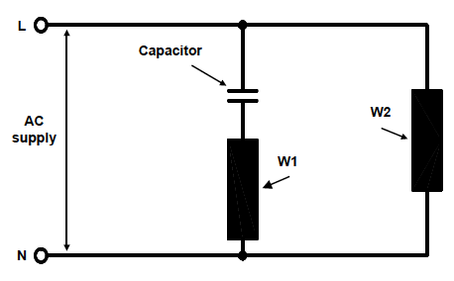
Capacitor-Start and Run Motor Diagram
Here is a schematic of a typical PSC motor. Notice the lack of a centrifugal switch. Therefore, the capacitor stays engaged.
?
What effect on the running of the motor do you think having a permanent capacitor has?
Notes:
Redraw image

Slide 12
Capacitor-Start and Run Motor Features
Complete a table of differences between capacitor-start and PSC motors. When you are done, click the submit button to see how you did and learn more.
Start activity
Notes:
Display empty 2 column table. Present the following words and phrases in random order for learner to drag into one or the other column.
Has centrifugal switch
Has no centrifugal switch
Has higher starting torque
Has lower starting torque
Has higher running torque
Has lower running torque
Has a smoother operation
Has a less smooth operation
More efficient
Less efficient

Slide 13
Compare Capacitor-Start and Run Motor Features
Capacitor-Start Motor | Permanent Split Capacitor Motor
Has centrifugal switch | Has no centrifugal switch
Has higher starting torque | Has lower starting torque
Has lower running torque | Has higher running torque
Has a less smooth operation | Has a smoother operation
Submit
Notes:
On submit highlight which words/phrases are in the correct column and present a “?” icon next to each. On click, display the following additional information as a tooltip.
Has centrifugal switch – Because the starting windings and capacitor are not rated for continual usage, a centrifugal switch needs to turn the off at about 80% speed.
Has no centrifugal switch – Both the starting windings and capacitor are rated to run all the time so no centrifugal switch is needed
Has higher starting torque – Because the start capacitor only needs to be in the circuit for a few seconds at most, it can be bigger. This helps to increase the phase angle between the starting and running windings which means the motor can start up with more force or torque
Has lower starting torque – Because the capacitor needs to run all the time, it has to be smaller which means that the phase angle between the starting and running windings is not as big as a capacitor-start motor. A smaller phase angle means the motor starts up with less force or torque.
Has higher running torque - When the motor is running both sets of windings are engaged. Therefore both the starting and running windings contribute to force on the rotor - the motor’s torque
Has lower running torque - When the motor is running, the starting windings are not used. Therefore it is only the running windings providing torque.
Has a smoother operation – Because only the running windings are working, the motor has fewer poles, meaning that the force or torque on the rotor is only acting some of the time, so the motor runs less smoothly.
Has a less smooth operation – Because the starting and running windings are working, the force being applied to the rotor is more consistently applied, hence the motor runs more smoothly.

Slide 14
Uses of Capacitor-Start and Run Motors
PSC motors tend to be compact and easy to maintain.
Most produce no more than 2HP.
Because of their lower starting torque they are used when starting torque is not needed.
Img05
Img06
Img07
Back to
motor menu
Fan
Roof Ventilator
Heater
Notes:
Img05 = Fan or blower
Img06 = roof ventilator
Img07 = heater
For all three images, add view full screen option.
Button 1 = Goto Slide 6

Slide 15
Capacitor-Start Capacitor-Run Motors
These motors have two capacitors:
Large start capacitor (connected and disconnected with a centrifugal switch)
Smaller run capacitor.
Img08
Like the PSC motor, the starting windings are rated to operate all the time. Capacitor-start capacitor-run (CSCR) motors combine the best of both capacitor-start and PSC motors.
Notes:
Img08 = example of PSC motor e.g. https://static.grainger.com/rp/s/is/image/Grainger/15WF51_AS01?$mdmain$

Slide 16
How Capacitor-Start Capacitor-Run Motors Work
Watch this short video to get a good overview of CSCR motors and their construction, operation and features.
Vid02
Notes:
Play vid02 (see brief) full screen

Slide 17
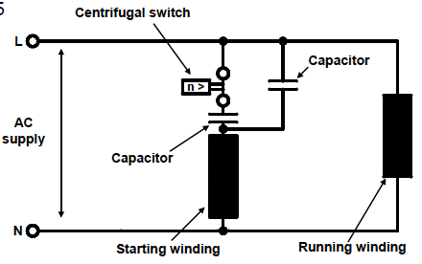
CSCR Motor Schematic
Here is a schematic of a CSCR motor.
Drag each of the labels below to the correct place on the diagram.
Running Winding
Neutral Terminal
Centrifugal Switch
Start Winding
Live Terminal
Run Capacitor
Rotor
Check
Start Capacitor
Notes:
Reproduce the diagram but without the labels. Labels to be dragged are:
Live Terminal
Neutral Terminal
Running winding
Starting winding
Run Capacitor
Centrifugal switch
Start Capacitor
Rotor
On check, highlight which labels are correct and incorrect and let learner try again before displaying the correct labels.

Slide 18
CSCR Motor Characteristics
CSCR motors have some important characteristics.
They have good starting and running torque
1
Because both windings are used, motors can be smaller for the same power
2
Using both sets of windings increases the motor’s efficiency
3
Notes:
Present boxes with just the number. On click/touch, reveal the full statement as a slide right animation
Display small animations to indicate that boxes can be clicked/touched

Slide 19
Uses of CSCR Motors
While CSCR are the most complex and expensive single phase motors, their improved efficiency makes up for the cost.
They range from about ½ to 25 HP.
They are used when there is a large starting load.
Img09
Img10
Img11
Back to
motor menu
Large Pump
Large Conveyor
Large Compressor
Notes:
Img09 = large pump
Img10 = large conveyor
Img11 = large compressor
For all three images, add view full screen option.
Button 1 = Goto Slide 6

Slide 20
A Quick Quiz
Before we end off, take some time to check your understanding of what we have covered in this unit by answering the following questions.

Slide 21
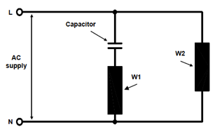
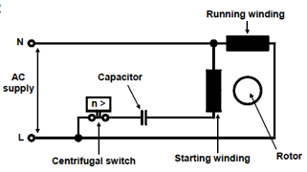
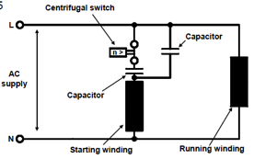
Question 1
Which of the following diagrams represent a CSCR motor?
a)
b)
c)
Notes:
Multiple choice question. Option a is correct.
Reproduce all images
Provide options to view images full screen.

Slide 22
Question 2
Which motor would be best suited for use in a small blower heater?
PSC
Capacitor-Start
Split Phase
CSCR
Notes:
Multiple choice question. Option a is correct.

Slide 23
Question 3
Which motor would be best suited to drive a conveyor belt that transports heavy boxes?
PSC
Capacitor-Start
Split Phase
CSCR
Notes:
Multiple choice question. Option d is correct.

Slide 24
Question 4
In CSCR motors, which capacitor has the lower value?
Start capacitor
Run capacitor
Notes:
Multiple choice question. Option a is correct.

Slide 25
Question 5
What are the advantages of a PSC motor over a capacitor-start motor. Select all that apply.
The motor has higher starting torque.
The motor has a smoother operation.
The motor has better running torque.
The motor does not need a centrifugal switch.
Notes:
Multiple correct question. Options b, c, d are correct.

Slide 26
Video Briefing – Vid01
Presentation and demonstration of the construction and operation of a PSC motor.
Notes:
Use https://www.dropbox.com/s/n9dlknx0srj7cd4/VTS_01_1.VOB?dl=0 (11:00 – 12:10) as a reference.

Slide 27
Video Briefing – Vid02
Presentation and demonstration of the construction and operation of a Capacitor-start capacitor-run motor.
Notes:
Use https://www.dropbox.com/s/n9dlknx0srj7cd4/VTS_01_1.VOB?dl=0 (12:13 – 13:35) as a reference.

Slide 28
Resource 01:

