Slide 1
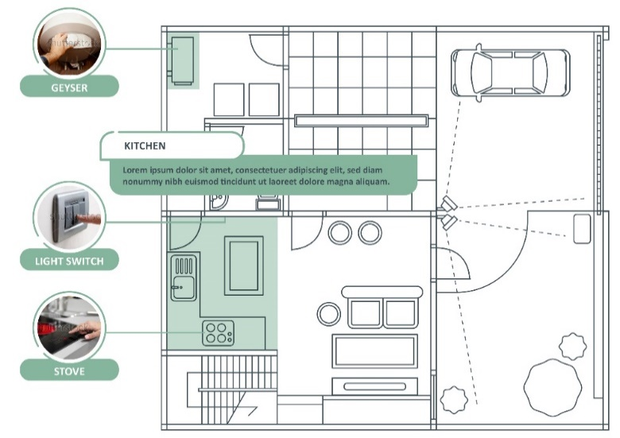
Placeholder Diagram needed for an industrial environment ie a factory. Must be similar in style to the example on the right.
Notes:
Note for design:
This diagram needs to be redrawn and styled similarly to the example provided.
Note for interactivity:
This should be an interactive map where users are able to click on each of the scenarios on the diagram and be taken to the information for that scenario.

Slide 2
Wireways
Topic 5- Install a 3 phase socket outlet
All copyright and intellectual property rights in respect of materials developed by the service provider during this project will vest in the Department of Higher Education and Training, which will have the right to allow any individual, company, agency or organisation to use or modify the materials for any purpose approved by this Department, including selling the materials or releasing them as Open Educational Resources (OER) under an appropriate copyright license.

Slide 3
Assumed prior learning
Fundamentals of electricity
Safety, health environment, risk and the quality principles in the workplace
Hand tools and power tools use and applicable safety requirements
Measuring and testing methodologies (electrical and mechanical)
Have completed the introduction to the world of work and the electrical trade
Notes:
Note for navigation on site:
This information needs to be taken into account and needs to stated on the LMS, perhaps as part of the introduction?

Slide 4
Disclaimer- Key points about working under supervision
No person may authorize, design, install or permit or require the installation of an electrical installation, other than in accordance with a health and safety standard incorporated into these Regulations under section 44 of the Act. (Electrical installation regulations section 5)
No person may do electrical installation work as an electrical contractor unless that person has been registered as an electrical contractor in terms of these Regulations (Electrical installation regulations section 6)
It must be noted that in terms of Occupational Health & Safety Act all electrical construction work must be conducted under the general control of the registered person, and in terms of this criteria you will not be allowed to work in the distribution board. You will be permitted under the general control of this registered person to do the following work. (Electrical installation regulations section 5)
The registered person will be responsible for issuing the certificate of compliance for this addition to the electrical installation, after he has inspected and tested the electrical installation. (Electrical installation regulations section 9)
During this exercise we will be providing 3 options to provide supply to a gate motor, we are aware that there are many more options and these will be influenced by finance, time, environment and skill.
It must be noted that any other installation must comply to the regulations, standards and manufactures specifications.
I have read the disclaimer and I understand that while I will be shown how to install a gate motor supply, I MAY NOT do this myself unless am I registered electrician, with a certificate or if I am under the supervision of a registered person.
Notes:
Note for navigation on site:
This information needs to stated on the LMS, there should be a tick box so that learner can acknowledge that they have read and understood the information.

Slide 5
Scenario Outcomes
By working through this scenario on how to install a gate motor supply you will be able to do the following:
Understand how to plan a task based on a client brief
Know the regulations for installing a 3 phase socket outlet
Choose the correct tools needed to install a 3 phase socket outlet
Conduct a risk assessment
Prepare a worksite
Understand how to install equipment and materials according to standards and codes as well as manufacture’s requirements
Conduct required tests for an alteration of and electrical supply
Interact and provide feedback to a client/supervisor
Notes:
Note for design:
This list of text should be broken up to make it more interesting. Text should be presented in a menu type of format.
Note for interactivity:
Information should be presented in a clickable menu so that learner can click on each outcome instead of it being one long list.

Slide 6
Install 3 phase socket

Slide 7
Glossary
There needs to be a glossary with all the electrical terms, techniques, tools equipment. When learner clicks on the word they should be able to see a definition an image/video for each item.
Add words and terms here
Notes:
Notes for interactivity/development:
There needs to be a glossary with all the electrical terms, techniques, tools equipment. When learner clicks on the word they should be able to see a definition an image/video for each item.

Slide 8
Introduction
In this scenario you will learn how to supply power to a industrial three phase socket outlet. As the electrician you would have to install the complete circuit including the socket outlet. The appliance that connects to the socket outlet is not part of the electrical installation.

Slide 9
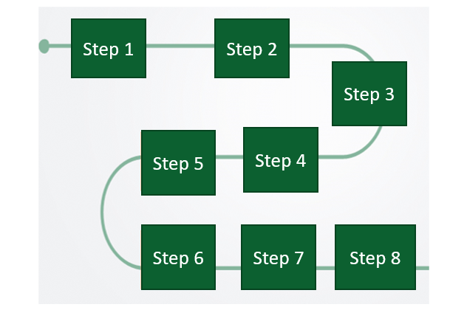
The 8 steps
In this scenario, you will work through eight key steps.
Move over each step to read what they are. And then click on the next button to get started.
Notes:
Note for development:
There are 8 steps for each of the 6 scenarios in Course 4. The scenario will be built out as once piece.
Please create suitable graphic to use throughout all scenarios
Popup text for step 1:
Step 1: Your supervisor gives you a brief
Step 2: You need to identify the best solution for doing the job
Step 3: Plan and design an approach for doing the job
Step 4: Follow the rules and regulations
Step 5: Do a Risk Assessment
Step 6: Complete the job
Step 7: Check if the job was done correctly
Step 8: Do the client handover

Slide 10
Placeholder image of supervisor Mr Jansen (coloured man 50-60 years of age)
About your environment
Imagine that you are an electrician working in a factory that makes bread. You have a supervisor named Mr Jansen who can be quite impatient.
Placeholder Video:
Should be of a factory (instrutrial environment) showing where an electrician responsible for installing 3 phase sockets would work.
Watch the video to find out more about your workplace
Notes:
Note for interactivity:
When clicked, video should play fullscreen.

Slide 11
Step 1-Supervisor brief
Step 1
Step 2
Step 3
Step 4
Step 5
Step 6
Step 7
Step 8
The factory has just bought another industrial dough mixer and Mr Jansen tells you that you need to install a 3 phase socket for this appliance. He has given you a piece of paper with the details on it.
Follow rules and regs
COC required
Follow OHS standards
Don’t damage walls or ceiling boards
Supply from any point installation but must be compliant
Finish in 1 day
CHEAP AS POSSIBLE!
Click on the clipboard to see the details of this project.
Find out more about 3 phase sockets and how they work.
Notes:
Note for interactivity:
When learner clicks on “Find out more” they should be taken to slide 12.
Next button should take them to Slide 13
Text on clipboard should fade in slowly after about 10 seconds.

Slide 12
3 phase sockets and how they work
Placeholder for Video 02 on 3 phase sockets:
https://www.youtube.com/watch?v=oyRrm_K7WSM
Link above can be used as reference.
Go back to previous page
Notes:
Note for interactivity:
When learner clicks on “Go back to options” button it should take them back to Slide 11

Slide 13
Supervisor brief
Mr Jansen isn’t the most patient man and likes to scribble down his instructions. Let’s make sure you have understood everything he wrote down.
Image of Mr Jansen standing and looking impatient
Click on the button to get started.
Get started
Notes:
Note for interactivity:
Button “ Go to list for details” should be hyperlinked to questions on Slide 11.

Slide 14
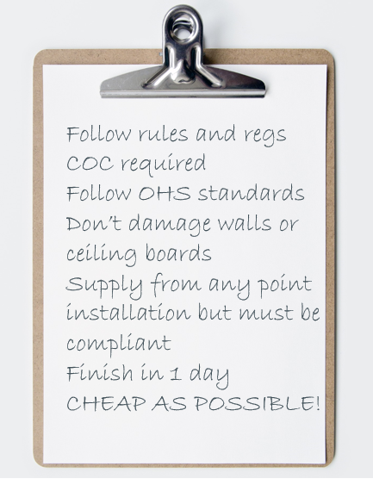
Client brief
What do you think COC stands for?
Certificate of Commerce
Certificate of Compliance
Commercial Official Certificate
Choose the correct answer from the options below:
Notes:
Note for interactivity:
This is a multiple choice question one correct answer.
Correct answer is in italics
Feedback for correct answer. Well done you are correct
Feedback for incorrect answer.
Oops not quite. COC stands for Certificate of Compliance.

Slide 15
Client brief
What do you think OHS stands for?
Occupational Heath and Safety
Occasional Health and Safety
Official Health and Security
Choose the correct answer from the options below:
Notes:
Note for interactivity:
This is a multiple choice question one correct answer.
Correct answer is in italics
Feedback for correct answer. Well done you are correct
Feedback for incorrect answer.
Oops not quite. OHS stands for Occupational Health and Safety

Slide 16
Client brief
When Mr Jansen wrote “ Supply from any point installation but must be compliant” can you explain in your own words what he means?
Type your answer in the block provided and click submit.
Submit
Notes:
Note for interactivity:
Text box for typing, when learner clicks submit the should be taken to Slide 16.

Slide 17
Client brief
When Mr Jansen wrote “ Supply from any point installation but must be compliant” he meant that ……. (get explanation from Nick)
Notes:
Note for interactivity:

Slide 18
Client brief
How many days do you have to complete this job?
1 day
2 days
7 days
As long as I need
Choose the correct answer from the options below:
Notes:
Note for interactivity:
This is a multiple choice question one correct answer.
Correct answer is in italics
Feedback for correct answer. Well done you are correct
Feedback for incorrect answer.
Oops not quite. You only have 1 day to finish your work so you will need to work quickly and efficiently.

Slide 19
Client brief
Why do you think Mr Jansen wrote “CHEAP AS POSSIBLE” in big letters?
Type your answer in the block provided and click submit.
Submit
Notes:
Note for interactivity:
Text box for typing, when learner clicks submit the should be taken to Slide 18.

Slide 20
Area details
It’s very important that you know the details of the area where you will be installing the 3 phase socket. You took a walk around and carefully looked at your surroundings.
Placeholder for Vid03: Area Details
Watch this video for more information about what you found when you walked around the area.
Notes:
Note for interactivity:
When learner clicks on video it should appear as full screen.

Slide 21
Summary of area details
Not sure you can remember all the area details?
Click on the button to download the area details. Keep this list handy for Step 2 coming up next.
(NAME OF factory) area details
Notes:
Notes for interactivity:
When user click on the box the following information should appear.
Reviewing the installations the following has been found
There a Sub DB’s surface mounted in the area where the circuit is required
The distance to where the socket outlet is required is 15 meters from the Sub DB and there are 12 slots available in the Sub DB for new circuit breakers and there is an earth leakage in board
There is an existing wire cable basket that runs up the wall and past the point where the socket outlet is required
The supply must be at least 4 mm wire as the current is32 amps for the socket outlet
The protection will need to be a 30A circuit breaker
There is a lot of forklifts and heavy machinery moving around on the premises
There is no ceiling in the plant
There are dogs on the property
There are toilet facilities for staff

Slide 22
Step 2- Choose the best option
Step 1
Step 2
Step 3
Step 4
Step 5
Step 6
Step 7
Step 8
It’s time to decide what the best option is for installing a 3 phase socket. You must keep in mind the instructions Mr Jansen gave you.
You have three options to choose from. You will need to decide which option is the best one for this job.
Click here to see options
Notes:
Note of interactivity:
When learner clicks on “Click here” they should be taken to Slide 23

Slide 23
Overview of options
Click on each of the options to see an overview. Once you’ve reviewed all three options, click on the ‘share your thoughts’ to move on.
Option 1
Option 2
Option 3
Share your thoughts
Notes:
Note for interactivity:
When learner clicks on Option 1 they should be taken to Slide 24
When learner clicks on Option 2 they should be taken to Slide 25
When learner clicks on Option 3 they should be taken to Slide 26
When learner clicks on the ‘share your thoughts” button they should be taken to Slide 27

Slide 24
Option 1
Placeholder for Video 04- Highlights reel
Go back to options menu
Notes:
Note for interactivity:
When learner clicks on “Go back to options” button it should take them back to the Options on Slide 23.

Slide 25
Option 2
Placeholder for Video 05
Go back to options menu
Go back to options menu
Notes:
Note for interactivity:
When learner clicks on “Go back to options” button it should take them back to the Options on Slide 23.

Slide 26
Option 3
Placeholder for Video 06
Go back to options menu
Go back to options menu
Notes:
Note for interactivity:
When learner clicks on “Go back to options” button it should take them back to the Options on Slide 23.

Slide 27
Share your thoughts
Now that you’ve seen the videos which option do you think looks the best one so far? Why do you say this?
Type in your answer in the block below and click on the submit button.
Submit
Notes:
Note for interactivity:
Text box, learner should be able to type in a response. There is no correct answer, this question is to be the learner thinking.
When learner clicks on the Submit button they should be taken to Slide 28

Slide 28
Additional details for options
Thanks for your response. Now, what tools, materials, labour, time and regulations are needed for each of the options?
Click on each block to find out more. When you are finished click on the “Remove option” button
Option 1
Option 2
Option 3
Remove option
Notes:
Note for interactivity:
When learner clicks on “Remove” button take them to Slide 32
When learner clicks on each of the options blocks they should be taken to the following slides:
Option 1- Slide 29
Option 2- Slide 30
Option 3- Slide 31

Slide 29
Option 1 details
Use 4mm Armoured (2+E) cable to supply a 3 phase socket outlet.
Click on each block to find out more information.
Placeholder for image showing Option 1:Use 4mm Armoured (2+E) cable to supply a 3 phase socket outlet
Tools and equipment
Materials
Cost
Regulations
Time
Labour
Environmental implications
Risk implications
Back to options menu
Notes:
Note for interactivity:
When learner clicks on “Back to” they should be taken to Slide 28.
When learner clicks on each of the boxes, information for that box should be revealed. See details below:
Tools and equipment
No special tools are required for installation
All components that can be used are available from the local electrical wholesaler
We will be making use of a ladder during the installations
Materials
Most of the materials are easily acquired form an electrical wholesaler.
Time
It is estimated that the task should take 6 hours
Labour
1 persons will be allocated for this task
Cost
Most of the materials are easily acquired form an electrical wholesaler, this is although not the cheapest option.
In this case the cost of IP rated equipment is higher then normal equipment but it is critical to keep the equipment intrinsically safe to prevent explosions and fires.
Environmental implications
Vehicles may damage the cable
Due to food contamination care should be taken in regards to the materials utilized.
Regulations
Volt drop over the cable is minimal
Risk Implications
Dust particles are combustible and explosive

Slide 30
Option 2 details
Use 4 mm flat twin and earth (2+E) cable to supply a 3 phase socket outlet
Click on each block to find out more information.
Placeholder for image showing Option 2:Use 4 mm flat twin and earth (2+E) cable to supply a 3 phase socket outlet
Tools and equipment
Materials
Cost
Regulations
Time
Labour
Environmental implications
Risk implications
Back to options menu
Notes:
Note for interactivity:
When learner clicks on “Back to” they should be taken to Slide 21.
When learner clicks on each of the boxes, information for that box should be revealed.
See details below:
Tools and equipment
No special tools are required for installation
All components that can be used are available from the local electrical wholesaler
We will be making use of a ladder during the installations
Materials
All components that can be used are available from the local electrical wholesaler
Time
It is estimated that the task should take 6 hours
Labour
2 persons will be allocated for this task
Cost
Most of the materials are easily acquired form an electrical wholesaler, this is although not the cheapest option.
In this case the cost of IP rated equipment is higher then normal equipment but it is critical to keep the equipment intrinsically safe to prevent explosions and fires.
Environmental implications
Vehicles may damage the cable
Due to food contamination care should be taken in regards to the materials utilized.
Regulations Volt drop over the cable is minimal due to the length of the cable
Risk Implications
Dust particles are combustible and explosive

Slide 31
Option 3 details
Use a 2.5 mm² 3 core SWA cable to connect 4 security lights that is connected to a day night sensor and a light switch.
Click on each block to find out more information.
Placeholder for image showing Option3: Use a 2.5 mm² 3 core SWA cable to connect 4 security lights that is connected to a day night sensor and a light switch.
Tools and equipment
Materials
Cost
Regulations
Time
Labour
Environmental implications
Risk implications
Back to options menu
Notes:
Note for interactivity:
When learner clicks on “Back to” they should be taken to Slide 21.
When learner clicks on each of the boxes, information for that box should be revealed. See details below:
Tools and equipment
No special tools are required for installation
All components that can be used are available from the local electrical wholesaler
Materials
All components that can be used are available from the local electrical wholesaler
Time
Need info here
Labour
2 persons will be allocated for this task
Cost
It is estimated that the task should take 6 hours
Environmental implications
Vehicles may damage the cable
Due to food contamination care should be taken in regards to the materials utilized.
Regulations and Risk Implications
Volt drop over the cable is minimal
Dust particles are combustible and explosive

Slide 32
Remove an option
Need clarity from Nick as to which option is the worst one
Click on the submit button once you have selected your answer.
Now that you know more about each option, which option do you think would be the worst one for this job?
Option 1
Option 2
Option 3
Submit
Notes:
Note for interactivity:
Multiple choice. If the learner chooses Option 1 and 2 which is are incorrect options, they should be given the option to try again (Feedback1) . Option 3 is correct so if chosen learner should see feedback and then get to move on.
Feedback :
If Option 1 is chosen: Oops not quite. Are you sure you want to get rid of this option? Option 1 uses a type of cable that is relatively inexpensive and really easy to work worth.
If Option 2 is chosen: Oops not quite. Are you sure you want to get rid of this option? Option 2 uses armoured cable which will last well in a busy environment like a factory.
If Option 3 is chosen. Well done you are correct. The type of cable used here is Not suitable for the environment and the conditions that the conductors are exposed to.

Slide 33
Final 2 options
Option 3 is the worst option because the type of cable can’t be used in the ground. You must choose between Option 1 and 2. Which is the best one for doing this job?
Need clarity from Nick on the advantages and disadvantages for each of these
Click on the boxes for more information.
Option 1
Advantages
Option 1
Disadvantages
Option 2
Advantages
Option 2
Disadvantages
I want to see the property details again
Notes:
Note for interactivity:
“Client brief” button should be linked to Resource 01.
When user the clicks on each of the boxes another layer with more information should appear:
Option 1 Advantages
Armoured cable is not cheapest cable to install and a very effective method to get the supply from the DB to the socket outlet
With this cable you have mechanical protection
It is flexible to work with
Option 1 Disadvantages
Should the incorrect equipment be selected there is a high risk of fire and or electrocution due to dust and water.
Option 2 Advantages
Un armoured cable is cheaper then armoured cable With this cable you have mechanical protection
It is flexible to work with
Option 2 Disadvantages
Un armoured cable is cheaper then armoured cable but due to environmental condition not a suitable option
Costs for armoured cable and glands are not cheap
It is difficult to work with

Slide 34
Choose the best option
Need clarity from Nick as to which options should appear here
What is the best option for completing this job?
Click on the option you think is the best one.
Option 1
Option2
Notes:
Note for interactivity:
When learner clicks on Option 1they should be taken to Slide 28
When learner clicks on Option 2 they should be taken to Slide 29

Slide 35
Option 2
Need clarity from Nick as to which option was best option
Well done! You chose the best option.
Why did you choose this option as the best one?
It was the cheapest
It was the quickest way to do the job
The cables were the best quality so will last longer.
Choose your answer and click submit.
Submit
Notes:
Note for interactivity:
When users click on submit button they should be taken to the feedback. Once learner has heard feedback they should be taken to Slide 31
Multiple choice
Feedback if learner selects answer 1: (Voiceover 01 should play) You are correct in choosing this option, however it’s not the cheapest option. Even though Mr Jansen said you must do the job as cheaply as possible, the reason why this option is the best is because the installation is in an industrial environment it will experience a lot of wear and tear. It is better to go for the more expensive armoured cable as it will last longer in this environment.
Feedback if learner selects answer 2 : (Voiceover 02 should play) While you are correct about Option 2 being the best option, it’s not because it’s the quickest. Option 2 would have taken 6 hours to do while Option 3 would have taken one hour less. The reason Option 2 is the best one is because Mrs Naidoo wanted you to a quality job but it needed to be done as cheaply as possible.
Feedback if learner selects answer 3. (Voiceover 03 should play) While you are correct about Option 2 being the best option its not because of the high quality of cables being used. The armoured cables used in Option 3 are of a much higher quality however, using them would have made the job more expensive . Using more expensive cables would have gone against Mrs Naidoos’s request that the job be done as cheaply as possible.

Slide 36
Option 1
Need clarity from Nick as to which option was best option
Why did you choose this option as being the best one?
It was the cheapest
It was the quickest way to do the job
The cables were the best quality so will last longer.
Choose your answer and click submit.
Submit
Notes:
Note for interactivity:
When users click on submit button they should be taken to the feedback. Once learner has heard feedback they should be taken to Slide 31
Multiple choice where learner can select 2 answers.
Feedback if learner selects answer 1. (Voiceover 04 should play) While Option3 is a good choice, it’s not the cheapest or most cost effective Option as the armoured cables used were more expensive that the cables used in Option 2. Since Mrs Naidoo wanted you to a quality job but it needed to be done as cheaply as possible Option 2 is the best choice.
Feedback if learner selects answer 2. (Voiceover 05 should play) While you are correct in saying that Option 2 is the quickest way of doing the job, Option1 is actually the best option because Mrs Naidoo wanted you to a quality job but it needed to be done as cheaply as possible. The cables used for Option 1 were still of a high enough quality.
Feedback if learner selects answer 3. (Voiceover 06 should play) You are right in saying that the cables used in Option 3 were of a better quality and would probably last much longer. However these cables tend to be more expensive. Remember in the client brief Mrs Naidoo mentioned that this job needs to be done as cheaply as possible? That’s why in this case, Option 2 would have been the better choice.

Slide 37
Step 3- Plan the task
Step 1
Step 2
Step 3
Step 4
Step 5
Step 6
Step 7
Step 8
The next step is to plan how to do the job. As it’s the(insert reasons), Option () will be used for the rest of the scenario.
Use the property details, the instructions and video for Option () to draw your own plan. You can use paper or a computer programme to make your drawing. Click on the “upload” button to upload your plan.
Area
details
Step by step instructions
Video of Option
Upload my plan
I need help with drawing my plan
Notes:
Note for interactivity:
When learner clicks on “Property” block they should see Resource 01
When learner clicks on “Step” block they should see the following information:
When learner clicks on “Video” block they should see Video
When learner clicks on Upload they should be taken to Slide 38
When learner clicks on “I need help” they should be taken to the relevant topic in Course 0: World of Electrician

Slide 38
Upload your plan
Submit your plan so that it can be saved in your ePortfolio. Upload your plan and click submit.
Submit
Notes:
Note for interactivity:
The word ePortfolio should be linked to information about what an ePortfolio is and how it works, how learner can access it.
There needs to be an upload function for user to upload their plan.
Once they click on submit they should be taken to Slide 39.

Slide 39
Example of the plan
This is an example of what your plan should have looked like. Did your plan come close to this?
Wire cable tray
Wire cable tray
Wire cable tray
2,5 4 core SWA
2,5 4 core SWA
3Ø Socket outlet
3Ø Sub distribution board
Notes:
Note for interactivity:

Slide 40
What will you need to do the job?
How do you even begin to think about all the things you will need to do the job?
Watch this video for advice from an experienced electrician on how you can plan for the job.
Placeholder video 05:
Notes:
Note for interactivity;
When learner clicks on video it should play as full screen.

Slide 41
Tools, materials, equipment and PPE
It’s easier to think of everything you will need for a job if you step through it task by task.
Click on each task to see a video. On a piece of paper, take note of the tools, materials equipment you will need for each task.
Task 1
Task 2
Task 3
Task 4
Task 5
Task 6
Task 7
Task 8
Go to ePortfolio Activity
Notes:
Note for interactivity;
When learner clicks on “Go to ePortfolio” they should be taken to Slide 50.
When learner clicks on each of the activities they should be taken to the following slides:
Task 1: Slide 42
Task 2: Slide 43
Task 3: Slide 44
Task 4: Slide 45
Task 5: Slide 46
Task 6: Slide 47
Task 7: Slide 48
Task 8: Slide 49

Slide 42
Task 1
Pull in 4mm Flat twin and earth the cable on the wireway available. Install wire mesh cable tray to the point where the socket outlet is to be mounted.
Placeholder Video 18
Task 1
Back to Task Menu
Notes:
Note for interactivity:
When learner clicks on “Back to Task Menu” they should be taken to Slide 41
Pull in 4mm Flat twin and earth the cable on the wireway available. Install wire mesh cable tray (Module 33) to the point where the socket outlet is to be mounted
Measure, mark and mount a flush mount enclosure (Module 4) to mount the 3phase socket outlet.
Prepare armoured cable for gland (Module 36) on both ends of the armoured cable.
Prepare a cable for terminations (Module 26) and Connect conductors to three socket outlet (Module 43)
Secure a cable on cable tray, ladder or mesh (Module 37)
Switch off supply to Sub DB1 and Test to ensure safe and isolated (Module 25)
Fit a circuit breaker in a DB (Module 20) rated at 30 A.
Connect supply from earth leakage supply to circuit breaker (Module 28) to new socket outlet supply in DB

Slide 43
Task 2
Measure, mark and mount a flush mount enclosure to mount the 3phase socket outlet.
Placeholder Video 19
Task 2
Back to Task Menu
Notes:
Note for interactivity:
When learner clicks on “Back to Task Menu” they should be taken to Slide 41
Pull in 4mm Flat twin and earth the cable on the wireway available. Install wire mesh cable tray (Module 33) to the point where the socket outlet is to be mounted
Measure, mark and mount a flush mount enclosure (Module 4) to mount the 3phase socket outlet.
Prepare armoured cable for gland (Module 36) on both ends of the armoured cable.
Prepare a cable for terminations (Module 26) and Connect conductors to three socket outlet (Module 43)
Secure a cable on cable tray, ladder or mesh (Module 37)
Switch off supply to Sub DB1 and Test to ensure safe and isolated (Module 25)
Fit a circuit breaker in a DB (Module 20) rated at 30 A.
Connect supply from earth leakage supply to circuit breaker (Module 28) to new socket outlet supply in DB

Slide 44
Task 3
Prepare armoured cable for gland on both ends of the armoured cable.
Placeholder Video 20
Task 3
Back to Task Menu
Notes:
Note for interactivity:
When learner clicks on “Back to Task Menu” they should be taken to Slide 41
Pull in 4mm Flat twin and earth the cable on the wireway available. Install wire mesh cable tray (Module 33) to the point where the socket outlet is to be mounted
Measure, mark and mount a flush mount enclosure (Module 4) to mount the 3phase socket outlet.
Prepare armoured cable for gland (Module 36) on both ends of the armoured cable.
Prepare a cable for terminations (Module 26) and Connect conductors to three socket outlet (Module 43)
Secure a cable on cable tray, ladder or mesh (Module 37)
Switch off supply to Sub DB1 and Test to ensure safe and isolated (Module 25)
Fit a circuit breaker in a DB (Module 20) rated at 30 A.
Connect supply from earth leakage supply to circuit breaker (Module 28) to new socket outlet supply in DB

Slide 45
Task 4
Prepare a cable for terminations and connect conductors to three socket outlet.
Placeholder Video 21
Task 4
Back to Task Menu
Notes:
Note for interactivity:
When learner clicks on “Back to Task Menu” they should be taken to Slide 41
Pull in 4mm Flat twin and earth the cable on the wireway available. Install wire mesh cable tray (Module 33) to the point where the socket outlet is to be mounted
Measure, mark and mount a flush mount enclosure (Module 4) to mount the 3phase socket outlet.
Prepare armoured cable for gland (Module 36) on both ends of the armoured cable.
Prepare a cable for terminations (Module 26) and Connect conductors to three socket outlet (Module 43)
Secure a cable on cable tray, ladder or mesh (Module 37)
Switch off supply to Sub DB1 and Test to ensure safe and isolated (Module 25)
Fit a circuit breaker in a DB (Module 20) rated at 30 A.
Connect supply from earth leakage supply to circuit breaker (Module 28) to new socket outlet supply in DB

Slide 46
Task 5
Secure a cable on cable tray, ladder or mesh (Module 37).
Placeholder Video 22
Task 5
Back to Task Menu
Notes:
Note for interactivity:
When learner clicks on “Back to Task Menu” they should be taken to Slide 41
Pull in 4mm Flat twin and earth the cable on the wireway available. Install wire mesh cable tray (Module 33) to the point where the socket outlet is to be mounted
Measure, mark and mount a flush mount enclosure (Module 4) to mount the 3phase socket outlet.
Prepare armoured cable for gland (Module 36) on both ends of the armoured cable.
Prepare a cable for terminations (Module 26) and Connect conductors to three socket outlet (Module 43)
Secure a cable on cable tray, ladder or mesh (Module 37)
Switch off supply to Sub DB1 and Test to ensure safe and isolated (Module 25)
Fit a circuit breaker in a DB (Module 20) rated at 30 A.
Connect supply from earth leakage supply to circuit breaker (Module 28) to new socket outlet supply in DB

Slide 47
Task 6
Switch off supply to Sub DB1 and Test to ensure safe and isolated.
Placeholder Video 23
Task 6
Back to Task Menu
Notes:
Note for interactivity:
When learner clicks on “Back to Task Menu” they should be taken to Slide 41
Pull in 4mm Flat twin and earth the cable on the wireway available. Install wire mesh cable tray (Module 33) to the point where the socket outlet is to be mounted
Measure, mark and mount a flush mount enclosure (Module 4) to mount the 3phase socket outlet.
Prepare armoured cable for gland (Module 36) on both ends of the armoured cable.
Prepare a cable for terminations (Module 26) and Connect conductors to three socket outlet (Module 43)
Secure a cable on cable tray, ladder or mesh (Module 37)
Switch off supply to Sub DB1 and Test to ensure safe and isolated (Module 25)
Fit a circuit breaker in a DB (Module 20) rated at 30 A.
Connect supply from earth leakage supply to circuit breaker (Module 28) to new socket outlet supply in DB

Slide 48
Task 7
Fit a circuit breaker in a DB (Module 20) rated at 30 A.
Placeholder Video 24
Task 7
Back to Task Menu
Notes:
Note for interactivity:
When learner clicks on “Back to Task Menu” they should be taken to Slide 41
Pull in 4mm Flat twin and earth the cable on the wireway available. Install wire mesh cable tray (Module 33) to the point where the socket outlet is to be mounted
Measure, mark and mount a flush mount enclosure (Module 4) to mount the 3phase socket outlet.
Prepare armoured cable for gland (Module 36) on both ends of the armoured cable.
Prepare a cable for terminations (Module 26) and Connect conductors to three socket outlet (Module 43)
Secure a cable on cable tray, ladder or mesh (Module 37)
Switch off supply to Sub DB1 and Test to ensure safe and isolated (Module 25)
Fit a circuit breaker in a DB (Module 20) rated at 30 A.
Connect supply from earth leakage supply to circuit breaker (Module 28) to new socket outlet supply in DB

Slide 49
Task 8
Connect supply from earth leakage supply to circuit breaker (Module 28) to new socket outlet supply in DB.
Placeholder Video 25
Task 8
Back to Task Menu
Notes:
Note for interactivity:
When learner clicks on “Back to Task Menu” they should be taken to Slide 41
Pull in 4mm Flat twin and earth the cable on the wireway available. Install wire mesh cable tray (Module 33) to the point where the socket outlet is to be mounted
Measure, mark and mount a flush mount enclosure (Module 4) to mount the 3phase socket outlet.
Prepare armoured cable for gland (Module 36) on both ends of the armoured cable.
Prepare a cable for terminations (Module 26) and Connect conductors to three socket outlet (Module 43)
Secure a cable on cable tray, ladder or mesh (Module 37)
Switch off supply to Sub DB1 and Test to ensure safe and isolated (Module 25)
Fit a circuit breaker in a DB (Module 20) rated at 30 A.
Connect supply from earth leakage supply to circuit breaker (Module 28) to new socket outlet supply in DB

Slide 50
ePortfolio activity- Plan
You now need to make a list of all the tools, equipment and materials you will need for the job. Use the videos of the tasks to help you.
Assessment instructions:
Download the Requirements template
Complete the template
Upload the template to your ePortfolio using the upload button
Download requirements template
Upload completed template
Watch the videos again
Notes:
Note for content development:
Create tools, materials, equipment and PPE list template for learner to complete
Note for interactivity;
When learner clicks on “Download requirements” it should be hyperlinked to the template and download automatically
When learner clicks on “Upload” they should be taken to Slide 51
When learner clicks on “Watch” they should be taken to Slide 52

Slide 51
Upload your requirements list
Submit your list so that it can be saved in your ePortfolio. Upload your list and click submit.
Submit
Notes:
Note for interactivity:
The word ePortfolio should be linked to information about what an ePortfolio is and how it works, how learner can access it.
There needs to be an upload function for user to upload their plan.
Once they click on submit they should be taken to Slide 47.

Slide 52
Click on each thumbnail to play the video.
Task 1 Video
Task 2 Video
Task 3 Video
Task 4 Video
Task 5 Video
Task 6 Video
Task 8 Video
Task 7 Video
Video of Task 1
Go back to ePortfolio instructions
Notes:
Note for interactivity:
Videos must be displayed as thumb prints on the left hand side of the page. When learner clicks on the video is should display on the right-hand side of the page.
When learner clicks on “Go back” they should be taken to Slide 50

Slide 53
Example of requirements list
Click on the example list below to download it and compare it to the list you created.
Example of Requirements List
Was your list the same as the example list?
Yes
No
Notes:
Note for content development:
Create tools, materials, equipment and PPE list
Note for interactivity;
When learner clicks on “Download requirements” it should be hyperlinked to example Requirements List
Multiple choice questions.
Feedback if learner chooses “Yes”: Well done! You gave careful thought to what is needed to complete this job. This kind of thinking will help to save time, effort and money when you are an electrician completing these types of jobs. (Take learner to Slide 55)
Feedback if learner chooses “No”. Let’s see if you can identify some of the items that you left off your list. (Take learner to Slide 54)

Slide 54
Missing tools, material and equipment
Type in the tools, equipment and materials that weren’t on your list in the space provided below and click submit.
Tools
Materials
Equipment
Submit
Notes:
Note for interactivity;
When learner clicks on submit they should be taken to slide 49

Slide 55
Tools List
Move your mouse over each of the tools to see more information about them.
Scriber Chalk Square / Combination square Drilling Machine Masonry Drill Bit | Chuck key Screw driver Spirit level Carpet Knife Hacksaw | Side Cutters Multi Grip Pliers Cable Knife Screw driver (star | Wire stripper Pliers Multi Meter Insulated screw driver (flat or star)
Notes:
Note for content development:
There should be an image and name for each of these tools.
Note for interactivity;
When learner moves mouse over each of the images additional information about each tool should appear:
Scriber
Chalk
Square / Combination square
Drilling Machine
Masonry Drill Bit
Chuck key
Screw driver
Spirit level
Carpet Knife
Hacksaw
Side Cutters
Multi Grip Pliers
Cable Knife
Screw driver (star
Wire stripper
Pliers
Multi Meter
Insulated screw driver (flat or star)

Slide 56
Equipment List
Move your mouse over each piece of equipment to see more information about them.
Tape measure
I might remove equipment as an option and just do tools and materials (there doesn’t seem to be much point just doing one
Notes:
Note for content development:
There should be an image and name for each of these tools.
Note for interactivity;
When learner moves mouse over each of the images additional information about each should appear:
Tape measure

Slide 57
Materials List
Move your mouse over each of the tools to see more information about them.
Steel wire mesh Support brackets Masonry drill bit Fisher plug with screws | SWA Cable SWA Cable Gland Armoured cable Suitable gland | Socket outlet 2.5mm²GP wire (red and black) 2.5mm² bare copper earth Cable | Cable ties Earth leakage unit Circuit breaker GP wire
Notes:
Note for content development:
There should be an image and name for each of these materials.
Note for interactivity:
Additional information for each of materials:
Steel wire mesh
Support brackets
Masonry drill bit
Fisher plug with screws
SWA Cable
SWA Cable Gland
Armoured cable
Suitable gland
Socket outlet
2.5mm²GP wire (red and black)
2.5mm² bare copper earth
Cable
Cable ties
Earth leakage unit
Circuit breaker
GP wire

Slide 58
Step 4- Rules and regulations
Step 1
Step 2
Step 3
Step 4
Step 5
Step 6
Step 7
Step 8
As an electrician you need to follow the SANS (South African National Standards) codes and regulations. These can be tricky to understand at first.
Sans 10142
Reg 6.15.2 Reg 6.15.6.1
SANS 10142-1
SANS 10142-1 See SANS 10142-1 Regulation 6.3.3.2 Regulation 6.3.7.1 Regulation 6.3.7.2
SANS 10142-1
SANS 10142
Reg 6.8.2.3
Watch the video to find out how to read and apply a SANS code correctly.
Placeholder: Vid 06
SANS CODE 10142
SANS CODE 10142-1
General or specific to each scenario?
Notes:
Note for interactivity:
When learner clicks on videos they should appear as full screen.

Slide 59
Multiple choice
Choose the correct answer from the options below.
Add question based on Vid 06 scripts (Dave Gravett)
Examples of questions:
What is the best way to read the code?
When reading the code you should focus on which part?
What parts are not important?
Do codes get updated? Then what?

Slide 60
SANS Codes
There are two SANS codes that you need to be aware of when installing a 3 phase socket outlet.
SANS code
10142
Click on each of the codes to read what they say. You will be asked questions about them in the next activity.
SANS CODE
10142-1
Notes:
Note for content development:
See if there is a step by step process that comes out of Video 07 and then use that structure here. Ie. Step 1 Scan for information, Step 2 highlight the important part.
Note for interactivity:
When learner clicks on each of the SANS codes they should be taken to the following slides:
SANS - Slide 55
SANS - Slide 56

Slide 61
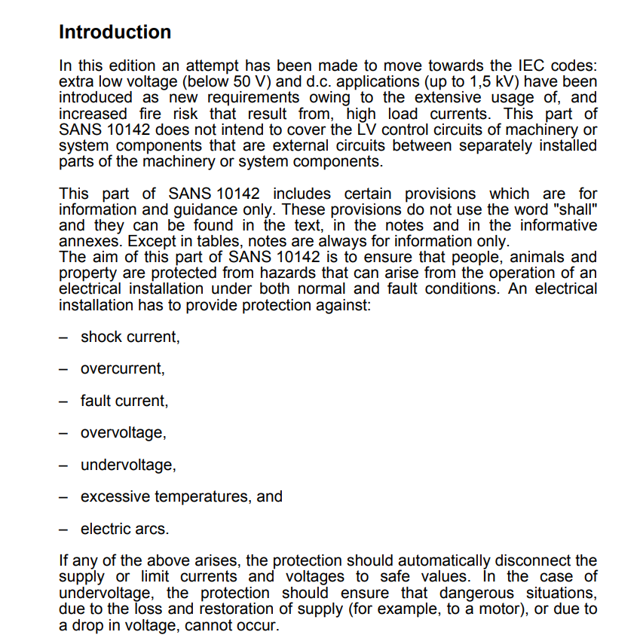
SANS
Read through the document below and then click on the ‘Next’ button to answer some questions about this code.
Scrollable text.
Notes:
NB: Licensing issue. I see that there is a copyright on the SANS codes. Do we need to apply for permission from SABS to use them in our learning materials?
Note for interactivity:
SANS document text should be inserted on this page in a scrollable window so that learner can read the entire document on this screen.

Slide 62
Multiple choice
Insert questions from Dave Gravette here
Notes:
Note for

Slide 63
SANS
Read through the document below and then click on the ‘Next’ button to answer some questions about this code.
Scrollable text.
Notes:
NB: Licensing issue. I see that there is a copyright on the SANS codes. Do we need to apply for permission from SABS to use them in our learning materials?
Note for interactivity:
SANS document text should be inserted on this page in a scrollable window so that learner can read the entire document on this screen.

Slide 64
Multiple choice
Insert questions from Dave Gravette here

Slide 65
Step 5- Do a risk assessment
Step 1
Step 2
Step 3
Step 4
Step 5
Step 6
Step 7
Step 8
A risk assessment is taking a careful look at your workplace to identify those things, situations and processes that could put your or your team in danger. You should always do a risk assessment before you begin any job.
Placeholder image of someone doing a risk assessment
Can’t remember how to do a risk assessment? Click on the link below remind yourself
Placeholder link: to the relevant section in World of Electrician
Notes:
Reference back to Course 0 but still ask them to do a specific risk assessment activity.

Slide 66
Step 5- Identify the risks
Step 1
Step 2
Step 3
Step 4
Step 5
Step 6
Step 7
Step 8
On the next page, you will be given a list of risks from the tasks for installing a 3 phase socket outlet. Match the risk to the correct task. You can watch the videos of the tasks again if you need to.
Notes:
Notes for interactivity:
When learner clicks on “I would like to” they should be taken to Slide 68

Slide 67
Step 5- Identify the risks
Pull cable on wireway available
Damage to hearing from drill noise
Prepare a cable for terminations
Working at high heights
Mount a flush mount enclosure
Hand injury from screw driver
Fit circuit breaker and connect supply
High risk of electrocution
Prepare armoured cable for gland
High risk of cutting oneself or others
Watch videos again
Notes:
Notes for interactivity:
When learner clicks on “Watch” they should be taken to Slide 62.
Matching activity. The order should be shuffled. Here are the correct pairs:
Pull cable on wireway- Damage to hearing from drill noise
Mount a flush mount enclosure- Hand injury from screw driver
Prepare armoured cable for gland- High risk of cutting oneself or others
Prepare a cable for terminations- Working at high heights
Fit circuit breaker and connect supply- High risk of electrocution
Feedback if answer is correct- Well done! You matched the correct risks with the correct tasks. (Take learner to slide 70)
Feedback if answer is incorrect- Oops not quite. On the following page you will see the tasks and the risks that go with those tasks. (69)

Slide 68
Placeholder Video 18
Placeholder Video 19
Placeholder Video 20
Placeholder Video 21
Placeholder Video 22
Placeholder Video 23
Placeholder Video 25
Placeholder Video 24
Placeholder Video 26
Placeholder Video 27
Placeholder Video 28
Placeholder Video 29
Video of Option 1
Go back to activity
Notes:
Note for interactivity:
Videos must be displayed as thumb prints on the left hand side of the page. When learner clicks on the video is should display on the right-hand side of the page.
When learner clicks on “Go back” they should be taken to Slide 61.

Slide 69
Feedback- tasks and risks
Here are the tasks and the risks that go with them.
Pull cable on wireway available
Damage to hearing from drill noise
Prepare a cable for terminations
Working at high heights
Mount a flush mount enclosure
Hand injury from screw driver
Fit circuit breaker and connect supply
High risk of electrocution
Prepare armoured cable for gland
High risk of cutting oneself or others

Slide 70
Prevent the risk
Choosing the right PPE will help you prevent some of the risk that you have identified. Here are two examples:
Image of electrician wearing ear plugs while drillng
Wearing ear plugs while drilling will help to prevent you from damaging your hearing from excessive noise.
Image of electrician wearing safety gloves while cutting cable
Wearing safety gloves while cutting cables with prevent you from cutting yourself with the sharp cable knife.
Notes:
Note for interactivity:
Drag and drop activity.

Slide 71
Select the correct PPE
What PPE do you think you would need for the entire job?
Drag and items onto the image of the electrician and click submit.
Image
Sun lotion
Placeholder:
Image of an electrician (he should not be wearing any PPE)
Safety glasses
Sunglasses
Ear plugs
Gas mask
Image
Hard hat
Safety shoes
Overalls
Safety gloves
Image
Sunhat
Submit
Notes:
Note for interactivity:
Drag and drop activity.
Correct items to be dropped onto the image are:
Safety glasses
Safety gloves
Safety shoes
overalls
Safety shoes
When learner clicks on ‘submit’ button they should be taken to feedback page.
Feedback if correct: Well done! You have chosen the correct PPE for completing this job.
(Take learner to Slide 66)
Feedback if incorrect: Oops not quite, the correct PPE needed for this job was
Overall
Safety shoes
Eye protection
Ear protection
Sun hat
Sun lotion
(Take learner back to Slide 66)

Slide 72
Complete Risk Assessment Table
Is this a good general example?
Imagine checking why the plugs keep shorting out. What are the potential risks involved? How would you prevent these risks?
Fill in the table below and click submit.
ACTIVITY | HAZARD | DANGER | RISK (Without preventive measures.) |  |  | PREVENTIVE MEASURE
 |  |  | High | Med | Low
Check plugs shorting out
Submit
Notes:
Note for interactivity:
Learner should be able to type in text in each area of the table
When learner clicks on submit they should be taken to Slide 73.

Slide 73
Example
I need Nick/Dave to help me complete this correctly.
How does your table compare to this one? Did you have the right preventative measures?
ACTIVITY | HAZARD | DANGER | RISK (Without preventive measures.) |  |  | PREVENTIVE MEASURE
 |  |  | High | Med. | Low
Check tripped switches
Notes:
Note for interactivity:
Learner should be able to type in text in each area of the table

Slide 74
ePortfolio activity- Risk Assessment Table
Hint: Here is an example of a completed Risk Assessment Table to help you:
Electrical Installations Skill 18 National Skills Competition Durban ICC 14th to 19th February 2017
Download the Risk Assessment Table template and then use the tasks to complete the Risk Assessment Table. Once completed, upload your completed table.
Download Risk Assessment Table template
See the tasks for installing a gate motor supply
Upload completed Risk Assessment Table
Help on how to complete a Risk Assessment Table
Notes:
Note for interactivity:
The word ePortfolio must be hyperlinked to information about ePortfolios
“Download” should be linked to a blank copy of Risk Assessment Table (see hyperlink on block)
“See steps” should be link to the following information:
Pull in 4mm Flat twin and earth the cable on the wireway available. Install wire mesh cable tray (Module 33) to the point where the socket outlet is to be mounted
Measure, mark and mount a flush mount enclosure (Module 4) to mount the 3phase socket outlet.
Prepare armoured cable for gland (Module 36) on both ends of the armoured cable.
Prepare a cable for terminations (Module 26) and Connect conductors to three socket outlet (Module 43)
Secure a cable on cable tray, ladder or mesh (Module 37)
Switch off supply to Sub DB1 and Test to ensure safe and isolated (Module 25)
Fit a circuit breaker in a DB (Module 20) rated at 30 A.
Connect supply from earth leakage supply to circuit breaker (Module 28) to new socket outlet supply in DB
When learner clicks on “Upload” they should be taken to Slide 75
Hint: should be hyperlinked to the following document: https://www.dropbox.com/s/629g3jsrgwi1hj7/Electrical%20Installation%20skill%2018%20BASE%20LINE%20RISK%20ASSESSMENT%202017.docx?dl=0

Slide 75
Upload your requirements list
Submit your list so that it can be saved in your ePortfolio. Upload your list and click submit.
Submit
Notes:
Note for interactivity:
The word ePortfolio should be linked to information about what an ePortfolio is and how it works, how learner can access it.
There needs to be an upload function for user to upload their plan.
Once they click on submit they should be taken to Slide 76.

Slide 76
Step 6- Do the job
Step 1
Step 2
Step 3
Step 4
Step 5
Step 6
Step 7
Step 8
Now it’s time to complete the job by know you are familiar with the tasks. Do you know in what order they should be completed?
The tasks are not in order, you will need to put them in the correct order and click submit.
Begin activity
Notes:
Note for interactivity;
When user clicks on “Begin” they should be taken to Slide 71

Slide 77
Step 1
Step 2
Step 3
Step 4
Step 5
Step 6
Step 7
Step 8
Image of Task 5
Image of Task 2
Image of Task 3
Placeholder for Task 1
Placeholder for Task 2
Placeholder for Task 3
Image of Task 1
Image of Task 4
Placeholder for Task 4
Placeholder for Task 5
Placeholder for Task 6
Image of Task 7
Image of Task 8
Placeholder for Task 7
Placeholder for Task 8
Image of Task 6
Submit
Notes:
Sequencing icons instead of videos
Note for interactivity;
Drag and drop activity
Pull in 4mm Flat twin and earth the cable on the wireway available. Install wire mesh cable tray (Module 33) to the point where the socket outlet is to be mounted
Measure, mark and mount a flush mount enclosure (Module 4) to mount the 3phase socket outlet.
Prepare armoured cable for gland (Module 36) on both ends of the armoured cable.
Prepare a cable for terminations (Module 26) and Connect conductors to three socket outlet (Module 43)
Secure a cable on cable tray, ladder or mesh (Module 37)
Switch off supply to Sub DB1 and Test to ensure safe and isolated (Module 25)
Fit a circuit breaker in a DB (Module 20) rated at 30 A.
Connect supply from earth leakage supply to circuit breaker (Module 28) to new socket outlet supply in DB
Feedback if correct: Well done! You are correct. (Take learner to slide 79)
Feedback if incorrect: Oops not quite, let’s take a look at the correct order of tasks (Slide 78)

Slide 78
Feedback- tasks
Step 1
Step 2
Step 3
Step 4
Step 5
Step 6
Step 7
Step 8
Here is the correct order of the tasks for installing a gate motor supply.
Image of Task 1
Image of Task 2
Image of Task 3
Image of Task 4
Image of Task 5
Image of Task 6
Image of Task 7
Image of Task 8
Submit
Notes:
Note for interactivity;

Slide 79
Step 7- Check if the task was done correctly
Step 1
Step 2
Step 3
Step 4
Step 5
Step 6
Step 7
Step 8
Once you have completed the job you must check that everything was done correctly.
Click on the blocks to see an image of each check.
The cable is level and parallel and secured properly
The isolator is square, level and parallel and secured properly
Correct lengths of conductor left in socket outlet and DB
Connections tight at termination points
Circuit labeled water heater on DB 1
Verify this one… I think it should say 3 phase?
Notes:
Note for design:
There needs to be an image to accompany each one of these blocks showing what is described by the text.
The cable is level and parallel and secured properly
The isolator is square, level and parallel and secured properly
Correct lengths of conductor left in socket outlet and DB
Connections tight at termination points
Circuit labeled water heater on DB 1

Slide 80
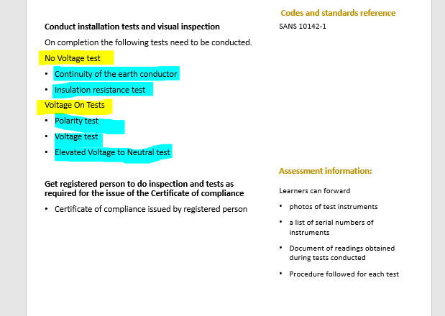
Do the necessary tests
Need Dave/Nick’s help in building out the values that would be needed here
In addition to checking the elements, you must make sure that the No Voltage Tests and Voltage On Tests are completed.
No Voltage Tests
Voltage On Tests
Simulation
Continuity of the earth conductor
Simulation
Voltage Test
Simulation
Polarity Test
Simulation
Elevated Voltage to Neutral test
Placeholder: Vid 31
Insultation resistance test
Notes:
Note for interactivity:
When learner clicks on simulation it should appear full screen.
(These tests belong in Course 2)
Focus on range of acceptable values what does it indicate when values are out of this range.

Slide 81
Step 8- Hand over to supervisor
Step 1
Step 2
Step 3
Step 4
Step 5
Step 6
Step 7
Step 8
You are almost finished installing the 3 phase socket outlet. The final thing you need to do is show your supervisor, Mr Jansen what you have done so that he can issue the Certificate of Compliance.
Placeholder for Video
Watch this video to see how to show your supervisor what you have done.
Check with Nick what handover procedure is followed in an industrial setting
Notes:
Note for interactivity:
Video should play full screen when clicked.

Slide 82
Conclusion
Congratulations! You have now worked through the entire scenario for installing a gate motor supply. There are 5 more scenarios for you to try, would you like to try another one now?
Go back to scenario map
Notes:
Note for interactivity:
“Go back” should be linked to the interactive scenario map in the LMS.

Slide 83
Video 01:Your environment
Documentary type video:
Should be of a factory (instrutrial environment) showing where an electrician responsible for installing 3 phase sockets would work.

Slide 84
Video 02: 3 phase sockets and how they work
Demonstration video explaining 3 phase sockets and how they work within an industrial environment. Why would they need to be installed what are the benefits.
Use following link as reference:
https://www.youtube.com/watch?v=oyRrm_K7WSM

Slide 85
Vid 03: Area details
Documentary style video showing the back of someone walking around a factory area where a 3 phase socket will be installed. As the person walks around the following information should come up as banners when he reaches those areas:
Reviewing the installations the following has been found
There a Sub DB’s surface mounted in the area where the circuit is required
The distance to where the socket outlet is required is 15 meters from the Sub DB and there are 12 slots available in the Sub DB for new circuit breakers and there is an earth leakage in board
There is an existing stainless steel wire cable basket that runs up the wall and past the point where the socket outlet is required
The supply must be at least 4 mm wire as the current is 32 amps for the socket outlet
The protection will need to be a 30A circuit breaker
There is a lot of forklifts and heavy machinery moving around on the premises
There is no ceiling in the plant
The plant is used for manufacturing food products
The machines are cleaned using water sprayers

Slide 86
Vid 04: Step 2 Option 1
Demonstration video with voice over and text banners appearing as action on the video is completed.
Use 4mm Armoured (2+E) cable to supply a 3 phase socket outlet
Use 4mm Armoured (2+E) cable to supply a 3 phase socket outlet
Pull in 4mm Armoured the cable on the wireway available. Install wire mesh cable tray (Module 33) made of stainless steel to the point where the socket outlet is to be mounted
Measure, mark and mount a flush mount enclosure (Module 4) to mount the 3phase socket outlet.
Prepare armoured cable for gland (Module 36) on both ends of the armoured cable. Due to dust and water a suitable IP rated cable gland should be used.
Prepare a cable for terminations (Module 26) and Connect conductors to three socket outlet (Module 43) due to dust and water a suitable IP rated socket outlet should be used.
Secure a cable on cable tray, ladder or mesh (Module 37)
Switch off supply to Sub DB1 and Test to ensure safe and isolated (Module 25)
Fit a circuit breaker in a DB (Module 20) rated at 30 A.
Connect supply from earth leakage supply to circuit breaker (Module 28) to new socket outlet supply in DB

Slide 87
Vid 05: Step 2 Option 2
Demonstration video with voice over and text banners appearing as action on the video is completed.
Use 4mm unamoured (2+E) cable to supply a 3 phase socket outlet
Pull in 4mm unamoured the cable on the wireway available. Install wire mesh cable tray (Module 33) made of stainless steel to the point where the socket outlet is to be mounted
Measure, mark and mount a flush mount enclosure (Module 4) to mount the 3phase socket outlet.
Prepare unarmoured cable for gland (Module 36) on both ends of the unarmoured cable. Due to dust and water a suitable IP rated cable gland should be used.
Prepare a cable for terminations (Module 26) and Connect conductors to three socket outlet (Module 43) due to dust and water a suitable IP rated socket outlet should be used.
Secure a cable on cable tray, ladder or mesh (Module 37)
Switch off supply to Sub DB1 and Test to ensure safe and isolated (Module 25)
Fit a circuit breaker in a DB (Module 20) rated at 30 A.
Connect supply from earth leakage supply to circuit breaker (Module 28) to new socket outlet supply in DB

Slide 88
Vid 06: Step 2 Option 3
Demonstration video with voice over and text banners appearing as action on the video is completed.
Use 4mm Surfix (2+E) cable to supply a 3 phase socket outlet
Pull in 4mm unamoured the cable on the wireway available. Install wire mesh cable tray (Module 33) made of galvanized steel to the point where the socket outlet is to be mounted
Measure, mark and mount a flush mount enclosure (Module 4) to mount the 3phase socket outlet.
Prepare unarmoured cable for gland (Module 36) on both ends of the unarmoured cable. Due to dust and water a suitable IP rated cable gland should be used.
Prepare a cable for terminations (Module 26) and Connect conductors to three socket outlet (Module 43) due to dust and water a suitable IP rated socket outlet should be used.
Secure a cable on cable tray, ladder or mesh (Module 37)
Switch off supply to Sub DB1 and Test to ensure safe and isolated (Module 25)
Fit a circuit breaker in a DB (Module 20) rated at 30 A.
Connect supply from earth leakage supply to circuit breaker (Module 28) to new socket outlet supply in DB

Slide 89
Vid 05: Planning for the job
Talking head video of electrician discussing the following:
How to plan for the job, must include info about working through the steps in your head and thinking about what you will need for each step to make sure you don’t miss anything. Must discuss tools, equipment, materials, PPE.

Slide 90
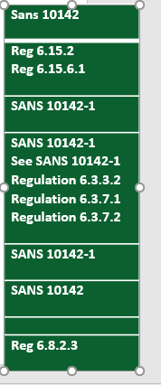
Vid 06: How to interpret SANS codes
Demonstration video. Take an example of a SANS code relevant to this scenario (ie SANS 10142). Video should alternate between showing the facilitator talking and screenshots of the SANS code as demonstrator highlights various aspects of it.
Information that should be covered in this video:
How do we read a SANS code? (Highlight important info in the document for learner)
How to we apply the SANS code?
Notes:
Video script for placeholder on Slide 3.

Slide 91
Vid 17: Complete a risk assessment table
Demonstrator video/ voice over and screen shots going through how to complete a risk assessment table step by step.
Notes:
Video script for placeholder on Slide 3.

Slide 92
Vid 18: Do the job
Demonstration Video showing:
Pull in 4mm Flat twin and earth the cable on the wireway available. Install wire mesh cable tray to the point where the socket outlet is to be mounted
Notes:
Video script for placeholder on Slide 3.

Slide 93
Vid 19: Do the job
Demonstration Video showing:
Measure, mark and mount a flush mount enclosure (Module 4) to mount the 3phase socket outlet.

Slide 94
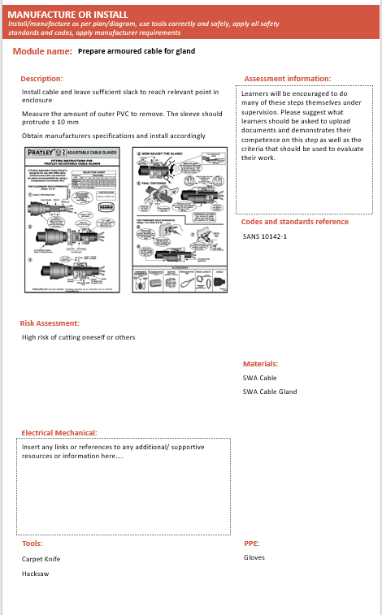
Vid 20: Do the job
Demonstration Video showing:
Prepare armoured cable for gland (Module 36) on both ends of the armoured cable.

Slide 95
Vid 21: Do the job
Demonstration Video showing:
Prepare a cable for terminations (Module 26) and Connect conductors to three socket outlet (Module 43).

Slide 96
Vid 22: Do the job
Demonstration Video showing:
Secure a cable on cable tray, ladder or mesh (Module 37).
Notes:
Video script for placeholder on Slide 3.

Slide 97
Vid 23: Do the job
Demonstration Video showing:
Switch off supply to Sub DB1 and Test to ensure safe and isolated (Module 25)
Notes:
Video script for placeholder on Slide 3.

Slide 98
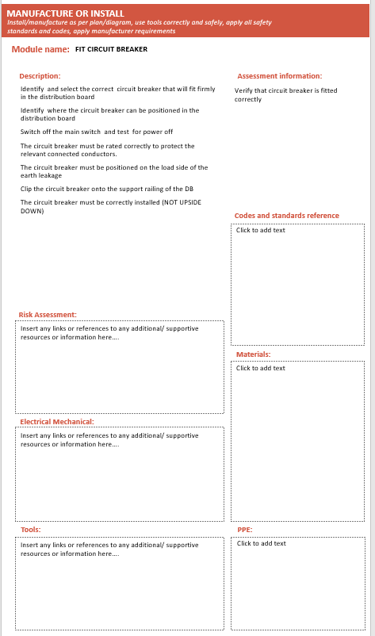
Vid 24: Do the job
Demonstration Video showing:
Fit a circuit breaker in a DB (Module 20) rated at 30 A.

Slide 99
Vid 25: Do the job
Demonstration Video showing:
Connect supply from earth leakage supply to circuit breaker (Module 28) to new socket outlet supply in DB.

Slide 100
Vid 37: Client Handover
Demonstration Video showing the electrician interacting with the client:
The route of the wire way and the depth of installation
Indicate the positioning of the breaker and where it is installed.
Provide the client with the certificate of compliance (COC) as per legislation explaining its purpose as well clients responsibility in terms of maintain the electrical installation
Need to check with Nick about the handover procedure if electrician is working in the factory and needs to show his boss what was done. Will his boss check everything and then issue COC?
Notes:
Video script for placeholder on Slide 3.

Slide 101
Voiceover 01- Option 2- Choice 1
Voice recording
While you are correct about Option 2 being the best option, it’s not because it’s the quickest. Option 2 would have taken 6 hours to do while Option 3 would have taken one hour less. The reason Option 2 is the best one is because Mrs Naidoo wanted you to a quality job but it needed to be done as cheaply as possible.
Notes:
Video script for placeholder on Slide 3.

Slide 102
Voiceover 02- Option 2 Choice 2
Voice over
While you are correct about Option 1 being the best option, it’s not because it’s the quickest. Option 2 would have taken 5 hours to do while Option 1 would have taken an hour longer. The reason Option 1 is the best one is because Mr Mabuzo wanted you to a quality job but it needed to be done as cheaply as possible.
Notes:
Video script for placeholder on Slide 3.

Slide 103
Voiceover 03- Option 2 Choice 3
Voice recording
While you are correct about Option 2 being the best option its not because of the high quality of cables being used. The armoured cables used in Option 3 are of a much higher quality however, using them would have made the job more expensive . Using more expensive cables would have gone against Mrs Naidoos’s request that the job be done as cheaply as possible.
Notes:
Video script for placeholder on Slide 3.

Slide 104
Voiceover 04- Option 3- Choice 2
Voice recording
While Option3 is a good choice, it’s not the cheapest or most cost effective Option as the armoured cables used were more expensive that the cables used in Option 2. Since Mrs Naidoo wanted you to a quality job but it needed to be done as cheaply as possible Option 2 is the best choice.
Notes:
Video script for placeholder on Slide 3.

Slide 105
Voiceover 05- Option 3 Choice 2
Voice over
While you are correct in saying that Option 2 is the quickest way of doing the job, Option1 is actually the best option because Mrs Naidoo wanted you to a quality job but it needed to be done as cheaply as possible. The cables used for Option 1 were still of a high enough quality.
Notes:
Video script for placeholder on Slide 3.

Slide 106
Voiceover 06- Option 3 Choice 3
Voice recording
You are right in saying that the cables used in Option 3 were of a better quality and would probably last much longer. However these cables tend to be more expensive. Remember in the client brief Mrs Naidoo mentioned that this job needs to be done as cheaply as possible? That’s why in this case, Option 2 would have been the better choice.
Notes:
Video script for placeholder on Slide 3.

Slide 107
Simulation 1- No Voltage Test_Continuity of earth conductor
Simulation whereby learner is able to conduct a continuity of earth conductor test. Screen must look the same as a real life tester. Learner should get the opportunity test and see voltage (which is a problem) and then they should be able to test and see no voltage.
Notes:
https://incident-prevention.com/ip-articles/no-voltage-testing

Slide 108
Simulation 2- No Voltage Tests_Insulation Resistance Test
Device used to do Insulation Resistance Test should be simulated. Users should have the opportunity to ‘preform’ tests according to a set of guidelines.
Notes:
https://www.sefelec.com/en/insulation-resistance-test.php

Slide 109
Simulation 1- Voltage on Tests_Voltage Test
Simulations
Notes:
Video script for placeholder on Slide 3.

Slide 110
Simulation 1- Voltage on Tests_Polarity Test
Simulations
Notes:
Video script for placeholder on Slide 3.

Slide 111
Simulation 1- Voltage on Tests_Neutral Test
Simulations
Notes:
Video script for placeholder on Slide 3.

Slide 112
Resource 01: Client brief and property details
Downloadable information sheet should be created with the following information:
Property details:
There are 2 DB’s 1 in the main house(BD 1) flush mounted and 1 in the garage (BD 2) surface mounted
The distance to the gate is 29 meters from the gate to the DB1 and there are 4 slots available in the DB for new circuit breakers and there is an earth leakage in board
The distance to the gate is 8 meters from the gate to the DB2 and there are 9 slots available in the DB for new circuit breakers and there is an earth leakage in board
There is paving from the garage to the gate
There are flowerbeds along the driveway
The boundary wall is single brick and painted grey
The distance from the garage to the boundary wall is 5 meters
There is grass between the garage and the boundary wall to the gate
No visible water points or pipes between garage and boundary wall
The ground is a rich dark brown which indicates that digging will be relatively easy
There is no ceiling in the garage
There are dogs on the property
There are toilet facilities for staff
Client Brief:
The project must follow all regulations and standards
You must give Mrs Naidoo a certificate of compliance once you have finished the job.
You must make sure that you and your team follow the health and safety standards at all times
Activities must not damage the walls and must not look unsightly (bad)
You are allowed to dig in the garden but you must put the lawn and garden back to its original state as best as possible
You can get the supply from any point in the installation as long as it is compliant
You must finish all your work in 1 day
Finances are limited and you need to do the project as cheaply as possible

Slide 113
List of images required for this scenario:

