Slide 1
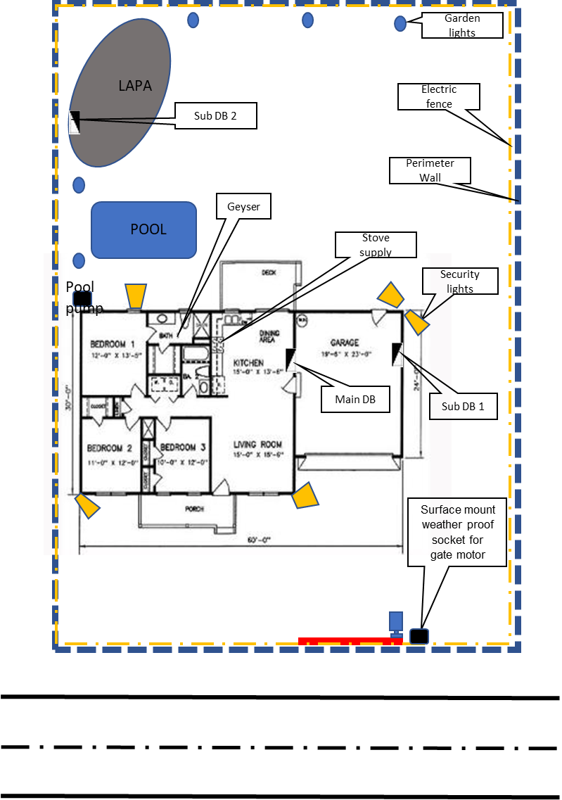
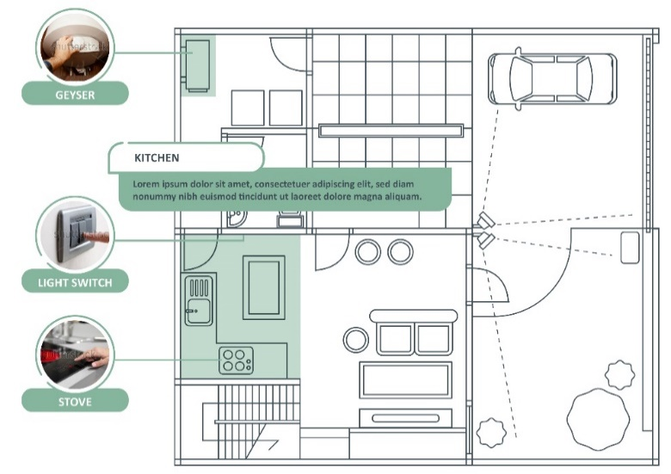
Notes:
Note for design:
This diagram needs to be redrawn and styled similarly to the example provided.
Note for interactivity:
This should be an interactive map where users are able to click on each of the scenarios on the diagram and be taken to the information for that scenario.

Slide 2
Wireways
Topic 4 – Water Heater Supply Scenario
All copyright and intellectual property rights in respect of materials developed by the service provider during this project will vest in the Department of Higher Education and Training, which will have the right to allow any individual, company, agency or organisation to use or modify the materials for any purpose approved by this Department, including selling the materials or releasing them as Open Educational Resources (OER) under an appropriate copyright license.
Notes:
Notes for Nick Du Plessis:

Slide 3
Assumed prior learning
Fundamentals of electricity
Safety, health environment, risk and the quality principles in the workplace
The use of hand and power tools and applicable safety requirements
Measuring and testing methodologies (electrical and mechanical)
Introduction to the world of work and the electrical trade
Don’t feel confident yet about these topics? Click on each to review the content. Feeling confident? Click next to proceed with this unit.
Notes:
Interactivity notes:
Each point to take learner to that particular section in course to recap:
Eg.01 = direct learner to Topic X in Course 0

Slide 4
Disclaimer
NOTE for SME:
See content highlighted in red- what sections need to be referred to?
No person may authorize, design, install or permit or require the installation of an electrical installation, other than in accordance with a health and safety standard incorporated into these Regulations under section 44 of the Act. (Electrical installation regulations section 5)
No person may do electrical installation work as an electrical contractor unless that person has been registered as an electrical contractor in terms of these Regulations (Electrical installation regulations section 6)
It must be noted that in terms of Occupational Health & Safety Act all electrical construction work must be conducted under the general control of the registered person, and in terms of this criteria you will not be allowed to work in the distribution board. You will be permitted under the general control of this registered person to do the following work. (Electrical installation regulations section 5)
The registered person will be responsible for issuing the certificate of compliance for this addition to the electrical installation, after he has inspected and tested the electrical installation. (Electrical installation regulations section 9)
During this exercise we will be providing 3 options to provide supply to a gate motor, we are aware that there are many more options and these will be influenced by finance, time, environment and skill.
It must be noted that any other installation must comply to the regulations, standards and manufactures specifications.
I have read and understood all points contained in the Disclaimer.
Notes:
Notes to SME: See content highlighted in red- what sections need to be referred to?
Notes for interactivity/development:
1. Present boxes with just the number. On click/touch, reveal the full statement as a slide right animation. Display small animations to indicate that boxes can be clicked/touched
2. Add checkbox for student to indicate they have read and understood all points in disclaimer

Slide 5
Scenario Outcomes
By the of this unit, you will be able to:
1. Plan a job and understand the regulations applicable to the specific task
2. Select and apply the correct tools for the task
3. Conduct a risk assessment for the task
4. Prepare the worksite
5. Install equipment and materials according to relevant standards, and manufacturer requirements
6. Conduct the required tests for an alteration of an electrical supply
7. Interact with and provide feedback to the client
Notes:
Present boxes with just the number. On click/touch, reveal the full statement as a slide right animation
Display small animations to indicate that boxes can be clicked/touched

Slide 6
Glossary
NOTE for SME:
Please verify and add missing terms.
Add words and terms here….
Notes:
Notes for interactivity/development:
There needs to be a searchable glossary with all the electrical terms, techniques, tools equipment. When learner clicks on the word they should be able to see a definition an image/video for each item.
Glossary terms:
Hammer
Screwdriver ( terminal, Flat, star)
Side cutter
Wire strippers
Pliers
Fish tape
Ladder
2,5mmflat twin and earth
Isolator enclosure
saddles
Circuit breaker

Slide 7
Supply for a water heater (geyser)

Slide 8
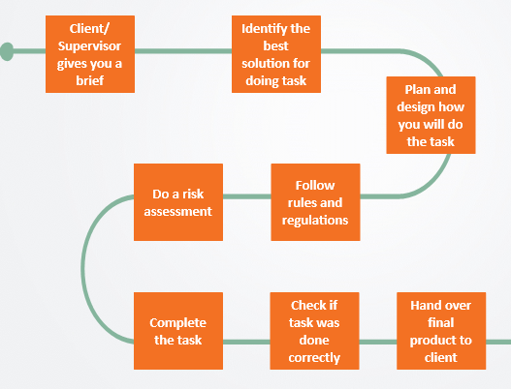
Introduction
In this scenario, you will work through eight key steps.
1
2
3
Move over each step to find out more. Then, click Next to get started with Step 1.
5
4
6
7
8
Notes:
Note for development:
There are 8 steps for each of the 6 scenarios in Course 4. Please create suitable graphic to use represent steps and use throughout all scenarios.
Number and relevant graphic to appear at first on each step. Graphics provided here are examples only. Will need to be redrawn.
Learner will click to reveal text description for each box. See below
Mouseover/Popup text
Step 1: Your client or supervisor gives you a brief
Step 2: You need to identify the best solution for doing the job
Step 3: Plan and design an approach for doing the job
Step 4: Follow the rules and regulations
Step 5: Do a Risk Assessment
Step 6: Complete the job
Step 7: Check if the job was done correctly
Step 8: Do the client handover

Slide 9
Step 1- Client brief
1
2
3
4
5
6
7
8
You have just received a call from Mr Pretorius. He has just replaced his burst water heater and needs you, a qualified electrician, to provide power at the gate for the water heater urgently.
Click on the speaker icon to replay the conversation.
TIP: Listen carefully to what Mr Pretorius has to say. You will need to answer a question soon after.
Notes:
Note for interactivity:
When learner clicks on the speaker, Voice Rec 01: Client brief should play. (next slide) – animated scenario with VO
Note for design:
Need an image of Mr Pretorius (white male, casually dressed, middle aged, the same person should be used throughout this entire scenario. Need to have him in different poses and positions
Will also need image to represent qualified electrician (same as is to be used for Stove scenario)

Slide 10
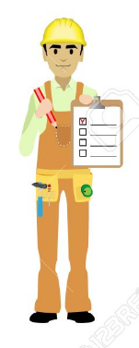
Yes. How can I help you?
1
Hello, this is Ted Pretorius. Are you John of Expert Electricians?
2
3
I need you to provide a supply for my water heater and its rather urgent.
I see. When do you need the job done by?
4
I am expecting visitors over the week-end, so need you to complete the job in two days. The sooner you can start, the better!
6
That should not be a problem. My team and I can have the work done by the end of the week. What else can you tell me? Do you have any constraints?
5
8
Of course! We are committed to adhering to all regulations as well as health and safety standards. Do you have any requests about how we need to do the work? Or where my team and I can get the supply?
7
Great to hear! The insurance is not going to cover this work, so I need you conduct the work in the cheapest way possible, while still adhering to all the required regulations and standards.
10
No problem. Will you be available tomorrow so my team and I can do a property visit?
9
Please make sure that activities do not damage the walls or look unsightly. You are also not allowed to chase the walls or damage ceiling boards. You can get the supply from any point in the installation as long as it is compliant.
12
Of course! See you tomorrow Mr Pretorius!
11
Yes, that would be great. One more thing, I will need you to provide a certificate of compliance when the job is done.
Notes:
Note for interactivity:
Rebuild this as an animated scenario embedded into content. Create characters/personas for the two individuals. Male on right must look like authentic electrician. It is a phone call between the two characters. Audio and visual should play for relevant person. Characters to be in different poses and positions.

Slide 11
Client brief
Did you listen carefully to what your client said?
You will be given a list of details from the conversation. Choose all the correct details from this list and click SUBMIT when you are finished.
See client details
Notes:
Note for interactivity:
Button “ Go to list for details” should be hyperlinked to questions on Slide 12

Slide 12
Client brief
The project must follow all regulations and standards
You do not need to provide Mr Pretorius with a certificate of compliance
Health and safety regulations must be complied to at all times
You can get the supply from any point in the installation as long as it is compliant
Activities must not damage the walls and must not look unsightly
You are allowed to chase the walls and damage ceiling boards
You must finish all the work in 7 days
Financial resources are very limited and you need to do the work as cheap as possible
SUBMIT
Notes:
Note for interactivity:
This is a multiple choice question, with multiple answers correct. Correct answers are in italics.
The project must follow all regulations and standards
You do not need to provide Mr Pretorius with a certificate of compliance
Health and safety regulations must be complied to at all times
You can get the supply from any point in the installation as long as it is compliant
Activities must not damage the walls and must not look unsightly
You are allowed to chase the walls and damage ceiling boards
You must finish all the work in 7 days
Financial resources are very limited and you need to do the work as cheap as possible
Feedback for ALL correct answers.
Well done! You got them all correct. You are ready to move on to finding out more about your client’s property details. (Go to slide 14)
Feedback for any incorrect answer.
Oops you didn’t get all the correct details. Make sure you listen carefully to what your client has to say. Click here to refresh your mind. (Link to slide 13)(RECAP)

Slide 13
Client brief
Let’s review the details that Mr Pretorius gave you over the phone.
Click on each of the blocks below to find out more. You will need this information for the remainder of the steps in this scenario.
Notes:
Note for interactivity:
Student clicks on each card to flip over/reveal content. Relevant graphics/icon to be created to represent each item which displays before card is flipped. Example provided only- they must be recreated.
Content for blocks:
The project must follow all regulations and standards
You need to provide Mr Pretorius with a certificate of compliance
Health and safety regulations must be complied to at all times
You can get the supply from any point in the installation as long as it is compliant
Activities must NOT damage the walls or look unsightly
You are NOT allowed to chase the walls and damage ceiling boards
You must finish all the work in 2 days
Financial resources are very limited and you need to do the work as cheap as possible

Slide 14
Mr Pretorius’s property
Now that you know what your client wants, you need to find out specific details about the property. You can do this by visiting the property before you begin the job. This helps with your planning.
Watch this video to learn more information about the property.
Placeholder for Vid01: Property Details
Notes:
Note for interactivity:
When learner clicks on video it should appear as full screen.

Slide 15
Summary of property details
Property Details
Can’t remember all the property details? Click on the boxes below to refresh your mind.
Tip: Keep the client and property details handy for future reference. Click here to download.
Notes:
Note for interactivity:
Student clicks on each card to flip over/reveal content. Relevant graphics/icons to be created and displayed on each card to represent each item before it is clicked. Then, when card is clicked, content will display in placeholder box on the right.
Content on cards:
There are 2 DB’s . One in the main house (BD 1), which is flush mounted and one in the garage (BD 2), which is surface mounted.
The heater that has been installed by the plumber is 8 meters from DB1. There are 2 slots available in the DB for new circuit breakers and there is an earth leakage in board. The heater is 16 meters from the DB2. There are 9 slots available in the DB for new circuit breakers and there is an earth leakage in board
The roof is pitched and easy to move around
There are spare pipes in the wall to feed the supply from the DB’s into the roof space
The water heater is 2kw and is used for the kitchen
The supply must be at least 2,5mm wire as the current is 9,66 amps for the water heater
The protection will need to be a 20A circuit breaker
There is no ceiling in the garage
There are dogs on the property
There are toilet facilities for staff
Click Here to be linked to Resource 1 in Appendix. “Client and property details”. Users should be able to download this resource and save it on their computers/phones.

Slide 16
Step 2- Choose the best option
1
2
3
4
5
6
7
8
Factors to consider:
In this step you first need to weigh up the options and decide which will be the best approach to take. A number of factors could affect your decision.
Environmental conditions
Availability of tools and Equipment
Availability of materials
Time constraints
Availability of labour
Regulation codes and standards
Possible risks
1
8
2
7
3
Move over each item to find out what these factors are…
6
4
5
Notes:
Note for interactivity:
Picture representing each factor shows initially. Graphic to be recreated. Then, as learner rolls over, description shows.
Descriptions as follows:
Cost restrictions
Environmental conditions
Availability of tools and equipment
Availability of materials
Time constraints
Availability of labour
Regulation codes and standards
Possible risks

Slide 17
Step 2- Choose the best option
Option 1 and 3 appear to be the same…need to clarify
You have three possible options available to you when providing the supply for Mr Pretorius’s water supply.
Take a look at the options below. You will soon need to decide which option is the best for this job.
TIP: Keep in mind the information that your client told you and the property details.
Option 1
Option 2
Option 3
Notes:
Note for interactivity:
Each video to play in new window with ability to close and go back to remaining options. See video scripts in appendix
When learner clicks on the “Next” button (standard navigation int the player) they should be taken to next slide- Stop and reflect

Slide 18
Stop and reflect
Option 1 and 3 appear to be the same…need to clarify
So far, which option do you think might be the best for installing the supply for your client’s water heater supply….? Move the slider scale to indicate which option you believe is Good, Better and Best…
OPTION 2
OPTION 1
OPTION 2
OPTION 3
Image placeholder to represent option 1
Image placeholder to represent option 2
Image placeholder to represent option 3
GOOD
BETTER
BEST
GOOD
BETTER
BEST
GOOD
BETTER
BEST
Notes:
Note for interactivity:
1.Create suitable graphics to represent each option at first. When learner mouses over, then details about option display. See below:
2. Create slider scale under each option for learner to select good, better and best option.
Option 1: ( to be displayed when flashcard moused over)
Use 2,5mm Norsk (2+E) cable to supply a isolator that will allow the water heater to be supplied from
Option 2:
Use 2,5mm flat twin and earth (2+E) cable to supply a isolator that will allow the water heater to be supplied from
Option 3:
Use 2,5mm Norsk (2+E) cable to supply a isolator that will allow the water heater to be supplied from

Slide 19
Stop and reflect
You chose Option X as the best option for the job. Why? Type a reason in the text area below and click submit.
Submit
Notes:
Note for interactivity:
The bold text “Option X’ in the instruction box needs to be replaced with whatever option the learner chose as the BEST option in the previous slide.
Text box, learner should be able to type in a response. There is no correct answer, this question is to be the learner thinking.
When learner clicks on the Submit button they should be taken to Slide 20

Slide 20
Factors to consider
We know that there are a number of factors will affect the option you finally choose to complete the job.
What to Consider?
Review each option to see what you need to consider.
Environmental conditions
Cost
Tools & Equipment
Materials
Option 1
Option 2
Option 3
Time
Labour
Codes and Standards
Possible risks
Notes:
Note for interactivity:
When learner clicks on each of the options blocks they should be taken to the following slides:
Option 1- Slide 21
Option 2- Slide 22
Option 3- Slide 23
When all options have been completed, the NEXT button will only appear
When learner rolls over each icon, the following description will display (ALL graphics need to be redrawn)
Money

Slide 21
Option 1: Details
Option 1 and 3 appear to be the same…need to clarify
Use 2,5mm Norsk (2+E) cable to supply a isolator that will allow the water heater to be supplied from.
Click on each of the boxes to find out more.
Tools and equipment
Materials
Cost
Regulations
Time
Labour
Environmental implications
Risk implications
Go Back
Notes:
Note for interactivity:
When learner clicks on each of the boxes, information for that box should be revealed. Create icon/graphic to show on each card with the text before it is flipped over. See details below:
Tools and equipment
No special tools are required for installation or chasing but a cutting machine can be used to assist in chasing the wall. We will be making use of a ladder during the installations
Materials
All components that can be used are available from the local electrical wholesaler.
Time
It is estimated that the task should take 5 hours
Labour
1 persons will be allocated for this task
Cost
Most of the materials are easily acquired form an electrical wholesaler, this is possibly the cheapest option
Environmental implications
No environmental concerns for this installation.
Regulations
Volt drop over the cable is minimal.
Risk Implications
The dogs will have to be put away in order to allow for the installation.

Slide 22
Option 2: Details
Use 2,5mm flat twin and earth (2+E) cable to supply a isolator that will allow the water heater to be supplied from.
Click on each of the boxes to find out more.
Tools and equipment
Materials
Cost
Regulations
Time
Labour
Environmental implications
Risk implications
Go Back
Notes:
Note for interactivity:
When learner clicks on each of the boxes, information for that box should be revealed. See details below:
Tools and equipment
No special tools are required for installation. We will be making use of a ladder during the installations
Materials
All components that can be used are available from the local electrical wholesaler.
Time
It is estimated that the task should take 5 hours
Labour
1 persons will be allocated for this task
Cost
The cable used is the cheapest cable and will save time on labour.
Environmental implications
No environmental concerns related to this task.
Regulations
Volt drop over the cable is minimal due to the length of the cable.
Risk Implications
The dogs will have to be put away in order to allow for the installation

Slide 23
Option 3: Details
Details for each option missing.
Use 2,5mm Norsk (2+E) cable to supply a isolator that will allow the water heater to be supplied from.
Click on each of the boxes to find out more.
Tools and equipment
Materials
Cost
Regulations
Time
Labour
Environmental implications
Risk implications
Go Back
Notes:
Note for interactivity:
When learner clicks on each of the boxes, information for that box should be revealed. See details below:
Tools and equipment
No special tools or equipment is required.
Materials
We will be making use of a ladder during the installations
Time
It is estimated that the task should take 5 hours
Labour
1 persons will be allocated for this task
Cost
Cabtyre is the cheapest type of cable
Environmental implications
Regulations
Volt drop over the cable is minimal due to the length of the cable. This type of cable cannot be placed in the ground.
Risk Implications
The dogs will have to be put away before installation.

Slide 24
Advantages and Disadvantages
Option 1 and 3 appear to be the same…need to clarify
Before you choose the best option for this job, you should weigh up the advantages and disadvantages. Click on each option to view.
Disadvantage for Option 2 missing
Advantages
Disadvantages
OPTION 1
OPTION 2
Image placeholder to represent option 1
Image placeholder to represent option 2
OPTION 3
Image placeholder to represent option 3
Notes:
Note for interactivity:
When learner mouses over each graphic, the description for that option appears.
When learner CLICKS on each of the boxes, information for that box should be revealed on the boxes on the right. See details below:
Option 1 Description mouse over text: Use 2,5mm Norsk (2+E) cable to supply a isolator that will allow the water heater to be supplied from
Option 2 Description mouse over text:
Use 2,5mm flat twin and earth (2+E) cable to supply a isolator that will allow the water heater to be supplied from
Option 3 Description mouse over text: Use 2,5mm Norsk (2+E) cable to supply a isolator that will allow the water heater to be supplied from
When learner CLICKS on an option, the advantages and disadvantages display in boxes on rhs:
Option 1:
Advantages
This appears to be the cheapest and most cost effective method to get the supply from the DB 1 to the new water heater supply
Disadvantages
Norsk cable is more expensive than flat twin ands earth
Option 2:
Advantages
Flat twin and earth is cheapest cable to install and a very effective method to get the supply from the DB 1 to the new water heater supply
With this cable you have no mechanical protection
It is flexible to work with
Disadvantages
With this cable you have no mechanical protection
Option 3:
Advantages
Fairly cheap method
Disadvantages
Does not meet client requirement that installation must be compliant to manufactures requirements and standards

Slide 25
Choose the best option
Time to select the best option for this job. Choose an answer and click submit. You may review the options before deciding.
Need to clarify with SME which is actual best option and then edit feedback content
Option 1
Option 2
Option 3
Submit
Notes:
Note for interactivity:
Three options imbedded. Learner can click to view in new window. Video scripts in appendix – see option 1, 2 and 3 video scripts.
Multiple choice, feedback below: (correct answer in italics)
Option 1 Feedback:
Option 2 Feedback:
Option 3 Feedback:

Slide 26
1
2
3
4
5
6
7
8
Step 3- Plan the job
As Option 1 is the most cost effective option, we will use it for the rest of the scenario. But how do you even begin to think about all the things you will need to do the job..?
Watch this video for advice from an experienced electrician on how to properly plan for a job.
Placeholder video:
How to plan for the job, must include info about working through the steps in your head and thinking about what you will need for each step to make sure you don’t miss anything. Must discuss tools, equipment, materials, PPE. Its an overview.

Slide 27
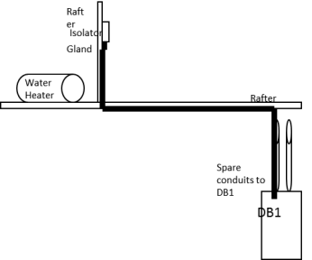
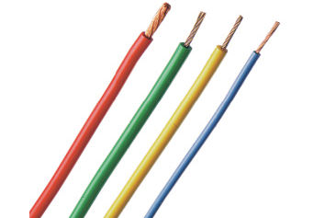
1
2
3
4
5
6
7
8
Step 3- Plan the job
Let’s review what needs to be done as part of proper job planning.
Draw your plan
Select tools and equipment
Select materials
Select PPE
Notes:
Graphics to represent each block to be recreated.
Link each block to corresponding slide that follows
Draw plan- slide 28
Identify tools – slide 32
Identify materials- slide 35
Select PPE – slide 37
As learner reviews all elements, they need to come back here. Only when all has been viewed, can they proceed to next section- Step 4

Slide 28
Draw your plan
The plan is used by you and your team when you go to a client’s property.
Placeholder-Video 05
Take a look at this video which explains how the plan is created.
Notes:
Note for interactivity:
When user clicks on the video it should appear as full screen. Link to video in appendix

Slide 29
Draw your plan
You are going to now draw your OWN plan for Option 1.
Use the property details, job instructions and video for Option 1 to draw your own plan. You can use paper or a computer programme to make your drawing.
Mr Pretorius’s property details
Step by step instructions
Video of Option 1
I need help with drawing my plan
Notes:
Note for interactivity:
When learner clicks on “Property” block they should see Resource 01
When learner clicks on Video – they should see Option 1 Video in Appendix
When learner clicks on “I need help” they should be taken to the relevant topic in Course 0: World of Electrician
When learner clicks on “Step by step” block they should see the following information:
STEPS:
Measure, mark and mount a flush mount enclosure in a roof onto a rafter within arms reach of the water heater
Connect GP conductors to isolator
Drill a hole using a holesaw in enclosure for a gland
Connect an appliance using Norsk cable into an enclosure
Using cable clips Saddling multicore cable onto wood or rafters to DB1
We will draw in the cable into the spare conduit into the DB1
Strip sheath off cable allowing sufficient length for cores to reach the new circuit breaker as well as earth and neutral bars NOTE : always leave some slack in the wire minimum 200mm
Switch off supply to DB1 and test to ensure safe to work
Fit 20 Amp circuit breaker in DB and connect supply from earth leakage supply to circuit breaker
Connect supply from earth leakage supply to circuit breaker to new water heater supply in BD
Conduct relevant tests
Complete COC
Hand over to client
When learner clicks on “Video” block they should see Video Option 1

Slide 30
Upload your plan
Submit your plan so that it can be saved in your ePortfolio. Upload your plan and click submit.
Submit
Notes:
Note for interactivity:
The word ePortfolio should be linked to information about what an ePortfolio is and how it works, how learner can access it.
There needs to be an upload function for user to upload their plan.

Slide 31
The completed plan
How does your completed plan look? Your plan should resemble something like this.
Notes:
Note for interactivity:
Recreate plan

Slide 32
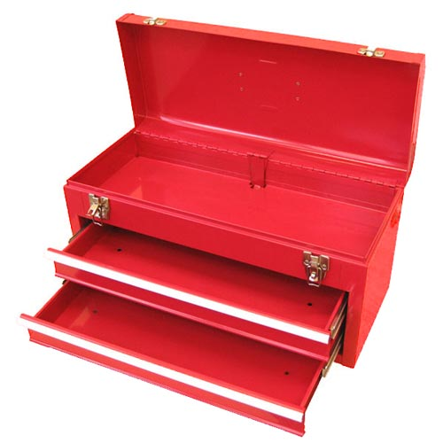
Identify tools and equipment
Which tools do you think are needed to complete this job? Click on each tool to find out more about its purpose. Then, drag and drop your chosen tools into the tool box.
Hammer
Screwdriver (terminal, flat, star)
Pliers
Fish tape
Placeholder for another tool
Placeholder for another tool
Side cutter
Ladder
Placeholder for another tool
Placeholder for another tool
Wire strippers
Placeholder for another tool
Submit
Notes:
Note for interactivity:
Create images to use for each item instead of the text box
This is a drag and drop activity. Learner should be able to drag and drop the each tool to the image of the toolbox.
When they click on the submit button they should be taken to feedback page. – see below
When the learner clicks on each tool, the corresponding info should appear. See example on Slide 34 of suggest layout for each tool.
Correct tools:
Hammer
Screwdriver ( terminal, Flat, star)
Side cutter
Wire strippers
Pliers
Fish tape
Ladder
Incorrect tools - OTHER OPTIONS TO INCLUDE
Drill
Hacksaw
Bender spring
Multi meter
Scriber
Feedback for correct answer:
Well done! You have chosen the correct tools for this job. (learner should proceed)
Feedback for incorrect answer:
Oops not quite. You are missing some essential tools for this job. Not to worry on the next page we will review the tools needed for this job. (learner should be taken to Slide 33)

Slide 33
Tools for the job
Not too sure which tools were required? Don’t worry, we have listed them here again. Mouse over each one to review their intended use.
Hammer
Image of a hammer
Short description of what a hammer does.
Notes:
NOTE TO MEDIA DESIGN TEAM:
Show all picture icons for each of the CORRECT tools. Student can rollover each one to review the details for each. Details to display in block. Refreshes to display new info pertaining to each tool selected.

Slide 34
Placeholder for tool descriptions
Hammer
Image of a hammer
Short description of what a hammer does.

Slide 35
Materials
In order to complete this job you will need materials such as wires and connectors. Click on each box below to see more information.
12 meters of 2,5mm flat twin and earth
1 x Isolator enclosure complete
2,5mm saddles
20A Circuit breaker 3KA
Label (water heater/geyser)
Notes:
Note for interactivity:
When user clicks on each of the blocks, another block with information about each material should appear. See Slide 36 for example.

Slide 36
Placeholder for material descriptions
Circuit breaker
Image of PVC cable
Short description of a circuit breaker and what it is used for.

Slide 37
Personal protective equipment (PPE)
When completing a job you must always make sure that you are protecting yourself and the people who are working with you. One of the ways you do that is by making sure you and your team are wearing the correcting personal protective equipment or PPE.
Placeholder-Video 06 - PPE
Watch this video on PPE to find out why its so important.
Notes:
Note for interactivity:
When learner clicks on video it should play full screen. Refer to Appendix for video

Slide 38
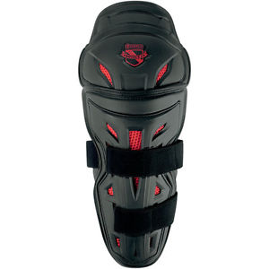
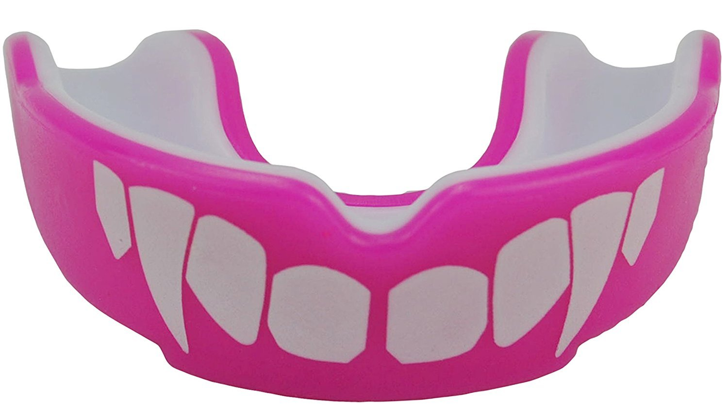
Select the correct PPE
Choose the PPE you think you would need for this job. Drag and drop the items onto the image of the electrician. Click ‘submit’ once you are done.
Tip: Not sure what each item is used for? Click on each to view a description first.
Submit
Placeholder:
Image of an electrician (he should not be wearing any PPE)
Notes:
Note for interactivity:
Drag and drop activity. Electrician does not have any safety equipment/gear on to start. As student drops into correct place, then it displays on him. Need to include some completely incorrect choices up front as well. Icons used here are examples only. Need to create relevant icons in accordance with correct options specified below.
User can click on each item to view more info before dragging and dropping – See slide 39 as example
Correct items to be dropped onto the image are:
Overall
Safety shoes
Safety glasses
When learner clicks on ‘submit’ button they should be taken to feedback page.
Feedback if correct: Well done! You have chosen the correct PPE for completing this job.
Feedback if incorrect: Oops not quite, the correct PPE needed for this job was :
Overall
Safety shoes
Safety glasses

Slide 39
Placeholder for PPE descriptions
Safety glasses
Image of safety glasses
Short description of safety glasses and what it is used for.

Slide 40
1
2
3
4
5
6
7
8
Step 4 - Follow rules and regulations
Another name for rules and regulations is codes. As an electrician you need to follow the SANS (South African National Standards) codes. These can be tricky to understand at first.
Watch the video to find out how to read and apply a SANS code correctly.
Placeholder: Video o7 and Vid 08 combined into 1
Notes:
Note for interactivity:
When learner clicks on videos they should appear as full screen.

Slide 41
Multiple choice
Choose the correct answer from the options below.
Add question based on Vid 07 and 08 scripts (Dave Gravett)
Examples of questions:
What is the best way to read the code?
When reading the code you should focus on which part?
What parts are not important?
Do codes get updated? Then what?

Slide 42
SANS Codes
There is one SANS code that you need to be aware of when installing the supply for a water heater.
Click on the code to find out what it covers. You will be asked questions about it in the next activity.
SANS 10142-1
Notes:
Note for content development:
See if there is a step by step process that comes out of Video 07 and 08 and then use that structure here. Ie. Step 1 Scan for information, Step 2 highlight the important part.
Note for interactivity:
When learner clicks on each of the SANS codes they should be taken to the following slides:
SANS 10142-1: Slide 43

Slide 43
SANS 10142-1
Read through the document below and then click on the ‘Next’ button to answer some questions about this code.
Scrollable text.
Notes:
NB: Licensing issue. I see that there is a copyright on the SANS codes. Do we need to apply for permission from SABS to use them in our learning materials?
Note for interactivity:
SANS document text should be inserted on this page in a scrollable window so that learner can read the entire document on this screen.

Slide 44
Multiple choice
Insert questions from Dave Gravette here
Verify that the voltage drop are within the permitted range
Verify that the method of installation is expectable
of cable installation is applied.
OHS ACT

Slide 45
Step 5- Do a risk assessment
1
2
3
4
5
6
7
8
A risk assessment involves taking a careful look at your workplace to identify those things, situations and processes that could put you or your team in danger. You should always do a risk assessment before you begin any job.
Placeholder: Video 9 and Video 10 combined into one video on Risk assessment
Can’t remember what a risk assessment is? Watch the video to refresh your mind.
Notes:
Reference back to Course 0 but still ask them to do a specific risk assessment activity.

Slide 46
Step 5- Identify the risks
Time to have some fun and identify some potential risks. From the list below, match the task with a potential risk when installing the supply for a water heater.
Add tasks and risks
Notes:
Notes for interactivity:
Matching activity. The order should be shuffled. Here are the correct pairs:
Feedback if answer is correct- Well done! You matched the correct risks with the correct tasks. (Take learner to slide 67)
Feedback if answer is incorrect- Oops not quite. On the following page you will see the tasks and the risks that go with those tasks. (66)

Slide 47
Step 6- Complete the job
1
2
3
4
5
6
7
8
Well done on getting this far! To complete the job for your client (and correctly provide the supply for Mr Pretorius’s water heater), you need to now carry out the tasks required.
Watch the videos to see how each task is performed.
Task 1
Task 2
Task 3
Task 4
Task 5
Task 6
Task 7
task 8
Task 9
Task 10
Task 11
Notes:
Each block links to the relevant video of task – See appendix for example of layout for each video
Measure, mark and mount a flush mount enclosure in a roof onto a rafter within arms reach of the water heater
Connect GP conductors to isolator
Drill a hole using a holesaw in enclosure for a gland
Connect an appliance using norsk cable into an enclosure
Using cable clips Saddling multicore cable onto wood or rafters to DB1
We will draw in the cable into the spare conduit into the DB1
Strip sheath off cable allowing sufficient length for cores to reach the new circuit breaker as well as earth and neutral bars NOTE : always leave some slack in the wire minimum 200mm
Switch off supply to DB1 and test to ensure safe to work
Fit 20 Amp circuit breaker in DB and connect supply from earth leakage supply to circuit breaker
Connect supply from earth leakage supply to circuit breaker to new water heater supply in BD
Conduct relevant tests

Slide 48
Step 6- Complete the job
Oh No! These steps for installing the supply for the water heater are not in the correct order! Drag and drop them into the correct sequence. Click submit when you are done.
Measure, mark and mount a flush mount enclosure in a roof onto a rafter within arms reach of the water heater
Connect an appliance using norsk cable into an enclosure
Drill a hole using a holesaw in enclosure for a gland
Conduct relevant tests
Saddling multicore cable onto wood or rafters to DB1
Switch off supply to DB1 and test to ensure safe to work
Submit
Notes:
Note for interactivity;
Recreate boxes for each element so that all 11 steps are shown, have only created a few here as an example.
Users must be able to move the videos into the correct order. Correct order supplied below:
Measure, mark and mount a flush mount enclosure in a roof onto a rafter within arms reach of the water heater
Connect GP conductors to isolator
Drill a hole using a holesaw in enclosure for a gland
Connect an appliance using norsk cable into an enclosure
Using cable clips Saddling multicore cable onto wood or rafters to DB1
We will draw in the cable into the spare conduit into the DB1
Strip sheath off cable allowing sufficient length for cores to reach the new circuit breaker as well as earth and neutral bars NOTE : always leave some slack in the wire minimum 200mm
Switch off supply to DB1 and test to ensure safe to work
Fit 20 Amp circuit breaker in DB and connect supply from earth leakage supply to circuit breaker
Connect supply from earth leakage supply to circuit breaker to new water heater supply in BD
Conduct relevant tests
Feedback:
Feedback if correct: Well done! You have placed all the steps for completing this job in the correct order..
Feedback if incorrect: Oops not quite, the correct order of steps is:
(Show correct order as per above)

Slide 49
Step 7- Check job done correctly
1
2
3
4
5
6
7
8
Once you have completed the job you must check that everything was done correctly.
Click on each block below to see what you should check for this job.
Placeholder image representing relevant text
Placeholder image representing relevant text
Placeholder image representing relevant text
Placeholder image representing relevant text
Placeholder image representing relevant text
Placeholder image representing relevant text
Notes:
Note for design:
There needs to be an image to accompany each one of these blocks. When student clicks on block, it flips over to reveal text below:
The cable is level and parallel and secured properly
The isolator is square, level and parallel and secured properly
Correct lengths of conductor left in socket outlet and DB
Connections tight at termination points
Circuit labeled water heater on DB 1

Slide 50
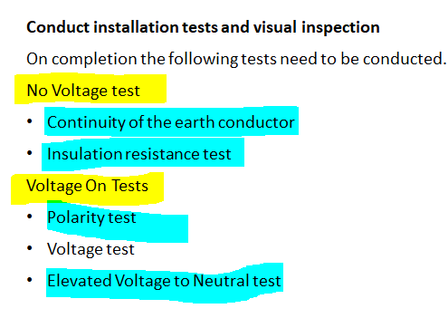
Step 7- Check job done correctly
Need Dave/Nick’s help in building out the values that would be needed here
In addition to checking the elements, you must make sure that the No Voltage Tests and Voltage On Tests are completed.
No Voltage Tests
Voltage On Tests
Continuity of the earth conductor
Placeholder: Insulation resistance test
Simulation:
Polarity Test
Simulation:
Voltage Test
Simulation
Elevated Voltage to Neutral test
Notes:
Note for interactivity:
When learner clicks on simulation it should appear full screen.
(These tests belong in Course 2)
Focus on range of acceptable values what does it indicate when values are out of this range.

Slide 51
Step 8- Handover to client
1
2
3
4
5
6
7
8
You are almost finished installing the power supply Mr Pretorius’s water heater. The final step is to show your client what you have done and provide the Certificate of Compliance (COC).
Placeholder for Video on Handover
Watch the videos to find out about COC’s and to see how a client handover is done.
Placeholder for Video on Handover
How long is a certificate of compliance valid for?
Notes:
Note for interactivity:
Video- see appendix. Video should play full screen when clicked. See appendix – Client handover
Video- see appendix. Video should play full screen when clicked. See appendix – COC Video

Slide 52
Conclusion
Congratulations! You have now worked through the entire scenario for installing a water heater supply.
There are 5 more scenarios for you to try, would you like to try one now?
Scenario: Gate Motor Supply
Scenario: Security Light
Scenario: Water Heater Supply
Scenario: 3 Phase socket outlet installation
Scenario: Motor controls centre installation
Notes:
Note for interactivity:
Interactive map allowing learners to go to remaining scenarios. Student should click on each one to be able to go directly there.
“

Slide 53
ICONS REQUIRED
ICON REQUIRED | ICON PURPOSE | Example:
Outcomes | Icon to represent Learning Outcomes
Extra Information | Icon to represent Additional Information
Instruction | Icon/ Or actual person to represent an Instruction (something learner needs to do)
Tip | Icon to represent a hint or tip
Glossary | Icon to represent Glossary Page
Reflection | Icon to represent Reflection
Important point
Notes:
Icons to be re-created and used across all UNITS. These are examples only.

Slide 54
Animated scenario: 01: Client brief
Voice of an middle-aged white male, speaking over a phone with the electrician:
Client: Hello, this is Ted Pretorius. Are you John of Expert Electricians?
Electrician: Yes. How can I help you?
Client: I need you to provide a supply for my water heater and its rather urgent.
Electrician: I see. When do you need the job done by?
Client: I am expecting visitors over the week-end, so need you to complete the job in two days. The sooner you can start, the better!
Electrician: That should not be a problem. My team and I can have the work done by the end of the week. What else can you tell me? Do you have any constraints?
Client: Great to hear! The insurance is not going to cover this work, so I need you conduct the work in the cheapest way possible, while still adhering to all the required regulations and standards.
Electrician: Of course! We are committed to adhering to all regulations as well as health and safety standards. Do you have any requests about how we need to do the work? Or where my team and I can get the supply?
Client: Please make sure that activities do not damage the walls or look unsightly. You are also not allowed to chase the walls or damage ceiling boards. You can get the supply from any point in the installation as long as it is compliant.
Electrician: No problem. Will you be available tomorrow so my team and I can do a property visit?
Client: Yes, that would be great. One more thing, I will need you to provide a certificate of compliance when the job is done.
Electrician: Of course! See you tomorrow Mr Pretorius!
Notes:
Note for interactivity:
Rebuild this as an animated scenario embedded into content. Create characters/personas for the two individuals.. It is a phone call between the two characters. Audio and visual should play for relevant person. Characters to be in different poses and positions.

Slide 55
Vid 01: Property details
Animated video using a tool like GoAnimate. Black and white hand drawn images with a voice over. Each point should be on a separate slide.
Script for voice over:
When you visited Mr Pretorius’s property, here is what you found:
There are 2 DB’s . One in the main house (BD 1), which is flush mounted and one in the garage (BD 2), which is surface mounted.
The heater that has been installed by the plumber is 8 meters from DB1. There are 2 slots available in the DB for new circuit breakers and there is an earth leakage in board
The heater is 16 meters from the DB2. There are 9 slots available in the DB for new circuit breakers and there is an earth leakage in board
The roof is pitched and easy to move around
There are spare pipes in the wall to feed the supply from the DB’s into the roof space
The water heater is 2kw and is used for the kitchen
The supply must be at least 2,5mm wire as the current is 9,66 amps for the water heater
The protection will need to be a 20A circuit breaker
There is no ceiling in the garage
There are dogs on the property
There are toilet facilities for staff

Slide 56
Vid 02: Step 2 Option 1
Demonstration video with voice over and text banners appearing as action on the video is completed.
Use 2,5mm Norsk (2+E) cable to supply a isolator that will allow the water heater to be supplied from
Measure, mark and mount a flush mount enclosure in a roof onto a rafter within arms reach of the water heater
Connect GP conductors to isolator
Drill a hole using a holesaw in enclosure for a gland
Connect an appliance using norsk cable into an enclosure
Using cable clips Saddling multicore cable onto wood or rafters to DB1
We will draw in the cable into the spare conduit into the DB1
Strip sheath off cable allowing sufficient length for cores to reach the new circuit breaker as well as earth and neutral bars NOTE : always leave some slack in the wire minimum 200mm
Switch off supply to DB1 and test to ensure safe to work
Fit 20 Amp circuit breaker in DB and connect supply from earth leakage supply to circuit breaker
Connect supply from earth leakage supply to circuit breaker to new water heater supply in BD
Conduct relevant tests
Complete COC
Hand over to client

Slide 57
Vid 03: Step 2 Option 2
Demonstration video with voice over and text banners appearing as action on the video is completed.
Use 2,5mm flat twin and earth (2+E) cable to supply a isolator that will allow the water heater to be supplied from
Mount the isolator enclosure onto a rafter within arms reach of the water heater
Switch off supply to DB1 and test to ensure safe to work
Connect conductors to isolator
Drill 20mm hole in enclosure for the gland
Fit a PVC gland onto enclosure
Using cable clips saddle flat twin and earth cable to rafters to DB1
We will draw in the cable into the spare conduit into the DB1
Strip sheath off cable allowing sufficient length for cores to reach the new circuit breaker as well as earth and neutral bars NOTE : always leave some slack in the wire minimum 200mm
Fit 20 Amp circuit breaker in DB and connect supply from earth leakage supply to circuit breaker
Connect new water heater supply conductors in BD
Conduct relevant tests
Complete COC
Hand over to client

Slide 58
Vid 04: Step 2 Option 3
Demonstration video with voice over and text banners appearing as action on the video is completed.
Use 2,5mm Norsk (2+E) cable to supply a isolator that will allow the water heater to be supplied from
Switch off supply to DB1 and test to ensure safe to work
Connect conductors to water heater
Using cable clips saddle norsk cable to rafters to DB1
We will draw in the cable into the spare conduit into the DB1
Strip sheath off cable allowing sufficient length for cores to reach the new circuit breaker as well as earth and neutral bars. NOTE : always leave some slack in the wire minimum 200mm
Fit 20 Amp circuit breaker in DB and connect supply from earth leakage supply to circuit breaker
Connect new water heater supply conductors in BD
Conduct relevant tests
Complete COC
Hand over to client
NOTE there must be an isolator on a water heater installation within arms reach regulation

Slide 59
Vid 05: How to draw a plan
Demonstration video with electrician talking to the learner about how to do the plan, interspersed with screenshots of him doing the plan.
This link can be used as a basis: https://www.bhg.com/home-improvement/electrical/how-to-draw-electrical-plans/
Notes:
Video script for placeholder on Slide 3.

Slide 60
Vid 6: Personal protective equipment
An animated video discussing the following:
What is PPE
Why do we wear it?
What are the most common PPE for electricians?
Where can you find/buy PPE? (Is it your responsibility or that of your employer?
Notes:
Video script for placeholder on Slide 3.

Slide 61
Vid 07: Overview of the SANS codes and how they work
Animated video using a tool like GoAnimate. Black and white hand drawn images with a voice over.
SANS, refers to a standard that specifies the performance requirements of a specific product. A SANS standard may be either locally written or created by adopting an international (usually ISO) standard.
What does a SANS code look like?
Why do we have them?
Where can we access them?
What happens when the code changes? Does this happen often?

Slide 62
Vid 08: Overview of the SANS codes and how they work
Demonstration video. Take an example of a SANS code (ie SANS 10142). Video should alternate between showing the facilitator talking and screenshots of the SANS code as demonstrator highlights various aspects of it.
Information that should be covered in this video:
How do we read a SANS code? (Highlight important info in the document for learner)
How to we apply the SANS code?
Notes:
Video script for placeholder on Slide 3.

Slide 63
Vid 9:Risk Assessment
An animated video discussing the following:
A risk assessment is a term used to describe the overall process or method where you:
Identify hazards and risk factors that have the potential to cause harm (hazard identification).
Analyse and evaluate the risk associated with that hazard (risk analysis, and risk evaluation).
Determine appropriate ways to eliminate the hazard, or control the risk when the hazard cannot be eliminated (risk control).
A risk assessment is a thorough look at your workplace to identify those things, situations, processes, etc. that may cause harm, particularly to people. After identification is made, you analyse and evaluate how likely and severe the risk is. When this determination is made, you can next, decide what measures should be in place to effectively eliminate or control the harm from happening.

Slide 64
Vid 10: 5 Steps of doing a Risk Assessment
An animated video discussing the following:
ACTIVITY
HAZARD
DANGER
RISK (without preventative measures)
PREVENTIVE MEASURE
Must mention the difference between a hazard and a danger.

Slide 65
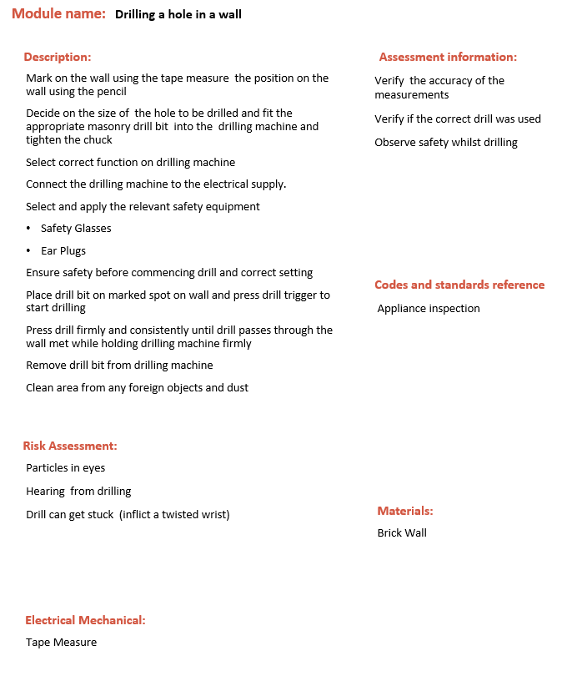
Video example for each task : Complete the task
Demonstration Video showing:
Drill a hole in a wall (Module 19)

Slide 66
Video : Client Handover
Demonstration Video showing the electrician interacting with the client:
Conduct walk about with client showing:
the route of the wire way of installation
Indicate the positioning of the breaker and where it is installed.
Provide the client with the certificate of compliance (COC) as per legislation explaining its purpose as well clients responsibility in terms of maintain the electrical installation

Slide 67
Video : COC
Discussion with qualified electrician discussing the following:
What is a COC?
Who can issue a COC?
What does a COC look like?
How long is a COC valid for?

Slide 68
Resource 01: Client brief and property details
Client Brief:
The project must follow all regulations and standards
You need to provide the client with a certificate of compliance
Health and safety regulations must be complied to at all times
You can get the supply from any point in the installation as long as it is compliant
Activities must NOT damage the walls or look unsightly
You are NOT allowed to chase the walls and damage ceiling boards
You must finish all the work in 2 days
Financial resources are very limited and you need to do the work as cheap as possible
Placeholder for visual representation/diagram of property details
Property details:
There are 2 DB’s . One in the main house (BD 1), which is flush mounted and one in the garage (BD 2), which is surface mounted.
The heater that has been installed by the plumber is 8 meters from DB1. There are 2 slots available in the DB for new circuit breakers and there is an earth leakage in board
The heater is 16 meters from the DB2. There are 9 slots available in the DB for new circuit breakers and there is an earth leakage in board
The roof is pitched and easy to move around
There are spare pipes in the wall to feed the supply from the DB’s into the roof space
The water heater is 2kw and is used for the kitchen
The supply must be at least 2,5mm wire as the current is 9,66 amps for the water heater
The protection will need to be a 20A circuit breaker
There is no ceiling in the garage
There are dogs on the property
There are toilet facilities for staff
Notes:
Notes:
Recreate and format downloadable sheet into visually appealing format with suitable imagery and graphics
If possible, create schematic diagram which shows layout of property

