Slide 1
Wireways
Topic 3 – Stove Supply Scenario
All copyright and intellectual property rights in respect of materials developed by the service provider during this project will vest in the Department of Higher Education and Training, which will have the right to allow any individual, company, agency or organisation to use or modify the materials for any purpose approved by this Department, including selling the materials or releasing them as Open Educational Resources (OER) under an appropriate copyright license.
Notes:
Notes for Nick Du Plessis:

Slide 2
Assumed prior learning
Fundamentals of electricity
Safety, health environment, risk and the quality principles in the workplace
The use of hand and power tools and applicable safety requirements
Measuring and testing methodologies (electrical and mechanical)
Introduction to the world of work and the electrical trade
Don’t feel confident yet about these topics? Click on each to review the content. Feeling confident? Click next to proceed with this unit.
Notes:
Interactivity notes:
Each point to take learner to that particular section in course to recap:
Eg.
01 = direct learner to Topic X in Course 0

Slide 3
Disclaimer
NOTE for SME:
See content highlighted in red- what sections need to be referred to?
No person may authorize, design, install or permit or require the installation of an electrical installation, other than in accordance with a health and safety standard incorporated into these Regulations under section 44 of the Act. (Electrical installation regulations section 5)
No person may do electrical installation work as an electrical contractor unless that person has been registered as an electrical contractor in terms of these Regulations (Electrical installation regulations section 6)
It must be noted that in terms of Occupational Health & Safety Act all electrical construction work must be conducted under the general control of the registered person, and in terms of this criteria you will not be allowed to work in the distribution board. You will be permitted under the general control of this registered person to do the following work. (Electrical installation regulations section 5)
The registered person will be responsible for issuing the certificate of compliance for this addition to the electrical installation, after he has inspected and tested the electrical installation. (Electrical installation regulations section 9)
During this exercise we will be providing 3 options to provide supply to a gate motor, we are aware that there are many more options and these will be influenced by finance, time, environment and skill.
It must be noted that any other installation must comply to the regulations, standards and manufactures specifications.
I have read and understood all points contained in the Disclaimer.
Notes:
Notes to SME: See content highlighted in red- what sections need to be referred to?
Notes for interactivity/development:
1. Present boxes with just the number. On click/touch, reveal the full statement as a slide right animation. Display small animations to indicate that boxes can be clicked/touched
2. Add checkbox for student to indicate they have read and understood all points in disclaimer

Slide 4
Scenario Outcomes
By the of this unit, you will be able to:
1. Plan and understand the regulations applicable to the specific task
2. Select and apply the correct tools for the task
3. Conduct a risk assessment for the task
4. Prepare the worksite
5. Install equipment and materials according to relevant standards, and manufacturer requirements
6. Conduct the required tests for an alteration of an electrical supply
7. Interact with and provide feedback to the client
Notes:
Present boxes with just the number. On click/touch, reveal the full statement as a slide right animation
Display small animations to indicate that boxes can be clicked/touched

Slide 5
Glossary
NOTE for SME:
Please verify and add missing terms.
Add words and terms here….
Notes:
Notes for interactivity/development:
There needs to be a searchable glossary with all the electrical terms, techniques, tools equipment. When learner clicks on the word they should be able to see a definition an image/video for each item.
Glossary terms:
Electromagnetism
Trenching

Slide 6
Supply for a stove

Slide 7
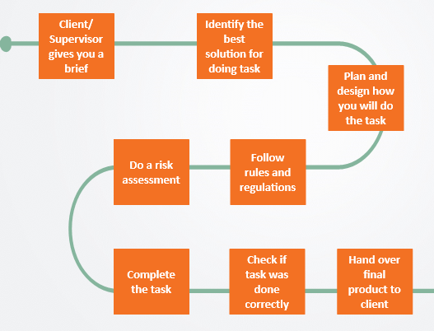
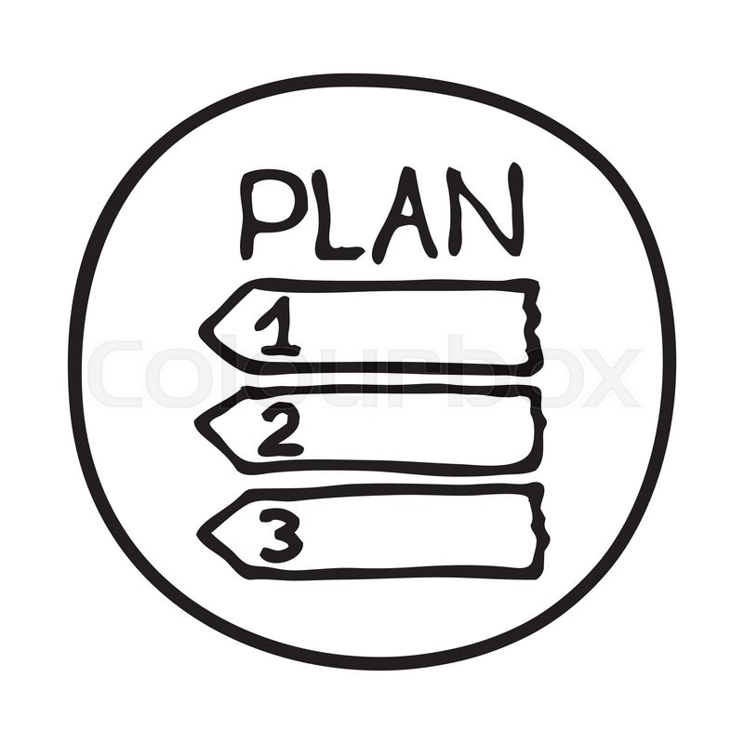
Introduction
In this scenario, you will work through eight key steps.
1
2
3
Move over each step to find out more. Then, click Next to get started with Step 1.
5
4
6
7
8
Notes:
Note for development:
There are 8 steps for each of the 6 scenarios in Course 4. Please create suitable graphic to use represent steps and use throughout all scenarios.
Number and relevant graphic to appear at first on each step. Graphics provided here are examples only. Will need to be redrawn.
Learner will click to reveal text description for each box. See below
Mouseover/Popup text
Step 1: Your client or supervisor gives you a brief
Step 2: You need to identify the best solution for doing the job
Step 3: Plan and design an approach for doing the job
Step 4: Follow the rules and regulations
Step 5: Do a Risk Assessment
Step 6: Complete the job
Step 7: Check if the job was done correctly
Step 8: Do the client handover

Slide 8
Step 1- Client brief
1
2
3
4
5
6
7
8
You have just received a call from Mrs Nkitseng, a potential client. She would like you to provide power in her kitchen for a new stove she has just installed.
Click on the speaker icon to replay the conversation.
TIP: Listen carefully to what Mrs Nkitseng has to say. You will need to answer a question soon after.
Notes:
Note for interactivity:
Create graphic which shows student the step they are on at each stage of the process. Step they are not currently on should be greyed out. If learner mouses over a step, then full description should display, i.e
Mouseover/Popup text
Step 1: Your client or supervisor gives you a brief
Step 2: You need to identify the best solution for doing the job
Step 3: Plan and design an approach for doing the job
Step 4: Follow the rules and regulations
Step 5: Do a Risk Assessment
Step 6: Complete the job
Step 7: Check if the job was done correctly
Step 8: Do the client handover
The text “Click on the phone to hear Mr Nkitseng brief to you” should fade in once learner clicks on this slide.
When learner clicks on the image of the cell phone Voice Rec 01: Client brief should play. (next slide) – animated scenario with VO
Hint box should fade in/float in approx. 7 seconds into the slide
Note for design:
Need an image of Mrs Nkitseng (black female, elderly, the same person should be used throughout this entire scenario. Need to have her in different poses and positions

Slide 9
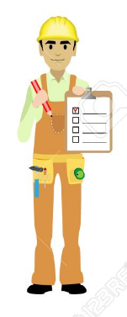
1
Hi, this is Mrs Nkitseng. I was referred to you by a good friend of mine. I need you to provide power for a new stove I have just installed.
2
Good to speak to you. It is great to have a referral. Can you tell me more? Do you have any time or money constraints?
3
As I am a elderly lady, I do not have access to a lot of money so you must complete the work as cheaply as possible but it must still be a professional job. You only have three days to finish the job.
4
That should not be a problem, but I will know more once I visit your property. Is there anything else my team should know?
6
Great – we are committed to following all required regulations and standards.
5
It is fine if your activities damage the walls as I will be re-tiling the kitchen. You can get a supply for electricity from any point in the installation as long as it is compliant.
8
No problem. We will see you in a few days to conduct the property visit.
7
Good! I cannot be held responsible for any injuries to any of your workers. I am intending to sell my property once I have renovated the kitchen, so I would need you to supply a certificate of compliance once you have finished the job.
Notes:
Note for interactivity:
Rebuild this as an animated scenario embedded into content. Create characters/personas for the two individuals. Male must look like authentic electrician. It is a phone call between the two characters. Audio and visual should play for relevant person. Characters to be in different poses and positions.

Slide 10
Client brief
Did you listen carefully to what your client said?
You will be given a list of details from the conversation. Choose all the correct details from this list and click SUBMIT when you are finished.
Go to list of details
Notes:
Note for interactivity:
Button “ Go to list for details” should be hyperlinked to questions on Slide 11

Slide 11
Client brief
The project must follow all regulations and standards
You must provide your client with a certificate of compliance
All health and safety must be complied to at all times
Activities must not damage the walls and must not look unsightly
You can get the supply from any point in the installation as long as it is compliant
You must finish all the work in 3 days
Money is of no concern to the client
SUBMIT
Notes:
Note for interactivity:
This is a multiple choice question, with multiple answers correct. Correct answers are in italics.
The project must follow all regulations and standards
You must provide your client with a certificate of compliance
All health and safety must be complied to at all times
Activities must not damage the walls and must not look unsightly
You can get the supply from any point in the installation as long as it is compliant
You must finish all your work in 3 days
Money is of no concern to the client
Feedback for ALL correct answers.
Well done! You got them all correct. You are ready to move on to finding out more about your client’s property details. (Go to slide 13)
Feedback for any incorrect answer.
Oops you didn’t get all the correct details. Make sure you listen carefully to what your client has to say. Click here to refresh your mind. (Link to slide 12)(RECAP)

Slide 12
Client brief
Let’s review the details that Mrs Nkitseng gave you over the phone.
Click on each of the blocks below to find out more. You will need this information for the remainder of the steps in this scenario.
Notes:
Note for interactivity:
Student clicks on each card to flip over/reveal content. Relevant graphics/icon to be created to represent each item which displays before card is flipped. Example provided only- they must be recreated.
Content for blocks:
The project must be in compliance with all regulations and standards
You must give Mrs Nkitseng a certificate of compliance when the job is complete
All health and safety must be complied to at all times
Activities may damage the walls as Mrs Nkitseng is refurbishing the kitchen and will be re-tiling
You can get the supply from any point in the installation as long as it is compliant
You must finish all your work in 3 days
Finances are limited and you need to do the project as cheaply as possible

Slide 13
Mrs Nkitseng’s property
Now that you know what your client wants, you need to find out specific details about the property. You can do this by visiting the property before you begin the job. This helps with your planning.
Watch this video to learn more information about Mrs Nkitseng’s property.
Placeholder for Vid01: Property Details
Notes:
Note for interactivity:
When learner clicks on video it should appear as full screen.

Slide 14
Summary of property details
Not sure you can remember all the property details? Don’t worry, click on the boxes below to refresh your mind.
You may want to keep this list as well as the client details handy for future reference. Click here to download.
Notes:
Note for interactivity:
Student clicks on each card to flip over/reveal content. Relevant graphics/icons to be created and displayed on each card to represent each item before it is clicked.
Content on cards:
There are two distribution boards or DB’s. The first DB in the main house is flush mounted and the other DB in the garage is surface mounted
The distance to the cooking appliance is 16 meters from the cooking appliance (stove) isolator to the distribution board. There are four slots available in the DB for new circuit breakers and there is an earth leakage in the board
There are six spare conduit pipes from the DB into the roof
There are no visible water points or pipes in the position where the cooking appliance isolator is to be installed
There is a ceiling in the kitchen
There are dogs on the property
There are toilet facilities for staff
Click Here to be linked to Resource 1 in Appendix.“Client and property details”. Users should be able to download this resource and save it on their computers/phones.

Slide 15
Step 2- Choose the best option
1
2
3
4
5
6
7
8
Factors to consider:
In this step you first need to weigh up the options and decide which will be the best approach to take. A number of factors could affect your decision.
Environmental conditions
Availability of tools and Equipment
Availability of materials
Time constraints
Availability of labour
Regulation codes and standards
Possible risks
1
8
2
7
3
Move over each item to find out what these factors are…
6
4
5
Notes:
Note for interactivity:
Picture representing each factor shows initially. Graphic to be recreated. Then, as learner rolls over, description shows.
Descriptions as follows:
Cost restrictions
Environmental conditions
Availability of tools and equipment
Availability of materials
Time constraints
Availability of labour
Regulation codes and standards
Possible risks

Slide 16
Step 2- Choose the best option
You have three possible options available to you when providing the supply for Mrs Nkitseng’s stove.
Take a look at the options below. You will soon need to decide which option is the best for this job.
TIP: Keep in mind the information that Mrs Nkitseng told you and the property details.
Option 1
Option 2
Option 3
Notes:
Note for interactivity:
Each video to play in new window with ability to close and go back to remaining options. See video scripts in appendix
When learner clicks on the “Next” button (standard navigation int the player) they should be taken to next slide- Stop and reflect

Slide 17
Stop and reflect
So far, which option do you think might be the best for installing the supply for Mrs Nkitseng’s stove….? Why..?
Move over each option to review the details.
OPTION 2
OPTION 1
OPTION 2
OPTION 2
Image placeholder to represent option 1
Image placeholder to represent option 2
Image placeholder to represent option 3
Notes:
Note for interactivity:
Create suitable graphics to represent each option at first. When learner mouses over, then details about option display. See below:
Option 1: ( to be displayed when flashcard moused over)
Use 20 mm conduit using GP wire to supply a cooking appliance that will allow the cooking appliance to be connected to an isolator via a metal flexible conduit
Option 2:
Use 20 mm conduit using GP wire to supply a cooking appliance that will allow the cooking appliance to be connected to an isolator via a PVC flexible conduit
Option 3:
Use a 2.5 mm² 3 core flat twin and earth cable to supply a cooking appliance directly

Slide 18
Factors to consider
We know that a number of factors would affect the option you finally choose to complete the job.
What to Consider?
Review each option to see what you need to consider.
Environmental conditions
Cost
Tools & Equipment
Materials
Option 1
Option 2
Option 3
Time
Labour
Codes and Standards
Possible risks
Notes:
Note for interactivity:
When learner clicks on each of the options blocks they should be taken to the following slides:
Option 1- Slide 19
Option 2- Slide 20
Option 3- Slide 21
When all options have been completed, the NEXT button will only appear
When learner rolls over each icon, the following description will display (ALL graphics need to be redrawn)
Money

Slide 19
Option 1: Details
Use 20 mm conduit using GP wire to supply a cooking appliance that will allow the cooking appliance to be connected to an isolator via a metal flexible conduit
Click on each of the boxes to find out more.
Tools and equipment
Materials
Cost
Regulations
Time
Labour
Environmental implications
Risk implications
Go Back
Notes:
Note for interactivity:
When learner clicks on each of the boxes, information for that box should be revealed. Create icon/graphic to show on each card with the text before it is flipped over. See details below:
Tools and equipment
No special tools are required for installation or chasing but a cutting machine can be used to assist in chasing the wall
All components that can be used are available from the local electrical wholesaler
Materials
We will be making use of a ladder during the installations
Time
It is estimated that the task should take 8 hours.
Labour
Two persons will be allocated for this task (1 will chase and 1 will do the electrical activities )
Cost
Most of the materials are easily acquired form an electrical wholesaler, but the task is more labour intensive and metallic flexible conduit is more expensive then normal conduit
Environmental implications
We would need to chase in the kitchen and care would need to be taken not the damage other components. We must be aware of possible water pipes when chasing
Regulations
Volt drop over the cable is 3,6 Volts (calculated) with a 3Kw load
Risk Implications
The dogs will have to be put away in order to allow for the installation

Slide 20
Option 2: Details
Use 20 mm conduit using GP wire to supply a cooking appliance that will allow the cooking appliance to be connected to an isolator via a PVC flexible conduit
Click on each of the boxes to find out more.
Tools and equipment
Materials
Cost
Regulations
Time
Labour
Environmental implications
Risk implications
Go Back
Notes:
Note for interactivity:
When learner clicks on each of the boxes, information for that box should be revealed. See details below:
Tools and equipment
No special tools are required for installation or chasing but a cutting machine can be used to assist in chasing the wall.
Materials
All components that can be used are available from the local electrical wholesaler
Time
It is estimated that the task should take 6 hours.
Labour
Two persons will be allocated for this task (1 will chase and 1 will do the electrical activities )
Cost
Most of the materials are easily acquired from an electrical wholesaler, this is possibly the cheapest option.
Environmental implications
We would need to chase in the kitchen and care would need to be taken not the damage other components. We must be aware of possible water pipes when chasing
Regulations
Volt drop over the cable is 3,6 Volts (calculated) with a 3Kw load
Risk Implications
The dogs will have to be put away in order to allow for the installation

Slide 21
Option 3: Details
Use a 2.5 mm² 3 core flat twin and earth cable to supply a cooking appliance directly.
Click on each of the boxes to find out more.
Tools and equipment
Materials
Cost
Regulations
Time
Labour
Environmental implications
Risk implications
Go Back
Notes:
Note for interactivity:
When learner clicks on each of the boxes, information for that box should be revealed. See details below:
Tools and equipment
No special tools are required.
Materials
All components that can be used are available from the local electrical wholesaler
Time
It is estimated that the task should take 6 hours.
Labour
2 persons will be allocated for this task (1 will chase and 1 will do the electrical activities )
Cost
The cables used for this option are the cheapest option.
Environmental implications
Cable should not be placed in direct concrete because it is very bad practice and dangerous
Regulations
Cannot be placed directly in the concrete
Risk Implications

Slide 22
Advantages and Disadvantages
Before you choose the best option for this job, you should weigh up the advantages and disadvantages. Click on each option to view.
Advantages
Disadvantages
OPTION 1
OPTION 2
Image placeholder to represent option 1
Image placeholder to represent option 2
OPTION 3
Image placeholder to represent option 3
Notes:
Note for interactivity:
When learner mouses over each graphic, the description for that option appears.
When learner CLICKS on each of the boxes, information for that box should be revealed on the boxes on the right. See details below:
Option 1 Description mouse over text:
Use 20 mm conduit using GP wire to supply a cooking appliance that will allow the cooking appliance to be connected to an isolator via a metal flexible conduit
Option 2 Description mouse over text:
Use 20 mm conduit using GP wire to supply a cooking appliance that will allow the cooking appliance to be connected to an isolator via a PVC flexible conduit
Option 3 Description mouse over text:
Use a 2.5 mm² 3 core flat twin and earth cable to supply the cooking appliance directly
When learner CLICKS on an option, the advantages and disadvantages display in boxes on rhs:
Option 1:
Advantages
Cheap and cost effective method to get the supply from the DB 1 to the new appliance at the stove
Owner has indicated that they are revamping and new tiles will be put on the wall after we have completed the chasing
Disadvantages
Require you to use both PVC and metal conduit and will cost more time and money
Should there be any water pipes the installation could be implicated and it could take a lot longer
Option 2:
Advantages
Cheap and cost effective method to get the supply from the DB 1 to the new appliance at the stove
Owner has indicated that they are revamping and new tiles will be put on the wall after we have completed the chasing
Disadvantages
Should there be any water pipes the installation could be implicated and it could take a lot longer
Option 3:
Advantages
This type of cable is easier to work with so is less time and labour intensive
Disadvantages
Does not meet client requirement that installation must be compliant to manufacturer requirements and standards

Slide 23
Choose the best option
Time to select the best option for this job. Choose an answer and click submit. You may review the options before deciding.
Option 1
Option 2
Option 3
Submit
Notes:
Note for interactivity:
Three options imbedded. Learner can click to view in new window. Video scripts in appendix – see option 1, 2 and 3 video scripts.
Multiple choice, feedback below: (correct answer in italics)
Option 1 Feedback: No, that is not correct. This option will require you to use both PVC and metal conduit and will cost more time and money. Also, if there are any water pipes, the installation could be implicated and it could take a lot longer
Option 2 Feedback: Well done! That is the correct option. This is the cheapest and most cost effective method to get the supply from the DB 1 to the new cooking appliance . Remember, this was one of the clients key requirements as their finances were very limited
Option 3 Feedback: Sorry. That is incorrect. Although this option will be easier to work with, as a result of non-compliance to the manufacturer requirements and standards, this option is just not feasible.

Slide 24
1
2
3
4
5
6
7
8
Step 3- Plan the job
As Option 2 is the most cost effective option, we will use it for the rest of the scenario. But how do you even begin to think about all the things you will need to do the job..?
Watch this video for advice from an experienced electrician on how to properly plan for a job.
Placeholder video:
How to plan for the job, must include info about working through the steps in your head and thinking about what you will need for each step to make sure you don’t miss anything. Must discuss tools, equipment, materials, PPE. Its an overview.

Slide 25
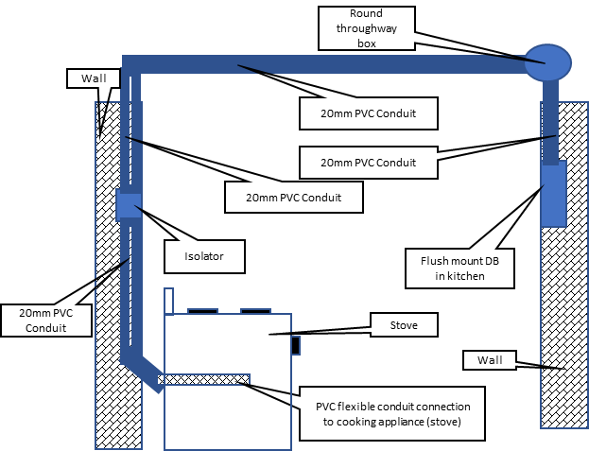
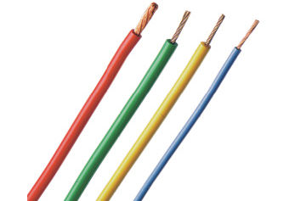
1
2
3
4
5
6
7
8
Step 3- Plan the job
Let’s review what needs to be done as part of proper planning
Draw your plan
Select tools and equipment
Select materials
Select PPE
Notes:
Graphics to represent each block to be recreated.
Link each block to corresponding slide that follows
Draw plan- slide 26
Identify tools – slide 30
Identify materials- slide 33
Select PPE – slide 36
As learner reviews all elements, they need to come back here. Only when all has been viewed, can they proceed to next section- Step 4

Slide 26
Draw your plan
The plan is used by you and your team when you go to a client’s property.
Placeholder-Video 05
Take a look at this video which explains how the plan is created.
Notes:
Note for interactivity:
When user clicks on the video it should appear as full screen. Link to video in appendix

Slide 27
Draw your plan
You are going to now draw your OWN plan for Option 2.
Use the property details, instructions and video for Option 2 to draw your own plan. You can use paper or a computer programme to make your drawing.
Mrs Nkitseng’s property details
Step by step instructions
Video of Option 2
Notes:
Note for interactivity:
When learner clicks on “Property” block they should see Resource 01
When learner clicks on Video – they should see Option 2 Video in Appendix
When learner clicks on Example – they should see example of a plan, but not the actual completed plan
When learner clicks on “Step by step” block they should see the following information:
Mark the wall where you will chase by the stove for the conduit and the 4 x4 isolator box
Chase into concrete or brick using an angle grinder and a chisel to fit 20mm conduit in the marked position for the conduit and isolator box
Connect PVC Conduit with a female connector to the isolator box
Place the conduit in the chased area in the wall and secure conduit with concrete nails with the end protruding into the ceiling space and the other end with a slight offset in conduit allowing the conduit to protrude out of the wall about 400mm above the floor
Get the builder to plaster the conduit into the wall with only the 4 x 4 box flush mount and the offset showing
Allow the plastering to dry before working with conduit
In the ceiling space join the new conduit with the spare conduit from the DB using a through way box and connectors ensure you use PVC glue to prevent the conduits from uncoupling from each other
Draw in conductors into conduit using a fish tape into the conduit with 2,5mm red, black and earth conductors from the DB to the Isolator switch
Connect GP conductors to isolator
Test to ensure safe and isolated at DB1 and Fit a circuit breaker in a DB
Connect supply from earth leakage supply to circuit breaker for the cooking appliance and label board
Connect GP conductors to isolator for the cooking appliance
Connect an appliance using flexible metal conduit of the wall
When the stove is available connect the supply from the isolator to the stove termination points
Conduct relevant tests
When learner clicks on “Video” block they should see Video 02.

Slide 28
Upload your plan
Submit your plan so that it can be saved in your ePortfolio. Upload your plan and click submit.
Submit
Notes:
Note for interactivity:
The word ePortfolio should be linked to information about what an ePortfolio is and how it works, how learner can access it.
There needs to be an upload function for user to upload their plan.

Slide 29
The completed plan
How does your completed plan look? Your plan should resemble something like this.
Notes:
Note for interactivity:
When learner moves mouse/finger over the diagram they should see an image of what this plan may look like in real life. (ie Real garage, walls, conduit in the ground)
(Possibly reuse images from installation here)

Slide 30
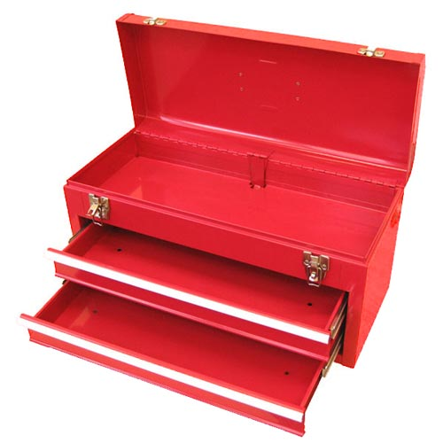
Identify tools and equipment
Which tools do you think are needed to complete this job? Click on each tool to find out more about its purpose. Then, drag and drop your chosen tools into the tool box.
Pencil
Measuring tape
Straight edge
Angle grinder
Masonry drill bit
Spring bender
Screwdriver (star)
Wire stripper
Placeholder for another tool
Insulated screwdriver
Multi grip pliers
Ladder
Placeholder for another tool
Multi meter
Hacksaw
Placeholder for another tool
Insulation resistance tester
Placeholder for another tool
Pliers
Steel rule
Submit
Notes:
Note for interactivity:
Create images to use for each item instead of the text box
This is a drag and drop activity. Learner should be able to drag and drop the each tool to the image of the toolbox.
When they click on the submit button they should be taken to feedback page. – see below
When the learner clicks on each tool, the corresponding info should appear. See example on Slide 32 of suggest layout for each tool.
Correct tools:
Pencil
Measuring tape
Straight edge
Angle grinder
Masonry drill bit
Spring bender
Screwdriver (star)
Wire stripper
Pliers
Multi meter
Insulated screw driver
Hacksaw
Multi grip pliers
Ladder
Insulation resistance tester
Steel rule
Feedback for correct answer:
Well done! You have chosen the correct tools for this job.
Feedback for incorrect answer:
Oops not quite. You are missing some essential tools for this job. Not to worry on the next page we will review the tools needed for this job. (learner should be taken to Slide 29)

Slide 31
Tools for the job
Not too sure which tools were required? Don’t worry, we have listed them here again. Mouse over each one to review their intended use.
Hacksaw
Image of a hacksaw
Short description of what a hacksaw does.
Notes:
Show all picture icons for each of the tools. Student can rollover each one to review the details for each. Details to display in block. Refreshes to display new info pertaining to each tool selected.

Slide 32
Placeholder for tool descriptions
Hacksaw
Image of a hacksaw
Short description of what a hacksaw does.

Slide 33
Materials
In order to complete this job you will need materials such as wires and connectors. Click on each box below to see more information.
Circuit breaker
PVC female adapter
PVC conduit
PVC weld
Socket outlet
2,5mm2 wire (red and black)
2,5mm2 bare copper earth
Earth leakage unit
GP wire
Steel flexible conduit
Steel flexible conduit adapters (x2)
Notes:
Note for interactivity:
When user clicks on each of the blocks, another block with information about each material should appear. See Slide 34 for example.

Slide 34
Placeholder for material descriptions
PVC
Image of PVC cable
Short description of PVC cable and what it is used for.

Slide 35
Personal protective equipment (PPE)
When completing a job you must always make sure that you are protecting yourself and the people who are working with you. One of the ways you do that is by making sure you and your team are wearing the correcting personal protective equipment or PPE.
Placeholder-Video 06 - PPE
Watch this video on PPE to find out why its so important.
Notes:
Note for interactivity:
When learner clicks on video it should play full screen. Refer to Appendix for video

Slide 36
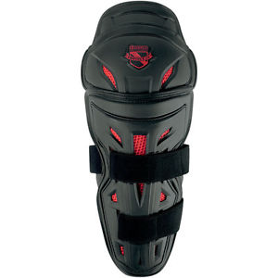
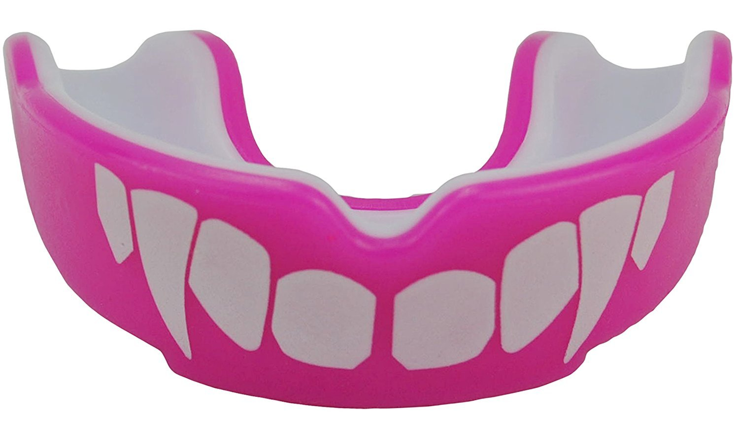
Select the correct PPE
Choose the PPE you think you would need for this job. Drag and drop the items onto the image of the electrician. Click ‘submit’ once you are done.
Tip: Not sure what each item is used for? Click on each to view a description first.
Submit
Placeholder:
Image of an electrician (he should not be wearing any PPE)
Notes:
Note for interactivity:
Drag and drop activity. Electrician does not have any safety equipment/gear on to start. As student drops into correct place, then it displays on him. Need to include some completely incorrect choices up front as well. Icons used here are examples only. Need to create relevant icons in accordance with correct options specified below.
User can click on each item to view more info before dragging and dropping – See slide 37 as example
Correct items to be dropped onto the image are:
Safety glasses
Dust mask
Ear plugs
Working hand gloves
Safety shoes
Safety glasses
When learner clicks on ‘submit’ button they should be taken to feedback page.
Feedback if correct: Well done! You have chosen the correct PPE for completing this job.
Feedback if incorrect: Oops not quite, the correct PPE needed for this job was :
Safety glasses
Dust mask
Ear plugs
Working hand gloves
Safety shoes
Safety glasses

Slide 37
Placeholder for PPE descriptions
Safety glasses
Image of safety glasses
Short description of safety glasses and what it is used for.

Slide 38
1
2
3
4
5
6
7
8
Step 4- Follow rules and regulations
Another name for rule and regulations is codes. As an electrician you need to follow the SANS (South African National Standards) codes. These can be tricky to understand at first.
Watch the video to find out how to read and apply a SANS code correctly.
Placeholder: Video o7 and Vid 08 combined into 1
Notes:
Note for interactivity:
When learner clicks on videos they should appear as full screen.

Slide 39
Multiple choice
Choose the correct answer from the options below.
Add question based on Vid 07 and 08 scripts (Dave Gravett)
Examples of questions:
What is the best way to read the code?
When reading the code you should focus on which part?
What parts are not important?
Do codes get updated? Then what?

Slide 40
SANS Codes
Do we only need to mention SANS codes or the regulations as well?
There are two SANS codes that you need to be aware of when installing the supply for a stove.
Click on each of the codes to read what they say. You will be asked questions about them in the next activity.
SANS 10142
SANS 10142-1
Notes:
Note for content development:
See if there is a step by step process that comes out of Video 07 and 08 and then use that structure here. Ie. Step 1 Scan for information, Step 2 highlight the important part.
Note for interactivity:
When learner clicks on each of the SANS codes they should be taken to the following slides:
SANS 10142- Slide 41
SANS 101980- Slide 43

Slide 41
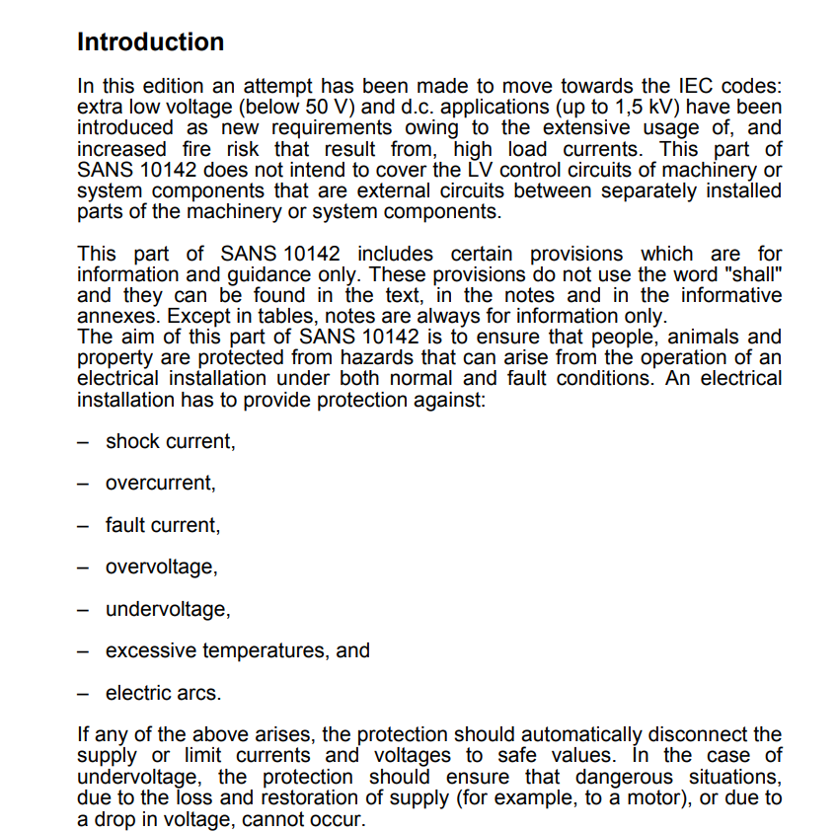
SANS 10142
Read through the document below and then click on the ‘Next’ button to answer some questions about this code.
Scrollable text.
Notes:
NB: Licensing issue. I see that there is a copyright on the SANS codes. Do we need to apply for permission from SABS to use them in our learning materials?
Note for interactivity:
SANS document text should be inserted on this page in a scrollable window so that learner can read the entire document on this screen.

Slide 42
Multiple choice
Insert questions from Dave Gravette here

Slide 43
SANS 10142-1
Read through the document below and then click on the ‘Next’ button to answer some questions about this code.
Scrollable text.
Notes:
NB: Licensing issue. I see that there is a copyright on the SANS codes. Do we need to apply for permission from SABS to use them in our learning materials?
Note for interactivity:
SANS document text should be inserted on this page in a scrollable window so that learner can read the entire document on this screen.

Slide 44
Multiple choice
Insert questions from Dave Gravette here

Slide 45
Step 5- Do a risk assessment
1
2
3
4
5
6
7
8
A risk assessment is a thorough look at your workplace to identify situations or processes that may cause harm, particularly to people.
Watch the video for more information.
Placeholder: Video 9 and Video 10 combined into one video on Risk assessment
Notes:
Reference back to Course 0 but still ask them to do a specific risk assessment activity.

Slide 46
Complete the risk assessment table
Before you begin the actual installation of a power supply to a stove, it’s important to first complete a risk assessment table.
Hint: Here is an example of a completed Risk Assessment Table to help you:
Electrical Installations Skill 18 National Skills Competition Durban ICC 14th to 19th February 2017
Watch the video for more information.
Placeholder: Video - Complete Risk Assessment Table
Tip: Watch carefully, this video will help you in the next activity where you will need to do a risk assessment for installing a supply flor a stove.
You will find the resources you need to assist you with this task in the resource kit.

Slide 47
Complete the risk assessment table
This is an ePortfolio activity. Follow the steps below to complete the activity:
1. Download the Risk Assessment Table
Tip: Click here to view an example of a completed Risk Assessment Table to help you
2. Use the steps provided for installing a power supply to a stove to complete your Risk Assessment Table.
3. Save the completed Risk Assessment document to your computer.
4. Upload your completed Risk Assessment to your e-Portfolio.
Upload to e-Portfolio
Notes:
Note for interactivity:
The word ePortfolio must be hyperlinked to information about ePortfolios
Buttons to link to info
“Risk assessment table should be linked to a BLANK copy of Risk Assessment Table - https://www.dropbox.com/s/629g3jsrgwi1hj7/Electrical%20Installation%20skill%2018%20BASE%20LINE%20RISK%20ASSESSMENT%202017.docx?dl=0
2. STEPS should be linked to the following information:
Mark the wall where you will chase by the stove for the conduit and the 4 x4 isolator box
Chase into concrete or brick using an angle grinder and a chisel to fit 20mm conduit in the marked position for the conduit and isolator box
Connect PVC Conduit with a female connector to the isolator box
Place the conduit in the chased area in the wall and secure conduit with concrete nails with the end protruding into the ceiling space and the other end with a slight offset in conduit allowing the conduit to protrude out of the wall about 400mm above the floor
Get the builder to plaster the conduit into the wall with only the 4 x 4 box flush mount and the offset showing
Allow the plastering to dry before working with conduit
In the ceiling space join the new conduit with the spare conduit from the DB using a through way box and connectors ensure you use PVC glue to prevent the conduits from uncoupling from each other
Draw in conductors into conduit using a fish tape into the conduit with 2,5mm red, black and earth conductors from the DB to the Isolator switch
Connect GP conductors to isolator
Test to ensure safe and isolated at DB1 and Fit a circuit breaker in a DB
Connect supply from earth leakage supply to circuit breaker for the cooking appliance and label board
Connect GP conductors to isolator for the cooking appliance
Connect an appliance using flexible metal conduit of the wall
When the stove is available connect the supply from the isolator to the stove termination points
Conduct relevant tests
Complete Certificate of Compliance (COC)
Hand over to client
4. Example- Should be hyperlinked to the following document:
Electrical Installations Skill 18 National Skills Competition Durban ICC 14th to 19th February 2017
“Upload” box should allow a learner to upload a document to the system.

Slide 48
Step 6- Complete the job
1
2
3
4
5
6
7
8
Well done on getting this far! To complete the job for your client (and correctly provide the supply for Mrs Nkitseng’s stove), you need to now carry out the tasks required.
Watch the videos to see how each task is performed.
Task 1
Task 2
Task 3
Task 4
Task 5
Task 6
Task 7
task 8
Task 9
Task 10
Task 11
Task 12
Task 13
Task 14
Task 15
Notes:
Each block links to the relevant video of task – See appendix
Mark the wall where you will chase by the stove for the conduit and the 4 x4 isolator box
Chase into concrete or brick using an angle grinder and a chisel to fit 20mm conduit in the marked position for the conduit and isolator box
Connect PVC Conduit with a female connector to the isolator box
Place the conduit in the chased area in the wall and secure conduit with concrete nails with the end protruding into the ceiling space and the other end with a slight offset in conduit allowing the conduit to protrude out of the wall about 400mm above the floor
Get the builder to plaster the conduit into the wall with only the 4 x 4 box flush mount and the offset showing
Allow the plastering to dry before working with conduit
In the ceiling space join the new conduit with the spare conduit from the DB using a through way box and connectors ensure you use PVC glue to prevent the conduits from uncoupling from each other
Draw in conductors into conduit using a fish tape into the conduit with 2,5mm red, black and earth conductors from the DB to the Isolator switch
Connect GP conductors to isolator
Test to ensure safe and isolated at DB1 and Fit a circuit breaker in a DB
Connect supply from earth leakage supply to circuit breaker for the cooking appliance and label board
Connect GP conductors to isolator for the cooking appliance
Connect an appliance using flexible metal conduit of the wall
When the stove is available connect the supply from the isolator to the stove termination points
Conduct relevant tests

Slide 49
Step 6- Complete the job
Oh No! These steps for installing the supply for a stove are not in the correct order! Drag and drop them into the correct sequence. Click submit when you are done.
Mark the wall where you will chase by the stove for the conduit and the 4 x4 isolator box
Allow the plastering to dry before working with conduit
Connect GP conductors to isolator
Connect an appliance using flexible metal conduit of the wall
Get the builder to plaster the conduit into the wall with only the 4 x 4 box flush mount and the offset showing
conduit
When the stove is available connect the supply from the isolator to the stove termination points
Submit
Notes:
Note for interactivity;
Recreate boxes for each element so that all 15 steps are shown, have only created a few here as an example.
Users must be able to move the videos into the correct order. Correct order supplied below:
Mark the wall where you will chase by the stove for the conduit and the 4 x4 isolator box
Chase into concrete or brick using an angle grinder and a chisel to fit 20mm conduit in the marked position for the conduit and isolator box
Connect PVC Conduit with a female connector to the isolator box
Place the conduit in the chased area in the wall and secure conduit with concrete nails with the end protruding into the ceiling space and the other end with a slight offset in conduit allowing the conduit to protrude out of the wall about 400mm above the floor
Get the builder to plaster the conduit into the wall with only the 4 x 4 box flush mount and the offset showing
Allow the plastering to dry before working with conduit
In the ceiling space join the new conduit with the spare conduit from the DB using a through way box and connectors ensure you use PVC glue to prevent the conduits from uncoupling from each other
Draw in conductors into conduit using a fish tape into the conduit with 2,5mm red, black and earth conductors from the DB to the Isolator switch
Connect GP conductors to isolator
Test to ensure safe and isolated at DB1 and Fit a circuit breaker in a DB
Connect supply from earth leakage supply to circuit breaker for the cooking appliance and label board
Connect GP conductors to isolator for the cooking appliance
Connect an appliance using flexible metal conduit of the wall
When the stove is available connect the supply from the isolator to the stove termination points
Conduct relevant tests
Feedback:
Feedback if correct: Well done! You have placed all the steps for completing this job in the correct order..
Feedback if incorrect: Oops not quite, the correct order of steps is:
(Show correct order as per above)

Slide 50
Step 7- Check job done correctly
1
2
3
4
5
6
7
8
Once you have completed the job you must check that everything was done correctly.
Click on each block below to see what you should check for this job.
Placeholder image representing relevant text
Placeholder image representing relevant text
Placeholder image representing relevant text
Placeholder image representing relevant text
Placeholder image representing relevant text
Placeholder image representing relevant text
Notes:
Note for design:
There needs to be an image to accompany each one of these blocks. When student clicks on block, it flips over to reveal text below:
The chasing is deep enough for the conduit and 4 x 4 box
No sharp objects in the chase
The 4 x 4 box is square, level and parallel and secured properly
Correct lengths of conductor left in socket outlet and DB
Connections tight at termination points
Circuit labeled cooking appliance on DB 1

Slide 51
Step 7- Check job done correctly
In addition to checking the elements, you must make sure that the No Voltage Tests and Voltage On Tests are completed.
No Voltage Tests
Voltage On Tests
Continuity of the earth conductor
Placeholder: Insulation resistance test
Simulation
Voltage Test
Simulation
Polarity Test
Simulation
Elevated Voltage to Neutral test
Notes:
Note for interactivity:
When learner clicks on simulation it should appear full screen.
(These tests belong in Course 2)
Focus on range of acceptable values what does it indicate when values are out of this range.
No Voltage test
Continuity of the earth conductor
Insulation resistance test
Voltage On Tests
Polarity test
Voltage test
Elevated Voltage to Neutral test

Slide 52
Step 8- Handover to client
1
2
3
4
5
6
7
8
You are almost finished installing the power supply for Mrs Nkitseng’s stove. The final step is to show your client what you have done and provide the Certificate of Compliance (COC).
Placeholder for Video on Handover
Watch the videos to find out about COC’s and to see how a client handover is done.
Placeholder for Video on Handover
How long is a certificate of compliance valid for?
Notes:
Note for interactivity:
Video- see appendix. Video should play full screen when clicked. See appendix – Client handover
Video- see appendix. Video should play full screen when clicked. See appendix – COC Video

Slide 53
Conclusion
Congratulations! You have now worked through the entire scenario for installing a power supply to a stove!
There are 5 more scenarios for you to try, would you like to try one now?
Scenario: Gate Motor Supply
Scenario: Security Light
Scenario: Water Heater Supply
Scenario: 3 Phase socket outlet installation
Scenario: Motor controls centre installation
Notes:
Note for interactivity:
Interactive map allowing learners to go to remaining scenarios. Student should click on each one to be able to go directly there.
“

Slide 54
ICONS REQUIRED
ICON REQUIRED | ICON PURPOSE | Example:
Outcomes | Icon to represent Learning Outcomes
Extra Information | Icon to represent Additional Information
Instruction | Icon/ Or actual person to represent an Instruction (something learner needs to do)
Tip | Icon to represent a hint or tip
Glossary | Icon to represent Glossary Page
Reflection | Icon to represent Reflection
Important point
Notes:
Icons to be re-created and used across all UNITS. These are examples only.

Slide 55
Voice Rec 01: Client brief
Voice of an elderly black female, speaking over a phone with the electrician:
Client: Hi, this is Mrs Nkitseng. I was referred to you by a good friend of mine. I need you to provide power for a new stove I have just installed.
Electrician: Good to speak to you. It is great to have a referral. Can you tell me more? Do you have any time or money constraints?
Client: As I am a elderly lady, I do not have access to a lot of money so you must complete the work as cheaply as possible but it must still be a professional job. You only have three days to finish the job.
Electrician: That should not be a problem, but I will know more once I visit your property. Is there anything else my team should know?
Client: It is fine if your activities damage the walls as I will be re-tiling the kitchen. You can get a supply for electricity from any point in the installation as long as it is compliant.
Electrician: Great – we are committed to following all required regulations and standards.
Client: Good! I cannot be held responsible for any injuries to any of your workers. I am intending to sell my property once I have renovated the kitchen, so I would need you to supply a certificate of compliance once you have finished the job.
Electrician: No problem. We will see you in a few days to conduct the property visit.

Slide 56
Vid 01: Property details
Animated video using a tool like GoAnimate. Black and white hand drawn images with a voice over. Each point should be on a separate slide.
Script for voice over:
When you visited Mrs Nkitseng’s property, here is what you found:
There are two distribution boards or DB’s. The first DB in the main house is flush mounted and the other DB in the garage is surface mounted
The distance to the cooking appliance is 16 meters from the cooking appliance (stove) isolator to the distribution board. There are four slots available in the DB for new circuit breakers and there is an earth leakage in the board
There are six spare conduit pipes from the DB into the roof
There are no visible water points or pipes in the position where the cooking appliance isolator is to be installed
There is a ceiling in the kitchen
There are dogs on the property
There are toilet facilities for staff
Notes:
Video script for placeholder on Slide

Slide 57
Vid 02: Step 2 Option 1
Demonstration video with voice over and text banners appearing as action on the video is completed.
Use 20 mm conduit using GP wire to supply a cooking appliance that will allow the cooking appliance to be connected to an isolator via a metal flexible conduit
Mark the wall where you will chase by the stove for the conduit and the 4 x4 isolator box
Chase into concrete or brick using an angle grinder and a chisel (Module 1) to fit 20mm conduit in the marked position for the conduit and isolator box
Connect PVC Conduit with a female connector (Module 14) to the isolator box
Place the conduit in the chased area in the wall and secure conduit with concrete nails (Module 21)with the end protruding into the ceiling space and the other end with a slight offset in conduit (Module 30) allowing the conduit to protrude out of the wall about 400mm above the floor
Get the builder to plaster the conduit into the wall with only the 4 x 4 box flush mount and the offset showing
Allow the plastering to dry before working with conduit
In the ceiling space join the new conduit with the spare conduit from the DB using a through way box and connectors ensure you use PVC glue to prevent the conduits from uncoupling from each other
Draw in conductors into conduit using a fish tape (Module 18) into the conduit with 2,5mm red, black and earth conductors from the DB to the Isolator switch
Connect GP conductors to isolator (Module 38)
Test to ensure safe and isolated (Module 25) at DB1 and Fit a circuit breaker in a DB (Module 20)
Connect supply from earth leakage supply to circuit breaker (Module 28) for the cooking appliance and label board
Connect GP conductors to isolator (Module 38) for the cooking appliance
Connect an appliance using flexible metal conduit (Module 15) of the wall
When the stove is available connect the supply from the isolator to the stove termination points

Slide 58
Vid 03: Step 2 Option 2
Demonstration video with voice over and text banners appearing as action on the video is completed.
Use 20 mm conduit using GP wire to supply a cooking appliance that will allow the cooking appliance to be connected to an isolator via a PVC flexible conduit
Mark the wall where you will chase by the stove for the conduit and the 4 x4 isolator box
Chase into concrete or brick using an angle grinder and a chisel (Module 1) to fit 20mm conduit in the marked position for the conduit and isolator box
Connect PVC Conduit with a female connector (Module 14) to the isolator box
Place the conduit in the chased area in the wall and secure conduit with concrete nails (Module 21)with the end protruding into the ceiling space and the other end with a slight offset in conduit (Module 30) allowing the conduit to protrude out of the wall about 400mm above the floor
Get the builder to plaster the conduit into the wall with only the 4 x 4 box flush mount and the offset showing
Allow the plastering to dry before working with conduit
In the ceiling space join the new conduit with the spare conduit from the DB using a through way box and connectors ensure you use PVC glue to prevent the conduits from uncoupling from each other
Draw in conductors into conduit using a fish tape (Module 18) into the conduit with 2,5mm red, black and earth conductors from the DB to the Isolator switch
Connect GP conductors to isolator (Module 38)
Test to ensure safe and isolated (Module 25) at DB1 and Fit a circuit breaker in a DB (Module 20)
Connect supply from earth leakage supply to circuit breaker (Module 28) for the cooking appliance and label board
Connect GP conductors to isolator (Module 38) for the cooking appliance
Connecting a appliance isolator using flexible PVC conduit (Module 27) and use PVC glue to ensure the conduit stays in place
When the stove is available connect the supply from the isolator to the stove termination points
Notes:
Video script for placeholder on Slide 3.

Slide 59
Vid 04: Step 2 Option 3
Demonstration video with voice over and text banners appearing as action on the video is completed.
Use a 2.5 mm² 3 core flat twin and earth cable to supply a cooking appliance directly
Mark the wall where you will chase by the stove for the conduit and the 4 x4 isolator box
Chase wall to fit 20mm conduit in the marked position for the conduit and isolator box
Place the 2.5 mm² 3 core flat twin and earth cable into the concrete this type of cable cannot be installed directly in the concrete see regulation
Connect flat twin and earth and prepare urmoured cable for gland to the isolator box
Place the flat twin and earth in the chased area in the wall and secure flat twin and earth with concrete nails with the end Get the builder to plaster the flat twin and earth into the wall with only the 4 x 4 box flush mount and insert a conduit for final connection with the offset showing out
Allow the plastering to dry before working with conduit
In the ceiling space insert the flat twin and earth with the spare conduit from the DB using a through way box and connectors ensure you use PVC glue to prevent the conduits from uncoupling from each other
Draw in conductors into conduit using a fish tape (Module 18) into the conduit with 2,5mm red, black and earth conductors from the DB to the Isolator switch
Connect GP conductors to isolator (Module 38)
Test to ensure safe and isolated (Module 25) at DB1 and Fit a circuit breaker in a DB (Module 20)
Connect supply from earth leakage supply to circuit breaker (Module 28) for the cooking appliance and label board
Connect GP conductors to isolator (Module 38) for the cooking appliance
Connecting a appliance isolator using flexible PVC conduit (Module 27) and use PVC glue to ensure the conduit stays in place
When the stove is available connect the supply from the isolator to the stove termination points
Notes:
Video script for placeholder on Slide 3.

Slide 60
Vid 05: How to draw a plan
Demonstration video with electrician talking to the learner about how to do the plan, interspersed with screenshots of him doing the plan.
This link can be used as a basis: https://www.bhg.com/home-improvement/electrical/how-to-draw-electrical-plans/
Notes:
Video script for placeholder on Slide 3.

Slide 61
Vid 6: Personal protective equipment
An animated video discussing the following:
What is PPE
Why do we wear it?
What are the most common PPE for electricians?
Where can you find/buy PPE? (Is it your responsibility or that of your employer?
Notes:
Video script for placeholder on Slide 3.

Slide 62
Vid 07: Overview of the SANS codes and how they work
Animated video using a tool like GoAnimate. Black and white hand drawn images with a voice over.
SANS, refers to a standard that specifies the performance requirements of a specific product. A SANS standard may be either locally written or created by adopting an international (usually ISO) standard.
What does a SANS code look like?
Why do we have them?
Where can we access them?
What happens when the code changes? Does this happen often?

Slide 63
Vid 08: Overview of the SANS codes and how they work
Demonstration video. Take an example of a SANS code (ie SANS 10142). Video should alternate between showing the facilitator talking and screenshots of the SANS code as demonstrator highlights various aspects of it.
Information that should be covered in this video:
How do we read a SANS code? (Highlight important info in the document for learner)
How to we apply the SANS code?
Notes:
Video script for placeholder on Slide 3.

Slide 64
Vid 9:Risk Assessment
An animated video discussing the following:
A risk assessment is a term used to describe the overall process or method where you:
Identify hazards and risk factors that have the potential to cause harm (hazard identification).
Analyse and evaluate the risk associated with that hazard (risk analysis, and risk evaluation).
Determine appropriate ways to eliminate the hazard, or control the risk when the hazard cannot be eliminated (risk control).
A risk assessment is a thorough look at your workplace to identify those things, situations, processes, etc. that may cause harm, particularly to people. After identification is made, you analyse and evaluate how likely and severe the risk is. When this determination is made, you can next, decide what measures should be in place to effectively eliminate or control the harm from happening.

Slide 65
Vid 10: 5 Steps of doing a Risk Assessment
An animated video discussing the following:
ACTIVITY
HAZARD
DANGER
RISK (without preventative measures)
PREVENTIVE MEASURE
Must mention the difference between a hazard and a danger.

Slide 66
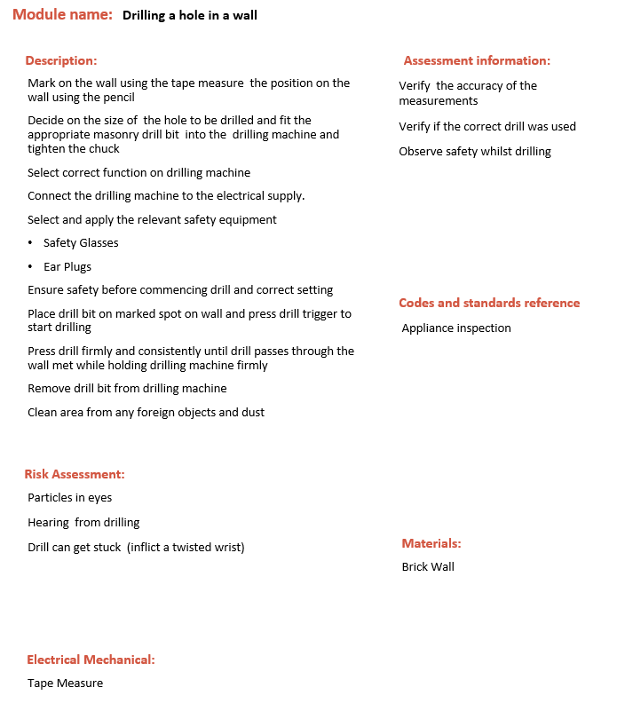
Vid 11: Complete the task
Demonstration Video showing:
Drill a hole in a wall (Module 19)

Slide 67
Video : Client Handover
Demonstration Video showing the electrician interacting with the client:
Conduct walk about with client showing:
the route of the wire way of installation
Indicate the positioning of the breaker and where it is installed.
Provide the client with the certificate of compliance (COC) as per legislation explaining its purpose as well clients responsibility in terms of maintain the electrical installation

Slide 68
Video : COC
Discussion with qualified electrician discussing the following:
What is a COC?
Who can issue a COC?
What does a COC look like?
How long is a COC valid for?

Slide 69
Resource 01: Client brief and property details
Client Brief:
The project must be in compliance with all regulations and standards
You must give Mrs Nkitseng a certificate of compliance when the job is complete
All health and safety must be complied to at all times
Activities may damage the walls as Mrs Nkitseng is refurbishing the kitchen and will be re-tiling
You can get the supply from any point in the installation as long as it is compliant
You must finish all your work in 3 days
Finances are limited and you need to do the project as cheaply as possible
Placeholder for visual representation/diagram of property details
Property details:
There are two distribution boards or DB’s. The first DB in the main house is flush mounted and the other DB in the garage is surface mounted
The distance to the cooking appliance is 16 meters from the cooking appliance (stove) isolator to the distribution board. There are four slots available in the DB for new circuit breakers and there is an earth leakage in the board
There are six spare conduit pipes from the DB into the roof
There are no visible water points or pipes in the position where the cooking appliance isolator is to be installed
There is a ceiling in the kitchen
There are dogs on the property
There are toilet facilities for staff
Notes:
Notes:
Recreate and format downloadable sheet into visually appealing format with suitable imagery and graphics
If possible, create schematic diagram which shows layout of property

