Slide 1
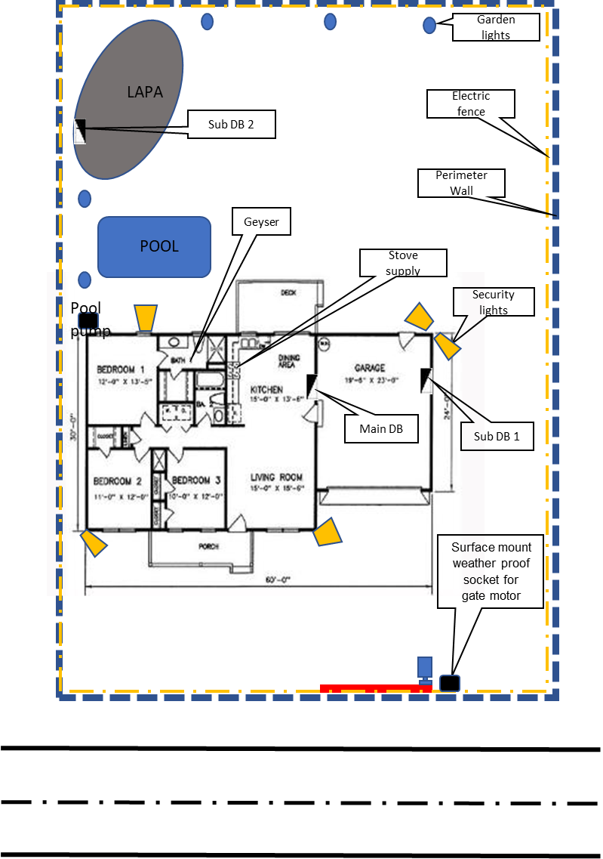
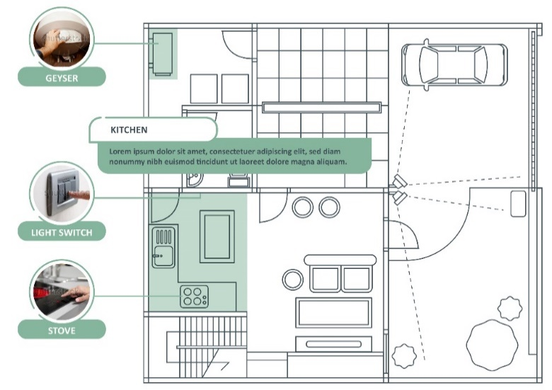
Notes:
Note for design:
This diagram needs to be redrawn and styled similarly to the example provided.
Note for interactivity:
This should be an interactive map where users are able to click on each of the scenarios on the diagram and be taken to the information for that scenario.

Slide 2
Wireways
Topic 1- Gate Motor Supply Scenario
All copyright and intellectual property rights in respect of materials developed by the service provider during this project will vest in the Department of Higher Education and Training, which will have the right to allow any individual, company, agency or organisation to use or modify the materials for any purpose approved by this Department, including selling the materials or releasing them as Open Educational Resources (OER) under an appropriate copyright license.
Notes:
Notes for Nick Du Plessis:
How much time would be estimated to complete the job for Option 3? (Slide 25)
What are the steps for drawing/making a plan?

Slide 3
Assumed prior learning
Fundamentals of electricity
Safety, health environment, risk and the quality principles in the workplace
Hand tools and power tools use and applicable safety requirements
Measuring and testing methodologies (electrical and mechanical)
Have completed the introduction to the world of work and the electrical trade
Notes:
Note for navigation on site:
This information needs to be taken into account and needs to stated on the LMS, perhaps as part of the introduction?

Slide 4
Disclaimer- Key points about working under supervision
No person may authorize, design, install or permit or require the installation of an electrical installation, other than in accordance with a health and safety standard incorporated into these Regulations under section 44 of the Act. (Electrical installation regulations section 5)
No person may do electrical installation work as an electrical contractor unless that person has been registered as an electrical contractor in terms of these Regulations (Electrical installation regulations section 6)
It must be noted that in terms of Occupational Health & Safety Act all electrical construction work must be conducted under the general control of the registered person, and in terms of this criteria you will not be allowed to work in the distribution board. You will be permitted under the general control of this registered person to do the following work. (Electrical installation regulations section 5)
The registered person will be responsible for issuing the certificate of compliance for this addition to the electrical installation, after he has inspected and tested the electrical installation. (Electrical installation regulations section 9)
During this exercise we will be providing 3 options to provide supply to a gate motor, we are aware that there are many more options and these will be influenced by finance, time, environment and skill.
It must be noted that any other installation must comply to the regulations, standards and manufactures specifications.
I have read the disclaimer and I understand that while I will be shown how to install a gate motor supply, I MAY NOT do this myself unless am I registered electrician, with a certificate or if I am under the supervision of a registered person.
Notes:
Note for navigation on site:
This information needs to stated on the LMS, there should be a tick box so that learner can acknowledge that they have read and understood the information.

Slide 5
Scenario Outcomes
By working through this scenario on how to install a gate motor supply you will be able to do the following:
Understand how to plan a task based on a client brief
Know the regulations for installing a gate motor supply
Choose the correct tools needed to install a gate motor supply
Conduct a risk assessment
Prepare a worksite
Understand how to install equipment and materials according to standards and codes as well as manufacture’s requirements
Conduct required tests for an alteration of and electrical supply
Interact and provide feedback to a client
Notes:
Note for design:
This list of text should be broken up to make it more interesting. Text should be presented in a menu type of format.
Note for interactivity:
Information should be presented in a clickable menu so that learner can click on each outcome instead of it being one long list.

Slide 6
Gate Motor Supply
Notes:
Note for development:
There are 8 steps for each of the 6 scenarios in Course 4. The scenario will be built out as once piece. This storyboard covers:
Step 1- Client Brief

Slide 7
Glossary
There needs to be a glossary with all the electrical terms, techniques, tools equipment. When learner clicks on the word they should be able to see a definition an image/video for each item.
Add words and terms here
Notes:
Notes for interactivity/development:
There needs to be a glossary with all the electrical terms, techniques, tools equipment. When learner clicks on the word they should be able to see a definition an image/video for each item.

Slide 8
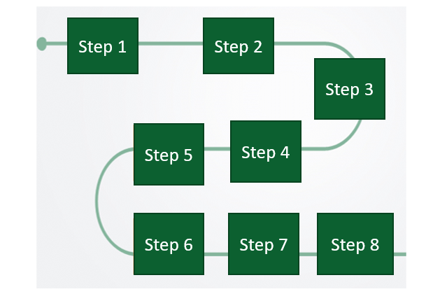
Introduction
In this scenario, you will work through eight key steps.
Move over each step to read what they are. And then click on the next button to get started.
Notes:
Note for development:
There are 8 steps for each of the 6 scenarios in Course 4. The scenario will be built out as once piece.
Please create suitable graphic to use throughout all scenarios
Popup text for step 1:
Step 1: Your client or supervisor gives you a brief
Step 2: You need to identify the best solution for doing the job
Step 3: Plan and design an approach for doing the job
Step 4: Follow the rules and regulations
Step 5: Do a Risk Assessment
Step 6: Complete the job
Step 7: Check if the job was done correctly
Step 8: Do the client handover

Slide 9
Step 1- Client brief
Step 1
Step 2
Step 3
Step 4
Step 5
Step 6
Step 7
Step 8
Placeholder for image of Mr Mabuzo
Mr Mabuzo is your client. He has recently put in a new security gate at his house and he wants to you install a gate motor so that the gate can open and close using a remote.
Click on the phone to hear the client brief. Listen carefully you will need this information for the next activity.
Click here
Notes:
Note for interactivity:
The text “Click on the phone to hear Mr Mabuzo’s brief to you” should fade in once learner clicks on this slide.
When learner clicks on the image of the cell phone Voice Rec 01: Client brief should play.
Hint box should fade in/float in approx. 7 seconds into the slide
Note for design:
Need an image of Mr Mabuzo (black male, middle age, professional, the same person should be used throughout this entire scenario as Mr Mabuzo.
If possible Steps should be shown on each page with the steps.

Slide 10
Client brief
Did you listen carefully to what your client said?
You will be given a list of details from the conversation. Choose all the correct details from this list and click SUBMIT when you are finished.
Go to list of details
Notes:
Note for interactivity:
Button “ Go to list for details” should be hyperlinked to questions on Slide 10.

Slide 11
Client brief
You must follow all regulations and standards
Mr Mabuzo doesn’t need a certificate of compliance
All health and safety must be complied to at all times
Activities must not damage the walls and must not look unsightly
You can dig in the garden but you must put the lawn and garden back to its original state as best as possible
You can get the supply from any point in the installation as long as it is compliant
You must finish all your work in 4 days
Finances are limited and you need to do the project as cheaply as possible
Notes:
Note for interactivity:
This is a multiple choice question, with multiple answers correct. Correct answers are in italics.
If answer is incorrect, user should be taken to Slide 13.
If answer is correct, user should be taken to Slide 12.
Feedback for correct answer.
Well done! You are ready to move onto the next step.
Feedback for incorrect answer.
Oops you didn’t get all the correct details. Make sure you listen carefully to what your client has to say.

Slide 12
Client brief
Let’s review the details that Mr Mabuzo gave you over the phone.
Click on each of the blocks to find out more. You will need this information for the rest of the steps in this scenario.
Detail 1
Detail 2
Detail 3
Detail 4
Detail 5
Detail 6
Detail 7
Detail 8
Notes:
Note for interactivity:
These details can be revealed one by one or user can click on each one in order to reveal them.
Note for design:
Design/template can be created to make this layout more interesting.
Content for blocks:
Block 1: The project must follow all regulations and standards
Block 2: You must give Mr Mabuzo a certificate of compliance once you have finished the job.
Block 3: You must make sure that you and your team follow the health and safety standards at all times
Block 4: Activities must not damage the walls and must not look unsightly (bad)
Block 5: You are allowed to dig in the garden but you must put the lawn and garden back to its original state as best as possible
Block 6: You can get the supply from any point in the installation as long as it is compliant
Block 7: You must finish all your work in 2 days
Block 8: Finances are limited and you need to do the project as cheaply as possible

Slide 13
Mr Mabuzo’s property
Now that you know what the client wants, you need to know more specific details about his property. This will help you with your planning.
Placeholder for Vid01: Property Details
Watch this video to learn more information about Mr Mabuzo’s property.
Notes:
Note for interactivity:
When learner clicks on video it should appear as full screen.

Slide 14
Summary of property details
Not sure you can remember all the property details?
Click on the button to download Mr Mabuzo’s property details. Keep this list handy for Step 2 coming up next.
Mr Mabuzo’s property details
Notes:
Notes for interactivity:
When user click on the box the following information should appear.
There are dogs on the property
There are toilet facilities for staff
The ground is a rich dark brown which indicates that digging will be relatively easy
There is paving from the garage to the gate
There are flowerbeds along the driveway
The boundary wall is single brick and painted grey
The distance from the garage to the boundary wall is 5 meters
There is grass between the garage and the boundary wall to the gate
No visible water points or pipes between garage and boundary wall
There is no ceiling in the garage
There are 2 distribution boards or DB’s 1 in the main house.
The first DB, let’s call it DB 1 is flush mounted. This means that has been installed inside of the wall. (show image flush mount)
The distance to the gate is 29 meters from the gate to the DB1 and there are 4 slots available in the DB for new circuit breakers and there is an earth leakage in board
The second DB, let’s call it DB2, is in the garage and surface mounted. This means that it has been installed on the wall (show image of surface mount)
The distance to the gate is 22 meters from the gate to the DB2 and there are 9 slots available in the DB for new circuit breakers and there is an earth leakage in board
Resource 01 should be linked to the sentence that says “Client and property details”. Users should be able to download this resource and save it on their computers/phones.

Slide 15
Step 2- Choose the best option
Step 1
Step 2
Step 3
Step 4
Step 5
Step 6
Step 7
Step 8
It’s time to decide how you are going to install the gate motor supply for Mr Mabuzo.
You have three options to choose from. You will need to decide which option is the best one for this job.
Click here to see options
Notes:
Note of interactivity:
When learner clicks on “Click here” they should be taken to Slide 16.

Slide 16
Overview of options
Click on each of the options to see an overview. Once you’ve reviewed all three options, click on the ‘share your thoughts’ to move on.
Option 1
Option 2
Option 3
Hint: Keep in mind the information from Mr Mabuzo and also the details about his property.
Share your thoughts
Notes:
Note for interactivity:
When learner clicks on Option 1 they should betaken to Slide 17
When learner clicks on Option 2 they should betaken to Slide 18
When learner clicks on Option 3 they should betaken to Slide 19
When learner clicks on the ‘share your thoughts” button they should be taken to Slide 20

Slide 17
Option 1
Placeholder for Video 02- Highlights reel
Go back to options menu
Notes:
Note for interactivity:
When learner clicks on “Go back to options” button it should take them back to the Options on Slide 16.

Slide 18
Option 2
Placeholder for Video 03
Go back to options menu
Go back to options menu
Notes:
Note for interactivity:
When learner clicks on “Go back to options” button it should take them back to the Options on Slide 16.

Slide 19
Option 3
Placeholder for Video 04
Go back to options menu
Go back to options menu
Notes:
Note for interactivity:
When learner clicks on “Go back to options” button it should take them back to the Options on Slide 16.

Slide 20
Share your thoughts
So far, which option do you think might be the best one for installing a gate motor supply at Mr Mabuzo’s house?
Option 1
Option 2
Option 3
Complete the question and click on the submit button.
Submit
Notes:
Note for interactivity:
Multiple choice question, there is no correct answer this is simply to get the learner thinking.
When learner clicks on submit button they should be taken to Slide 21.

Slide 21
Share your thoughts
Complete the question and click on the submit button.
Can you give some reasons for your answer?
Submit
Notes:
Note for interactivity:
Text box, learner should be able to type in a response. There is no correct answer, this question is to get the learner thinking.
When learner clicks on the Submit button they should be taken to Slide 22

Slide 22
Additional details for options
Thanks for your responses. Now, what tools, materials, labour, time and regulations are needed for each of the options?
Click on each block to find out more. When you are finished click on the “Remove option” button
Option 1
Option 2
Option 3
Remove option
Notes:
Note for interactivity:
When learner clicks on “Remove” button take them to Slide 26
When learner clicks on each of the options blocks they should be taken to the following slides:
Option 1- Slide 23
Option 2- Slide 24
Option 3- Slide 25

Slide 23
Option 1 details
Placeholder for image showing Option 1:Use 20 mm conduit using GP wire to supply a weatherproof socket outlet that will allow the gate motor to be plugged into.
Use 20 mm conduit using GP wire to supply a weatherproof socket outlet that will allow the gate motor to be plugged into.
Click on each block to find out more information.
Tools and equipment
Materials
Cost
Regulations
Time
Labour
Environmental implications
Risk implications
Back to options menu
Notes:
Note for interactivity:
When learner clicks on ‘Back to options” they should be taken to Slide 22.
When learner clicks on each of the boxes, information for that box should be revealed.
See details below:
Tools and equipment
No special tools are required for installation or trenching. We will be using a ladder during the installations.
Materials
Most of the materials are easily acquired form an electrical wholesaler.
Time
Esimated time is 6 hours
Labour
3 persons will be allocated for this task (2 will trench and 1 will do the electrical activities )
Cost
This is the cheapest option
Environmental implications
We would need to trench in the garden and care would need to be taken not the damage plants
We must be aware of possible water pipes when trenching
Regulations
Volt drop over the cable is 5,47 Volts (calculated) allowing for 16 Amps at the socket outlet
Risk Implications
The dogs will have to be put away in order to allow for the installation

Slide 24
Option 2 details
Placeholder for image showing Option 2:Use a 2.5 mm² 3 core SWA cable to supply a weatherproof socket outlet that will allow the gate motor to be plugged into
Use a 2.5 mm² 3 core SWA cable to supply a weatherproof socket outlet that will allow the gate motor to be plugged into.
Click on each block to find out more information.
Tools and equipment
Materials
Cost
Regulations
Time
Labour
Environmental implications
Risk implications
Back to options menu
Notes:
Note for interactivity:
When learner clicks on ‘Back to options” they should be taken to Slide 22.
When learner clicks on each of the boxes, information for that box should be revealed. See details below:
Tools and equipment
No special tools are required for installation or trenching. We will be using a ladder during the installations.
Materials
All components that can be used are easily found at the local electrical wholesaler
Time
Esimated time is 5 hours
Labour
3 persons will be allocated for this task (2 will trench and 1 will do the electrical activities )
Cost
The cable is more expensive but will save time on labour seeing that it could be time consuming to pull the conductors into the conduit
Environmental implications
We would need to trench in the garden and care would need to be taken not the damage plants
We must be aware of possible water pipes when trenching
Regulations
Volt drop over the cable is 5,47 Volts (calculated) allowing for 16 Amps at the socket outlet
Risk Implications
The dogs will have to be put away in order to allow for the installation

Slide 25
Option 3 details
Placeholder for image showing Option3: Use a 2.5 mm² 3 core flat twin and earth cable to supply a weatherproof socket outlet that will allow the gate motor to be plugged into
Use a 2.5 mm² 3 core flat twin and earth cable to supply a weatherproof socket outlet allowing the gate motor to be plugged into
Click on each block to find out more information.
Tools and equipment
Materials
Cost
Regulations
Time
Labour
Environmental implications
Risk implications
Back to options menu
Notes:
Use a 2.5 mm² 3 core flat twin and earth cable to supply a weatherproof socket outlet that will allow the gate motor to be plugged into
Note for interactivity:
When learner clicks on ‘Back to options” they should be taken to Slide 22.
When learner clicks on each of the boxes, information for that box should be revealed. See details below:
Tools and equipment
No special tools are required. Just need to verify that a drilling machine and the correct size drill bit is available.
Make sure that a shovel and pick is available for use.
Materials
This type of cable is not designed for use in ground.
Time
Esimated time is 5 hours
Labour
3 persons will be allocated for this task (2 will trench and 1 will do the electrical activities )
Cost
This is the cheapest method but the manufacturer specifications for this type of cable does not recommend using it for burying it in the ground.
Environmental implications
Cable cannot be exposed to direct sun
Cable cannot be placed in the ground
Regulations
This type of cable cannot be placed directly in the ground
Risk Implications
This type of cable was not designed for burying in the ground

Slide 26
Remove an option
Click on the submit button once you have selected your answer.
Now that you know more about each option, which option do you think would be the worst one for this job?
Option 1
Option 2
Option 3
Submit
Notes:
Note for interactivity:
Multiple choice. If the learner chooses Option 1 or 2 which are the incorrect options they should be given the option to try again (Feedback1) . Once they have had another opportunity they should get feedback 2.
Feedback 1
Feedback if learner chooses Option 1: Do you really want to get rid of this option? Try again. (take learner back to this slide)
Feedback if learner chooses Option 2: Do you really want to get rid of this option? Try again. ((take learner back to this slide)
Feedback if learner chooses Option 3: Well done you are correct. Option 3 is the worst option for this job because a 2.5 mm² 3 core flat twin and earth cable cannot be used in the ground, which means that it doesn’t follow the regulations. (Take learner to Slide 27)
Feedback 2
Feedback if learner chooses Option 1: Oops, still not right. Option 3 is the worst option for this job because a 2.5 mm² 3 core flat twin and earth cable cannot be used in the ground, which means that it doesn’t follow the regulations. (Take learner to Slide 27)
Feedback if learner chooses Option 2: Oops, still not right. Option 3 is the worst option for this job because a 2.5 mm² 3 core flat twin and earth cable cannot be used in the ground, which means that it doesn’t follow the regulations. (Take learner to Slide 27)

Slide 27
Final 2 options
Option 3 is the worst option because the SANS code 10142 says that this type of cable can’t be used in the ground. You must choose between Option 1 and 2. Which is the best one for doing this job?
Click on the boxes for more information.
Option 1
Advantages
Option 1
Disadvantages
Option 2
Advantages
Option 2
Disadvantages
I want to see the property details again
Notes:
Note for interactivity:
“I want to see” button should be linked to Resource 01.
When user the clicks on each of the boxes another layer with more information should appear:
Option 1 Advantages
This appears to be the cheapest and most cost effective method to get the supply from the DB 2 to the new weatherproof socket outlet at the gate
Option 1 Disadvantages
Should there be any foreign objects like rocks the installation could be implicated and it could take a lot longer
The sun could affect the PVC conduit over time even though it is UV protected
The PVC conduit provides some mechanical protection for the conductors but could be damaged by the weed eater or if something knocks up against it with force
This method will take a little longer than installing an armored cable
The PVC conduit could look unsightly but could be painted by owner to merge into surroundings
Option 2 Advantages
Armored cable is faster to install and a very effective method to get the supply from the DB 2 to the new weatherproof socket outlet at the gate
With this cable you have mechanical protection down the wall, as well as in the ground
It is more flexible to work with
Option 2Disadvantages
Costs for armored cable is more expensive
The PVC conduit provides some mechanical protection for the conductors but could be damaged by the weed eater or if something knocks up against it with force
The PVC conduit could look unsightly but could be painted by owner to merge into surroundings

Slide 28
Choose the best option
What is the best option for completing this job?
Click on the option you think is the best one.
Option 1
Option 2
Notes:
Note for interactivity:
When learner clicks on Option 1 they should be taken to Slide 29
When learner clicks on Option 2 they should be taken to Slide 30

Slide 29
Option 1
Well done! You chose the best option.
Why did you choose this option as the best one?
It was the cheapest
It was the quickest way to do the job
The cables were the best quality so will last longer.
Choose your answer and click submit.
Submit
Notes:
Note for interactivity:
When users click on submit button they should be taken to the feedback. Once learner has heard feedback they should be taken to Slide 31
Multiple choice
Feedback if learner selects answer 1: (Voiceover 01 should play) Well done! You are correct in saying that this option was the cheapest way to do the job. This is important because Mr Mabuzo wanted you to a quality job but it needed to be done as cheaply as possible.
Feedback if learner selects answer 2 : (Voiceover 02 should play) While you are correct about Option 1 being the best option, it’s not because it’s the quickest. Option 2 would have taken 5 hours to do while Option 1 would have taken an hour longer. The reason Option 1 is the best one is because Mr Mabuzo wanted you to a quality job but it needed to be done as cheaply as possible.
Feedback if learner selects answer 3. (Voiceover 03 should play) While you are correct about Option 1 being the best option its not because of the high quality of cables being used. The cable used in Option 1 is of a lower quality than Option 2 but still good enough for this job. Using more expensive cables would have gone against Mr Mabuzo’s request that the job be done as cheaply as possible.

Slide 30
Option 2
Why did you choose this option as being the best one?
It was the cheapest
It was the quickest way to do the job
The cables were the best quality so will last longer.
Choose your answer and click submit.
Submit
Notes:
Note for interactivity:
When users click on submit button they should be taken to the feedback. Once learner has heard feedback they should be taken to Slide 31
Multiple choice where learner can select 2 answers.
Feedback if learner selects answer 1. (Voiceover 04 should play) While Option 2 is a good choice, it’s not the cheapest or most cost effective Option as the cables used for this Option were more expensive that the cables used in Option 1. Since Mr Mabuzo wanted you to a quality job but it needed to be done as cheaply as possible Option 1 is the best choice.
Feedback if learner selects answer 2. (Voiceover 05 should play) While you are correct in saying that Option 2 is the quickest way of doing the job, Option1 is actually the best option because Mr Mabuzo wanted you to a quality job but it needed to be done as cheaply as possible. The cables used for Option 1 were still of a high enough quality for this job.
Feedback if learner selects answer 3. (Voiceover 06 should play) You are right in saying that the armoured cables used in this option will last longer. However the cables in Option 1 were still good enough for this job and they were much cheaper. Using the more expensive cables would have gone against Mr Mabuzo’s request that the job be done as cheaply as possible. That’s why Option 1 is the best option for this job.

Slide 31
Step 3- Plan the task
Step 1
Step 2
Step 3
Step 4
Step 5
Step 6
Step 7
Step 8
The next step is to plan how to do the job. How do you even begin to do this?
Vid 05
Watch this video for advice from an expert electrician on how to plan for a job.
Notes:
Note for interactivity:

Slide 32
Step 3- Plan the task
Step 1
Step 2
Step 3
Step 4
Step 5
Step 6
Step 7
Step 8
Now that you have some tips on how to plan. The first thing you need to do is make a drawing of what your installation will look like. As it’s the best and most cost effective option, Option 1 will be used for the rest of this scenario.
Vid 06- How to draw an installation plan
Not sure how to draw a plan? Watch this video for some tips.
Notes:
Notes for interactivity:

Slide 33
Step 3- Plan the task
Step 1
Step 2
Step 3
Step 4
Step 5
Step 6
Step 7
Step 8
Use the property details, the instructions and video for Option 1 to draw your own plan. You can use paper or computer programme to make your drawing. Click on the “upload” button to upload your plan.
Mr Mabuzo’s property details
Step by step instructions
Video of Option 1
See an example of a plan
Notes:
Note for interactivity:
When mouse scrolls over the word “Option 1” the following wording should appear:
Use 20 mm conduit using GP wire to supply a weatherproof socket outlet that will allow the gate motor to be plugged into.
When learner clicks on “Property” block they should see Resource 01 and Video 01
When learner clicks on “Step” block they should see the following information:
Drill a hole in a wall
Fit conduit through the new hole drilled in the wall
Install PVC multicore cable onto concrete or brick wall down the outside of the garage wall
Trench from the garage down through the garden to the gate to where we plan to install the socket outlet and install multicore cable underground or in a trench
Measure, mark and mount a flush mount enclosure that is weather-proof for a socket outlet on the boundary wall
We will draw in conductors into conduit using a fish tape
Connect GP conductors to socket outlet Switch off supply to DB2 and test to ensure safe and isolated to work
Install PVC conduit from one available space in the DB1 1 at the bottom
Fit a circuit breaker in a DB and connect supply from earth leakage supply to circuit breaker Connect new gate socket outlet supply conductors in BD
Conduct relevant tests
When learner clicks on “Video” block they should see Video 02.
When learner clicks on “See an example of a plan” they should see an example of a plan used by electricians. (Resource 01)

Slide 34
Upload your plan
Submit your plan so that it can be saved in your ePortfolio. Upload your plan and click submit.
Submit
Notes:
Note for interactivity:
The word ePortfolio should be linked to information about what an ePortfolio is and how it works, how learner can access it.
There needs to be an upload function for user to upload their plan.
Once they click on submit they should be taken to Slide 33.

Slide 35
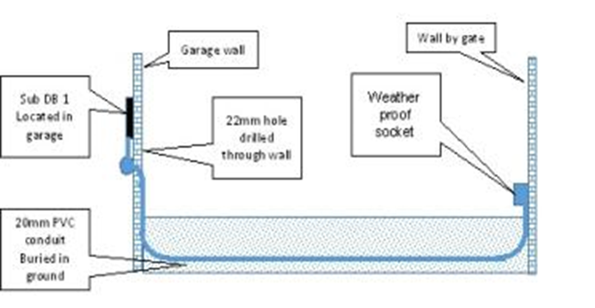
Example of the plan
This is an example of what your plan should have looked like. Did your plan come close to this?
Notes:
Note for interactivity:

Slide 36
What will you need to do the job?
How do you even begin to think about all the things you will need to do the job?
Watch this video for advice from an experienced electrician on how you can plan for the job.
Placeholder video 05:
Notes:
Note for interactivity;
When learner clicks on video it should play as full screen.

Slide 37
Tools, materials, equipment and PPE
It’s easier to think of everything you will need for a job if you step through it task by task.
Click on each task to see a video. On a piece of paper, take note of the tools, materials equipment you will need for each task.
Task 1
Task 2
Task 3
Task 4
Task 5
Task 11
Task 6
Task 7
Task 8
Task 9
Task 10
Go to ePortfolio Activity
Notes:
Note for interactivity;
When learner clicks on “Go to ePortfolio” they should be taken to Slide 49.
When learner clicks on each of the activities they should be taken to the following slides:
Task 1: Slide 36
Task 2: Slide 37
Task 3: Slide 38
Task 4: Slide 39
Task 5: Slide 40
Task 6: Slide 41
Task 7: Slide 42
Task 8: Slide 43
Task 9: Slide 44
Task 10: Slide 45
Task 11: Slide 46

Slide 38
Task 1
Drill a hole in a wall
Placeholder Video 18
Task 1
Back to Task Menu
Notes:
Note for interactivity:
When learner clicks on “Back to Task Menu” they should be taken to Slide 37

Slide 39
Task 2
Fit conduit through the new hole drilled in the wall
Placeholder Video 19
Task 2
Back to Task Menu
Notes:
Note for interactivity:
When learner clicks on “Back to Task Menu” they should be taken to Slide 37

Slide 40
Task 3
Install PVC multicore cable onto concrete or brick wall down the outside of the garage wall.
Placeholder Video 20
Task 3
Back to Task Menu
Notes:
Note for interactivity:
When learner clicks on “Back to Task Menu” they should be taken to Slide 37

Slide 41
Task 4
Fit conduit through the new hole drilled in the wall.
Placeholder Video 21
Task 4
Back to Task Menu
Notes:
Note for interactivity:
When learner clicks on “Back to Task Menu” they should be taken to Slide 37

Slide 42
Task 5
Measure, mark and mount a flush mount enclosure that is weather-proof for a socket outlet on the boundary wall.
Placeholder Video 22
Task 5
Back to Task Menu
Notes:
Note for interactivity:
When learner clicks on “Back to Task Menu” they should be taken to Slide 37

Slide 43
Task 6
Draw in conductors into conduit using a fish tape.
Placeholder Video 23
Task 6
Back to Task Menu
Notes:
Note for interactivity:
When learner clicks on “Back to Task Menu” they should be taken to Slide 37

Slide 44
Task 7
Connect GP conductors to socket outlet.
Placeholder Video 24
Task 7
Back to Task Menu
Notes:
Note for interactivity:
When learner clicks on “Back to Task Menu” they should be taken to Slide 37

Slide 45
Task 8
Switch off supply to DB2 and test to ensure safe and isolated to work.
Placeholder Video 25
Task 8
Back to Task Menu
Notes:
Note for interactivity:
When learner clicks on “Back to Task Menu” they should be taken to Slide 37

Slide 46
Task 9
Install PVC conduit from one available space in the DB1 1 at the bottom.
Placeholder Video 26
Task 9
Back to Task Menu
Notes:
Note for interactivity:
When learner clicks on “Back to Task Menu” they should be taken to Slide 37

Slide 47
Task 10
Fit a circuit breaker in a DB and connect supply from earth leakage supply to circuit breaker.
Placeholder Video 27
Task 10
Back to Task Menu
Notes:
Note for interactivity:
When learner clicks on “Back to Task Menu” they should be taken to Slide 37

Slide 48
Task 11
Connect new gate socket outlet supply conductors in BD.
Placeholder Video 28
Task 11
Back to Task Menu
Notes:
Note for interactivity:
When learner clicks on “Back to Task Menu” they should be taken to Slide 37

Slide 49
ePortfolio activity- Plan
You now need to make a list of all the tools, equipment and materials you will need for the job. Use the videos of the tasks to help you.
Assessment instructions:
Download the Requirements template
Complete the template
Upload the template to your ePortfolio using the upload button
Download requirements template
Upload completed template
Watch the videos again
Notes:
Note for content development:
Create tools, materials, equipment and PPE list template for learner to complete
Note for interactivity;
When learner clicks on “Download requirements” it should be hyperlinked to the template and download automatically
When learner clicks on “Upload” they should be taken to Slide 48
When learner clicks on “Watch” they should be taken to Slide 49

Slide 50
Upload your requirements list
Submit your list so that it can be saved in your ePortfolio. Upload your list and click submit.
Submit
Notes:
Note for interactivity:
The word ePortfolio should be linked to information about what an ePortfolio is and how it works, how learner can access it.
There needs to be an upload function for user to upload their plan.
Once they click on submit they should be taken to Slide 34.

Slide 51
Click on each thumbnail to play the video.
Task 1 Video
Task 2 Video
Task 3 Video
Task 4 Video
Task 5 Video
Task 6 Video
Task 8 Video
Task 7 Video
Task 9 Video
Task 10 Video
Task 11 Video
Video of Task 1
Go back to ePortfolio instructions
Notes:
Note for interactivity:
Videos must be displayed as thumb prints on the left hand side of the page. When learner clicks on the video is should display on the right-hand side of the page.
When learner clicks on “Go back” they should be taken to Slide 47

Slide 52
Example of requirements list
Click on the example list below to download it and compare it to the list you created.
Example of Requirements List
Was your list the same as the example list?
Yes
No
Notes:
Note for content development:
Create tools, materials, equipment and PPE list
Note for interactivity;
When learner clicks on “Download requirements” it should be hyperlinked to example Requirements List
Multiple choice questions.
Feedback if learner chooses “Yes”: Well done! You gave careful thought to what is needed to complete this job. This kind of thinking will help to save time, effort and money when you are an electrician completing these types of jobs. (Take learner to Slide 52)
Feedback if learner chooses “No”. Let’s see if you can identify some of the items that you left off your list. (Take learner to Slide 51)

Slide 53
Missing tools, material and equipment
Type in the tools, equipment and materials that weren’t on your list in the space provided below and click submit.
Tools
Materials
Equipment
Submit
Notes:
Note for interactivity;
When learner clicks on submit they should be taken to slide 53

Slide 54
Tools List
Move your mouse over each of the tools to see more information about them.
Scriber Square /Combination square Drilling Machine Masonry Drill Bit Chalk line or pencil Tape measure Screw driver | Spirit level Pick Shovel Spade Water pump pliers Chuck key Drilling machine Fibre glass Ladder | Wire stripper Pliers Multi Meter Ball pein hammer Bender spring Steel ruler Hacksaw
Notes:
Note for content development:
There should be an image and name for each of these tools.
Note for interactivity;
When learner moves mouse over each of the images additional information about each tool should appear:
Scriber
Square /Combination square
Drilling Machine
Masonry Drill Bit
Chalk line or pencil Tape measure
Screw driver
Spirit level
Pick
Shovel
Spade
Water pump pliers
Chuck key
Drilling machine
Aluminium Ladder
Wire stripper
Pliers
Multi Meter
Ball peen hammer
Bender spring
Steel ruler
Hacksaw

Slide 55
Measuring Equipment List
I might remove equipment as an option and just do tools and materials
Move your mouse over each piece of equipment to see more information about them.
Spirit Level Tape measure
Notes:
Note for content development:
There should be an image and name for each of these tools.
Note for interactivity;
When learner moves mouse over each of the images additional information about each should appear:
Spirit Level
Tape measure

Slide 56
Materials List
Not sure how to fit all of these on one page
Move your mouse over each of the tools to see more information about them.
Brick Wall PVC saddles PVC couplings PVC adaptor Fisher plugs with screws Masonry drill bit PVC conduit Polysaddles | Two short steel rods Gut or nylon string Compression glands PVC insulated multicore cable Marker tape Two steel rods | Nylon string or gut Masonry drill bit Fisher plug with screws Socket outlet 2.5mm²GP wire (red and black) 2.5mm² bare copper earth | PVC conduit PVC saddles PVC adaptor Fisher plug and screws Earth leakage unit Circuit breaker GP wire Distribution board
Notes:
Note for content development:
There should be an image and name for each of these tools.
Note for interactivity;
When learner moves mouse over each of the images additional information about each tool should appear:
PVC conduit
PVC saddles
PVC adaptor
Fisher plug and screws
Earth leakage unit
Circuit breaker
GP wire

Slide 57
Step 4- Rules and regulations
Step 1
Step 2
Step 3
Step 4
Step 5
Step 6
Step 7
Step 8
Another name for rule and regulations is codes. As an electrician you need to follow the SANS (South African National Standards) codes. These can be tricky to understand at first.
Watch the video to find out how to read and apply a SANS code correctly.
Placeholder: Vid 06
Including Normative References as per SANS 10142-1
Notes:
Note for interactivity:
When learner clicks on videos they should appear as full screen.

Slide 58
Multiple choice
Choose the correct answer from the options below.
Add question based on Vid 07 scripts (Dave Gravett)
Examples of questions:
What is the best way to read the code?
When reading the code you should focus on which part?
What parts are not important?
Do codes get updated? Then what?

Slide 59
SANS Codes
There are many SANS codes that you need to be aware of when installing a gate motor supply. We will be working through two codes to get you started.
Click on each of the codes to read what they say. You will be asked questions about them in the next activity.
SANS 10142-1
Look for version in supportive docs
Notes:
Note for content development:
See if there is a step by step process that comes out of Video 07 and then use that structure here. Ie. Step 1 Scan for information, Step 2 highlight the important part.
Note for interactivity:
When learner clicks on each of the SANS codes they should be taken to the following slides:
SANS 10142- Slide 39
SANS 101980- Slide 40

Slide 60
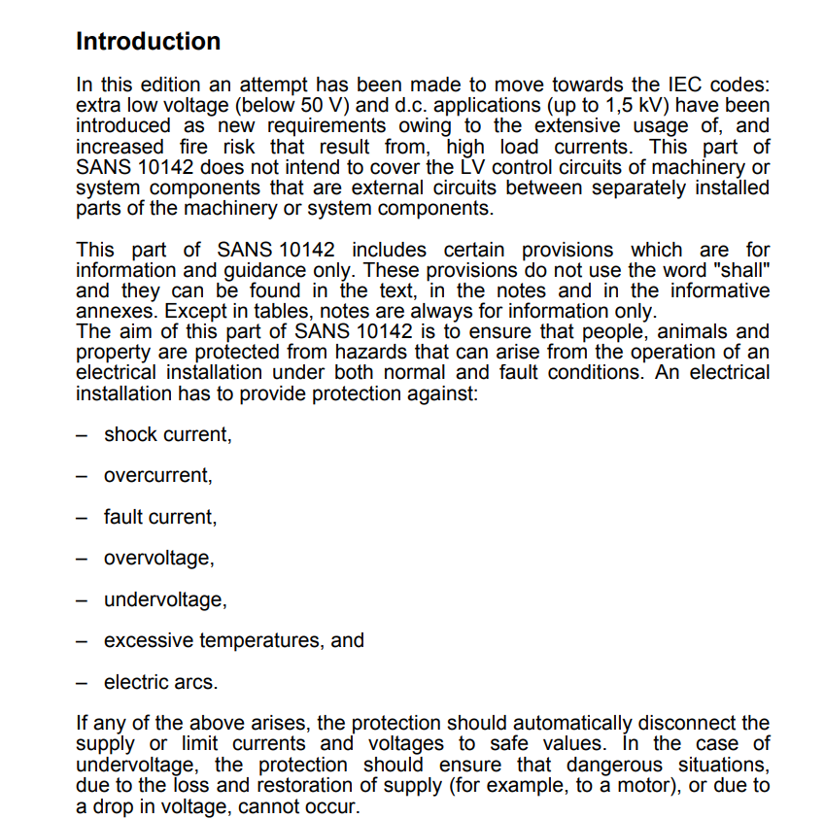
SANS 10142
Read through the document below and then click on the ‘Next’ button to answer some questions about this code.
Scrollable text.
Notes:
NB: Licensing issue. I see that there is a copyright on the SANS codes. Do we need to apply for permission from SABS to use them in our learning materials?
Note for interactivity:
SANS document text should be inserted on this page in a scrollable window so that learner can read the entire document on this screen.

Slide 61
Multiple choice
Insert questions from Dave Gravette here
Notes:
Note for

Slide 62
Step 5- Do a risk assessment
Step 1
Step 2
Step 3
Step 4
Step 5
Step 6
Step 7
Step 8
A risk assessment is taking a careful look at your workplace to identify those things, situations and processes that could put your or your team in danger. You should always do a risk assessment before you begin any job.
Placeholder image of someone doing a risk assessment
Can’t remember how to do a risk assessment? Click on the link below remind yourself
Placeholder link: to the relevant section in World of Electrician
Notes:
Reference back to Course 0 but still ask them to do a specific risk assessment activity.

Slide 63
Step 5- Identify the risks
Step 1
Step 2
Step 3
Step 4
Step 5
Step 6
Step 7
Step 8
On the next page, you will be given a list of risks from the tasks for installing a gate motor supply. Match the risk to the correct task. You can watch the videos of the tasks again if you need to.
Notes:
Notes for interactivity:
When learner clicks on “I would like to” they should be taken to Slide 68

Slide 64
Step 5- Identify the risks
Step 1
Step 2
Step 3
Step 4
Step 5
Step 6
Step 7
Step 8
Drill a hole
Particles in the eyes from bits of bricks
Switch off supply to DB2
High risk of electrocution
Dig a trench
Splinters in hands from holding pick/shovel
Fit a circuit breaker in a DB
Hand becomes affected by use of glue
Connect GP conductors to socket outlet
Injury to fingers from copper ends
Watch videos again
Notes:
Notes for interactivity:
When learner clicks on “Watch” they should be taken to Slide 65.
Matching activity. The order should be shuffled. Here are the correct pairs:
Drill a hole- particles in eyes from bits of bricks
Dig a trench- Splinters in hands from holding pick/shovel
Connect GP conductors to socket- Injury to fingers from copper ends
Switch off supply to DB2- High risk of electrocution
Fit a circuit breaker in DB- Hand becomes affected by use of glue
Feedback if answer is correct- Well done! You matched the correct risks with the correct tasks. (Take learner to slide 67)
Feedback if answer is incorrect- Oops not quite. On the following page you will see the tasks and the risks that go with those tasks. (66)

Slide 65
Placeholder Video 18
Placeholder Video 19
Placeholder Video 20
Placeholder Video 21
Placeholder Video 22
Placeholder Video 23
Placeholder Video 25
Placeholder Video 24
Placeholder Video 26
Placeholder Video 27
Placeholder Video 28
Placeholder Video 29
Video of Option 1
Go back to activity
Notes:
Note for interactivity:
Videos must be displayed as thumb prints on the left hand side of the page. When learner clicks on the video is should display on the right-hand side of the page.
When learner clicks on “Go back” they should be taken to Slide 64.

Slide 66
Feedback- tasks and risks
Here are the tasks and the risks that go with them.
Drill a hole
Particles in the eyes from bits of bricks
Switch off supply to DB2
High risk of electrocution
Dig a trench
Splinters in hands from holding pick/shovel
Fit a circuit breaker in a DB
Hand becomes affected by use of glue
Connect GP conductors to socket outlet
Injury to fingers from copper ends
Notes:
Reference back to Course 0 but still ask them to do a specific risk assessment activity.

Slide 67
Prevent the risk
Choosing the right PPE will help you prevent some of the risk that you have identified. Here are two examples:
Image of electrician wearing gloves while using a shovel
Wearing gloves will help to prevent splinters in your hands when using a shovel.
Image of electrician wearing safety goggles while drilling a hole
Wearing safety glasses will ensure that don’t get any particles in your eyes when using a drill.
Notes:
Note for interactivity:
Drag and drop activity.

Slide 68
Select the correct PPE
What PPE do you think you would need for the entire job?
Drag and items onto the image of the electrician and click submit.
Image
Sun lotion
Placeholder:
Image of an electrician (he should not be wearing any PPE)
Eye protection
Sunglasses
Ear protection
Gas mask
Image
Hard hat
Safety shoes
Overall
Image
Insulation socks
Image
Sun hat
Submit
Notes:
Note for interactivity:
Drag and drop activity.
Correct items to be dropped onto the image are:
Overall
Safety shoes
Eye protection
Ear protection
Sun hat
Sun lotion
When learner clicks on ‘submit’ button they should be taken to feedback page.
Feedback if correct: Well done! You have chosen the correct PPE for completing this job.
(Take learner back to Slide 36)
Feedback if incorrect: Oops not quite, the correct PPE needed for this job was
Overall
Safety shoes
Eye protection
Ear protection
Sun hat
Sun lotion
(Take learner back to Slide 36)

Slide 69
Complete Risk Assessment Table
Think about something simple yet potentially dangerous like standing on a ladder to put up a photo frame. Can you think of the potential risks involved? What would you do to try and prevent them form happening? See if you can fill in the table below. Click ‘submit’ when you are finished.
ACTIVITY | HAZARD | DANGER | RISK (Without preventive measures.) |  |  | PREVENTIVE MEASURE
 |  |  | High | Med. | Low
Put up a photo frame using a ladder.
Submit
Notes:
Note for interactivity:
Learner should be able to type in text in each area of the table
When learner clicks on submit they should be taken to Slide 70.

Slide 70
Example
I need Nick/Dave to help me complete this correctly.
How does your table compare to this one? Did you have the right preventative measures?
ACTIVITY | HAZARD | DANGER | RISK (Without preventive measures.) |  |  | PREVENTIVE MEASURE
 |  |  | High | Med. | Low
Put up a photo frame using a ladder. | Falling off the ladder | Injuring yourself |  | x |  | Two people are needed for the job. One person should hold the ladder while the other person climbs up the ladder. Make sure ladder is standing secure. Make sure ladder is good condition
Notes:
Note for interactivity:
Learner should be able to type in text in each area of the table
When learner clicks on submit they should be taken to Slide 58.

Slide 71
ePortfolio activity- Risk Assessment Table
Hint: Here is an example of a completed Risk Assessment Table to help you:
Electrical Installations Skill 18 National Skills Competition Durban ICC 14th to 19th February 2017
Download the Risk Assessment Table template and then use the tasks to complete the Risk Assessment Table. Once completed, upload your completed table.
Download Risk Assessment Table template
See the tasks for installing a gate motor supply
Upload completed Risk Assessment Table
Help on how to complete a Risk Assessment Table
Notes:
Note for interactivity:
The word ePortfolio must be hyperlinked to information about ePortfolios
“Download” should be linked to a blank copy of Risk Assessment Table (see hyperlink on block)
“See steps” should be link to the following information:
Drill a hole in a wall
Fit conduit through the new hole drilled in the wall
Install PVC multicore cable onto concrete or brick wall down the outside of the garage wall
Trench (Module 6) from the garage down through the garden to the gate to where we plan to install the socket outlet and install multicore cable underground or in a trench
Measure, mark and mount a flush mount enclosure that is weather-proof for a socket outlet on the boundary wall
We will draw in conductors into conduit using a fish tape
Connect GP conductors to socket outlet
Switch off supply to DB2 and test to ensure safe and isolated to work
Install PVC conduit from one available space in the DB1 1 at the bottom
Fit a circuit breaker in a DB and connect supply from earth leakage supply to circuit breaker
Connect new gate socket outlet supply conductors in BD
Conduct relevant tests
When learner clicks on “Upload” they should be taken to Slide 72
Hint: should be hyperlinked to the following document: https://www.dropbox.com/s/629g3jsrgwi1hj7/Electrical%20Installation%20skill%2018%20BASE%20LINE%20RISK%20ASSESSMENT%202017.docx?dl=0

Slide 72
Upload your requirements list
Submit your list so that it can be saved in your ePortfolio. Upload your list and click submit.
Submit
Notes:
Note for interactivity:
The word ePortfolio should be linked to information about what an ePortfolio is and how it works, how learner can access it.
There needs to be an upload function for user to upload their plan.
Once they click on submit they should be taken to Slide 74.

Slide 73
Step 6- Do the job
Step 1
Step 2
Step 3
Step 4
Step 5
Step 6
Step 7
Step 8
Step 1
Step 2
Step 3
Step 4
Step 5
Step 6
Step 7
Step 8
Now it’s time to complete the job by know you are familiar with the tasks. Do you know in what order they should be completed?
The tasks are not in order, you will need to put them in the correct order and click submit.
Begin activity
Notes:
Note for interactivity;
When user clicks on “Begin” they should be taken to Slide 74

Slide 74
Step 1
Step 2
Step 3
Step 4
Step 5
Step 6
Step 7
Step 8
Placeholder for Task 1
Placeholder for Task 2
Placeholder for Task 3
Image of Task 1
Image of Task 2
Image of Task 3
Placeholder for Task 4
Placeholder for Task 5
Placeholder for Task 6
Image of Task 4
Image of Task 5
Image of Task 6
Placeholder for Task 7
Placeholder for Task 8
Placeholder for Task 9
Image of Task 7
Image of Task 8
Image of Task 9
Placeholder for Task 10
Placeholder for Task 11
Image of Task 10
Image of Task 11
Submit
Notes:
Sequencing icons instead of videos
Note for interactivity;
Drag and drop activity
Drill a hole in a wall
Fit conduit through the new hole drilled in the wall
Install PVC multicore cable onto concrete or brick wall down the outside of the garage wall
Trench from the garage down through the garden to the gate to where we plan to install the socket outlet and install multicore cable underground or in a trench (Module 12)
Measure, mark and mount a flush mount enclosure that is weather-proof for a socket outlet on the boundary wall
We will draw in conductors into conduit using a fish tape
Connect GP conductors to socket outlet
Switch off supply to DB2 and test to ensure safe and isolated to work
Install PVC conduit from one available space in the DB1 1 at the bottom
Fit a circuit breaker in a DB (Module 28) and connect supply from earth leakage supply to circuit breaker
Connect new gate socket outlet supply conductors in BD
Conduct relevant tests
Feedback if correct: Well done! You are correct. (Take learner to slide 76)
Feedback if incorrect: Oops not quite, let’s take a look at the correct order of tasks (Slide 75)

Slide 75
Feedback- tasks
Step 1
Step 2
Step 3
Step 4
Step 5
Step 6
Step 7
Step 8
Here is the correct order of the tasks for installing a gate motor supply.
Image of Task 1
Image of Task 2
Image of Task 3
Image of Task 4
Image of Task 5
Image of Task 11
Image of Task 6
Image of Task 7
Image of Task 8
Image of Task 9
Image of Task 10
Submit
Notes:
Note for interactivity;

Slide 76
Step 7- Check if the task was done correctly
Step 1
Step 2
Step 3
Step 4
Step 5
Step 6
Step 7
Step 8
Once you have completed the job you must check that everything was done correctly.
Click on the blocks for more information to see an image of each check.
Trench is 500mm deep
No sharp objects in backfill
Conduit is square, level, parallel secured properly
Conduit is secure at equal spaces
Circuit labeled gate motor on DB 2
Socket outlet is square, level, parallel, secured properly
Correct lengths of conductor left in socket outlet and DB
Connections tight at termination points
Garden restored
Notes:
Note for design:
There needs to be an image to accompany each one of these blocks showing what is described by the text.
The trench is 500mm deep
No sharp objects in backfill
The conduit is square, level and parallel and secured properly
Conduit is secure at equal spaces
The socket outlet is square, level and parallel and secured properly
Correct lengths of conductor left in socket outlet and DB
Connections tight at termination points
Garden restored
Circuit labeled gate motor on DB 2

Slide 77
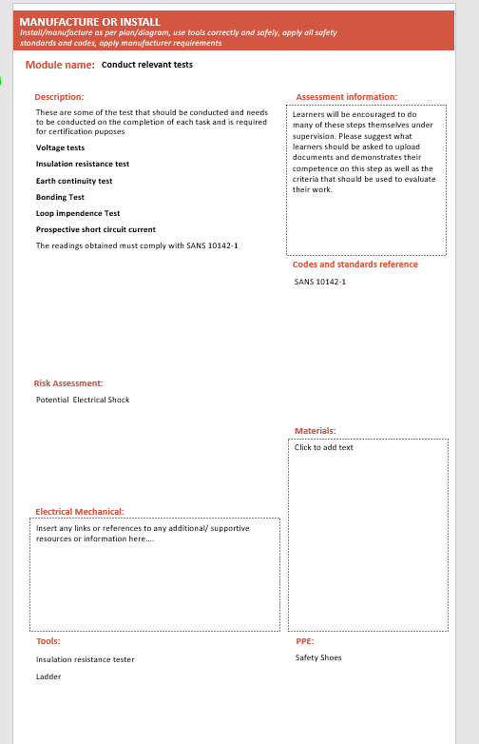
Do the necessary tests
Speak to Major Tech about reading ranges and images videos.
In addition to checking the elements, you must make sure that the No Voltage Tests and Voltage On Tests are completed.
No Voltage Tests
Voltage On Tests
Simulation
Continuity of the earth conductor
Simulation
Voltage Test
Simulation
Polarity Test
Simulation
Elevated Voltage to Neutral test
Placeholder: Vid 31
Insultation resistance test
Notes:
Note for interactivity:
When learner clicks on simulation it should appear full screen.
(These tests belong in Course 2)
Focus on range of acceptable values what does it indicate when values are out of this range.

Slide 78
Step 8- Hand over the client
Step 1
Step 2
Step 3
Step 4
Step 5
Step 6
Step 7
Step 8
You are almost finished installing a gate motor supply. The final thing you need to do is show the client what you have done and give him his Certificate of Compliance. Watch this video to see how a client handover is done.
Placeholder for Video
Notes:
Note for interactivity:
Video should play full screen when clicked.

Slide 79
Conclusion
Congratulations! You have now worked through the entire scenario for installing a gate motor supply. There are 5 more scenarios for you to try, would you like to try another one now?
Go back to scenario map
Notes:
Note for interactivity:
“Go back” should be linked to the interactive scenario map in the LMS.

Slide 80
Resource 01: Example of an installation plan
This image should be an example of an installation plan typically used by electricians.

Slide 81
Voice Rec 01: Client brief
Voice of a black male, professional sounding. Must sound like he is speaking over a phone.
Hi this is Mr. Mabuzo speaking, I hear that you will be installing a gate motor supply at my house next week. Here is the information that you asked for in your email.
I don’t have a lot of money for this project so you must please do it as cheaply as possible but it must still be a professional job. You have two days to finish the job.
You are allowed to dig in the garden but as much as possible, you must make sure that my lawn and garden are put back to the way they were. Your activities mustn’t damage my walls and they mustn’t look ugly or untidy. You can get a supply for electricity from any point in the installation as long as it is compliant.
It’s import that you make sure that you follow all the regulations and standards that you are supposed because I would like you to give me a certificate of compliance once you have finished the job. I don’t want anyone suing me so you much make sure that your workers stick to the healthy and safety standards.
Have you got all of that information? Good. See you next week.

Slide 82
Vid 01: Property details
Animated video using a tool like GoAnimate. Black and white hand drawn images with a voice over. Each point should be on a separate slide.
Script for voice over:
When you visited Mr Mabuzo’s property here is what you found:
There are dogs on the property
There are toilet facilities for staff
The ground is a rich dark brown which indicates that digging will be relatively easy
There is paving from the garage to the gate
There are flowerbeds along the driveway
The boundary wall is single brick and painted grey
The distance from the garage to the boundary wall is 5 meters
There is grass between the garage and the boundary wall to the gate
No visible water points or pipes between garage and boundary wall
There is no ceiling in the garage
There are 2 distribution boards or DB’s 1 in the main house.
The first DB, let’s call it DB 1 is flush mounted. This means that has been installed inside of the wall. (show image flush mount)
The distance to the gate is 29 meters from the gate to the DB1 and there are 4 slots available in the DB for new circuit breakers and there is an earth leakage in board
The second DB, let’s call it DB2, is in the garage and surface mounted. This means that it has been installed on the wall (show image of surface mount)
The distance to the gate is 22 meters from the gate to the DB2 and there are 9 slots available in the DB for new circuit breakers and there is an earth leakage in board

Slide 83
Vid 02: Step 2 Option 1
Demonstration video with voice over and text banners appearing as action on the video is completed.
Use 20 mm conduit using GP wire to supply a weatherproof socket outlet that will allow the gate motor to be plugged into
Drill a hole in a wall
Fit conduit through the new hole drilled in the wall
Install PVC multicore cable onto concrete or brick wall down the outside of the garage wall
Trench from the garage down through the garden to the gate to where we plan to install the socket outlet and install multicore cable underground or in a trench
Measure, mark and mount a flush mount enclosure that is weather-proof for a socket outlet on the boundary wall
We will draw in conductors into conduit using a fish tape
Connect GP conductors to socket outlet
Switch off supply to DB2 and test to ensure safe and isolated to work
Install PVC conduit from one available space in the DB1 1 at the bottom
Fit a circuit breaker in a DB and connect supply from earth leakage supply to circuit breaker
Connect new gate socket outlet supply conductors in BD

Slide 84
Vid 03: Step 2 Option 2
Demonstration video with voice over and text banners appearing as action on the video is completed.
Use a 2.5 mm² 3 core SWA cable to supply a weatherproof socket outlet that will allow the gate motor to be plugged into
TrTrench from the garage down through the garden to the gate to where we plan to install the socket outlet
Mount the weatherproof socket on the boundary wall
Drill a hole in the wall
Place the 2.5 mm² 3 core SWA cable into the trench
Push cable through the new hole in the wall
Secure the 2.5 mm² 3 core SWA cable down the outside of the garage wall
Fit gland onto cable and secure onto weatherproof socket housing at the bottom
Connect conductors to socket outlet
Switch off supply to DB2 and test to ensure safe to work
Fit gland onto cable and secure onto DB2 at the bottom
Fit 20 Amp circuit breaker in DB and connect supply from earth leakage supply to circuit breaker
Connect new gate socket outlet supply conductors in BD 2

Slide 85
Vid 04: Step 2 Option 3
Demonstration video with voice over and text banners appearing as action on the video is completed.
Use a 2.5 mm² 3 core flat twin and earth cable to supply a weatherproof socket outlet that will allow the gate motor to be plugged into
Trench from the garage down through the garden to the gate to where we plan to install the socket outlet
Mount the weatherproof socket on the boundary wall
Drill a hole in the wall
Place the 2.5 mm² 3 core flat twin and earth cable into the trench
Push cable through the new hole in the wall
Secure the 2.5 mm² 3 core flat twin and earth cable down the outside of the garage wall
Fit gland onto cable and secure onto weatherproof socket housing at the bottom
Connect conductors to socket outlet
Switch off supply to DB2 and test to ensure safe to work
Fit gland onto cable and secure onto DB2 at the bottom
Fit 20 Amp circuit breaker in DB and connect supply from earth leakage supply to circuit breaker
Connect new gate socket outlet supply conductors in BD 2

Slide 86
Vid 05: How to plan for the job.
Talking head video of electrician discussing the following:
How to plan for the job, must include info about working through the steps in your head and thinking about what you will need for each step to make sure you don’t miss anything. Must discuss tools, equipment, materials, PPE.

Slide 87
Vid 06: How to do installation drawing
Ask SME to give step by step instructions on how they go about doing an installation drawing
Demonstration video of an electrician explaining how to do an installation drawing for example for installing a gate motor supply. The video should move between the electrician and a screen where he demonstrates how he is doing a drawing on a computer. He should talk through each item that he adds to the drawing. Towards the end of the video he should also show learner how to do an installation drawing by hand.

Slide 88
Vid 07: Overview of the SANS codes and how they work
Demonstration video. Take an example of a SANS code (ie SANS 10142). Video should alternate between showing the facilitator talking and screenshots of the SANS code as demonstrator highlights various aspects of it.
Information that should be covered in this video:
How do we read a SANS code? (Highlight important info in the document for learner)
How to we apply the SANS code?
Notes:
Video script for placeholder on Slide 3.

Slide 89
Vid 08: How to video
Demonstration video. Showing how to use a 20mm PVC Spring bender.
Notes:
Video script for placeholder on Slide 3.

Slide 90
Vid 09: How to video
Demonstration video. Facilitator needs to explain how to work out the quantities of materials required for the job.
Notes:
Video script for placeholder on Slide 3.

Slide 91
Vid 11: How to video- Polarity Tester
Demonstration video. Facilitator needs to explain how a polarity tester works
Notes:
Video script for placeholder on Slide 3.

Slide 92
Vid 12: How to video- Insulation Resistance Tester
Demonstration video. Facilitator needs to explain how an insulation resistance tester works.
Notes:
Video script for placeholder on Slide 3.

Slide 93
Vid 13: How to video- PSCC and Loop Impedance Tester
Demonstration video. Facilitator needs to explain how PSCC and Loop Impedance Tester works.
Notes:
Video script for placeholder on Slide 3.

Slide 94
Vid 14: How to video-Tape measure
Demonstration video. Facilitator needs to explain how a tape measure works.
Notes:
Video script for placeholder on Slide 3.

Slide 95
Vid 15: Personal protective equipment
An animated video discussing the following:
What is PPE
Why do we wear it?
What are the most common PPE for electricians?
Where can you find/buy PPE? (Is it your responsibility or that of your employer?
Notes:
Video script for placeholder on Slide 3.

Slide 96
Vid 16:Risk Assessment
An animated video discussing the following:
A risk assessment is a term used to describe the overall process or method where you:
Identify hazards and risk factors that have the potential to cause harm (hazard identification).
Analyze and evaluate the risk associated with that hazard (risk analysis, and risk evaluation).
Determine appropriate ways to eliminate the hazard, or control the risk when the hazard cannot be eliminated (risk control).
A risk assessment is a thorough look at your workplace to identify those things, situations, processes, etc. that may cause harm, particularly to people. After identification is made, you analyze and evaluate how likely and severe the risk is. When this determination is made, you can next, decide what measures should be in place to effectively eliminate or control the harm from happening.
Notes:
Video script for placeholder on Slide 3.

Slide 97
Vid 17: 5 Steps of doing a Risk Assessment
An animated video discussing the following:
ACTIVITY
HAZARD
DANGER
RISK (without preventative measures)
PREVENTIVE MEASURE
Must mention the difference between a hazard and a danger.
Notes:
Video script for placeholder on Slide 3.

Slide 98
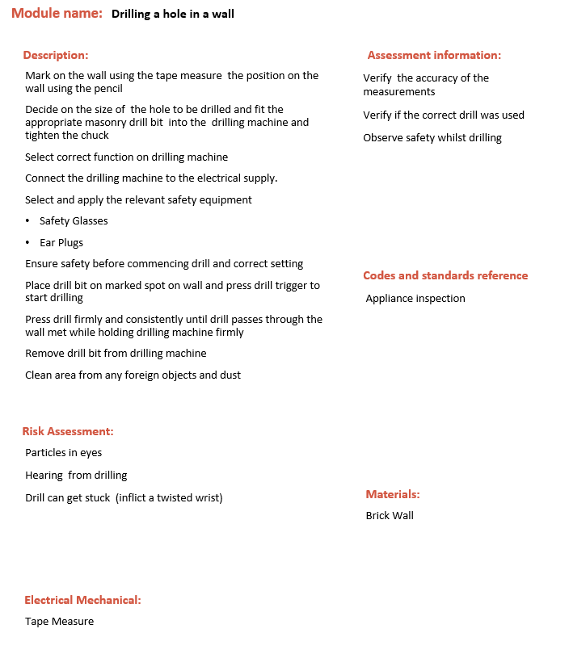
Vid 18: Do the job
Demonstration Video showing:
Drill a hole in a wall (Module 19)
Notes:
Video script for placeholder on Slide 3.

Slide 99
Vid 19: Do the job
Demonstration Video showing:
Fit conduit through the new hole drilled in the wall

Slide 100
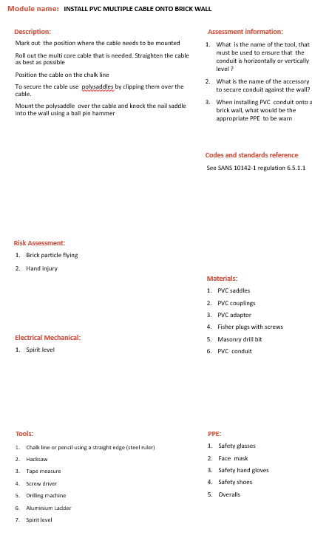
Vid 20: Do the job
Demonstration Video showing:
Install PVC multicore cable onto concrete or brick wall down the outside of the garage wall (Module 7)
Notes:
Video script for placeholder on Slide 3.

Slide 101
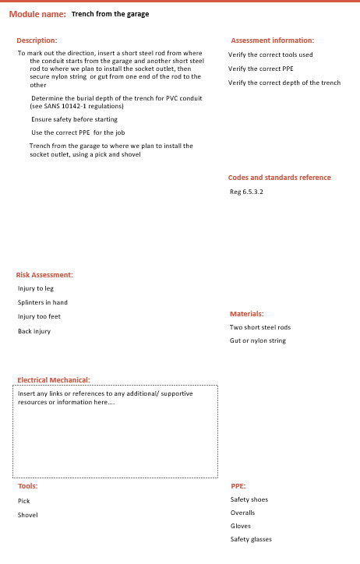
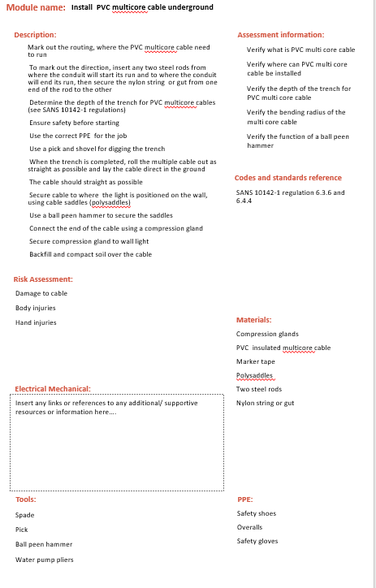
Vid 21: Do the job
Demonstration Video showing:
Trench (Module 6) from the garage down through the garden to the gate to where we plan to install the socket outlet and install multicore cable underground or in a trench (Module 12)
Notes:
Video script for placeholder on Slide 3.

Slide 102
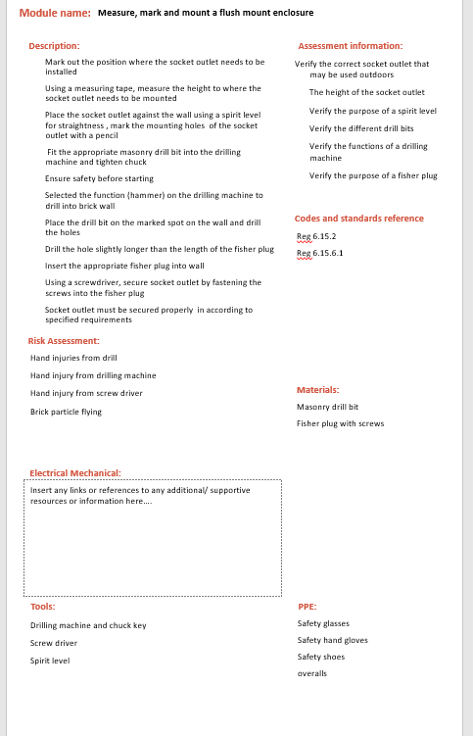
Vid 22: Do the job
Demonstration Video showing:
Measure, mark and mount a flush mount enclosure (Module 4) that is weather-proof for a socket outlet on the boundary wall
Notes:
Video script for placeholder on Slide 3.

Slide 103
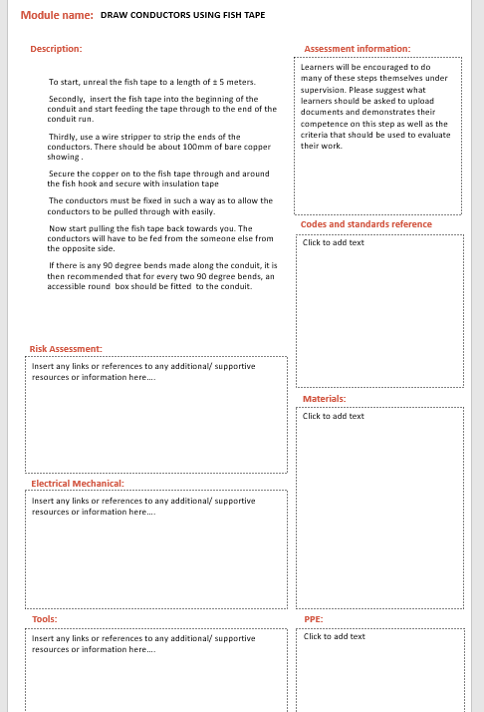
Vid 23: Do the job
Demonstration Video showing:
We will draw in conductors into conduit using a fish tape (Module 18)
Notes:
Video script for placeholder on Slide 3.

Slide 104
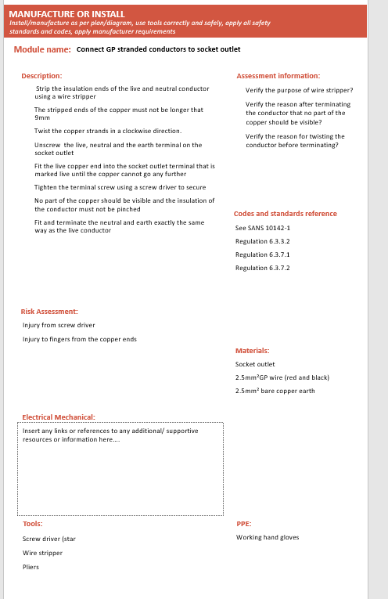
Vid 24: Do the job
Demonstration Video showing:
Connect GP conductors to socket outlet (Module 24)
Notes:
Video script for placeholder on Slide 3.

Slide 105
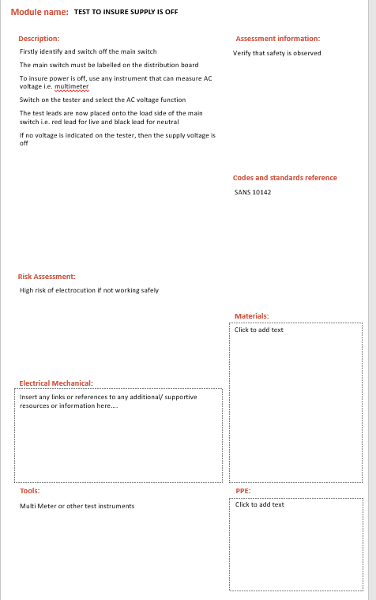
Vid 25: Do the job
Demonstration Video showing:
Switch off supply to DB2 and test to ensure safe and isolated (Module 25) to work
Notes:
Video script for placeholder on Slide 3.

Slide 106
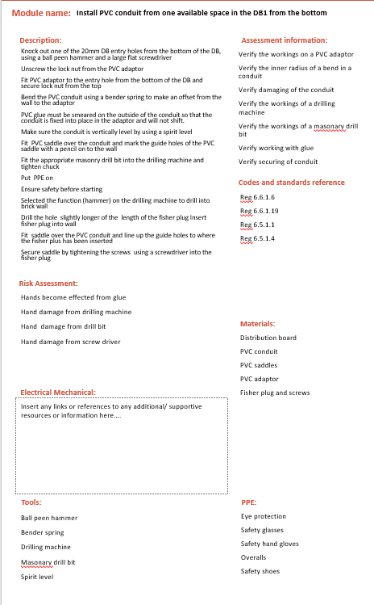
Vid 26: Do the job
Demonstration Video showing:
Install PVC conduit from one available space in the DB1 (Module 10)1 at the bottom
Notes:
Video script for placeholder on Slide 3.

Slide 107
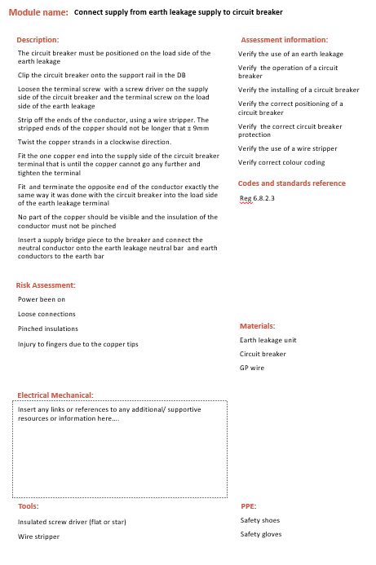
Vid 27: Do the job
Demonstration Video showing:
Fit a circuit breaker in a DB (Module 28) and connect supply from earth leakage supply to circuit breaker (Module 28)
Notes:
Video script for placeholder on Slide 3.

Slide 108
Vid 28: Do the job
Demonstration Video showing:
Connect new gate socket outlet supply conductors in BD
Notes:
Video script for placeholder on Slide 3.

Slide 109
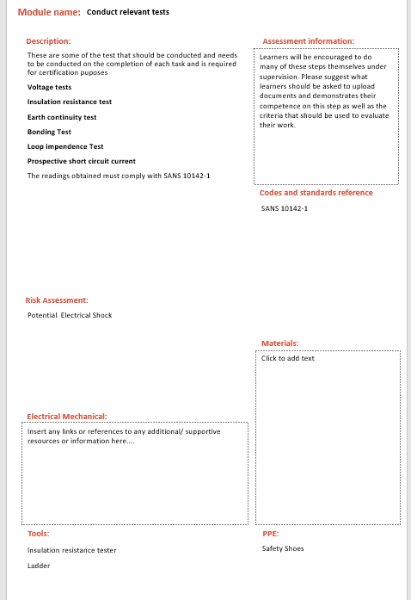
Vid 29: Do the job
Demonstration Video showing:
Conduct relevant tests (Module 44)
Notes:
Video script for placeholder on Slide 3.

Slide 110
Vid 37: Client Handover
Demonstration Video showing the electrician interacting with the client:
The route of the wire way and the depth of installation
Indicate the positioning of the breaker and where it is installed.
Provide the client with the certificate of compliance (COC) as per legislation explaining its purpose as well clients responsibility in terms of maintain the electrical installation
Notes:
Video script for placeholder on Slide 3.

Slide 111
Voiceover 01- Option 1- Choice 1
Voice recording
Well done! You are correct in saying that this option was the cheapest way to do the job. This is important because Mr Mabuzo wanted you to a quality job but it needed to be done as cheaply as possible.
Notes:
Video script for placeholder on Slide 3.

Slide 112
Voiceover 02- Option 1 Choice 2
Voice over
While you are correct about Option 1 being the best option, it’s not because it’s the quickest. Option 2 would have taken 5 hours to do while Option 1 would have taken an hour longer. The reason Option 1 is the best one is because Mr Mabuzo wanted you to a quality job but it needed to be done as cheaply as possible.
Notes:
Video script for placeholder on Slide 3.

Slide 113
Voiceover 03- Option 1 Choice 3
Voice recording
While you are correct about Option 1 being the best option its not because of the high quality of cables being used. The cables used in Option 1 are of a lower quality than Option 2 but were still good enough for this job. Using more expensive cables would have gone against Mr Mabuzo’s request that the job be done as cheaply as possible.
Notes:
Video script for placeholder on Slide 3.

Slide 114
Voiceover 04- Option 2- Choice 1
Voice recording
While Option 2 is a good choice, it’s not the cheapest or most cost effective Option as the cables used were more expensive that the cables used in Option 1. Since Mr Mabuzo wanted you to a quality job but it needed to be done as cheaply as possible Option 1 is the best choice.
Notes:
Video script for placeholder on Slide 3.

Slide 115
Voiceover 05- Option 2 Choice 2
Voice over
While you are correct in saying that Option 2 is the quickest way of doing the job, Option1 is actually the best option because Mr Mabuzo wanted you to a quality job but it needed to be done as cheaply as possible. The cables used for Option 1 were still of a high enough quality.
Notes:
Video script for placeholder on Slide 3.

Slide 116
Voiceover 06- Option 3 Choice 3
Voice recording
Not quite. The cables used in Option 1 were of a lower quality than Option 2 but were still good enough for this job. Using more expensive cables would have gone against Mr Mabuzo’s request that the job be done as cheaply as possible.
Notes:
Video script for placeholder on Slide 3.

Slide 117
Simulation 1- No Voltage Test_Continuity of earth conductor
Simulation whereby learner is able to conduct a continuity of earth conductor test. Screen must look the same as a real life tester. Learner should get the opportunity test and see voltage (which is a problem) and then they should be able to test and see no voltage.
Notes:
https://incident-prevention.com/ip-articles/no-voltage-testing

Slide 118
Simulation 2- No Voltage Tests_Insulation Resistance Test
Device used to do Insulation Resistance Test should be simulated. Users should have the opportunity to ‘preform’ tests according to a set of guidelines.
Notes:
https://www.sefelec.com/en/insulation-resistance-test.php

Slide 119
Simulation 1- Voltage on Tests_Voltage Test
Simulations
Notes:
Video script for placeholder on Slide 3.

Slide 120
Simulation 1- Voltage on Tests_Polarity Test
Simulations
Notes:
Video script for placeholder on Slide 3.

Slide 121
Simulation 1- Voltage on Tests_Neutral Test
Simulations
Notes:
Video script for placeholder on Slide 3.

Slide 122
Resource 01: Client brief and property details
Downloadable information sheet should be created with the following information:
Property details:
There are dogs on the property
There are toilet facilities for staff
The ground is a rich dark brown which indicates that digging will be relatively easy
There is paving from the garage to the gate
There are flowerbeds along the driveway
The boundary wall is single brick and painted grey
The distance from the garage to the boundary wall is 5 meters
There is grass between the garage and the boundary wall to the gate
No visible water points or pipes between garage and boundary wall
There is no ceiling in the garage
There are 2 distribution boards or DB’s 1 in the main house.
The first DB, let’s call it DB 1 is flush mounted. This means that has been installed inside of the wall. (show image flush mount)
The distance to the gate is 29 meters from the gate to the DB1 and there are 4 slots available in the DB for new circuit breakers and there is an earth leakage in board
The second DB, let’s call it DB2, is in the garage and surface mounted. This means that it has been installed on the wall (show image of surface mount)
The distance to the gate is 22 meters from the gate to the DB2 and there are 9 slots available in the DB for new circuit breakers and there is an earth leakage in board
Client Brief:
The project must follow all regulations and standards
You must give Mr Mabuzo a certificate of compliance once you have finished the job.
You must make sure that you and your team follow the health and safety standards at all times
Activities must not damage the walls and must not look unsightly (bad)
You are allowed to dig in the garden but you must put the lawn and garden back to its original state as best as possible
You can get the supply from any point in the installation as long as it is compliant
You must finish all your work in 2 days
Finances are limited and you need to do the project as cheaply as possible

Slide 123
List of images required for this scenario:

