Slide 1
Electrical components and systems
Topic 11 – Fault Finding in Basic Circuits

Slide 2
Fault find basic circuits
Unit 11

Slide 3
Assumed prior learning
General Basic Safety
Wire a circuit
Tools and Electrical Measuring Instruments
Don’t feel confident yet about these topics? Click on each to review the content.
Feeling confident? Click next to proceed with this unit.

Slide 4
Outcomes
Use a systematic approach to fault find electrical circuits.
Locate faults on given electrical panels or equipment by using circuit diagrams and inspection and testing procedures.
Build a circuit and fault find hen there is no output voltage.

Slide 5
Introduction
Whenever faults have to be rectified, it should be done efficiently and in the shortest possible time in order to save costs and reduce production downtime. Effective fault finding can only be done by using logical thinking and having a good knowledge of the equipment, which is essential. In this unit we look at the procedure to fault find basic electrical circuits.
Notes:
Link each to the relevant section below.

Slide 6
Safety rules
Safety can never be over-emphasized. Click on ‘Safety first’ for tips on safety that will help to ensure your safety and the safety of others in the workplace.
SAFETY FIRST !
Notes:
Click on ‘safety first’ = list of items as follows:
“•Isolate, lock out and test before commencing work.
• Ensure that the power to the equipment on which you are going to work is turned off and that it is locked out.
• Use electrical test instruments in accordance with the manufacturer’s specifications to prevent damage to the equipment.
• Do not restore power to the equipment unless you have ensured that no person can be injured.
• Electrical test instruments, such as a megger/ insulation tester, produce output voltages equal to, or greater than the operating voltage of the equipment. Therefore, DO NOT touch the test leads as this may result in electrical shock.
Potential Hazard!
Damage to equipment, serious injury to persons or loss of life. ”

Slide 7
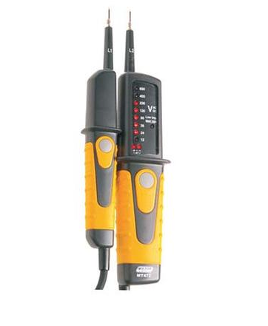
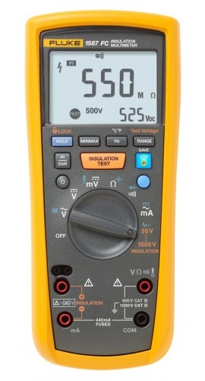
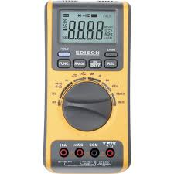
Test instruments
The following instruments may be used for fault finding:
• A bell tester to determine conductor continuity.
• A multimeter to measure resistance.
• A megger to determine if there is any breakdown of insulation or the resistance values of coils.
NOTE: It is assumed that, by now, you know exactly how to use test instruments and that you can test and measure resistance, current, voltage, etc. correctly.
Bell tester
Multimeter
Megger
Notes:
Img01 Bell tester: https://cdn.shopify.com/s/files/1/0749/6999/products/MT472_large.jpg?v=1525339008
Img02 Multimeter: https://static-content.cromwell.co.uk/images/854_854/g/jeeps/516/edi5163460k.jpg
Img03 Megger: https://cdn3.volusion.com/xhagc.zyomv/v/vspfiles/photos/1587-FC-2.jpg?1458899727

Slide 8
When using measuring instruments remember:
Measuring instruments are expensive and must be handled with care at all times.
When an instrument is not in use, ensure that it is switched off and stored safely.
Check to ensure that the measuring instruments that you intend using are in good working order.
Select a measuring instrument that is the right one for the task.
Notes:
Link each to the relevant section below.

Slide 9
Successful testing of electrical circuits
Electric circuits must be systematically tested for faults. The results obtained at each stage of the testing must be used as guides to accurately locate faults that may occur. In general, the successful testing of electrical circuits depends on the following factors:
• A fundamental knowledge of the circuit to be tested.
• An understanding of the operation of the components in the circuit.
• The ability to use the test equipment available.
• The ability to analyse results correctly.
Notes:
Link each to the relevant section below.

Slide 10
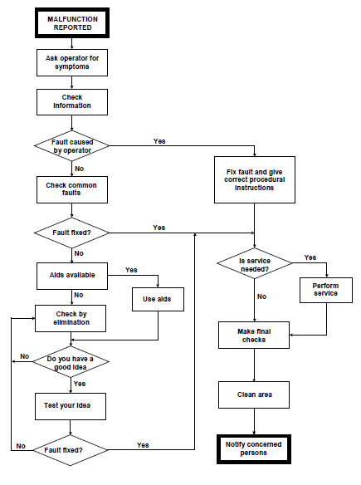
Basic fault finding flow chart
Some of the equipment you are going to work on will most likely have manuals, hand books or instruction sheets with fault finding flow charts to assist you in tracing the likely faults quickly and efficiently. The Basic Fault Finding Flow Chart alongside should be of great help to do systematic fault finding.
Notes:
Flow chart: CTC Book 4, EC-1, Pg 48.
Allow scroll on chart.

Slide 11
Safe work procedure
What follows will guide you through the procedure for fault finding an electrical panel, which is isolated from all sources of electricity. The only time, during training, that you will be allowed to restore power is to initially test the panel for diagnostic purposes.
NOTE:
Remember that, when you are at work in industry, you will be personally responsible for isolating and switching on power to circuits and equipment!

Slide 12
Fault finding procedure
Fault finding is a systematic process of narrowing down the possible reasons for failure until only the actual cause of failure is left. The following should be considered when doing fault finding:
• Symptoms of failure
• Diagnosis
• Visual inspection
• Testing
Notes:
On click link each to the relevant section below.

Slide 13
Symptoms of failure
A person doing fault finding must be able to perceive the symptoms that have possibly led to the failure. This means that they must be able to determine whether the panel or equipment operates according to the circuit diagram. It is therefore essential that the person doing fault finding is capable of reading circuit diagrams.
Symptoms of failure method
Notes:
Click on Symptoms of failure method = “Get the circuit diagram of the panel or equipment. Study the circuit diagram to ensure that you understand the operation of the panel or equipment. The best way to ascertain symptoms of failure is to:
• Ask the machine or equipment operator what happened just before the equipment failed.
• Start the panel or equipment in accordance with the starting procedures.
• Observe to see if the panel or equipment operates according to the circuit diagram.
• If not, observe at which point the system fails.
• Determine what effects overloading of the system will have.”

Slide 14
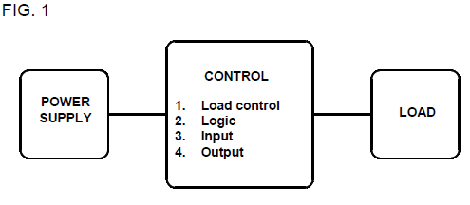
Diagnosis
Restore power to the panel.
• Use Fig. 1 as a guideline to the systematic approach to fault finding.
Procedure for diagnosis
Click here for more information
Notes:
Fig1: CTC Book 2, FF-1-E, Pg 258.
Click ‘here’ for more information = “
Power supply: This section is responsible for the power distribution throughout the entire system. Different voltages may be supplied to the control section depending on the actual circuit requirements of the system. It will detect any defects in the system and shut off the supply.
Control
This section may be seen as the heart of the system. It will be responsible for the control of all functions of the system and may include the following:
- Stop/Start stations
- Forward and reverse functions
Process information from sensors and switches
Monitor current and voltage variations
Respond to input and output devices.
Load
The load may be any electrical or mechanical device that is required to do work such as:
- Motors
- Heaters
Hydraulic systems, etc.”
Click on Procedure for diagnosis = “Start the panel or equipment and decide, while observing its operation, in which area the fault may possibly be.
• Taking into account the circuit diagram and the operation of the panel or equipment, determine the following:
(i) Is there a short circuit in the wiring?
(ii) Is there an open circuit in the wiring?
(iii) Is the fault of a mechanical or electrical nature?
(iv) Is there overloading of the circuit or sections of the circuit?
• Once you have decided, isolate the power to the panel or equipment and to visual inspection.”

Slide 15
Visual inspection
Now that it has been decided in which area the fault is most likely to be, components must be visually inspected to determine if physical defects can be detected. It may be a burnt or loose connection, a blown fuse or something that visually indicates that there is a fault.
Visual inspection process
Notes:
Click on Visual inspection process = “It must not be expected that the fault is in the most difficult part of the circuit, as faults are often simple to find and are in most cases overlooked only because they are so simple.
For example, fuses do not blow for no reason. Test the circuit that the fuse protects to ensure that the reason for the fuse blowing is rectified.
If there are no visual defects, proceed to the next step.”

Slide 16
Testing parallel circuits
Select the appropriate testing equipment:
• Remember when measuring resistance, parallel circuits may give false readings. Disconnect the circuit to ensure that the required component resistance is measured.
• When continuity of conductors is tested using a continuity or bell tester, parallel circuits may give false readings because the tester conducts through the parallel circuit. See Figs. 2 and 3 on the following slide for examples of this.
Notes:
Link each to the relevant section below.

Slide 17
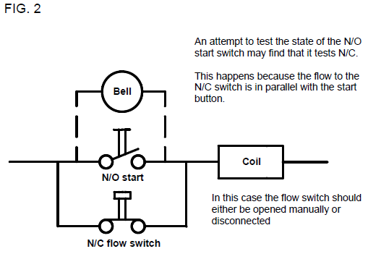
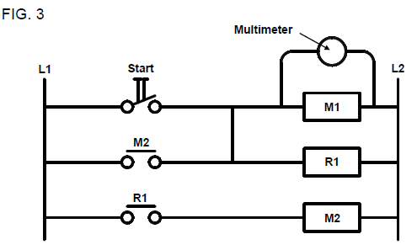
Testing: continuity of conductors
Using the multimeter to determine the condition of the contactor coil M1 may result in an inaccurate reading due to M1 being in parallel with relay coil R1.
Notes:
Fig 2 and 3: CTC Bk 2, FF-1-E, Pg 260.
Click on ‘testing’ = “
Using the multimeter or bell tester, trace the circuit and determine the location of the fault.
Once the fault has been located, repair it.”

Slide 18
Practise
In your practical lesson you must fault find electrical panels, making use of circuit diagrams, testing instruments and by following a systematic fault finding procedure. Watch the video below before attempting to fault find the circuit you build.
Vid 01:
Fault find a circuit using Ohm’s law
Notes:
Vid 01.= get Youtube link: https://www.youtube.com/watch?v=qotB1xxQols
See appendix, play full screen.

Slide 19
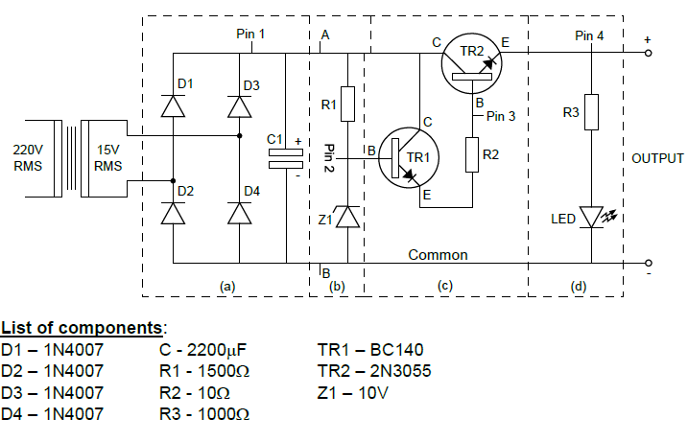
Build the circuit
Select the components from your electronics toolkit according to the diagram in the figure below.
• Ensure that the supply to the training board is switched off.
• Build the circuit of the given drawing on the training board.
Click here for further instructions
SAFETY FIRST !
Notes:
Diagram: CTC Book 10, FF-1, Pg 175, Fig 1.
Allow scroll and zoom on the figure.
‘Click here for further instructions’ = show table 01 as created in Appendix
Click on Safety first =
“Prepare to commence electrical work - Isolate, lock out and test before commencing work.
Select conductors and components - Use conductors of correct current-carrying capacity, insulation, colour coding and application. Adhere to SANS Wiring Code. Use components of correct rating and application.”

Slide 20
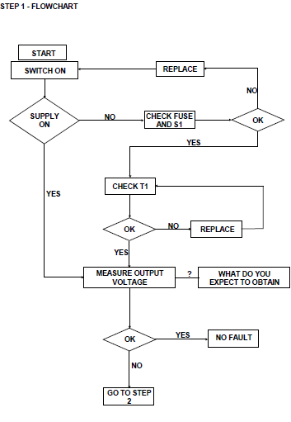
Finding the fault: no output voltage
Step 1
- Fault – no output voltage
- Follow the steps in the flow chart
Notes:
Flow chart: CTC Book 10, FF-1, Pg 177
Allow scroll on chart.

Slide 21
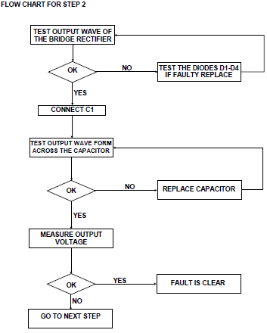
No output voltage: Step 2
Step 2
• Disconnect the circuits at points A and B
• Disconnect the capacitor at point C1
Notes:
Flow chart: CTC Book 10, FF-1, Pg 178
Allow scroll on chart.

Slide 22
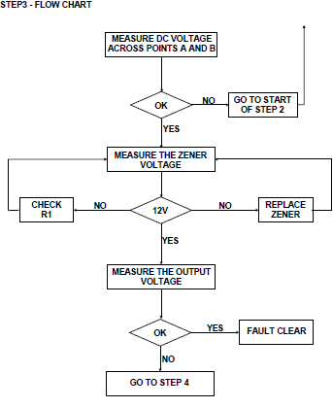
No output voltage: Step 3
Step 3
•Reconnect circuit at points A and B the carry out the following:
Notes:
Flow chart: CTC Book 10, FF-1, Pg 179
Allow scroll on chart.

Slide 23
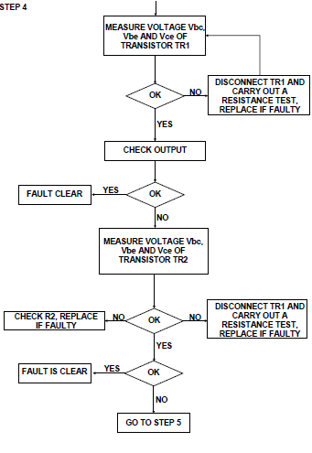
No output voltage: Step 4
Notes:
Flow chart: CTC Book 10, FF-1, Pg 181
Allow scroll on chart.

Slide 24
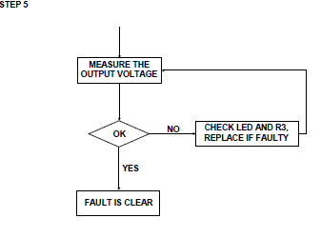
No output voltage: Step 5
Notes:
Flow chart: CTC Book 10, FF-1, Pg 182
Allow scroll on chart.

Slide 25
Quiz time
We have come to the end of this unit. Answer the following questions to make sure you understand how to fault find basic electrical circuits.

Slide 26
Question 1
What safety measures must be taken before attempting to do fault finding on electrical equipment?
Ensure that the power to the equipment on which you are going to work is turned off and that it is locked out.
Use electrical test instruments in accordance with the manufacturer’s specifications to prevent damage to the equipment.
Do not restore power to the equipment unless you have ensured that no person can be injured.
All of the above.
Notes:
MCQ
Allow click on the choices.
Correct answer is D
Feedback:
Correct – Good job.
Incorrect – Try again.

Slide 27
Question 2
What effects will a parallel circuit have on testing procedures?
May give false readings.
It may cause a loose connection.
Overload the system.
System failure.
Notes:
MCQ
Correct answer is A
Feedback:
Correct – Well done.
Incorrect – Try again.

Slide 28
Question 3
A bell tester is used to determine if there is any breakdown of insulation.
TRUE
FALSE
Click on the correct answer.
Notes:
True or False: Allow click on answers.
Correct answer is False
Feedback:
Correct – Well done. A bell tester is used to determine conductor continuity.
Incorrect – That is not correct. A bell tester is used to determine conductor continuity.

Slide 29
Question 4
Rearrange the following in the correct order, as discussed in this unit, of the fault finding procedure.
a) Visual inspection
b) Diagnosis
c) Testing
d) Symptoms of failure
Notes:
MCQ
Allow drag and drop.
Correct steps in order are: D, B, A and C
d) Symptoms of failure
b) Diagnosis
a) Visual inspection
c) Testing
Feedback:
Correct – Excellent.
Incorrect – Try again.

Slide 30
Let’s review:
In this lesson we have covered:
Safety rules.
Test instruments.
Fault finding flow chart.
Fault finding procedure.
Building a circuit.
Fault find: No output voltage.
Make sure you have a complete understanding of all the work covered here before you start the next unit.

Slide 31
Video01: Fault finding using Ohm’s law
Get video: https://www.youtube.com/watch?v=qotB1xxQols
Play full screen.

Slide 32
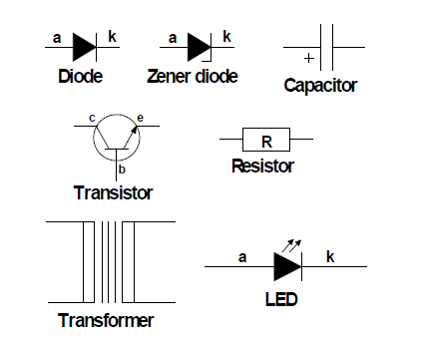
Table 01: Building a circuit
NOTE | DESCRIPTION
The seven main components used in the circuit are Transformers, Diodes, Capacitors, Resistors, Zener diodes, LEDs and transistors. | Symbols used are the following:
The modes in which the components are used: Diodes for rectification Capacitor for smoothing Zener diode for constant voltage regulation Resistors for current limiting Transistors for common collector configuration
The functions of combined components a) Rectification and smoothing b) Parallel regulation c) Series regulation d) Load | Test the voltage between the test points and the common: TP1=........................., TP2=........................., TP3=........................., TP4=........................., • Components can be tested open circuit or short circuit when faulty.
Notes:
Allow scroll and zoom on table.

