Slide 1
Electrical components and systems
Topic – Wire circuits

Slide 2
Wire circuits
Unit 10

Slide 3
Assumed prior learning
Contactors and overloads
Circuit protection
Lighting systems
Introduction to Drawings and Schematics
How Electrical Circuits Work
Don’t feel confident yet about these topics? Click on each to review the content.
Feeling confident? Click next to proceed with this unit.

Slide 4
Outcomes
Wire and test a relay control circuit.
Wire and test a relay and timer control circuit.
Wire specified circuits and use truth tables to fault find the circuits.

Slide 5
Introduction
Make sure you have gone over the ‘lighting systems’ lesson, where you will learn the symbols and abbreviations for electrical components, before starting this lesson. Both contactors and relays perform the task of switching a circuit but they have very different applications. Relays are used for low voltage switching hence the smaller electromagnets require much less power than contactors.
Notes:
Click on ‘lighting system’ redirects to that lesson (unit 9.1 and 9.2).
Click on ‘contactors’ = Contactors are used for high voltage switching so they have much larger electromagnets that draw significant amounts of power.
Click on ‘switching’ = Turning an electric current on or off, directing an electric current, or making or breaking a circuit.

Slide 6
Hazard identification and control (HIAC) form
Refer to the HIAC to wire circuits to make sure you understand steps in the process and what controls are needed to prevent a potential incident.
CLICK HERE FOR THE HIAC FORM
Notes:
Click on HIAC form = bring up form 1 as shown in appendix.

Slide 7
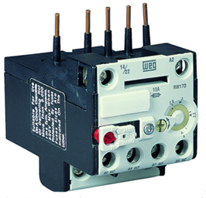
Relays
A relay is an electro-magnetically operated switch having one or more contacts. One advantage is that switch functions can be executed locally by a command given from a distance. If a relay is equipped with several contacts it is possible to close or open more than one circuit.
NOTE: WE HAVE COVERED RELAYS IN DETAIL IN THE LESSON: OVERLOADS AND CONTACTORS.
Notes:
Img01=: https://temcoindustrial.com/media/static/product_guides/contactors/overload_relay.jpg
Click on ‘Overloads and contactors’ = redirect to that lesson (Unit 4.1) in Electrical components

Slide 8
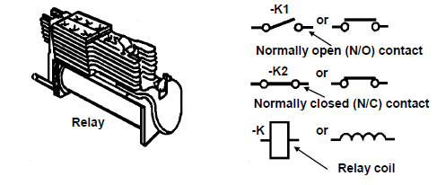
Construction of a relay
One type of relay and its symbols are shown in the figure below. Click on the figure to learn more.
Notes:
Fig 01 = CTC Book 4, EC-1, Page 41.
Click on Fig 01=
The relay consists of two main parts, the electro-magnetic part and the switching part (the contacts). The electro-magnetic part consists of a soft iron core enclosed by a coil. The armature drawn in by the coil is also made of soft iron.
When current flows through the coil, the core becomes magnetised and attracts the armature to it. A piece of non-conducting material is attached to the armature in such a way that it is pressed against the spring contacts which will then be operated.

Slide 9
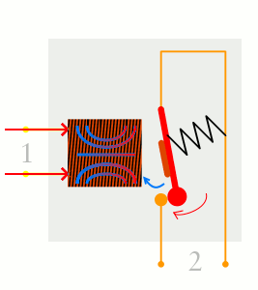
How relays work
Click on the below animation for an illustration of how relays use one circuit to switch on a second circuit.
When power flows through the first circuit (1), it activates the electromagnet (brown), generating a magnetic field (blue) that attracts a contact (red) and activates the second circuit (2). When the power is switched off, a spring pulls the contact back up to its original position, switching the second circuit off again.
This is an example of a "normally open" (NO) relay: the contacts in the second circuit are not connected by default, and switch on only when a current flows through the magnet. Other relays are "normally closed" (NC, the contacts are connected so a current flows through them by default) and switch off only when the magnet is activated, pulling or pushing the contacts apart. Normally open relays are the most common.
Notes:
Click on Img 02 = get animation and wording from https://cdn4.explainthatstuff.com/how-relay-works2.gif
Allow scroll on explanation.

Slide 10
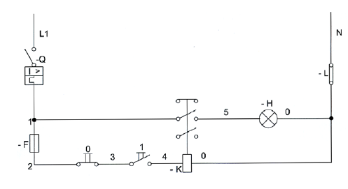
Circuit operation – a lamp
For the relay coil to operate the current must flow from the line through the relay coil to neutral. Click on the figure to learn more.
Notes:
Fig 02 = CTC Book 4, EC-1, Page 43.
Click on the figure =
The current flows from the line through the circuit breaker contacts, which are closed and through the stop button contacts, which are also closed. The stop button is spring loaded and only by pushing the button will the contacts open. When released it will return to the normally closed (abbreviated N/C) position.
The symbol O above the contact indicates the stop button and the symbol 1 indicates the start button.
Wires are numbered for ease of wiring. The numbers also indicate a particular section of the circuit.
There is no current flow to the relay coil, because the start button contacts are normally open (abbreviated N/O), but when the start button is pushed the contacts will close allowing the current to flow through the contacts to the relay coil. This will allow the relay coil to become energised, which in turn will pull in the relay armature and close all the N/O contacts and open all the N/C contacts mounted on the relay.
When the start button is released, the start button contacts will open, the relay will become de-energised and the relay contacts to the lamp will open again and so switch off the lamp.
The relay consists of two main parts, the electromagnetic part and the switching part. The figure shows that the light operates through the relay contacts fed from the line. This is normally referred to as the “main circuit”. The relay coil is also fed from the line through a fuse, this is normally referred to as the “control circuit”.

Slide 11
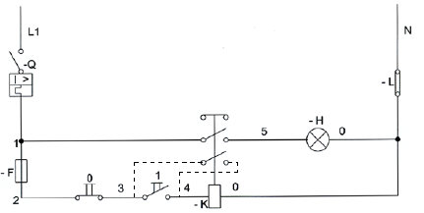
Circuit operation of a lamp continued
To overcome the relay dropping out (de-energising) when the start button is released, something is needed to retain the closed circuit. Click on the figure to learn more.
Notes:
Fig 03 = CTC Book 4, EC-1, Page 44
Click on Fig03 =
To overcome the relay dropping out (de-energising) when the start button is released, something is needed to retain the closed circuit for example a set of contacts in parallel with the start button and the only contact available are on the relay. When contacts are used for this purpose they are referred to as retaining contacts. Another set of N/O contacts on the relay will be used for retaining contacts as shown by the dotted line in the figure.
The new condition will be as follows: When the start button is pushed the relay will close (energise) and the N/O contacts will close, switching on the light with the top relay contact and closing the bottom retaining contact in parallel with the start button. Now the start button can be released and the circuit will remain closed through the stop button and the retaining contact, which allows current to keep on flowing through the relay coil, keeping it energised.
To switch the light off again, push the stop button, which will open the circuit feeding current to the relay coil.
A fuse is included in the control circuit to protect the relay coil, because the relay coil draws a very small current (about 200 mA) while the circuit breaker, which is rated to operate the lamp, has a rating too high to protect the relay coil.

Slide 12
Quiz time
Before the next task, complete the quiz that follows to make sure you understand how to work with relays.

Slide 13
Question 1
What are the two main parts of a relay? Click on the correct answers.
Armature
Electromagnet
Core
Contacts
Notes:
MCQ: Allow click on the options.
Correct answers are B and D
Feedback:
Correct – Good job.
Incorrect – Try again.

Slide 14
Question 2
Which of the following is the symbol for a relay?
Notes:
MCQ
Correct answer is C
Feedback:
Correct – Good job.
Incorrect – Try again.

Slide 15
Question 3
Which of the following letters is used to represent a relay?
K
F
H
Q
Notes:
MCQ
Correct answer is A
Feedback:
Correct – Good job.
Incorrect – Try again.

Slide 16
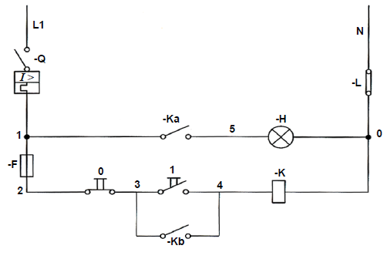
Practise
Wire a relay operated circuit controlling lamp as shown in the figure below. Click on each of the symbols or letters for more information.
DANGER:
LIVE TERMINALS ISOLATE SUPPLY BEFORE WORKING ON TERMINALS
Start
Stop
Notes:
Fig 04= CTC, Book 4, EC-1, Pg45.
Allow click on each of the symbols in the diagram:
Click on:
-F =Fuse
-Q = Circuit breaker
-H = Lamp
-K = Relay

Slide 17
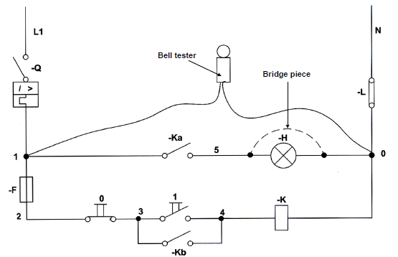
Wire a relay operated switch continued
Test the circuit with a bell tester. Click on the figure for more information on testing the circuit.
Notes:
Fig 05= CTC, Book 4, EC-1, Pg46.
Click on image =
Test the main circuit:
• Connect one lead of the bell tester onto the load side of the circuit breaker and the other lead onto the neutral bar. The bell should not ring.
• Bridge the lamp holder connections with a piece of wire.
• Press the start button. The bell should not ring.
• Press in the armature of the relay. The action closes the N/O (-Ka and – Kb) contacts.
• The bell should ring because the circuit between the line and neutral is now complete.
• Release the start button. The bell should still ring because the circuit is retained by the N/O (-Kb) contact of the relay.
The main circuit has now been tested.
Next test the control circuit:
• Remove the bridge from the lamp and bridge out the relay coil.
• Push the start button. The bell tester should now ring, release the start button and push the armature of the relay in. The bell tester should ring again because the circuit is completed by the N/O (-Kb) contact.
• Press the stop button to make sure that it is correctly connected in the circuit, in series with the start button. The bell should stop ringing.

Slide 18
Fault finding
Electric circuits must be systematically tested for faults. The results obtained at each stage of the testing must be used as guides to accurately locate faults that may occur. Fault finding is discussed in detail in another lesson, here we go over the basic process.
Notes:
Click on Fault Finding = link to Electrical components_Fault Finding (units 11.1 and 11.2)

Slide 19
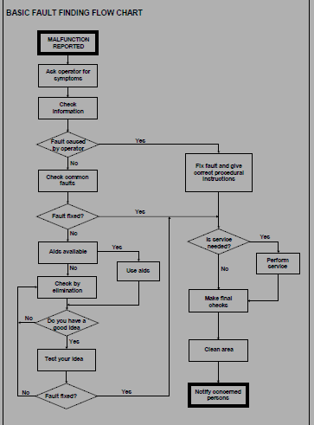
Systematic fault finding
Some of the equipment you are going to work on will most likely have manuals, hand books or instruction sheets with fault finding flow charts to assist you in tracing the likely faults quickly and efficiently. The Basic Fault Finding Flow Chart below should be of great help to do systematic fault finding. Click on the chart for more details.
Notes:
Basic fault finding chart= CTC, Book 4, EC-1, Pg 49.
Click on chart = In general, the successful testing of electrical circuits depends on the following factors:
• A fundamental knowledge of the circuit to be tested.
• An understanding of the operation of the components in the circuit.
• The ability to use the test equipment available.
• The ability to analyse results correctly.
In dealing with the simple electric circuits, isolate the defective stage of the circuit first, and then look for defective components in that stage. In more complex electric circuits, it is necessary to first locate the defective section, then the defective stage, and finally the defective equipment.

Slide 20
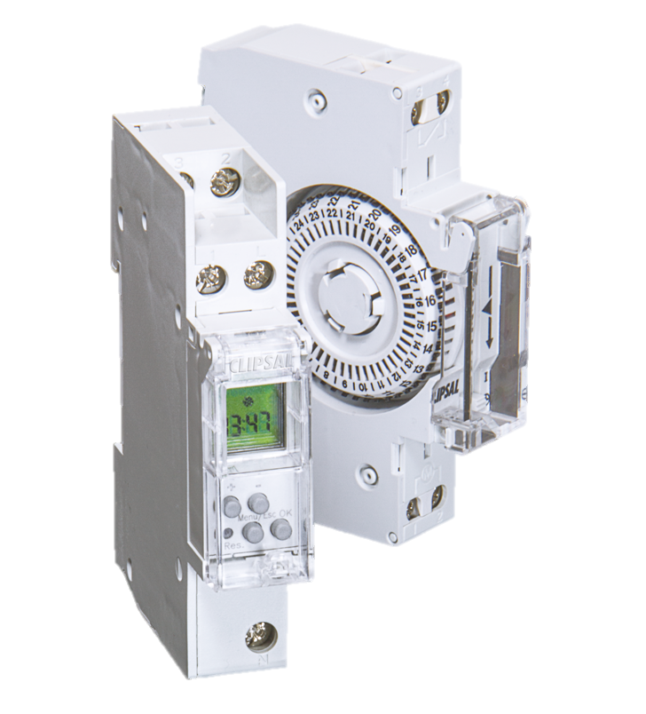
What is a timer?
A time switch or timer is a device used to delay the operation of the circuit. The timer consists of a coil, which when energised, operates a small motor like the one found in an electric clock. The motor drives a train of gears, which in turn operates the contacts.
Notes:
Img 02= https://www.clipsal.com/getmedia/b7d732c7-53f1-45f2-b539-ee051fef5f91/PO_Timers_PIS.png.aspx?width=728&height=804&ext=.png

Slide 21
Operation of a timer
The timer may have one N/O and one N/C contact or it may have many such open and closed contacts.
Timers can be operated electro-magnetically on a pneumatic principle or mechanically.
Notes:
Click on ‘pneumatic principle’ = link to the next slide (slide 21).
Click on ‘mechanically’ = link to next slide+1 (slide 22).

Slide 22
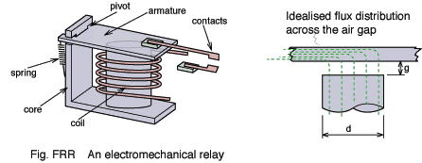
Pneumatic timer switch
A pneumatic device makes uses of gas or pressurised air.
When the coil is energised it attracts (pulls in) the armature. One end of a rod is connected to the armature and the other end to a diaphragm. The diaphragm is situated in a compartment where air is allowed to enter.
The moving contacts are fixed to the diaphragm by means of a length of non-conducting material. As the diaphragm moves the contacts move with it, thus opening or closing the contacts.
Notes:
Img 03 = http://info.ee.surrey.ac.uk/Workshop/advice/coils/relay.png

Slide 23
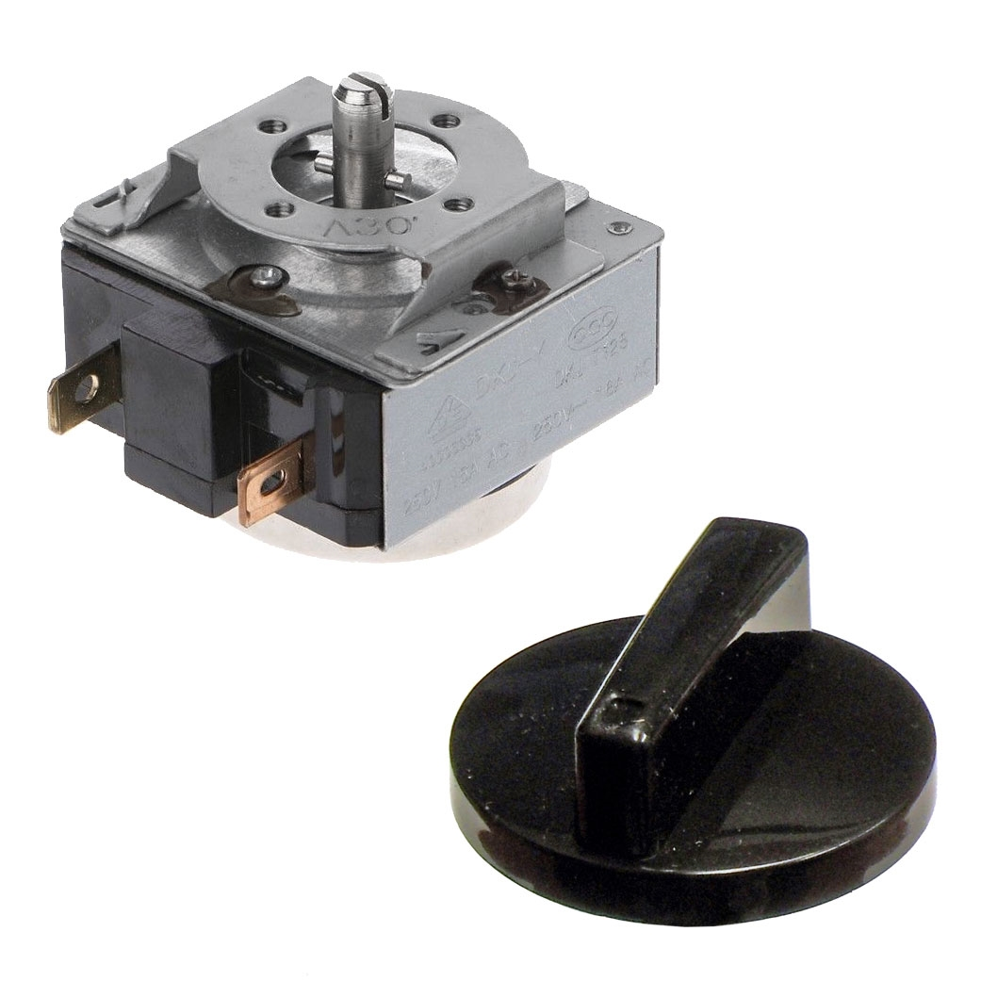
Mechanical timer
This timer operates on the same principle as an electric clock. When the coil is energised the motor starts turning. The motor shaft turns a train of gears. The last gear has pins on it which operate the contacts by either opening or closing them.
Notes:
Img 04 =https://cdn3.volusion.com/4mpcs.dyg25/v/vspfiles/photos/246-515-666-2.jpg?1536755163

Slide 24
Controlling a lamp with a timer
Set the timer to a certain time, so turn it away from the “off” position. Use a bell tester to test across the contact.
Their normal position that is N/O or N/C is always in that position when the timer is set. When the timer operates this situation is reversed, so a N/O switch will be closed and a N/C switch will be opened.

Slide 25
Watch the video below to see how a timer can be used to control lights
Video 01
Notes:
Click on Video01 = link to creative commons video https://www.youtube.com/watch?v=_-EP3F0SNL8

Slide 26
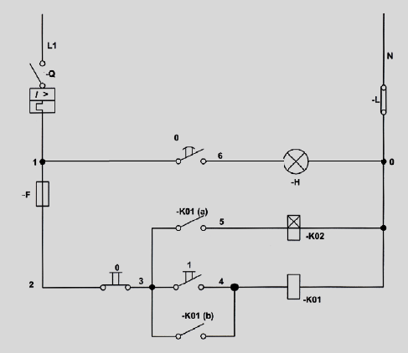
We return to the previous task: Circuit operation of a lamp - let’s add a timer
The circuit operates in the same way as the one used previously except that a timer has now been added to delay lamp operation.
When the circuit breaker is closed and the start button pressed, the relay will operate. In this case the relay will energise the coil of the timer instead of switching the light on.
Once the timer motor is energised it will start turning. The motor turns the gears, which in turn operate the contacts. When the times has run through it set time the N/O contacts will close. The closing of the contacts, switches on the light. To switch the light off the stop button (O) must be pressed.
Notes:
Fig 06 = CTC Book 4, EC-1, Page 51.

Slide 27
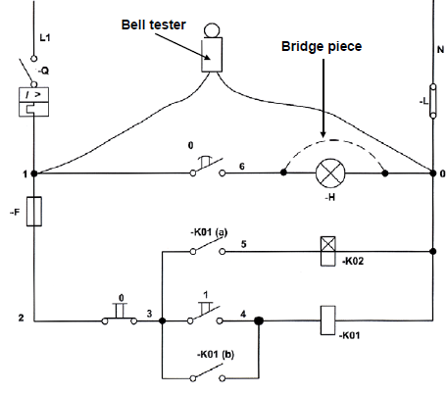
Wire a timer operated circuit
Wire a timer operated circuit controlling a lamp as shown in the figure below and test the circuit with a bell tester. Click on the figure for more information.
Did your circuit test out correctly? If not, find the fault by using the fault finding flow chart.
DANGER
LIVE TERMINALS
ISOLATE SUPPLY BEFORE WORKING ON TERMINALS
Notes:
Fig 07 = CTC Book 4, EC-1, Page 52.
Click on figure = Test the main circuit
• Connect one lead of the bell tester onto the load side of the circuit breaker and the other lead onto the neutral bar. The bell should not ring.
• Bridge the lampholder connections with a piece of wire.
• Turn the timer to the “off” position. The N/O contacts will close, thus finally completing the circuit. The bell should now ring.
The main circuit has now been tested.
Test the control circuit
• Remove the bridge from the lamp and bridge out the timer coil.
• Press the relay armature. The bell tester should now ring because contact -K01(a) completes the circuit.
• Press in the stop button, the bell tester should stop ringing.
• Remove the bridge from the timer coil and bridge the relay coil.
• Press the start button. The bell tester should ring.
• Release the start button and push in the relay armature. The bell tester should now ring again because the circuit is completed by contact -K01(b).
• Press the stop button while the relay armature is still pushed in. The bell tester will now stop ringing.

Slide 28
How to read diagrams
The symbols discussed up to here are only a few of those actually used, but for the purpose of doing this lesson, they will be adequate. If you want more information, get a book or manual that contains all the known symbols. Also make sure to go over Introduction to Drawings and Schematics.
The diagrams in the figures up to here, were drawn according to a system known as the ladder system. From now on the diagrams will be drawn according to a system known as the current path wiring system (downward wiring system).
Think of a complex schematic diagram of, for example a compressor or hoist and it will be obvious that it could not possibly fit onto one page. The problem is overcome by using more pages and an effective cross referencing system.
Notes:
Click on Introduction to Drawings and Schematics = link to that unit in World of electricians ( unit 4)

Slide 29
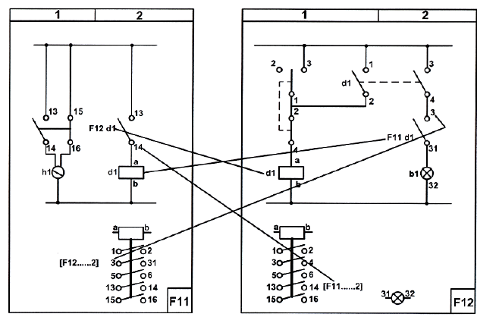
See if you can identify symbols and understand the cross referencing below
Notes:
Fig 08 = CTC Book 4, EC-1, Page 53.

Slide 30
Quiz time
Before you move on to truth tables, complete the quiz that follows to make sure you understand how timers work and how to read schematics.

Slide 31
Question 1
What is a timer? Write your answer in the text box below.
Notes:
Allow text to be entered.
Correct answer (accept slight variations of the following): A timer is a device, which is used to delay the operation of the circuit.

Slide 32
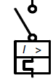
Question 2
What symbol is shown below?
Fuse
Relay
Timer
Circuit breaker
Notes:
MCQ Allow click on answer
Correct answer is D
Feedback:
Correct – Good job.
Incorrect – Try again.

Slide 33
Question 3
Name the two types of timer switches available.
A)
B)
Notes:
Allow answers to be entered into text boxes.
Correct answers (allow in any order):
A) Pneumatic timer switch
B) Mechanical timer

Slide 34
Completing truth tables
Truth tables are normally only used to fault-find electronic circuits. However, they will also help you to understand electric circuits better.
When completing truth tables, a “1” denotes a positive voltage (energised) and a “0” denotes a zero voltage (de-energised).
It is useful to make a diagram of the current paths in the circuit just below the circuit as it helps to locate the components.

Slide 35
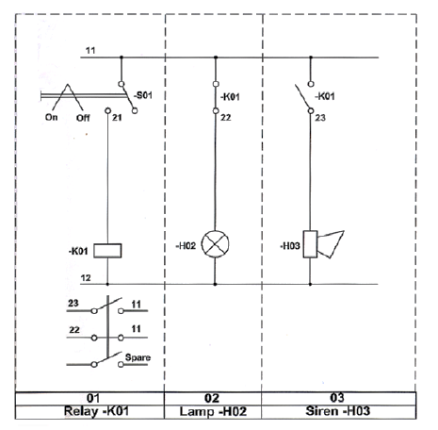
Example 1
Study the diagram shown. Remember the circuit is de-energised to start with as shown in the truth table.
Notes:
Allow scroll.
Fig 09 = CTC Book 4, EC-1, Page 57.

Slide 36
Example 1 continued
If you now switch on the main supply (with switch –S01 still in the off position) the truth table will change as follows:

Slide 37
Example 1 continued
With the power still on and switch –S01 in the on position, the truth table will change again, as shown below:
Because the relay is energised the contact’s state has changed.

Slide 38
Example 2
The truth table on the next page shows the state of the relays, bells, contacts and lamps for the circuit diagram, also on the next page, with the power on, and switches S1 and S2 closed. The state of the components is indicated with an “X”.

Slide 39
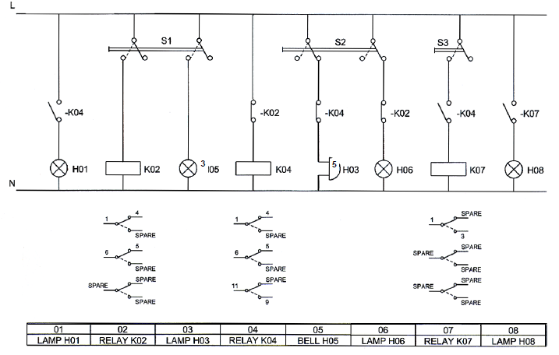
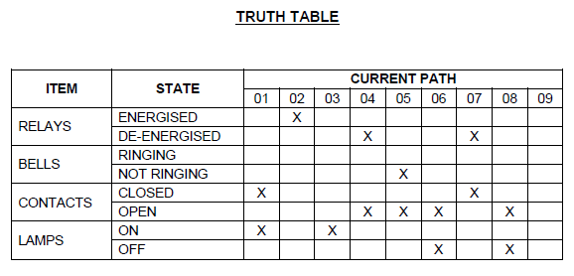
Example 2 continued
Notes:
Allow scroll.
Fig 10 = CTC Book 4, EC-1, Page 60.

Slide 40
Let’s review:
In this lesson we have covered:
Characteristics of relays.
Circuit operation of a lamp.
Controlling a lamp with a timer.
Basic fault finding.
Truth tables.
Make sure you have a complete understanding of all the work covered here before you start the next unit.

Slide 41
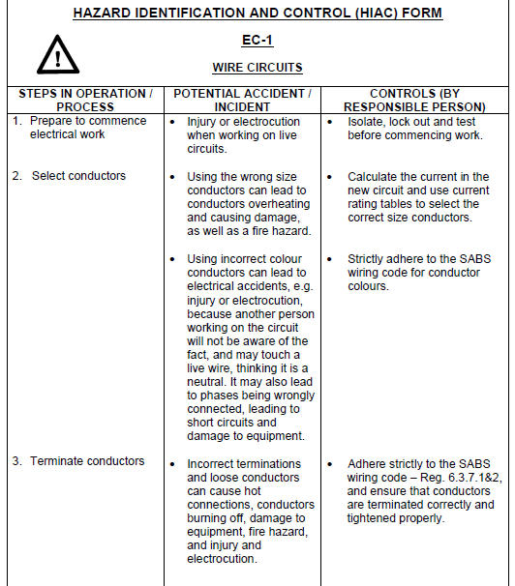
Form brief – Form 1
Notes:
Allow scroll on form.

Slide 42
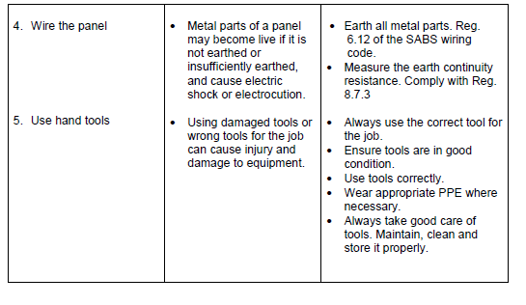
Form brief – Form 1 contin.
Notes:
Allow scroll on form.

Slide 43
Vid01
Get video via link: https://www.youtube.com/watch?v=_-EP3F0SNL8

