Slide 1
Electrical components and systems
Topic 9 – Lighting systems

Slide 2
Identifying lights and lighting circuits
Unit 9.2

Slide 3
Assumed prior learning
Lighting systems (light switching)
Wiring a panel
Don’t feel confident yet about these topics? Click on each to review the content.
Feeling confident? Click next to proceed with this unit.

Slide 4
Outcomes
Identify different lamp holders and lamps.
Wire and identify circuits for different types of lamps.
Mount day-light switches.
Troubleshoot common lighting problems.

Slide 5
Introduction
Working in well-lit areas is better than working in poorly lit areas. Also good lighting reduces the possibility of accidents. It is therefore essential for personnel working in metallurgical plants, factories and mines to ensure that all lighting and its associated equipment are properly maintained.
Notes:
Link each to the relevant section below.

Slide 6
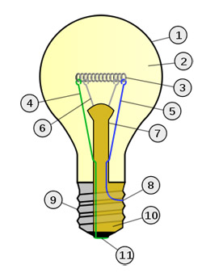
Eureka!
We all know what a light bulb looks like but few understand the components that make up a bulb and how it operates.
major parts of a modern incandescent light bulb
1 | Glass bulb
2 | Inert gas
3 | Tungsten filament
4 | Contact wire (goes to foot)
5 | Contact wire (goes to base)
6 | Support wires
7 | Glass mount/support
8 | Base contact wire
9 | Screw threads
10 | Insulation
11 | Electrical foot contact
Incandescent bulb
Notes:
Click on ‘eureka’=“Eureka (meaning “I found it”) is a well-known Greek phrase that is associated with a Greek mathematician named Archimedes. Legend has it, he proclaimed "Eureka! Eureka!" after he suddenly understood a mathematical concept to do with the volume of water. Today the word is often used when someone has a brilliant idea, it is also called ‘a lightbulb moment’.”
Img01: https://www.bulbs.com/images/resource_section/incandescent002.jpg
Allow click on each number shown on the bulb. Each click 1 to 11 to show information as in table. DO NOT SHOW THE TABLE, JUST ALLOW CLICK ON EACH NUMBER.

Slide 7
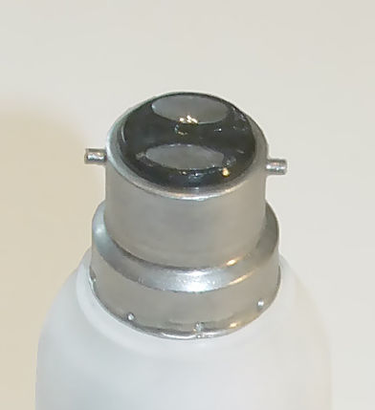
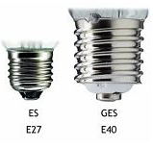
Lamp holders
Light bulb sockets, lamp sockets or lamp holders provide a lamp’s electrical connection. There are basically three types of lamp holders in general use:
BC - Bayonet cap
ES - Edison screw AND GES - Giant Edison Screw
(for higher wattage lamps)
Notes:
Img 01 ‘bayonet cap’:https://upload.wikimedia.org/wikipedia/commons/thumb/b/bc/Lightbulb-Bayonet-Cap.jpg/392px-Lightbulb-Bayonet-Cap.jpg
Img 02 ‘edison screw and giant edison screw’:http://www.lightbulbsocket.com/wp-content/uploads/2017/03/E14-Edison-Screw-Cap.jpg

Slide 8
Lamps
The light bulb or lamp, has come a long way since the days of Thomas Edison. Light bulbs are classified into the following groups:
• Incandescent
• Mercury tungsten
• Fluorescent
• Mercury vapour
• High pressure sodium
• Low pressure sodium
• Metal halide
Notes:
Click on:
‘Incandescent’ =“Glowing with white heat, shining brightly. An incandescent light bulb, incandescent lamp or incandescent light globe is an electric light with a wire filament heated to such a high temperature that it glows with visible light.”
‘Mercury tungsten’ = “Mercury is a silvery-white, normally liquid metal, also called quicksilver. Tungsten is a steel-grey heavy metallic element with very high melting- point, used for the filaments of electric lamps. A mercury tungsten lamp is one in which light is produced by a tungsten filament heated to incandescence by an electric current.”
‘Fluorescent’ = “An electric lamp that produces light through fluorescence (visible or invisible radiation). In most fluorescent lamps, a mixture of argon and mercury gas contained in a glass bulb is stimulated by an electric current, producing ultraviolet rays.”
‘Mercury vapour’=“A mercury-vapor lamp is a gas discharge lamp that uses an electric arc through vaporized mercury to produce light.”
‘High pressure sodium’=“High-pressure sodium lamps are started by a high-voltage pulse caused by an igniter which ceases to function once the arc has struck.”
‘Low pressure sodium’=“The lamp works by creating an electric arc through vaporized sodium metal.”
‘Metal halide’=“A metal-halide lamp is an electrical lamp that produces light by an electric arc through a gaseous mixture of vaporized mercury and metal halides.”

Slide 9
Comparing light bulbs
Each light bulb has advantages and disadvantages and certain lamps work better in different areas. Watch the video for detailed descriptions, uses, advantages and disadvantages of the different types of bulbs.
Vid01: Comparing light bulbs
Notes:
Vid 01 Play full screen, see Appendix for script.

Slide 10
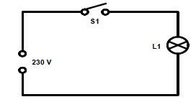
Try this after watching Video 01
Construct the circuit shown to observe the operation of incandescent lamps.
SAFETY FIRST !
Notes:
Diagram (Fig 6): CTC Book 3, LC-1, Page 36.
Click on safety first =“Live terminals isolate supply before working on terminals.”

Slide 11
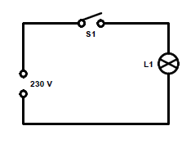
Try this after watching Video 01
Construct the circuit shown to observe the operation of the mercury tungsten lamp.
SAFETY FIRST !
Notes:
Diagram (Fig 8): CTC Book 3, LC-1, Page 37.
Click on safety first =“Live terminals isolate supply before working on terminals.”

Slide 12
Quiz time
Before you continue with Lighting Control, test your knowledge on the different types of light bulbs and circuits by completing the following questions.

Slide 13
Question 1
Name the three types of lamp holders.
1) ENTER ANSWER HERE
2) ENTER ANSWER HERE
3) ENTER ANSWER HERE
Notes:
Allow text to be entered.
Solution(Accept in any order):
Bayonet cap OR BC
Edison screw OR ES
Giant Edison Screw OR GES -

Slide 14
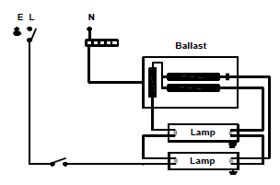
Question 2
The diagram below shows the circuit of which lamp?
Mercury vapour lamp circuit
Incandescent circuit
Two-tube slimline fluorescent circuit
Quick-start fluorescent circuit
Notes:
MCQ
Correct answer is C
Circuit: CTC Book3, LC-1, Page 46.
Feedback:
Correct – Good job.
Incorrect – Try again.

Slide 15
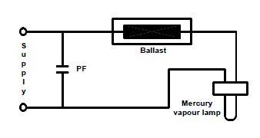
Question 3
The diagram below shows the circuit of which lamp?
Mercury vapour lamp circuit
Incandescent circuit
Two-tube slimline fluorescent circuit
Quick-start fluorescent circuit
Notes:
MCQ
Correct answer is A
Circuit: CTC Book3, LC-1, Page 50.
Feedback:
Correct – Good job.
Incorrect – Try again.

Slide 16
Question 4
The mercury vapour lamp requires control gear to stabilise the current.
TRUE
FALSE
Click on the correct answer.
Notes:
True or False
Correct answer is TRUE
Feedback:
Correct – Well done
Incorrect – That is not correct. The mercury vapour lamp is a discharge-type lamp and therefore requires control gear to stabilise the current.

Slide 17
Question 5
The high-pressure sodium lamp requires a ballast to stabilise and control the current.
TRUE
FALSE
Click on the correct answer.
Notes:
True or False
Correct answer is TRUE
Feedback:
Correct – Well done
Incorrect – That is not correct. The high-pressure sodium lamp is also a discharge lamp and therefore requires control gear (ballast) to stabilise and control the current.

Slide 18
Lighting control
Have you ever wondered how street lights turn on automatically at night?
The switching on and off of outside lighting is normally controlled either by a time-switch or a photo-electric cell. The photo-electric cell is generally preferred, as the time-switch has the disadvantage that it must be adjusted for summer and winter times.

Slide 19
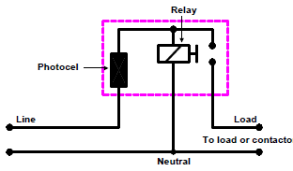
Photo-electric cells
The photo-electric cell (day-light switch) is basically a resistance, which is sensitive to light. Its resistance is increased when exposed to light and decreased when light is removed. The diagram below illustrates the internal arrangement of the switch.
Click for more information
Notes:
Figure 01: CTC Book 3, LC-1, Page 54 (Fig 28)
Click on figure = “The photo-electric cell is connected to a relay coil whose contacts operate either a lamp, or an external contactor if a multiple of lamps are to be controlled. The photo-electric cell is very sensitive and therefore will energise the relay at dusk and de-energise it at dawn.”

Slide 20
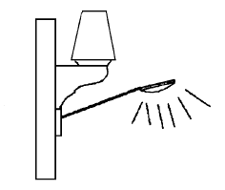
Positioning day-light switches
Choose a good location and select the right position for the switch so that it may work by the natural light only. The figure below illustrates such a position.
Care should be taken to avoid use of the switch in any of the following places:
• Where the switch is directly exposed to corrosive gases;
• Where the switch is exposed to salt water splashes;
• Where vapour or steam is constantly dissipated
Notes:
Figure 02: CTC Book 3, LC-1, Page 54 (Fig 29)

Slide 21
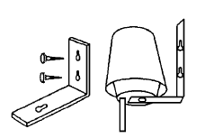
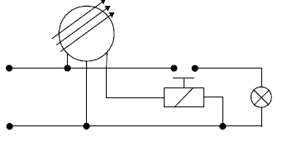
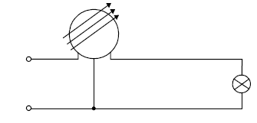
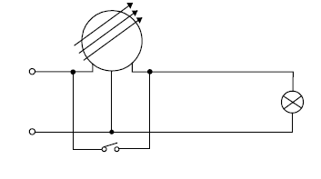
How to mount day-night switches
The method to mount day-light switch brackets is illustrated below. Click on each image, including the connection diagrams, for more information.
Mounting cells
Day-light switch with a contactor
Day-light switch without a contactor
Override switch
Notes:
Click on:
‘Mounting cells’=“Fix the metal bracket in a proper position. • Mount the day-light switch on the bracket as illustrated.”
‘Day-light switch with a contactor’ = “Some day-light switches have built-in delay circuits for obvious reasons, that is when it suddenly becomes dark due to clouds or if it is dark and a lightning strike lights up the area in the vicinity of the switch. A built-in delay will prevent the switch from turning the lamp on or off. Also some lamps have a “cool down” period before they start up again. Another point to remember is that a day-light switch will, when switched on during the day, stay on for approximately two minutes and then switch off. This is another characteristic of a day-light switch and in no way indicates a defective function of the device.”
‘Day-light switch without a contactor’ = “Some day-light switches have built-in delay circuits for obvious reasons, that is when it suddenly becomes dark due to clouds or if it is dark and a lightning strike lights up the area in the vicinity of the switch. A built-in delay will prevent the switch from turning the lamp on or off. Also some lamps have a “cool down” period before they start up again. Another point to remember is that a day-light switch will, when switched on during the day, stay on for approximately two minutes and then switch off. This is another characteristic of a day-light switch and in no way indicates a defective function of the device.”
‘Override switch’=“For testing the circuit during daylight you need an override switch, as shown here, to bypass the day-light switch or you have to cover the photo-electric switch with a dark cloth.
Figure03 ‘mounting day-light on brackets’: CTC Book 3, LC-1, Page 55 (Fig 30)
Figure 04,05,06: CTC Book 3, LC-1, Page 55-56 (Fig 31a, 31b and 32)

Slide 22
Safety aspects of lighting
All portable lights used for working inside filters, tanks or mills must be a low-voltage type. Click on ‘Safety first’ for a list of the safety precautions according to SANS regulations when working on lighting systems.
SAFETY FIRST !
Notes:
Click on ‘Safety first’ = “
All portable lights used for working inside filters, tanks or mills must be a low-voltage type. According to the regulations, these lamps will be 32 volt, fed from a portable 220 volt to 32 volt double-wound single-phase transformer. This transformer is plugged into a 220 volt socket via a 30 mA earth-leakage unit.
Care must be taken when testing circuits with transformer ballasts and igniters. The secondary windings of the transformers could produce high voltage while the igniter may generate high-pressure voltages.
Electrical equipment must always be isolated from its supply before any work is carried out on the equipment. This also applies when replacing lamps.
Type, wattage and voltage should be checked when replacing lamps and control gear. Lamps and control gear should always be kept clear of water.
Care should be taken when handling lighting equipment. Control gear is normally heavy and sometimes reaches high temperatures. Capacitors have only a thin shell and they must not be punctured, as some types contain a liquid, which will burn if it comes into contact with the skin or eyes.
If work is to be carried out for a prolonged period in close proximity to mercury discharge or metal halide lamps, suitable protection should be used. There is a possibility of a low-level ultra-violet radiation hazard, causing skin burns and arc-eyes.
When disposing of lamps and control gear, certain precautions should be taken. Fluorescent tubes and high-pressure discharge lamps should be broken in a closed container. The operation should be carried out outside or in a well ventilated area.
Low-pressure sodium lamps should be broken, taking precautions against the risk of fire. The lamps (not more than 20 at a time) should be broken into small pieces in a large dry container in a dry atmosphere. The container, when one quarter full, should be filled with water from a distance (using a hose). After a few minutes the metallic sodium will be inactive, and the debris may be disposed of as glass. Always be careful of flying glass when disposing of lamps.
Precautions must also be taken when disposing of ballasts and certain control gear. Some types contain a liquid that becomes harmful when incinerated.”

Slide 23
Troubleshooting
Click below for a table showing the symptoms, possible causes and remedies for each type of lamp
TABLE 01
Notes:
See Appendix for table 01.

Slide 24
Quiz time
We have come to the end of this unit. Answer the following questions to make sure you can identify lamps and their circuits.

Slide 25
Question 1
The time-switch is generally preferred, over the photo-electric cell.
TRUE
FALSE
Click on the correct answer.
Notes:
True or False
Correct answer is FALSE
Feedback:
Correct – Well done
Incorrect – That is not correct. The photo-electric cell is generally preferred, as the time-switch has the disadvantage that it must be adjusted for summer and winter times.

Slide 26
Question 2
If an incandescent lamp does not light but is visibly intact, then the possible remedy would be:
A faulty tube.
Supply could have been interrupted.
A faulty starter.
A faulty ballast.
Notes:
MCQ
Correct answer is B
Feedback:
Correct – Well done.
Incorrect – Try again.

Slide 27
Question 3
The operation of compact fluorescent lamps is identical to that of a switch-start circuit.
TRUE
FALSE
Click on the correct answer.
Notes:
True or False
Correct answer is TRUE
Feedback:
Correct – Well done
Incorrect – That is not correct.

Slide 28
Question 4
Click on the disadvantages of fluorescent lamps.
They are temperature sensitive and so are difficult to start in very cold weather.
They are expensive because they require chokes and starters for auxiliary starting.
Lamp life is about 1000 hours.
They have a low power factor.
Notes:
MCQ
Allow click on the letters a, b, c and d.
Correct answers are a, b and d.
Feedback:
Correct – Excellent.
Incorrect – Try again.

Slide 29
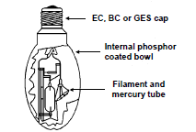
Question 5
Below is a diagram of a mercury tungsten lamp. What is A in the diagram called?
A
ENTER ANSWER HERE
Notes:
Allow text to be entered.
Solution =Internal phosphor coated bowl
Feedback:
Correct – Great job.
Incorrect – Try again.

Slide 30
Let’s review:
In this lesson we have covered:
Different types of lamps, including advantages and disadvantages.
Working with and identifying different lamp circuits.
Lighting control and day-light switches.
Troubleshooting for common lighting problems.
Safety procedures when working with lighting systems.
Make sure you have a complete understanding of all the work covered here before you start the next unit.

Slide 31
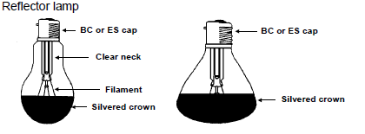
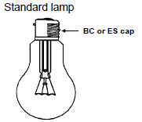
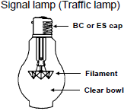
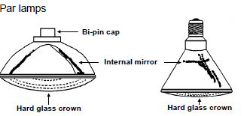
Video brief - Vid01 Expert presenter describing and comparing light bulbs
Voice over | Image
There are many different types of light bulbs. We will go over each type in detail and list the advantages and disadvantages of each. See SANS Regulation 6.14.1 for lighting installation guide. We start with the Incandescent lamps. The advantage of using incandescent lamps is that control gear is not required. However, the disadvantage is the amount of heat generated and the amount of light (luminance) per watt being very small compared to lamps with control gear. The luminous efficiency of an incandescent lamp is ± 14 lumens/watt. These lamps are available in different sizes, wattages, cap types and colours. These are generally classified as reflector lamps, standard lamps, signal or traffic lamps, par lamps and the tungsten halogen lamps. Incandescent light output is determined by the temperature of the filament. The higher the temperature, the brighter the bulb (lumens per watt of power consumed), and the shorter the life. These lamps should operate at the recommended voltage stated on the lamp. Under-voltage operation will result in longer lamp life, but a reduction in wattage, efficiency and light output. Over-voltage operation results in higher wattage, efficiency and light output but a shorter lamp life. | Incandescent lamps
Notes:
Images are just for reference and the presenter as far as possible must show actual bulbs and components and link to script. Create video similar to: https://www.youtube.com/watch?v=DIGqBb3iZPo using script as above.
All images of lamps from 1 to 5: CTC Book 3, LC-1, Pg 35.

Slide 32
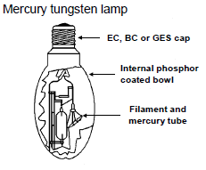
Video brief - Vid01 contin. Expert presenter describing and comparing light bulbs
Voice over | Image
As an incandescent lamp burns at a constant voltage, the filament will gradually deteriorate, causing a slow but continuous reduction in wattage and light output, until the normal end of its life is reached when the filament will break or burn through at its thinnest spot. To reduce the rate of evaporation of the filament, which is made of tungsten, the lamp bulb is filled with an inert gas, such as argon or nitrogen, which does not affect the filament chemically. | Demonstrate this with an incandescent bulb .
Next we move on to Mercury tungsten lamps. Mercury tungsten lamps or mercury blended, as they are normally called, also require no control gear. The luminous efficacy is ± 20 lumens / watt. | Mercury tungsten lamps
Notes:
Images are just for reference and the presenter as far as possible must show actual bulbs and components and link to script. Create video similar to: https://www.youtube.com/watch?v=DIGqBb3iZPo using script as above.
Image of Mercury tungsten lamp : CTC Book 3, LC-1, Page 36.

Slide 33
Video brief - Vid01 contin. Expert presenter describing and comparing light bulbs
Voice over | Image
This type of lamp consists of a mercury discharge tube in series with a tungsten filament, and are available in BC, ES or GES cap-type. Operating voltage is 230 volts, and they are available in 160, 250 and 500 watts. The lamp life is ± 6000 hours. When the lamp is initially switched on it takes approximately one to two minutes to obtain its maximum light output. If the power supply is interrupted at any time, the hot re-ignition time takes five to seven minutes. A minimum of 198 volts is required to strike the lamp and an added advantage is that it will operate, mounted in any position. | Mercury tungsten lamps
Notes:
Images are just for reference and the presenter as far as possible must show actual bulbs and components and link to script. Create video similar to: https://www.youtube.com/watch?v=DIGqBb3iZPo using script as above.
Image of Mercury tungsten lamp : CTC Book 3, LC-1, Page 36.

Slide 34
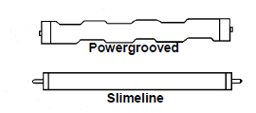
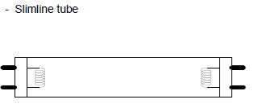
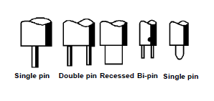
Video brief - Vid01 contin. Expert presenter describing and comparing light bulbs
Voice over | Image
Before discussing the wiring of fluorescent lamps, we first go over a brief description on the different types and how they operate. In contrast to the well known filament lamp in which electricity flows from one lead wire to another through the solid tungsten wire, thus heating it to incandescence (glowing with heat), the fluorescent lamp is a glass tube, with a filament-type electrode sealed into each of its ends. The filaments are made of coils of tungsten wire and are coated with a material, which has the ability to emit electrons. The inner surface of the tube is coated with a layer of a phosphor. During the manufacturing of the lamp, most of the air is removed from the tube and a small amount of argon gas and mercury vapour is placed inside it. This fluorescent lamp is an electrical discharge source, which makes use of ultra violet energy, generated by passing an electric current through a low-pressure mercury vapour, to activate the phosphor coating on the inner surface of the glass tube. The life of a florescent lamp depends to a certain degree on the frequency of switching. A lamp, which is switched infrequently will last considerably longer. For the fluorescent lamp to produce light, control gear is required. The function of the control gear is to create a momentary high voltage impulse, in order to establish an arc between the electrodes (filaments), and to limit the arc current. The two principle elements required are an iron-cored choke coil, called a ballast, which causes the high voltage and limits the current flowing through the lamp, and a starter or a method of starting the arc between the electrodes. There are two basic types of tubes available, namely the slimline and the “power grooved”. Slimline tubes are the most commonly used and are used in offices, shops, etc. Power grooved tubes require a much higher voltage than the slimline tubes and provide more illumination. Fluorescent tubes are obtainable in wattages from 4 to 215 watts and voltages from 6 to 230 volts. The luminous efficacy is ± 80 lumens / watt. Here is a typical slimline fluorescent lamp. These lamps are also manufactured in a “U” or “C” shape as well as the normal straight tube. They are also available in different cap-types | Fluorescent lamps (presenter to demonstrate as per script wording)
Notes:
Images are just for reference and the presenter as far as possible must show actual bulbs and components and link to script. Create video similar to: https://www.youtube.com/watch?v=DIGqBb3iZPo using script as above.
Image of slimline and the “power grooved” lamps (Fig 9) : CTC Book 3, LC-1, Page 40.
Image of slimline tube(Fig 10):CTC Book 3, LC-1, Page 40.
Image of cap types (Fig 11): CTC Book 3, LC-1, Page 40.

Slide 35
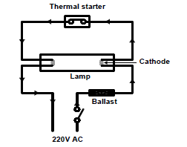
Video brief - Vid01 contin. Expert presenter describing and comparing light bulbs
Voice over | Image
Now that you understand the different types of Fluorescent lamps , we move onto the method of operation. The choke (ballast): • The choke, or ballast, is a coil of wire wound around an iron core. When AC current flows a change in the direction of current is opposed by the inductive reactance of the coil. • When the current flowing through the choke is suddenly cut off, the magnetic field around the coil collapses, inducing a high voltage into the coil. This principle is used for the starting circuit of a fluorescent lamp but special types of ballasts are used for power grooved tubes. The ignition of a fluorescent tube: • When the line switch is closed, current flows through the choke, through the one filament (cathode) through the starter, and through the second cathode back to the other side of the line. The arrows in show this flow. •When this occurs, the ends of the lamp glow but do not light up. After one or two seconds the starter switch, which contains a bi-metal strip, which is heated up by the current, opens. The current stops flowing through the choke and the magnetic field around the choke coil collapses, thus inducing a high voltage. The voltage “kick” establishes an arc between the two cathodes of the fluorescent tube. Once started, the arc continues and the fluorescent tubes glows from radiation of the electric arc. The choke has performed its first duty, that is that of starting the arc in the tube. | Fluorescent lamps contin.(presenter to demonstrate as per script wording)
Notes:
Images are just for reference and the presenter as far as possible must show actual bulbs and components and link to script. Create video similar to: https://www.youtube.com/watch?v=DIGqBb3iZPo using script as above.
Image of (Fig 12) : CTC Book 3, LC-1, Page 41.

Slide 36
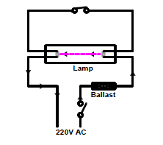
Video brief - Vid01 contin. Expert presenter describing and comparing light bulbs
Voice over | Image
Here now we see the flow of current through the fluorescent tube, after it has been started, the starter switch is open. The current flows as indicated by the arrows, i.e. through the choke, the tube, the mercury vapour and back to the other side of the line. • The choke also limits the current flowing through the lamp. This is done by the inductive reactance of the choke coil. The current flows through the space from one end of the lamp to the other end. • The cathodes are of tungsten wire, coated with a layer of barium oxide. (The barium oxide when heated emits electrons). • The electrons boil off the barium coating in much the same way as steam from boiling water, and the argon gas in the fluorescent tubes provides the path for the electron current. • The electrons heat the argon gas by colliding with the gas particles. The hot argon gas heats the mercury, which vaporises. The vaporised mercury (mercury being an electrical conductor) becomes the path for the current. The electrons emitted from the cathode hit the fluorescent coating in the tube and the coating glows, giving off light. • The electron stream is emitted from one cathode and it flows to the opposite end on the first half of an AC cycle. On the second half of the AC cycle the current reverses, and so it continues at a rate of 50 times per second. | Fluorescent lamps contin.(presenter to demonstrate as per script wording)
Notes:
Images are just for reference and the presenter as far as possible must show actual bulbs and components and link to script. Create video similar to: https://www.youtube.com/watch?v=DIGqBb3iZPo using script as above.
Image of circuit ( Fig 13) : CTC Book 3, LC-1, Page 42.

Slide 37
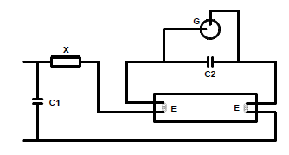
Video brief - Vid01 contin. Expert presenter describing and comparing light bulbs
Voice over | Image
There are different methods of starting fluorescent lamps; Thermal starter (which we’ve just discussed), Quick starter and Glow starting switch. In the Quick starter method a cathode is on each end of the lamp but they are not short-circuited. A starter is not required. The cathode is heated by a special winding in the choke and the starting principle is the same as for the instant-start tubes. A glow starter (G) consists of two electrodes enclosed in a glass bulb filled with a mixture of helium and hydrogen. • One electrode is fixed and the other is a U-shaped bimetallic strip. The contacts are N/O (normally open), but the application of the supply voltage starts a glow discharge between the electrodes, and the heat generated is sufficient to bend the bi-metal strip until it makes contact with the fixed electrode, thereby closing the circuit causing the current to flow through the electrodes (E). A relatively large current flows through the electrodes raising them to incandescence (to glow with heat). • After a second or two, the bi-metal strip in the starter cools down sufficiently to break contact and the sudden interruption of current induce a voltage surge in the choke (X). The surge is sufficient to ionise the argon in the space between the electrodes E-E, causing the tube to strike. • The heat generated in the tube vaporises the mercury, and the potential difference across the tube falls to about 100 – 110 volts. This potential difference is not sufficient to restart the flow in the starter switch (G). | Methods of starting fluorescent lamps (presenter to demonstrate as per script wording) Glow starting switch (This diagram will need to be used unless presenter constructs the circuit and uses labels, G C etc.)
Notes:
Images are just for reference and the presenter as far as possible must show actual bulbs and components and link to script. Create video similar to: https://www.youtube.com/watch?v=DIGqBb3iZPo using script as above.
Image of Glow starting switch (Fig 14) : CTC Book 3, LC-1, Page 42.

Slide 38
Video brief - Vid01 contin. Expert presenter describing and comparing light bulbs
Voice over | Image
The are a few advantages of fluorescent lighting: The light output per watt is greater than the output by normal lamps. •The light output of a 30 watt fluorescent lamp and a 100 watt incandescent lamp is approximately the same. • The generation of low heat results in a possible saving in air conditioning. • Lamp life is about 7500 hours as compared to the 1000 hours for incandescent lamps. • It gives surface brightness and therefore produces less glare. The disadvantages of fluorescent lamps are: • They are temperature sensitive and so are difficult to start in very cold weather. • They are expensive because they require chokes and starters for auxiliary starting. • They have a low power factor. | Advantages of fluorescent lighting (can have the words pop up on screen under the headings) •The light output per watt is greater than the output by normal lamps. The light output of a 30 watt fluorescent lamp and a 100 watt incandescent lamp is approximately the same. • The generation of low heat results in a possible saving in air conditioning. • Lamp life is about 7500 hours as compared to the 1000 hours for incandescent lamps. • It gives surface brightness and therefore produces less glare. Disadvantages of fluorescent lamps: • They are temperature sensitive and so are difficult to start in very cold weather. • They are expensive because they require chokes and starters for auxiliary starting. • They have a low power factor.
Notes:
Images are just for reference and the presenter as far as possible must show actual bulbs and components and link to script. Create video similar to: https://www.youtube.com/watch?v=DIGqBb3iZPo using script as above.

Slide 39
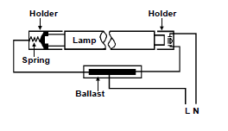
Video brief - Vid01 contin. Expert presenter describing and comparing light bulbs
Voice over | Image
We now look at the Slimline fluorescent lamp in more detail. This is the most common type of lamp and is started without the normal preheating process. It uses a higher starting voltage, for example about 625 to 750 volts for the 2,4 metre 72 watt lamp. Direct starting eliminates the starter. After starting the lamp, voltage is reduced to limit the current. This is achieved by a specially designed transformer or ballast. • Due to the high voltages involved the circuit is normally so designed to open the primary circuit when the lamp is removed. The circuit of such a lamp is shown here. | Slimline fluorescent lamp:
Notes:
Images are just for reference and the presenter as far as possible must show actual bulbs and components and link to script. Create video similar to: https://www.youtube.com/watch?v=DIGqBb3iZPo using script as above.
Image of Slim line circuit (Fig 15) : CTC Book 3, LC-1, Page 45.

Slide 40
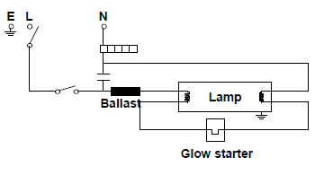
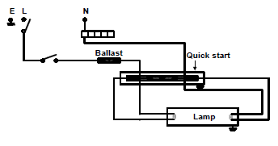
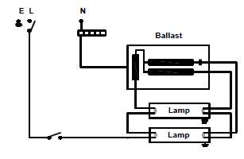
Video brief - Vid01 contin. Expert presenter describing and comparing light bulbs
Voice over | Image
The circuit diagrams are for the different fluorescent fittings. Study the diagrams carefully as you will be required to draw them from memory. | Glow-start fluorescent circuit (exact diagrams to be used) Two-tube slimline fluorescent circuit
Notes:
Image of circuits (Fig 16, 17 and 18) : CTC Book 3, LC-1, Page 45-46.
Images of circuits to be scaled up and clearly visible. Images to pop up on screen.

Slide 41
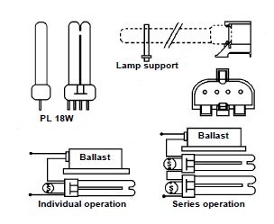
Video brief - Vid01 contin. Expert presenter describing and comparing light bulbs
Voice over | Image
The last type of fluorescent bulb we discuss is the Compact fluorescent lamps or CFL. Compact fluorescent lamps, also known as PL lamps are compact, single-ended, cost-saving lamps in 18 W, 24 W and 36 W ratings, manufactured in the colours, warm-white, white and with a tube diameter of 17,5 mm. They have four-pin bases for universal applications. • By applying the very efficient tri-phosphor fluorescent powders, these PL lamps offer a combination of compact dimensions, high luminous efficacy and excellent colour rendering properties, thus making them ideal cost-saving light sources for many indoor and outdoor applications. • Because of the four-pin base, the lamps are suitable for operation in conventional high-voltage switch-start circuits, in low-voltage sequence-start circuits, and in advanced electronic circuits. • PL lamps also outlast normal incandescent lamps’ lifespan by about 5 times. An 18W PL lamp’s light output is roughly the same as a 100 W incandescent lamp’s light output. The operation of compact fluorescent lamps is identical to that of a rapid or switch-start circuit. Some lamps are manufactured with its own electronic starter built into it and these will have only two (2) points for connection. They also come in the ES & BC package for ease of installation. The four pin lamps need a separate switch starter (ballast). Here is an example of a PL lamp, its construction, holder and connection diagrams. | Compact fluorescent lamps:
Notes:
Images are just for reference and the presenter as far as possible must show actual bulbs and components and link to script.
Image of CFL(Fig 19) : CTC Book 3, LC-1, Page 47.

Slide 42
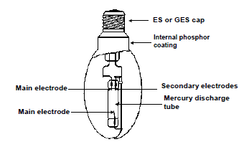
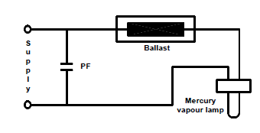
Video brief - Vid01 contin. Expert presenter describing and comparing light bulbs
Voice over | Image
We move on now to the next type of lamp, called a Mercury vapour lamp. The mercury vapour lamp is a discharge-type lamp and therefore requires control gear to stabilise the current. The luminous efficacy is ± 55 lumen/watt. When voltage is applied to the two main electrodes in the discharge tube, ionisation of the gas takes place and current will flow between the electrodes. This current will continue to increase until it destroys the lamp, unless it is externally controlled by means of a ballast (choke). These lamps are available in wattages from 50 to 1000 watts. A typical electric circuit is shown. This type of lamp strikes immediately, but its re-strike time is ± 7 minutes. The mercury vapour lamp takes four to five minutes to reach 80% of maximum light output. | Mercury vapour lamp Typical Mercury vapour lamp circuit (either to be drawn by presenter or demonstrated)
Notes:
Images are just for reference and the presenter as far as possible must show actual bulbs and components and link to script.
Image of Mercury vapour lamp (Fig 20) : CTC Book 3, LC-1, Page 50.

Slide 43
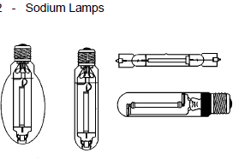
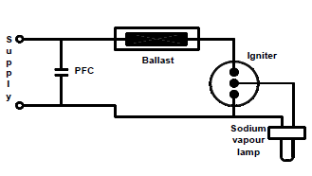
Video brief - Vid01 contin. Expert presenter describing and comparing light bulbs
Voice over | Image
The high-pressure sodium lamp is also a discharge lamp and therefore requires control gear (ballast) to stabilise and control the current. This type of lamp also requires an ignition to strike the lamp. The lamp is available in phosphor-coated and clear bulbs. AS you can see there are three types . High-pressure sodium lamps are started by a high-voltage pulse caused by an igniter which ceases to function once the arc has struck. Full brightness is achieved in about five minutes, and the average re-strike time is thirty seconds. A simple circuit is shown here. These types of lamps are manufactured in wattages ranging from 70 to 1000 watts. | High-pressure sodium lamp High-pressure sodium lamp circuit
Notes:
Images are just for reference and the presenter as far as possible must show actual bulbs and components and link to script.
Image of High-pressure sodium lamp (Fig 22) : CTC Book 3, LC-1, Page 51.
Image of High-pressure sodium lamp circuit (Fig 23) : CTC Book 3, LC-1, Page 51.

Slide 44
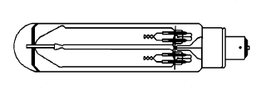
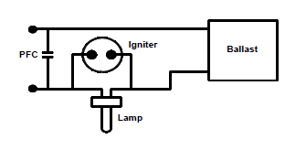
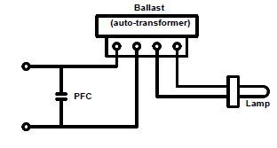
Video brief - Vid01 contin. Expert presenter describing and comparing light bulbs
Voice over | Image
Both High-pressure sodium lamps and Low-pressure sodium lamps are commonly used for outdoor lighting like parking lots, along streets and highways, Low pressure sodium lamps produce more light per watt of energy consumed than high-pressure sodium lamps, which are slightly less efficient. Low-pressure sodium discharge lamps are available in wattages from 80 to 180 watts. Luminous efficacy is ± 150 lumen/watt. An example of a low-pressure sodium lamp, using a U-shape arc tube, as seen here. The lower voltage lamps make use of an external igniter while the higher voltage lamps are started by means of a step-up auto-transformer, which acts as a ballast when the lamp is working. Here we have two circuit diagrams of the Low-pressure sodium lamp . The lamp takes about seven minutes to reach its full brightness and it will re-strike immediately if the power is interrupted. | Low-pressure sodium lamp Low-pressure sodium lamp circuit
Notes:
Images are just for reference and the presenter as far as possible must show actual bulbs and components and link to script.
Image of Low-pressure sodium lamp (Fig 24) : CTC Book 3, LC-1, Page 52.
Image of Low-pressure sodium lamp circuit (Fig 25) : CTC Book 3, LC-1, Page 52.

Slide 45
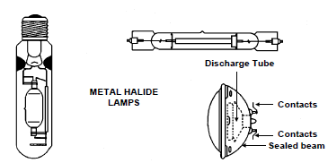
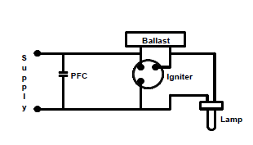
Video brief - Vid01 contin. Expert presenter describing and comparing light bulbs
Voice over | Image
Lastly, we come to the Metal halide lamps. Metal halide lamps are manufactured in various shapes and sizes. Some have clean envelopes while others have an internal phosphor coating. These lamps must never be touched with the bare hands. If by accident, contact is made with the hands, clean the lamp with electrical solvent. These lamps range in wattages from 250 to 3500 watt and their luminous efficacy is ± 75 lumens / watt. Here are examples of these lamps. Metal halide lamps are started by means of an igniter and controlled by a ballast. This is the electrical circuit. Other circuits do exist, but they are only used for special purposes such as those used for photography. | Metal halide lamps Metal halide lamp ciruit diagram
Notes:
Images are just for reference and the presenter as far as possible must show actual bulbs and components and link to script.
Image of Metal halide lamps (Fig 26) : CTC Book 3, LC-1, Page 53.
Image of Metal halide lamp circuit (Fig 27) : CTC Book 3, LC-1, Page 53.

Slide 46
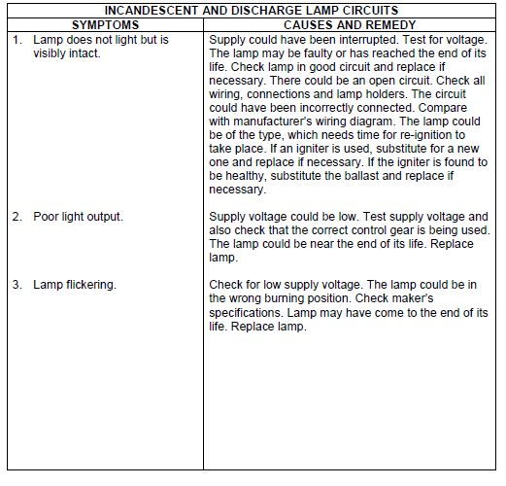
Table brief – Table 01 contin.
Notes:
Allow scroll down and up.

Slide 47
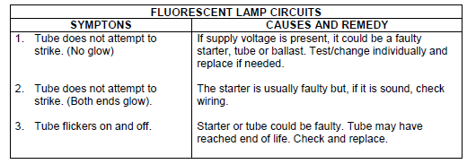
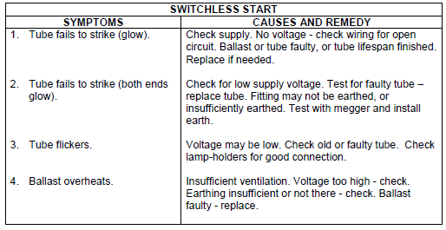
Table brief – Table 01 contin.
Notes:
Allow scroll down and up.

Slide 48
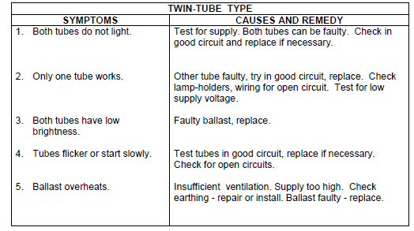
Table brief – Table 01 contin.
Notes:
Allow scroll down and up.

