Slide 1
Electrical components and systems
Topic 9 – Lighting systems

Slide 2
Light switching and circuit testing
Unit 9.1

Slide 3
Assumed prior learning
Electrical components (circuit protection).
Wire a circuit.
Don’t feel confident yet about these topics? Click on each to review the content.
Feeling confident? Click next to proceed with this unit.
Notes:
Link to unit upon clicking.

Slide 4
Outcomes
Explain the different types of light switching.
Understand and interpret all symbols used in a circuit diagram.
Wire a two-way switch.
Wire an intermediate switch.
Test a circuit using a bell tester.
Notes:
Link each to the relevant section below.

Slide 5
Introduction
Lighting systems are essential in modern society. In this lesson we focus on the different ways lights can be wired and get to grips with circuit diagrams.

Slide 6
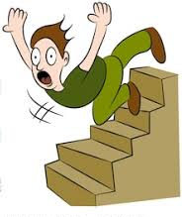
Mr West needs your help
Mr. West has moved into a very old house. The house has a staircase leading up to the bedroom. There is one light switch at the bottom of the staircase so he can turn the light on or off when he is at the bottom of the staircase but when he reaches the top of the staircase he cannot turn the light off. The house is very dark at night and Mr. West cannot make is way up the stairs if the light is not on. How can he switch the light off when he is at the top of the stairs without going back down again?
Notes:
Img 01: https://bit.ly/2QDzOef

Slide 7
To solve Mr. West’s problem you will need to know more about light switches and circuits. We go over that first and then help him a little later on when we have a much better understanding of light switching.

Slide 8
Standard symbols
In order for you to read and understand a circuit diagram, you must be able to identify electrical equipment and components from the symbols that are used. There are many different symbols you need to recognise, rather than memorizing the symbols make sure you understand them and it will be easier to recall. View the chart by clicking below for DIN and IEC symbols commonly used.
STANDARD SYMBOLS
Notes:
On click of ‘Standard symbols’ = Display chart 01 as in appendix.

Slide 9
Equipment identification
Equipment and components can also be identified by a minus sign and a capital letter, click the button below to view the standard identification.
EQUIPMENT IDENTIFICATION
Notes:
On click of ‘equipment identification’= show table 01. See Appendix for details.

Slide 10
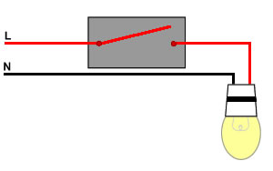
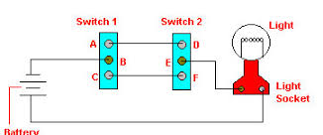
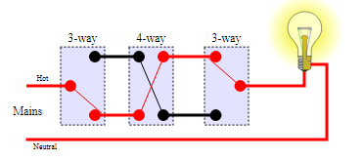
Switching methods
There are many types of switches and they are used for various purposes. Click on any image to watch a video on light switching.
Notes:
Img01: https://socketstore.co.uk/media/65663/one-way-switch-diagram.jpg
Img02:https://encrypted-tbn0.gstatic.com/images?q=tbn:ANd9GcTFxW2NfEJYbEbCq_ICtLKeukwl18ddF0U94Pr5NOfsphoa4aPR
Img03:https://upload.wikimedia.org/wikipedia/commons/thumb/4/47/4-way_switches_position_2.svg/350px-4-way_switches_position_2.svg.png
Click on Img 01, Img02 or Img03 =Play Vid01 full screen. See appendix for script.

Slide 11
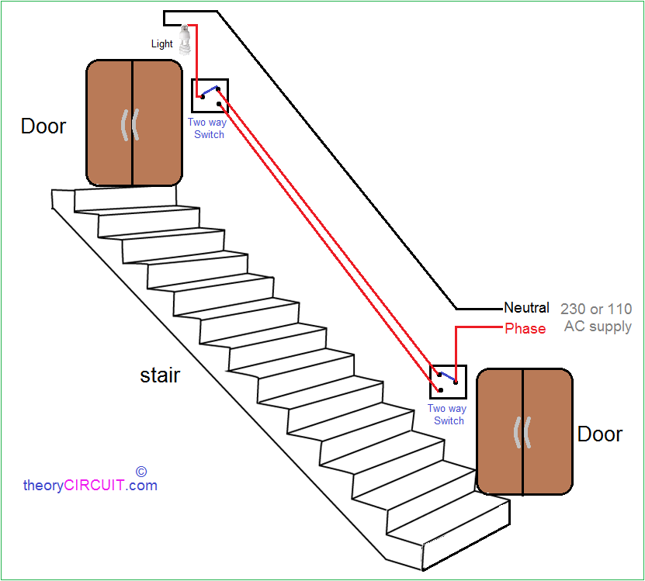
After watching the video on light switching you should be able to help Mr West now. Compare your answer to the one below.
In order for Mr. West to switch the staircase light off from the top of the staircase without going back down, he must install a two-way switch. Two way switching is the method by which one or more lamps may be switched on or off from either of two places, any distance apart, like the top and bottom of the staircase in Mr. West’s case.
Notes:
Img04: http://lambdarepos.org/wp-content/uploads/2018/06/stair-case-light-wiring-for-two-way-switch-wiring-diagram.png

Slide 12
Quiz time
Test your understanding of light switching and circuit diagrams by answering the following questions.

Slide 13
Question 1
What component or piece of equipment does -M identify?
Power switching
Motors
Measuring instruments
Mechanical equipment
Notes:
MCQ
Correct answer is B
Feedback:
Correct – Good job.
Incorrect – Try again. Go over all Equipment Identification letter symbols thoroughly and commit them all to memory.

Slide 14
Question 2
What does the following symbol represent in a circuit diagram?
Lamp
Timer coil for a delay contact
Thermal tripping device
Switching mechanism
Notes:
MCQ
Correct answer is D
Feedback:
Correct – Good job.
Incorrect – Try again.

Slide 15
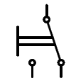
Question 3
Which symbol represents a manual change-over switch?
Img
Img
Img
Img
Notes:
MCQ
Correct answer is C
Feedback:
Correct – Good job.
Incorrect – Try again.

Slide 16
Question 4
What type of control system would you used to control a light point from two different points?
One way
Two way
Intermediate switch
Dimmer switch
Notes:
MCQ
Correct answer is B
Feedback:
Correct – Good job.
Incorrect – Try again.

Slide 17
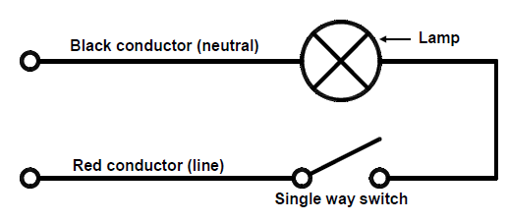
Question 4
What is A in the diagram called?
Isolator
Two-way switch
Single-way switch
Dimmer switch
A
Notes:
MCQ
Correct answer is C
Feedback:
Correct – Good job.
Incorrect – Try again.

Slide 18
Electrical protection
In all of the previous circuit diagrams it was assumed that a 220 V AC supply was used. Therefore, some form of protection must be incorporated to protect persons, equipment, cables and wires. Fuses and circuit breakers are used for this purpose.
Notes:
Click on ‘fuses’ = “Fuses are used to disconnect a circuit when the current exceeds a certain value. You can also find the definition for a fuse in the Electrical components, circuit protection unit. The revised SANS Code of Practice for the Wiring of Premises does not allow for the use of fuses in a domestic installation. Look up regulation 6.10.1.”
Click on ‘circuit breakers’ = “Circuit breakers are used for disconnecting a load when the current exceeds a certain value. Study the definition for a circuit breaker in the SANS Code of Practice for the Wiring of Premises (section 2 under circuit breaker). For further information on the construction and operation of fuses and circuit breakers, see the Electrical components, circuit protection unit.

Slide 19
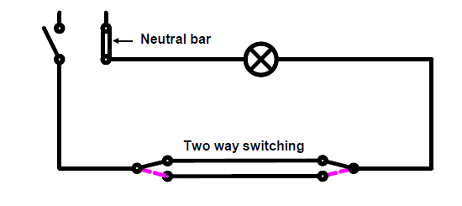
Practise: Wire a two-way switching circuit
Wire a two-way switching circuit controlling a lamp as shown in the circuit diagram.
For more help on wiring circuits see Getting familiar with resistors .
You will need:
a) a circuit breaker,
b) two two-way switches,
c) a 220 V lamp,
d) a lamp holder and
e) conductors (wire).
Notes:
Two-way switching circuit diagram: CTC Book 3, LS-1, Pg 24
Click on ‘Getting familiar with resistors’ = redirect to that topic

Slide 20
Steps: Wire a two-way switching circuit
Calculate the current that the lamp will draw by means of the power equation (you have the lamp wattage and voltage).
$$I=\frac{P}{V}$$
Select the correct size of conductor by using current rating tables.
Wire the circuit. (The wiring and terminating of conductors must conform to that described in Wiring a panel).
Test the circuit with a bell tester.
Notes:
Click on ‘Wiring a panel’ = redirect to that topic in Electrical components.
Click on ‘bell tester’ = link to slide 22

Slide 21
Testing a circuit
Before any electrical installation is made or apparatus is connected to a supply, tests should be carried out to check that the operation of the circuit is correct. There are several methods of carrying out these tests, but only the commonly used bell tester will be described in this lesson.
Notes:
Link each to the relevant section below.

Slide 22
The bell tester
The bell tester consists of a battery and an electrical bell or buzzer which is usually built into a portable box.
SAFETY FIRST !
USING A BELL TESTER TO TEST A CIRCUIT
Notes:
Click on ‘Safety first’ = “NEVER TEST A CIRCUIT WITH THE SUPPLY TURNED ON.”
Click on ‘Using a bell tester to test a circuit’ =Play Vid02, full-screen. For script see Appendix

Slide 23
Quiz time
We have come to the end of this unit. Answer the following questions to make sure you understand how to work with circuits.

Slide 24
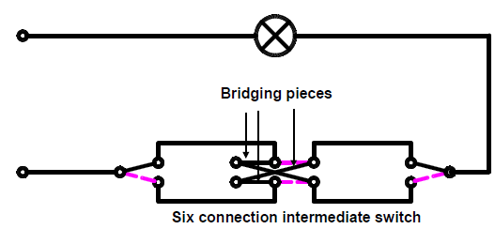
Question 1
What is this diagram showing?
Single-way switching
Two-way switching
Intermediate switching
Four-way switching
A
Notes:
MCQ
Correct answer is C
Feedback:
Correct – Well done.
Incorrect – Try again.

Slide 25
Question 2
What does A in the diagram show?
Lamp
Bridging pieces
Runner conductors
Earth connection
A
Notes:
MCQ
Correct answer is B
Feedback:
Correct – Well done.
Incorrect – Try again.

Slide 26
Question 3
Before any electrical installation is made or apparatus is connected to a supply, tests should be carried out to check that the operation of the circuit is correct.
TRUE
FALSE
Click on the correct answer.
Notes:
True or False
Correct answer is TRUE
Feedback:
Correct – Well done
Incorrect – That is not correct.

Slide 27
Question 4
If the bell in the bell tester rings, it indicates that there is no continuity in the circuit.
TRUE
FALSE
Click on the correct answer.
Notes:
True or False
Correct answer is FALSE
Feedback:
Correct – Well done
Incorrect – That is not correct. If the bell rings, switch off one of the switches. The bell should stop ringing. Then switch on the other switch. The bell should start ringing again. If the bell rings, it indicates that the circuit is continuous and operating.

Slide 28
Let’s review:
In this lesson we have covered:
Light switching methods.
Various symbols used in circuits.
Wiring of the various switches.
Using a bell tester.
Make sure you have a complete understanding of all the work covered here before you start the next unit.

Slide 29
Chart brief – Show following text before bringing the chart up
Standard symbols are used by most countries. Listed below are some of the standards that you will encounter.
DIN - Federal Republic of Germany
BS 3939 - UK
ANC 32.2 - SA
NEMA ICS - USA
CEMA ICS - Canada
IEC Publ 117 - International Electro-technical Commission
For practical reasons the DIN and IEC symbols are primarily used in the mining industry. Some symbols and alternates are shown.

Slide 30
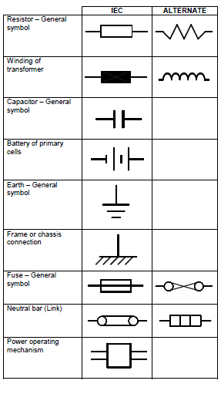
Chart brief – Chart 01 continued
Notes:
Allow scroll down the chart of symbols. Chart: CTC, Book 3, LS-1, Pages 10-14.

Slide 31
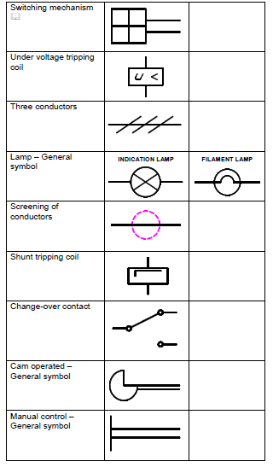
Chart brief – Chart 01 continued
Notes:
Allow scroll down the chart of symbols. Chart: CTC, Book 3, LS-1, Pages 10-14.

Slide 32
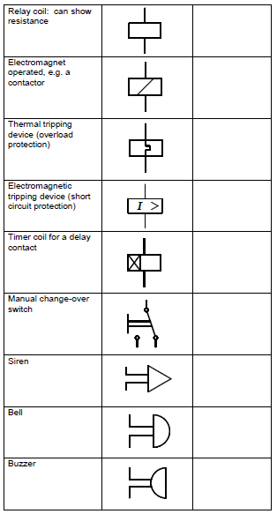
Chart brief – Chart 01 continued
Notes:
Allow scroll down the chart of symbols. Chart: CTC, Book 3, LS-1, Pages 10-14.

Slide 33
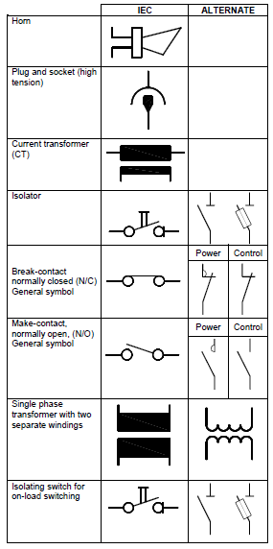
Chart brief – Chart 01 continued
Notes:
Allow scroll down the chart of symbols. Chart: CTC, Book 3, LS-1, Pages 10-14.

Slide 34
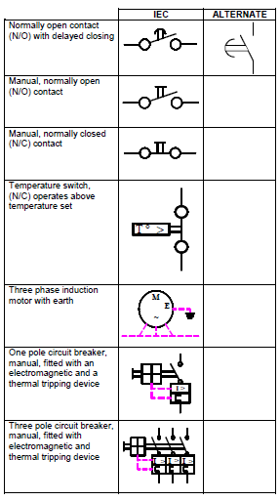
Chart brief – Chart 01 continued
Notes:
Allow scroll down the chart of symbols. Chart: CTC, Book 3, LS-1, Pages 10-14.

Slide 35
Table brief – Table 01
EQUIPMENT IDENTIFICATION
-Q | Power switching
-S | Auxiliary switches
-K | Auxiliary contactors and relays
-F | Protective equipment, e.g. fuses
-L | Neutral bars (links)
-P | Measuring instruments
-H | Signalling or alarm system
-M | Motors
-G | Generators
-T | Transformers
-R | Resistors
-Y | Mechanical equipment
-A | Equipment combinations involving items Q to Y
Notes:
Allow scroll down. Table made from list in CTC, Book 3, LS-1, Page 15.

Slide 36
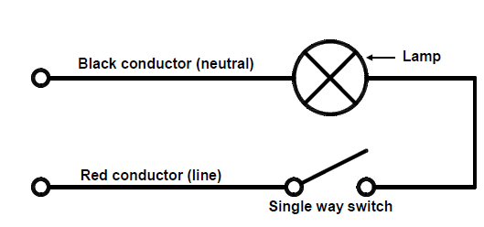
Video brief - Vid01 Expert technician explaining light switching
Voice over | Image
There are many types of switches and they are used for various purposes. The simplest is a single-way switch, for simply switching on and off, for example the common light switch in a house. Here we have a circuit diagram for simple single-way switching. | SINGLE-WAY SWITCHING
Notes:
Create a video similar to https://www.youtube.com/watch?v=eKFICF88AkY use script as above (an expert technician can elaborate beyond the script-as in the video)
Fig01 ‘Single way switching’: CTC Book 3, LS-1, Pg 15.

Slide 37
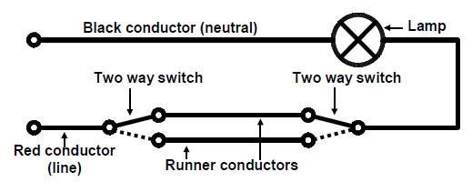
Video brief - Vid01contin. Expert technician explaining light switching
Voice over | Image
Next we move on to switching from two points. Two way switching is the method by which one or more lamps may be switched on or off from either of two places, any distance apart. Two examples are, (a) the control of a lamp in a hall or landing from either the top or the bottom of a flight of stairs, and (b) the control of a bedroom light from two switches in different parts of the room. Remember to isolate the supply before working on live terminals.
Double control of this nature is achieved by having a two-way switch at each point as shown in this circuit diagram, with two separate “runner-wires” from the one to the other. In the diagram the light is on, because there is a connection from the line to neutral via the lamp and upper switch wire. If either switch is moved over to the dotted line position the circuit is broken, but if the other switch is also moved over, the circuit is restored again through the lower switch wire. The outer construction of a two-way switch is identical to the single-way switch, but the internal construction as well as the symbol is different. | TWO-WAY SWITCHING
Notes:
Create a video similar to https://www.youtube.com/watch?v=eKFICF88AkY use script as above (an expert technician can elaborate beyond the script-as in the video)
Fig02 ‘’: CTC Book 3, LS-1, Pg 16.

Slide 38
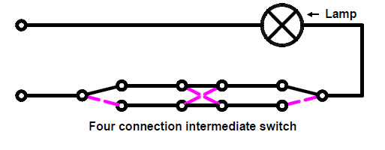
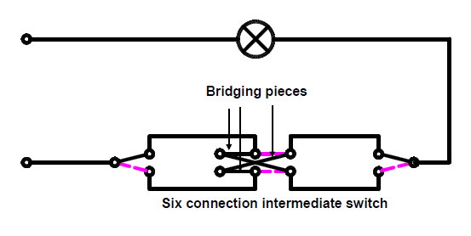
Video brief - Vid01 contin. Expert technician explaining light switching
Voice over | Image
Lastly we look at Intermediate switching. Switching from three or more points, commonly called intermediate switching, is an extension of two-way switching by the addition of intermediate switches of different internal construction connected in the running wires as shown in circuit diagrams 3 and 4. There are two types of intermediate switches and both are shown. -Intermediate switches can have either four or six connection points diagram 3 shows a four connection intermediate switch. -The solid lines indicate one switching position and the dotted lines indicate the second switching position. The circuit is switched “on” or “off” by switching to one of the positions. -Diagram 4 shows a six connection intermediate switch. This switch actually consists of two two-way switches, connected together by means of the two bridge pieces between the outer connections, and operated by a common switching lever. | INTERMEDIATE SWITCHING Circuit Diagram 3 Circuit Diagram 4
Notes:
Create a video similar to https://www.youtube.com/watch?v=eKFICF88AkY use script as above (an expert technician can elaborate beyond the script-as in the video)
Fig03 and 04 : CTC Book 3, LS-1, Pg 17.

Slide 39
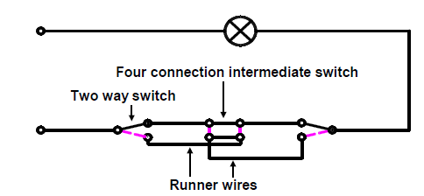
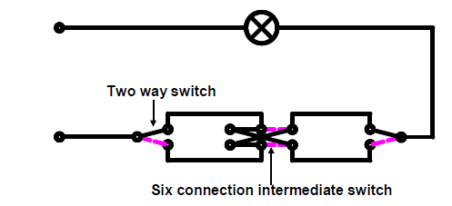
Video brief - Vid01 contin. Expert technician explaining light switching
Voice over | Image
The intermediate switches are connected between the two two-way switches as shown in diagrams 5 and 6. -By using two-way switches, the lamps may be turned on or off from either end, and no matter how these two-way switches are placed, the intermediate switch can always turn the lamps on if they are off or vice versa. It is possible to have three, four or more switching points by installing intermediate switches in the runner wires. -The correct cross connection of the runner wire, as shown at the lower terminals of the intermediate switch in diagram 5, is essential. | INTERMEDIATE SWITCHING Circuit Diagram 5 Circuit Diagram 6
Notes:
Create a video similar to https://www.youtube.com/watch?v=eKFICF88AkY use script as above (an expert technician can elaborate beyond the script-as in the video)
Fig05 and 06 : CTC Book 3, LS-1, Pg 18.

Slide 40
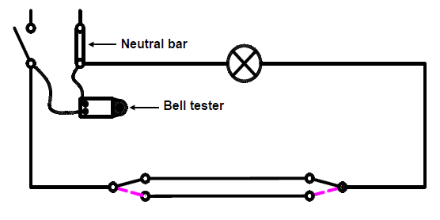
Video brief - Vid02 Expert presenter explaining: Using a bell tester to test a circuit
Voice over | Image
The bell tester consists of a battery and an electrical bell or buzzer which is usually built into a portable box. This method of testing is extensively used, but due to the low voltage of the battery, normally 6 – 12 V, it is limited to the testing of low-resistance circuits. Make sure the supply is switched off before commencing to test the circuit. Never test a circuit with the supply turned on. Connect the bell tester leads to the neutral bar and to the “load” side of the circuit breaker, (bottom stud) as seen in this circuit diagram. If the bell rings, switch off one of the switches. The bell should stop ringing. Then switch on the other switch. The bell should start ringing again. If the bell rings, it indicates that the circuit is continuous and operating.
Notes:
Create a video similar to https://youtu.be/bZh4YGR3rX4 use script as above (an expert technician can elaborate beyond the script-as in the video)
Fig08 : CTC Book 3, LS-1, Pg 23.

