Slide 1
Electrical components and systems
Topic – Test a three phase installation

Slide 2
Test a three phase installation
Unit 8

Slide 3
Assumed prior learning
Fault Finding
Wiring a panel
Three Phase Electricity and Distribution
Tools and Electrical Measuring Instruments
Don’t feel confident yet about these topics? Click on each to review the content.
Feeling confident? Click next to proceed with this unit.

Slide 4
Outcomes
Carry out a continuity resistance test on conductors.
Carry out a cable rating test.
Carry out a switch gear rating test.
Carry out an insulation resistance test between conductors.
Carry out an insulation resistance test between conductors and earth.
Carry out an earth leakage relay test.
Carry out an earth continuity resistance test.
Carry out a mechanical inspection (test).

Slide 5
Introduction
In this lesson you will learn how to inspect and test a three-phase installation to ensure that it is safe and meets the requirements of the SANS Code of Practice for the Wiring of Premises.
Notes:
Link each to the relevant section below.

Slide 6
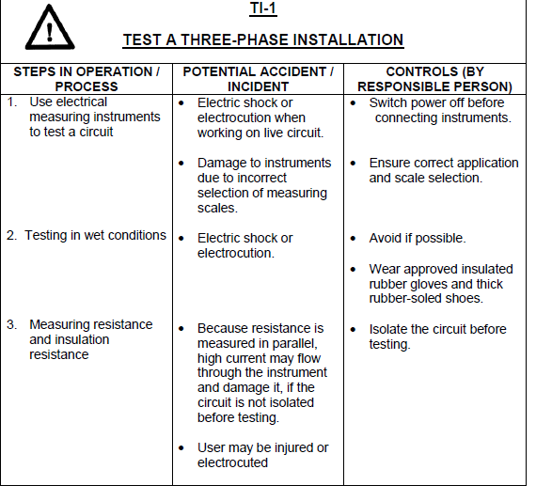
Hazard identification and control (HIAC) form
Notes:
Allow scroll on HIAC form.

Slide 7
Testing an electrical installation
Each new installation and any addition to an existing installation must be tested. There are three sides to testing an electrical installation:
Preliminary internal testing,
Official tests and
Fault finding.
Notes:
Click on:
Preliminary internal testing = “Firstly there is the preliminary internal testing that must be carried out by the electrician when an installation or an addition to an installation is completed and before it is made live.”
Official tests=“Secondly, there are official tests that must be carried out by the supply authorities before the installation is connected to the main supply.”
Fault finding =“Thirdly, there is the testing necessary to find faults, or to ascertain the condition of an old installation.”

Slide 8
Test instruments and procedures
Testing must be done in accordance with Clause 8 in the SANS Code of Practice for the Wiring of Premises.
The instruments used for this test are a 500/1000 volt insulation tester for testing the insulation resistance and an earth leakage tester (TP 400 E/L Tester).
All installations must be tested and inspected before the power supply to it is connected.
Test results must be entered on the prescribed form for recording test readings.
Notes:
Click on ‘prescribed form’ = link to document 01 in appendix.

Slide 9
Continuity resistance test of conductors
This test is done to ensure that conductors are not only continuous throughout their length, but that they are truly conductors, with a resistance value close to zero ohms.

Slide 10
Continuity resistance test of conductors STEP1
Use a continuity resistance tester set on the ohm scale.
NOTE: It is assumed that, by now, you know exactly how to use test instruments and that you can test and measure resistance, current and voltage correctly.

Slide 11
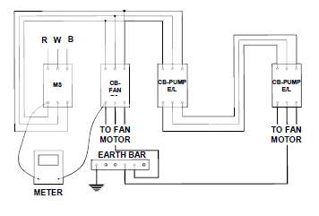
Continuity resistance test of conductors STEP 2
Connect the one lead of the tester to the one end of the red phase of the three-phase system and the other lead to the other end of the same conductor as seen in the figure below.
Notes:
Figure 01 = CTC Book 7, IT-2, Pg 152.

Slide 12
Continuity resistance test of conductors STEP 3
Repeat this test procedure for all three phases and the earth of the three-phase system, which feeds to the fan and the pump.

Slide 13
Continuity resistance test of conductors STEP 4
Test and record these resistance readings.

Slide 14
Cable rating test
This test must be done to ensure that the cables are of the correct size for the particular loads. This test is performed in conjunction with the SANS Code of Practice. This test is done visually.
Check the supply cable and note its capacity.
Check the fan cable and note its capacity.
Check the pump cable and note its capacity. This will be the true current these cables can carry.
Compare these ratings with the actual ratings of the loads it must supply.
Notes:
Each point to fly in as indicated in the animation.

Slide 15
Circuit breaker rating test
This test must be done to ensure that the circuit breakers are of the correct rating for the particular loads for protection against over-currents and short circuits. This test is done visually.
Check the main circuit breaker and note its rating.
Check the circuit breaker for the fan and note its rating.
Check the circuit breaker for the pump and note its rating. These will be the true values of the circuit breakers.
Compare these values with the actual load values and record them on the prescribed form.
Notes:
Each point to fly in as indicated in the animation.

Slide 16
Contactor rating test
This test is done to ensure that the contactor/s used is of the correct size for the particular load/s. This test is done visually.
Check the rating of the contactor and note it. This is the true rating.
Compare this value with the actual load value.
Notes:
Each point to fly in as indicated in the animation.

Slide 17
Overload protection rating test
This test is done to ensure that the overload unit used is of the correct rating for the particular load. This test is done visually.
Check the operating range and note it down.
Compare this value with the actual load.
Notes:
Each point to fly in as indicated in the animation.

Slide 18
Insulation resistance test between conductors and conductors and earth
The purpose of this test is to prove the insulating materials used. We will go over each test, which is carried out with an insulation resistance tester set to the megohm scale.

Slide 19
Insulation resistance between conductors
• Connect one lead of the tester to the red phase and the other lead to the white phase above the circuit breakers.
• Disconnect all loads and switch on all circuit breakers.
• Test and record the reading.
• Follow this procedure through all three the phases.
Remember to consult the relevant regulation in the SANS Wiring Code for the minimum value allowed for this resistance.
Notes:
Allow scroll on page. Each point to float in as animated.
Figure 02 = CTC Book 7, IT-2, Pg 154.

Slide 20
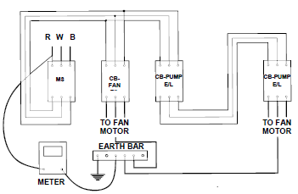
Insulation resistance test between conductors and earth
Connect the one lead of the tester to the earth terminal and the other to the red phase above the circuit breakers.
• Ensure that all switches and circuit breakers are switched on.
• Turn off the main switch.
• Test and record the reading.
• Perform this test on the remaining white, blue and black wires and record the readings.
Consult the relevant regulation in the SANS Wiring Code for the minimum value allowed for this resistance.
Notes:
Figure 03=CTC Book 7, IT-2, Pg 155.
Allow scroll. Each point to float in as animated.

Slide 21
Earth leakage relay (core balance) test
The purpose of this test is to determine whether the earth leakage relays are functioning properly within the stipulated ratings printed on it.
Take the earth leakage tester and set the selector switch on the 250mA setting and connect one lead to anyone off the live phases underneath the specific circuit breaker to be tested, and the other lead to the earth terminal.
The earth leakage relay should trip, indicating a healthy relay.

Slide 22
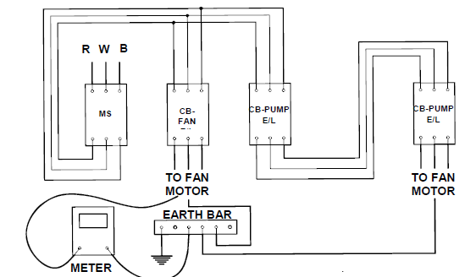
Earth continuity resistance test
The purpose of this test is to verify that the earth continuity resistance is not in excess of that specified by the SANS Wiring Code. The correct instrument for this test is the impedance loop tester, but for purposes of this lesson an insulation resistance tester will be used.
Set the insulation resistance tester on the ohm scale.
Connect the one lead of the meter to the main earth terminal, as shown in the figure, and carry out the test to all metal parts of the installation.
Notes:
Figure 04=CTC Book 7, IT-2, Pg 156.
Allow scroll. Each point to float in as animated.

Slide 23
Mechanical test (check)
The purpose of this test is to prove that the installation is mechanically sound. The test is done visually.
• Check that all components on the installation conform to the applicable standards or have been authorised for use.
• Check that all the components have been correctly selected, installed and suitably rated.
• Check components for damage.
• Check that fire barriers have been erected and that other precautions have been taken to prevent the spread of fire, or the harmful effects of heat.
• Check that conductors are of the correct current capacity.
Notes:
Allow scroll. Each point to float in as animated.

Slide 24
Mechanical test continued
• Check that protective devices are of the correct rating and capable of withstanding the protective fault levels.
• Check that disconnecting devices to the electrical equipment is correctly located.
• Check that the different circuits are separated correctly.
• Check that the connections of all conductors, including earthing and bonding, are mechanically sound and electrically continuous.
• Check that circuits, fuses, switches, terminals, earth leakage devices, circuit breakers and all other electrical components have been permanently marked or labelled.
• Check that the installation complies with the all the requirements of the SANS Code of Practice for the Wiring of Premises.
Notes:
Allow scroll. Each point to float in as animated.

Slide 25
Practise
You must be able to test a simulated three-phase installation. Bear the following in mind:
The installation must be tested by using the correct instruments, set to correct scale for each test.
Record all the readings on the Standard Test Evaluation Form.
State your conclusions as a result of the readings taken.
Check your answers with the use of the regulations contained in the SANS Code of Practice for the Wiring of Premises.

Slide 26
Quiz time
We have come to the end of this unit. Answer the following questions to make sure you understand how to test a three-phase installation.

Slide 27
Question 1
What must the test voltage be when doing an insulation resistance test?
500V
1000V
500/1000V
250V
Notes:
MCQ
Correct answer is C
Feedback:
Correct – Good job.
Incorrect – Try again.

Slide 28
Question 2
What is the purpose of the contactor rating test?
To ensure that the contactors used are of the correct size for the particular load.
To ensure that the contactors used are of the correct rating for the particular load.
To determine if the contactors are functioning properly.
To prove that the contactors are mechanically sound.
Notes:
MCQ
Correct answer is A
Feedback:
Correct – Well done.
Incorrect – Try again.

Slide 29
Question 3
What is the purpose of the overload protection rating test?
To ensure that the overloads used are of the correct size for the particular load.
To ensure that the overloads used are of the correct rating for the particular load.
To determine if the overloads are functioning properly.
To prove that the overloads are mechanically sound.
Notes:
MCQ
Correct answer is B
Feedback:
Correct – Well done.
Incorrect – Try again.

Slide 30
Question 4
What is the purpose of the mechanical test?
To ensure that the installation is of the correct size for the particular load.
To ensure that the installation is of the correct rating for the particular load.
To determine if the installation is functioning properly.
To prove that the installation is mechanically sound.
Notes:
MCQ
Correct answer is D
Feedback:
Correct – Well done.
Incorrect – Try again.

Slide 31
Let’s review:
In this lesson we have covered:
Test instruments and procedures.
Testing a panel.
Make sure you have a complete understanding of all the work covered here before you start the next unit.

Slide 32
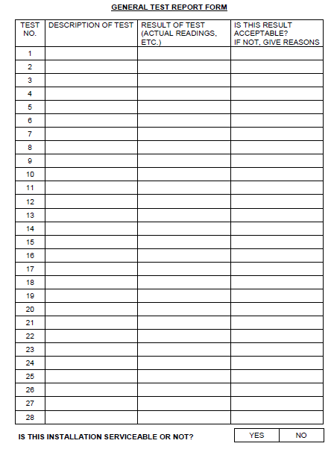
Document 01: Standard Test Evaluation Form
Notes:
Document 1= CTC Book 7, IT-2, Pg 160. Allow scroll and print of document.

