Slide 1
Electrical components and systems
Topic – Connect three single-phase energy meters

Slide 2
Connect three single-phase energy meters
Unit 7.5

Slide 3
Assumed prior learning
Using energy meters
Connect a single-phase energy meter
Connect a three-phase energy meter
Wire a three-phase balanced load
Don’t feel confident yet about these topics? Click on each to review the content.
Feeling confident? Click next to proceed with this unit.
Notes:
All previous units in this topic must be covered first (units: 7.1 to 7.4 in topic 3)

Slide 4
Outcomes
Wire a given panel so that the energy meters will correctly measure the power consumed.

Slide 5
Introduction
Every household, business or industry needs electricity and in order to measure power consumption energy meters are installed in all types of establishments. In this lesson we look at connecting three, single-phase energy meters to measure power consumption.

Slide 6
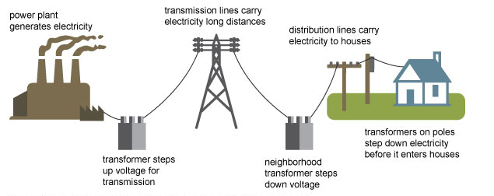
Supplying power to a consumer
When a house or industry is supplied with electricity, the connections are made in a certain order. Click on each number in the image to learn about the process of power supply to consumers.
3
1
2
Notes:
Img01= https://www.eia.gov/energyexplained/images/transmission.jpg
Allow click on the numbers in the image and show details as below.
Click on 1 = “-Electricity is generated at power plants and moves through a complex system, sometimes called the grid, of electricity substations, transformers, and power lines.
-The electricity supply is purchased from the local municipality or other supply authority. The owner of the house or factory is the person who purchases the electricity and is known as the consumer.”
Click on 2=“-High-voltage transmission lines, such as those that hang between tall metal towers, carry electricity over long distances to where consumers need it. Higher voltage electricity is more efficient and less expensive for long-distance electricity transmission.
-Lower voltage electricity is safer for use in homes and businesses. Transformers at substations increase (step up) or reduce (step down) voltages to adjust to the different stages of the electricity journey.”
Click on 3 = “ -When the supply authority supplies the consumer with electricity, energy meters are installed to measure and record the power consumed by the consumer for payment purposes.
- The supply authority also requires certain electrical protection, not only for their energy meters, but also for the consumer’s circuits.”

Slide 7
Order of the supply to the circuit
The order of arrangement of the supply to the consumer’s circuit is as follows:
- The supply authority’s service mains.
- The supply authority’s main fuses or other protective device.
- The supply authority’s meters.
- Main distribution boards.
- Sub-distribution boards.
Each component of the above arrangement will be discussed.

Slide 8
Service mains, protective devices and meters
The mains are either underground cables or overhead lines, which carry the supply power from the substation to a kiosk, usually situated on the pavement next to the consumer’s premises. The supply authority terminates their service mains in these kiosks.
The supply authority’s main circuit breakers and energy meters are located in this kiosk.
From the energy meters, cables are laid to the house where they terminate in connection boxes that are mounted on the outside wall of the house.
The consumer installs conductors from this connection box to the main distribution board in his house.

Slide 9
Consumer’s main distribution board
The consumer has a main switch or circuit breaker mounted in a distribution board.
The main circuit-breaker’s value is usually 10 amps smaller than the supply authority’s, which is mounted in the kiosk outside the building.
Circuit-breakers, which supply the power to the lighting, plugs, geysers, stove and bell circuits are mounted on the distribution board.
Notes:
Link each to the relevant section below.

Slide 10
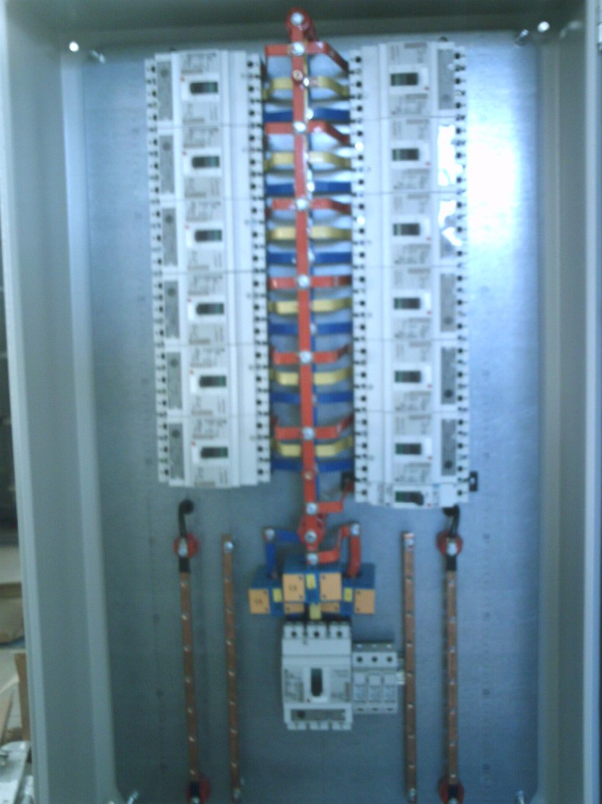
Sub-main distribution boards
Sub-main distribution boards, which in turn are supplied from the main distribution board, are only used in very large houses, hotels, blocks of flats and factories where one distribution board is too small to facilitate all the protective devices.
The above background serves as an introduction for this lesson on connecting energy meters in the supply line from the supply authority to the consumer.
Note that instead of using a distribution board a contactor, timer and a load is mounted on the panel and a three-phase power supply is used.
Notes:
Img02: http://tecogrp.com/wp-content/uploads/IMAG0076-773x1030.jpg

Slide 11
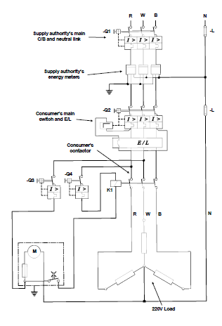
Connecting energy meters
The wiring diagram shows the layout of a circuit containing the necessary equipment to practise wiring the consumer’s circuits to the supply authority’s power supply in the correct order.
All panels are not set out the same way but the order of connections will always be the same.
Notes:
Allow scroll on fig 01.
Fig01= CTC, Book 7, PW-5, Pg 140.

Slide 12
Method to wire the panel
The main circuit
Determine the current that will be drawn by the load because this current will determine the size of the conductor to be used and also the ratings of the disconnectors (fuses etc.).
Wire to the top of the supply authority’s main circuit-breaker. This is a three-phase supply and it is suggested that red, white and blue conductors be used from left to right in that order.
Wire from the bottom of the supply authority’s circuit- breaker to the left-hand connection of the supply authority’s meters.
It is standard procedure to connect the supply line on the left-hand side, and to the load line from the right hand side connection of any energy meter.
Notes:
Allow scroll.

Slide 13
Method to wire the panel (continued)
Wire from the right hand connection of the meters to the bottom of the consumer's main circuit breaker.
Wire from the “load” side of the contactor to the load.
Wire the supply authority’s neutral bar to one of the centre terminals of the nearest meter. The other centre terminal loop must then be wired to the next meter and so on until all the meters have a neutral conductor.
Wire from the supply authority’s neutral bar to the consumer’s neutral bar.
Notes:
Click on ‘neutral bar’ = Note: Only neutral conductors that are connected to the supply authority’s equipment, may be connected to the supply authority’s neutral bar and only neutral conductors connected to the consumer’s equipment may be connected to the consumer’s neutral bar.

Slide 14
Method to wire the panel (continued)
The phasing of the panel must at all times be the same, that is, keep the red conductor on the left, the white in the centre and the blue on the right side. Maintaining this order of colours will prevent any cross-phasing between the equipment.

Slide 15
Method to wire the panel (control circuit)
The control circuit for the consumer’s contactor is the same as that of a direct-on-line starter where a stop-start button, or a timer switch is used. Refer back to Connecting and Starting Three Phase AC Motors, if necessary. The main and control circuits are shown in the wiring diagrams contained in that unit.
Notes:
Click on Connecting and Starting Three Phase AC Motors= link to topic 7 unit 4.

Slide 16
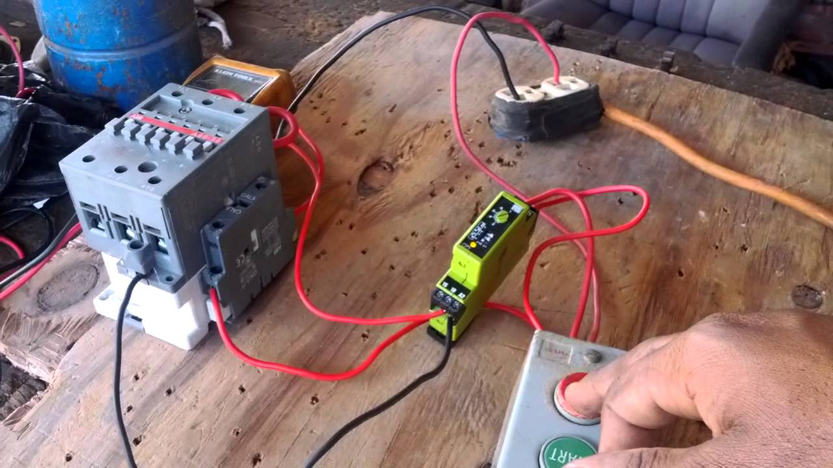
Method to wire the panel (control circuit continued)
The time switch operates on the same principle as an electric clock. Click on the image for more information
Notes:
Img03=https://i.ytimg.com/vi/WfVqDoaeK-8/maxresdefault.jpg
Click on image =“The time switch operates on the same principle as an electric clock.
-A motor, which operates on 220 volts, is inside the time switch. This motor uses a train of gears to turn the dial of the timer. The dial turns one complete revolution in every twenty-four hours and has the same markings on it as an ordinary clock.
-On the same shaft as the dial are a number of adjustable levers, which are used to switch the supply “on” of “off” as required. These levers can be adjusted to alter the switching “on” or “off” times.
-Three connection points are at the bottom of the time switch. The left-hand connection is for the supply line because in this connection a fuse is on the inside of the time switch to protect the motor coils. This connection is also the side of the main contact switch that operates the coil of the neutral conductor and is connected to the other end of the timer’s motor coils.
-The right hand connection is for the load conductor, and it is also the fixed contacts of the main contact switch in the timer, which is placed in series with the contactor’s operating coils.”

Slide 17
Earthing
All the metal casings on the board must be earthed. The earthing must comply with the SANS Code of Practice for the Wiring of Premises (Regulation 6.12).
Note: Test the complete installation and correct any faults that may be found, before switching on the power supply.
Check to ensure that the energy meters are registering the power consumption correctly.

Slide 18
Assessment criteria
You will have a practical assessment, which must be completed without using references other than current rating tables.
You will be provided with a wiring diagram, a three-phase supply and a panel with all the components and equipment (energy meters etc.) mounted on it, and must wire the panel according to the following standards:
(a) The panel must be wired according to the wiring diagram.
(b) The circuit must be wired according to the order of arrangement as set out here.
(c) If a consumer’s time switch is used it must be arranged so that the load can be switched “on” or “off” at a pre-set time.
(d) The energy meters must correctly register the power consumed.
(e) The wiring of the panel, the selection of the sizes and colours of the conductors and the termination of conductors, must be according to the standards described in Wiring a panel and the SANS Code of Practice for the Wiring of Premises.
(f) All the metal parts must be earthed.
Notes:
Click on ‘Wiring a panel’ = link to same topic (topic 3) unit 2.

Slide 19
Practise
Use the appropriate circuit diagrams, and wire the given panels according to the procedures described in the lesson.
Test each completed installation before switching on the power supply.
Check whether the energy meters are registering the power consumption correctly.
REMEMBER to adhere to all the relevant safety procedures when doing the practical work. Refer to the HIAC Form.
Notes:
Click on HIAC form= bring up form 01 from the appendix.

Slide 20
Quiz time
We have come to the end of this unit. Answer the following questions to make sure you understand how to connect three single-phase energy meters.

Slide 21
Question 1
Order the following in the correct arrangement to connect the power supply from the supplier to the consumer’s circuit (drag and drop to rearrange).
A) The supply authority’s meters.
B) The supply authority’s service mains.
C) Main distribution boards.
D) The supply authority’s main fuses or other protective device.
E) Sub-distribution boards.
Notes:
Allow drag and rearrangement of text boxes.
Answer: B,D,A,C,E
B) The supply authority’s service mains.
D) The supply authority’s main fuses or other protective device.
A) The supply authority’s meters.
C) Main distribution boards.
E) Sub-distribution boards.

Slide 22
Question 2
Where is the consumers main switch or circuit breaker mounted?
INSERT YOUR ANSWER HERE.
Notes:
Allow text to be entered.
Answer (accept slight variations): The consumer’s main switch or circuit breaker is mounted in a distribution board.
Feedback:
Correct – Well done.
Incorrect – Try again.

Slide 23
Question 3
The time switch operates on the same principle as an electric clock.
TRUE
FALSE
Click on the correct answer.
Notes:
True or False
Correct answer is TRUE
Feedback:
Correct – Well done
Incorrect – That is not correct.

Slide 24
Let’s review:
In this lesson we have covered:
How power is supplied and distributed to consumers.
Connecting energy meters.
Method to wire a panel on an energy meter.
Make sure you have a complete understanding of all the work covered here before you start the next unit.

Slide 25
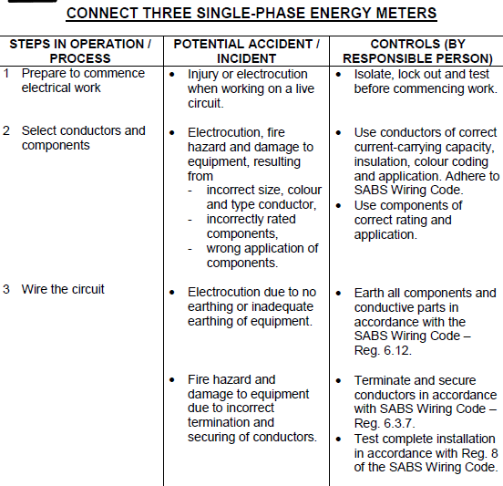
Form 01 brief – HIAC
Notes:
Allow scroll. Continued on next page.

Slide 26
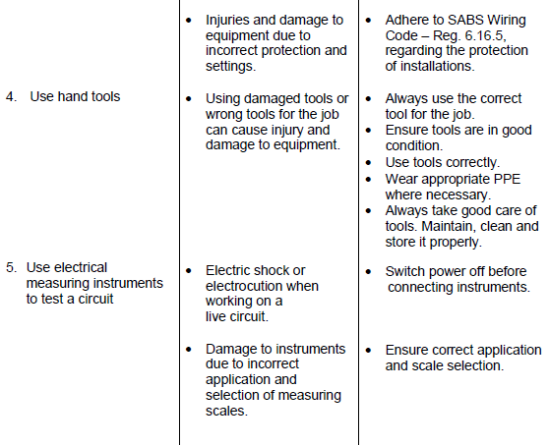
Form 01-HIAC
Notes:
Allow scroll.

