Slide 1
Electrical components and systems
Topic – Metering Systems and Load Balancing

Slide 2
Wire a three-phase balanced load
Unit 7.4

Slide 3
Assumed prior learning
Connect a three phase energy meter
Three phase motors
Don’t feel confident yet about these topics? Click on each to review the content.
Feeling confident? Click next to proceed with this unit.
Notes:
Connect a three phase energy meter= Same topic (topic 3) unit 7.3
Three phase motors = Topic 7

Slide 4
Outcomes
Balance a three-phase load and draw the circuit diagram of the balanced load.
Wire the panel according to the diagram.

Slide 5
Introduction
When a load is connected to a three-phase supply it is essential that it be balanced so that each phase draws the same amount of current. There are a number of different types of loads that can be used, for example; lights, motors and resistance circuits and they, in turn, can be connected in a number of different ways. For example; motors in star or delta and resistance circuits and lights in parallel. In this lesson we will describe different loads that must be balanced and connected.

Slide 6
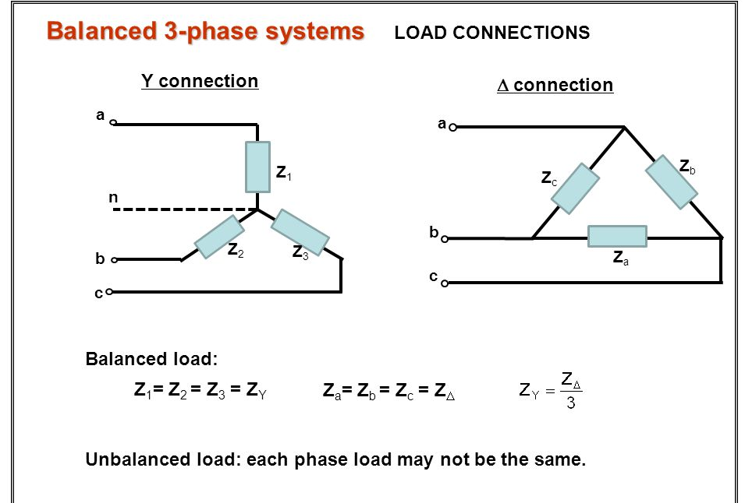
What is a 3-phase balanced system?
A balanced three-phase system is one in which the impedances in the three phases are identical. With such a balanced load, if a balanced three-phase supply is applied, the currents will also be balanced.
Notes:
Click on ‘impedance’ = Electrical impedance is the measure of the opposition that a circuit presents to a current when a voltage is applied.
Img01=https://slideplayer.com/slide/5867350/19/images/14/Balanced+3-phase+systems.jpg

Slide 7
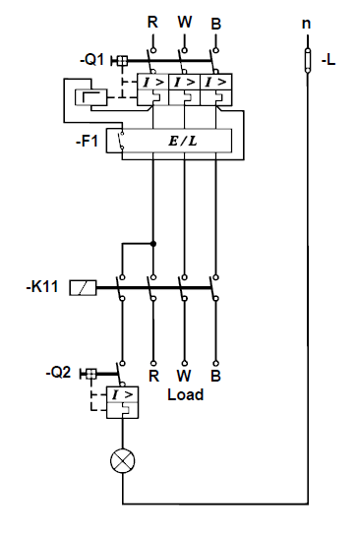
The main circuit of a balanced load
The main circuit for a three-phase balanced load is exactly the same as the main circuit used for a direct-on-line starter.
A lamp is added to the main circuit to indicate when the contactor is “on” and when the supply is connected to the load.
Notes:
Fig01= CTC, Book 7, PW-4, Pg 119. Allow scroll.

Slide 8
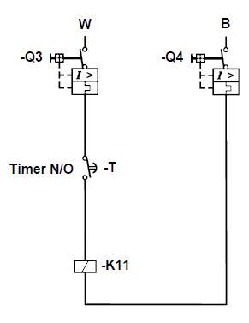
The control circuit of a balanced load
The control circuit is also the same as that of a direct-on-line starter, instead of stop-start buttons, a thermostat or timer can be used as a means of control.
Notes:
Fig02= CTC, Book 7, PW-4, Pg 120. Allow scroll.

Slide 9
Different ways of connecting three-phased balanced loads
Figures 3, 4, 5 and 6 on the following pages show different ways of connecting three-phased balanced loads to a supply through different timers and contactor coils.

Slide 10
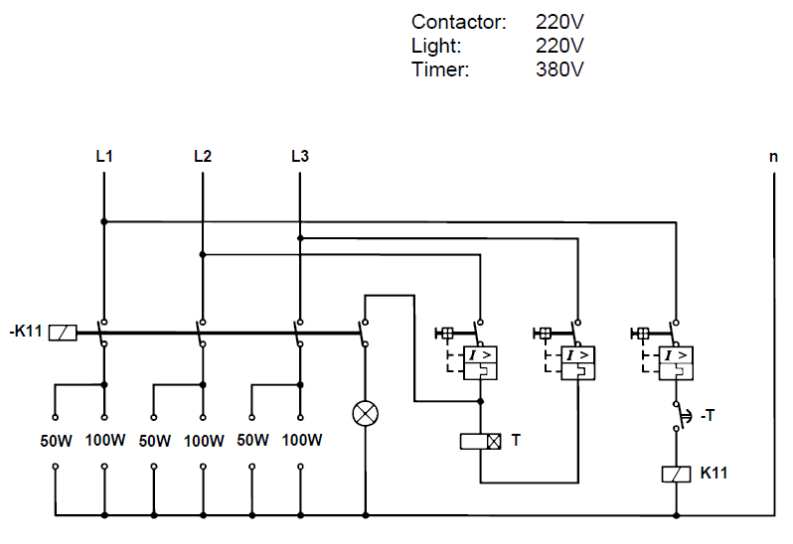
Figure 3
NOTE: You will be provided with a three-phase power supply, a number of loads as well as all the necessary tools and equipment and must be able to balance the load for the power supply, draw the circuit diagram and wire the panel. The circuit diagram must conform to the diagrams in this lesson.
Notes:
Fig03= CTC, Book 7, PW-4, Pg 121. Allow scroll.

Slide 11
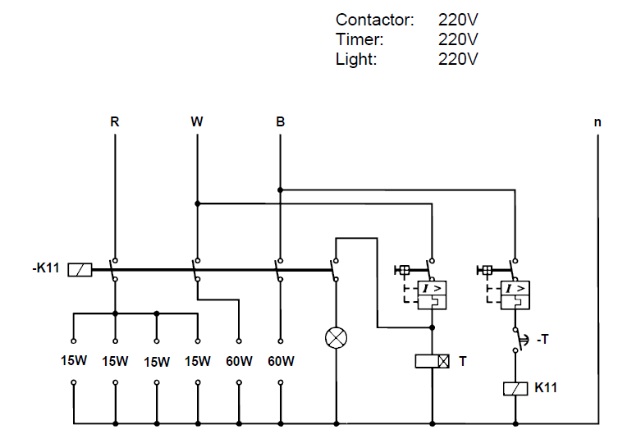
Figure 4
NOTE: You will be provided with a three-phase power supply, a number of loads as well as all the necessary tools and equipment and must be able to balance the load for the power supply, draw the circuit diagram and wire the panel. The circuit diagram must conform to the diagrams in this lesson.
Notes:
Fig04= CTC, Book 7, PW-4, Pg 121. Allow scroll.

Slide 12
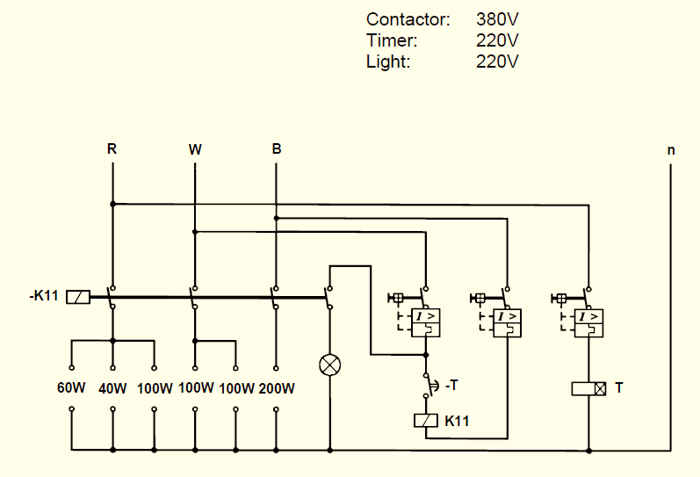
Figure 5
NOTE: You will be provided with a three-phase power supply, a number of loads as well as all the necessary tools and equipment and must be able to balance the load for the power supply, draw the circuit diagram and wire the panel. The circuit diagram must conform to the diagrams in this lesson.
Notes:
Fig05= CTC, Book 7, PW-4, Pg 122. Allow scroll.

Slide 13
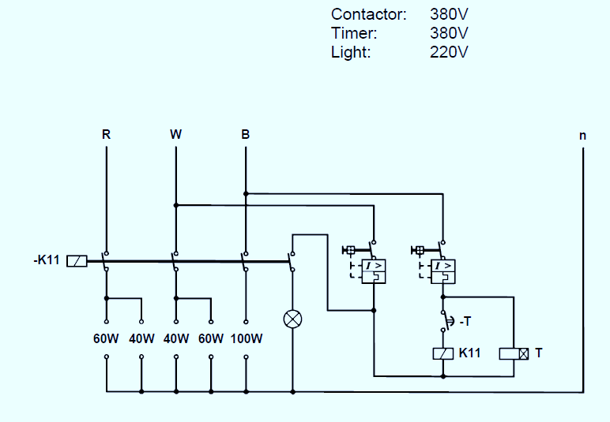
Figure 6
NOTE: You will be provided with a three-phase power supply, a number of loads as well as all the necessary tools and equipment and must be able to balance the load for the power supply, draw the circuit diagram and wire the panel. The circuit diagram must conform to the diagrams in this lesson.
Notes:
Fig06= CTC, Book 7, PW-4, Pg 122. Allow scroll.

Slide 14
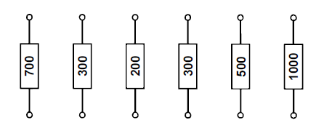
Balancing resistive loads
Before the main and control circuits are wired, the load must be identified and balanced (if not exactly then as close as possible), and then drawn into the wiring diagram.
The resistors will be connected between the studs as shown below:
Note: Loads used further in this lesson will consist of resistors, with their values given in watts.
Notes:
Fig07= CTC, Book 7, PW-4, Pg 123.

Slide 15
Balanced wattage loads
This load is usually made up of six resistors of which the values are given in watts instead of ohms. When a wattage load is given, it is always correct to connect the individual resistances in parallel.
The best way of explaining the method of connecting the load is by means of an example.
Notes:
Click on ‘example’ = link to next slide.

Slide 16
Example: Balanced wattage loads
Balance the loads given below and connect it to a three-phase, 380 volt supply so that 220 volt flows can be measured across each phase.
1 x 700 watts
1 x 300 watts
1 x 200 watts
1 x 300 watts
1 x 500 watts
1 x 1000 watts
The voltage in this case indicates that the total load is connected in star.

Slide 17
Example: Balanced wattage loads continued
Procedure for wiring the load
Add the six resistors together
700 + 300 + 200 + 300 + 500 + 1000 = 3000 watts.
Divide the answer by 3 to determine the watts/phase
3000 ÷ 3 = 1000 watts per phase

Slide 18
Example: Balanced wattage loads continued
Use the given resistors values to form combinations that will give 1000 watts/phase. In this case the resistors will have to be connected in parallel.
Phase 1: 700 + 300 = 1000 watts
Phase 2: 200 + 300 + 500 = 1000 watts
Phase 3: 1000 watts

Slide 19
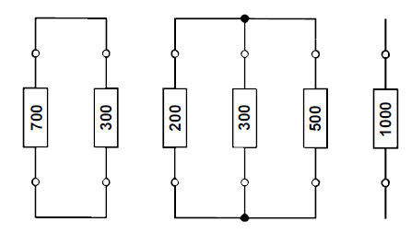
Example: Balanced wattage loads continued
Connect them in the circuit as shown:
Notes:
Fig08= CTC, Book 7, PW-4, Pg 124. Allow scroll.

Slide 20
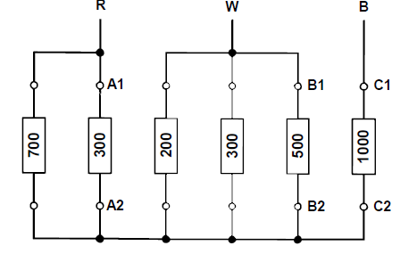
Example: Balanced wattage loads continued
Connect the three phases in star, as shown:
Notes:
Fig09= CTC, Book 7, PW-4, Pg 125.

Slide 21
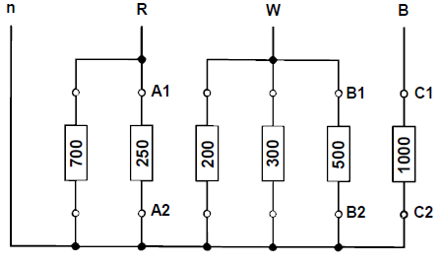
Example: Balanced wattage loads continued
Note: For safety reasons, it is recommended that a neutral always be connected from the neutral bar to the star point on the load, as shown in the figure below, although it is strictly speaking not necessary for balanced loads.
Notes:
Fig10= CTC, Book 7, PW-4, Pg 125.

Slide 22
Unbalanced wattage loads
If the resistors cannot be balanced exactly, then use the following procedure:
• Use the same method as described above and balance the load per phase as close as possible to each other.
• Connect the resistors in parallel. This has been explained above.
• Connect the three separate loads in star.

Slide 23
Unbalanced wattage loads continued
For unbalanced loads it is imperative to connect a neutral from the neutral bar to the star point on the load as shown below:
Notes:
Fig10= CTC, Book 7, PW-4, Pg 125.

Slide 24
Motor loads
A motor is always treated as a balanced load. Refer to the lesson; Testing Single Phase AC Motors.
The nameplate of the motor will indicate whether the motor must be connected in star or delta.
Note: If the motor is to be connected in star, there is no need for a neutral.
Notes:
Click on Testing Single Phase AC Motors= link to Topic 5 unit 3 Testing Single Phase AC Motors

Slide 25
Wire a three-phase load balanced panel
• Determine the type of load and balance it according to the methods described in this lesson.
• On a clean sheet of paper draw a wiring diagram of the main and control circuits with the load connected.
• Test the circuit with a bell tester and mark the studs that are used for the main and control circuits.
• Wire the main circuit and the load according to the wiring diagram that has been drawn.
• Wire the control circuit according to the drawn diagram.
• Test the completed circuit with a bell tester for correct operation.
Note: Do not apply power to this panel!

Slide 26
Assessment criteria
In practise you will be provided with a three-phase power supply, a number of loads as well as all the necessary tools and equipment and must balance the load for the power supply, draw the circuit diagram and wire the panel to the following standards:
(a) The load must be balanced, if not correctly, then as close as possible, according to the examples in the module.
(b) The circuit diagram must conform to the diagrams in this module.
(c) The resistances must be connected in parallel.
(d) The loads must be connected in either star or delta as described in an earlier lesson.
(e) The indicating lamp must only operate when the contactor is “on”.
(f) The timer must switch the contactor “on” or “off” at a pre-set time.
(g) The wiring of the panel, the selection of the sizes and colours of conductors, and the termination of the conductors, must be according to the standards described in Wiring a panel and the SANS Code of Practice for the Wiring of Premises.
(h) All the metal parts must be earthed.
Notes:
Click on Wiring a panel = link to unit 2 in topic 3 (same topic).

Slide 27
Control form
All the relevant safety procedures must be adhered to. Refer to the HIAC Form.
HIAC FORM: Wire a three-phased balanced load
Notes:
Click on HIAC form = see appendix for form 01

Slide 28
Practise
Balance different sets of loads provided, draw the wiring diagrams and wire the panels. At least three loads must be correctly balanced and two panels completely wired.
REMEMBER to adhere to the relevant safety procedures when doing the practical work. Refer to the HIAC Form.

Slide 29
Quiz time
We have come to the end of this unit. Answer the following questions to make sure you understand how to work with conductors and insulators.

Slide 30
Question 1
Why is it necessary to balance a 3-phase load?
INSERT YOUR ANSWER HERE
Notes:
Allow text to be entered.
Answer (accept slight variations of the following): It is necessary to balance a 3-phase load so that each phase draws the same amount of current.

Slide 31
Question 2
How would an unbalanced load be connected?
INSERT YOUR ANSWER HERE
Notes:
Allow text to be entered.
Answer (accept slight variations): An unbalanced load will be connected in star.

Slide 32
Question 3
A balanced three-phase system is one in which the impedances in the three phases are identical.
TRUE
FALSE
Click on the correct answer.
Notes:
True or False
Correct answer is TRUE
Feedback:
Correct – Well done
Incorrect – That is not correct.

Slide 33
Question 4
Why is an indication lamp used and where should it be connected?
INSERT YOUR ANSWER HERE
Notes:
Allow text to be entered.
Answer(accept slight variations): A lamp is added to the main circuit to indicate when the contactor is on and when the supply is connected to the load.

Slide 34
Let’s review:
In this lesson we have covered:
Definition of a three-phase balanced system.
The main circuit and the control circuit of a balanced load.
Balanced wattage loads.
Make sure you have a complete understanding of all the work covered here before you start the next unit.

Slide 35
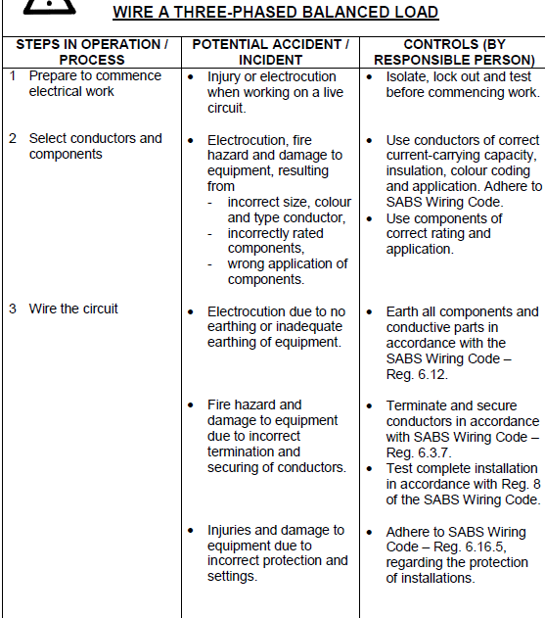
HIAC brief – Form 01
Notes:
Allow scroll. Continued on next slide.

Slide 36
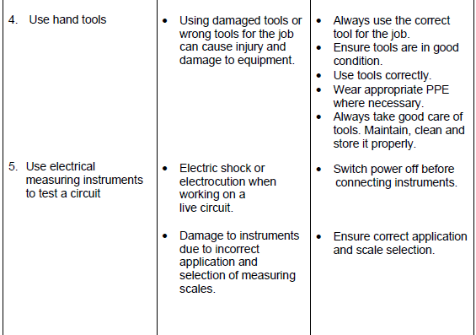
HIAC brief – Form 01continued
Notes:
Allow scroll.

