Slide 1
Electrical components and systems
Topic – Connect a three phase energy meter

Slide 2
Connect a three phase energy meter
Unit 7.3

Slide 3
Assumed prior learning
Using energy meters
Connect a single phase energy meter
Don’t feel confident yet about these topics? Click on each to review the content.
Feeling confident? Click next to proceed with this unit.
Notes:
Using energy meters (unit 7.1 in same topic)
Connect a single phase energy meter (unit 7.2 in same topic)

Slide 4
Outcomes
Connect a three-phase, three-wire energy meter to a three-phase load.
Connect a three-phase four-wire energy meter to a three-phase load.
Connect a three-phase energy meter with range extension.
Connect an energy meter to a balanced load.

Slide 5
Introduction
The connections of a single-phase energy meter and the recording of the readings of the dials were explained in earlier lessons. Make sure you go over those lessons before starting this one.
In this lesson we look at the methods to measure the power in a 3-phase system.

Slide 6
Measuring the power in a 3-phase system
The power in a 3-phase system can either be measured by means of the one-wattmeter or the two-wattmeter method or by using the 3-phase wattmeter.
Notes:
Link each to the relevant section below.

Slide 7
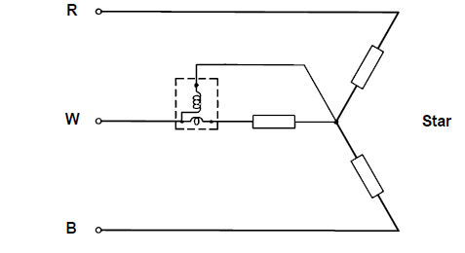
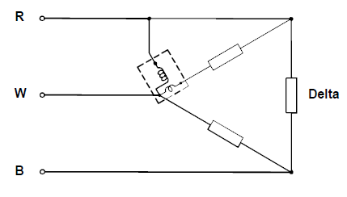
One-wattmeter method
This method is used only when the load is balanced.
Notes:
Figs 01: CTC, Book 7, EM-2, Pg 87.

Slide 8
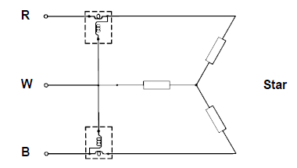
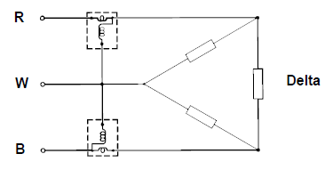
Two-wattmeter method
• In this method the wattmeters are connected in two of the three lines and the voltage coils are then both connected to the third line (see below).
• The total power in a 3-phase three-wire system is given by the sum of the two wattmeter readings, whether the system is balanced or unbalanced.
Notes:
Fig 02: CTC, Book 7, EM-2, Pg 88.

Slide 9
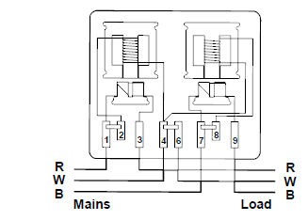
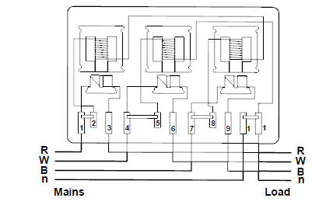
The 3-phase kilowatt-hour meter
Polyphase (2-phases and more) electric circuits require measuring instruments with multiple stators (voltage and current coil assemblies). Polyphase meters can have either two or three electromagnetic stators and the windings can be adapted to specific circuits.
Notes:
Figs 03: CTC, Book 7, EM-2, Pg 89.

Slide 10
What is the difference between a balanced load and unbalanced load?
Watch the video below for an explanation of the difference between a balanced and unbalanced load in a three phase circuit.
Balanced load vs unbalanced load
Notes:
Click on vid01= get link https://www.youtube.com/watch?v=nRzsH0plXIc

Slide 11
Blondel’s theorem
Blondel’s theorem states: to measure the power in a circuit having N wires, it is necessary to have N minus 1 wattmeters, with the voltage coils connected to a common wire which is usually earthed, and a current coil in each of the phases.
The design of some meters does not completely conform to Blondel's theorem. However, the error involved is insignificant.
Notes:
Link each to the relevant section below.

Slide 12
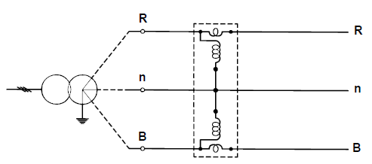
Three-wire network
The three-wire network service (two-phases and neutral) corresponds to a three-wire single-phase, except that the current and voltages are 120° out of phase. A two-stator watt-hour meter is required to measure the energy in this circuit as shown below.
Current/voltage coil for the three-wire network service
Notes:
Fig 04: CTC, Book 7, EM-2, Pg 89.

Slide 13
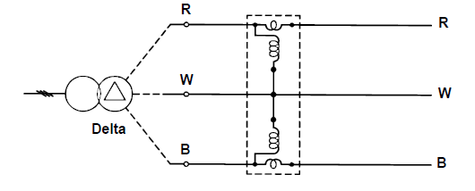
Three-phase three-wire meter
The three-phase three-wire service is the circuit from an unearthed star or delta system. Current and voltage of each wire are 120° out of phase. A two-stator watt-hour meter is used for energy measurement in the same manner as two separate single-phase wattmeters are used.
Current/voltage coil for the three-phase three-wire service
Notes:
Fig 05: CTC, Book 7, EM-2, Pg 89.

Slide 14
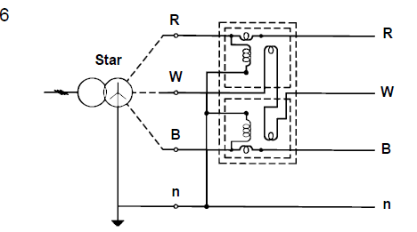
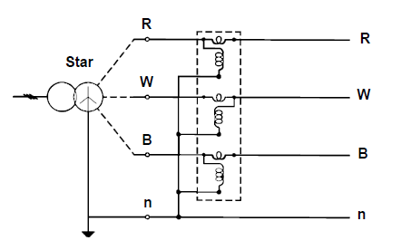
Three-phase four-wire meter
Three-phase four-wire star circuits are widely used in the application of polyphase services.
a)
b)
Single-phase circuits for lighting are provided between each of the three phases and the earthed neutral wire, with the polyphase supply connected to power equipment. A two-stator watt-hour can be used to measure the energy in this circuit as shown in Fig. (a) or a three-stator meter can be used as shown in Fig. (b).
Notes:
Figs 06 (a) and (b): CTC, Book 7, EM-2, Pg 90.

Slide 15
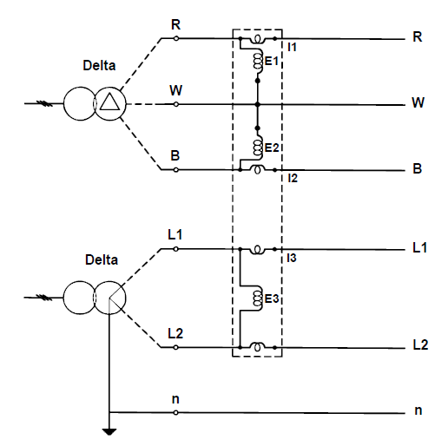
Multi-circuit watt-hour meters
Polyphase circuits, which combine power and lighting circuits, are measured with multi-circuit watt-hour meters
NOTE: The current and voltage coils in the meters shown in all the figures so far are in one meter, that is the meter is either a two or three stator assembly.
Notes:
Allow scroll on page. Fig 07: CTC, Book 7, EM-2, Pg 91.

Slide 16
Quiz time
Before you wire a kilowatt-hour meter, answer the following questions.

Slide 17
Question 1
In a three phase-machine the most common starting points of the different phase windings are?
30 electrical degrees apart
90 electrical degrees apart
120 electrical degrees apart
270 electrical degrees apart
Notes:
MCQ
Allow click on the options.
Correct answer is C
Feedback:
Correct – Well done
Incorrect – That is not correct.

Slide 18
Question 2
Identify the symbol shown:
Delta
Star
Resistor bank
Resistor diagram
Notes:
MCQ
Allow click on the options.
Correct answer is A
Feedback:
Correct – Well done
Incorrect – That is not correct.

Slide 19
Question 3
Identify the symbol shown:
Delta
Star
Resistor bank
Resistor diagram
Notes:
MCQ
Allow click on the options.
Correct answer is B
Feedback:
Correct – Well done
Incorrect – That is not correct.

Slide 20
Question 4
What electrical measuring instrument could be used to measure the amount of electricity used per hour?
Voltmeter
Ammeter
Kilowatt hour meter
Time switch
Notes:
MCQ
Allow click on the options.
Correct answer is C
Feedback:
Correct – Well done
Incorrect – That is not correct.

Slide 21
Question 5
Which of these circuit diagrams show a three-phase four-wire service system being measured by a two-stator watthour meter?
A)
B)
Click on the correct diagram.
Notes:
MCQ
Allow click on each option.
Correct answer is A
Feedback:
Correct – Well done
Incorrect – That is not correct.

Slide 22
Connecting a three-phase energy meter to a load
The load to be used in this lesson is taken as a balanced load. The balancing of three-phase loads is only done in a later lesson. The load must first be connected in delta for the three-phase balanced load, and then in star, with the neutral connected to the star-point, for the three-phase four-wire unbalanced circuit.

Slide 23
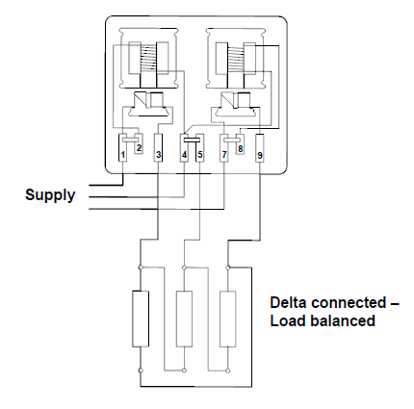
Three-phase three-wire circuit (balanced)
• Note the full load current value given for the meter.
• Use current rating tables and select the colours and size conductors for this current.
• Wire the circuit as shown in the figure.
• Test the load and connect it in delta or in star depending on the current drawn. Refer back to Connecting and Starting Three Phase AC Motors if necessary.
• Switch the circuit breaker on.
• Make sure that the disc of the meter is turning in the direction indicated by the arrow (applicable only to disc type meter).
• Let the meter run for the allotted time, switch off the circuit breaker, and take the reading.
Notes:
Fig 08: CTC, Book 7, EM-2, Pg 93. Allow scroll.
Click on Connecting and Starting Three Phase AC Motors= link to that unit (4) in Three phase motors.

Slide 24
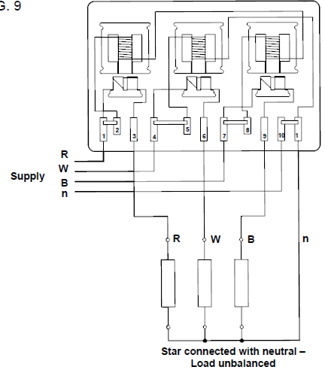
Three-phase four-wire circuit (unbalanced)
Follow the procedure as set out for the three-phase three-wire circuit, on the previous slide, except wire the circuit as shown below.
• Test the load and connect it in star.
• Switch the circuit breaker on.
• Make sure that the disc of the meter is turning in the direction indicated by the arrow (only applicable to disc type energy meter).
• Let the meter run for the allotted time, switch off the circuit breaker, and take the reading.
Notes:
Fig 09: CTC, Book 7, EM-2, Pg 94. Allow scroll.

Slide 25
Practise
Practise connecting a three-phase 3-wire and a three-phase 4-wire energy meter to a load as explained in this lesson.
Vary the size of the load, let the meter run for a specific time period and read the meter.
Measure the load and check the reading by calculation.
The conductor sizes must be checked and changed, if necessary, each time that the load is changed.
REMEMBER to adhere to the relevant safety procedures when doing the practical work. Refer to the HIAC Form.

Slide 26
Connect a three-phase energy meter with range extension
Next you will learn how to connect a three-phase energy meter to a load through a potential and current transformer, thereby extending the range of the energy meter.
HIAC form
Notes:
HIAC form: see appendix for form 01. Click on button = show form 01.

Slide 27
Designing the meter
When energy has to be measured in three-phase circuits, which have a voltage higher than 500 volts and a current in excess of 100 amps, it becomes difficult to insulate the coils effectively.
Another problem, which arises, is the size of the instrument. As the voltage and current increase so the insulation and the wires must increase in size.
Thus to effectively prevent the meter from becoming too large and bulky it is necessary to design the meter for a maximum voltage and current. The meter is designed for a maximum operating voltage of 110 volts and a maximum operating current of 5 amps.
The energy meter is equipped with a potential transformer, which steps the voltage down from the line supply voltage to 110 volts, and current transformers, which reduces the load current to a maximum of 5 amps.
Notes:
Allow scroll.

Slide 28
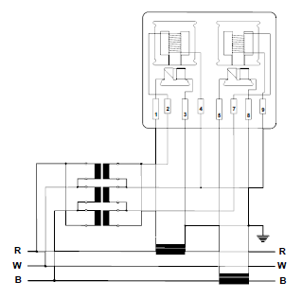
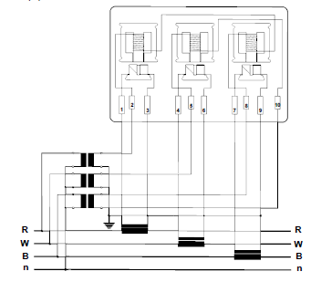
Extending the voltage and current range
a) The wiring diagram shown in Fig (a) shows how both the current and voltage ranges of a three-phase, three-wire energy meter are extended.
b) The wiring diagram shown in Fig (b) shows how both the current and voltage ranges of a three-phase, four-wire energy meter are extended.
Notes:
Fig1 (a) and (b): CTC, Book 7, EM-3, Pg 106.

Slide 29
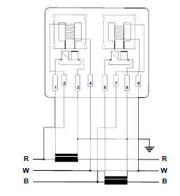
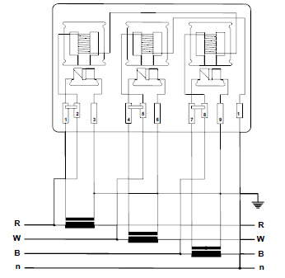
Extending the current range
Figures (a) and (b) below show how just the current range for the two types of energy meters under discussion can be extended. This is because a high current can be drawn from a comparatively low voltage.
a)
b)
Notes:
Fig2 (a) and (b): CTC, Book 7, EM-3, Pg 106 and 107.

Slide 30
Connecting the energy meter to a load
The following procedure should be followed when connecting a three phase 3-wire or a three-phase 4-wire energy meter through a potential and current transformer to a given load (in this instance a three-phase rheostat):
• Calculate the maximum current that is going to be drawn by the rheostat. Use Ohm’s Law.
$Max. current drawn by rheostat =\frac{V}{R}$
Where V = supply voltage and R = resistance of rheostat at the point of the least resistance.
• Use the current value calculated above and current rating tables to select the correct size and colour conductors for wiring the main circuit to the load.
• Wire the main circuit from the circuit breaker to the primary sides of the potential transformer and to the current transformer (if any). Loop the lines from there to the rheostat (the load).

Slide 31
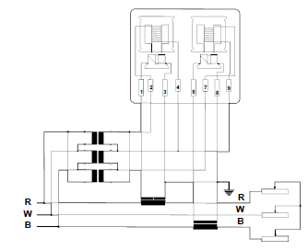
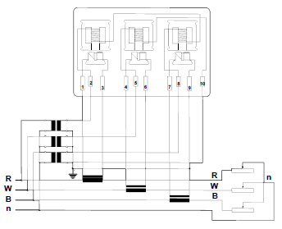
Connecting the energy meter to a load (continued)
Wire the main circuit from the circuit breaker to the primary sides of the potential transformer and to the current transformer (if any). Loop the lines from there to the rheostat (the load). As shown in Fig (a) (3-wire system) and Fig (b) (4-wire system).
a)
b)
Notes:
Fig (a)=Figure 3 and (b)=Figure 4: CTC, Book 7, EM-3, Pg 108.

Slide 32
Connecting the energy meter to a load (continued)
Wire the secondary circuit from the secondary sides of the potential and the current transformers to the energy meter connections.
Check the connections and the circuit again.
Make sure that the installation is properly earthed.
Test the circuit and correct any faults before switching on the supply.
If you are using the old disc type energy meter, make sure that it turns in the right direction.
Measure the current and voltage in the supply lines and the energy meter circuit. Multiply the ammeter and voltmeter readings on the secondary side by the transformer ratios and see if it is the same as the main supply line readings.
Notes:
Allow scroll.

Slide 33
Example to illustrate range extension
Ammeter readings (secondary side)
Current indicated on the ammeter = 3,7 amps
Current transformer ratio = 1:10
Thus the current in the circuit = 3,7 x 10= 37 amps
Voltmeter readings (secondary side)
Voltage indicates on the voltmeter = 100 volts
Potential transformer ratio = 5:1
Thus the voltage in the circuit = 100 x 5= 500 volts

Slide 34
Practise
Practise connecting three-phase, 3-wire and three-phase, 4-wire energy meters to a load through current and potential transformers.
Measure the currents and voltages in the circuits and demonstrate, by calculation, the concept of range extension.
REMEMBER to adhere to all the relevant safety procedures when doing the practical work. Refer to the HIAC Form.

Slide 35
Let’s review:
In this lesson we have covered:
Measuring the power in a three phase system.
Wattmeters.
Extending the voltage and current range energy meters.
Connecting energy meters to a balanced load.
Make sure you have a complete understanding of all the work covered here before you start the next unit.

Slide 36
Video brief - Vid01
Get link to; 3 phase balanced vs 3 phase unbalanced load https://www.youtube.com/watch?v=nRzsH0plXIc
Notes:
https://www.youtube.com/watch?v=nRzsH0plXIc

Slide 37
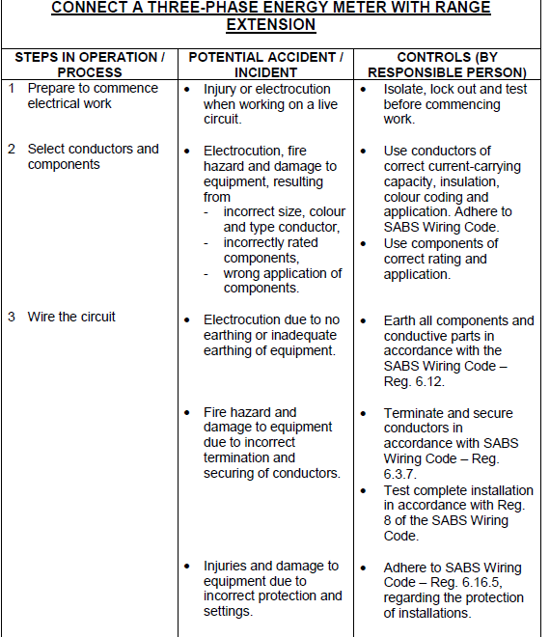
Form brief – Form 01
Notes:
Allow scroll on form. Continued on next slide

Slide 38
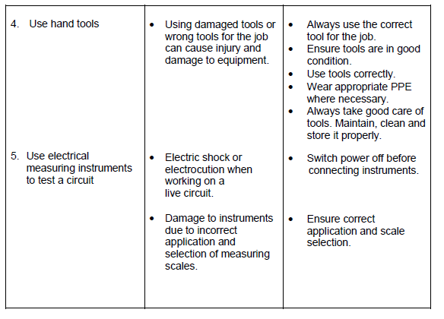
Form brief – Form 01contin.
Notes:
Allow scroll on form. Continued from previous slide.

