Slide 1
Electrical components and systems
Topic – Metering Systems and Load Balancing

Slide 2
Connect a single phase energy meter
Unit 7.2

Slide 3
Assumed prior learning
Using energy meters
Don’t feel confident yet about these topics? Click on each to review the content.
Feeling confident? Click next to proceed with this unit.
Notes:
Using energy meters unit 7.1 in the same topic.

Slide 4
Outcomes
Draw the circuit diagram to show how a single-phase energy meter is connected into a circuit.
Connect a single-phase energy meter into a circuit according to the wiring diagram.

Slide 5
Introduction
In this lesson we look at the connection of the kilowatt-hour meter to a load and the recording, at certain intervals of time, of the energy consumed. The construction of the kilowatt-hour meter as well as the reading of its dials were fully explained in an earlier lesson, and you should refer to it before doing this lesson.
Notes:
Click on ‘kilowatt-hour meter’ = The energy meter is also known as the kilowatt-hour meter. This is used to register the amount of energy consumed in kilowatt-hours by a specific load. A kilowatt-hour is the amount of energy consumed in one hour by a load that consumes one kilowatt of power during operation, for example, a 2 kW heater burning for 3 hours will consume 2 x 3 = 6 kWh of energy.
Click on ‘earlier lesson’ = link to ‘Using energy meters’ unit 7.1 in the same topic.

Slide 6
HIAC Form: Connect a single phase energy meter
Make sure you follow the steps and processes set out in the HIAC form for connecting a single phase energy meter, to avoid any potential incidents.
HIAC form: Connect a single phase energy meter
Notes:
Form 1= See appendix for HIAC form. Allow scroll and full screen view.

Slide 7
Reading an energy meter
There are two methods of displaying the amount of energy measured by an energy meter (kilowatt-hour meter):
Digital display and
Analogue (dial type) display.
Notes:
Click on: Digital =Digital display, makes use of digits (numbers) to register the result, i.e. you can read the number of kilowatt-hours directly, e.g. 1 435 kWh. Most modern installations make use of this type of energy meter.
Analogue =Analogue display makes use of pointers or hands on numbered dials, and is more difficult to read. Older installations may still use this type of energy meter, hence this module to teach you how to read it.

Slide 8
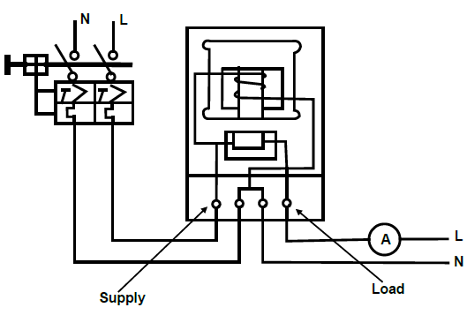
Connecting an energy meter circuit
Figure 01
Notes:
Fig01, CTC Book 3, EM-1, Pg 115.

Slide 9
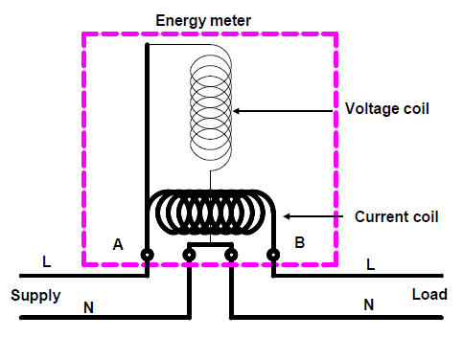
Construction of energy meter
You will recall that internally, the energy meter is wired so that the current element is in series with the load, while the voltage element is in parallel as shown below.
NOTE: It is standard on energy meters for the live terminal to be on the LEFT on the supply side (A) and the load terminal to be on the RIGHT on the load side (B).
Notes:
Fig02, CTC, Book 3, EM-1, Pg 116

Slide 10
Method to connect single-phase energy meter into a circuit
Use Ohm’s law to determine the current that will be drawn for the load value selected. $I=\frac{V}{R}$
Select the correct size conductor for this current. Refer to the wiring a panel lesson and regulation 6.28.2 in the SANS Code of Practice for the Wiring of Premises. The correct conductor colours must also be selected.
Wire the circuit as shown in Fig 01. Note that the supply terminals are on the left and the load terminals on the right.
Switch the circuit breaker on.
Notes:
Click on ‘Wiring a panel’ = link to that unit (Topic 3, unit 2)

Slide 11
Method to connect single-phase energy meter into a circuit continued
Make sure that the disc of the meter is turning in the direction indicated by the arrow. If not, you have wired it wrongly to the supply.
Check the current calculated against the current indicated on the ammeter.
Notes:
Link each to the relevant section below.

Slide 12
Practise
In a practical lesson you will be given an energy meter, a load and the necessary conductors, and must connect the energy meter to the load in accordance with the following standards:
The wiring diagram must be drawn correctly in accordance with the contents of these notes;
The physical wiring of the circuit must be in accordance with the SANS Code of Practice for the Wiring of Premises and the standards learnt in panel wiring;
All metal parts must be earthed;
The energy meter must operate correctly;
The current in the load must not exceed the rating of the meter.
Notes:
Link each to the relevant section below.

Slide 13
Let’s review:
In this lesson we have covered:
Circuit diagram of a single phase energy meter.
Connect a single phase energy meter.
Make sure you have a complete understanding of all the work covered here before you start the next unit.

Slide 14
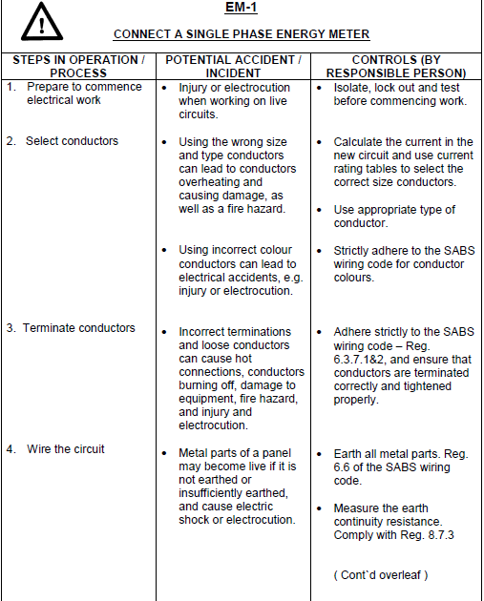
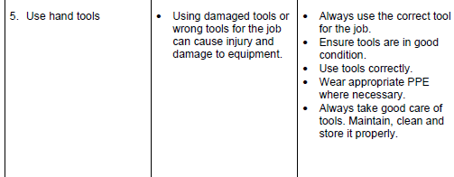
HIAC form brief
Notes:
Allow scroll.

