Slide 1
Electrical components and systems
Topic – Metering Systems and Load Balancing

Slide 2
Using energy meters
Unit 7.1

Slide 3
Assumed prior learning
Electrical Measuring Instruments
Don’t feel confident yet about these topics? Click on each to review the content.
Feeling confident? Click next to proceed with this unit.
Notes:
Electrical Measuring Instruments (topic: 2 - Tools and Elecrical Measuring Instruments unit 7)

Slide 4
Outcomes
Identify the three main internal components of an energy meter (kilowatt-hour meter).
Draw a simple circuit diagram to show how an energy meter is connected in a circuit.
Read and record the amount of energy registered by a dial type energy meter (kilowatt-hour meter).

Slide 5
Introduction
In this lesson we look at the construction of the energy meter as well as the reading of its dials. The energy meter is also known as the kilowatt-hour meter. It is used to register the amount of energy consumed in kilowatt-hours by a specific load. A kilowatt-hour is the amount of energy consumed in one hour by a load that consumes one kilowatt of power during operation, for example, a 2 kW heater burning for 3 hours will consume 2 x 3 = 6 kWh of energy.

Slide 6
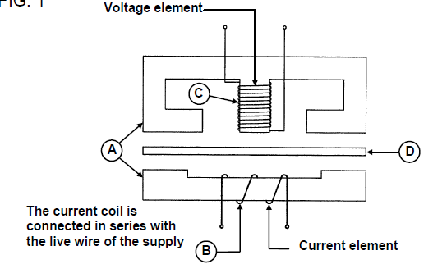
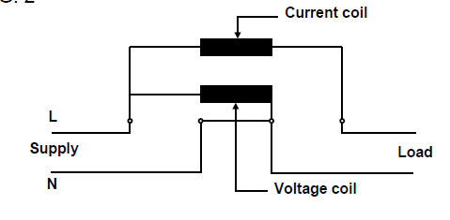
Construction of energy meter
Figure 01: Voltage element
Figure 02: Circuit diagram
Click on each figure to learn more
Notes:
Fig 01= CTC, Book 1, EM-T-2, Pg 205.
Fig 02= CTC, Book 1, EM-T-2, Pg 206
Click on Fig01 = -The voltage element is shown in consists of a coil (C) of many turns of thin wire and high resistance, wound on a laminated iron core (A), and is connected in parallel with the load (Fig 02).
-The current elements consists of coil (B), with a few turns of thick wire and low resistance, also wound on a laminated iron core (A) (Fig 01), and connected in series with the load (Fig 02).
-The aluminium disc (D) is mounted between the two elements.
Click on Fig02 = -All energy meters have the supply terminals on the left-hand side and the load terminals on the right hand side.
-The circuit diagram shown in Fig 02 illustrates how the meter is connected to the supply and load.

Slide 7
Practise
Familiarise yourself with the connections and wiring of an energy meter by examining it as follows:
• Remove the front cover from the energy meter.
• Identify the current coil and the voltage coil.
• Measure the resistance of the two coils and record the values.
What do you notice about the resistance of the voltage coil compared to the current coil?

Slide 8
Reading an energy meter
There are two methods of displaying the amount of energy measured by an energy meter (kilowatt-hour meter):
Digital display and
Analogue (dial type) display.
Notes:
Click on: Digital =Digital display, makes use of digits (numbers) to register the result, i.e. you can read the number of kilowatt-hours directly, e.g. 1 435 kWh. Most modern installations make use of this type of energy meter.
Analogue =Analogue display makes use of pointers or hands on numbered dials, and is more difficult to read. Older installations may still use this type of energy meter, hence this module to teach you how to read it.

Slide 9
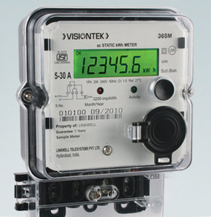
Digital type energy meter
The digital type kilowatt-hour meter usually has six large number wheels.
Notes:
Img02= https://5.imimg.com/data5/WA/AI/MY-43646231/smart-electrical-meter-500x500.jpg

Slide 10
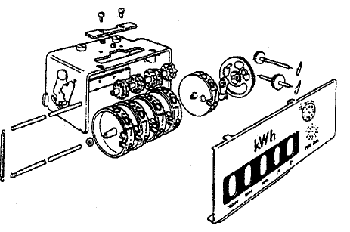
Digital energy meter numbered wheels
The numbered wheels on an digital energy meter represent the following values from right to left:
The first wheel on the right represents single units (kWh x 1)
The second wheel represents kWh x 10
The third wheel represents kWh x 100
The fourth wheel represents kWh x 1 000
The fifth wheel represents kWh x 10 000
The sixth wheel represents kWh x 100 000
An exploded view of a typical digital type energy meter
Notes:
Fig 03= CTC, Book1, EM-T-2, Pg 207.

Slide 11
Analogue energy meter
Since the watt-hour is too small a measure of power consumption, the kilowatt-hour (kWh) is used as the unit for measuring energy consumed per hour. One kilowatt is equal to 1 000 watts. There are usually four or five dials on the energy meter with each dial marked from 0 to 9, as shown below.
Notes:
Fig 04= CTC, Book1, EM-T-2, Pg 208.

Slide 12
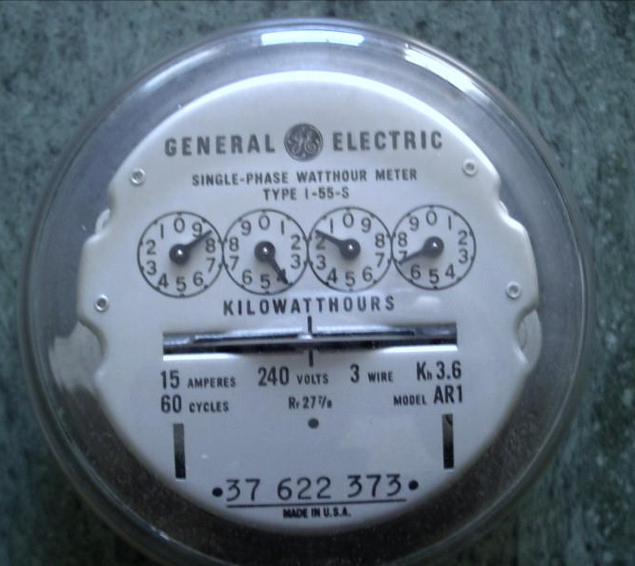
The dials on an analogue energy meter
The dials register from left to right, 1 000 kWh, 100 kWh, 10 kWh, 1 kWh and in case of five dials, the extreme right hand dial registers one tenth’s of a kilowatt-hour. The reading on the first dial on the right of the energy meter registers the number of single units.
Each dial pointer must complete a revolution to advance the dial pointer located to its left by one division.
Therefore when you read a dial, the dial before it ( to the right of it) must be checked first.
Unless that pointer has reached or passed 0 (that is unless it has completed a revolution), the pointer in question has not reached the division on which it may appear to rest.
For this reason, read the meter from right to left for accurate readings.
Notes:
Img03 = http://www.tdsurplus.com/images/ElectricMeterFront005.jpg

Slide 13
Quiz time
Practise reading dial type energy meters by completing the following quiz.

Slide 14
Question 1
Read the value shown below and enter your answers in the box provided.
Enter answer here
Notes:
Allow text to be entered.
Answer: 6509 kWh
Feedback:
Correct – Good job.
Incorrect – Try again.

Slide 15
Question 2
Read the value shown below and enter your answers in the box provided.
Notes:
Allow text to be entered.
Answer: 213 kWh
Feedback:
Correct – Good job.
Incorrect – Try again.

Slide 16
Question 3
Read the value shown below and enter your answers in the box provided.
Notes:
Allow text to be entered.
Answer: 2992 kWh
Feedback:
Correct – Good job.
Incorrect – Try again.

Slide 17
Let’s review:
In this lesson we have covered:
Construction of energy meters.
Reading energy meters.
Types of energy meters.
Make sure you have a complete understanding of all the work covered here before you start the next unit.

