Slide 1
Electrical components and systems
Topic 1 – Cables and conductors

Slide 2
Assumed prior learning
-Cable glands (unit 1.5)
Notes:
Lesson to provide links to the stated units.

Slide 3
Low voltage cable joints
Unit 1.6

Slide 4
In this lesson you will learn about:
Cable termination
Cable joints
Notes:
Link each to the relevant section in the lesson.

Slide 5
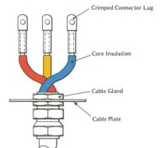
Cable termination and joints
We will refer to cable termination and cable joints a lot in this lesson but what exactly do these terms mean?
Joints and terminations provide the electrical connection, mechanical support and physical protection of the cable. There are different types of joints and terminations based on the cable function, type and construction materials.
Click on the image to find out more about cable joints and terminations
Notes:
On clicking image 01 present the following: ”A cable termination describes the specific point at which a cable, ends or starts. The cable terminations are often designed to enable the physical and electrical connecting of two cable ends. The cable joints are used to connect low, medium or high voltage cables. The joints provide electrical insulation as well as mechanical protection and strength.”
https://bit.ly/2MIjm9T

Slide 6
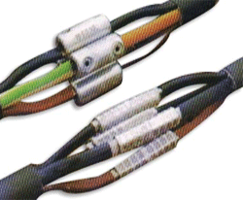
Types of cable joints
The type of cable joints vary according to the voltage, structure, insulation and number of cores of the cable to be jointed. The electrical connection can be made in various ways, including by crimp connectors, mechanical connectors or soldering.
Low tension jointing
Notes:
Img 02: https://bit.ly/2w6xR0m

Slide 7
Join a low tension cable
Armoured cables must only be joined by using acceptable cable couplers or manufacturers jointing kits, in which case it must be done in accordance with the manufacturer’s instructions. Watch the video below to learn how to correctly join a cable.
Vid 01 Screenshot
SAFETY FIRST !
Notes:
Screenshot of vid01 (see brief). Play video full screen.
On clicking ‘Safety First’ present the following: “Before you commence electrical work, remember to isolate, lock out and test to avoid injury or electrocution by working on live circuits.”

Slide 8
Practise makes perfect
After watching Video 1 in this lesson and joining your own cable, try this activity:
Take a piece of cable that is exactly the same size and length as the jointed cable. Use an insulation tester to test the resistances of both pieces of cable.
Compare the two sets of readings. If they differ by more than ±5% then your joint is not up to the standard set out in Regulation 6.3.7.2(a) in the Wiring Code SANS 10142, which requires that the joint should not adversely affect the characteristics of the cable.

Slide 9
Let’s review:
In this lesson we have covered:
Types of cable joints.
Method to join a LV cable.
Make sure you have a complete understanding of all the work covered here before you start the next unit.

Slide 10
Quiz time
We have come to the end of this unit. Check your knowledge on cable joints by answering the following questions.

Slide 11
Question 1
When you prepare a cable for jointing what do you do if the cable ends are damaged?
Use a different cable.
If damage is found it must be cut off square so that the cable ends are clean.
Lay the cables end to end and fit the mould over it.
Use a stronger jointing.
Notes:
MCQ
Correct answer is B
Feedback:
Correct – Great job.
Incorrect – Try again.

Slide 12
Question 2
What is a ferrule?
A cylindrical piece of tinned copper tubing used to join two conductor ends together.
A cylindrical piece of tinned copper tubing used to join two insulator ends together.
A cylindrical piece of plastic tubing used to join two conductor ends together.
A cylindrical piece of plastic tubing used to join two insulator ends together.
Notes:
MCQ
Correct answer is A
Feedback:
Correct – Well done.
Incorrect – Try again.

Slide 13
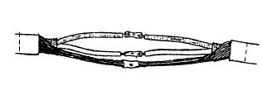
Question 3
The image shows a step in the process of joining a cable. Based on the image, is the following statement TRUE or FALSE: The joint is now ready to have the mould fitted around it
TRUE
FALSE
Notes:
True or False
Correct answer is TRUE
Feedback:
Correct – Well done
Incorrect – That is not correct.

Slide 14
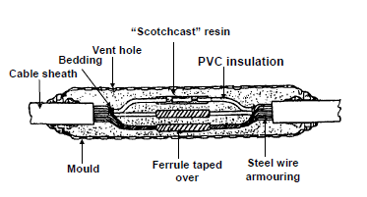
Question 4
Study the image and choose the correct step in the process of cable jointing it corresponds to.
The joint is now ready to have the mould fitted around it.
This image shows what the complete joint should look like.
The two cables are now ready to be joint by means of the correct size ferrules.
Notes:
MCQ
Correct answer is B
Feedback:
Correct – Great job.
Incorrect – Try again.

Slide 15
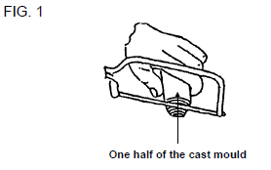
Video brief- Vid01 Video with presenter explaining how to joint a low tension cable
Voice over | Image/Gfx
There are several standard type s of cable joints and terminations, however, manufactures can make tailor made joints to suit different technical requirements. It must further be ensured that cable joints comply with Regulations 6.12.1.1(c), 6.3.7.2(a) and 6.3.7.2(c) of the SANS Wiring Code. Let’s go over the steps to join a cable according to manufacturer’s instructions.
Prepare cable for jointing 1) Examine the cable ends to be joined for damage. If damage is found it must be cut off square so that the cable ends are clean. 2) Cut off the stepped ends of the mould halves with a junior hacksaw until the assembled mould body fits snugly over the outside diameter of the cable (FIG. 1). 3) Lay the cables end to end, fit the mould over it and mark the position of the ends of the mould with adhesive tape on the two cable ends.
Notes:
Screencast video with SME explaining method of jointing a low tension cable with script as above brief for video 01and the relevant matching actions on screen. Please do not use black and white images, this needs to show a real life application of this task. Create a video similar to the combination of the following two videos: https://bit.ly/2w6f59d and https://bit.ly/2w8dCz9

Slide 16
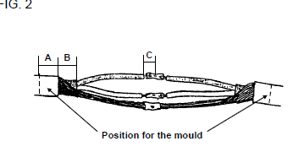
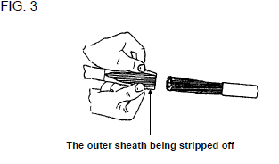
Video brief- Vid01 contin..Video with presenter explaining how to joint a low tension cable
Voice over | Image/Gfx
4) Note the dimensions A, B and C in FIG. 2. They will be specified by the manufacturer of the jointing kit. In this module A = B = outside diameter of the cable being joined and C = ½ length of the ferrule used to join the cores of the cable. 5) Measure the equivalent of the cable diameter towards the cable ends from this point (distance A in FIG. 2).
6) Ring cut the cable at this point and strip off the outer PVC sheath (FIG. 3). 7) Twist the wires of the armouring together for purposes of earthing. From the ends of the cable sheath measure the equivalent of the cable diameter on the cable (distance B in FIG. 2), and strip the bedding off. Care must be taken not to damage the conductors during this process. Do the same to the other cable end. 8) Remove the insulation at the end of each core to a distance equal to half the length of the ferrule (distance C in FIG. 2).
Notes:
Screencast video with SME explaining method of jointing a low tension cable with script as above brief for video 01and the relevant matching actions on screen. Please do not use black and white images, this needs to show a real life application of this task. Create a video similar to the combination of the following two videos: https://bit.ly/2w6f59d and https://bit.ly/2w8dCz9

Slide 17
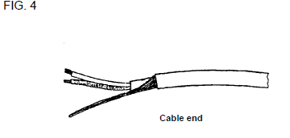
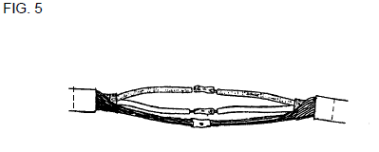
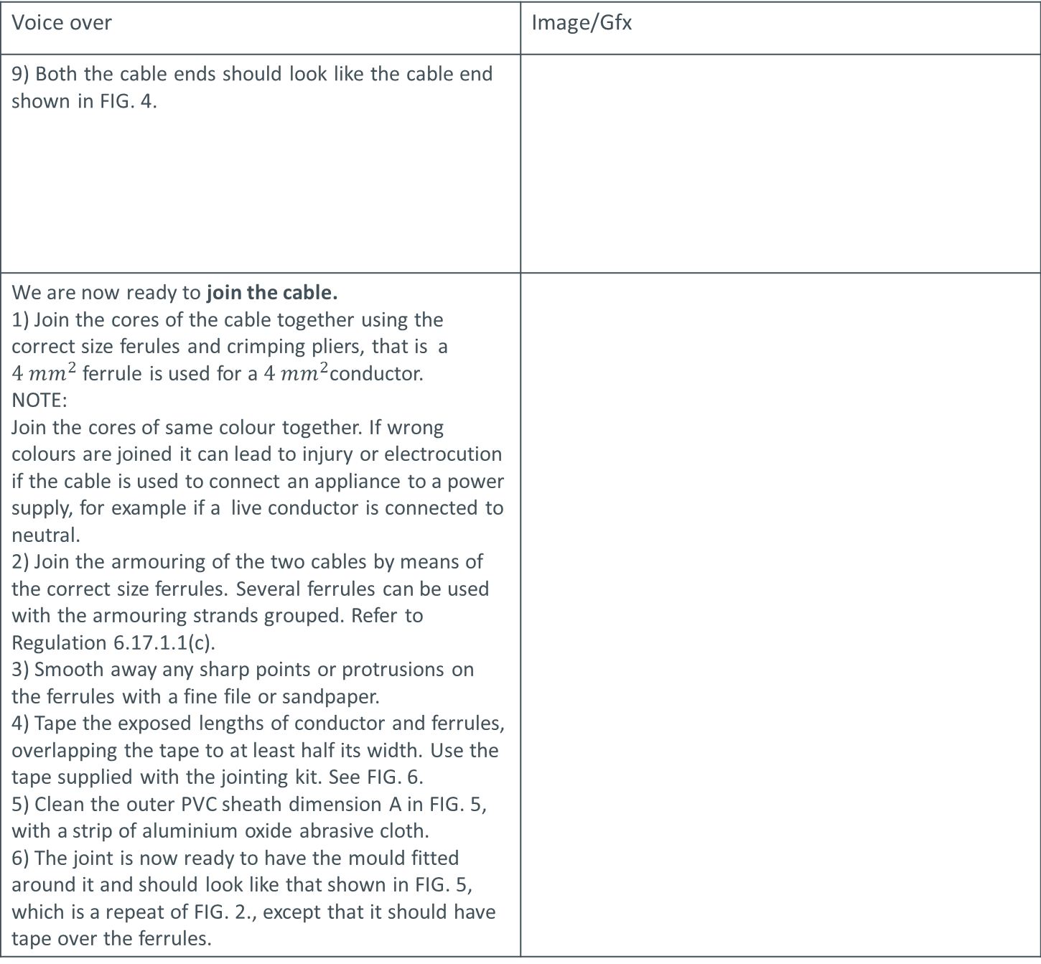
Video brief- Vid01 contin..Video with presenter explaining how to joint a low tension cable
Voice over | Image/Gfx
9) Both the cable ends should look like the cable end shown in FIG. 4.
We are now ready to join the cable. 1) Join the cores of the cable together using the correct size ferules and crimping pliers, that is a $4 mm^{2}$ferrule is used for a $4 mm^{2}$conductor. NOTE: Join the cores of same colour together. If wrong colours are joined it can lead to injury or electrocution if the cable is used to connect an appliance to a power supply, for example if a live conductor is connected to neutral. 2) Join the armouring of the two cables by means of the correct size ferrules. Several ferrules can be used with the armouring strands grouped. Refer to Regulation 6.17.1.1(c). 3) Smooth away any sharp points or protrusions on the ferrules with a fine file or sandpaper. 4) Tape the exposed lengths of conductor and ferrules, overlapping the tape to at least half its width. Use the tape supplied with the jointing kit. See FIG. 6. 5) Clean the outer PVC sheath dimension A in FIG. 5, with a strip of aluminium oxide abrasive cloth. 6) The joint is now ready to have the mould fitted around it and should look like that shown in FIG. 5, which is a repeat of FIG. 2., except that it should have tape over the ferrules.
Notes:
Screencast video with SME explaining method of jointing a low tension cable with script as above brief for video 01and the relevant matching images or actions on screen. Please do not use black and white images, this needs to show a real life application of this task. Create a video similar to: https://bit.ly/2w6f59d

Slide 18
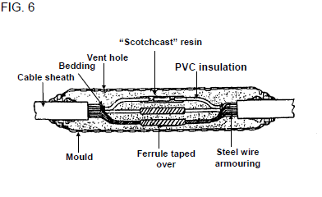
Video brief- Vid01contin.. Video with presenter explaining how to joint a low tension cable
Voice over | Image/Gfx
Now we can complete the cable joint. 1) Position the mould over half the joint, remove the original piece of PVC adhesive tape and re-mark both cables with the tape supplied. At these points apply as many layers of this tape as is necessary to ensure a resin-tight fit between the mould and the cable. 2) Position the mould halves round the cable and snap them together, ensuring that they are completely closed, then seal the ends to the cable with several highly stretched layers of tape. 3) Insert the funnels into the holes provided in the mould, making sure that the joint is level. Mix the resin and hardener according to the instructions given on the bag or tin. As soon as it is thoroughly mixed, pour the resin into the mould. FIG. 6 shows what the complete joint should look like. NOTE: Do not move the joint or pass current through the cable until the resin has completely solidified, which it is when the mould has cooled down.
Notes:
Screencast video with SME explaining method of jointing a low tension cable with script as above brief for video 01and the relevant matching actions on screen. Please do not use black and white images, this needs to show a real life application of this task. Create a video similar to the combination of the following two videos: https://bit.ly/2w6f59d and https://bit.ly/2w8dCz9

