Slide 1
Electrical components and systems
Topic 1 – Cables and conductors

Slide 2
Assumed prior learning
- Conductors and insulators basics (unit 1.1)
- Identifying conductors and cables (unit 1.2)
Notes:
Lesson to provide links to the stated units.

Slide 3
Cable glands
Unit 1.5

Slide 4
In this lesson you will learn about:
Fitting a gland to a flexible cable.
Fitting a gland to an armoured PVC cable.
Notes:
Link each to the relevant section below.

Slide 5

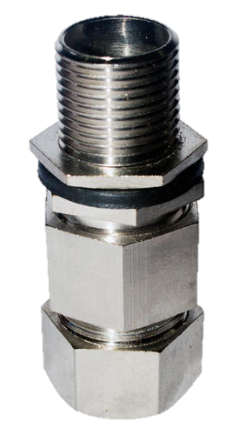
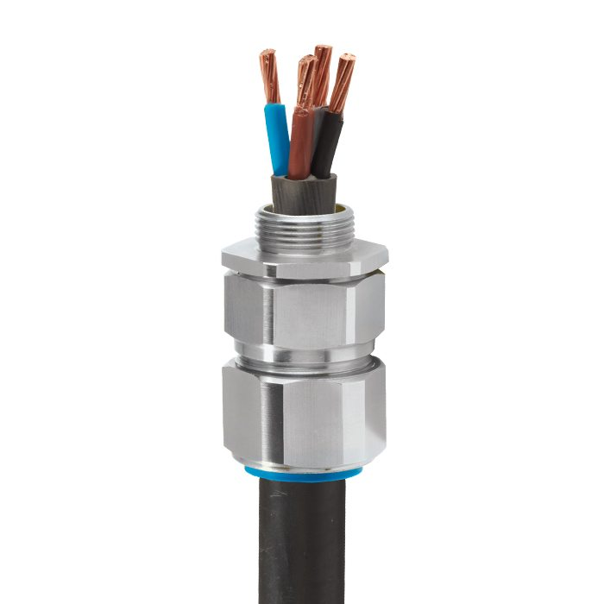
Cable glands
Glands are devices fitted to the ends of flexible cables to spread tension placed on the cable over the whole cable. Cable glands can be made of plastic, steel, brass or aluminium.
Click on the image to find out more about cable glands.
Notes:
On clicking image 01 present the following: “This is a double compression gland. Glands are fitted to the end of flexible cables so that if any tension is placed on the cable it will not be on the connections but on the cable as a whole. They are used as a sealing and termination device.” https://tinyurl.com/ya2hshan and https://www.cmp-products.com/wp-content/uploads/CW.jpg

Slide 6
Gland selection
There are different types of cable glands with different sizes too and you must be able to choose the correct one for your specific application. One of the important considerations is gland size, which is determined by the outer diameter of the cable. Luckily, there is a table, which will help you select the correct gland size.
Watch the video to see an example of how to select the correct gland size.
Vid 01 Screenshot
Notes:
Screenshot of vid01 (see brief). Play video full screen.

Slide 7
Select the correct gland size for flexible cables with an outside diameters of 16,5mm. Use the table provided.
CLICK FOR THE ANSWER
Notes:
Table must appear as a pop up. Table: Book 2, CA-2 Fit a compression gland, Pg 64
On clicking the button present the following: “Look under the column marked “Cable Diameter Range”. It is divided into two columns “MIN”, and “MAX”.
• Select the size smaller than 16,5 mm from the column marked “MIN”. In this case it is 14,5mm. Under the column marked “MAX” and opposite 14,5 is 19,8 or 17,2, thus 16,5 mm is between either of these ranges. Now look in the left-hand column marked “GLAND NO.” is the number 2 Therefore, a No. 2 compression gland is the correct size for a flexible cable of 16,5 mm outside diameter.”

Slide 8
Select the correct gland size for flexible cables with an outside diameters of 27mm. Use the table provided.
CLICK FOR THE ANSWER
Notes:
Table must appear as a pop up. Table: Book 2, CA-2 Fit a compression gland, Pg 64
On clicking the button present the following: “Look under the column marked “Cable Diameter Range”. It is divided into two columns “MIN”, and “MAX”.
• Select the size smaller than 27 mm from the column marked “MIN”. In this case it is 26,1mm. Under the column marked “MAX” and opposite 26,1 is 28,5 or thus 27 mm is between this range. Now look in the left-hand column marked “GLAND NO.” is the number 3. Therefore, a No. 3 compression gland is the correct size for a flexible cable of 27 mm outside diameter.”

Slide 9
Method of fitting a gland
Now that you know how to select the right size of gland for a project, watch the following video to learn how to fit a cable gland.
Vid 02 screenshot
Notes:
Screenshot of vid02 (see brief). Play video full screen.

Slide 10
Armoured PVC cable gland
Glands are fitted to armoured PVC cables so that they carry the mass of the cable when it is fitted in a vertical position and prevent any tension from being placed on the conductors and terminals. Once again there is a table to help you choose the correct gland size.
Vid 03 screenshot
Notes:
Screenshot of vid03 (see brief). Play video full screen.

Slide 11
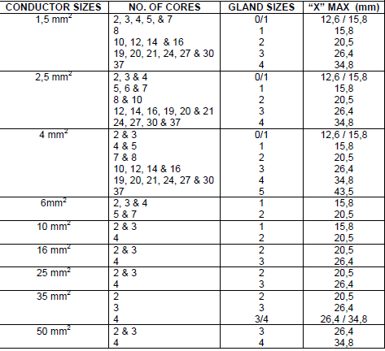
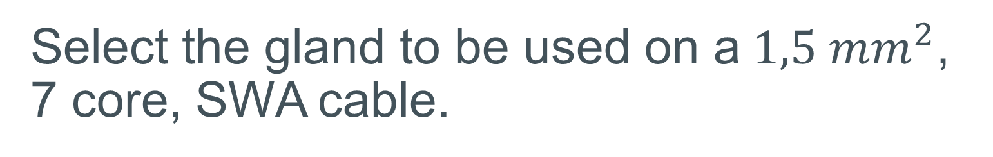
Select the gland to be used on a$1,5 mm^{2}$, 7 core, SWA cable.
CLICK FOR THE ANSWER
Notes:
Table must appear as a pop up. Table2: Book 2, CA-3,Table 1 Pg 79
On clicking the button present the following: “Look in the left hand column marked “CONDUCTOR SIZES” until $1,5 mm^{2}$ is found. Place a ruler horizontally across the tables on the line between $1,5 mm^{2}$ and $2,5 mm^{2}.$In the second column marked “NO. OF CORES” find the given number of cores in the cable – 7 in this case. In the column marked “GLAND SIZE”, opposite the 7 in the second column, will be a number. In this case it is 0/1. Thus a number zero or one gland must be used on a $1,5 mm^{2}$, 7 core, SWA cable.”

Slide 12
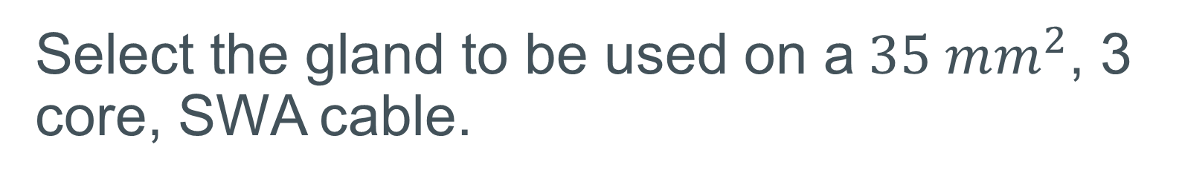
Select the gland to be used on a$35 mm^{2}$, 3 core, SWA cable.
CLICK FOR THE ANSWER
Notes:
Table must appear as a pop up. Table2: Book 2, CA-3,Table 1 Pg 79
On clicking the button present the following: “Look in the left hand column marked “CONDUCTOR SIZES” until $35 mm^{2}$ is found. Place a ruler horizontally across the tables on the line between $35 mm^{2}$ and $50 mm^{2}.$In the second column marked “NO. OF CORES” find the given number of cores in the cable – 3 in this case. In the column marked “GLAND SIZE”, opposite the 3 in the second column, will be a number. In this case it is 3. Thus a number 3 gland must be used on a $35 mm^{2}$, 3 core, SWA cable.”

Slide 13
Fitting armoured PVC cable gland
Fitting a gland to an armoured PVC cable follows similar steps to fitting a gland to a flexible cable, however, due to the armour there is a difference in the method too. Watch the video to learn how to fit a PVC cable gland.
Vid 04 screenshot
Notes:
Screenshot of vid04 (see brief). Play video full screen.

Slide 14
Let’s review:
In this lesson we have covered:
Using tables to select the correct cable gland size.
How to fit a cable gland.
Make sure you have a complete understanding of all the work covered here before you start the next unit.

Slide 15
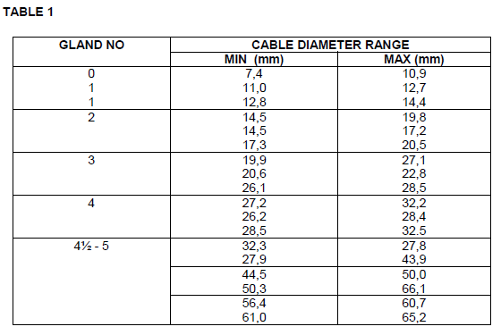
Video brief- Vid01 Screencast video with presenter explaining how to choose gland size
These videos will need to be recorded using an SME or technician.
Voice over | Image/Gfx
The correct gland to be used for a cable may be selected by using this table. From Table 1 you can see that the gland size is determined by the outer diameter of the cable. For example: To select a gland for an unarmoured flexible cable with an outside diameter of 21 mm. • Look under the column marked “Cable Diameter Range”. It is divided into two columns “MIN”, and “MAX”. • Select the size smaller than 21 mm from the column marked “MIN”. In this case it is 20,6. Under the column marked “MAX” and opposite 20,6 is 22,8, thus 21 mm is between these values. Now look in the left-hand column marked “GLAND NO.” is the number 3. Therefore, a No. 3 compression gland is the correct size for a flexible cable of 21 mm outside diameter.
Notes:
Video to have a scripted voice over as in Vid01 brief. Zoom into the selected areas as pointed out when each section is mentioned by the voice over.

Slide 16
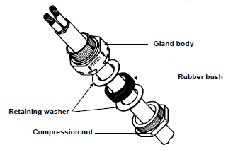
Video brief - Vid02 Screencast video with expert presenter explaining the Method of fitting a gland.
Voice over | Image/Gfx
Before we learn how to fit a gland, let’s look at the parts of a compression gland. A gland is made up of the gland body, retaining washers, rubber bush and compression nut. Separate the gland into its components before fitting the cable gland.
Now let’s go over the steps to fit a compression gland. 1) Measure the required length of cable, allowing enough conductor tail to reach the furthermost terminal. 2) Mark this point on the cable by measuring the distance from the end of the cable to the point where the gland must be fixed. This is the point to where the outer insulation of the cable will be stripped. 3) Use a sharp knife to strip off the outer insulation to the required length. 4) Thread the compression nut over the cable, the hexagon end first. 5) Thread the retaining washer. If it does not fit over the cable, discard it, or use a round file to enlarge the hole. 6) Thread the neoprene or rubber compression bush onto the cable and then the next retaining washer. If it does not fit discard it. NOTE: The No. 0 compression gland only has a retaining washer between the compression bush and the compression nut. 7) Thread the gland body onto the cable and mate it with the thread of the compression nut. 8) Use spanners to hold the gland body and tighten the compression nut into it until the cable is firmly gripped. It must be impossible to pull it out by hand. 9) Fit the cable “tails” or conductors and the nipple through the hole in the apparatus and fix it tightly with a lock nut. | Create video similar to this with the appropriate actions to match the voice over on the left: https://tinyurl.com/ya8q9y2j
There are also situations where the gland of the cable must be fitted into a threaded hole and it is not possible to turn the cable. In such cases use the following method. 1) Prepare the cable end as previously discussed. 2) Screw the gland body (see FIG. 1) into the threaded hole and lock it in position with a spanner. 3) Thread the cable “tails” or conductors through the gland body and screw the compression nut into the gland body. Tighten it with a spanner until the cable is firmly gripped. It must not be possible to pull it out by hand.
Notes:
Screencast video with SME explaining method of fitting a gland with script as above brief for video 02 and the relevant matching images or actions on screen.
A video needs to be created to match the scripting in rows 1, 2 and 3 in a similar video style to this one https://tinyurl.com/ya8q9y2j
SME to assemble the cable gland for video:

Slide 17
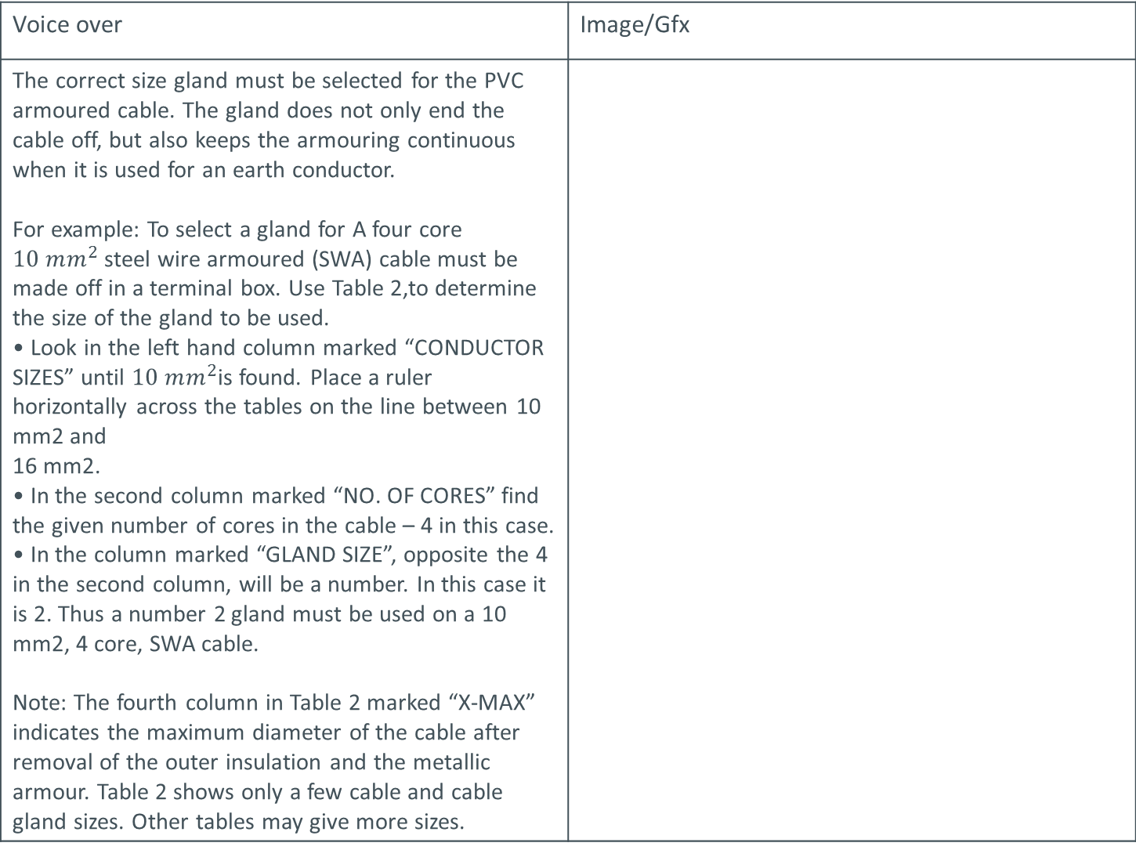
Video brief- Vid03 Screencast video with presenter explaining how to choose gland size
Voice over | Image/Gfx
The correct size gland must be selected for the PVC armoured cable. The gland does not only end the cable off, but also keeps the armouring continuous when it is used for an earth conductor. For example: To select a gland for A four core $10 mm^{2}$steel wire armoured (SWA) cable must be made off in a terminal box. Use Table 2,to determine the size of the gland to be used. • Look in the left hand column marked “CONDUCTOR SIZES” until $10 mm^{2}$is found. Place a ruler horizontally across the tables on the line between 10 mm2 and 16 mm2. • In the second column marked “NO. OF CORES” find the given number of cores in the cable – 4 in this case. • In the column marked “GLAND SIZE”, opposite the 4 in the second column, will be a number. In this case it is 2. Thus a number 2 gland must be used on a 10 mm2, 4 core, SWA cable. Note: The fourth column in Table 2 marked “X-MAX” indicates the maximum diameter of the cable after removal of the outer insulation and the metallic armour. Table 2 shows only a few cable and cable gland sizes. Other tables may give more sizes.
Notes:
Video to have a scripted voice over as in Vid03 brief. Zoom into the selected areas as pointed out when each section is mentioned by the voice over.
Table 2: Book 2, CA-3 , Table 1 on Pg 79

Slide 18
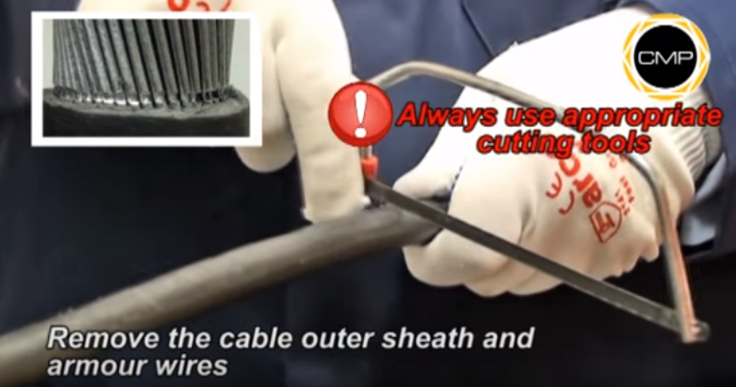
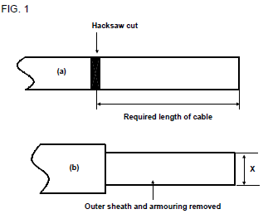
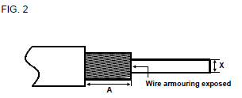
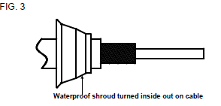
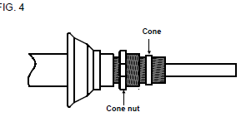
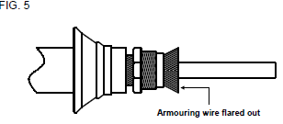
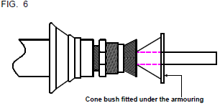
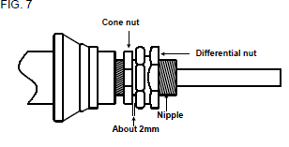
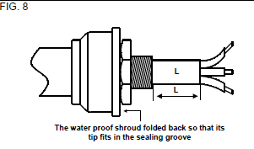
Video brief - Vid04 Screencast video with expert presenter explaining the Method of fitting a gland.
Voice over | Image/Gfx
Separate the gland into its components before fitting the cable gland. 1) Measure the required length of cable, allowing enough conductor “tail” to reach the furthermost terminal and mark this point on the cable by sawing right around the cable with a hacksaw. | Create video similar to this with the appropriate actions to match the voice over on the left: https://tinyurl.com/ya8q9y2j
2) Cut through the outer PVC sheath and about halfway through the wire armouring FIG. 1(a). Do not cut right through the armouring because you may damage the insulation below it. 3) Remove the outer sheath down to the hacksaw cut. 4) Remove the armouring from the cable by bending it at the hacksaw cut until it breaks off. See FIG. 1(b). 5) Expose the wire armouring to the length of the cone of the gland (FIG. 2). 6) Turn the waterproof shroud inside out and pull it over the cable end, large end first FIG. 3. 7) Fit the cone nut (hexagon end first) and cone over the exposed armouring. FIG. 4. 8) Flare out the wire armouring. On smaller cables this may be done by wobbling the cable bedding with a circular motion. On larger cables a screwdriver may be used to prise the wire away from the cable bedding FIG. 5. 9) Fit the cone bush over the cable bedding, sharp edge first. Fit the cone under the armouring, ensuring that no wires are caught underneath it FIG. 6. 10) Fit the differential nut and nipple over the cable and screw it onto the cone nut. On larger cables, partially screw the nipple out (anti-clockwise) so that the two parts of the gland can mate easily. 11) By means of the adjustable method of screwing the nipple further in or out, ensure about a 2 mm clearance between the face of the differential nut and the opposing face of the cone nut FIG. 7. 12) Lock the gland by tightening the differential nut onto the cone nut by using spanners. 13) Using a knife and starting at the end of the cable, strip off the bedding of the cable around the conductors. The bedding should be left protruding through the gland with a length L, which is specified by the manufacturer FIG. 8. 14) Thread the cable “tails” or conductors and the nipple through the hole in the apparatus. Fit the lock-nut to the nipple inside the apparatus and tighten it. 15) Roll back the waterproofing shroud, right side out, and fit the inside lip of the shroud snugly into the sealing groove on the differential nut. See FIG. 8. NOTE: The armouring of the PVC cable is used as an earthing conductor, therefore, it is essential that: • The gland is correctly fitted and firmly tightened. • The lock-nut is correctly fitted and firmly tightened. | Create video similar to this with the appropriate actions to match the voice over on the left: https://tinyurl.com/ya8q9y2j
Notes:
Screencast video with SME explaining method of fitting a gland with script as above brief for video 04 and the relevant matching images or actions on screen.
A video needs to be created to match the scripting in rows 1, 2 and 3 in a similar video style to this one https://tinyurl.com/ya8q9y2j
SME to assemble the cable gland for video: Please note; this practical should not be demonstrated with black and white images as in the image column but rather demonstrated as a real life application.

Slide 19
Video brief - Vid04 contin. Screencast video with expert presenter explaining the Method of fitting a gland.
Voice over | Image/Gfx
In situations where the gland of the cable must be fitted into a threaded hole and it is not possible to turn the cable, use the following method: 1) Prepare the cable end as set out above and fit the gland. Lock the differential nut and the cone nut so that the wire armouring may be formed. Loosen these two nuts again. 2) Remove the differential nut and nipple, without disturbing the adjustment. Holding the nipple inside the differential nut with the thumb, screw it into the hole. 3) Tighten the differential nut and nipple as one assembly and lock it into position with a spanner. 4) Insert the cable “tails” or conductors through the differential nut and screw the cone into the differential nut after having made sure that the cone bush is correctly seated under the armouring. 5) Tighten the cone nut into the differential nut. Hold the cable with one hand to prevent it from twisting. Before finally tightening the cone nut, twist the cable about ¼ of a turn in an anti-clockwise direction so that it will be straight when the cone nut is fully tightened. 6) Roll back the waterproofing shroud, correct side out, and fit the inside lip of the shroud snugly into the sealing groove on the differential nut. | Create video similar to this with the appropriate actions to match the voice over on the left: https://tinyurl.com/ya8q9y2j
Notes:
Screencast video with SME explaining method of fitting a gland with script as above brief for video 04 and the relevant matching images or actions on screen.
A video needs to be created to match the scripting in rows 1 in a similar video style to this one https://tinyurl.com/ya8q9y2j
SME to assemble the cable gland for video: Please note; this practical should not be demonstrated with black and white images but rather demonstrated as a real life application.

