Slide 1
Electrical Components and Systems
Topic 1: Cables and conductors

Slide 2
Testing a low voltage cable
Unit 1.3

Slide 3
In this lesson you will learn about:
Classification of faults in cables.
How to test a low voltage (LV) cable.
Safety procedures for testing a LV cable.
Notes:
Link each to the relevant section below.

Slide 4
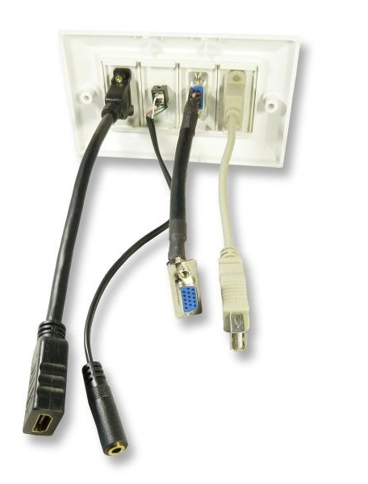
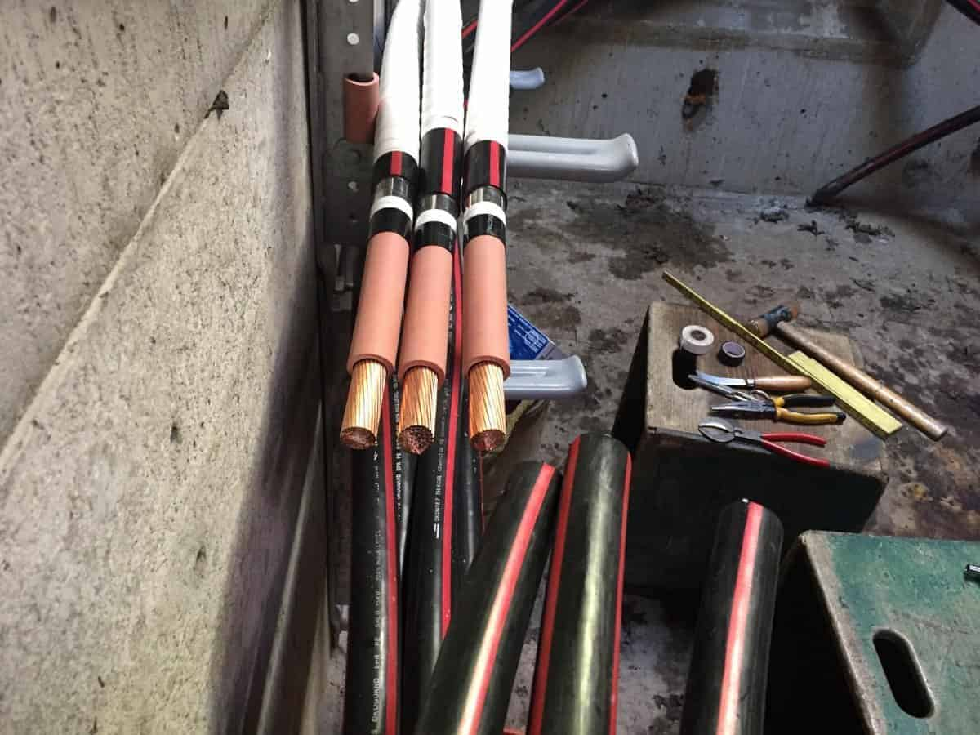
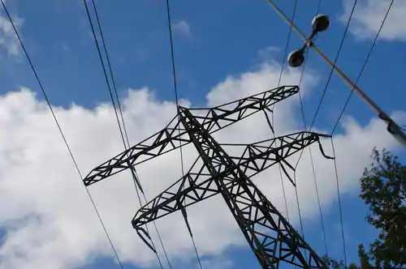
What is a low voltage cable?
Electrical cables can be categorised in different ways including by voltage rating. Low voltage cables carry up to a 1000volts of electricity. LV cables have an ordinary construction as the stresses in the cable are low.
Click on each image to learn more about the different cable voltage ratings.
Notes:
On clicking Img01) present the following: “Low-Voltage cables include voltages up to 1000V. These are mainly used in electric distribution at the nearest end to users items, for example; appliances, lightings, power outlets.” https://tinyurl.com/y9c9t466
On clicking Img02) present the following: “Medium-Voltage Cables from 1000V to 44kV. Medium-voltage cables are commonly used in mobile substation equipment, for distribution of power in industrial settings and in mining.” https://tinyurl.com/y9rjy559
On clicking Img03) present the following: “High-Voltage cables from 44kV to 230kV. Extra High Voltage cables are above 230kV range. High-voltage cables are used in power transfer and distribution, national transfer network cabling, electric stations and municipal networks.” https://tinyurl.com/y79zv3of

Slide 5
Types of faults that occur in cables
There are many reasons why a cable may fail and there can be more than one fault at a time in a cable. External damage to the cable or a voltage or current that is too high can cause the insulation of the cable to break down or conductors to burn off thus causing a fault in the cable.
Click the button to watch a video explaining the different types of faults that can occur in cables.
Video 01 screenshot
Notes:
screenshot of vid01 (see brief). Play video full screen.

Slide 6
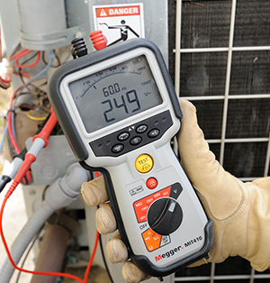
Test instruments
There are a number of insulation testers that are used to test cables. These instruments are suitable for testing the insulation resistance and the continuity for all medium voltage domestic and industrial wiring systems and equipment, transformers, motors, generators and low tension cables. Refer to the unit where you have learnt how to use these testers.
Notes:
On clicking Img04 present: “Before using the instruments, they must be checked for proper operation as you have been taught earlier.”
On clicking “Refer to the module where you have learnt how to use these testers.” the student must be re-directed to the module on test instruments/resistors.

Slide 7
Safety warning
A cable stores high voltages due to capacitance when tested with a high voltage tester, and will discharge through the body of the person touching it or through the instrument.
NOTE: You must read the safety warning on this page and complete the self test that follows in order to continue with this lesson.
SAFETY FIRST !
Notes:
NOTE: Do not allow learner to move on, until the have clicked on the ‘Safety first’ button.
On clicking ‘capacitance’ present the following: “Capacitance is the ability of a system of electrical conductors and insulators to store electric charge when a potential difference exists between the conductors.”
On clicking Safety first present all of the below:
“Before and after testing a cable for short circuits, all the cores must be discharged to earth by means of an insulated conductor at both ends.
There is a Danger of electrocution if cable is tested live. Isolate cable at both ends and lock out the switching devices before testing the cable.
1. Insulation resistance values and also cable core resistance values will vary with the type and length of cable used, therefore no fixed values can be given in these notes. When testing any cable it is essential that the manufacturer’s specifications are used to compare the values obtained with the test instrument.
2. Different size insulation testers for example; Meggers and Insulation Continuity Testers are used for different sizes and voltages of cables. These notes do not include the testing of cables above 500 volts.
3. A cable need only be tested from ONE end.“

Slide 8
Self-test
Before practising to use an insulation tester to test a cable to determine its condition, you must answer the following questions after watching Video 01 and reading the ‘Safety warning’ slide. If you do not get all the questions correct you will not be able to continue with this lesson.
Notes:
NOTE: Do not allow learner to bypass the self test. They must get all questions correct to proceed.

Slide 9
Question 1
Which tests would you do to determine the condition of a given cable?
Continuity test
Insulation resistance between conductors
Insulation resistance between conductors and earth
Notes:
NOTE: Do not allow learner to bypass this self test. They must get all questions correct to proceed.
Answers above in grey are correct and may be accepted in any order.
Feedback:
Correct answer: Well done!
Incorrect answer: Try again after watching video 01 of this lesson.

Slide 10
Question 2
Which selector switch ranges would you use to do these tests?
a) Continuity test MΩ range, Insulation resistance between conductors MΩ
range and Insulation resistance between conductors and earth MΩ range.
b) Continuity test Ω range, Insulation resistance between conductors MΩ
range and Insulation resistance between conductors and earth Ω range.
c) Continuity test Ω range, Insulation resistance between conductors Ω
range and Insulation resistance between conductors and earth Ω range.
d) Continuity test Ω range, Insulation resistance between conductors MΩ
range and Insulation resistance between conductors and earth MΩ range.
Notes:
NOTE: Do not allow learner to bypass this self test. They must get all questions correct to proceed.
MCQ
Correct option is D
Feedback
Correct answer: Well done
Incorrect answer: Looks like you need to watch video 01 of this lesson again.

Slide 11
Question 3
What is the danger after the short circuit test is done and how can it be avoided?
a) Cables store high voltages due to capacitance when tested with a high voltage tester. To avoid the danger switch the tester off after testing.
b) Cables store high voltages due to capacitance when tested with a high voltage tester. After testing the cable, current carrying cores must be discharged to earth.
c) Cables store high voltages due to capacitance when tested with a high voltage tester. Wear rubber gloves to protect yourself from any danger.
d) Cables store high voltages due to capacitance when tested with a high voltage tester. Disconnect the tester lead from the blue phase and connect it onto the white phase to avoid electrocution.
Notes:
NOTE: Do not allow learner to bypass this self test. They must get all questions correct to proceed.
MCQ
Correct option: B
Feedback:
Correct answer: Good job!
Incorrect answer: Looks like you need to watch video 01 of this lesson again.

Slide 12
Question 4
What must be done to a cable before any testing is attempted?
a) Isolate cable at both ends and lock out the switching devices.
b) Set up the insulation resistance tester.
c) Disconnect the tester lead from the blue phase and connect it onto the white phase.
d) The resistance tester must be switched on.
Notes:
NOTE: Do not allow learner to bypass this self test. They must get all questions correct to proceed.
MCQ
Correct option: A
Feedback:
Correct answer: Nicely done!
Incorrect answer: Looks like you need to watch video 01 of this lesson again.

Slide 13
Method of testing a cable
Isolate cable at both ends and lock out the switching devices. Before and after testing discharge all the cores to earth by means of insulated conductor at both ends.
SAFETY FIRST !
Test for a short circuit between cores
Test for an open circuit in the cores
Test for an earth fault
Notes:
On clicking Safety first present: “Danger of electrocution if cable is tested live. Capacitance may build up in the cable if it is tested with a high voltage tester, which may cause a person touching it to receive an electric shock.” Do not allow learner to pass onto the next slide without reading the warning.
On clicking ‘Test for a short circuit between cores’ link to steps for Vid02
On clicking ‘Test for an earth fault’ link to steps for Vid03
On clicking ‘Test for an open circuit in the cores’ link to steps for Vid04

Slide 14
Let’s review:
In this lesson we have covered:
Classifying cables by voltage.
Method to test for faults in cables.
Safety procedures when testing a LV cable.
Make sure you have a complete understanding of all the work covered here before you start the next unit.

Slide 15
Vid01:Different types of faults in cables
Cables are tested before and after they are joined and terminated, to determine faults which may have occurred during their installation and also to ensure that the joints and/or the terminations were made correctly. The weak link in all electric equipment is its insulation. When this fails, current is allowed to flow along incorrect paths. Equipment can thus be damaged and/or harm caused to human lives. There are three types of faults that may be recognised when first examining a faulty cable. There is also a chance that two or even all three of these may occur at the same time in the same cable.
NOTE: Insulation resistance values and also cable core resistance values will vary with the type and length of cable used, therefore no fixed values can be given in these notes. When testing any cable it is essential that the manufacturer’s specifications are used to compare the values obtained with the test instrument. Different size insulation testers for example; Meggers and Insulation Continuity Testers are used for different sizes and voltages of cables. These notes do not include the testing of cables above 500 volts. A cable need only be tested from ONE end.
1.Open circuit fault
1.1 An open circuit fault occurs when one or more of the cores burn off.
1.2 This is usually caused by either too high a current passing through the conductors or by some external cause of damage to the cores.
1.3 A continuity test of all cores must be done. The selector switch must be set to the “Ω” range to perform this test.
2. Short circuit fault
2.1 A short circuit fault occurs when the insulation breaks down between the cores.
2.2 This fault can be caused by applying too high a voltage over the cable, causing too high a current to flow in the cable or there may be a weak spot in the insulation.
2.3 An insulation resistance test between all conductors must be done. The selector switch must be set to the “MΩ” range to perform this test.
3. Earth fault
3.1 An earth fault occurs when one of the above faults causes the current to find a path to either the armouring of the cable or to the general mass of the earth.
3.2 An insulation resistance test between all conductors and earth must be done. The selector switch must be set to the “MΩ” range to perform this test.
NOTE:
• There is also a chance that two or even all three faults may occur at the same time in the same cable.
• In this lesson only low-tension cables (500 volt and less), which are on the surface of walls, buildings or in cable trays or ducts, will be considered. The methods used for locating faults below ground level are complex, and make use of more sophisticated instruments and will not be discussed.
Notes:
Create video with script as above and use an expert presenter to explain the concept of low tension cable testing using the correct visual aids, similar to this video: https://www.youtube.com/watch?v=WhUz_VrG-yY

Slide 16
Vid02: Test for a short circuit between cores
Step by step instructions for Insulation resistance test between all conductors:
1.1 Set the selector switch to the “MΩ” range.
1.2 Start at one end and test between all the cores. Connect insulation continuity tester lead onto the red phase and the other lead onto the blue phase and test. Note and record the reading.
1.3 Disconnect the tester lead from the blue phase and connect it onto the white phase. Leave the other lead on the red phase. Test and record the reading.
1.4 Disconnect the tester lead from the red phase and connect it onto the blue phase. Leave the other lead on the white phase. Test and record the reading.
1.5 If a reading of less than 1MΩ is obtained then it indicates that there is a short between the two cores under test.
NOTE:
When a test voltage is applied to any system of appreciable capacitance, for example a cable, a current will flow into the system until it is fully charged, causing the pointer of the tester to initially fall and then rise to the correct insulation value.
Refer to the SANS Code of Practice for the minimum resistance readings allowed, for both the insulation between conductors and insulation between conductor and earth test.
Notes:
Create video with script as above and use an expert presenter to explain the concept of testing for a short circuit with the correct visual aids, similar to this video: https://www.youtube.com/watch?v=WhUz_VrG-yY

Slide 17
Vid03: Test for an earth fault
Step by step instructions for Insulation resistance test between all conductors and earth
2.1 Set the selector switch to the “MΩ” range.
2.2 Connect the one lead of the instrument onto the armouring of the cable or onto an earth point that includes the earth of the cable.
2.3 Connect the other lead onto the red phase of the cable. Test and record the reading.
2.4 Disconnect the lead from the red phase and reconnect it onto the white phase. Test and record the reading.
2.5 Disconnect the lead of the instrument you are using from the white phase and reconnect it onto the blue phase. Test and record the reading.
2.6 If a reading of zero is obtained then it indicates that the particular core has an earth fault.
NOTE:
When a test voltage is applied to any system of appreciable capacitance, for example a cable, a current will flow into the system until it is fully charged, causing the pointer of the tester to initially fall and then rise to the correct insulation value.
Refer to the SANS Code of Practice for the minimum resistance readings allowed, for both the insulation between conductors and insulation between conductor and earth test.
Notes:
Create video with script as above and use an expert presenter to explain the concept of testing for an Earth fault with the correct visual aids, similar to this video: https://www.youtube.com/watch?v=WhUz_VrG-yY

Slide 18
Vid04 Test for an open circuit in the cores
Step by step instructions for Continuity test on all conductors (between phases)
3.1 Set the selector switch to the “Ω” range.
3.2 Connect the red phase, at the other end of the cable, to earth by means of an insulated conductor.
3.3 Connect the one lead of the instrument that you are using to earth, and the other lead onto the red phase. Test and record the reading.
3.4 Disconnect both the earth lead on the far end, and the instrument lead from the red phase and reconnect them to the white phase. Test and record the reading.
3.5 Repeat the test on the blue phase. Test and record the reading.
3.6 The readings obtained here must be compared to those specified by the manufacturer, but if the three readings are the same it can be safely assumed that there is continuity in the cores. An infinity reading indicates and open circuit.
NOTE:
When a test voltage is applied to any system of appreciable capacitance, for example a cable, a current will flow into the system until it is fully charged, causing the pointer of the tester to initially fall and then rise to the correct insulation value.
Notes:
Create video with script as above and use an expert presenter to explain the concept of continuity testing with the correct visual aids, similar to this video: https://www.youtube.com/watch?v=WhUz_VrG-yY

