Slide 1
Electrical Components and Systems
Topic 1: Cables and conductors

Slide 2
Assumed prior learning
Conductors and insulators (unit 1.1 in topic 3)
Notes:
Link to unit 1.1 upon clicking the unit.

Slide 3
In this lesson you will learn about:
Arrangement of stranded conductors
Unarmoured and Armoured cables
Classification of cables
Sizes and colours of conductors
Notes:
Link each to the relevant section below.

Slide 4
Identifying conductors and cables
Unit 1.2

Slide 5
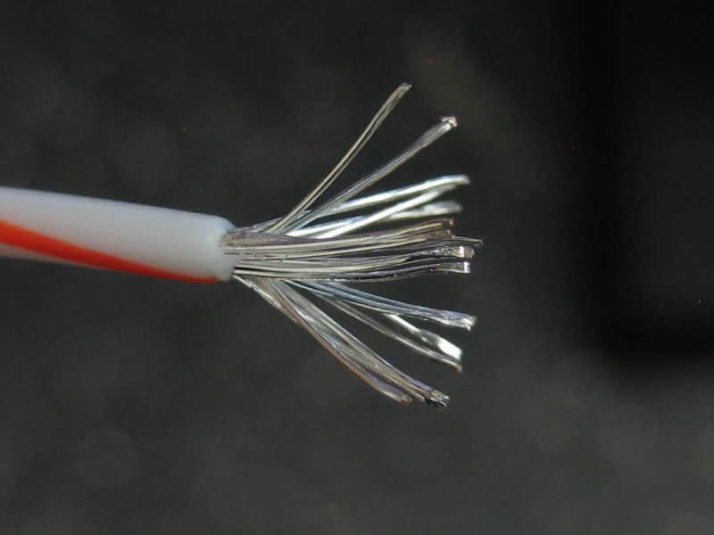
Conductor materials
Copper and aluminium are most commonly used as conductor materials, for reasons discussed in unit 1.1. Copper is used extensively and can be coated with another metal to improve its conductivity for different uses. Silver is the most conductive material, however, due to its cost a much cheaper option will be silver plated wire.
Notes:
On clicking unit ‘1.1’ re-direct to previous lesson Section 3 unit 1.1
On clicking Img00 present: “Silver plated copper wire.” Img00: https://bit.ly/2Odr24s

Slide 6
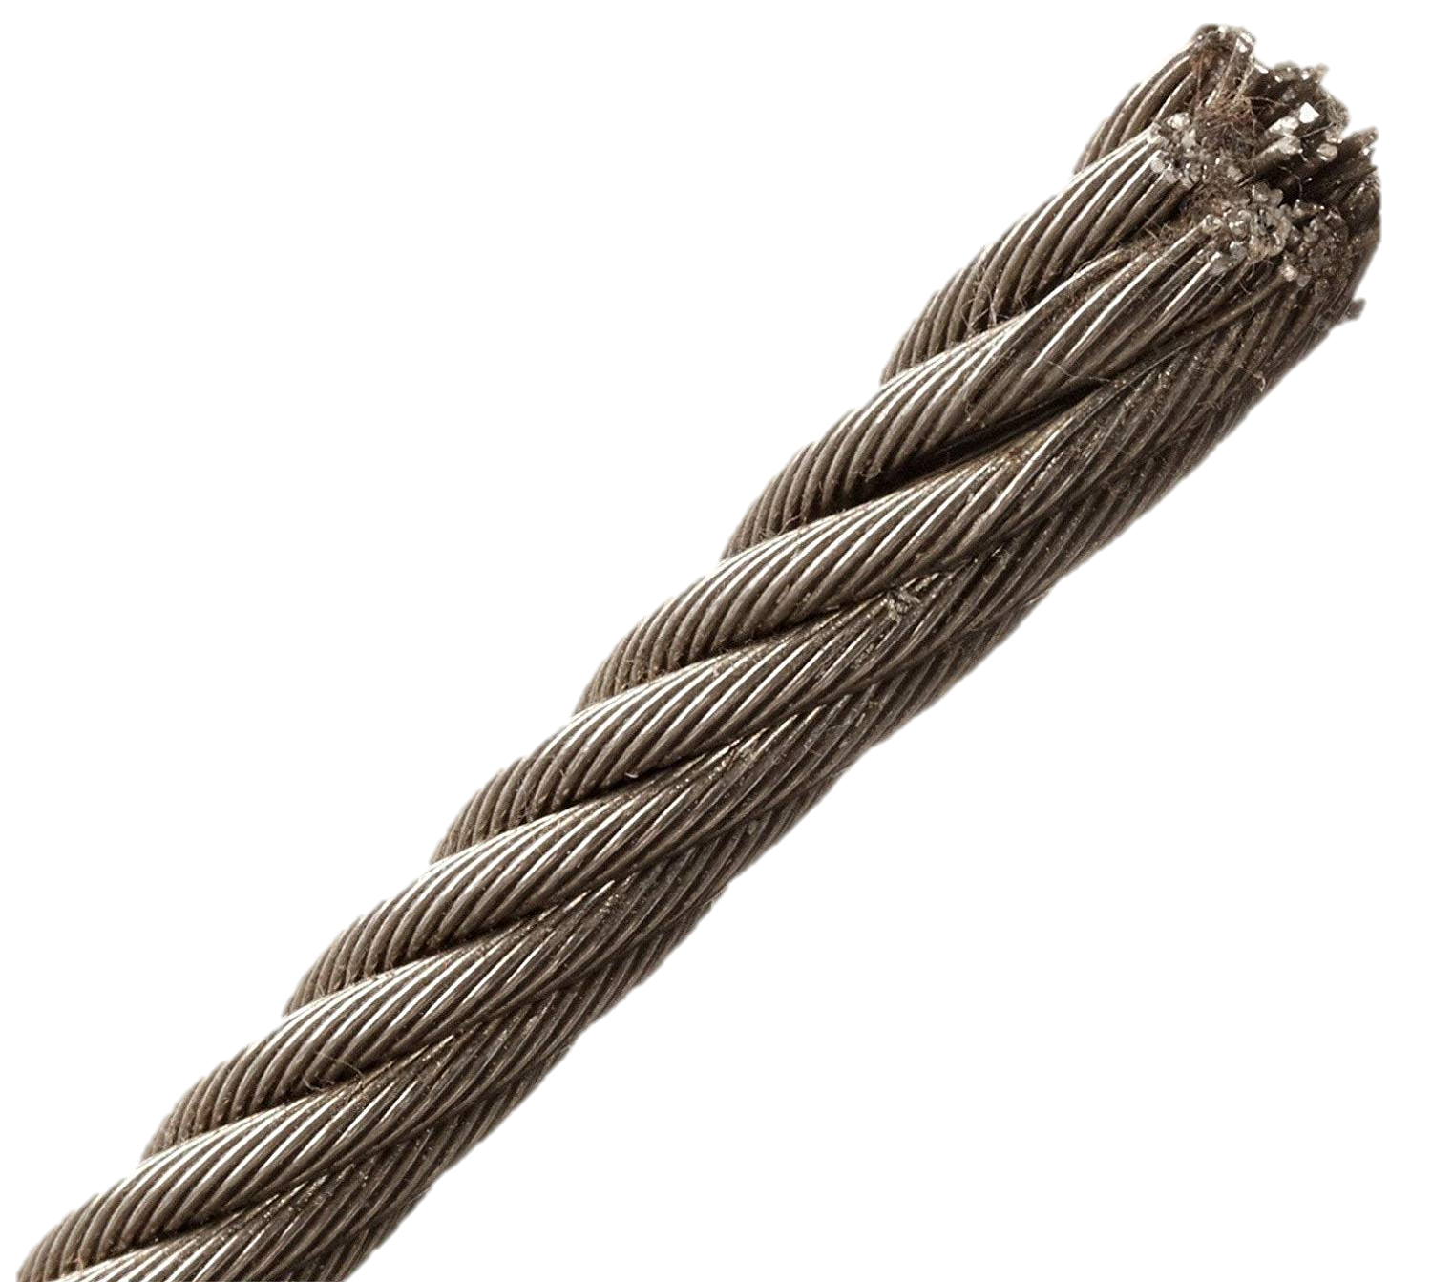
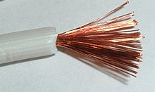
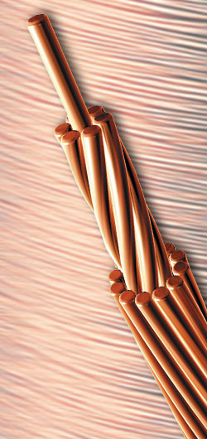
Arrangement of stranded cables
In unit 1.1 you saw that conductors can be solid or stranded. There are several ways the strands in stranded conductors may be arranged. Bunched strands are the most common but for some applications circular patterns such as concentric, unilay or rope lay arrangements are preferred. Each material and arrangement has advantages and disadvantages.
Notes:
On clicking unit ‘1.1’ re-direct to previous lesson Section 3 unit 1.1
On clicking Img 1 present: “Bunched strands are simply gathered together without a specific arrangement.” https://bit.ly/2Kstths
On clicking Img 2 present: “In concentric stranding the layers alternate in twist direction.” https://bit.ly/2LUK96M Animate the direction of the green and red arrows.
On clicking Img 3 present: “In unilay stranding every layer is twisted in the same direction. An easy way to remember this is, ‘uni’ means one therefore unilay means the wire twists in one direction.” https://bit.ly/2vAoBRP Animate the green arrows moving in one direction.
On clicking Img 4 present: “In rope lay the strands are arranged similar to a rope pattern.” https://bit.ly/2vov2Z9

Slide 7
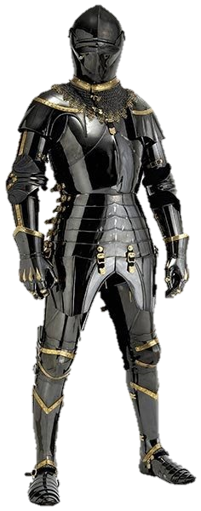
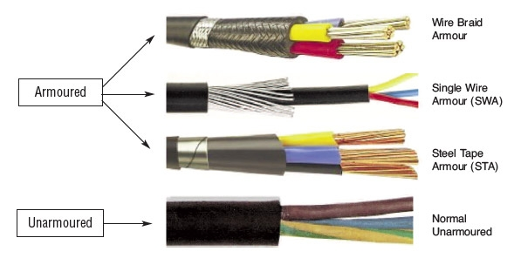
Difference between armoured and unarmoured cables
I’ll protect you!
Armour provides protection against damage or injury. Conductors in armoured cables are protected against mechanical damage while an unarmoured cable has no extra layer of protection. Armoured cables are stronger than unarmoured cables.
Notes:
Img 05 : https://tinyurl.com/ybc5pzlf
Img 06 https://tinyurl.com/y7y9oa8g

Slide 8
Unarmoured cables
Flexible cord and flexible cable are two examples of unarmoured cables. Flexible cords are usually manufactured with only two cores. They are used for plastic reading lamps and small plastic electrical appliances. Flexible cable is available in different sizes and cores depending on the specific requirements.
Click the button to watch a video on flexible cord and flexible cables.
Vid 01 screenshot
Notes:
On clicking ‘Flexible cord’ present: “A cable in which the nominal cross-sectional area of each conductor does not exceed $4 mm^{2}$and in which each conductor is composed of strands of a diameter less than $0,31mm$.
On clicking ‘Flexible cable’ present: “A cable in which the conductors consist of strands of diameter not exceeding $0,51mm$ and in which the insulation and covering are such that they afford flexibility and in which the nominal cross-sectional area of each conductor exceeds $4 mm^{2}$.
Screenshot of vid01 (see brief). Play video full screen.

Slide 9
Armoured cables
An armoured cable is a cable with a metallic covering of wires or tapes as a protection against mechanical damage.
Click the button to watch a video on armoured cables
Vid 02 screenshot
Notes:
Screenshot of vid02 (see brief). Play video full screen.

Slide 10
So many cables to choose from
There are so many choices when it comes to selecting the right cable for a job, it is understandable if it all seems a bit overwhelming. Not only are there different types of conductors for indoor, outdoor, underground or overhead use but they also come in different materials, sizes, colours and current carrying capacities. However, you luckily have a great guide in the SANS wiring code (section 6.3), which has an entire set of regulations, codes and tables to help you make the right choices.
Notes:
Should link to SABS Wiring code section 6.3

Slide 11
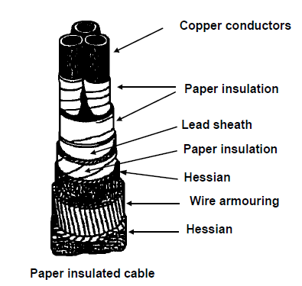
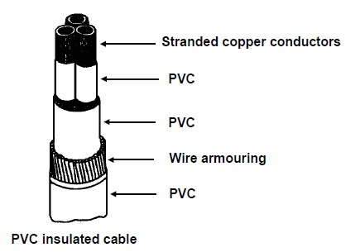
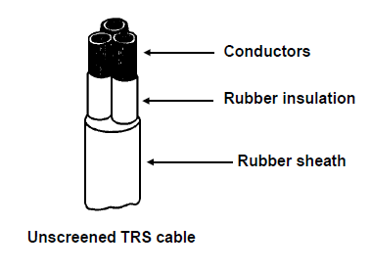
Classification of cables
Cables may be classified according to the insulation around the conductors. Recall that, an insulator is made of a material, which offers a very high resistance to the flow of electricity.
Click the diagrams to learn more about each type of insulation.
Notes:
On clicking Img 07 present: “Paper insulated cables can either be; Paper insulated, lead covered, double steel armoured (PILCSWA) or Paper insulated, lead covered, double wire armoured.” (Fig 1 Page 24 Book 2) link to section on Paper insulated cable.
On clicking Img 08 present: “PVC cables are commonly used for low and medium tension installations. In this type of cable each core is insulated separately with PVC. The cores are then collectively covered with PVC, then armoured with wire, which in turn is covered with a final PVC covering.” (Fig 2 Page 26 Book 2) link to section on PVC cables
On clicking Img 09 present: “Cables with TRS insulation, or trailing cables as they are commonly known, for use with portable or transportable apparatus may be divided into two main classes: Flexible cables for use with portable apparatus, Pliable or semi-flexible cables for use on machinery which is stationary during its operation but is moved frequently.” (Fig3 Page 27 Book 2) link to section on TRS cable.

Slide 12
Paper insulated cable
Paper when injected with resin oils is used as cable insulation and is a common insulation in underground cables. Commonly known as belting tape, it is also cheap and can withstand high temperatures. There are two types of armouring for paper insulators:
- Paper insulated, lead covered, double steel armoured.
- Paper insulated, lead covered, double wire armoured.
Click on the links to learn more.
Notes:
See Vid03 briefing both of the links here should direct to vid03. Play video fullscreen.

Slide 13
PVC insulated cables
Polyvinyl chloride (PVC) is extensively used as insulation around conductors and cables. It is acid and oil resistant, strong and flexible, and can be coloured easily. PVC cables are commonly used for low and medium tension installations.
Click on the link to learn more.
Notes:
See Vid04 briefing, the links here should direct to vid04. Play video full screen.

Slide 14
TRS insulated cables
Tough rubber sheath (TRS) is used as insulation for heavy duty cables. Cables with TRS insulation, or trailing cables as they are commonly known, may be divided into two main classes:
-Flexible cables for use with portable apparatus,
-Pliable or semi-flexible cables for use on machinery which is stationary during its operation but is moved frequently.
Click on the links to learn more.
Notes:
See Vid05 briefing, the links here should direct to vid05. Play video full screen.

Slide 15
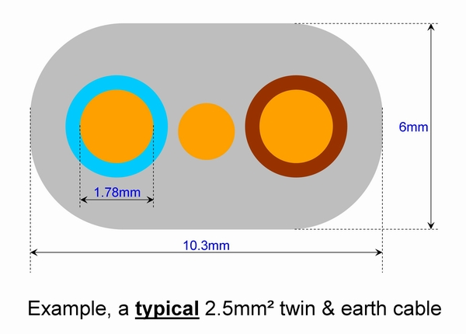
Conductor size and colour
As a qualified electrician you should be able to recognise conductor sizes and colours by simply looking at it. Do the Quiz at the end of this unit to make sure you can identify the different types of conductors commonly used.
SAFETY FIRST !
Notes:
On clicking the button “SAFETY FIRST” present the following: “Using the wrong size and type of conductors can lead to conductors overheating and a fire hazard. Using incorrect colour conductors can lead to electrical accidents, like injury or electrocution.”
Img 10: https://tinyurl.com/y9g3t2pn

Slide 16
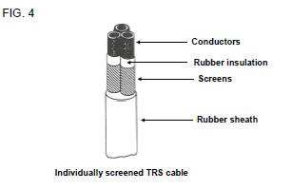
Example
Study the sketch and choose the correct description of the cable below.
Paper insulated cable (PILCSWA).
PVC insulated cable.
Individually screened TRS cable.
Unscreened TRS cable.
Notes:
Img:Fig3 Page 27 Book 2
MCQ
Correct answer is C
Feedback:
Correct – Well done, you know your conductors!
Incorrect – Watch Video 05 in this module again and try this again.

Slide 17
Let’s review:
In this lesson we have covered:
Stranded and solid conductors.
Difference between Armoured and Unarmoured cables.
Flexible cords and flexible cables.
How to choose the correct colour and size of conductors.
Identifying cables by the type of insulation material used.
Make sure you have a complete understanding of all the work covered here before you start the next unit.

Slide 18
Quiz time
We have come to the end of this unit. Answer the following questions to make sure you understand how to select and identify cables and conductors.

Slide 19
Question 1
In which of the following cases will a flexible cord be used?
Ripcords and Cabtyre cords.
With a conductor with cross sectional area of $6mm^{2}$.
Small plastic electrical appliances.
Where conductor strands are $0,51mm$ in diameter.
Notes:
MCQ
Correct answer is C
Feedback:
Correct – Well done.
Incorrect – Try again.

Slide 20
Question 2
In which of the following instances will a flexible cable be used?
Drilling machines, single phase motors, electric irons and heaters.
With a conductor with cross sectional area of $3mm^{2}$.
For underground cables.
Where conductor strands are $0,6mm$ in diameter.
Notes:
MCQ
Correct answer is A
Feedback:
Correct – Great work.
Incorrect – Try again.

Slide 21
Question 3
What is the current-carrying capacity of flexible cable with conductor cross-sectional area of $16 mm^{2}$used for DC? Use the tables in Reg. 6.2.6. Table 6.9(a).
41A
73A
99A
86A
Notes:
MCQ
Correct answer is C
Feedback:
Correct – Well done.
Incorrect – Try again.

Slide 22
Question 4
What is the current-carrying capacity of flexible cord with conductor cross-sectional areas of $4 mm^{2}$x 3 core mounted on a rack? Use the tables in SANS 10142-1 Reg. 6.2.6. Table 6.9(a).
41A
73A
99A
36A
Notes:
MCQ
Correct answer is D
Feedback:
Correct – Excellent.
Incorrect – Try again.

Slide 23
Question 5
What is the purpose, according to the SI colour code, of the brown conductor and insulation in flexible cables?
Live
Earth
Neutral
Notes:
MCQ
Correct answer is A
Feedback:
Correct – Excellent.
Incorrect – Try again.

Slide 24
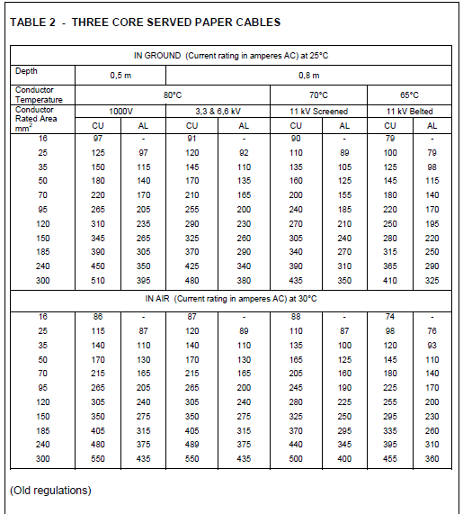
Question 6
What is the current-carrying capacity of the following cable
(Use Table 2 in Video 3): 25 $mm^{2}$, 3.3 kV paper-insulated, 3 core cable with copper conductors, in ground?
91A
92A
145A
120A
Notes:
MCQ
Correct answer is D
Feedback:
Correct – Excellent.
Incorrect – Try again.
Table 2 to pop up when question is clicked.

Slide 25
Video 01 Briefing
Flexible cord is a cable in which the nominal cross-sectional area of each conductor does not exceed $4mm^{2}$ and in which each conductor is composed of strands of a diameter less than 0,31mm.
Flexible cords are usually manufactured with only two cores, with the cores insulated separately by PVC. They are used for plastic reading lamps and small plastic electrical appliances. They do not need to be earthed. They are also used for the electrical connection between the ceiling rose and lamp holder. These cords are sold under the name “rip cord”. The household “rip cord” which is discussed here is of the twin core type and has a core area of $1 mm^{2}$and can be used to carry a maximum of 10 amps.
Notes:
Use script in Video 01 briefing and an SME to create a video similar to this one but showing the differences between flexible cord and flexible cable: https://www.youtube.com/watch?v=Bpo7M3B06gY

Slide 26
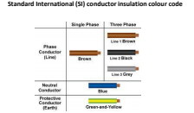
Video 01 Briefing- cont.
Flexible cable is a cable in which the conductors consist of strands of diameter not exceeding 0,51mm and of which the insulation and covering are such that they afford flexibility and in which the nominal cross-sectional area of each conductor exceeds $4mm^{2}$.
This type of cable is available in different sizes and cores depending on the specific requirements. It is available in 2, 3, 4, 5 and 7 cores and each core is insulated separately. All cores are then enclosed in a common insulating covering of PVC or TRS (tough rubber sheathing). Each core has a different coloured insulation for easy identification.
Refer to Regulation 6.3.3 to determine the requirements relating to the identification of terminations of cores.
This type of flexible cable, also known as “Cabtyre cord”, is used mainly for connecting portable electrical appliances such as drilling machines, grinders, small welding machines and the single phase motors of fridges, washing machines and freezers.
Another type of flexible cable, known as “household flex”, which consists of three cores with the same core areas as that of “Cabtyre cord”, is also available. The stranded cores are insulated with either PVC, TRS or heat resistant silicone. These three cores are then enclosed with black and white braided cotton. This cable can withstand higher temperatures than “Cabtyre cord” and is used for electric irons, portable water heaters, electric kettles and heaters.
The standard type of “domestic flex” and “Cabtyre cord” have the conductor and insulation colours according to the SI colour code, namely: Brown - live; Blue – neutral; Yellow/green - earth.
Notes:
Use script in Video 01 briefing and an SME to create a video similar to this one but showing the differences between flexible cord and flexible cable: https://www.youtube.com/watch?v=Bpo7M3B06gY OR as in video: https://www.youtube.com/watch?v=KBvyX80Pdec
Table 1: Cables.pptx by DB in the dropbox folder https://tinyurl.com/y8b3amab

Slide 27
Video 02 Briefing
An armoured cable is a cable provided with a metallic covering of wires or tapes as a protection against mechanical damage. Two layers of helically applied steel tape armouring (STA) are applied over a cushion of bitumenized textile material which contributes to corrosion protection. STA is however, not used on PVC cables. A single wire armour (SWA), consisting of a layer of galvanised steel wire applied with a fairly long lay, is generally used on PVC covered cables.
The main requirement of a cable is to conduct electricity economically and safely. The cable core consists of a number of strands to ensure complete flexibility. Each layer of strands is spiralled onto the core in the opposite direction to the previous layer, in order to prevent the danger of “bird caging” or the opening up of the strands with bending or twisting.
Aluminium in solid form is often used as core material for underground cables, for both low and medium tension. Besides being a good conductor, aluminium is light and easy to handle and comparatively inexpensive. The solid conductor with PVC insulation allows for a compactly constructed cable.
Notes:
Use script in Video 02 briefing and an SME to create a video similar to this one discussing armoured cables only: https://www.youtube.com/watch?v=5XST0DkotYw

Slide 28
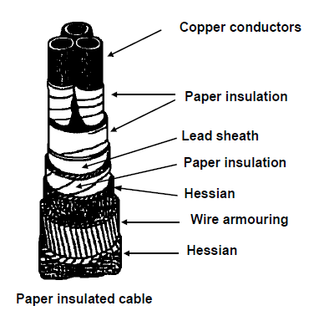
Video 03 Briefing
Paper insulated cables
Some cables used for transmission have copper conductors insulated with spiral layers of special vacuum-dried, resin-impregnated paper and covered with a continuous lead sheath. The lead sheath is essential to protect the paper from moisture. It offers very little mechanical protection, however, so a further armouring in the form of double steel tape or wire is therefore required to protect the cable mechanically.
Notes:
Create a video similar to this: https://www.youtube.com/watch?v=Nn58AvA_JDs with script as in video03
Diagram: (Fig 1 Page 24 Book 2)

Slide 29
Video 03 Briefing cont.
Note that:
The paper is specially manufactured for the purpose and must be comparatively strong and elastic as well as able to absorb the impregnating oil satisfactorily, whilst excluding any moisture.
All joints as well as the ending off of the cable must be done in special cable boxes and cable glands so that the lead sheath remains a continuous tube. The cable is suitably terminated in a gland, which fits onto a cable end-box and filled with a compound to form the required seal. Refer to Regulations 6.3.7.1-3
Cable lugs are sweated or crimped onto the cores to ensure a perfect connection when the cable is connected to an electrical apparatus.
Table 2 below contains sizes and current carrying capacities of paper-insulated cables.
Notes:
Create a video similar to this: https://www.youtube.com/watch?v=Nn58AvA_JDs with script as in video03

Slide 30
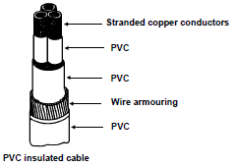
Video 04 Briefing
PVC insulated cables
PVC cables are commonly used for low and medium tension installations. In this type of cable each core is insulated separately with PVC. The cores are then collectively covered with PVC, then armoured with wire, which in turn is covered with a final PVC covering.
-PVC cables are easier to handle than paper-insulated cables and are highly resistant to oils and chemicals.
-Being non-hygroscopic, the insulation is not affected by moisture.
-They are easily joined in a ready-made plastic joint box, which is packed with resin once the joint is made.
Crimping ferrules are used to joint the cores as well as the armouring. Use is made of mechanical cable glands when the cable is fitted into an end-box, distribution board, meter or starter. Refer to Regulations 6.3.7 and 6.4.3.2. The current carrying capacity of PVC insulated cables depends on the voltage at which it will operate and whether or not the cables are buried underground or are surrounded by air.
See Regulation 6.2.6. Table 6.3(a) contains the sizes and current carrying capacities of PVC cables.
Notes:
Create a video similar to this: https://www.youtube.com/watch?v=Nn58AvA_JDs with script as in video04
Diagram: Fig 2 Page 26 Book 2

Slide 31
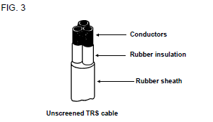
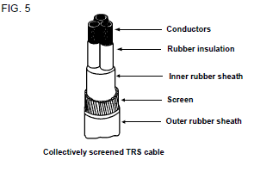
Video 05 Briefing
TRS insulated cables
Cables with TRS insulation, or trailing cables as they are commonly known, for use with portable or transportable apparatus may be divided into two main classes:
a) Flexible cables for use with portable apparatus, which is continually moved or moving about under its own power during its operation.
b) Pliable or semi-flexible cables for use on machinery which is stationary during its operation but is moved frequently, for example to adjust to the daily advance in a section of a coal mine.
Screening: In cables used for 11kV and above, each core is surrounded by a screen consisting of a thin conducting material (usually copper) connected to earth. The screen is used to keep electrical stresses radial thus eliminating the chances of insulation failure. It also reduces the electromagnetic fields around the cables being transmitted to the surrounding cables.
The two main classes are each divided into a further three classes as seen in FIG. 3, 4 and 5.
a) Unscreened.
b) Individually screened.
c) Collectively screened.
Notes:
Create a video similar to this: https://www.youtube.com/watch?v=Nn58AvA_JDs with script as in video05
Diagram: Fig3,4,5 Page 27 Book 2

