Slide 1
Electrical components and systems
Topic 1 – Cables and conductors

Slide 2
Conductors and insulators basics
Unit 1.1

Slide 3
In this lesson you will learn about:
Cables
Conductors: uses, material, properties and cross sectional area
Insulators: uses, types, properties and colour coding
Current carrying capacity of conductors
Bus-bar precautions
Notes:
Link each to the relevant section below.

Slide 4
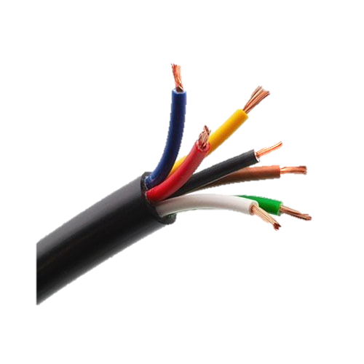
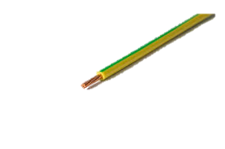
Cables have many uses
Cables conduct electricity and come in different shapes and sizes. Look around you and see how many different cables you can find with different uses. When deciding on the right cable for a project, there are many things to consider, which you will learn more about in future lessons.
Click on the image to see what type of cables these are.
Notes:
On clicking image 01 present the following: “Single core cables are made up of a single conductor covered by PVC insulation. They are generally used in power and lighting circuits and for domestic and commercial applications.” https://bit.ly/2LqhbXf
On clicking image 02 present the following: “Multi-core cable is an electrical cable that has multiple ‘cores’ made of copper wire.” Multi-core cables are used in electronic equipment and for applications where space is limited, such as aircraft and medical equipment.” https://bit.ly/2LvfWtY

Slide 5
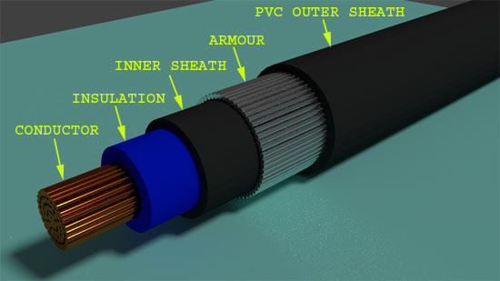
What are cables made of?
We see cables everywhere but what are they made of? Let’s strip away the outer jacket of a cable and take a closer look inside.
Click on each part of the cable to learn more.
Notes:
On clicking Img03 itself present the following: “This is a steel wired armoured cable or SWA, which is a heavy-duty power cable. An armoured cable has a metallic covering of wires or tape as protection against mechanical damage.”
On clicking each section of Img03 the name of that part should appear, as named in image. In addition when;
1) Conductor is clicked present the following: “A material that easily conducts electricity.”
2) Insulator is clicked present the following: ”A material that does NOT easily conduct electricity.”
3) Inner sheath is clicked present the following: “The sheath provides shielding, keeping out external electrical noise, and also isolating pairs of wire to prevent cross-talk between pairs.”
4) Armour is clicked present the following: ”Provides mechanical protection, which means the cable can withstand higher stresses, be buried directly and used in external or underground projects.”
5) PVC outer sheath is clicked present the following: “The outer jacket provides protection against rodents, abrasion and twisting and is usually made of plastic.”
https://tinyurl.com/y73leomo
NB: When they click on; conductor, insulator there must be a link to the relevant section below.

Slide 6
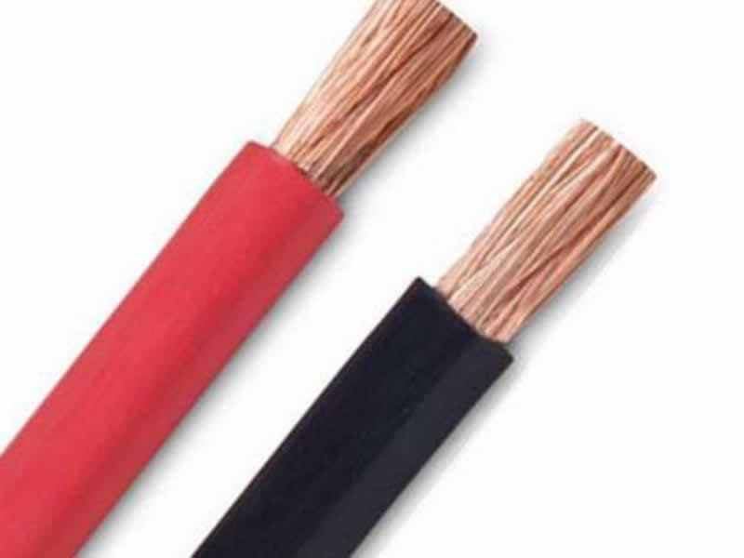
Conductors
A metal conductor does the main job in a cable and is found at the centre of a cable, it is often called the wire. It easily moves or ‘conducts’ electricity from one point to another.
SAFETY FIRST !
Copper conductor
Click the button to learn about the different types of metal conductors.
See other conducting materials
Notes:
On clicking the button “SAFETY FIRST” present the following: “Your body is a good conductor of electricity. Never touch a circuit conductor or component unless you are sure that it is not energised.”
On clicking Img 04 present the following: “Copper is the most commonly used conducting material.” https://bit.ly/2uOwbIT
On clicking the button “See other conducting materials” show the following:
Silver, Aluminium, Gold , Zinc, Nickel and Tin can be used as conductors.
Silver is the best conductor but due to its high price it is not used often. Most conductors are made of either Copper or Aluminium since these metals are cheaper.

Slide 7
Which of the following properties do you think a conductor that is used everyday should have?
offer little resistance to the flow of electric current
not be affected by the weather or heat
be readily available
be inexpensive
CLICK FOR THE ANSWER
Notes:
On clicking the button show: “This was a trick question! Good job, if you got it right! A good conductor that is used everyday must have all of these properties.”

Slide 8
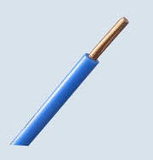
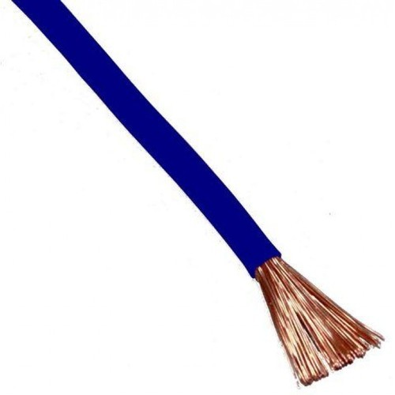
Solid conductors vs Stranded conductors
Conductors can either be a solid piece of metal or be made up of thin strands of metal. Stranded conductors are more flexible and more expensive than solid conductors. There can be 1, 3, 7 or 19 strands in a stranded conductor.
Click on each conductor to learn more.
SOLID
STRANDED
Notes:
On clicking the word ‘SOLID’ on Img B5.1 (https://bit.ly/2NHypku) present the following and animate the conductor moving inflexibly from right to left: “Solid conductors are tough and not very flexible. They are very strong and generally used for outdoor or rugged applications which may expose the wire to corrosive elements, adverse weather condition or frequent movement”
On clicking the word ‘STRANDED’ on B5.2 (https://bit.ly/2LLM8Gd) present the following and animate the conductor bending flexibly all around: ”Stranded conductors are made of a number of small strands. Due to the number of strands these conductors are very flexible and is well-suited to applications which will demand flexibility and reshaping, such as electronic devices and circuit boards, where the wire will be protected but may bend or twist in order to connect electronic components.”

Slide 9
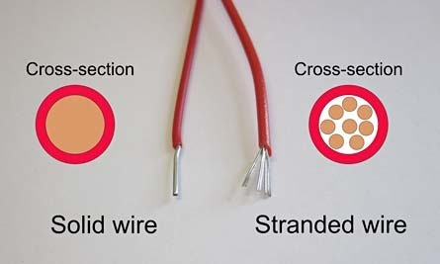
Sizing of conductors
The cross-sectional area of a conductor determines how much current it can handle. The larger the cable cross-sectional area, the more strands it will have. When a conductor has two or more strands, the strands must all be the same diameter.
Click on stranded wire to learn more
Notes:
When the words 'cross-sectional' are clicked present the following: “A view inside of something made by cutting through it at right-angles to its length.”
When the word ‘diameter’ is clicked present the following: “A diameter is a line that goes through the center of a circle connecting two points on the circumference. A diameter is twice the length of the radius of a circle.”
Img 06: https://bit.ly/2JVUjho
On Clicking ‘Stranded wire’ on Img 06 present the following: “All conductors of rated area exceeding 1,5 mm^2 shall be stranded (Regulation 6.3.2.1 of
SANS 10142-1). The total area of the conductor is determined by the magnitude of the current (amps) that it will be required to carry.”

Slide 10
Cross sectional area of conductors
Conductors with a larger cross sectional area have less resistance and carry a larger amount of current than conductors with a smaller cross sectional area. The total area of the conductor is determined by the magnitude of the current (amps) that it will be required to carry.
The cross sectional area of a conductor can be calculated using:
Cross sectional area = $\frac{πD^{2}}{4} ×number of strands, where D is the diameter$
Note: this formula may also be written as: $πr^{2}×number of strands, where D is the diameter$
Click button to see table of acceptable conductor sizes for wiring circuits.
ACCEPTABLE CONDUCTOR SIZES
Notes:
TABLE 1, see brief.

Slide 11
Copper conductors vs Aluminium conductors
Most conductors are made of either copper or aluminum. Each has advantages and disadvantages.
Click the button to watch a video explaining the advantages of each metal.
Vid01 screenshot
Notes:
screenshot of vid01 (see brief). Play video full screen. On clicking the button show an animated video.

Slide 12
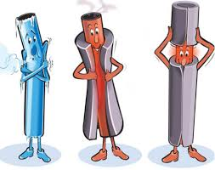
Insulators
When you insulate an object you protect or cover it from any outside interference. An electrical insulator does the opposite job of a conductor. An insulator does not easily conduct electric current.
Notes:
Img 08 = https://tinyurl.com/ybdxkkmt
On clicking Img08 present: “Insulator: A material, which offers a very high resistance to the flow of electricity. You will notice that plugs and wall sockets are covered with insulators like plastic or rubber to protect us from the electric currents flowing through the metal conductors inside the sockets.”

Slide 13
Types of insulators
Depending on what the insulator is used for, there are many different insulation materials to choose from. Great care must be taken to choose the right insulating material for your specific task.
Click the button to watch a video on the types of insulators.
Vid 02 screenshot
Notes:
Screenshot of vid02 (see brief). Play video full screen. On clicking the button show an animated video.

Slide 14
Example 1 Which 4 properties determines the usefulness of an insulator?
After watching video 02 fill in the correct answers below. You will not be able to continue until you list all properties.
1) Electrical 
2) Mechanical 
3) Physical 
4) Chemical 
Notes:
The answers in grey are the correct ones. Accept these answers in any order, correct answers are rewarded with a green thumbs up and incorrect answers with a red thumbs down. Learners will not be able to continue to the next slide unless they get 4 thumbs up.
Feedback:
Correct: Good job!
Incorrect: “Watch video 2 again. Remember: The resistivity, tensile, effects of moisture and temperature and the possibility of chemicals coming into contact with the insulating material must be taken into consideration.”

Slide 15
TRS and PVC
Tough rubber sheathing (TRS) and Polyvinyl chloride (PVC) are most commonly used as insulation around conductors.
Watch the video for a comparison of TRS and PVC
Vid 03 screenshot
Notes:
Screenshot of vid03 (see brief). Play video full screen

Slide 16
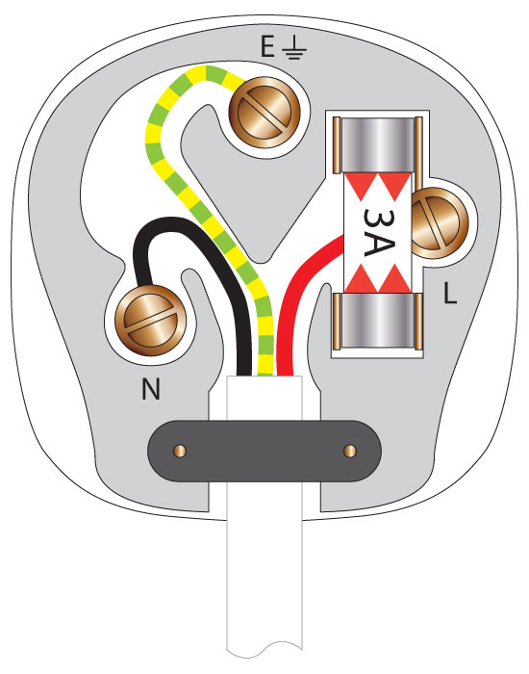
Colours around conductors
The most common insulation used around copper conductors is PVC, and it comes in a variety of colours. Black indicates the neutral conductor, bicolour green / yellow, indicates the earth conductor and red indicates the live conductor.
Click each coloured conductor to learn more.
The bicolour green / yellow, indicates the earth continuity conductor. It protects you from an electric shock by providing a path for a fault current to flow to earth
Black indicates the neutral conductor. The neutral conductor completes the circuit by forming a path for the current back to the source.
The phase and any special purpose conductor shall be any base colour (red in this diagram) other than green / yellow or black. The live wire carries electric current to a device.
Notes:
On clicking Img 09
Black conductor present: “Black indicates the neutral conductor. The neutral conductor completes the circuit by forming a path for the current back to the mains.”
Green/yellow conductor: “The bicolour green / yellow, indicates the earth continuity conductor. It protects you from an electric shock by providing a path for a fault current to flow to earth.”
Red conductor: “The phase and any special purpose conductor shall be any base colour (red in this diagram) other than green / yellow or black. The live wire carries electric current to a device.”
https://tinyurl.com/y8gx4mmb

Slide 17
Current carrying capacity of conductors
The current carrying capacity of an insulated conductor, also called ampacity, is the maximum current that it can continuously carry without melting. The ampacity is measured in Amperes or amps for short. With the help of table 6.3a) in the SABS wiring code you can work out the ampacity of conductors.
Click the button to learn how to determine the current carrying capacity of conductors.
Vid 04 screenshot
Notes:
screenshot of vid04 (see brief). Play video full screen.

Slide 18
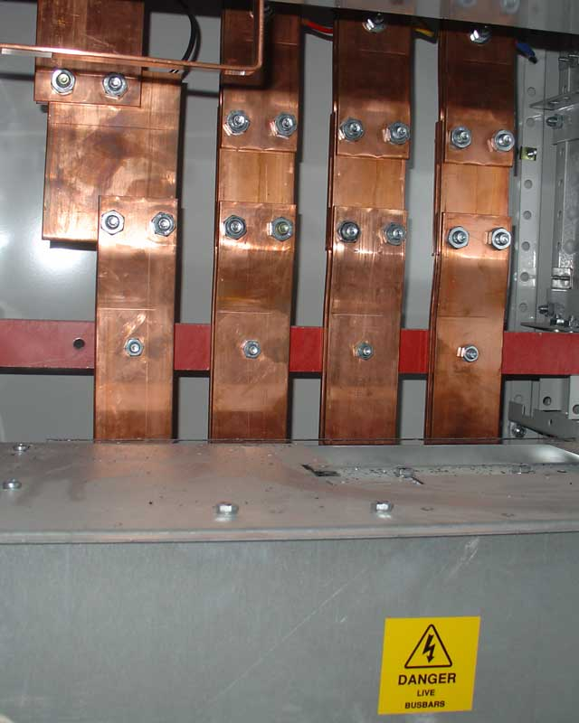
Bus-bar Precautions
Busbars are metallic strips or bars used in electrical power distribution and are usually made out of aluminium or copper. They are able to conduct electricity to transmit power from the source of electric power to the load. Precautions must be taken when open bus-bar systems are used.
SAFETY FIRST !
Notes:
On clicking the button SAFETY FIRST present the following:
Precautions when open bus-bar systems are used with voltages greater than 50 volts AC:
• They must be inaccessible to unauthorised persons;
• They must be able to expand;
• They must be effectively insulated.
On clicking Img 10 present: “Bus-bars are metallic strips or bars used in electrical power distribution and are usually made out of aluminium or copper.” https://tinyurl.com/znu8ert

Slide 19
Let’s review:
In this lesson we have covered:
Properties, composition and uses of different types of conductors and insulators.
The cross sectional area and current carrying capacity of conductors.
Colours of insulators to be used around conductors.
Busbar safety.
Make sure you have a complete understanding of all the work covered here before you start the next unit.

Slide 20
Quiz time
We have come to the end of this unit. Answer the following questions to make sure you understand the basics of how to work with conductors and insulators.

Slide 21
Question 1
Which two materials are the most commonly used for conductors?
Silver and gold
Silver and copper
Silver and aluminium
Copper and aluminium
Notes:
MCQ
Correct answer is D
Feedback:
Correct – Good job.
Incorrect – Silver is very expensive and not used as often as other cheaper materials.

Slide 22
Question 2
Why are stranded conductors used?
They are stronger than solid conductors.
They are flexible.
They are more rigid than solid conductors.
They are made of copper.
Notes:
MCQ
Correct answer is B
Feedback:
Correct – Well done.
Incorrect – Try again.

Slide 23
Question 3
Conductors with a larger cross sectional area have less resistance.
TRUE or FALSE
Click on the correct answer.
Notes:
True or False
Correct answer is TRUE
Feedback:
Correct – Well done
Incorrect – That is not correct.

Slide 24
Question 4
What is the current carrying capacity of a conductor with a cross-sectional area of $4mm^{2}$ according to the tables for Regulation 6.2.6? (Use Column 3 in Table 6.3a.)
a) 25A
b) 17,5A
c) 29A
d) 23A
Notes:
MCQ
Correct answer is D
Feedback:
Correct – Excellent.
Incorrect – Try again. Remember to look closely at the table using column 3.

Slide 25
Question 5
Which of the following are commonly used insulator materials?
a) Cotton and Porcelain
b) Asbestos and Porcelain
c) Copper and Silver
d) Paper and Carbon
Notes:
MCQ
Correct answer is A
Feedback:
Correct – Great job.
Incorrect – Try again. Remember, an insulator is a poor conductor and due to the health hazard, asbestos is no longer used.

Slide 26
Table brief – Table 1
The conductors that have been discussed are those that are used for wiring domestic houses, shops and blocks of flats. Each municipality has its own by-laws, but the following sizes are generally accepted for the wiring of the given circuits:
Acceptable conductor sizes for wiring circuits
 | $$1 mm^{2}$$
Light circuits | $$1,5 mm^{2}$$
Plug (socket outlet) circuit | $$2,5mm^{2}$$
Geyser circuits | $$4 mm^{2}$$
Electric stove circuits | $$6 mm^{2}$$
Distribution board wiring | $$10 mm^{2}$$
Supply from meter to distribution Board | $$16 mm^{2}$$
Bell circuits
Notes:
Table to appear as in animation preview (click star)

Slide 27
Video brief - Vid01
Animated video explaining the advantages of each type of conducting material.
Copper is the most commonly used conducting material, because it
- is the next best conductor after silver since it has low resistivity,
is relatively cheap,
solders easily,
is corrosion resistant,
has a high melting point.
Aluminium is also extensively used to manufacture electrical conductors, because it
- is a good conductor though not as good as copper,
- is very light,
- is relatively cheap,
- is fairly resistant to corrosion.
Notes:
Create an animated video similar to https://www.youtube.com/watch?v=gtAaZ2hFYTA but using script wording as above

Slide 28
Video brief - Vid01 continued
Compared to copper, aluminium has the following disadvantages:
• It has a higher resistance and therefore thicker conductors must be used for the same current carrying capacity;
• It has a lower tensile strength and is not as rigid;
• It cannot be soldered and welded as easily as copper;
• It is not as resistant to corrosion.
Notes:
Create an animated video similar to https://www.youtube.com/watch?v=gtAaZ2hFYTA but using script wording as above

Slide 29
Video brief - Vid02
Insulators are used to prevent the flow of electric current where a potential difference exists between two points, for example between two parallel conductors in an electrical flex conductor of a reading lamp. The higher the voltage at which a piece of equipment works, the more complex the problem of insulation becomes.
In order to assess the usefulness of a material for the purpose of insulation it should be examined with reference to the following factors:
• Electrical
The resistivity, electric strength, flash over value, permittivity and dielectric loss of the material must be considered.
• Mechanical
The tensile, compressive, shear and impact strengths of the material as well as its machinability must be considered.
• Physical
The effects of moisture and temperature on the insulation material must be considered.
• Chemical
The possibility of chemicals and oils coming into contact with the insulating material, and the effect they will have on it, must be taken into consideration.
An example of how closely these four properties are inter-related is, that a material, which has excellent electrical properties at normal temperatures, may have very poor electrical properties at a high temperature due to its thermal instability. If moisture absorption of a material is high the electrical properties are frequently impaired, rendering the material unsuitable as an insulator. It is clear, therefore, that the greatest care must be exercised in selecting a suitable material, especially when it is remembered how many materials ranging from solids, liquids and gases are used for insulation.
Notes:
Create video similar to this youtube clip but with script wording as above: https://www.youtube.com/watch?v=E7_Bu9e_qXY

Slide 30
Video brief - Vid02 continued
Here are some of the best, most commonly used insulation materials, together with their possible uses.
Porcelain Insulators are used for overhead lines.
Asbestos was used for conductor insulation under excessive temperature conditions, e.g. electrical stove wiring, boilers, geysers, etc. however, due to the health hazard, this material is no longer used.
Heat resistant Silcone is used for insulation under excessive temperature conditions, e.g. electrical stove wiring, boilers, geysers, etc.
Mica used for insulation between commutator segments, electric iron elements, insulating washers, etc.
Bakelite is used for outer casings of batteries; also obtainable in sheet form and used for panel wiring boards.
Cotton with varnish and certain oils added within, is used to cover conductors used for motor and transformer coils. Also used as insulation tape.
Shellac comes in flake form and is mixed with methylated spirits to produce a high quality insulating varnish.
Paper after resin oils, have been added to it, is used as cable insulation. It is also cheap and can withstand high temperatures.
Vulcanised rubber insulation or VRI is used as insulation around conductors in flexible cables and cords. Tough rubber sheathing or TRS for heavy duty cables.
Polyvinyl chloride commonly known as PVC is extensively used today as insulation around conductors and cables. It is acid and oil resistant, strong and flexible, and can be coloured easily.
Notes:
Create video similar to this youtube clip but with wording as above: https://www.youtube.com/watch?v=E7_Bu9e_qXY

Slide 31
Video brief - Vid03
Tough rubber sheathing or TRS is very flexible but is affected by water, oil and chemicals. It must be protected from direct sunlight as it will easily burn when overheated.
Polyvinyl chloride or PVC hardens at low temperatures and softens at high temperatures. It is largely unaffected by water, oil and chemicals. PVC is not as badly affected by direct sunlight as TRS. It does not burn easily but if it is overheated, a poisonous and corrosive gas is given off.
Notes:
Create video similar to this youtube clip but with script wording as above: https://www.youtube.com/watch?v=E7_Bu9e_qXY

Slide 32
Video brief - Vid04
SME must go over this section to add depth to video 04. I suggest the video be created similar to the youtube link in the notes
Screencast video of an expert presenter explaining: Effective current carrying capacity of conductors.
Regulation 6.2.6.1 of the SANS wiring code: The value of a tabulated current represents the effective current carrying capacity only where no correction factor is applicable. Otherwise the current-carrying capacity of a cable corresponds to the tabulated value multiplied by the appropriate correction factor or factors for ambient temperature, grouping, neutral imbalance, harmonics, thermal insulation and solar radiation, as applicable.
Notes:
Cable size and current carrying capacity: https://www.youtube.com/watch?v=KBvyX80Pdec

Slide 33
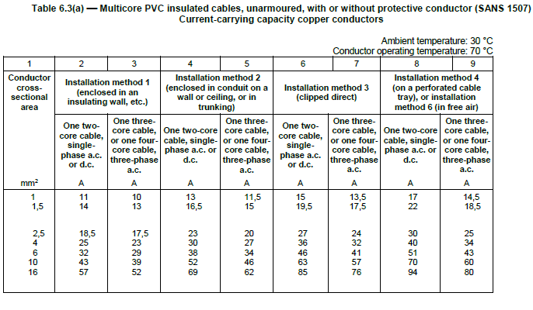
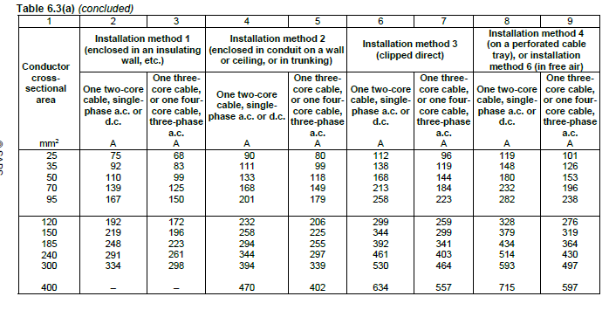
Video brief - Vid04 continued
By using table 6.3a) of the SANS wiring code and looking at the cross sectional areas of conductors in column 1 we can use column 2 to determine the current carrying capacity of one two-core cable, single phase enclosed in an insulating wall. Current carrying capacity is measured in amperes.

Slide 34
Video brief - Vid04 continued
For example using the table and looking at column 2 we can see that the current carrying capacity of conductors with a cross-sectional area
of 1,5 mm^2 is 14 A.
of 2.5mm^2 is 18,5 A and
of 25 mm^2 is 75 A

