Slide 1
Electrical components and systems
Topic 6 – Low voltage protection

Slide 2
Low voltage protection
Unit 6

Slide 3
Assumed prior learning
Electrical components (contactors and overloads)
Electrical components (circuit protection)
Earthing and Bonding
Don’t feel confident yet about these topics? Click on each to review the content.
Feeling confident? Click next to proceed with this unit.
Notes:
Link to unit upon clicking.

Slide 4
Outcomes
Understand where LV systems are used
Circuit breakers used in LV protection
Earth leakage used in LV protection
Notes:
Link each to the relevant section below.

Slide 5
Introduction
Statistics show that the majority of electrocutions occur on low voltage (LV) systems. It is therefore vital to understand LV systems and the appropriate protective devices. We go over the basics of LV protection in this unit, make sure you also complete units 4 and 5 for a deeper understanding of this topic.
Notes:
Click on ‘majority of electrocutions’ = “Any voltage higher than 25 volts could be life threatening. Most of the LV electrocutions happen in the 220 – 500 volt range and are due to earth leakage currents, that is currents flowing from a live conductor or apparatus via the victim’s body to earth. The current path is usually from one hand to the feet, in other words a path linked to the heart.”
Source: CTC Book 2, Page 179

Slide 6
Low voltage defined
LV is defined differently in power supply and distribution, and electrical safety codes define LV circuits that are exempt from the protection required at higher voltages. Definitions vary by country and specific codes or regulations. SANS 10142-1 defines LV as voltage that does not exceed 1 000 V a.c. or 1 500 V d.c, including Extra Low Voltage.
Types of voltages
Notes:
Click on ‘types of voltages’= Table01, as shown in Appendix.

Slide 7
Basic structure of electric power system
Notes:
Img01: https://slideplayer.com.br/slide/5814496/18/images/1/Sistemas+de+Potencia.jpg

Slide 8
Low Voltage application in households
In electric power systems LV commonly refers to the mains voltages as used by domestic households, who are the secondary consumers of electricity. Typically LV systems are found in lighting systems, alarms, household appliances and monitoring systems.

Slide 9
Low Voltage protection
LV overcurrent protection is achieved through the use of circuit interruption devices, which both detect and interrupt the flow of circuit overcurrent. We will briefly discuss circuit breakers and earth leakage units in this lesson. For a detailed discussion on circuit breakers view UNIT 4 and for Earthing and Bonding view UNIT 5.
Notes:
Upon click ‘Circuit interruption devices’=Electrical components circuit protection unit 4. Specifically link to ‘circuit breakers’ in that unit.
Click on ‘unit 4’ = link to Unit 4 Electrical components_circuit protection.
Click on unit 5 = link to Unit 5 Earthing and Bonding.

Slide 10
How is an electrical device earthed?
Earthed describes connecting an electrical device to the ground (earth) to ensure, at all times, an immediate discharge of electrical energy without danger. Electrical earthing is achieved by connecting the non-current carrying part of the appliance or equipment or neutral of supply system to the ground.

Slide 11
Earth leakage protection
The objective of earthing is to protect the person using an electric appliance or apparatus against electric shock. The most important connection on an appliance or installation is, therefore, the earth conductor. Wiring regulations are very strict about the proper earthing of installations and socket outlets, and the fact that earth conductors must have very low resistance. For example, in a normal domestic installation the resistance should be less than 0,25 Ω. Refer to Reg. 6.12.1.4. of SANS Code of Practice.
Notes:
On clicking ‘Earthing’ link to unit 5 on Earthing and Bonding.

Slide 12
Importance of Earthing
Earthing is essential for following reasons:
protects a person from a short-circuit current.
provides the easiest path for the flow of short-circuit current even after the failure of the insulation.
protects the equipment and personnel from the high voltage surges and lightning discharge.

Slide 13
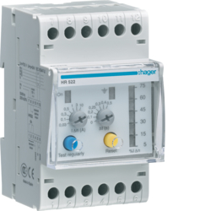
Earth leakage relays
Wiring regulations also require that additional protection in the form of earth leakage relays should be installed to protect persons against the possibility of failure of the earthing system. The earth leakage protection device automatically switches out the faulty apparatus or electrical network. For more on earth leakage devices see UNIT 5.
Notes:
Img02: http://www.africa.hager.com/bs/ecatimages/detail/HR522.jpg
On clicking ‘UNIT 5’ link to Earthing and Bonding unit.

Slide 14
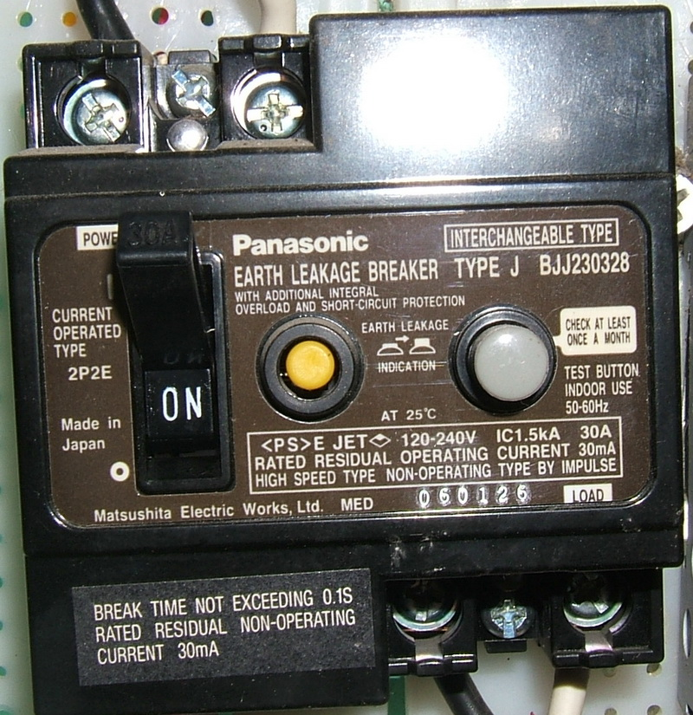
Protection units
There are many different types of earth leakage protection units and circuit breakers on the market, the three most commonly used types are:
• High sensitivity earth leakage protection units,
• Sensitive core balance relay, and
• Sensitive core balance relay with separate core.
Earth leakage circuit breaker
Notes:
Img03: https://upload.wikimedia.org/wikipedia/commons/3/3f/ELCB_Panasonic_30A_type_2P2E.jpg
On clicking ‘Earth leakage protection units’= “All earth leakage units are provided with a test button. When pressed, the test button causes an imbalance to simulate an earth fault operation. The test button should be pressed often to prove the unit is in working order.”
On clicking ‘Earth leakage circuit breaker’ = “An Earth-leakage circuit breaker (ELCB) is a safety device used in electrical installations with high Earth impedance to prevent shock. It detects small stray voltages on the metal enclosures of electrical equipment, and interrupts the circuit if a dangerous voltage is detected. Once widely used, more recent installations use residual current circuit breakers which instead detect leakage current directly.”

Slide 15
Quiz time
We have come to the end of this unit. Answer the following questions to make sure you understand the basics of low voltage protection.

Slide 16
Question 1
What is the purpose of the button on the earth leakage device?
To disconnect the light circuit
To be used as an emergency stop button
To test the effectiveness of the relay
None of the above
Notes:
MCQ
Correct answer is C
Feedback:
Correct – Good job. All earth leakage units are provided with a test button. When pressed, the test button causes an imbalance to simulate an earth fault operation. The test button should be pressed often to prove the unit is in working order.
Incorrect – Try again.

Slide 17
Question 2
What do you understand by the terms “Earthed”?
Four socket outlets installed next to each other
Connected to earth to ensure discharge of electrical energy without danger
Put down on ground
Two light switches for one light point
Notes:
MCQ
Correct answer is B
Feedback:
Correct – Well done.
Incorrect – Try again.

Slide 18
Question 4
The purpose of earthing is to guard every installation, appliance or apparatus against the effects of?
Stray current
Voltage spikes
Stray voltages
Leakage currents
Notes:
MCQ
Correct answer is A
Feedback:
Correct – Excellent.
Incorrect – Try again. Remember to look closely at the table using column 3.

Slide 19
Let’s review:
In this lesson we have covered:
Low voltage applications in households.
Basic electric power system
Earth leakage basics
To have a full understanding of low voltage protection you will need to have completed Unit 4 and 5 too.

Slide 20
Table brief – Table 1
TYPES OF VOLTAGES
a) Extra low voltage | Not exceeding 30 volts (ELV<30V)
b) Low voltage | Exceeding 30 volts but not exceeding 250 volts (30V<LV<250V)
c) Medium voltage | Exceeding 250 volts but not exceeding 650 volts (250V<MV<650V)
d) High voltage | Exceeding 650 volts but not exceeding 3000 volts (650V<HV< 3000V)
e) Extra high voltage | Exceeding 3000 volts (EHV>3000V)
Voltages a) and b) above are used on single phase and c), d) and e) are used on three-phase systems.
Notes:
Source: CTC Book 1, Page

