Slide 1
Electrical components and systems
Topic 5 – Earthing and Bonding

Slide 2
Three-phase earth leakage protection
Unit 5.2

Slide 3
Assumed prior learning
Electrical components (circuit protection)
How Single Phase AC Motors Work
Single phase earth leakage protection
Don’t feel confident yet about these topics? Click on each to review the content.
Feeling confident? Click next to proceed with this unit.

Slide 4
Outcomes
Explain the principle of operation of a three-phase core-balance earth leakage relay.
Name and briefly describe the operation of the three types of commonly used earth leakage protection units.
Explain what is meant by the terms “sensitivity” and “kA rating” of an earth leakage protection unit.
Draw circuit diagrams to explain how a MS1 / MS2 relay, and a core balance relay with separate core are connected in a circuit.
Explain what a circuit breaker is, what is meant by the term “breaking capacity” and name two types of overloads used in circuit breakers.

Slide 5
Introduction
A fundamental principle in the wiring or cabling in underground situations, factories, offices and domestic installations, is to ensure the safety of persons, animals and property against the hazards that may arise in the daily use of electricity. Earth leakage protection is essential in any electrical installation.
Notes:
Click on ‘safety of persons’ = “Statistics show that the majority of electrocutions occur on low voltage systems, 220 – 500 volts, and are invariably due to earth leakage currents, those are currents flowing from a live conductor or apparatus via the victim’s body to earth. The current path is usually from one hand to the feet, that is a path embracing the heart.”
Click on ‘hazards’ = “The two major hazards inherent in the use of an electrical installation are shock currents and excessively high temperatures that may cause burns, fires and other injurious effects.”
Click on ‘Earth leakage protection’ = “A device that trips (causes current to stop flowing in the circuit) when there is an earth leak in the system.”

Slide 6
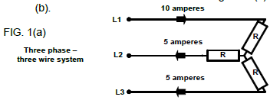
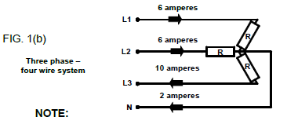
Core balance relay
The operating principle of a core balance relay in a three-phase circuit is the same as for a single-phase circuit (discussed in single-phase earth leakage protection). The currents flowing in the conductors are always in balance if there is no earth fault (see diagrams below).
The sketches are drawn to explain the counter balancing of currents and cannot be taken as indicating fixed values and directions, because the values and direction of current flow constantly change. However, they are always balanced in a “healthy” circuit.
Notes:
Click on ‘single-phase earth leakage protection’ = link to the unit on single-phase earth leakage protection
Figure 1a and 1 b: CTC Book 2, EL-T-1, Pg 179

Slide 7
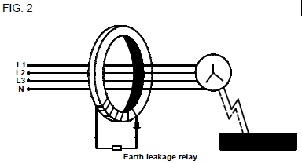
Operation of core balance relay
If the three or four wires are passed through a soft iron core with a secondary winding as shown in the figure below, and the circuit is in balance, the resultant magnetic flux in the core, caused by the currents, will be in balance and equal to zero. Therefore no emf will be induced in the secondary coil.
Earth leakage relay
Notes:
Fig02: CTC Book 2, EL-T-1, Pg 180
Click on ‘Earth leakage relay’ on the figure = “If an earth fault should occur, as shown by the dotted line, some current will flow directly to earth and cause an imbalance in the currents flowing through the core. This will result in an imbalance in the magnetic flux in the core; that is there will be a resultant flux in the core, which will induce an emf in the secondary winding. A current will flow in the secondary circuit, which will activate the tripping coil in the earth leakage relay, causing it to trip the circuit.”

Slide 8
Types of earth leakage protection units
There are many different types of earth leakage protection units and circuit breakers on the market, but we look at only the three most commonly used types:
• High sensitivity earth leakage protection units,
• Sensitive core balance relay, and
• Sensitive core balance relay with separate core.
Notes:
Click on High sensitivity earth leakage protection units = link to next slide (slide 9)
Click on Sensitive core balance relay= link to slide 10 +11
Click on Sensitive core balance relay with separate core =link to slide12

Slide 9
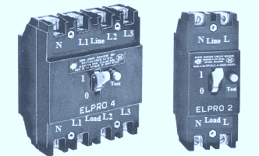
High sensitivity earth leakage protection units
The compact, high sensitivity current operated earth leakage unit for protection of persons on direct contact, operates on the core balance principle discussed earlier.
Click for more information
Notes:
Fig03: CTC Book 2, EL-T-1, Pg 181.
‘Click for more information’ = “•The unit is independent of mains excitation for its operation, employing a high permeability toroidal magnetic core, which under earth fault conditions, operates a sensitive polarised release via a trigger circuit. •The polarised release unlatches the circuit breaker mechanically, no shunt trip being used.
The ELPRO 2 and ELPRO 4 with a sensitivity of 30 mA has been designed for installation as the incoming isolator in the distribution board to protect persons against earth leakage currents on all circuits fed by the switchboard. Because the incoming supply and all sub-circuit breakers are provided with overload and short circuit protection, these elements are not provided in the ELPRO unit. The reasons for this is to discriminate between earth leakage and overload/short circuit faults and it is recommended that earth leakage relays should not be combination types including overload elements.
Overload and short circuit faults are more frequently encountered, hence it is logical that the overload elements function more often and are, therefore, more prone to failure than earth leakage devices. It is also more economical to replace overload circuit breakers than earth leakage devices.
The ELPRO unit is capable of safely interrupting earth fault currents up to 2500 amperes (2,5 kA) at standard supply voltages; that is it has a 2,5 kA rating.”

Slide 10
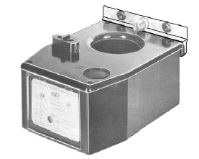
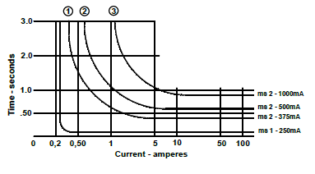
Sensitive core balance relay
There are two types of relays in this range, the MS1, which is instantaneous and the MS2, which has a time delay before tripping. the sensitivity of the different MS2 relays is depicted in the graph.
Click for more information
Notes:
Fig 04 and 05: CTC Book 2, EL-T-1, Pg 182.
‘Click for more information’ =“Note the sensitivity of the different MS2 relays depicted here. The more sensitive (the lower the mA rating) the quicker the response (time in seconds) for the relay to trip the circuit if over-currents occur. For example at 5A the response times are 0,4 ; 0,7 and 1,2 seconds from the highest to the lowest sensitivities.”

Slide 11
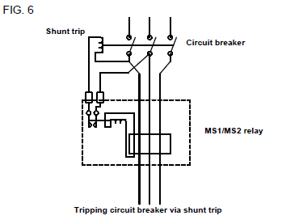
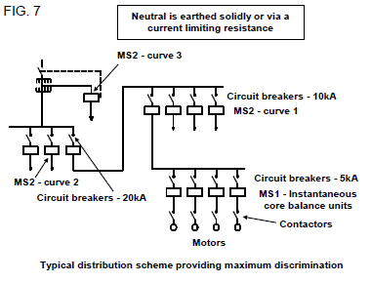
Operation of sensitive core balance relay
Click on each figure to learn more about the operation of the sensitive core balance relay.
Notes:
Fig 06 and 07: CTC Book 2, EL-T-1, Pg 183.
Click on fig06 = “Under healthy circuit conditions, with no earth fault or leakage, the vector sum of the current in the phases at any instant is zero and no emf is induced in the secondary winding of the core. With an earth fault or earth leakage on the system the “imbalance” is detected by the magnetic core on the familiar core-balance principle and an emf is induced in the secondary winding, which causes a capacitor to energise and trip the circuit breaker (FIG. 6).”
Click on fig07= “ This is a typical distribution scheme providing maximum discrimination. The curves mentioned in the diagram refer to FIG. 5 on slide 10.

Slide 12
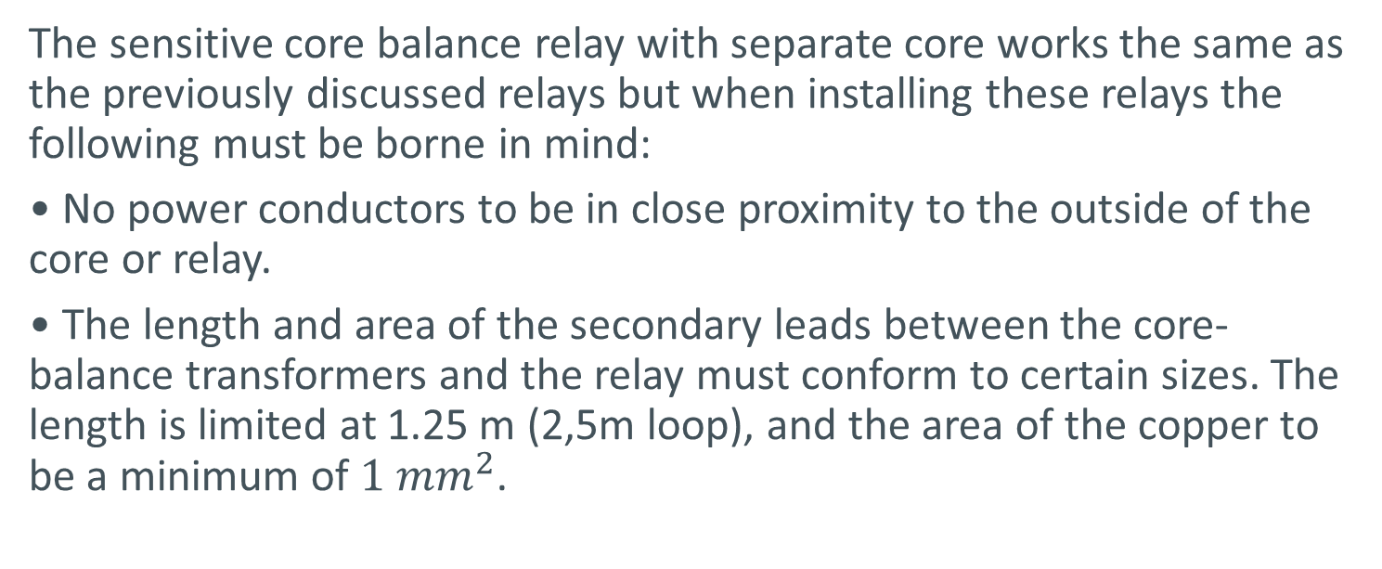
Sensitive core balance relay with separate core
The sensitive core balance relay with separate core works the same as the previously discussed relays but when installing these relays the following must be borne in mind:
• No power conductors to be in close proximity to the outside of the core or relay.
• The length and area of the secondary leads between the core-balance transformers and the relay must conform to certain sizes. The length is limited at 1.25 m (2,5m loop), and the area of the copper to be a minimum of $1 mm^{2}$.

Slide 13
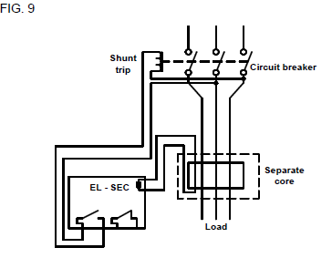
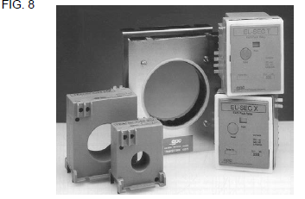
Operation of sensitive core balance relay with separate core
Click for more information
Notes:
Fig 08 and 09: CTC Book 2, EL-T-1, Pg 184.
Click for more information = “This is the connection diagram for a core-balance relay with a separate core.”

Slide 14
Circuit breakers
Circuit breakers are discussed in detail in the ‘electrical components (circuit protection)’ unit, in this unit we will just go over the basics. Circuit breakers are divided into three groups; small frame Miniature Circuit Breakers (MCB’s), large frame Moulded Case Circuit Breakers (MCCB’s) and Air Circuit Breakers (ACB’s).
Notes:
Click on ‘circuit breakers’ = “A circuit breaker is an automatic switching device having a switching capacity sufficient to connect, disconnect and carry current under fault and fault free conditions, and also capable of interrupting overloads after a defined time period.”

Slide 15
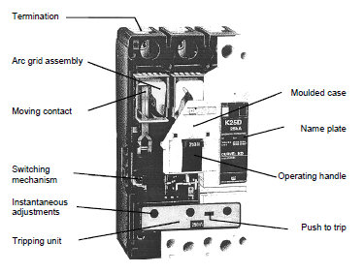
Moulded case circuit breaker
Construction of a moulded case circuit breaker
Notes:
Fig 10: CTC Book 2, EL-T-1, Pg 185.

Slide 16
Terminology
The following terms are often used in connection with circuit breakers and should be understood:
Breaking capacity (kA) / Interrupting capacity
Hydraulic magnetic
Thermal magnetic
Shunt trip
Notes:
Click on:
‘Breaking capacity (kA) / Interrupting capacity’ =“Breaking capacity (kA) / Interrupting capacity (kA) is the highest prospective current that the circuit breaker will interrupt and make-and-break successfully at a specified voltage.”
‘Hydraulic magnetic’ =“Hydraulic magnetic (type of overload) refers to an MCB/MCCB using a solenoid coil and armature activated by a core moving in oil to trip on overload currents. The armature moves instantaneously to trip on short circuit currents.”
‘Thermal magnetic’ =“Thermal magnetic (type of overload) refers to an MCCB using bimetal strips to trip on overload currents, and an electromagnet to trip on short circuit currents.”
‘Shunt trip’ =“Shunt trip is an electromagnet, which picks up when its solenoid is energised and this releases the breaker latching mechanism. It is used for remote tripping of circuit breakers.”

Slide 17
Bonding
The aim of bonding is to bring all the bonded parts to the same electrical potential and reduce the risk of electrical shocks. Bonding to electrical earth is used to ensure that all conductors (person, surface and product) are at the same electrical potential. When all conductors are at the same potential no discharge can occur. Refer to SANS Regulations 6.13 for detailed descriptions of items that may be bonded.

Slide 18
Parts to be bonded
According to SANS Regulation 6.13.2 the following parts should be bonded:
Hot and cold water systems
Antennas.
Roofs, gutters, down pipes and waste pipes
Water pumps

Slide 19
Quiz time
We have come to the end of this unit. Answer the following questions to test your knowledge of three-phase earth leakage protection.

Slide 20
Question 1
Name the three types of earth leakage protection units as mentioned in this unit.
1)
2)
3)
Notes:
Allow text to be entered.
Solution (accept in any order):
1) High sensitivity earth leakage protection units,
2) Sensitive core balance relay, and
3) Snsitive core balance relay with separate core.

Slide 21
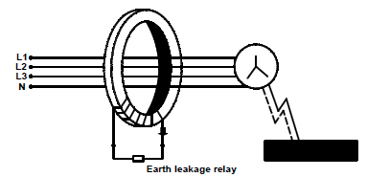
Question 2
True or false: If an earth fault should occur, as shown by the dotted line in the diagram, some current will flow directly to earth and cause a balance in the currents flowing through the core.
TRUE
FALSE
Notes:
True or False
Fig02: CTC Book 2, EL-T-1, Pg 180
Correct answer is FALSE
Feedback:
Correct – Well done.
Incorrect – That is not correct. If an earth fault should occur, as shown by the dotted line, some current will flow directly to earth and cause an imbalance in the currents flowing through the core.

Slide 22
Question 3
Name two types of overloads used in circuit breakers, mentioned in this unit.
1)
2)
Notes:
Allow text to be entered.
Solution (accept answers in any order):
1) Hydraulic magnetic
2) Thermal magnetic

Slide 23
Question 4
What is the aim of bonding?
To earth appliances
To earth all electrical armouring of cable
To bring all the bonded parts to the same electrical potential
To bring all electrical cables to the same electrical point
Notes:
MCQ
Correct answer is C
Feedback:
Correct – Excellent.
Incorrect – Try again.

Slide 24
Question 5
Which of the items listed below need to be bonded?
Spiral iron staircase
Galvanized roof
Aluminium TV dish
All of the above
Notes:
MCQ
Correct answer is D
Feedback:
Correct – Great job.
Incorrect – Try again.

Slide 25
Let’s review:
In this lesson we have covered:
Core balance relays.
Three-phase earth leakage protection.
Types and operation of earth leakage protection units.
Circuit breaker basics.
Bonding.
Make sure you have a complete understanding of all the work covered here before you start the next unit.

Slide 26
Table brief – Table 1

Slide 27
Video brief - Vid01
Notes:
Create an animated video similar to https://www.youtube.com/watch?v=gtAaZ2hFYTA but using script wording as above

Slide 28
Video brief - Vid01 continued
Notes:
Create an animated video similar to https://www.youtube.com/watch?v=gtAaZ2hFYTA but using script wording as above

Slide 29
Video brief - Vid02
Notes:
Create video similar to this youtube clip but with script wording as above: https://www.youtube.com/watch?v=E7_Bu9e_qXY

