Slide 1
Electrical components and systems
Topic 5 – Earthing and Bonding

Slide 2
Single phase earth leakage protection
Unit 5.1

Slide 3
Assumed prior learning
Electrical components (circuit protection)
How Single Phase AC Motors Work
Don’t feel confident yet about these topics? Click on each to review the content.
Feeling confident? Click next to proceed with this unit.

Slide 4
Outcomes
Explain the dangers of electric current flowing through the human body.
Explain the necessity for good earthing of electrical installations.
State the reason for installing earth leakage protection.
Explain, with the aid of circuit diagrams, the operation of two types of single-phase core balance relays in electrical circuits.

Slide 5
Introduction
If an electric current passes through the human body it can be deadly. Every year thousands of people worldwide die due to electrical shock and thousands more are injured due to electric current passing through the body . The objective of earthing is to protect the person using an electric appliance or apparatus against electric shock.
Notes:
Click on ‘Earthing’ = Link each to the relevant section below.

Slide 6
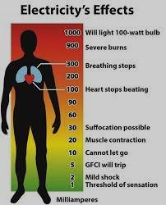
Fatal current
If an electric current passes through the human body, it can cause serious burns at the points of contact, as well as damage to blood vessels, nerves, muscles and organs along the route that the current moves through the body. REMEMBER: It is the current flowing through the body that causes the damage but sufficient voltage is necessary to cause the current to flow through the body.
TABLE 01: Effects of electric current on the human body
Notes:
Img01: https://sites.google.com/site/electrichazardsandsafety/_/rsrc/1457489941436/electric-hazards/electric-shock/images.jpg?height=400&width=323
Click on Table 01 = Bring table in as a pop up. See appendix for table brief.

Slide 7
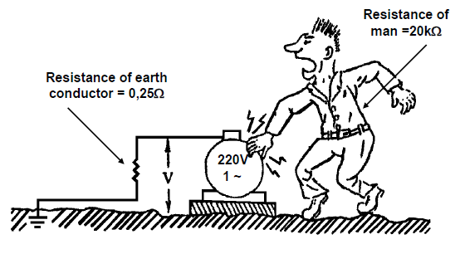
Importance of earthing
The purpose of earthing is to protect the person using an electric appliance or apparatus against electric shock.
Electric current takes the path of least resistance. It would rather flow through an earth conductor (which offers very little resistance), than through the human body, which offers a great deal of resistance. Remember Ohm’s Law?
Notes:
Fig01: CTC, Book 2, EL-T, Pg 166.
Click on ‘Remember Ohm’s law?’ =
“ $I=\frac{V}{R} \left(Ohm^{′}s law\right)$
$Current through earth conductor=\frac{220}{0.25}=880A$
$Current through man=\frac{220}{20000}=11mA$ .”

Slide 8
Earthing and wiring regulations
Wiring regulations require that additional protection in the form of earth leakage relays should be installed to protect persons against the possibility of failure of the earthing system. Earth leakage protection does not replace the earthing system it supplements it.
The earth leakage protection device automatically switches out the faulty apparatus or electrical network.
Notes:
Click on ‘Earth leakage…supplements it’ =“The most important connection on an appliance or installation is the earth conductor. Wiring regulations are very strict about the proper earthing of installations and socket outlets, and the fact that earth conductors must have very low resistance. For example, in a normal domestic installation the resistance should be less than 0,25 Ω. Refer to SANS Reg. 6.12.1.4.”

Slide 9
Single phase earth leakage relays
There are two types of earth leakage relays used in practice:
• The voltage operated type.
• The core (current) balance type.
Only the core balance type is used in the mining industry and domestic installations and will be discussed further.
Vid 01:
Principles of operation and testing of earth leakage relays
Notes:
Click on Vid01=, Play full screen. See Appendix for script.

Slide 10
Sensitivity of core balance relays
“Sensitivity” of a relay refers to the value of the earth leakage current at which the relay must trip the circuit.
The sensitivity of a relay is clearly marked on the relay.
The standard domestic and industrial earth leakage relay (ELR) has a sensitivity rating of 30 mA.
NOTE:
The ELR must operate before the leakage current exceeds the rated tripping current, whatever it may be.

Slide 11
Quiz time
We have come to the end of this unit. Answer the following questions to make sure you understand the importance of earth leakage protection.

Slide 12
Question 1
The purpose of earthing is to guard every installation, appliance or apparatus against the effects of?
Stray current
Voltage spikes
Stray voltages
Leakage currents
Notes:
MCQ
Correct answer is A
Feedback:
Correct – Good job.
Incorrect – Try again.

Slide 13
Question 2
At what value must the earth leakage protection device trip?
25ma
30ma
Between (15-30) ma
Between (5-25) ma
Notes:
MCQ
Correct answer is B
Feedback:
Correct – Well done. The standard domestic and industrial earth leakage relay (ELR) has a sensitivity rating of 30 mA.
Incorrect – Try again.

Slide 14
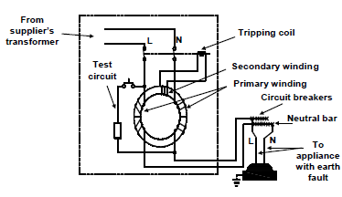
Question 3
The diagram below shows:
Core balance with wound primaries device.
Single core balance earth leakage unit.
Three - phase core balance earth leakage unit.
Motor installation circuit.
Notes:
MCQ
Correct answer is A
Feedback:
Correct – Excellent.
Incorrect – Try again.

Slide 15
Question 4
What do understand by the term “Earthed”?
Four socket outlets installed next to each other.
Connected to earth to ensure discharged of electrical energy without danger.
Put down on ground.
Two light switches for one light point.
Notes:
MCQ
Correct answer is B
Feedback:
Correct – Great job.
Incorrect – Try again.

Slide 16
Question 5
What is the purpose of the button on the earth leakage device?
To disconnect the light circuit.
To be used as an emergency stop button.
To test the effectiveness of the relay.
None of the above.
Notes:
MCQ
Correct answer is C
Feedback:
Correct – Great job.
Incorrect – Try again.

Slide 17
Question 4
The core balance type earth leakage relay makes use of electromagnetic induction effects to operate.
TRUE
FALSE
Click on the correct answer.
Notes:
True or False
Correct answer is TRUE
Feedback:
Correct – Well done
Incorrect – That is not correct.

Slide 18
Let’s review:
In this lesson we have covered:
The importance of earthing.
Earthing and wiring regulations.
Single phase earth leakage relays.
Sensitivity of core balance relays.
Make sure you have a complete understanding of all the work covered here before you start the next unit.

Slide 19
Table brief – Table 01Effects of electric current on the human body
CURRENT | RESULT
AC current of 1 – 2 milli-amperes (mA) and DC current of 5 m A. | This will just be noticeable as a tingling feeling or very light electrical shock. These currents can take place with voltages as low as 25 volts. The higher the voltage, the higher the current will become. This also depends on your body’s resistance at the time. Average body resistance is about 20 kilo ohm. But can drop to as low as 1000 ohm.
AC current of more than 15 mA and DC current of more than 75 mA. | Will cause strong contraction of the muscles, and it may be difficult or impossible to release the hands from the conductor.
AC current of 60 – 75 mA at 220 V. | Passing through the chest, (For example, from one hand to the other, or from one hand to a foot), can paralyse the heart in less than one second.
High voltage current | Can cause severe third degree burns and strong muscular contractions that can lead to bone fractures and spine damage.
WARNING: If someone has been electrocuted, switch off the power before removing the affected person from the current carrying conductor.
Notes:
Allow scroll on table.

Slide 20
Video brief - Vid01 Expert presenter explaining: Principles of operation and testing of core balance earth leakage relay
Voice over | Image
There are two types of earth leakage relays used in practice: • The voltage operated type. • The core (current) balance type. Only the core balance type is used in the mining industry and domestic installations and will be discussed here. The core balance type earth leakage relay makes use of electromagnetic induction effects to operate. For more information on this go over the unit, “How Single Phase AC Motors Work.” | Presenter to show actual relays described
Notes:
Presenter to demonstrate as necessary.

Slide 21
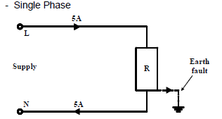
Video brief - Vid01 contin. Expert presenter explaining: Principles of operation and testing of core balance earth leakage relay
Voice over | Image
In “healthy” electrical circuits the current in the line conductors and in the neutral conductor will balance. This means that exactly the same amount of current flowing in one direction in a cable core will flow in the opposite direction in another core. As you can see in this circuit diagram. If an earth fault occurs in the system, for example at an appliance (R) in this diagram, some current will be lost (flow to earth from the appliance), and the current in the neutral conductor (N) will be less than the current in the live conductor (L). Remember Kirchoff’s Current Laws? We know that a magnetic field is induced around a conductor that carries electric current and that the flux strength is proportional to the magnitude of the current. In the case described above the magnetic fields around the live and neutral conductors will therefore be different when an earth fault occurs. This difference (or imbalance) of the magnetic fields is used to activate a relay and trip the circuit breaker (switch off the power). | (Presenter to draw or use the figure provided in the CTC book)
Notes:
Figure of single phase circuit: CTC Book2, EL-T, Pg167 (Fig 2)

Slide 22
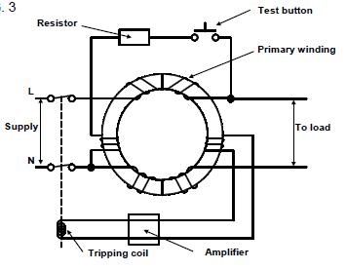
Video brief - Vid01 contin. Expert presenter explaining: Principles of operation and testing of core balance earth leakage relay
Voice over | Image
Let’s move onto the types of core balance relays. This is an example of a core balance relay with wound primaries. If there is no earth fault ( the circuit is “healthy”), the magnetic flux produced by the live and neutral conductors are the same and in opposite direction to one another, in other words the core is balanced. If an earth fault occurs (in case of an earth leakage current) the magnetic flux produced by the live conductor will differ from that produced by the neutral conductor. The difference in flux then induces an emf, and current, in the secondary coil, which in turn sets up a flux in the tripping coil, making it into an electromagnet that attracts a leaver, causing the device to trip. | (Presenter may use figure 3 provided in the CTC book 2)
Notes:
Figure 3: CTC Book2, EL-T, Pg168 (Fig 3)

Slide 23
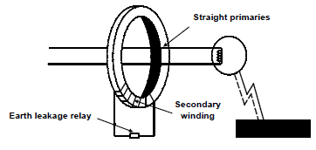
Video brief - Vid01 contin. Expert presenter explaining: Principles of operation and testing of core balance earth leakage relay
Voice over | Image
Here we see a simplified example of a core balance relay with straight primaries. If an earth fault occurs causing different currents to flow in the line and neutral conductors, the resulting imbalance will cause a magnetic field equal in strength to the difference of the currents in the conductors. • The magnetic field induces an electromotive force (emf) in the secondary coil. • This electromotive force is then used to activate a relay and trip the circuit breaker feeding the circuit. Earth fault current is indicated in this diagram by the dotted line. NOTE: The same system is used in three-phase power supplies and will be dealt with in a subsequent unit. | (Presenter may use figure 4 provided in the CTC book 2) simplified example of a core balance relay with straight primaries.
Notes:
Figure 4: CTC Book2, EL-T, Pg168 (Fig 4)

Slide 24
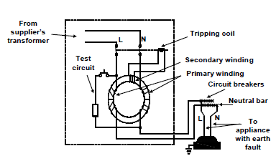
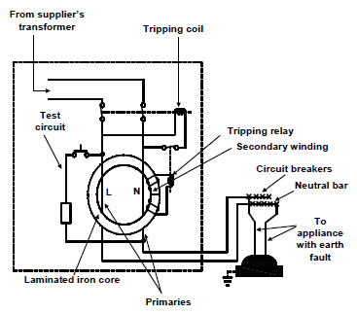
Video brief - Vid01 contin. Expert presenter explaining: Principles of operation and testing of core balance earth leakage relay
Voice over | Image
Here we will see more detailed connection diagrams of the two types of core balance earth leakage relays just described. First is the - Core balance with wound primaries. Next diagram is the Core balance with straight primaries and a tripping relay. | (Presenter may use figure 5 and 6 provided in the CTC book 2) Core balance with wound primaries Core balance with straight primaries and a tripping relay
Notes:
Figure 5 and 6: CTC Book2, EL-T, Pg169 (Fig 5 and 6)

Slide 25
Video brief - Vid01 contin. Expert presenter explaining: Principles of operation and testing of core balance earth leakage relay
Voice over | Image
No we look at Testing earth leakage units. Earth leakage relays should be tested periodically for correct functioning. • A pushbutton is provided on a relay, especially for test purposes. Refer to the figures we’ve just seen for the test circuits. • If the button is pressed, a current is allowed to flow to earth causing the circuit breaker to trip. • If this action does not cause the circuit breaker to trip, it is a clear indication that either there is no supply to the relay, or the relay is faulty. The SANS Code of Practice for the Wiring of Premises also requires that the effectiveness of earth leakage protection should be tested before an installation may be permanently connected to the supply. A later unit will deal with this in greater detail. Refer to Regulation 6.7.5 | (Presenter to demonstrate with actual relays)
Notes:
Figures 3, 5 and 6: CTC Book2, EL-T, Pg168-169 (Fig3, 5 and 6)

