Slide 1
Electrical components and systems
Topic 2 – Electrical components

Slide 2
Circuit protection
Unit 4.2

Slide 3
Assumed prior learning
Contactors and overload relays
Don’t feel confident yet about these topics? Click on each to review the content.
Feeling confident? Click next to proceed with this unit.
Notes:
Link to unit 1.1 upon clicking the unit.

Slide 4
Outcomes
Explain the functions and operations of the different types of fuses.
Identify and explain the operation of the two types of circuit breakers.
Notes:
Link each to the relevant section below.

Slide 5
Introduction
Contactors, overload relays, fuses and circuit breakers are the main components in an electrical circuit. While overload relays protect the motor, circuit breakers and fuses protect the circuit. In this lesson we find out more about the circuit protection provided by fuses and circuit breakers.
CONTACTORS, OVERLOADS, FUSES AND CIRCUIT BREAKERS
Notes:
Img 01: https://i.ytimg.com/vi/GQlqoYmUWrs/maxresdefault.jpg
On clicking ‘fuses and circuit breakers’ =“Circuit breakers and fuses are designed to detect when there is too much current in the circuit, while overload relays are designed to detect if a motor is overheating and will open the circuit if the motor gets too hot. For example, an overload relay can trip without a circuit breaker tripping. One does not replace the other.”

Slide 6
What are fuses used for?
A fuse is a device for protecting a circuit or appliance from excessive current flowing across it (short circuit current in defective circuits or overload currents in circuits that are not defective).
CONTACTORS, OVERLOADS, FUSES AND CIRCUIT BREAKERS
Notes:
Img 01:https://i.ytimg.com/vi/GQlqoYmUWrs/maxresdefault.jpg
Zoom into the ‘fuse’ section of Img 01. Play animation on slide to see effect.

Slide 7
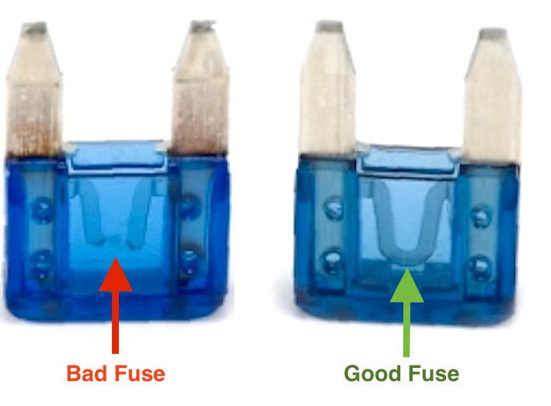
How do fuses work?
A fuse protects the circuit by disconnecting the circuit from the supply when the fuse element melts. The fuse element or fuse wire in a fuse is designed to melt when the current through it exceeds a certain value for a certain time.
Note: the fuse element is connected in series with the electrical supply to the appliance, so that when the fuse blows (opens) it will open the entire circuit and stop current through the components.
Notes:
Img02:https://bit.ly/2xeEYoI

Slide 8
Experimenting with fuses
Watch the video to see a simple demonstration on how a low rating electrical fuse works.
Vid01: Experimenting with fuses
Notes:
Get code for ‘Fun with electrical fuses’ YT01= https://www.youtube.com/watch?v=70arPvsHKkk, play video full screen.

Slide 9
Materials used for fuse elements
The materials commonly used as fuse elements are:
Copper – tends to oxidise;
Tin - leaves a vapour that could extend the duration of the arc;
Lead - which splashes and could damage adjacent circuits;
Zinc - affords time delay
Silver - used for high rupturing capacity (h.r.c.) fuses

Slide 10
Fuse element materials
The material used as a fuse element must have the following properties; low melting point, low ohmic resistance, high conductivity, low cost and it should be free from deterioration.
There is no material that satisfies all of the above properties.
METAL | MELTING POINT IN °C | RESISTANCE in μΩ-mm
SILVER | 980 | 16
TIN | 240 | 112
ZINC | 419 | 60
LEAD | 328 | 210
COPPER | 1090 | 17
ALUMINIUM | 665 | 28
Notes:
Table 01 content source: https://bit.ly/2xh2YXv

Slide 11
Types of fuses
The two types of fuses in general use are:
The semi-enclosed type;
Totally enclosed type or cartridge fuse (h.r.c. fuse)
Vid02: Construction and selection of fuses
Notes:
Vid 02 = Play full screen, see appendix for script.

Slide 12
After watching Video 02 on the construction and selection of fuses answer the questions that follow.

Slide 13
Question 1
Give the definition of a fuse.
ENTER ANSWER HERE
Notes:
Insert text box for answer to be entered.
Solution: ‘A fuse is a device for protecting a circuit or appliance from excessive current.’ Accept slight variations of this definition

Slide 14
Question 2
Name the two types of fuses in general use.
1)
2)
Notes:
Allow text to be entered. Accept answers in any order.
Solution:
1) The semi-enclosed type
2) Totally enclosed type or cartridge fuse

Slide 15
Question 3
Semi-enclosed fuses are normally used to protect circuits exceeding
30A.
TRUE
FALSE
Click on the correct answer.
Notes:
True or False
Correct answer is FALSE
Feedback:
Correct – Well done.
Incorrect – That is not correct. Semi-enclosed fuses are normally not used to protect circuits exceeding 30 A.

Slide 16
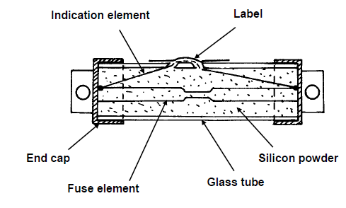
Question 4
What type of fuse is shown below?
A
ENTER ANSWER HERE
Notes:
Allow text to be entered.
Solution: High rupturing capacity fuse
May also accept: h.r.c. fuse as an answer.

Slide 17
Question 5
What is ‘A’ in this fuse diagram called?
A
ENTER ANSWER HERE
Notes:
Allow text to be entered.
Solution: Indication element

Slide 18
Function of a circuit breaker
A circuit breaker is a mechanical switching device, used to protect electrical circuits and equipment in the event of fault current and over-current.
CONTACTORS, OVERLOADS, FUSES AND CIRCUIT BREAKERS
Notes:
Img 01:https://i.ytimg.com/vi/GQlqoYmUWrs/maxresdefault.jpg
Zoom into the ‘circuit breaker’ section of Img 01. Play animation on slide to see effect.

Slide 19
Difference between circuit breaker and fuse
A fuse is a piece of metal that melts when overheated due to an excessive flow of current whereas a circuit breaker has a switching mechanism, which is activated due to power overloads and short circuits. Fuses are faster to disrupt the current flow but they must be replaced after a piece of metal melts down while circuit breakers can be reset and used again.

Slide 20
Advantages of circuit breakers
A circuit breaker can:
be used as an isolator,
simply be reset after a fault or over-current (it does not have to be replaced), and
be used in case of overload and short-circuit conditions.

Slide 21
Types of breakers
There are two basic types in use:
The magnetic type,
The thermo-magnetic type.
Vid03: Types of circuit breakers and arc quenching
Notes:
See appendix for Vid03 script. Play full screen.

Slide 22
Selection of circuit breakers
The ratings of circuit breakers are clearly marked on them. Take care when installing or replacing circuit breakers that the correct rating in terms of amperage and time delays (where appropriate) are taken into account.

Slide 23
After watching Video 03 answer the following questions.

Slide 24
Question 1
List three advantages of circuit breakers over fuses.
1)
2)
3)
Notes:
Allow text to be entered.
Solution:
1) A circuit breaker can be used as an isolator
2) A circuit breaker can simply be reset after a fault or over-current and does not need to be replaced.
3) A circuit breaker can be used in case of overload and short-circuit conditions.
Accept slight variations of the above and in any order.

Slide 25
Question 2
What is the function of the plunger in a magnetic-type circuit breaker?
Increase the strength of the magnetic flux.
Damping or slowing down effect.
Bend when it is heated.
To quench the arcs.
Notes:
MCQ
Correct answer is A
Feedback:
Correct – Great job.
Incorrect – Try again.

Slide 26
Question 3
Name two types of circuit breakers.
1)
2)
Notes:
Allow text to be entered.
Solution:
1) The magnetic type
2) The thermo-magnetic type
Accept answers in any order.

Slide 27
Question 4
Arc quenching is achieved in mini circuit breakers by a number of metal plates placed diagonally and below the contacts as arc interrupters.
TRUE
FALSE
Click on the correct answer.
Notes:
MCQ
Correct answer FALSE
Feedback:
Correct – Great job.
Incorrect – Arc quenching is achieved in mini circuit breakers by a number of metal plates placed diagonally and above the contacts as arc interrupters.They divide and absorb the spark, thus protecting the contact points.

Slide 28
Question 4
A circuit breaker may be used as a disconnector provided it complies with the standards of the relevant disconnectors.
TRUE
FALSE
Click on the correct answer.
Notes:
MCQ
Correct answer TRUE
Feedback:
Correct – Great job.
Incorrect – Regulation 6.8.1 of SANS states: A circuit-breaker that is used as a main or local switch-disconnector(see 6.9.4) shall comply with the relevant requirements of a standard given in clause 4 for switch-disconnectors, or, alternatively, a switch-disconnectorshall be positioned on the supply side of the circuit-breaker.

Slide 29
Question 4
An abnormally low ambient temperature will delay the tripping of thermal magnetic circuit breakers on overload.
TRUE
FALSE
Click on the correct answer.
Notes:
MCQ
Correct answer TRUE
Feedback:
Correct – Great job.
Incorrect – Low temperatures might prevent thermal protection from tripping.

Slide 30
Let’s review:
In this lesson we have covered:
Function and operation of fuses
Types of fuses
Function and operation of circuit breakers
Types of circuit breakers
Make sure you have a complete understanding of all the work covered here before you start the next unit.

Slide 31
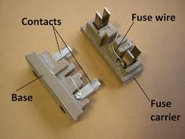
Video brief - Vid02 Expert technician explaining the construction of fuses
Voice over | Image
Three types of fuse are used as circuit protection ; the rewireable or semi-enclosed fuse, enclosed fuses and the high rupturing capacity (HRC) fuse. We will discuss each one . For the applicable standards of fuses and fuse holders see Table 4.1 of the SANS Code.
In older homes the switchboard may still have semi-enclosed rewireable fuses. These fuses are ceramic plug-in units on the switchboard. They have a length of fuse wire connected between two screws on the contacts of a fuse holder and operate in an overload or short-circuit . The semi-enclosed fuse is made up of a fuse holder, an element and a fuse carrier. The holder and carrier can be made of porcelain or bakelite.
Notes:
Vid02: script as above. Presenter to show actual fuses and demonstrations not just images-the images here are just used for reference.
Semi-enclosed image: https://bit.ly/2Mwt6Dw

Slide 32
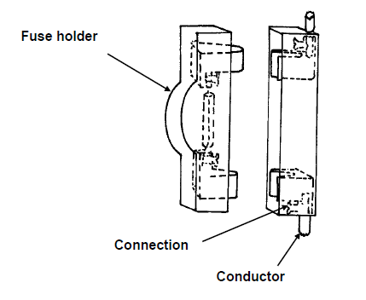
Video brief - Vid02 Expert technician explaining the construction of fuses
Voice over | Image
The figure shows the construction of a semi-enclosed, re-wireable fuse. The fuse holder must never be wired with an element exceeding the rated value of the fuse, since it will then fail to protect the appliance or circuit for which it was intended. The element is screwed to a contact at each end and wired through an asbestos, ceramic, or porcelain tube, which serves to enclose the spark when the fuse blows. See SANS Regulation 6.10 for the use of fuses not being permitted as overcurrent protection in residential installations.
Notes:
Vid02: script as above. Presenter to show actual fuses and demonstrations not just images-the images here are just used for reference.
Figure 10: Book 4, CO-T, Page 21

Slide 33
Video brief - Vid02 Expert technician explaining the construction of fuses
Voice over | Image
The relative advantages of semi-enclosed fuses is that they are; cheap and easy to rewire. The relative disadvantages are : • It deteriorates easily because it is not enclosed; • Ratings are unreliable; • Gives no indication if blown; • Not effective under short-circuit conditions; • Can be wrongly rewired with an element of incorrect value, thus negatively affecting the rating of the fuse. Please note that: Semi-enclosed fuses are normally not used to protect circuits exceeding 30 A.
Notes:
Vid02: script as above. Presenter to show actual fuses and demonstrations not just images-the images here are just used for reference.

Slide 34
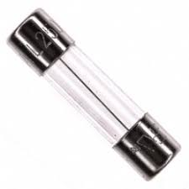
Video brief - Vid02 Expert technician explaining the construction of fuses
Voice over | Image
An enclosed fuse is one in which the element is totally enclosed by means of a container or sealed tube, thus protecting the element from the atmosphere and containing the spark when it blows. We will discuss a few important examples of enclosed fuses., the cartridge fuse, Edison screw fuse and High rupturing capacity (h.r.c.) fuses.
Notes:
Vid02: script as above. Presenter to show actual fuses and demonstrations not just images-the images here are just used for reference.
Image of enclosed fuse: https://bit.ly/2MwBoLI

Slide 35
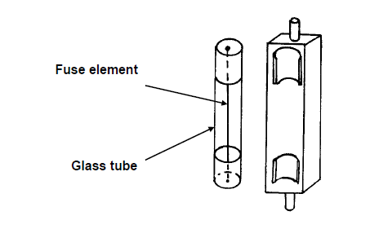
Video brief - Vid02 Expert technician explaining the construction of fuses
Voice over | Image
This is a Cartridge fuse. The fuse element is enclosed by means of a glass, porcelain or ceramic tube. The ends of the elements are soldered to tinned brass caps. They are commonly used in motor vehicles.
Notes:
Vid02: script as above. Presenter to show actual fuses and demonstrations not just images-the images here are just used for reference.
Figure 11: Book 4, CO-T, Page 23.

Slide 36
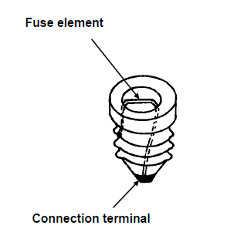
Video brief - Vid02 Expert technician explaining the construction of fuses
Voice over | Image
The Edison screw fuse is another form of cartridge fuse, since its element is enclosed in a glass container. It is commonly found in stoves.
Notes:
Vid02: script as above. Presenter to show actual fuses and demonstrations not just images-the images here are just used for reference.
Figure 12: Book 4, CO-T, Page 23.

Slide 37
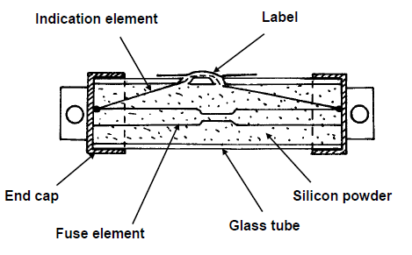
Video brief - Vid02 Expert technician explaining the construction of fuses
Voice over | Image
High rupturing capacity or h.r.c fuses are cartridge fuses able to interrupt high currents. • Their elements are manufactured from silver; • Apart from the fuse element, it also has an indicating element, which is wired in parallel with the fuse element and has the function to indicate if the fuse is blown. A small quantity of explosive powder is placed in a tiny hole behind the indicating label. If the indicating element melts when the fuse blows, the powder ignites and blows a hole in the indicating label. • The fuse element is surrounded by an insulating material such as fire clay or silica granules, which quench the arc instantaneously. • An important characteristic is that it can operate at very high and very low over-currents, with different time delays. The higher the current, the shorter the time delay before it blows and vice versa. NOTE: At excessively high currents it operates instantaneously.
Notes:
Vid02: script as above. Presenter to show actual fuses and demonstrations not just images-the images here are just used for reference.
Figure 13: Book 4, CO-T, Page 24.

Slide 38
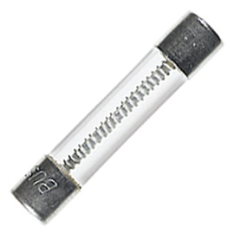
Video brief - Vid02 Expert technician explaining the construction of fuses
Voice over | Image
Lastly we look at ; Quick blow and slow blow fuses. Normal fast-blow fuses are the most general purpose fuses. A time-delay fuse (also known as an anti-surge or slow-blow fuse) is designed to allow a current which is above the rated value of the fuse to flow for a short period of time without the fuse blowing. Fuses are designed to be capable of carrying current at 50% above the rated value for approximately four hours, but small overloads for an indefinite period. Slow blow fuses are for example, incorporated in the starting circuits of motors where the overload during starting will exceed 50%. The fuse must be able to carry this current for a few seconds without blowing. Fuse elements are made of zinc.
Notes:
Vid02: script as above. Presenter to show actual fuses and demonstrations not just images-the images here are just used for reference.
Image of slow blow fuse: https://bit.ly/2NekHtB

Slide 39
Video brief - Vid02 Expert technician explaining the construction of fuses
Voice over | Image
A quick blow fuse is designed to blow within a very short period of time during overload. This type of fuse is used in circuits that are very sensitive to overload currents.
Be careful in your selection of fuses. Fuses are normally clearly marked. Take care to replace fuses with ones of correct rating, considering both amperage and time delay where applicable. When rewiring semi-enclosed fuses, take care to rewire them with element wire of the correct (same) value.
Notes:
Vid02: script as above. Presenter to show actual fuses and demonstrations not just images-the images here are just used for reference.
Image of quick blow fuse: https://bit.ly/2MwBoLI

Slide 40
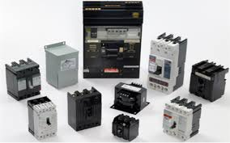
Video brief - Vid03 Expert technician explaining the different types of breakers in use
Voice over | Image
Breakers can be a small device to guard one household appliance or big switchgear designed to shield high voltage circuits that supply a complete city. Circuit breakers can be classified according to its features such as voltage class, construction type, interrupting type, and structural features. For the applicable standards of circuit breakers see Table 4.1 of the SANS Code. A circuit-breaker that is used as a main or local switch disconnector SANS Regulation see 6.9.4 shall comply with the relevant requirements of a standard given in clause 4 for switch-disconnectors, or, alternatively, a switch-disconnectorshall be positioned on the supply side of the circuit-breaker. We will discuss the operating principle of a magnetic circuit breaker and a thermo-magnetic circuit breaker.
Notes:
Vid03 script as above. Presenter to show actual breakers and demonstrations not just images-the images here are just used for reference.
Presenter to show the different types of circuit breakers.
Image of circuit breakers: https://www.elprocus.com/wp-content/uploads/2016/10/Types-of-Circuit-Breakers.png
Create a video similar to this: https://www.youtube.com/watch?v=iY9skBNKFGE

Slide 41
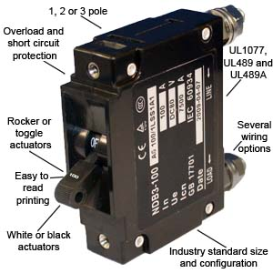
Video brief - Vid03 Expert technician explaining the different types of breakers in use
Voice over | Image
Magnetic circuit breakers use a solenoid (electromagnet) whose pulling force increases with the current. The operating principle of a magnetic circuit breaker (also called a mini circuit breaker or m.c.b.) is to trip if the magnetic flux produced by the current exceeds a pre-set limit.
Notes:
Vid03 script as above. Presenter to show actual breakers and demonstrations not just images-the images here are just used for reference.
Presenter to show the different types of circuit breakers.
Image of magnetic circuit breaker: https://www.asi-ez.com/pix/illustrations/ndb-100_series_cb.jpg
Create a video similar to this: https://www.youtube.com/watch?v=iY9skBNKFGE

Slide 42
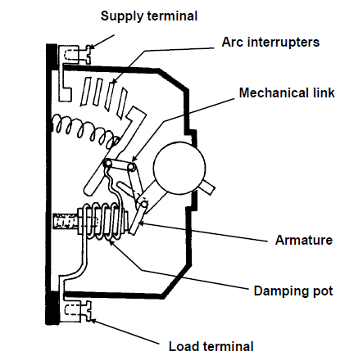
Video brief - Vid03 Expert technician explaining the different types of breakers in use
Voice over | Image
Let’s look at the construction of a magnetic-type circuit breaker . • A current coil is connected between the input and output terminals. It is wound around a non-magnetic cylinder, which contains a soft iron plunger in oil. • The function of the plunger is to increase the strength of the magnetic flux as it is pulled towards the centre of the coil. • The oil (in the damping pot) has a damping or slowing down effect that provides the time delay. • When the plunger reaches the centre of the coil, the flux is sufficient to attract the armature, which causes the breaker (m.c.b.) to trip. • Under short circuit conditions the current may reach values of 2 500 A, which will set up a flux in the coil that is strong enough to attract the armature without the assistance of the plunger, causing the m.c.b. to trip instantaneously.
Notes:
Vid03 script as above. Presenter to show actual breakers and demonstrations not just images-the images here are just used for reference.
Figure 14: Book 4, CO-T, Page 29
Create a video similar to this: https://www.youtube.com/watch?v=iY9skBNKFGE

Slide 43
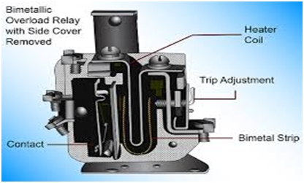
Video brief - Vid03 Expert technician explaining the different types of breakers in use
Voice over | Image
The difference between the magnetic and thermo-magnetic circuit breaker is that the thermo-magnetic has both thermal (for overload trip) and magnetic (for inrush/instantaneous trip) elements. This is used primarily for conductor protection. The magnetic only breaker is mainly used for motor protection. The majority of circuit breakers are thermo-magnetic, which means they accomplish electrical protection by combining two mechanisms that respond to heat and magnetic fields.
Notes:
Vid03 script as above. Presenter to show actual breakers and demonstrations not just images-the images here are just used for reference.
Image of thermo-magnetic breaker: http://engineering.electrical-equipment.org/wp-content/uploads/2014/02/Thermal-Magnetic-Circuit-Breakers.jpg
Create a video similar to this: https://www.youtube.com/watch?v=iY9skBNKFGE

Slide 44
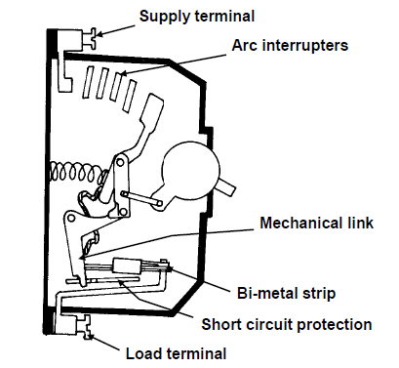
Video brief - Vid03 Expert technician explaining the different types of breakers in use
Voice over | Image
The construction of a thermo-magnetic (also called thermal-magnetic) circuit breaker is as follows: • A bimetal strip is incorporated between the input and output terminals. The bimetal strip will bend when it is heated and produce pressure on the tripping mechanism, causing the m.c.b. to trip. • The time delay is achieved by the time it takes for the current to heat up the bi-metal strip sufficiently to trip the m.c.b. • In the case of a short-circuit, the magnetic flux produced is sufficient to attract the tripping lever and trip the m.c.b.
Notes:
Vid03 script as above. Presenter to show actual breakers and demonstrations not just images-the images here are just used for reference.
Figure 15: Book 4, CO-T, Page 30
Create a video similar to this: https://www.youtube.com/watch?v=iY9skBNKFGE

Slide 45
Video brief - Vid03 Expert technician explaining the different types of breakers in use
Voice over | Image
When the current carrying contacts of the circuit breaker are moved apart, an arc is formed, which persists for a short period after the separation of contacts. This arc is dangerous due to the energy generated in it in the form of heat which may result in an explosive force. The circuit breaker should be able to extinguish the arc without causing disturbances to the equipment or danger to the operator. In mini circuit breakers it involves a number of metal plates placed diagonally and above the contacts as arc interrupters. They divide and absorb the spark, thus protecting the contact points. Experience has shown that in large circuit breakers, if the arc is broken in oil instead of in air, the tendency of the arc to be restruck is greatly reduced. Final quenching is thus more rapidly effected. This is due partly to the cooling action of the oil on the gas bubble as the arc is drawn out, and partly to the mechanical projection of the cold oil on the arc itself. | Demonstration by presenter similar to: https://www.youtube.com/watch?v=q7boSVgCRN0
Notes:
Vid03 script as above. Presenter to show actual breakers and demonstrations not just images-the images here are just used for reference.
Create a video similar to this: https://www.youtube.com/watch?v=iY9skBNKFGE

