Slide 1
Electrical components and systems
Topic 4 – Electrical components

Slide 2
Contactors and overloads
Unit 4.1

Slide 3
Assumed prior learning
DC motors
Don’t feel confident yet about these topics? Click on each to review the content.
Feeling confident? Click next to proceed with this unit.
Notes:
Link to unit upon clicking

Slide 4
Outcomes
Function of switching devices
Purpose and function of contactors
Types of contactors
Selection of contactors
Overload protection
Purpose and function of overload relays
Types of overload protection
Selection of overload relays
Notes:
Link each to the relevant section below.

Slide 5
Introduction
An electric circuit is made up of different components or building blocks such as contactors, overload relays, fuses and circuit breakers. These are connected to each other in different ways. In this lesson we will focus on the function and use of contactors and overloads.
Notes:
Click on ‘contactors’= “Contactors control electric current to the motor. Their function is to repeatedly establish and interrupt an electrical power circuit.”
Click on ‘overloads’=“Overload relays protects motors from drawing too much current, overheating and burning out.”

Slide 6
What is a switching device?
A switching device opens and closes an electrical circuit. Electrical circuits must form a continuous loop, a switch is like a gate in that loop. A circuit is ‘on’ when the switch is closed and the circuit is ‘off’ when the switch is open. According to the SANS wiring code, contactors , fuses, circuit breakers, relays and disconnectors are examples of switching devices.
Notes:
Source: https://www.thespruce.com/what-is-a-switching-device-1152770

Slide 7
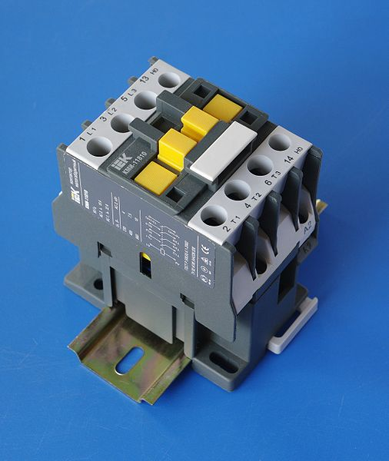
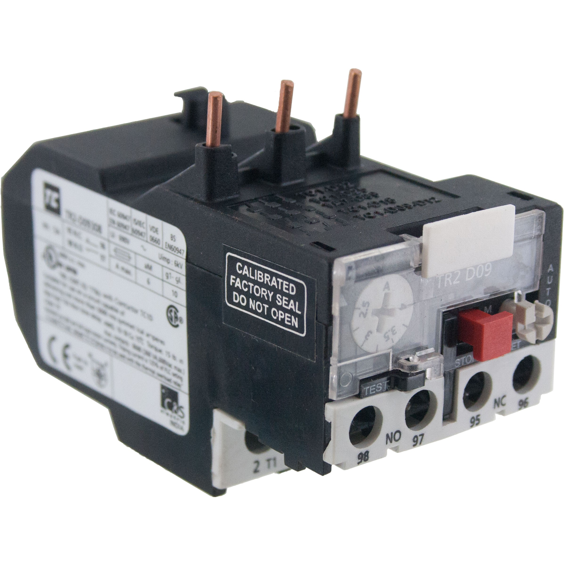
Motor components
A Starter, controls electrical power use in a motor or motor controlled equipment. Starters ‘start’ motors and can also stop, reverse and protect them. Starters have two main components, contactors and overload protection. Contactors with overload protection devices are often used to start motors.
Thermal overload relay
Contactor
Notes:
Img 01: https://bit.ly/2PtT6kL
Img 02: https://bit.ly/2ObS9x5
Click on ‘contactors’= “Contactors control electric current to the motor. Their function is to repeatedly establish and interrupt an electrical power circuit.”
Click on ‘overload protection’=“Overload protection protects motors from drawing too much current, overheating and burning out.”

Slide 8
What is a Contactor?
A contactor can be used on its own as a power control device or as part of a starter. Contactors are found in most electrical equipment, that is frequently turned on and off, from lighting to heating devices and complex industrial equipment.
Functions of contactors
Notes:
Same as previous Img 01: https://bit.ly/2PtT6kL
On clicking Img01 or ‘Functions of contactors’ = “The function of the contactor is to make and break all power supply lines running to a load or to repeatedly establish and interrupt an electrical power circuit. When control voltage is applied to a coil (or electromagnet) the contacts are pulled closed allowing current to pass through the contacts to the motor.
The 3-phase AC motor dominates the field of motor applications. Apart from small motors (fraction of a kW), which have manually operated starters, most motors are controlled with the aid of contactors and contactor combinations. These are operated by various control devices, either manually or automatically, from signals activated by time, movement, pressure or temperature. Control sequencing necessary between several drives can easily be carried out with contactors, interlocking being arranged via their auxiliary circuits.
The load rating stated in kW is the basic data required to enable the correct selection of contactors to be made, but this figure by itself is not always sufficient. The type of load , its operating cycle, switching frequency, and total life required, all influence the overall stress on the contactor.”

Slide 9
Lighting contactor
In large office buildings or shopping centres for example, lighting contactors are used to provide central, remote control of the large number of lighting installations. In a home, a light switch is an example of a switching device.
Notes:
Click on Img03= “Lighting contactors control the flow of electricity through a circuit, powering the lighting in an area. The lighting contactors exist remotely and control circuits with very high voltages, which can be dangerous if controlled directly by an operator. Though their output is used for switching very high loads, they are controlled by a circuit with much less power.”
Img02: https://bit.ly/2Qks9RU

Slide 10
Difference between contactors and relays
Both contactors and relays perform the task of switching a circuit BUT they have very different applications. The main differences between them are the loads they are designed to carry and the amount of power each uses.
Contactors are used for high voltage switching so they have much larger electromagnets that draw significant amounts of power.
Relays are used for low voltage switching hence the smaller electromagnets require much less power than contactors.

Slide 11
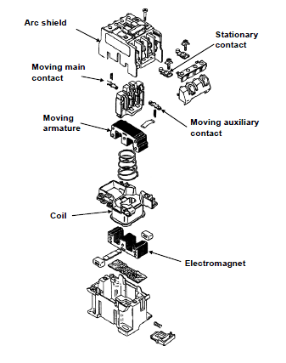
Contactor components
A contactor has three main parts:
The contacts, which are the current carrying parts of the contactor made up of the power contacts, auxiliary contacts and contact springs.
The electromagnet, which provides the force to close the contacts.
The enclosure, which is the frame that houses the contacts and electromagnet.
Click on each component in the figure to learn more.
Notes:
Figure 01: Book 4, CO-T, Pg8
On clicking ‘Arc shield’ = “Air break contacts: These contacts operate in normal atmospheric conditions. The spark is suppressed by the arc shield, which cools the air around the contacts.
Oil break contacts: These contacts operate in an oil bath. The oil is used to suppress and cool the arc.”
On clicking ‘Stationary contact’ = “The stationary contacts are normally marked 1,3,5; R,S,T, or L1, L2, L3 at the top of the contactor and T1, T2, T3; 2, 4, 6 or U, V, W at the bottom of the contactor. These contacts do not move and are used to connect the supply to the load in the circuit (power circuit). Main contacts are bigger than auxiliary contacts because they must handle the current capacity of the load and high switching frequency.
Note: When doing maintenance on a contactor, the stationary and moving contacts must always be checked for wear.”
On clicking ‘Moving contacts’ = “The moving contacts move against the stationary contacts when the coil is energised to ensure that the current flows through the contactor to the load.”
On clicking ‘Moving armature’ = “The armature can move and is mechanically connected to a set of contacts (moving contacts). When the magnet attracts the armature, the contacts move against the stationary contacts or away from the stationary contacts, depending on their characteristics.”
On clicking ‘Moving auxiliary contacts” = “Auxiliary contacts work on the same principle as the stationary and moving contacts. These contacts are much smaller because they are used in the control circuit, which draws less current. These are arranged as normally open, or normally closed contacts.”
On clicking ‘Coil’ present = “A coil consists of thin wire, which is placed around a soft iron core to form an electromagnet. When current flows through the coil, the magnet becomes magnetised and therefore attracts the armature. The coil is normally marked A1 and A2 on the contactor.
Note: When replacing a contactor coil, always make sure of the voltage of the coil.”
On clicking ‘Electromagnet’ = “Due to the current in the coil, the electromagnet becomes magnetised by the magnetic field of the coil and therefore attracts the armature.
Note: To prevent chattering (vibration and noise), always ensure that the area of contact between the magnet and armature is clean and rust free.”

Slide 12
How the armature works
In the construction of a contactor, the armature is connected mechanically to a set of contacts. When the armature moves to the closed position, the contacts close or open depending on their characteristics. There are three types of armature assemblies: Clapper, Vertical action and Bellcrank .
Notes:
Click on ‘armature’ =“Piece of soft iron placed in close proximity of an electro-magnet, to transmit force when the magnet is electrified.”
On clicking each of Clapper, Vertical action and Bellcrank = link to the relevant page below.

Slide 13
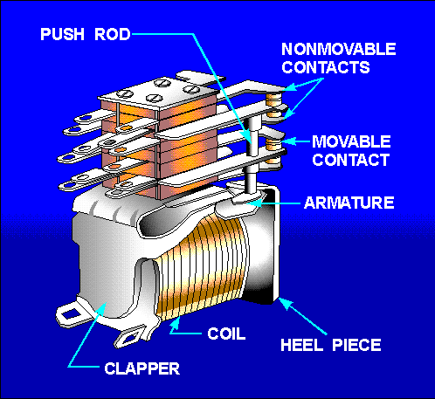
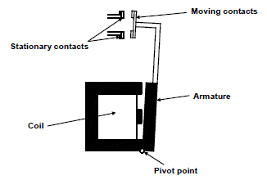
Clapper type armature
Notes:
Figure 02: Book 4, CO-T, Pg10
Img04: https://bit.ly/2CfAGma
On Clicking Img03 present = “Clapper type armature has a hinged armature and as it pivots to seat, the moveable contacts close against the stationary contacts, in this way closing the power circuit. When the coil is energized it generates an electromagnetic force that attracts the hinged armature so that the moving contact moves toward the fixed contact and then current flows from incoming terminal to outlet terminal. When the coil is de-energized then the spring will exerts its force on the movable contact to return it to its normal position.”

Slide 14
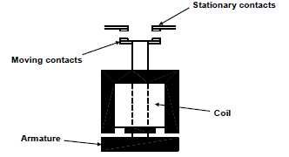
Vertical action armature
Notes:
Figure 03: Book 4, CO-T, Pg11
On Clicking Fig03 = “In a vertical action type the armature and moving contacts move upward in a vertical direction.”

Slide 15
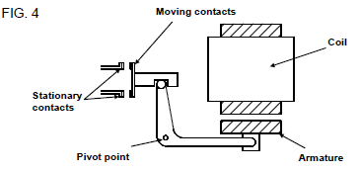
Bellcrank type armature
Notes:
Figure 04: Book 4, CO-T, Pg11
On Clicking Fig04 present =“A bellcrank lever converts the vertical action of the armature to a horizontal contact motion.”

Slide 16
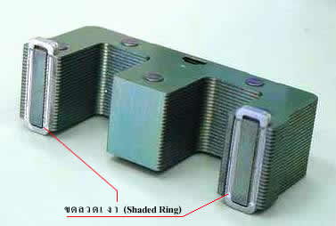
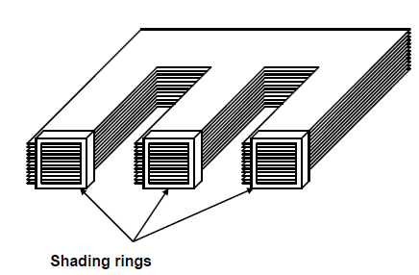
Shading rings
A shading ring is a single turn of copper mounted on the face of an electromagnet assembly or the armature.
Notes:
Img05: https://bit.ly/2NjojcP
Fig05: Book 4, CO-T, page 11
On clicking either Img03 or Figure05 = “A shading ring is a single turn of copper mounted on the face of an electromagnet assembly or the armature as shown. When a magnetic field is induced into the laminated core, it induces a current into the shading ring. The induced current in the shading ring causes a concentrated magnetic field in the centre of the shading ring. This then gives a better “hold-down” force on the armature of the contactor. This method eliminates excessive vibration and noise, which is caused by the alternating current.”

Slide 17
Selection of contactors
It is important that the correct contactor is selected for specific loads and applications. When replacing a contactor, look at both the current and application markings on the contactor.
Vid 01=Selection of contactors for specific loads and applications
Notes:
See Appendix for Vid01 script. Play Vid 01 full screen.

Slide 18
After watching Video01: selection of contactors, answer the questions that follow.
Notes:
MCQ
Correct answer is D
Feedback:
Correct – Good job.
Incorrect – Silver is very expensive and not used as often as other cheaper materials.

Slide 19
Question 1
What is the function of a contactor?
To manually operate starters
Motors are controlled with the aid of contactors
Control sequencing device
To open and close contacts electromagnetically
Notes:
MCQ
Correct answer is D
Feedback:
Correct – Good job.
Incorrect – Try again.

Slide 20
Question 2
Which contactor is suited to the load in printing machines?
AC-1
AC-2
AC-3
AC-4
Notes:
MCQ
Correct answer is D
Feedback:
Correct – Good job.
Incorrect – HINT: Breaking is severe and it applies to plugging and inching of squirrel cage motors.

Slide 21
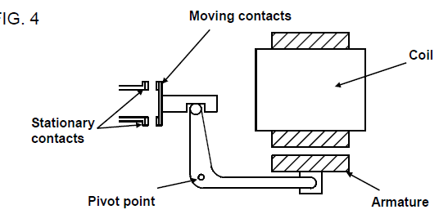
Question 3
Label the diagram below correctly. Choose the correct labels from the list on the right and drop them onto the corresponding positions in the diagram.
Pivot point
A
A
B
Armature
B
Stationary contacts
E
E
Coil
Moving
contacts
D
D
C
C
Notes:
Allow drag and drop of the answers. Only accept the below order.
The correct labels are:
A Moving contacts
B Coil
C Armature
D Pivot point
E Stationary contacts
For reference: The Correct diagram of the Bellcrank armature appears in Book 4, CO-T, Page 11.

Slide 22
How is a motor protected?
Motor protections vary according to the size of the motor and voltage level. SANS Regulation 6.7.1.1 states that protection against overload and short-circuit may be provided by separate devices or by a single device. One such device is the overload relay. Protective devices must operate at currents and voltages and within timeframes that are related to the characteristics of the circuit that they serve.
Notes:
Clicking ‘Sans Regulation’ = “Overload protection is a means of protecting both the load and the leads from damage caused by excessive loading. Regulations 6.6.1 and 6.6.2 in the SANS Code of Practice for the Wiring of Premises, state there must be some form of overload protection in each line. In three-phase supplies all three lines are live, therefore THREE phase overload relays are required in all starters controlling three phase loads.”

Slide 23
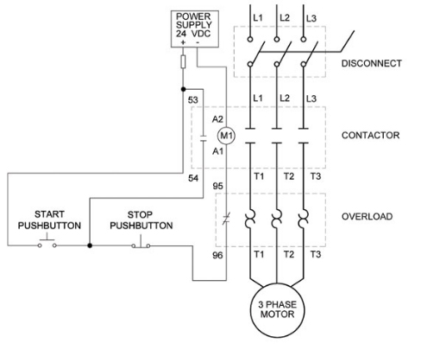
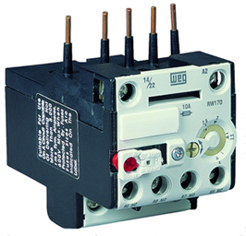
Overload relays
An overload relay protects an electrical motor from overheating once an overload is detected. When current is too high for too long, heaters cause the relay contacts, carrying current to the coil of the contactor, to open. When the contacts open, the contactor coil de-energizes, which results in an interruption of the main power to the motor.
Notes:
Clicking on ‘overload’ = “Overload is an excess amount above what is desirable or suitable. Over a definite limit, example magnitude of an electric current.
Overload relays follow the heating patterns of the electric motor it is installed in and interrupt the current once the heat sensing mechanism in the relay gets too hot. The overload contacts are connected in series and located between the contactor and the motor itself to prevent the motor from restarting once the overload trips.”
Img06: https://temcoindustrial.com/media/static/product_guides/contactors/overload_relay.jpg
Diagram01: https://temcoindustrial.com/media/static/product_guides/contactors/overload_relay_wiring.jpg

Slide 24
Type of overload relays
When current flows in a conductor, heat is generated and a magnetic field is set up around the conductor - both being proportional to the amount of current flowing. Overload relays make use of either the magnetic effect or the thermal effect of the current flowing in the power circuit.
SAFETY FIRST !
Notes:
Click on ‘magnetic effect’ = “Magnetic forces are used to operate some form of tripping mechanism to trip the starter. “
Click on ‘thermal effect’ = “When heated to a certain temperature the tripping mechanism trips the starter.”
On clicking ‘Safety first’ =“When the contacts open, the contactor coil de-energizes, which results in an interruption of the main power to the motor. These contacts do not affect control power, so don't assume there is an absence of current without a proper lockout.”

Slide 25
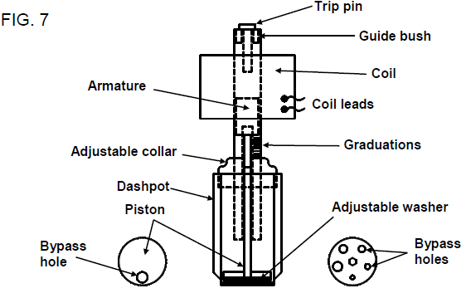
Magnetic overload relays
Magnetic forces are used to operate some form of tripping mechanism to trip the starter. Magnetic relays are usually set to trip at 100% of motor rating.
Magnetic overload relay
Notes:
Fig07: Book 4, CO-T, Pg 14
Click on ‘Magnetic overload relays’ =“The magnetic overload relay consists of a current coil connected in series with the motor load, an armature, a piston attached to a plunger and adjustable washer. The piston has a by-pass hole in it through which oil can pass.
The adjustable washer fits on top of the piston and has a number of holes of various diameters. The position of the adjustable washer determines the effective area of the by-pass hole in the piston.
The piston and adjustable washer fit in an oil filled cup known as a dash pot. To vary the time-delay, the effective area of the by-pass hole in the piston must be altered. This is done by turning the adjustable washer in relation to the piston.
Note: Tripping time can be altered by changing the position of the adjustable washer in relation to the piston.
The longest delay will occur when the smallest by-pass hole in the adjustable washer is over the by-pass hole in the piston.
The shortest delay will occur when the largest by-pass hole in the adjustable washer is over the by-pass hole in the piston.”

Slide 26
Key points on magnetic overload relays
• The deeper the plunger in the coil, the weaker the field needed to draw it into the coil.
• When the plunger is in its correct position and normal current is flowing, the magnetic force will be too weak to draw the plunger into the coil. When the current is increased due to an overload, the magnetic field becomes stronger and draws the plunger deeper into the coil. The plunger strikes the trip pin, which in turn trips the switch.
• The position of the plunger in the coil determines the current that will trip the starter.

Slide 27
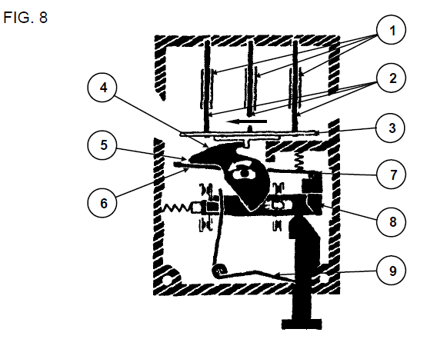
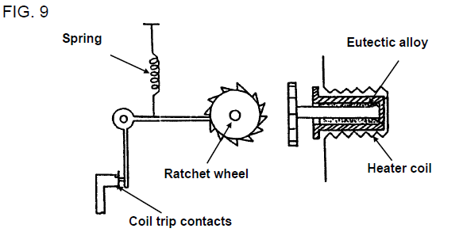
Thermal overload relays
There are two types of thermal overload relays:
Bimetallic overload relay
Eutectic alloy type overload
Notes:
Fig08: Book 4, CO-T, Pg 16
Fig09: Book 4, CO-T, Pg 17
Click on ‘Bimetallic overload relay’=“Each relay contains three bimetallic elements consisting of double strips of different metals or alloys having different coefficients of expansion.
Each element is fitted with a winding connected in series with each phase of the motor and with a cross-section adapted to the control current. When heated the elements bend. When an incident occurs, the current to the load increases bending of the elements, which activates the differential device, whose lateral or vertical displacement, depending upon the relay model, rotates the cam or shaft connected to the triggering device.
When the movement is sufficient, the piece to which the moving parts of the contacts are fixed, moves away from the holding stop causing the opening of the trip contact in the contactor coil circuit and the closing of the signal contact. The relay cannot be reset until the elements have cooled sufficiently.
The distance that must be travelled to escape the holding stop is a function of the tripping current set on the relay and of the ambient temperature, this requires a correction by the bimetal compensation element (FIG. 8).
When a high current flows through the heater windings (1), the main elements (2) bend and the differential bars (3) are moved in the direction of the arrow. The cam (4) is also driven and turns on its shaft. The leading edge of this cam (5) causes the compensation strip to rotate (6), the holding stop (7) is released, allowing the escape of the moveable piece (8) which is pulled by a spring (9). The contacts change position. In this illustration the relay is in the set position, ready to be tripped.
Click on ‘Eutectic alloy type overload’=“A spindle carrying a ratchet wheel is embedded in a low melting point, fusible, eutectic alloy.
The nature of the eutectic alloy is such that it will respond to temperature changes. It has a certain fixed temperature at which it will change from a solid to a liquid state without going through a mushy phase.
When the current is excessive, the alloy is heated and melts. When molten, it permits the ratchet wheel to rotate.
The ratchet wheel is spring loaded. As soon as the alloy film melts, the ratchet is free to turn, the trigger is released and a spring opens the contacts (normally closed) which are in the contactor coil circuit.”

Slide 28
Example: Thermal protection
Mrs Edwards is vacuuming her floors when suddenly the vacuum cleaner switches off. She tries to switch the machine on again but nothing happens, when she touches the vacuum cleaner she notices that it is very hot. After a few minutes, when the machine has cooled down, she is able to continue with the vacuuming. Explain the possible cause and reason for the machine switching itself off.
INSERT ANSWER HERE AND PRESS ENTER WHEN DONE
Notes:
Allow text to be entered.
Once the text has been inputted and the enter button clicked present the solution.
Solution: “The motor in the vacuum cleaner is protected from overheating. Thermal protection is present to turn the motor off when excessive heat is generated within the motor circuitry, it stops the temperature from increasing before it causes the motor to burn up. The thermal protector resets once the motor cools down to a safe operating temperature, which is why Mrs Edwards can use the machine again after a few minutes.”
Extended explanation: “Continuous operation of an electric motor at currents marginally above its rated value can result in thermal damage to the motor. The insulation can be degraded, resulting in reduced motor life through eventual internal motor faults.”

Slide 29
Functions of overload components
The overload components are:
Terminals (power circuit)
Current adjustment
Reset button
Trip switch terminals (control circuit)
Vid 02=Functions of overload components and selection of overloads

Slide 30
Quiz time
We have come to the end of this unit. Answer the following questions to make sure you understand how to work with overload protection.

Slide 31
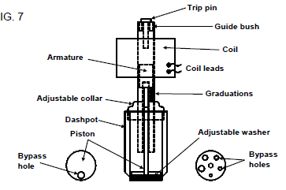
Question 1
What type of overload relay is shown in the figure below?
Thermal
Magnetic
Eutectic alloy type
Bimetallic
Notes:
MCQ
Correct answer is B
Feedback:
Correct – Good job.
Incorrect – Try again.

Slide 32
Question 2
Label the overload relay correctly. Choose the correct labels from the list and drop them onto the corresponding positions in the diagram.
Tripping contacts
Current setting range
Signaling contacts
Terminals (1L1, 3L2, 5L3)
RESET button
Terminals (2T1,4T2, 6T3)
STOP button
Status indicator
Notes:
Allow drag and drop.
Img 07=https://www.galco.com/images/moreinfo/t16_diagram.jpg
Solution:
1 Terminals (1L1, 3L2, 5L3)
2 Current setting range
3 Status indicator
4 RESET button
5 Signaling contacts
6 Terminals 2T1,4T2, 6T3
7 Tripping contacts
8 STOP button

Slide 33
Question 3
Overload current is defined as the current that flows when a short circuit occurs.
TRUE
FALSE
Click on the correct answer.
Notes:
True or False
Correct answer is FALSE
Feedback:
Correct – Well done. Overload current: is overcurrent that occurs in an electrically undamaged circuit.
Incorrect – That is not correct.

Slide 34
Question 4
The main difference between a contactor and a relay is a contactor :
Only works on AC power
Only has one set of contacts
Controls larger currents
Controls voltage only
Notes:
MCQ
Correct answer is C
Feedback:
Correct – Excellent.
Incorrect – Try again.

Slide 35
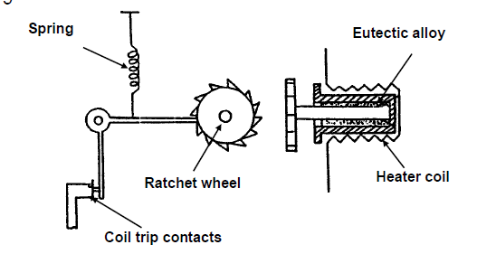
Question 5
What is the part labelled X in the diagram called?
Adjustable washer
Eutectic alloy
Bimetallic strip
Guide bush
X
Notes:
MCQ
Correct answer is B
Feedback:
Correct – Great job.
Incorrect – Try again.

Slide 36
Let’s review:
In this lesson we have covered:
Identifying different types of contactors.
Selecting contactors for different loads.
Types of overload relays.
Functions and selection of overload relays.
Make sure you have a complete understanding of all the work covered here before you start the next unit.

Slide 37
Video brief - Vid001Expert technician explaining: Selection of contactors for specific loads and applications (NB: Presenter must be able to explain the in-rush current diagrams)
It is important that the correct contactor is selected for specific loads and applications. Contactor ratings are clearly marked on the contactor, but care must be taken to select the correct contactor, based on current and application. Remember: When replacing a contactor, look at both the current and application markings on the contactor. The load type and duty cycle of the load are known as the Utilisation Category. There are basically four utilisation categories of contactors, denoted AC-1, AC-2, AC-3 and AC-4. The categories are determined by the current values that the contactor must make (switch on) or break (switch off), and they depend on:
The type of load being switched for example squirrel cage or slip ring motor, resistors.
The condition under which opening and closing, that is breaking and making of the circuit is performed, like motor running or stalled or in the course of starting or reverse running.
Making capacity is the current capacity of the breaker, which it can handle during closing even if the line has a short circuit fault.
Breaking Capacity is the current capacity of the breaker, which it can handle during opening. This will be less than the Making capacity.
Notes:
This part can be said straight to camera.
Image: Presenter to either show actual squirrel cage or slip ring motors or use an image like the one here https://bit.ly/2N2tnTA

Slide 38
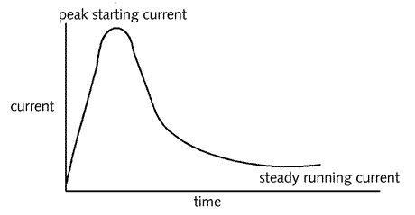
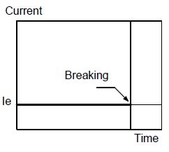
Video brief - Vid001 contin. Expert technician explaining: Selection of contactors for specific loads and applications
Voice over | Image
In the 3 phase Squirrel-cage inductive motor load, which is one of the most common load types in the industry, the motor draws a significant amount of current (inrush current) when starting. Squirrel cage and slip ring motors are discussed in detail in unit 6; DC motors. The inrush current during the start of the motor is significantly higher than the motor running current. This can be seen in this chart. The contactor will have to be able to withstand this current. We can summarise the four utilisation categories as; AC-1, AC-2, AC-3 and AC-4. The charts you are about to see have been compiled using various manufacturer’s standards. Let’s start with Category AC-1. The ‘le’ refers to the rated operational current. When selecting a contactor, make sure that the contactor’s rated current is specified. This applies to all AC machines (loads), for non-inductive or slightly inductive loads, whose power factor is at least equal to 0,95 (cos ∅ ≥ 0,95). An example of this is Heating distribution. | Category AC-1 Application example: Heating distribution.
Notes:
Chart 1 source and wording: https://bit.ly/2M8r0JP
Image showing AC-1, AC-2, AC-3, AC-4: Book 4, CO-T, Page13

Slide 39
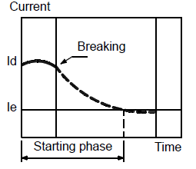
Video brief - Vid001 contin. Expert technician explaining: Selection of contactors for specific loads and applications
Voice over | Image
Category AC-2. Applies to starting, plugging and inching of slip ring motors. On closing, the contactor makes the starting current, (approximately 2.5 x Ie). On opening, it must break the starting current (voltage ≤ mains voltage). Breaking is severe. An example of this is Lifting overhead cranes, gantries. | Category AC-2 Application example: Lifting overhead cranes, gantries.
Notes:
Image showing AC-1, AC-2, AC-3, AC-4: Book 4, CO-T, Page13

Slide 40
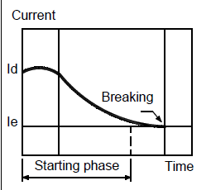
Video brief - Vid001 contin. Expert technician explaining: Selection of contactors for specific loads and applications
Voice over | Image
Category AC-3. This applies to squirrel cage motors where breaking occurs while the motor is running. On closing, the contactor makes the starting current, which is about 5 to 7 times the rated current of the motor. On opening, it breaks the rated current drawn by the motor. Examples of this include; Conveyor belts, compressors, pumps, mixers, and air conditioning units. | Category AC-3 Application example: Conveyor belts, compressors, pumps, mixers, and air conditioning units.
Notes:
Image showing AC-1, AC-2, AC-3, AC-4: Book 4, CO-T, Page13

Slide 41
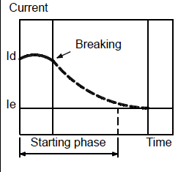
Video brief - Vid001 contin. Expert technician explaining: Selection of contactors for specific loads and applications
Voice over | Image
Category AC-4. Applies to plugging and inching of squirrel cage motors. The contactor makes the starting current, (approx. 5 to 7 x Ie). On opening, it breaks this same current, which varies according to motor speed. Breaking is severe. Application examples are: Hoists, printing machines, wire drawing machines. | Category AC-4 Application example: Hoists, printing machines, wire drawing machines.
Notes:
Image showing AC-1, AC-2, AC-3, AC-4: Book 4, CO-T, Page13

Slide 42
Video brief - Vid02 Expert technician explaining the function of overload components and selection of overloads
An overload relay protects an electrical motor from overheating once an overload is detected. When current is too high for too long, heaters cause the relay contacts, carrying current to the coil of the contactor, to open. When the contacts open, the contactor coil de-energizes, which results in an interruption of the main power to the motor.
We will examine the following components on the overloads display board.
Terminals (power circuit)
Incoming connectors are in the form of adjustable copper prongs or screw type terminals. These terminals or prongs are connected to the contactor terminals and are marked in the same manner as the contactor top stationary contacts (1, 3, 5; R,S,T; L1, L2, L3). Outgoing connectors are in the form of screw type terminals. These terminals connect the load to the power circuit and are marked the same as the contactor bottom stationary contacts (2, 4, 6; U,V,W; T1, T2, T3).
Current adjustment
Adjustment of the overload relay to match the full load current of the load can be by means of either a lever, a screw or heater coil. The lever is moved to the desired current mark. The screw works as a dial graduated in amperes. The heater coil works against a standard selection table. For a certain current rating, a heater coil has to be chosen from a chart to match the load current and it must be installed on the overload.
Reset button
A hand/auto lever or screw provides selection of either manual resetting of the trip switch by the insulated stop- reset push, or automatic resetting of the trip switch when the relay has cooled after tripping.
Trip switch terminals (control circuit)
The overload relay consists of two sets of trip switch terminals, a N/O and a N/C contact. The N/C contact opens when there is an overload condition and the N/O contact closes. The N/C contact is then used in the control circuit to trip the circuit when there is an overload condition and the N/O contact indicates that there is an overload condition.
Notes:
Create a video similar to this: https://www.youtube.com/watch?v=zJzq2X47bbk with expert demonstrating on the applicable overload relay, with script as above.

Slide 43
Video brief - Vid02 contin. Expert technician explaining the function of overload components and selection of overloads
Selection of overloads
After determining the full load current, it is important to select an overload that suits the contactor and the load. Remember overloads can be connected directly beneath the contactor or separately. Ensure that the range of current settings, which are marked on the overload, accommodates the full load current. In the case of a heater coil overload, ensure that the heater coils will be able to handle the full load current. According to SANS Code of Practice for the Wiring of Premises an overload protective device shall be installed
a) along a conductor where the current capacity of the conductor is reduced,
b) where the thermal rating of a disconnecting device could be exceeded (summation of ratings), and
c) where the thermal rating of an earth leakage protection device not provided with integral overcurrent protection, could be exceeded.
Make sure that you are able to select the correct overloads for different loads. Overload relays are inexpensive, but the results of selecting the wrong one for an application can be a disaster for your motor, process, or both.
Notes:
Create a video similar to this: https://www.youtube.com/watch?v=zJzq2X47bbk with expert demonstrating on the applicable overload relay, with script as above.

