Slide 1
Electrical components and systems
Topic 3 – Practising with stove switches

Slide 2
Assumed prior learning
Wiring of premises
Cables and conductors
Circuit diagrams

Slide 3
Practising with stove switches
Unit 2

Slide 4
In this lesson you will learn how to:
wire a three-heat stove switch
wire a five-heat stove switch
wire thermostatic control switches
Notes:
Link each to the relevant section below.

Slide 5

Before wiring any switches…
SAFETY FIRST !
Notes:
On clicking ‘Safety First’ present:
“Isolate, lock out and test before commencing work.
Calculate the current in the new circuit and use current rating tables to select the correct size conductors.
Use appropriate type of conductor.
Strictly adhere to the SANS wiring code for conductor colours.
Earth all metal parts. Reg. 6.12 of the SANS wiring code.
Measure the earth continuity resistance. Comply with Reg. 8.7.3
Always use the correct tool for the job.
Ensure tools are in good condition.
Use tools correctly.
Wear appropriate PPE where necessary.
Always take good care of tools. Maintain, clean and store it properly.”

Slide 6
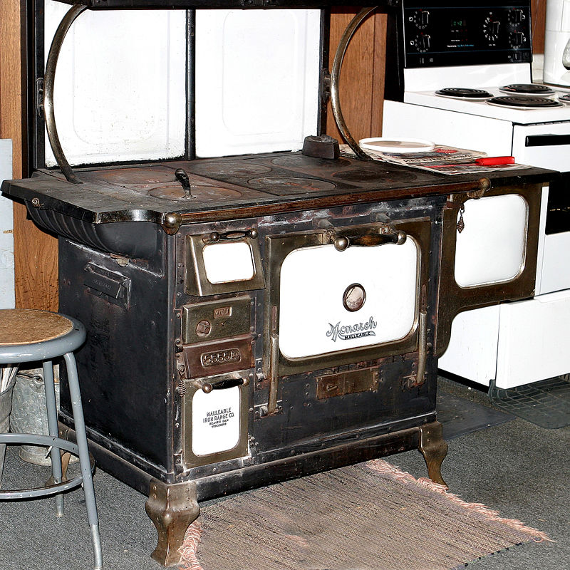
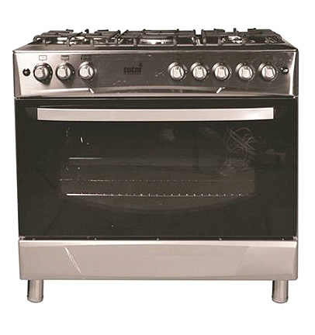
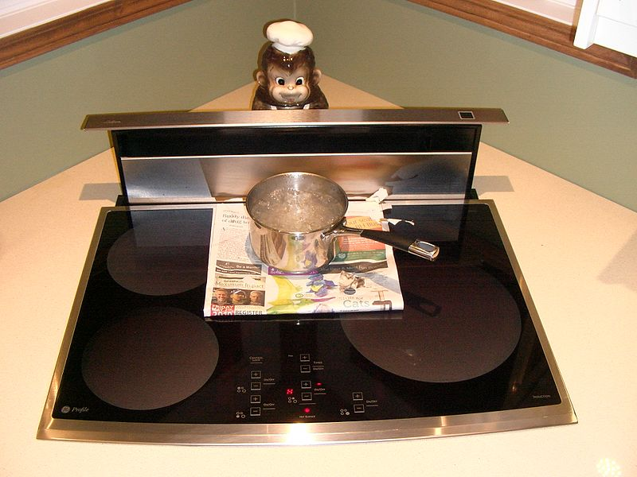
From charcoal to induction
Metal stove’s were first used in the 18th century, the fuel burning stove is the most basic design. Modern cooking appliances make use of gas and electricity. The first electric stoves used heating elements made of high-resistance metal to produce heat.
Notes:
Img 01: https://bit.ly/2BPXubM:
On clicking Img01 present the following: “A wood burning iron stove.”
Img 02: https://bit.ly/2PHuZQx
On clicking Img02 present the following: “Gas stoves today use two basic types of ignition sources, standing pilot and electric. A stove with a standing pilot has a small, continuously burning gas flame (called a pilot light) under the cooktop. Early gas stoves had to be lit manually with a match.” (source: https://en.wikipedia.org/wiki/Gas_stove)
Img03: https://bit.ly/2oeqgcz
On clicking Img03 present the following: “Induction cooking heats a cooking vessel by magnetic induction, rather than thermal conduction from a flame, or an electrical heating element. As inductive heating directly heats the vessel, very rapid increases in temperature can be achieved. In this image you see an induction cooking surface boiling water through several layers of newsprint. The paper is undamaged since heat is produced only in the bottom of the pot.” (source: https://en.wikipedia.org/wiki/Induction_cooking)

Slide 7
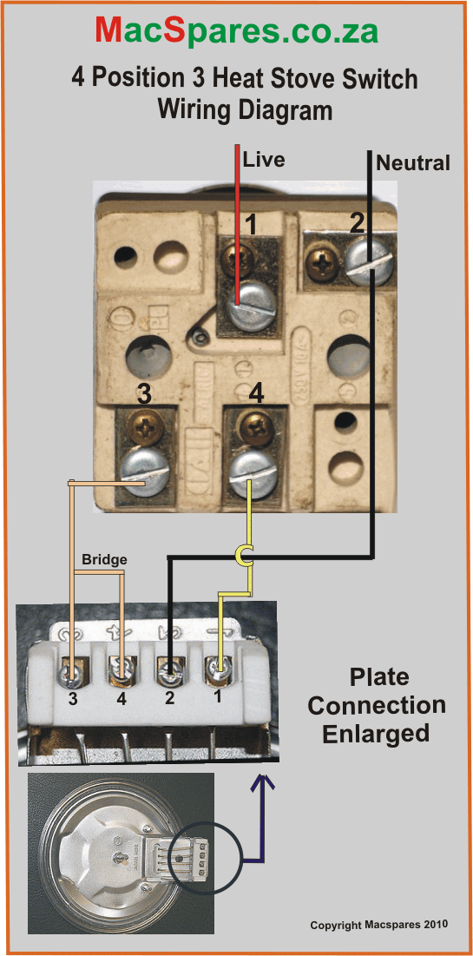
Four position, three-heat switch
These switches can still be found in use today but very rarely. It uses a combination of connections to control the heat of the stove plate.
Notes:
Img 04: https://bit.ly/2PII3Fp
On clicking Img01 present: “The 3-heat 4 position switch is rarely found nowadays. It used a combination of connections to control the heat of the stove plate.”

Slide 8
How do we get three levels of heat on a
3-heat switch?
To get three levels of heat, two resistance of equal value is used. The resistances are connected either (i) in series, (ii) using one resistance only, (iii) using two resistances in parallel. We will explain this concept further using the example below.
EXAMPLE
Notes:
On clicking ‘Example’ present the following information:
“Heat is a form of energy and the rate at which it is used is equal to the power consumed. The unit of power is the watt. Stove plates are rated in watts. The amount of heat produced is proportional to the square of the current and the resistance of the circuit ($P = I^{2}R$)
Assume that the two elements of a stove plate have resistance values of 96 ohms each.
i) Two resistances of 96 ohms each connected in series across a 220 V supply.
Total resistance = 96 + 96 = 192 ohms
Current $I =\frac{V}{R} =\frac{220}{192} = 1,2 amps$
ii) One resistance of 96 ohms connected across a 220 V supply.
Total resistance = 96 ohms
Current $I =\frac{V}{R} =\frac{220}{96} =2,3 amps$
iii) Two resistances of 96 ohms each connected in parallel across a 220 V supply.
Total resistance $=\frac{R_{1}×R_{2}}{R_{1}+R_{2}}=\frac{96×96}{96+96}=\frac{9216}{192}=48 ohms$
Current $I =\frac{V}{R} =\frac{220}{48} =4,6 amps$
From the above calculations three different current values were obtained which will produce three different heat levels.”

Slide 9
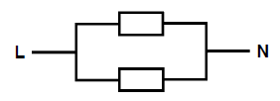


How the 3-heat switch works
A four position, three-heat stove switch is designed to operate a stove plate consisting of two separate elements. One end of each element being connected as a common point.
IN SERIES
ONE RESISTANCE ONLY
IN PARALLEL
Notes:
On Clicking Fig01 present the following: “For low heat the two elements of the stove plate are connected in series.”
On clicking Fig02 present the following:” For medium heat only one of the two stove plate elements are connected.”
On clicking Fig03 present the following: “For high heat the two elements of the stove plate are connected in parallel.”

Slide 10
The switching position diagrams
To determine the switching position on the four position three-heat stove switch:
Make a sketch of the terminals
Draw a diagram of the switch terminals
Use a megger or multimeter and test all the terminals
Vid 01 screenshot
Notes:
See brief for Vid01. Play full screen.

Slide 11
After watching video 1 answer the questions that follow based on circuit diagrams of a four-position, three-heat stove switch.
Notes:
Link to redirect to ‘video1’

Slide 12
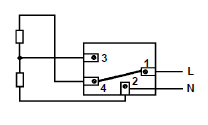
Question 1
Match the Circuit diagram shown with the position the three-heat stove switch is in.
Off position
Low position
Medium position
High position
Notes:
MCQ
Correct answer is B
Feedback:
Correct – Good job.
Incorrect – Try again.

Slide 13
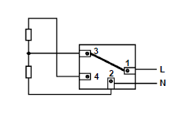
Question 2
Match the Circuit diagram shown with the position the three-heat stove switch is in.
Off position
Low position
Medium position
High position
Notes:
MCQ
Correct answer is C
Feedback:
Correct – Good job.
Incorrect – Try again.

Slide 14
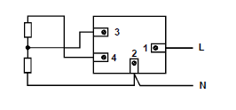
Question 3
Match the Circuit diagram shown with the position the three-heat stove switch is in.
Off position
Low position
Medium position
High position
Notes:
MCQ
Correct answer is A
Feedback:
Correct – Good job.
Incorrect – Try again.

Slide 15
Five-heat stove switch
To achieve five levels of heat on a 5-heat, six position stove switch, three resistances of equal value are used. The 5-heat switch is similar to the 3-heat, except that there is an extra high level where three elements are in parallel and an extra low one where three elements are in series.

Slide 16



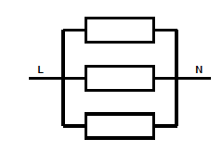

Five-heat, stove switching arrangement
The five different heats are obtained by the following switching arrangements:
First position – three in series
Second position – two in series
Third position – one in circuit
Fourth position – two in parallel
Fifth position – three in parallel

Slide 17
Exercise
Try this by yourself: Assume that each resistance on a five-heat switch has a value of 96Ω.
Calculate the current in each switching position, if the supply voltage is 220 V.

Slide 18
Five-heat, stove switching positions
To determine the switching positions on the six position five-heat stove switch:
Make a sketch of the terminals
Draw a diagram of the switch terminals
Use a megger or multimeter and test between all terminals
Vid 02 screenshot
Notes:
Vid02 screenshot. Play video full-screen.

Slide 19
After watching video 2 answer the questions that follow based on circuit diagrams of a six-position, five-heat stove switch.
Notes:
Link to redirect to ‘video2’

Slide 20
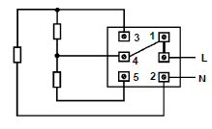
Question 1
Match the Circuit diagram shown with the position the five-heat stove switch is in.
First position
Second position
Fourth position
Fifth position
Notes:
MCQ
Correct answer is B
Feedback:
Correct – Excellent.
Incorrect – Try again. Remember to watch video 2 carefully.

Slide 21
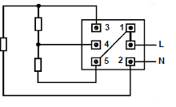
Question 2
Match the Circuit diagram shown with the position the five-heat stove switch is in.
First position
Second position
Fourth position
Off position
Notes:
MCQ
Correct answer is A
Feedback:
Correct – Excellent.
Incorrect – Try again.

Slide 22
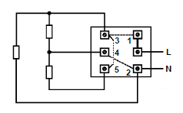
Question 3
Match the Circuit diagram shown with the position the five-heat stove switch is in.
First position
Second position
Fourth position
Fifth position
Notes:
MCQ
Correct answer is D
Feedback:
Correct – Excellent.
Incorrect – Try again.

Slide 23
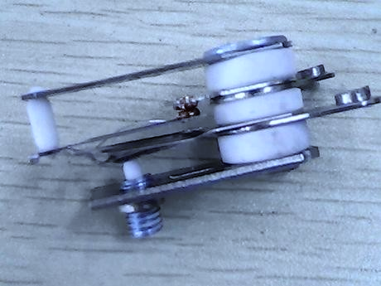
Thermostatic control switch
A thermostat is a device used to keep temperature steady in most heating appliances. It acts as a switch, which is operated by the application of heat.
Notes:
Img05: https://bit.ly/2PLiYtj

Slide 24
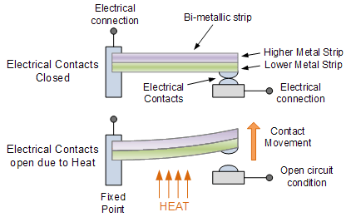
How does a bi-metal thermostat work?
There are three parts to the thermostat control; a small heater element, bi-metallic strip and an adjustment mechanism.
Click on figure 1 to learn more
Notes:
On clicking ‘Element’ present: A (resistance) wire that is the heating unit in an electrical heater, cooker, etc.
Figure 1: https://bit.ly/2Pg8fpD (Note: this can be created as an animated Gif)
On clicking Figure 01 present the following:” The moving part of a commonly used thermostat is a bi-metal strip, which changes its shape when heated. The bi-metal strip consists of two different kinds of metal jointed together, for example iron and brass. The strip may be straight or it may be wound in a spiral form. If a bi-metal strip is heated up, the two metals expand differently, causing the strip to bend.
The top part of Figure 1 shows the thermostat in its normally closed (N/C) position. With the contacts closed the current can flow through it, causing it to heat up.
The lower part of Figure 1 shows the thermostat in the open position. With heat, brass expands faster than iron and the bi-metal strip bends down and away from the top contact, thus breaking the circuit.
When the bi-metal strip cools it bends back to its original position thus closing and completing the circuit again.
This action of opening and closing the circuit is used to maintain a constant temperature in a stove plate, geyser, etc.”

Slide 25
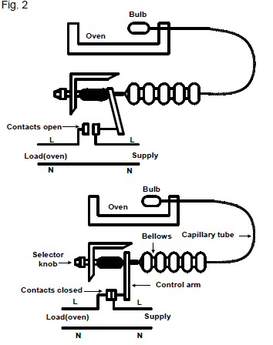
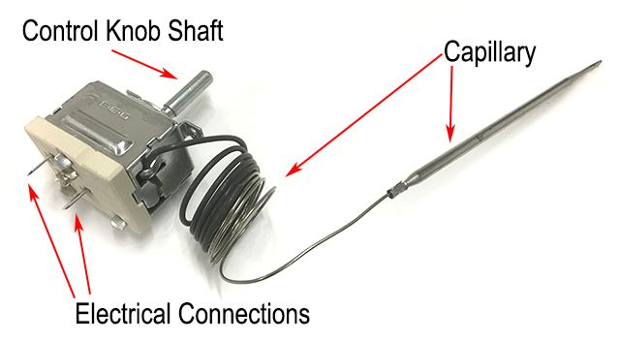
How does the oven thermostat work?
The oven switch connects both the top and the bottom elements of the oven. The temperature of the oven is usually controlled by a bellows type thermostat.
Click on figure 2 to learn more
Notes:
Img06: https://bit.ly/2BZswOs
Fig 2: Book 3, SW-3,Page 102. (Note: Figure 2 can be an animated gif)
On clicking Fig 02 present: ”The temperature of the oven is usually controlled by a bellows type thermostat. The main parts of such a thermostat are the bulb, the capillary tube, the bellows and the switch contacts. Fig. 2 shows the operation of the thermostat schematically.
The switch contacts are connected in series with the oven supply line. The bulb is filled with a liquid that expands when heated. The operation of the bellows thermostat is shown in Fig. 2.
To set the oven temperature the oven heat selector dial is turned to the required position. When the oven temperature increases above this setting the pressure within the bulb forces the bellows to expand.
The movement of the bellows is coupled to an arm that opens the circuit between the switch contacts (top figure).
As the oven cools, the bellows contracts and the switch is closed (bottom figure).
This action of the thermostat is repeated as often as necessary to keep the temperature in the oven constant and always equal to the setting of the heat selector.”

Slide 26
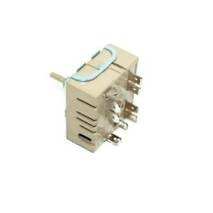
Exploring the Simmerstat
The thermostatic control switch for stove plates is sometimes known as a “simmerstat”, energy regulator or infinite switch. It operates on the same principle as the bi-metal thermostat and allows variable power output of the heating element.
Click on figure 3 to learn more
Notes:
Img07: https://bit.ly/2Nx8vA3
Figure 3:Book 3, SW-3,Page 103. (Can be created as an animated Gif)
On clicking Figure 3 present: “The construction principle of the simmerstat switch is shown in Fig. 3.
The two elements are connected in parallel to the supply and only two connections are made between the stove plate and the control switch.
The switch is controlled automatically by a bi-metal strip, which opens the stove plate circuit when the temperature coincides with the switch setting.
The bi-metal strip is heated by a small element connected across the supply.
The heating effect of this element is rated in accordance with the rating of the stove plate. It is essential that when a switch is replaced, its rating and the stove plate rating are the same, or else the temperature setting of the switch and the actual plate temperature will not be the same.
The heating element of the switch operates independently of the plate. The switch will thus open and close even when not connected to the load.
Some of these oven switches have an extra contact at the back for a pilot light, which is lit when switched on.”

Slide 27
Now that you’ve learnt how the different types of thermostats operate answer the questions that follow to test your understanding of this topic.

Slide 28
Question 1
What type of electrical equipment would you use to control the temperature in a geyser?
Time switch
Pressure switch
Thermostat
Thermometer
Notes:
MCQ
Correct answer is C
Feedback:
Correct – Great job.
Incorrect – Try again.

Slide 29
Question 2
What type of thermostat is normally used to control an oven?
Bi-metal
Simmerstat
Bellows
Capillary tube
Notes:
MCQ
Correct answer is C
Feedback:
Correct – Well done.
Incorrect – Try again.

Slide 30
Question 3
What is the thermostat control switch for stove plates also known as?
Bi-metal
Simmerstat
Bellows
Capillary tube
Notes:
MCQ
Correct answer is B
Feedback:
Correct – Well done.
Incorrect – Try again.

Slide 31
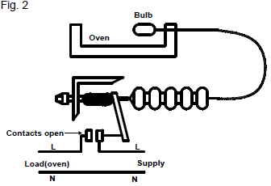
Question 4
Label the parts of the oven thermostat
Notes:
Allow text to be entered in the grey boxes.
The correctly labeled image is shown in Figure 2 on the right.

Slide 32
Let’s review:
In this lesson we have covered:
Three-heat, four-position switches and it circuit diagram.
Five-heat, six-position switches and its circuit diagram.
Types of thermostats used in heating appliances.
Circuit diagrams of thermostatic control switches.
Make sure you have a complete understanding of all the work covered here before you start the next unit.

Slide 33
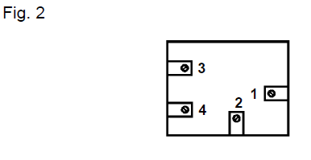
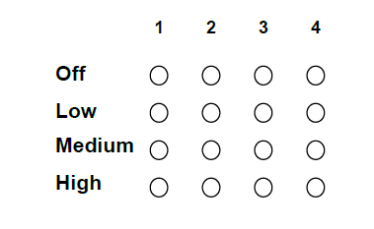
Video brief - Vid01 Video of expert presenter explaining how to determine the switching position on the four position three-heat stove switch
Voice over | Image
Remember you must isolate, lock out and test before commencing electrical work and Strictly adhere to the SANS wiring code. Wiring diagrams of the circuits must be drawn correctly and in accordance with the manufacturer’s markings; 1) The physical wiring of the circuits must be in accordance with the SANS Code of Practice for the Wiring of Premises, and the standards learnt in the unit on panel wiring; 2) All metal parts must be earthed; 3) The switch must operate correctly in all positions; 4) All the relevant safety precautions must be observed during the task. To determine the switching position on the four position three-heat stove switch, proceed as follows: Make a sketch of the terminals on the three-heat stove switch as viewed from the rear. (Fig. 2).
Draw a diagram of the switch terminals in their four respective positions, to indicate the switch bridging.
Notes:
Create a video similar to https://www.youtube.com/watch?v=3anj5r67iuk but using script wording as above and the matching images.
All images are in Book 3 SW-1.

Slide 34
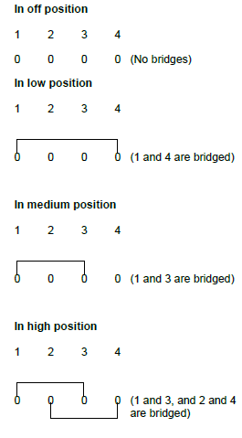
Video brief - Vid01 contin. Video of expert presenter explaining how to determine the switching position on the four position three-heat stove switch
Voice over | Image
Use a megger or multimeter and test between all the terminals in each position. Draw in all the bridge positions on the diagram as follows: In off position (Presenter to explain) In low position (Presenter to explain) In medium position (presenter to explain) In high position (presenter to explain)
From the above you can now determine which are your LIVE, NEUTRAL, COMMON and OTHER terminals. • It can be seen that No. 1 is the common terminal for three ON positions, therefore No. 1 is the live incoming terminal. • It is obvious that the LIVE and NEUTRAL should not be bridged (short-circuited) in any position. Therefore, No. 2 is the NEUTRAL incoming terminal. • In the MEDIUM position there is a common point to the two elements. Because the NEUTRAL is connected permanently to one end of an element it can be assumed that in the medium position the LIVE will bridge with a common point of one of the two elements. In this case it is No. 3 on the switch. • There is only one terminal remaining (No. 4) and this is called the OTHER terminal. • LIVE (No. 1), NEUTRAL (No. 2) COMMON (No. 3) and OTHER (No. 4) can be superimposed over the numbers on the switch. | Same image as above
Notes:
Create a video similar to https://www.youtube.com/watch?v=3anj5r67iuk but using script wording as above and the matching images.
All images are in Book 3 SW-1.

Slide 35
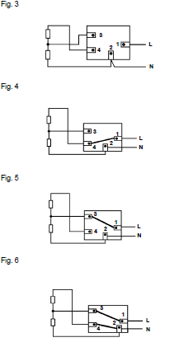
Video brief - Vid01 contin. Video of expert presenter explaining how to determine the switching position on the four position three-heat stove switch
Voice over | Image
Some of these switches have an extra contact at the back for a pilot light. As soon as the switch is switched on low, medium or high, the pilot light comes on, showing that the switch is on. Circuit diagrams for three-heat operation: These are shown in Fig. 3, 4, 5 and 6 for different positions. (a) Off position (Fig. 3) (b) Low position (Fig. 4) (c) Medium position (Fig. 5) (d) High position (Fig. 6) Practice drawing these wiring diagrams before attempting the self-test. The idea is not to memorise them, but to understand them.
Notes:
Create a video similar to https://www.youtube.com/watch?v=3anj5r67iuk but using script wording as above and the matching images.
All images are in Book 3 SW-1.

Slide 36
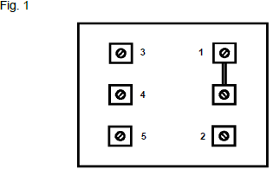
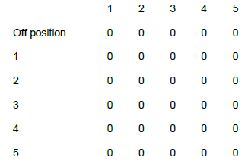
Video brief - Vid02 Video of expert presenter explaining how to determine the switching position on the six position five-heat stove switch
Voice over | Image
Remember you must isolate, lock out and test before commencing electrical work and Strictly adhere to the SANS wiring code. Wiring diagrams of the circuits must be drawn correctly and in accordance with the manufacturer’s markings; 1) The physical wiring of the circuits must be in accordance with the SANS Code of Practice for the Wiring of Premises, and the standards learnt in the unit on panel wiring; 2) All metal parts must be earthed; 3) The switch must operate correctly in all positions; 4) All the relevant safety precautions must be observed during the task. To determine the switching positions on the six position five-heat stove switch Make a sketch of the terminals on a five-heat stove switch as viewed from the rear. (Fig. 1).
Draw a diagram of the switch terminals in their five respective positions, to indicate the switch bridging as shown below.
Notes:
Create a video similar to https://www.youtube.com/watch?v=3anj5r67iuk but using script wording as above and the matching images.
All images are in Book 3 SW-2.

Slide 37
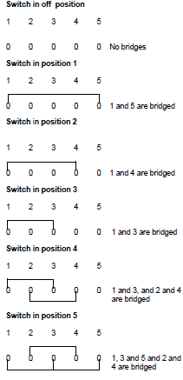
Video brief - Vid02 contin. Video of expert presenter explaining how to determine the switching position on the six position five-heat stove switch
Voice over | Image
Use a megger or multimeter and test between all terminals in each position. Draw in all the bridge positions on the diagram below as follows: In off position (Presenter to explain) In position1 (Presenter to explain) In position2 (presenter to explain) In position3 (presenter to explain) In position4 (Presenter to explain) In position5 (presenter to explain)
From the drawing the live, neutral and other terminals can be determined. In the above it can be seen that No. 1 is the common terminal for all five “ON” positions. Therefore No. 1 is the live incoming terminal. The live and neutral are never bridged in any position. Therefore No. 2 is the neutral incoming terminal. NOTE: Some of these switches have an extra contact at the back for a pilot light. As soon as the switch is switched on in low, medium or high, the pilot light comes on. | Same as above
Notes:
Create a video similar to https://www.youtube.com/watch?v=3anj5r67iuk but using script wording as above and the matching images.
All images are in Book 3 SW-2.

Slide 38
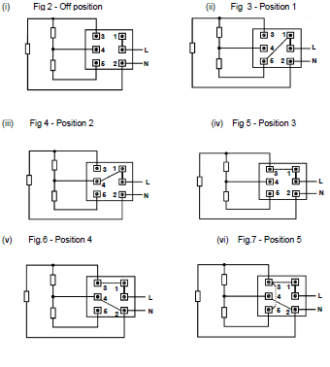
Video brief - Vid02 contin. Video of expert presenter explaining how to determine the switching position on the six position five-heat stove switch
Voice over | Image
These are the Circuit diagrams for a five-heat stove switch. (presenter to go over and explain each in turn) Fig 2 - Off position Fig 3 - Position 1 (iii) Fig 4 - Position 2 (iv) Fig 5 - Position 3 (v) Fig.6 - Position 4 (vi) Fig.7 - Position 5
Notes:
Create a video similar to https://www.youtube.com/watch?v=3anj5r67iuk but using script wording as above and the matching images.
All images are in Book 3 SW-2.

