Slide 1
Electrical components and systems
Topic 2 – Wiring a panel

Slide 2
Assumed prior learning
General Basic Safety (unit 00)
Cables and conductors (unit 1 topic 3)
Getting familiar with resistors (unit 3.1)
Notes:
Link to unit 00 upon clicking unit 00
Link to topic 3 lesson 1, upon clicking unit 1.
Link to unit 3.1 upon clicking unit 3.1

Slide 3
Wiring a panel
Unit 2

Slide 4
In this lesson you will learn about:
Terminating a conductor.
Planning a wiring layout.
Wiring a single-phase load panel.
Notes:
Link each to the relevant section below.

Slide 5
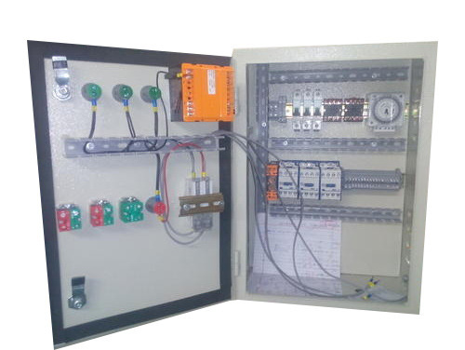
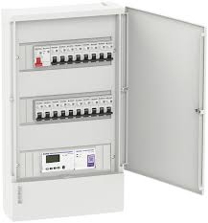
There are two images below, click on the image of an electrical panel
Notes:
Img01: https://bit.ly/2BLO9So
On clicking Img01 present: “That’s correct, this is a swimming pool control panel. Electrical panels are used to monitor and control mechanical equipment. Panels are designed according to specific system needs and includes devices that allow an operator to control specified equipment. Factories, production lines, alarm systems, ships, mainframe computer systems and swimming pools are some examples of where you can find control panels.”
Img02: https://bit.ly/2Mxtarw
On clicking Img02 present: “This is not an electronic control panel it is a distribution board (DB). Many people mistake the DB in their homes for an electric panel, however, each unit has very different uses and must not be confused. The DB is sometimes called the panelboard or breaker panel hence the terms DB and panel are often confused. The electrical supply is distributed from the DB within a building. The main supply cable comes into the board and is then distributed to the breakers and from there to all the circuits, including the lights and plugs. Electrical panels are used to control mechanical equipment. Panels are designed according to its specific use and includes devices that allow an operator to control specified equipment.”

Slide 6
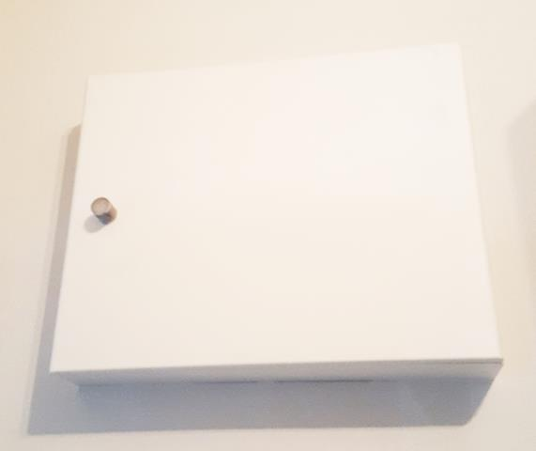
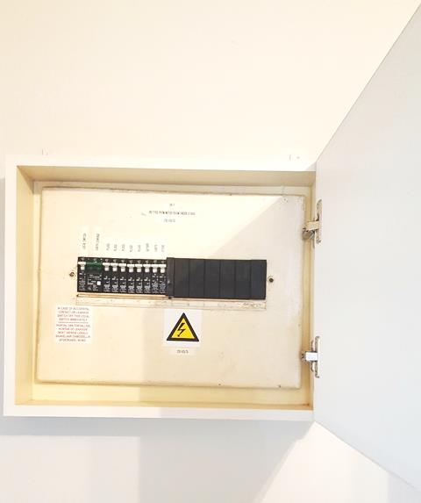
Distribution boards
If a switch ‘trips’ in your home, what do you do?
Notes:
Img 03 and 04: Writer’s own

Slide 7
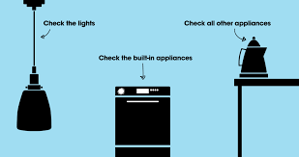
Distribution boards
If a switch ‘trips’ in your home, what do you do?
Notes:
Stick figure to ‘bounce in’ as animated (click on the star to start animation). On clicking the animated stick figure present the following: “Find the specific circuit breaker switch connected to the plugs found on the distribution board, within the home. If the breaker trips again right after you reset it, that indicates a bigger problem and you will have to find the cause of the problem before you can fix it.”
Image 01: https://tinyurl.com/yatyujwz

Slide 8
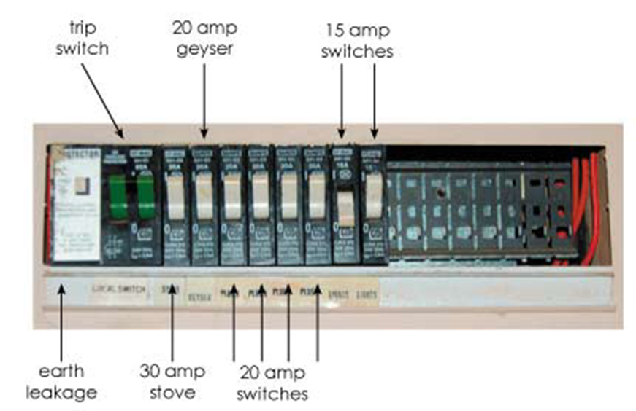
What does a circuit breaker do?
Insert your answer here
Notes:
Include a text box where answers can be inserted.
Accept any variation of the following: “A distribution board in a home contains a circuit breaker, which is a safety mechanism designed to trip and switch off the power in the case of electric overloads or short circuit occurs.”
Distribution board image: https://www.home-dzine.co.za/diy/images/circuit-1.jpg

Slide 9

What could cause a trip in a circuit breaker?
Enter three possible causes below.
Short circuit
Overloaded circuit
High power consuming devices
Too many devices on one plug point
Ground fault
Notes:
Leave spaces or text boxes for answers to be entered.
Answer: All answers above are correct. Accept any three of the five answers.

Slide 10
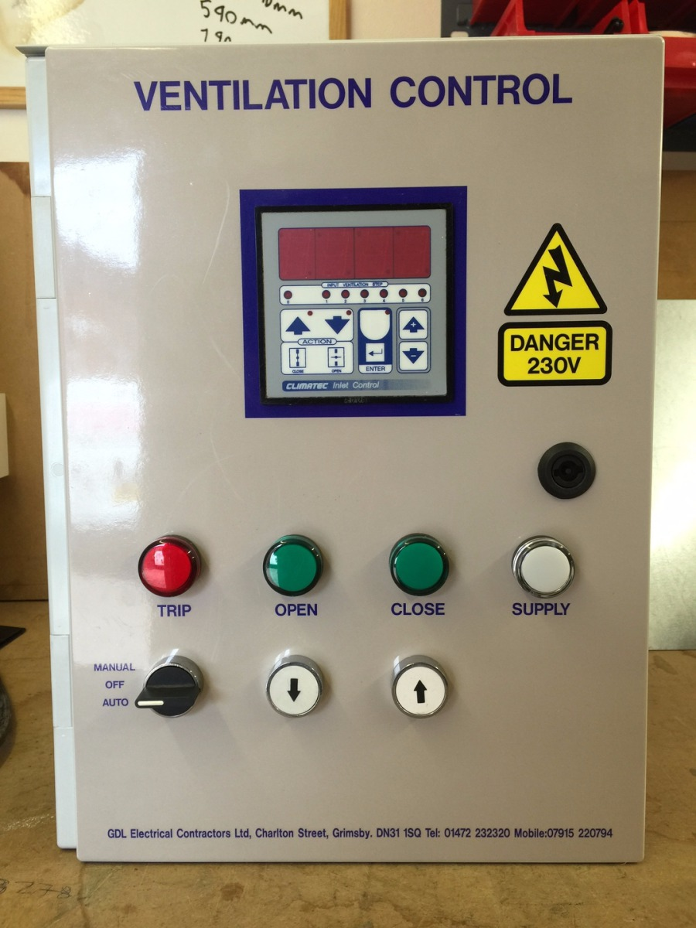
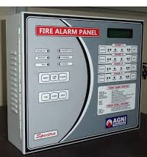
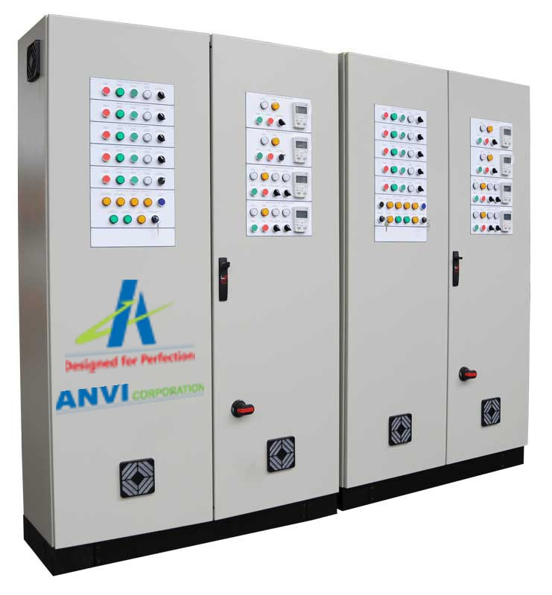
Electrical control panel uses
Click on each image to learn what the different panels are used for.
Notes:
Img05: https://bit.ly/2BMpgWG
On clicking Img05 present: “Ventilation panels monitor and control the temperature of electronic equipment. It prevents equipment overheating thereby preventing equipment failure.”
Img06:https://bit.ly/2wdsRaV:
On clicking Img05 present: “Fire alarm panels act as a control unit for fire alarm systems that have multiple linked detectors. They are typically used in larger buildings and commercial properties. Their primary tasks are to monitor fires, alert people to the location of a fire and supply power to fire detectors.”
On clicking Img07 present: “Production line panels are used to control and monitor machines and boost productivity in many industries. Technological advancements have modernised control panel wiring and are transforming how panels are designed, built, commissioned and maintained.”
Img07: https://bit.ly/2BL5P0v

Slide 11
Preparing to wire a panel
As an electrician you will be required to wire an electrical panel safely, neatly and as per wiring regulations. Before you learn how to wire a panel you must be able to terminate and join conductors.
SAFETY FIRST !
Notes:
On clicking the button “SAFETY FIRST” present the following: “Incorrect terminations and loose conductors can cause hot connections, conductors burning off, damage to equipment, fire hazard and injury and electrocution. Adhere strictly to the SANS wiring code – Reg. 6.3.7.1&2, and ensure that conductors are terminated correctly and tightened properly.”

Slide 12
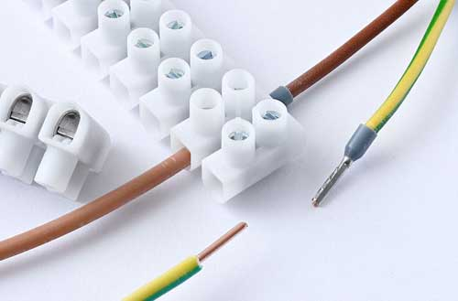
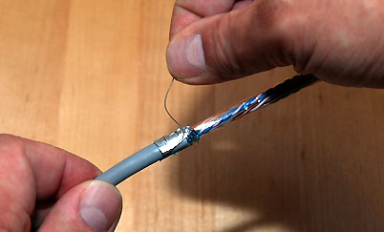
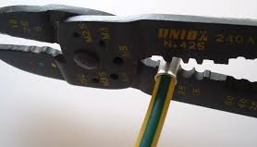
Methods of terminating a cable
A cable termination describes the specific point at which a cable, ends or starts. Cable terminations are often designed to enable the physical and electrical connecting of two cable ends. Connections must be safe, tight and neat.
Connector strip
Making a loop
Crimping a lug
(stranded conductors only)
Notes:
On clicking image 08 present: “Connector strips are used where a large number of conductors or cables must be terminated and marked, and where space is limited.”
https://tinyurl.com/ybuawerf
On clicking image 09 present: ”Using loops: when conductors are terminated on a terminal stud or screw, they are looped at the ends to form a compete circle.”
https://bit.ly/2N0f6Tz
On clicking image 10 present: “Crimping a lug: Instead of making loops at the ends of stranded conductors, lugs may be used. Lugs can be soldered on or crimped on with special crimping pliers.”
https://bit.ly/2wdTJqy

Slide 13
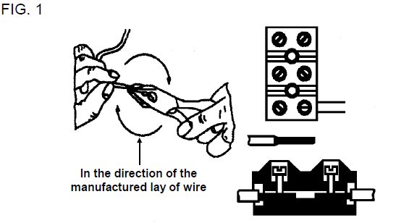
Using connector strips
Click on the diagram to learn how to use connector strips.
Notes:
Figure 1: Book 2, CW-T, Page 198
On clicking the diagram re-direct to video 1. See Vid01 brief. Play full screen.

Slide 14
Practise using connector strips
Practise preparing at least five conductor ends to fit into connector strips.
Use 1,5 mm² and 4 mm² copper conductors.

Slide 15
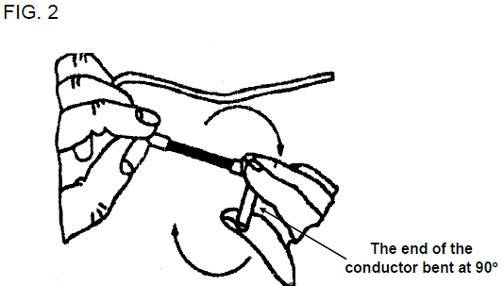
Using loops
Click on the diagram to learn how to form loops.
Notes:
Figure 2: Book 2, CW-T, Page 199
On clicking the diagram re-direct to video 2. See Vid02 brief. Play full screen.

Slide 16
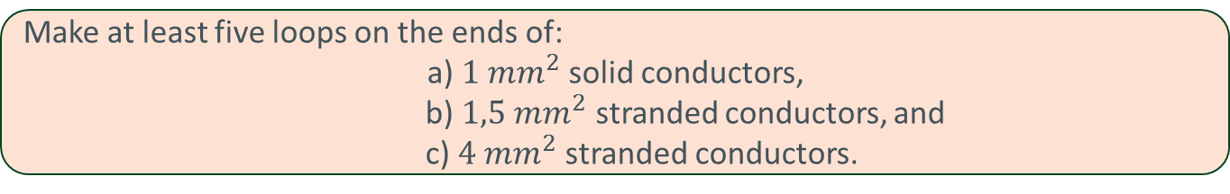
Practise forming loops
Make at least five loops on the ends of:
a) $1 mm^{2}$solid conductors,
b) $1,5 mm^{2}$ stranded conductors, and
c) $4 mm^{2}$stranded conductors.

Slide 17
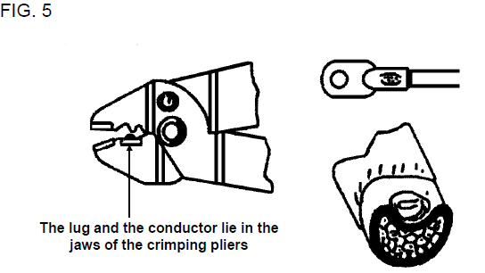
Using lugs
Click on the diagram to learn the method to crimp on a lug
Notes:
Figure 5: Book 2, CW-T, Page 201
On clicking the diagram re-direct to video 3. See Vid03 brief. Play full screen.

Slide 18
Practise using lugs
Prepare at least two conductor ends for entry into crimp lugs, using:
a) 1,5 mm² copper conductors.
b) 4 mm² copper conductors.

Slide 19
Joining conductors
We have discussed cable joints in unit 1.6 and will only go over it briefly in this unit. Thin conductors can be joined by soldering or using ferrules. We deal with using ferrules only. This type of joint is known as a “dry joint” and may not be used to join solid conductors.
Do you remember what a ferrule is?
Click here for the answer
Notes:
Answer: “A ferrule is a cylindrical piece of tinned copper tubing used to join two conductor ends together.”

Slide 20
Joining conductors with a crimp ferrule
Click on figure 6 for the steps to crimp a ferrule.
Notes:
Figure 6: Book 2, CW-T Page 202
On clicking figure 6 present the following: “When using ferrules the correct sizes must be used (according to the size of the conductors).
The method of joining two stranded conductors with a ferrule is as follows:
• Strip the insulation off to a length longer than is required.
• Use combination pliers to twist the strands lightly together in the same direction as the manufactured lay of the wires. Two full turns are usually sufficient.
• Cut the ends of the conductors to half the length of the ferrule so that when placed inside the ferrule they will touch at the centre. Thus, the insulation of the conductors will touch the ferrule on either side.
• Place the ferrule in the hollow of the crimping pliers with the centre of the one half in the centre of the pliers’ jaw. Crimp first one side and then the other.
• Test the completed joint by trying to pull the conductors apart by hand.”

Slide 21
Practise joining conductors
Join at least two sets of conductors by using crimp ferrules on:
a) 1,5 mm² copper conductors
b) 4 mm² copper conductors
First prepare the conductors to fit into the ferrules.

Slide 22
Points to remember when wiring a panel
Measure load resistance
Use Ohm’s Law
Plan the panel layout
Choose correct conductor colours and sizes
Notes:
Animated figure to ‘bounce in’. On clicking the animated stick figure present the following:
“- Wiring must be in accordance with given circuit diagram;
- Correct size of wire is selected by measuring load resistances, calculating the current through the loads (Ohm’s Law) and using the appropriate tables prescribed by wiring regulations (Reg. 6.2.5);
- Correct colour conductors are selected as per wiring regulations(Reg. 6.3.3);
Panel layout must be planned and conductors bunched together where possible and layed out neatly (horizontal conductors parallel to each other and to edge of panel, and the same for vertical conductors).
If you need to remind yourself of calculations then go over the lesson ‘Getting familiar with resistors’ (unit 3.1)”

Slide 23
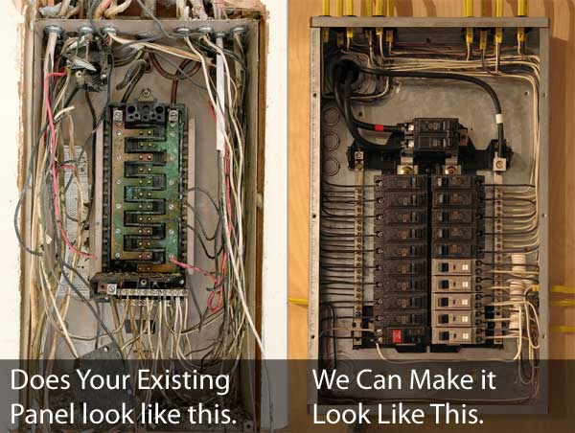
Wiring layout
Before a panel is wired it is essential that a plan of the wiring layout is made, so that when the panel is complete it will be neat and pleasing to look at.
Planning a wiring layout
Notes:
Image 11: https://bit.ly/2wj3kfK
‘Planning a wiring layout’ title plus screenshot of Vid04. See Vid04 brief. Play video full screen.

Slide 24
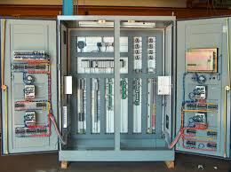
Wiring a single phase load panel
Given a single-phase load panel and a wiring diagram, you will be expected to wire a panel. It is very important that you pay close attention to the regulations in the SANS wiring code to guide you through the wiring process.
Are you ready to wire a panel?
Yes
No
Notes:
Img12:https://bit.ly/2wd162u
Upon clicking ‘No’ redirect back to the start of this lesson.
Upon clicking ‘Yes’ link to Video 05. See brief for Vid05. Play full screen.

Slide 25
Let’s review:
In this lesson we have covered:
Identifying electrical panels and its uses.
How to terminate and join conductors.
The importance of a wiring layout.
Process of wiring a panel.
Make sure you have a complete understanding of all the work covered here before you start the next unit.

Slide 26
Quiz time
We have come to the end of this unit. Answer the following questions to make sure you understand how to wire a panel.

Slide 27
Question 1
From the list of options, click on the correct steps to connect conductors to panel studs.
Nuts tightened firmly but not over-tightened.
Measure the earth continuity resistance. Comply with Reg. 8.7.3
Not more than 3 conductors to a stud.
When loops are used, washers to be placed on both sides of loop and between loops.
Notes:
The answers in Green are correct and the red one incorrect. All options to be shown in the same colour.
Feedback:
Correct – Good job.
Incorrect – That is a control step when we wire the panel.

Slide 28
Question 2
Regulation 6.1.5 of the Wiring Code SANS 10142 part 1 states that not more than _________ conductors must be connected to one terminal.
Notes:
Correct answer is ‘Three or 3’
Feedback:
Correct – Well done.
Incorrect – Try again.

Slide 29
Question 3
All the vertical and horizontal conductor bunches must be parallel with each other but do not have to be parallel to the top, bottom and sides of the panel.
OR
True
False
Notes:
True or False
Correct answer is FALSE. “All the vertical and horizontal conductor bunches must be parallel with each other and also parallel to the top, bottom and sides of the panel.”
Feedback:
Correct – Well done. “All the vertical and horizontal conductor bunches must be parallel with each other and also parallel to the top, bottom and sides of the panel.”
Incorrect – That is not correct. “All the vertical and horizontal conductor bunches must be parallel with each other and also parallel to the top, bottom and sides of the panel.”

Slide 30
Question 4
Where are you likely to find electrical panels?
a) Production lines.
b) Distribution boards.
c) Appliances.
d) All of the above.
Notes:
MCQ
Correct answer is A
Feedback:
Correct – Excellent.
Incorrect – Try again. Remember a panel is where control or monitoring instruments are displayed.

Slide 31
Question 5
Metal parts of a panel may become live if it is not earthed or insufficiently earthed, and cause electric shock or electrocution. How do you protect against this?
1) Earth all metal parts.
2) Measure the earth continuity resistance.
Notes:
Insert textbox for answer.
Accept slight variations in the answer: “1) Earth all metal parts. Reg. 6.12 of the SANS wiring code.
2) Measure the earth continuity resistance. Comply with Reg. 8.7.3”

Slide 32
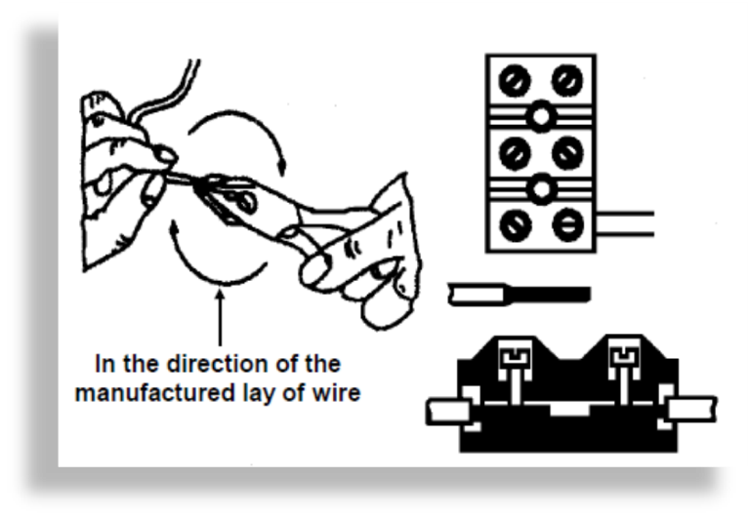
Video brief - Vid01 Technician using connector strips to terminate cables.
Let’s go over the method of terminating conductors using a connector strip. It is important that connections are safe, tight and neat. Connector strips are used where a large number of conductors or cables must be terminated and marked, and where the space is limited. First let’s look at a diagram to see how they are connected.
Notes:
Create a video (similar to https://www.youtube.com/watch?v=4nVR-5KNdVg from 00:25 to 01:35) but using script voice over as above.
Figure 1: Book 2, CW-T, Page 198

Slide 33
Vid01 contin. Technician using connector strips to terminate cables.
Now we will go over the method and steps of using connector strips.
1) Strip the insulation to about 20 mm by using a knife or a wire stripper.
2) The conductor must not be damaged or nicked in the stripping process.
3) Use the correct size hole (stripping slot) in the stripper or make sure that you only cut through the insulation and not the conductor when using a knife.
4) Twist the strands of the conductor together, in the same direction as the manufactured lay of the wire. Two full turns will be sufficient.
5) Insert the conductor into the terminal and tighten the screw onto the conductor (figure 1 shows the same steps), so that it can not be pulled out by hand.
Notes:
Create a video (similar to https://www.youtube.com/watch?v=4nVR-5KNdVg from 00:25 to 01:35) but using script voice over as above.
Figure 1: Book 2, CW-T, Page 198

Slide 34
Video brief - Vid02 Technician showing method to form loops
When conductors are terminated on a terminal stud or screw, they are looped at the ends to form a compete circle. Have a look at figure 2, 3 and 4 which shows the method to form a loop. We will go over the steps in detail.
Notes:
Create a video (similar to https://www.dailymotion.com/video/x5a46cw from 0:00 to 0:57 of this video) ) using script voice over as above.
Figure 2: Book 2, CW-T, Page 199

Slide 35
Vid02 contin. Technician showing method to form loops
1) Strip off the insulation to about 60 mm, but do not completely remove the insulation from the conductors. Pull the insulation off until there is about 20 mm of conductor left in the insulation (FIG. 2).
2) Bend the end of the conductor at the stripped insulation, to 90° (FIG. 2).
3) Twist the wires of the bent end together in the same direction as the manufactured lay of the wires. Two full twists are usually sufficient.
4) Remove the insulation completely and cut off the 20 mm piece of conductor that was left inside the insulation.
5) Make the loop with a pair of round nosed pliers (FIG. 3), and cut off the excess conductor with a side-cutter (diagonal pliers).
6) Or, form the loop around the actual stud or screw and again cut off the excess conductor.
7) The conductor must be in line with the centre of the loop as shown in FIG. 4.
8) Place the loop onto the stud, with a washer on both sides of it and tighten the nut. If more than one conductor terminates on the same stud, a washer must be placed between them.
Notes:
Create a video (similar to https://www.dailymotion.com/video/x5a46cw from 0:00 to 0:57 of this video) using script voice over as above. Keep Figure 2 as pop up in the corner of the screen while it is mentioned and then do the same as figures 3 and 4 are mentioned.
Figure 2: Book 2, CW-T, Page 199

Slide 36
Video brief - Vid03 Technician using crimping tool
Instead of making loops at the ends of stranded conductors, lugs may be used. Lugs can be soldered on or crimped on with special crimping pliers. We will only deal with the crimping on of lugs. Lugs may not be used to terminate solid conductors.
The method to crimp on a lug is as follows:
1) Strip the insulation off to a length longer than is required.
2) Use combination pliers to twist the strands lightly together in the same direction as the manufactured lay of the wires. Two full twists are usually sufficient.
3) Cut the conductor to the length of the lug’s socket. The insulation must touch the socket.
4) Place the lug, with the conductor in it, between the jaws of the crimping pliers. The socket of the lug must lie in the hollow part of the jaw as in figure 5.
5) Make sure that the conductor is properly inside the socket, and close the crimping pliers. The jaws of the pliers must be closed completely and the lug must be crimped in the centre of the socket. FIG. 5 shows what happens inside the socket when the lug is crimped.
Finally, test the connection by trying to pull the lug and conductor apart.
Notes:
Create a video using script voice over as above similar to the creative commons video or you may use the creative commons video ‘Crimping Ferrules’ https://www.youtube.com/watch?v=H63VTRLyerE .Have figure 5 pop up when it is mentioned.
Figure 5: Book 2, CW-T, Page 201

Slide 37
Video Brief: Vid04 Planning a wiring layout
Before a panel is wired it is essential that a plan of the wiring layout is made, so that when the panel is complete it will be neat and pleasing to look at. Conductors must be bunched as far as possible. Loose or separate conductors must not be visible on the board.
If two rows of studs are used plan the layout as follows:
• Take the conductors between the two rows, with all the conductors bunched and taped, and tap off to the studs from the main bunch.
• The best way of holding the bunches of conductors together is by using PVC insulation tape as in figure 7, although there are also other types of binders on the market.
• Bunch all the cables running horizontally into as few bunches as possible and do the same with the conductors running vertically.
• All the vertical and horizontal conductor bunches must be parallel with each other and also parallel to the top, bottom and sides of the panel.
Conductors should be bent around the thumb as shown in FIG. 8 to prevent damage to the insulation.
Notes:
Create a video (similar to https://www.youtube.com/watch?v=SBCH_6kNQTc from 04:55 to 6:03) but using script voice over as above. Keep Figure 7 as pop up in the corner of the screen while it is mentioned and then do the same as figures 3 and 4 are mentioned.
Figure 7 and 8: Book 2, CW-T, Page 203 and 204

Slide 38
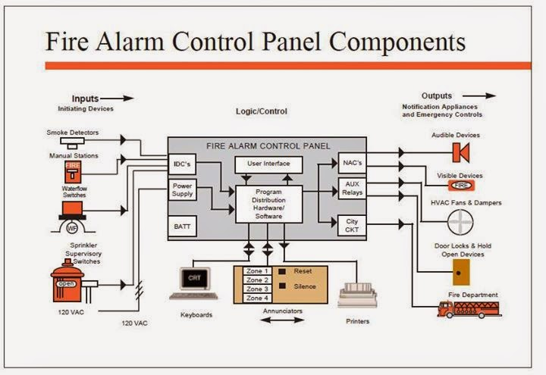
Video Brief: Vid04 contin. Planning a wiring layout
It is very important to note that Regulation 6.1.5 of the Wiring Code SANS 10142 part 1 states that not more than three conductors shall be connected to one terminal. Thus, it is important to plan the layout of the wiring before wiring the panel.
Notes:
Create a video (similar to https://www.youtube.com/watch?v=SBCH_6kNQTc from 04:55 to 6:03) but using script voice over as above. Keep Figure 7 as pop up in the corner of the screen while it is mentioned and then do the same as figures 3 and 4 are mentioned.
Figure 7 and 8: Book 2, CW-T, Page 203 and 204
Fire alarm wiring Image: https://bit.ly/2NhgbXj

Slide 39
Video brief – Vid05 Technician demonstrating how to wire a panel
A panel is where control or monitoring instruments are displayed or it is an enclosed unit that is the part of a system that users can access, such as alarm systems, mainframe computer systems and elevators. In this unit we only cover the process of wiring the panel
Older control panels are often equipped with push buttons and analog instruments but nowadays in many cases touchscreens are used for monitoring and control purposes.
When wiring a panel:
Select either a megger or a multimeter and measure the resistance between the studs marked “load”.
Use Ohm’s Law to calculate the value of the current that the load resistors will draw (refer to module: Getting familiar with resistors).
Use the tables given in Regulation 6.2.5 (SANS Code of Practice), Table 6.3(a), to determine the size (cross-sectional area) of the conductor that must be used for the calculated current. Refer also to Module ‘Selecting Cables and Conductors’.
NOTE:
In practice, correction factors as required by Reg. 6.2.5, must be used with tables to calculate the size of conductors to be used.
Select the correct colours to be used.
Wire the panel according to the diagram.
Notes:
Create a video similar to https://www.youtube.com/watch?v=SBCH_6kNQTc from 04:55 to 6:03 and https://www.youtube.com/watch?v=1PloSdS_hBU from 01:53 to end.
We can also include a video on how to wire a specific control panel, for example, ‘wiring a security alarm panel’: https://bit.ly/2MywBy7

